Slide 1
Richfield Connect
From enrolment to employment, in one verified network.
A mobile professional network for Richfield and AAA students, alumni, employers and staff.
Team GritSim AI
Mosa · Dali · Ina · Lindelani · Evan
Notes:
Presenter: Mosa.
Introduce the team and the one-line promise. Keep it under 30 seconds.

Slide 2
SCENARIO
The problem, and our response
Students
Alumni
Employers
Compete on visible portfolios and networks, not only qualifications.
Struggle to be seen by employers before they graduate.
Lose their institutional email at graduation.
Fall out of the network exactly when they could mentor and hire.
Can't easily find verified Richfield talent.
Have no trusted channel to reach the right students.
Our response: a mobile network where every account is verified, every profile is a portfolio, and every opportunity is matched to the students it fits.
Richfield Connect · Team GritSim AI
2
Notes:
Presenter: Mosa.
Frame each audience's pain, then land the response line.

Slide 3
AUTHENTICATION & AUTHORISATION
Four user types, four access levels
Role | How they get in | What they can do | What they cannot do
Student | Institutional email only (@my.richfield.ac.za, @richfield.ac.za, @my.aaa.ac.za, @aaa.ac.za) | Build a portfolio, connect, apply, get matched | See sections others haven't shared with them
Alumni | Registry-verified identity + email link | Mentor, recommend, share career journeys | Read the alumni registry
Employer | Registration + administrator approval gate | Post opportunities, discover talent | Use the app before approval
Administrator | Provisioned out-of-band by script | Approve, moderate, run events, broadcast, analytics | Self-register; suspend another administrator
Security boundary: roles are server-issued Firebase custom claims, enforced by Firestore rules and every Cloud Function. Hiding a screen is never the protection.
Richfield Connect · Team GritSim AI
3
Notes:
Presenter: Mosa.
Say aloud: roles live in server-issued custom claims and are enforced in Firestore security rules and every Cloud Function.

Slide 4
AUTHENTICATION
Authentication designed for each audience
Students — institutional domain gate
Alumni — our researched verification
A Firebase blocking function (beforeUserCreated) rejects any non-institutional email server-side.
The app's check is only a convenience.
Student number + personal email + national ID or birthdate, matched against a private registry.
Identical response on match or no match (no enumeration). 5 attempts / 15 min per identity, email and IP.
One-time 15-minute session, then an email link proves inbox ownership.
Employers — approval gate
Administrators — no sign-up path
A short-lived, server-issued registration intent is required to sign up.
Accounts stay locked (isApproved: false) until an administrator approves.
Created only by a CLI script with service-account credentials (admin/provision-admin.mjs).
App Check on every callable in production blocks scripted abuse.
Richfield Connect · Team GritSim AI
4
Notes:
Presenter: Mosa.
Demo step 1 proves the student gate live. Stress that the alumni flow never reveals whether a record matched.

Slide 5
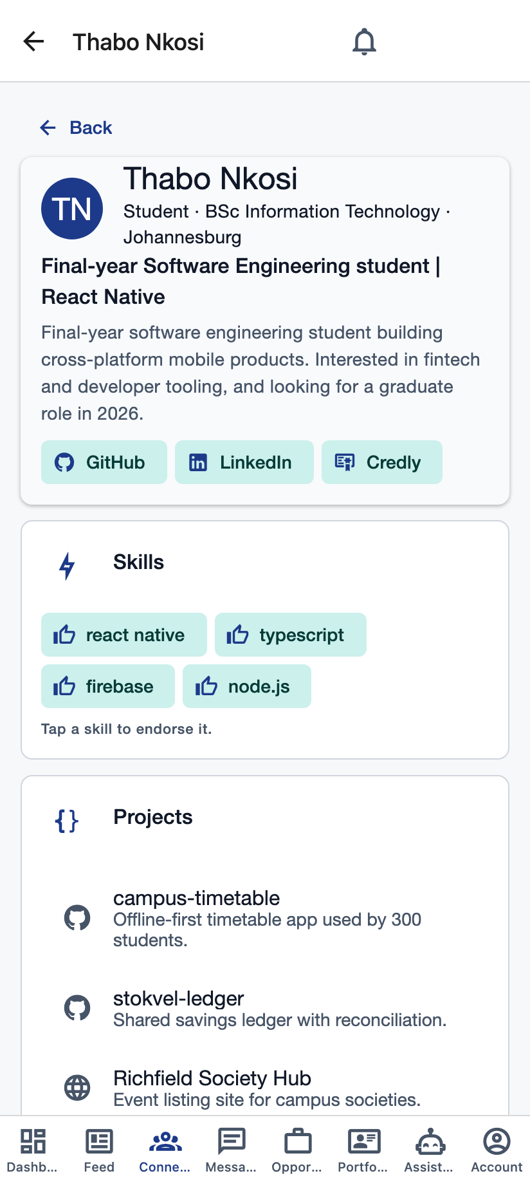
USER PROFILES
Profiles as digital portfolios
▪ Full brief schema: headline, summary, programme, campus, enrolment and graduation year.
▪ Evidence employers trust: qualifications, certifications, work experience, entrepreneurial ventures.
▪ Proof of skill: GitHub projects, deployed apps, digital badges and Credly.
▪ The whole person: achievements, leadership roles, clubs, hackathons, volunteering, career interests.
▪ Employers too: company profile including the graduates and skills they are seeking.
▪ Profile strength meter shows members what to add next to stand out in matching.
Thabo's portfolio, as another member sees it
Richfield Connect · Team GritSim AI
5
Notes:
Presenter: Lindelani.
Point at the populated sections on Thabo's profile.

Slide 6
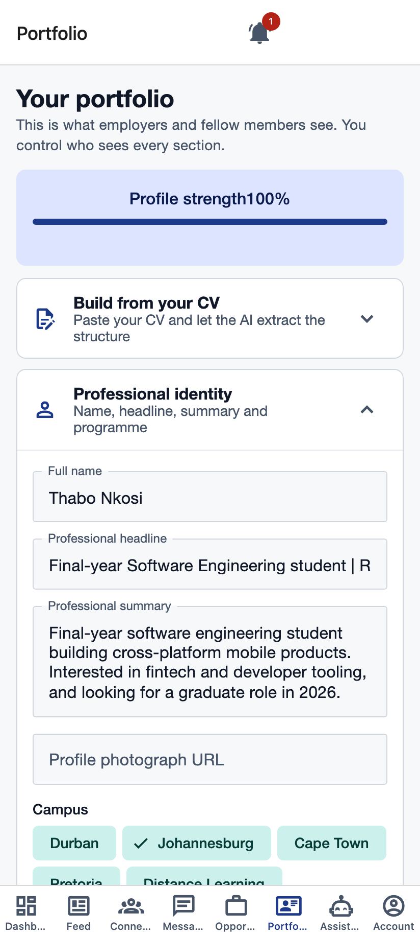
USER PROFILES · EXTRA TECHNOLOGIES
Endorsements, recommendations and AI CV import
Skill endorsements
Written recommendations
One per endorser per skill, validated server-side.
From connections, alumni, employers or staff. Author identity comes from the server, never the request. Reportable.
NLP-assisted profile building
Paste a CV: Google Gemini extracts headline, summary, skills, qualifications and experience as strict JSON.
Validated and length-capped server-side, told never to invent facts, and nothing saves until the member confirms.
Only a hash of the CV text is kept.
Portfolio editor with strength meter
Richfield Connect · Team GritSim AI
6
Notes:
Presenter: Lindelani.
If time allows, paste a short CV in the demo and show fields filling in (about 4 seconds).

Slide 7
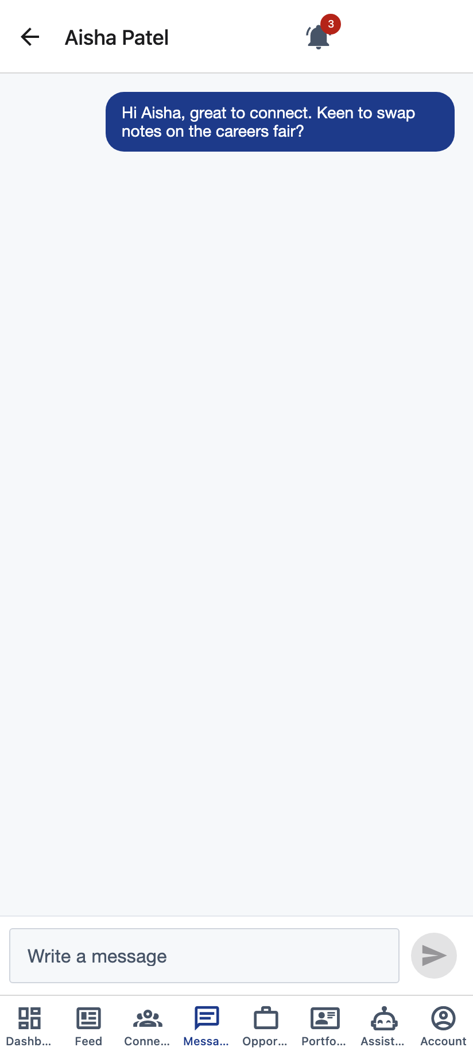
SOCIAL NETWORKING
Connections and a personalised feed
▪ Find people by name, skill, campus or role; send, accept or decline requests.
▪ Direct messaging between connected members only, enforced server-side.
▪ Posts, reactions and comments, with reporting to moderators.
Role-differentiated feed ranking, per viewer
score = role affinity × 100 + freshness × 40 + reactions × 2 + comments × 3
Freshness decays over 72 hours. Affinity depends on who is reading:
students rank employers (1.5×) and alumni (1.4×) higher; employers rank alumni (1.6×) and students (1.5×) higher.
Direct messaging between connections
Richfield Connect · Team GritSim AI
7
Notes:
Presenter: Evan.
Demo steps 4–5: connect with Aisha, open Lerato's profile, send a message.

Slide 8
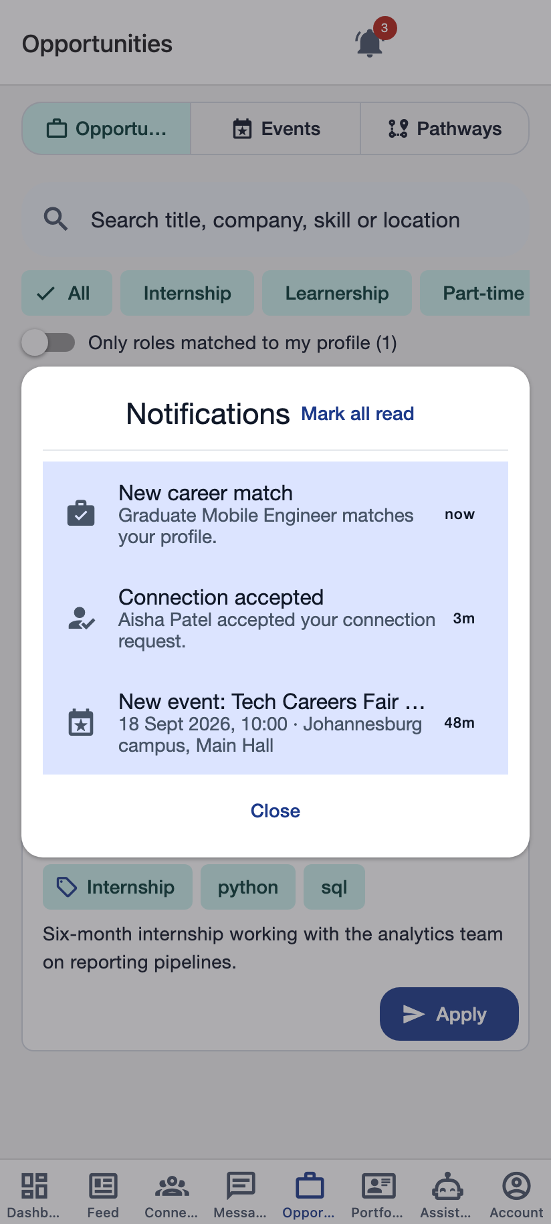
EXTRA TECHNOLOGIES
Real-time by default
▪ Live listeners, no polling: Firestore onSnapshot for the feed, messages, connections, approvals and the inbox.
▪ In-app notification inbox: a bell on every tab with a live unread badge and a toast for new alerts.
▪ Push notifications (FCM): Firestore-triggered Cloud Functions notify connection requests, acceptances, messages, opportunity matches, events and announcements.
▪ Targeted, not broadcast: a published event only notifies students whose programme or interests match its tags.
Notification inbox
Richfield Connect · Team GritSim AI
8
Notes:
Presenter: Evan.
When the admin publishes an event in the demo, switch to Thabo and show the bell badge.

Slide 9
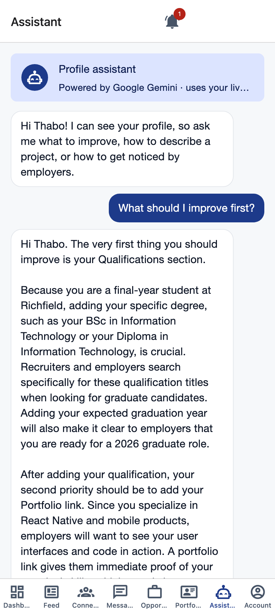
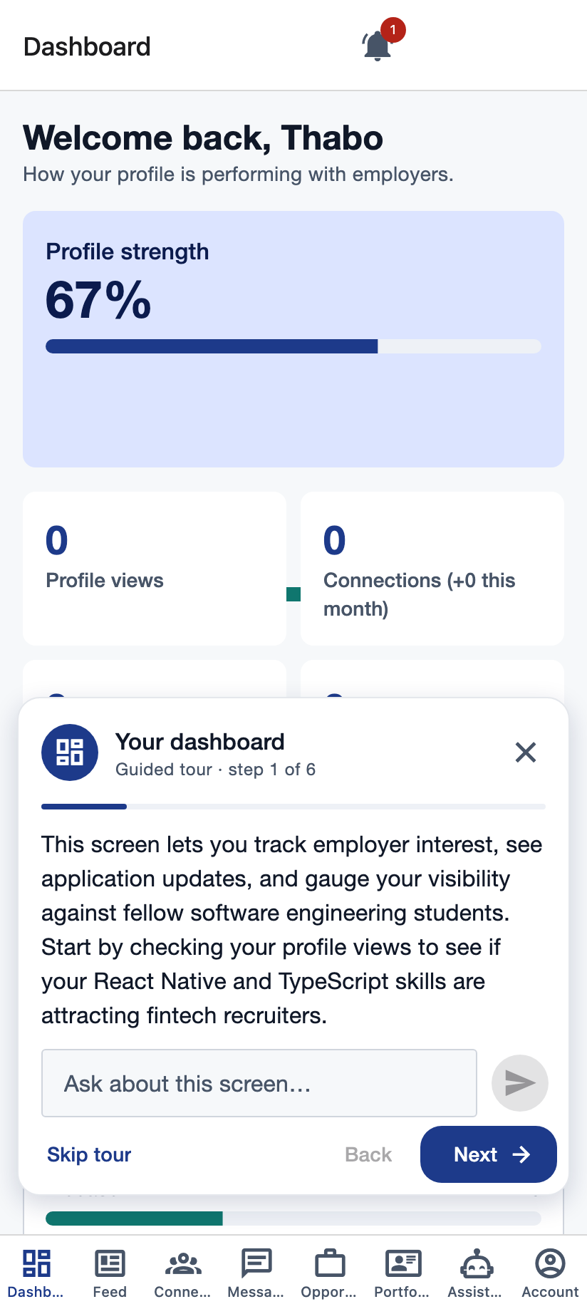
ONBOARDING & AI
Onboarding, AI assistant and guided tour
▪ Structured onboarding: identity → programme and campus → skills → evidence → review.
▪ AI coach reviews the draft before it is saved, so feedback is about what the member just wrote.
▪ Always-on assistant tab with conversation memory (last 12 messages).
▪ Interactive guided tour per role: it moves through the member's key screens and the AI writes each explanation from their live profile. Members can ask questions at any step.
▪ Genuine AI, not a script: Google Gemini, called only from Cloud Functions, so the key never reaches a device. Automatic retry and fallback model.
AI assistant
Guided tour step
Richfield Connect · Team GritSim AI
9
Notes:
Presenter: Ina.
Demo step 2: ask the assistant "What should I improve first?" First reply can take a few seconds.

Slide 10
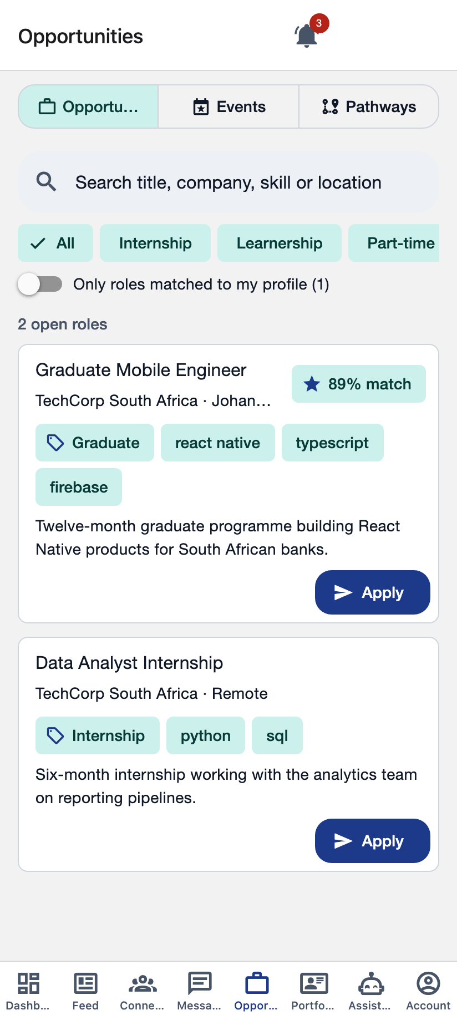
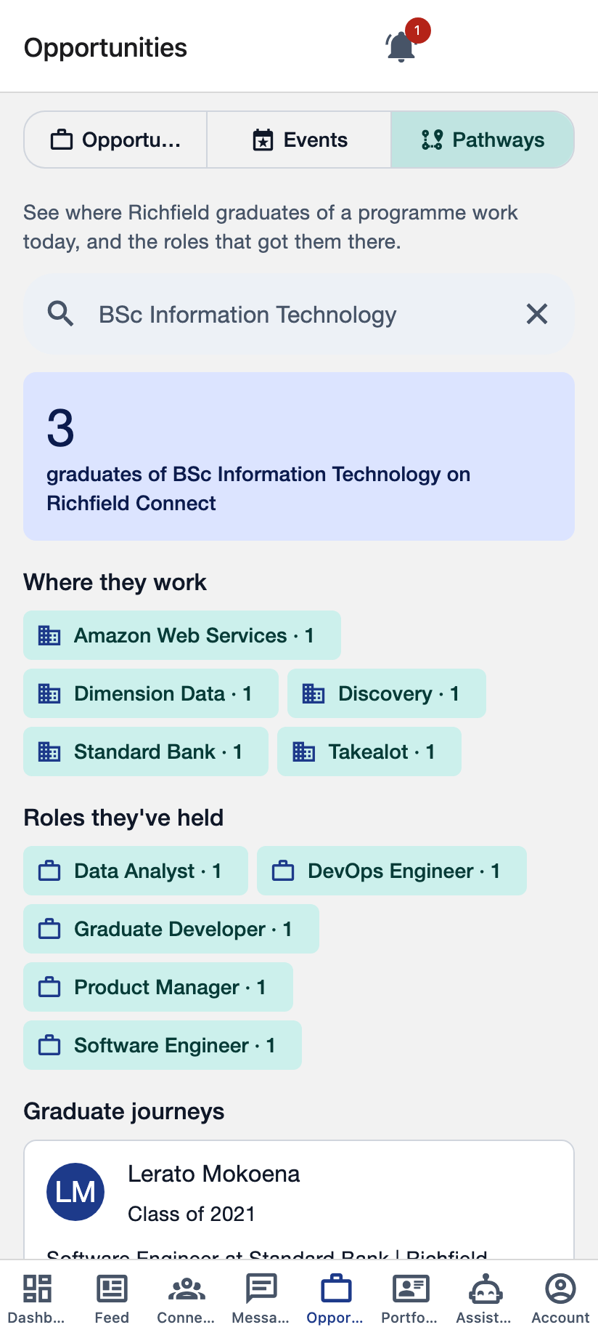
OPPORTUNITIES & CAREERS
Opportunities, events and career pathways
▪ Employers post internships, learnerships, part-time and graduate roles.
▪ Administrator approval gate: listings are invisible to students until published.
▪ Smart matching on approval: skill similarity × 0.85 + programme match × 0.15. Students see a match % and only matched students are notified.
▪ Search and filters by type, with a "matched to me" switch.
▪ Institutional events — career fairs, workshops, info sessions — with RSVP and capacity.
▪ Career pathway explorer: where graduates of a programme work now and the roles that got them there.
Opportunities with match %
Career pathways
Richfield Connect · Team GritSim AI
10
Notes:
Presenter: Ina (pathways) and Dali (matching).
Demo steps 6–8: employer posts, admin approves, Thabo sees the match.

Slide 11
TECHNOLOGY STACK
System architecture
Auth + claims
Firebase
sign in · blocking trigger
Google Cloud
Cloud Storage
upload triggers
App Check
React Native app
verified app instances
Google Gemini
Android · iOS · Web
React Native Paper (MD3)
assistant · tour · CV
Cloud Firestore
security rules · realtime
Cloud Messaging
Clients never write privileged data.
Every mutation goes through a callable that re-derives identity from the auth token.
push to devices
Cloud Functions v2
callables · triggers
Transcoder
video processing
Richfield Connect · Team GritSim AI
11
Notes:
Presenter: Dali.
Walk left to right: sign in → claims; realtime reads from Firestore; every write through a Cloud Function; functions call Gemini and send pushes.

Slide 12
STACK JUSTIFICATION · MOBILE FRAMEWORK
Why React Native
 | React Native (chosen) | Flutter | .NET MAUI
Language | TypeScript — shared with our Cloud Functions | Dart — a second language | C#
Firebase support | Mature React Native Firebase modules | Mature | Weaker, community-led
One codebase for mobile + web admin | Yes, via react-native-web | Partial | No
UI toolkit | React Native Paper (Material Design 3) | Material built in | Platform controls
Team skills | JavaScript / TypeScript already known | New to the team | New to the team
Why: one language from app to backend, first-class Firebase support, and the same code runs the administrator panel in a browser.
Richfield Connect · Team GritSim AI
12
Notes:
Presenter: Dali.
Flutter was the serious alternative; the deciding factor was one language across client and Cloud Functions.

Slide 13
STACK JUSTIFICATION · DATABASE
Why Firestore over PostgreSQL
What we need | PostgreSQL | Cloud Firestore (chosen)
Profiles with many nested lists | Many join tables | One document per member
Real-time feed, chat, approvals | Needs a separate realtime layer | Built-in listeners
Per-audience privacy | Row-level security | Security rules tied to Auth claims
Spiky campus-scale traffic | Provision and tune servers | Serverless, scales automatically
Complex relational queries | Strong | Weaker — we denormalise and bound scans
Trade-off we accepted: no joins or full-text search. We handle it with write-time feed fan-out and bounded server-side scans.
Richfield Connect · Team GritSim AI
13
Notes:
Presenter: Dali.
Be upfront about the trade-off; judges reward honesty. We considered Supabase for relational queries.

Slide 14
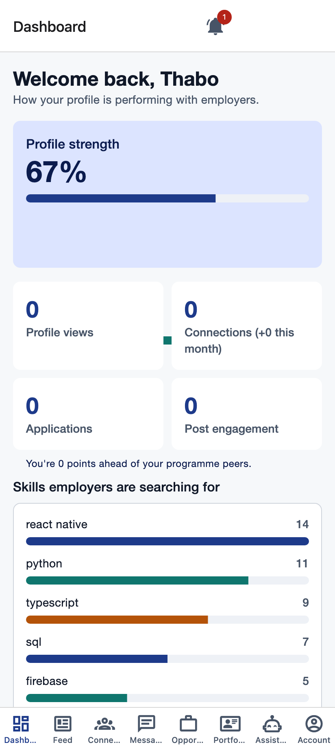
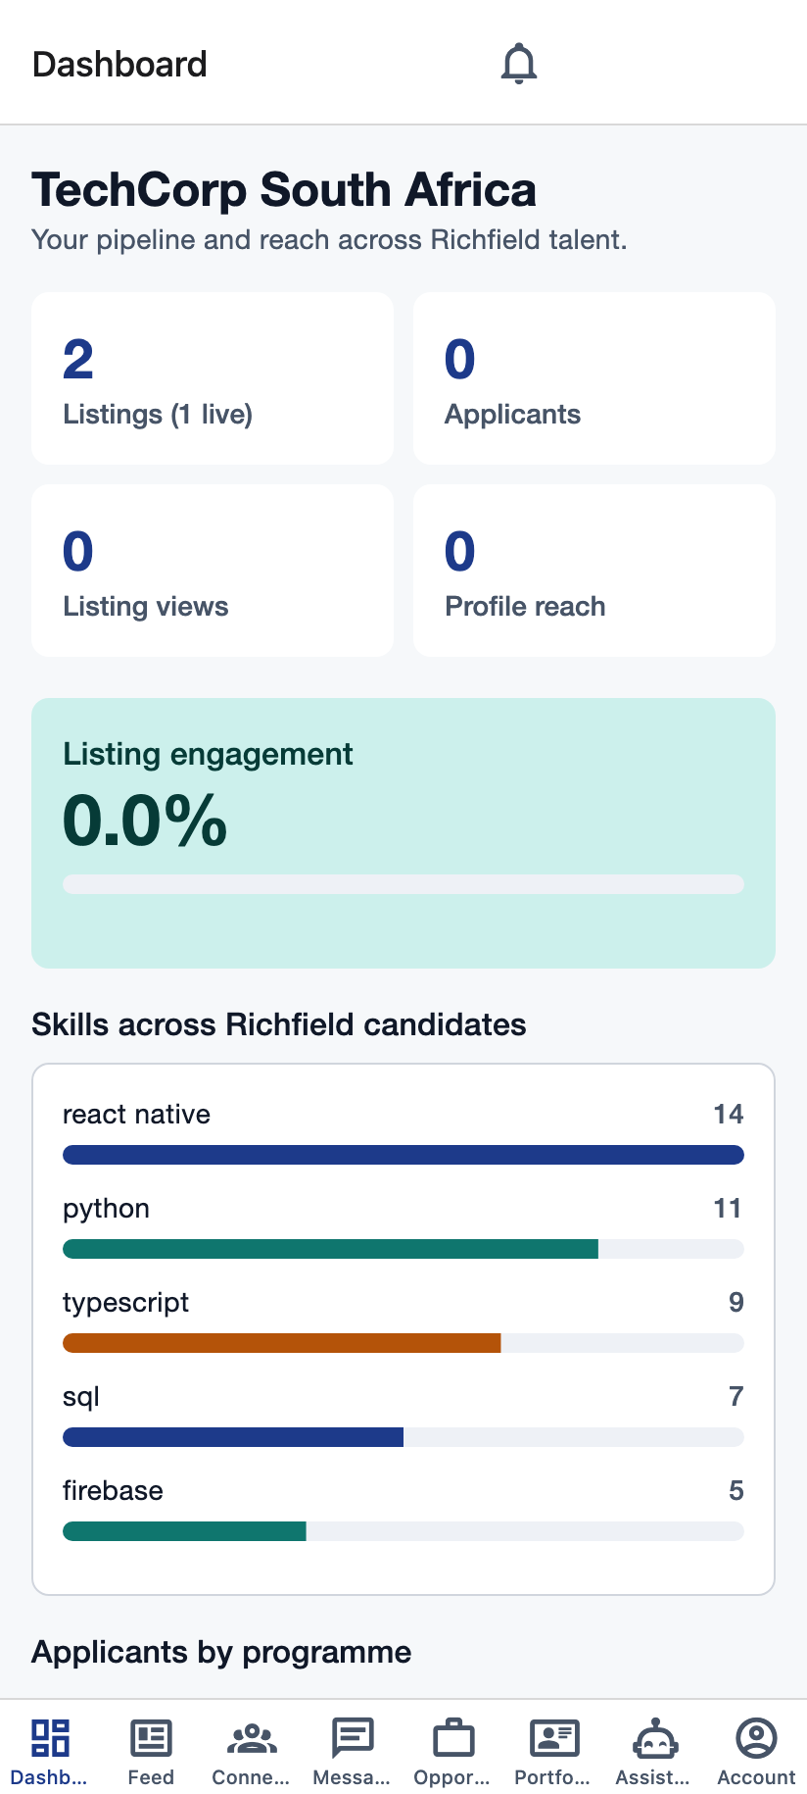
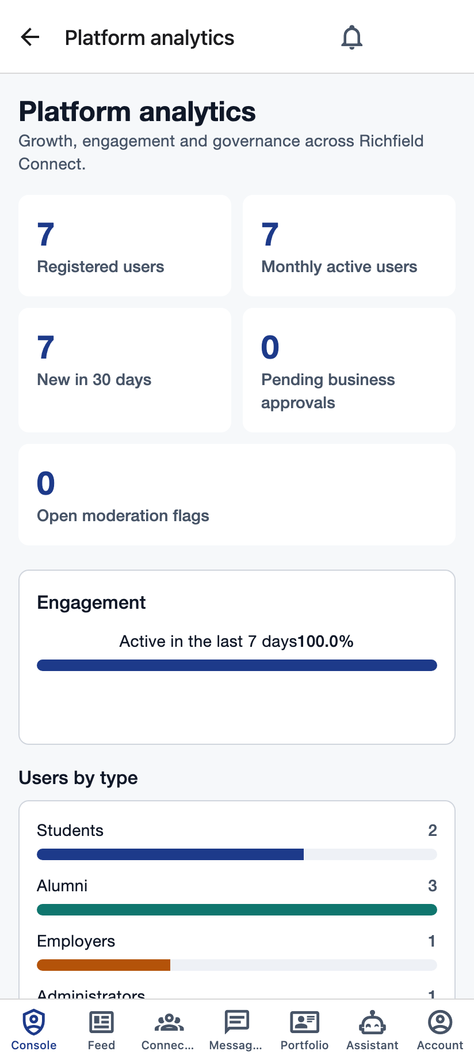
DASHBOARDS
An analytics dashboard for every user type
Student dashboard
Employer dashboard
Administrator analytics
Students
Employers
Administrators
Profile views, connections, applications, profile strength vs programme peers, top matches.
Listings, applicants, views, conversion, reach, applicants by programme, candidate skills.
Users by role, active users, registrations, content volume, open flags, pending approvals.
Richfield Connect · Team GritSim AI
14
Notes:
Presenter: Dali.
All figures are computed server-side from live data; open one dashboard per role in the demo.

Slide 15
PRIVACY
POPIA and data privacy by design
Per-audience visibility
Server-side redaction
Data minimisation
Each profile section can be shared with everyone, connections, students, alumni or employers.
Other members' profiles are never readable directly. The server returns only what that viewer may see.
Student numbers never leave the server. The registry is never client-readable. Only a hash of CV text is kept.
No account enumeration
Accountability
Alumni verification responds identically whether or not a record matched, and is rate-limited.
Administrator actions are written to an audit log. Members can report posts, comments, profiles and recommendations.
Richfield Connect · Team GritSim AI
15
Notes:
Presenter: Lindelani.
Honest limit to say aloud: software alone cannot certify POPIA compliance — that needs Richfield's Information Officer.

Slide 16
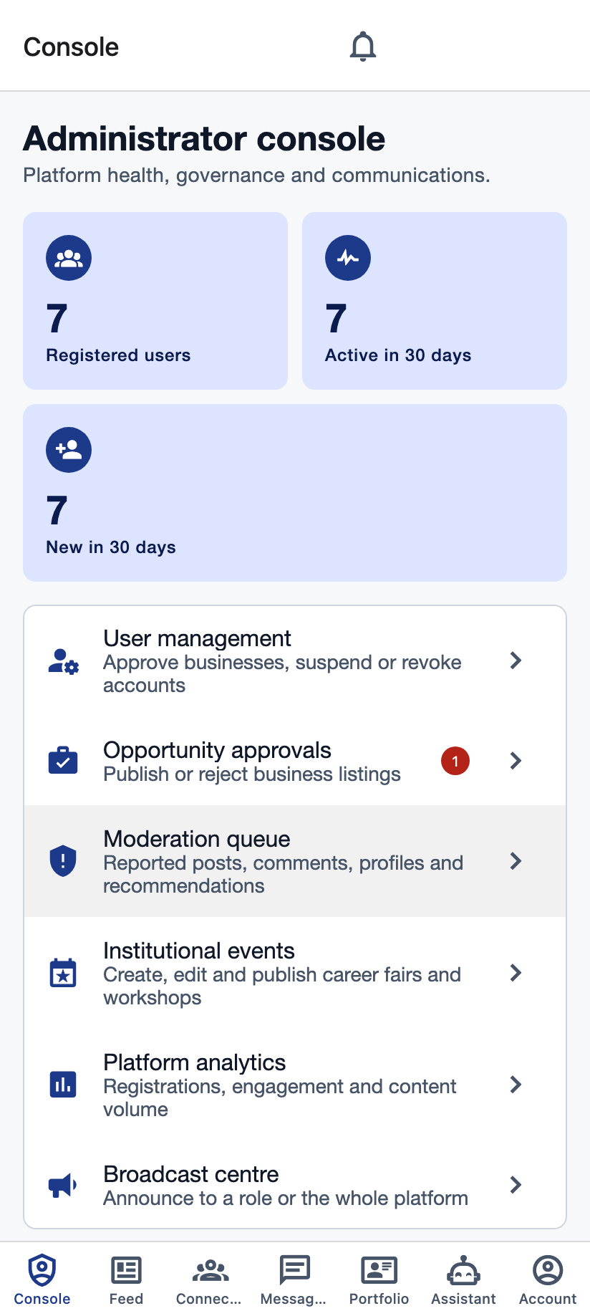
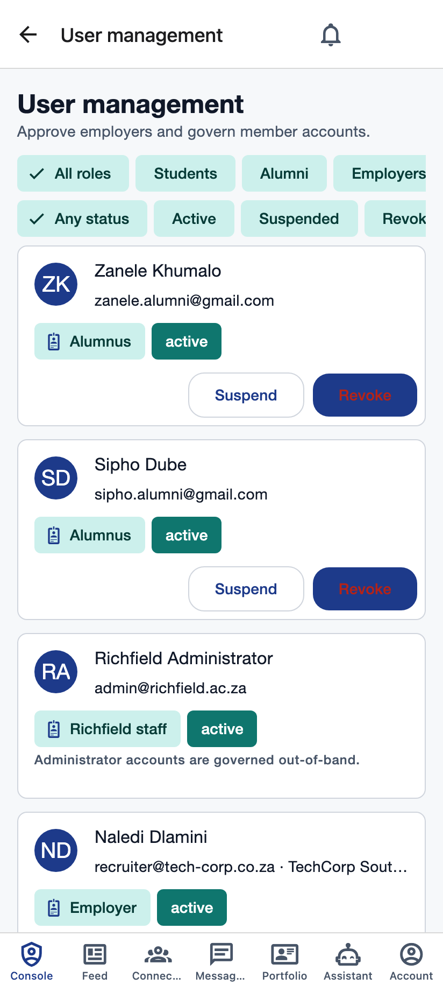
ADMINISTRATION
Administrator panel
▪ Console hub with live counts and pending-work badges.
▪ User management: approve employers, suspend, reactivate or revoke accounts.
▪ Opportunity approvals that trigger matching when published.
▪ Moderation queue for reported posts, comments, profiles and recommendations.
▪ Event management: create, publish or cancel career fairs and workshops.
▪ Platform analytics and a broadcast centre to reach everyone or one role.
▪ Every action audited.
Administrator console
User management
Richfield Connect · Team GritSim AI
16
Notes:
Presenter: Dali.
Demo steps 7 and 9: approve the listing, then moderation, analytics and a broadcast.

Slide 17
ROADMAP
What's next
Built for the demo
Next steps
✓ Four verified roles with server-enforced access
✓ Portfolios, endorsements, recommendations, AI CV import
✓ Connections, messaging, ranked feed, moderation
✓ Opportunities with matching, events, career pathways
✓ AI assistant and AI-guided tour (Google Gemini)
✓ In-app inbox and push notifications
✓ Dashboards for students, employers and administrators
→ Signed Android and iOS release builds
→ Short-form video upload (transcoding function exists)
→ CV and profile photo file upload
→ Production deployment with App Check enforced
→ Full-text search for people and opportunities
→ Pilot with one campus and Richfield's Information Officer
Every "next step" builds on the same verified-identity foundation — none needs a redesign.
Richfield Connect · Team GritSim AI
17
Notes:
Presenter: Dali.
Be honest here; judges reward it. Adjust the lists if anything changes before the presentation.

Slide 18
Thank you
Questions?
Richfield Connect · Team GritSim AI
Mosa · Dali · Ina · Lindelani · Evan
Notes:
All presenters.
If a demo step failed live, offer the backup recording during Q&A.

