Slide 1
MAPTA presents: R Coding Bootcamp Day 4: Importing & fitting data with built-in and user-defined equations
Joseph D. Butner, PhD
January 24, 2022

Slide 2
Importing data
Because no one will ever give you the data you want to analyze in R format
Chances are, you’ll be importing from Excel
We can do this in either interactive or automated approaches
Interactive:
Similar to copy & paste
Automated:
We will often want to repeat analysis on many data sets or similar sets of data
In this case, we may write stand-alone code (like you saw using R Markdown)

Slide 3
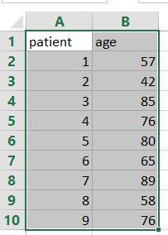
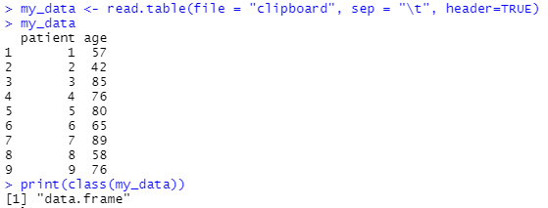
Importing data: Excel
Interactive import
We can (almost) copy & paste
NOTE: syntax is slightly different in Windows vs. MacOS
Windows:
Ctrl+c
my_data <- read.table(file = "clipboard", sep = "\t", header=TRUE)
MacOS:
Cmd+c
my_data <- read.table(pipe("pbpaste"), sep="\t", header = TRUE)
Suppose some data:
*or you can just copy & paste like you’re used to (but may need some manual editing, and data structure must be manually defined; will show this later)

Slide 4
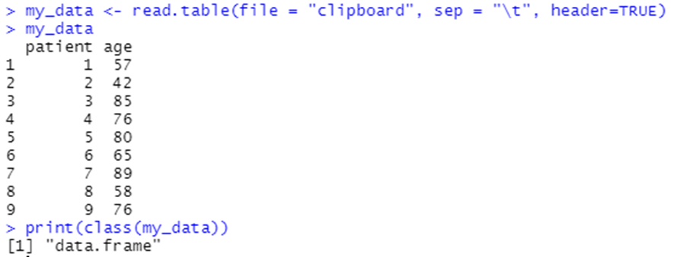
Importing data: Excel
Arguments:
File: tells R where to look for the data. We could use a file path instead
c\:user\username\doc\file1.xlxs
Sep: the rule for separating lines. If we had delimited data, this might be a comma or semicolon
Header: Boolean value. Does this case indicates the data has headers? True=1, false = 0

Slide 5
Importing data: Excel
But there are many more possible arguments!
Here’s an example
read.table(file, header = FALSE, sep = "", quote = "\"'",
dec = ".", numerals = c("allow.loss", "warn.loss", "no.loss"),
row.names, col.names, as.is = !stringsAsFactors,
na.strings = "NA", colClasses = NA, nrows = -1,
skip = 0, check.names = TRUE, fill = !blank.lines.skip,
strip.white = FALSE, blank.lines.skip = TRUE,
comment.char = "#",
allowEscapes = FALSE, flush = FALSE,
stringsAsFactors = default.stringsAsFactors(),
fileEncoding = "", encoding = "unknown", text, skipNul = FALSE)
https://www.rdocumentation.org/packages/utils/versions/3.6.2/topics/read.table

Slide 6
Importing data: Excel
These arguments allow us to fully customize how we import data
And are especially useful if you have messy data
Often, real data is missing values
And even though it looks messy you really only write it once and then copy & paste every time after that
In the real world, this is where most “new” computer code comes from…
But still, it would be nice to have an easier way to do this
Enter a tool to do it for us: Read Excel

Slide 7
Importing data with Read Excel package
But we’d rather work smarter, so let’s use another program instead
Install the Read Excel package (and another one you’ll need)
install.packages("readxl")
install.packages('Rcpp')
And then load the library
library("readxl")
This package will take care of some of the heavy lifting for us

Slide 8
Importing data with Read Excel package
Now we can just read excel files
data <- system.file(“C:\path\to\ExcelFile.xlsx", package = "readxl")
read_excel(data)
Or, we can read a specific tab within the excel file, either by sheet number or name:
Import data from tab 2:
read_excel(data, 2)
Import data from tab “patient_data”
read_excel(data, patient_data)

Slide 9

Importing data: paths
The path to a file is the location of that file
Programmers call this a directory
The path is the order of icons you double-click to get to it
It might look like C:\Users\Littl\Documents\Rcode\qBioBootcamp\examples
So all the files associated with example1 are in this directory
Excel files
R script
Exported plots/figures
Etc.
But R isn’t installed in the same directory as our data. It has a stored value called the working directory, which is where it will look for files if we don’t specify a path. R is happy to tell us where this is:

Slide 10

Importing data: paths
If we are doing a lot, typing this file path to where our files are will get old!
C:\Users\Littl\Documents\Rcode\RBootcamp\examples
A better way is to set our working directory to this file. Then, we don’t have to enter any paths at all!
Note: in windows, you have to use the double backslash “\\”
Windows uses backslashes, Linux/unix(Mac) uses front slashes “/”. Any guesses as to what operating system the R developers prefer?

Slide 11
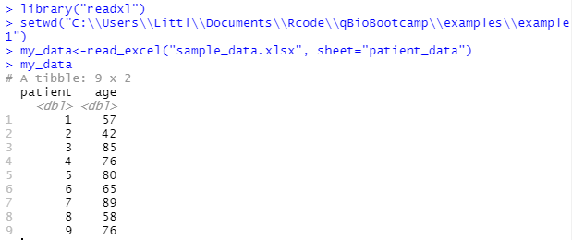
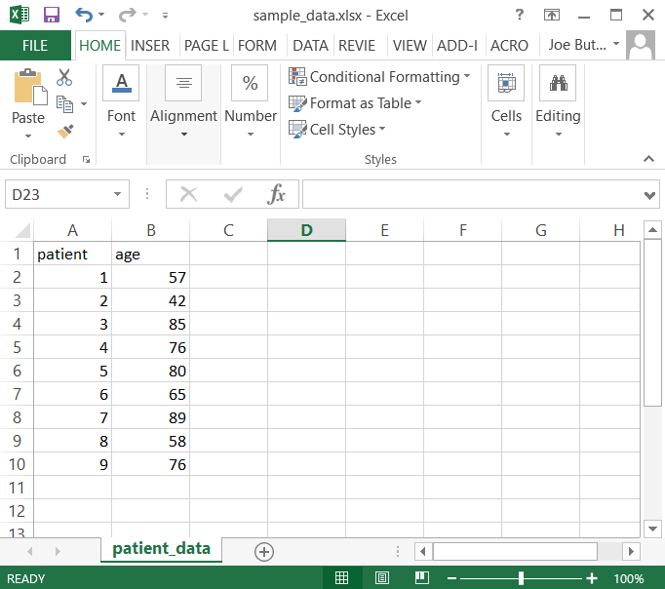
Importing data: paths
Let’s import the data set we saw earlier:
Setting a working directory is temporary to the session; it will revert to default after closing the program
Note: it’s possible to permanently set a different working directory (but we won’t get into this)

Slide 12
Importing data with Read Excel package
Q: what’s a tibble?
A: a tibble is a more modern data frame, which is another more advanced data structure (similar to a matrix)

Slide 13
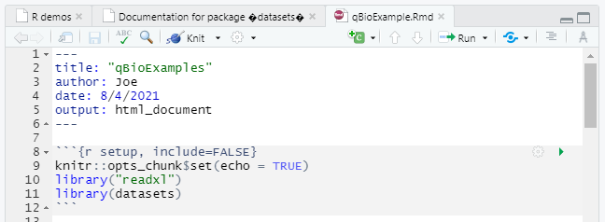
R Markdown: includes
Using “third-party libraries” (TPLs) in R Markdown
AKA: the software we installed from Cran or Github
In the same way that we load them in the console
→library("readxl")
We must load them in R Markdown if we want to use them: includes

Slide 14
R Markdown: includes
Note: includes are at the top of the script
This is an important point
Code is executed “in order”
This means you must define something before/above you call it!
Or it will be undefined and you’ll get an error
It’s easy to mess this up on large chunks of code, so good practice is to define everything at the top

Slide 15
Fitting to data: linear model
Linear model: y=mx+b
m=slope
b=intercept
I generated some data that should follow roughly the linear model y=1.3b+0
Formula for y: =A2*1.3+RAND()-0.5

Slide 16
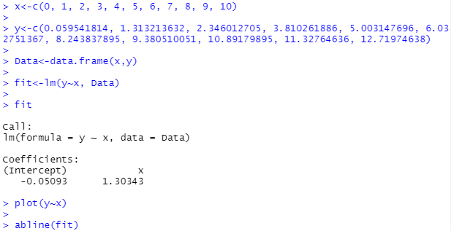
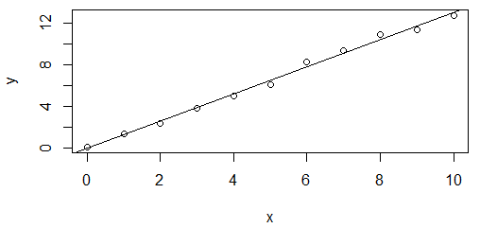
Fitting to data: linear model lm()
The data
Combine the data into a structure called a Frame (lm() needs this format)
Fit the data, save it to a variable named “fit”
Show us the fit parameters
Make the scatterplot
Plot the linear model

Slide 17
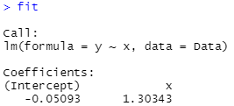
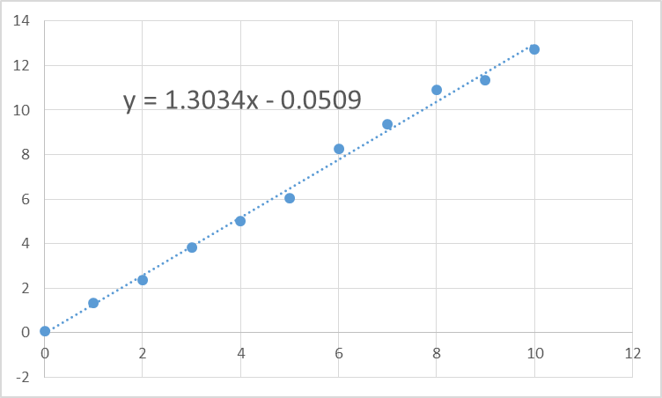
Linear model: the results
In R: linear model
In Excel: linear trendline
We got the same answer!

Slide 18
Defining equations in R
What if we want to fit some other (perhaps more complicated) function to some data?
A good place to start is by defining the mathematical function (the equation)…
The basic format:
myEquation <- function(var1, var2, …, varN){equation}

Slide 19
Fitting equations to data
Once we have a function, we can apply it to our data
With a linear model
lm()
We didn’t define the function, but we know it has y = mx + b built in
The developers did the work for us!
But of course there are other fitting algorithms
General fitting (let R pick the best one)
fitted()
Nonlinear least squares
nls()
And there are others. But for now, let’s do an example
It won’t be helpful to our learning if I list all the names here anyways…

Slide 20
An aside about vocabulary
Note that we are using computer functions
nlm(), lm(), etc.
to fit mathematical functions
y(x)= ….
I would call them “functions” but R has stacked the odds against me here:
So you can see how the vocabulary can get confusing!
Functions vs. functions…
I will refer to mathematical functions as equations in this talk
I will do my best, but please interrupt me and ask if it’s not clear (or if I misspeak)

Slide 21
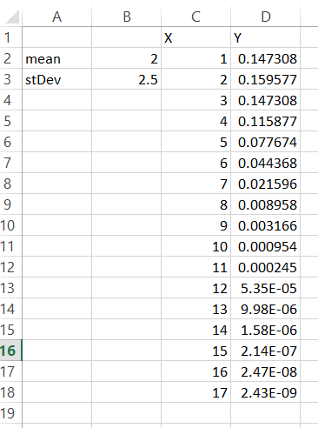
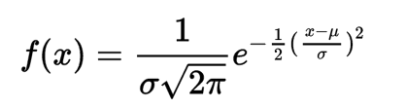
Example: Gaussian
The formula:
And in R:
I made us some “perfect” data, and we know the answer! Let’s ask R to fit this equation to the data and see how close R can get to finding μ and σ
The equation in column D:
=NORM.DIST(C2,$B$2,$B$3,FALSE)

Slide 22
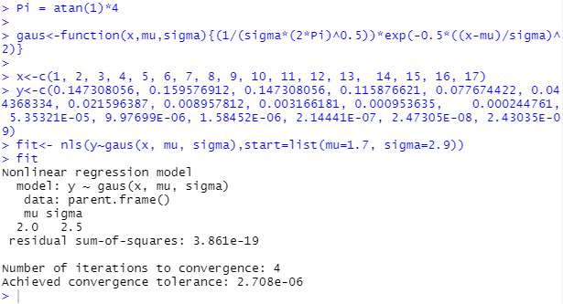
Example: Gaussian
Equation from last page
Data from last page (pasted manually)
Asking R to fit the data
The answer
Looks like R got it right!
**I’ve copied & pasted the data so we can see it all on one slide. But what if we import it from Excel? To make this example work, we would need to convert the tibble data format into a vector. Hint: you can do this with the “pull()” function in library("dplyr") version >0.7.0

Slide 23
Fitting data: a closer look
That was somewhat complicated, let’s take a closer look at what we did
We asked for a nonlinear least squares fit
Our “best guesses” as to what mu and sigma might be.
Numerical fitting algorithms need to start at a value; if we can start somewhere close we have a better chance of finding the answer
Some software don’t require guesses (they default =1) but we need this in the nls() function. Guess =1 if you don’t know
The function to use for the fit
The dependent variable
The variables to fit

Slide 24
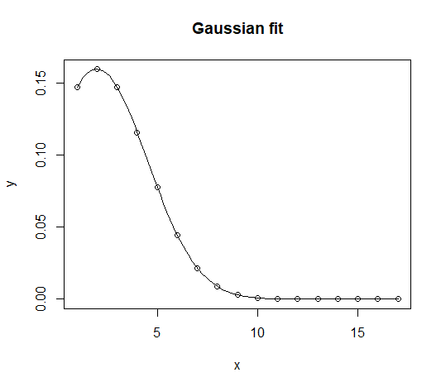
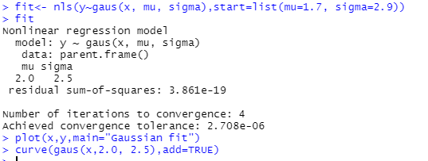
Fitting data: a closer look
And plotting the fit to make sure we got it right

Slide 25
A quick aside
In this example, I generated “perfect” data and fit it
It turns our, R cannot fit perfect data!
In reality, this is a bug that should be fixed, but hey what do you want for free? It works on all real data, and that’s good enough
If you import the data from Excel this example won’t work
By copy & pasting the data, I have rounded the number off at a certain decimal – introducing some error – so the example works

Slide 26
And a deeper look
There are actually more arguments we can use
nls(formula, data, start, control, algorithm, trace, subset, weights, na.action, model, lower, upper, …)
I will discuss SOME of these
Algorithm: a numerical method
Newton’s methods, Runge-Kutta, Levenberg–Marquardt
And many more!
Subset: only fit to some of the data
Lower, upper: bounds to data
For example, many physical quantities must be >0 (temperature, pressure, etc.)

Slide 27
And a deeper look
Fun fact about the nlm() function
Apparently, it will coerce (recast) your function to a working format if it doesn’t like your function(equation)
This could cause you problems, and could potentially change your result. So:
Write your equations carefully
Plot the result against your data to make sure it looks correct
Does the answer make physical sense?

Slide 28
Case study: maximize protein stability
An experiment was performed to measure urea-induced unfolding data of NEUPOGEN* under three different solution conditions:
acidic and low salt (pH 3.5)
acidic with salt (pH 3.5 with 150 mM NaCl)
physiological buffer (pH 7.4 phosphate buffered saline (PBS)).
Data were collected at room temperature (25°C) using circular dichroism (CD) spectroscopy at 222 nm
monitors α-helical content of proteins
*NEUPOGEN: granulocyte-colony stimulating factor, a glycoprotein

Slide 29
The data
Your boss has assigned you to select the buffer to maximize shelf-life of this drug (enzyme solution)
You be the engineer: which should we pick??

Slide 30
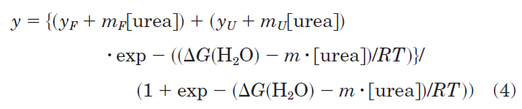
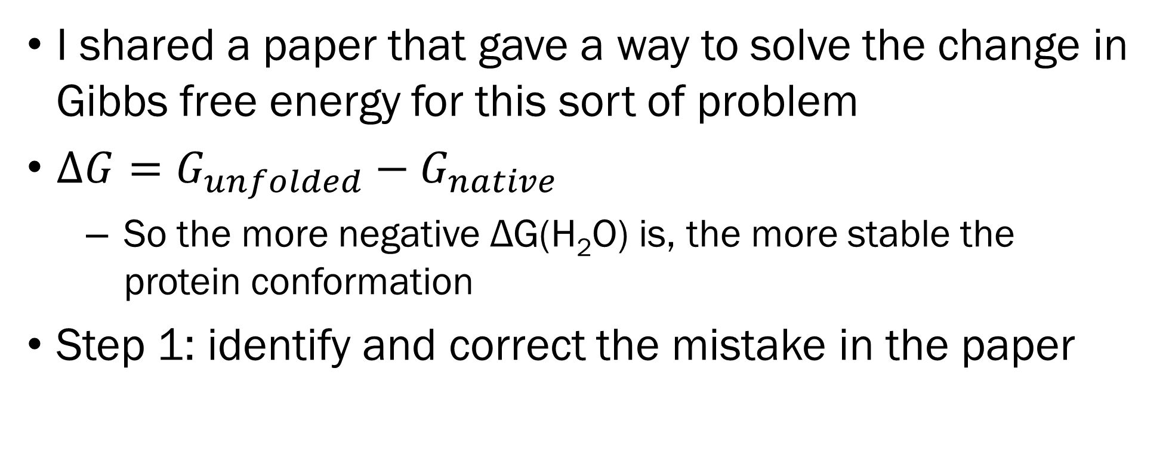
Solving the problem
I shared a paper that gave a way to solve the change in Gibbs free energy for this sort of problem
$∆G=G_{unfolded}−G_{native}$
So the more negative ΔG(H₂O) is, the more stable the protein conformation
Step 1: identify and correct the mistake in the paper
I believe this is the typo: this parenthesis shouldn’t be here

Slide 31
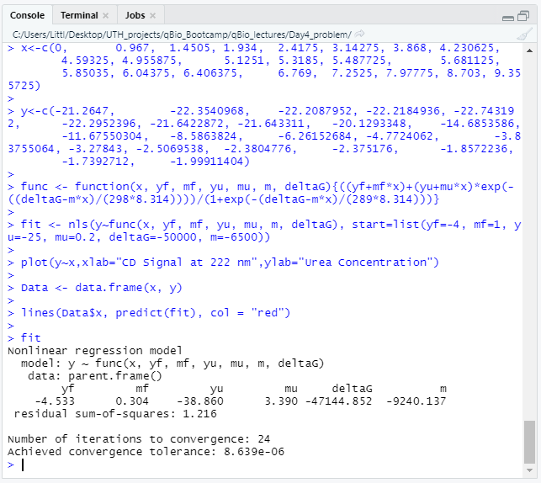
Solving the problem
pH 3.5 HCL data:
The data
Define the function (equation) we will fit to the data
Solve the problem with a nonlinear solver (nls)
Plot the data
And the curve
Show the fit results
And here’s our value for ΔG!

Slide 32
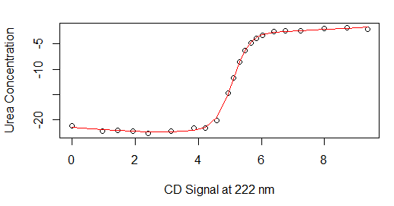
Solving the problem
And here’s the result, looks pretty good!
pH 3.5 HCL data & fit

Slide 33
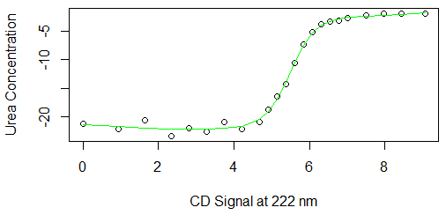
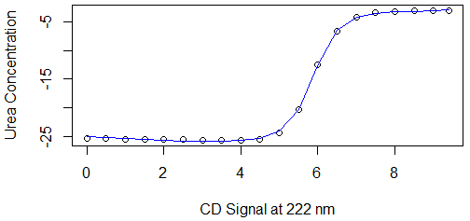
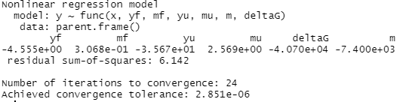
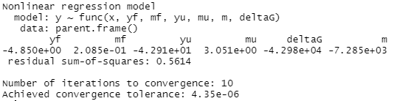
Solving the problem
Likewise, for the other two datasets
pH 3.5 HCL + 150mM NaCl data & fit
pH 7.4 PBS data & fit

Slide 34
Solving the problem
The answer:
Most negative ΔG is the most stable. We choose pH 3.5 HCL
Data set | ΔG
pH 3.5 HCL | -47,114
pH 3.5 HCL + 150nM NaCl | -40,700
pH 7.4 PBS | -42,980

