Slide 1
MAPTA presents: R Coding Bootcamp Day 3: Boolean logic, loops, and writing functions
Joseph D. Butner, PhD
January 17, 2022

Slide 2
An introduction to coding
Boolean logic, indexing, and loops
R is a high-level computer programming language
High-level: easier to use by trading some functionality/control
You will encounter some basic code as you use R
Understanding the common building blocks of the code will help you adopt some functions you may wish to use in the future
Syntax: the ‘grammar’ rules of computer code

Slide 3
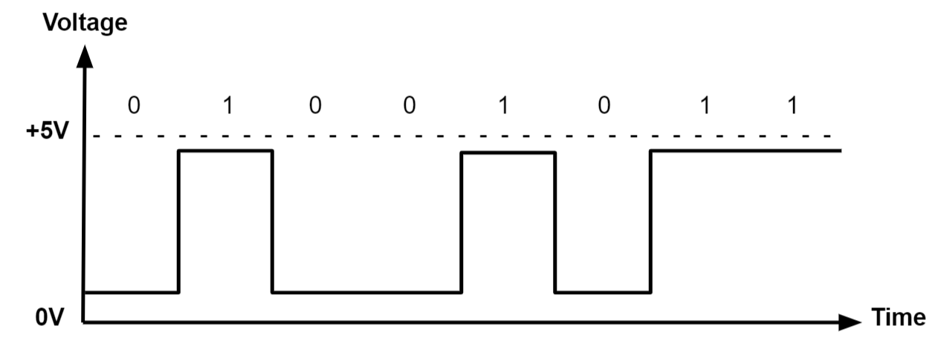
Binary and the need for Boolean logic
Transistors: the beginning
At the most fundamental level, computers only understand yes and no
Binary:
0=no
1=yes
Or for the engineers:
No = 0 volts
Yes = 5 volts
If you want to know why: https://www.youtube.com/watch?v=7ukDKVHnac4
TL;DW; the underlying architecture of computer processors means that all computer calculations are a sum or yes or no decisions!

Slide 4
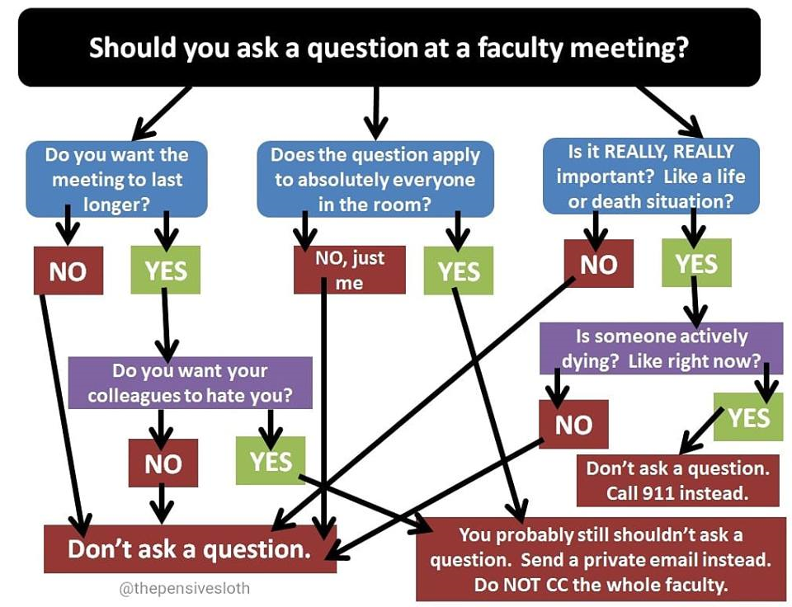
Thinking like a programmer: baby steps
We saw that, fundamentally, we must narrow down any decision to a ‘yes or no’ question
The challenge: we think at a much higher level, so going backwards to break simple tasks down to such minute steps is tough
But, we’ve all seen the basic idea used in different applications

Slide 5
Boolean logic
Boolean logic is a form of algebra based on 3 operators:
And
Or
Not
Yes or no = true or false
Our job as programmers is to solve ANY PROBLEM via a series of true or false checks
Boolean operators in R: the syntax
< | less than
<= | less than or equal to
> | greater than
>= | greater than or equal to
== | exactly equal to
!= | not equal to
!x | Not x
x | y | x OR y
x & y | x AND y
isTRUE(x) | test if X is TRUE
Pipe: above the right enter key

Slide 6
Boolean logic
And: [Smokers & cancer patients]
OR: [Smokers | cancer patients]
Not: [!Smokers]
Cancer patients
Cancer patients
Cancer patients
Smokers
Smokers
Smokers

Slide 7
Boolean logic & indexing
Define a simple vector:
x <- c(1:12)
x[x>9]
# 10 11 12
Or:
x[x < 3 | x > 9]
# 1 2 10 11 12
And:
x[x >= 3 & x < 9]
# 3 4 5 6 7 8
A look under the hood:
1 2 3 4 5 6 7 8 9 10 11 12
F F F F F F F F F T T T
R selects the values that are true(T) and returns this subset of values
This (above) is a “low-level” explanation of what the “high-level” functions (left column) are doing
Numbers 1-12 are indexes that reference one “indexed” value in vector c()

Slide 8
Boolean logic: if, then, else
Recall from before:
x <- c(1:12)
x[x>9]
# 10 11 12
And we broke this down as:
1 2 3 4 5 6 7 8 9 10 11 12
F F F F F F F F F T T T
So how does R select the values we want?
Looking even deeper under the hood:
R must check each value, and make a choice based on T/F
We can do this with the if() statement
Each value in x[i] may be accessed by the integer position [i] in the list
if(x[1]>9==T, {then do something})
if(x[2]>9 ==T, {then do something})
...
if(x[11]>9 ==T, {then do something})
if(x[12]>9 ==T, {then do something})
Note: in many languages, the double equals means “conditional equal” as opposed as “defined to be equal” (single equal sign)

Slide 9
Other logical functions: if, then, else
In general, the if() statement follows the format:
If(some condition = true {then do something})
In our example, R creates a second list that only holds the values that meet the conditions of our logical check
Define a temporary vector:
temp_list<-c()
Check the values in x[], and append selected values to the temp_list
if(x[1]>9 {temp_list <- c(temp_list, x[1]})
...
if(x[12]>9 {temp_list <- c(temp_list, x[12]})
And print the results to the R Studio window
Print(paste(“[x] “, temp_list])
Note: in R, we do not have to explicitly state the “==true” part of the if statement, this is implied. If we want to select based on an “if false” logic in our example, we would say “if(x[i]!>9 {…})

Slide 10
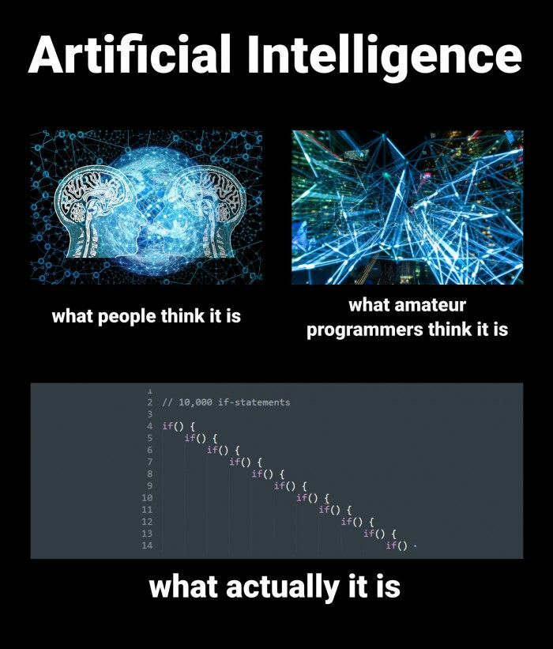
Logical functions: If, Then, Else
There is no limit to the number of if/then/else statements you can use in series or nested
And you can make very complicated decisions with it
But be careful, it can get difficult to debug

Slide 11
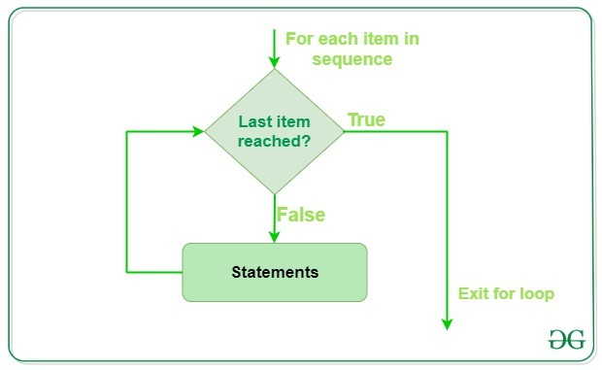
Loops
What if our list had 1,000 entries?
Continuing our example would get tedious!
Any time we need to the same basic operation many times over, we can write a loop to do this for us
In our example, we know the length of the list, so we can use a for() loop
https://www.geeksforgeeks.org/for-loop-in-julia/

Slide 12
For loops: when you know the number of steps needed
To implement a for() loop, we need:
The start and end values
Indices
These are integers
Define an integer variable that will serve as a counter
A set of instructions to be repeated on each entity
x <- c(1:12)
temp_list<-c()
for(i in 1:12)
{
if(x[i]>9
{temp_list <- c(temp_list, x[i]} )
)
}
Print(paste(“[x] “, temp_list])
*Pro tip: determine the length of x[] automatically so your code works for any list length: for(i in 1:x[length(x)] …

Slide 13
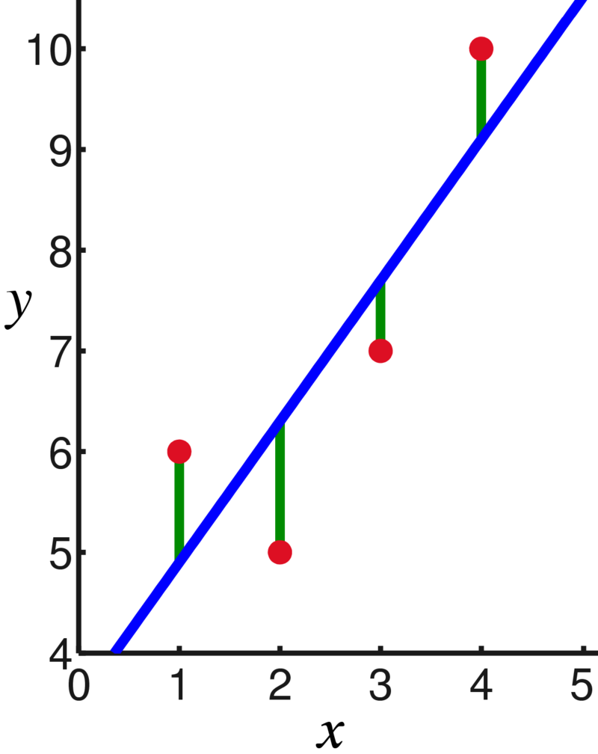
While loops: when you don’t know the number of steps
Often, we want to run a loop until a condition other than a known value is satisfied
Usually, we don’t know how many loop iterations it will take
Example: linear regression fitting to data
Take measured data, and fit a line by minimizing the residuals
(note there are many ways to do this mathematically)
A wonderful write-up (with code examples) on the details of this process can be found were I got this .gif from: https://towardsdatascience.com/gradient-descent-animation-1-simple-linear-regression-e49315b24672

Slide 14
Nesting Loops
We can run loops inside other loops!
Why might we want to do this?

Slide 15
Nesting Loops: an example
# Create a three-dimensional array†
my_array <- array(dim=c(10, 10, 10))
for (i in 1:dim(my_array)[1]) {
for (j in 1:dim(my_array)[2]) {
for (k in 1:dim(my_array)[3]) {
my_array[i,j,k] = i*j*k
}
}
}
# Show a 5x5x5 chunk of your array
my_array[1:5, 1:5, 1:5]
†arrays are data structures of the same type of data stored in contiguous memory locations, but can have higher dimensions (analogous to matrices)
Lists, matrices, and higher order structures are arrays
Arrays can hold numbers, strings, and more complex data types
Note: we don’t need these indentations for the code to work, but they make it easier to read. This is good practice, and how you will see code presented. You should do the same

Slide 16
Indexing
R assigns an easy-to-follow integer index value to each entry in our array
We can call these individually
x <- c(1:12)
x[1]
# 1
Under the hood:
Each index is a wrapper for a value called a pointer, which is the physical address in the RAM where the value is stored
Why?
Because the physical address looks like this (hexadecimal): 0x7fff5ed98c4c
And this doesn’t mean much to most people
Thank goodness for high-level languages!

Slide 17
Indexing: memory allocation and management
What if we want to add a 13th value to our vector x[]?
x<-c(x,13)
But x doesn’t have a 13th memory location!
R handles this by redefining/recycling x to have a 13th memory location
This is known as dynamic memory allocation
All languages that allow dynamic memory allocation work this way
The details:
first, R defines a temporary variable to store the new vector using the rep () = repeat function
temp-<rep(NA,13)
Then, it writes each value of x into temp
for (i in 1:12) { temp[i] = x[i]}
Append the 13th value on the end
temp[13]=13
Delete (rm()=remove*) x and reinitialize it with 13 elements:
rm(x)
x<-rep(NA,13)
And write the values from temp back into x
for (i in 1:13) { x[i] =temp[i]}
Lastly, delete* temp
rm(temp)
*the details of freeing allocated memory have been simplified for this example

Slide 18
Functions
Defining a function is similar to defining a variable, but a little more complicated
Format:
Let’s look at an example
Function_name <- function(arguments)
{
some_instructions
return(value)
}

Slide 19
Functions
Let’s define a basic function
Sometimes, people write it differently (note the bracket location); this doesn’t matter and is a point of personal preference
fahrenheit_to_celsius <- function(temp_F)
{
temp_C <- (temp_F - 32) * 5 / 9
return(temp_C)
}
fahrenheit_to_celsius <- function(temp_F) {
temp_C <- (temp_F - 32) * 5 / 9
return(temp_C)
}

Slide 20
Functions
“function”: a reserved word in R that tells R we are defying a function. This is called an identifier. Reserved means you cannot name anything else “function”
Function name: this is how we call the function. E.g., we’ve been using a function called c() a lot this week
fahrenheit_to_celsius <- function(temp_F)
{
temp_C <- (temp_F - 32) * 5 / 9
return(temp_C)
}
Argument(s): the value(s) we pass to the function – the function will do something to/with these values. In this case, a temperature in Fahrenheit
Return: this is the value that is “returned” – AKA the function output. We will discuss this more soon

Slide 21
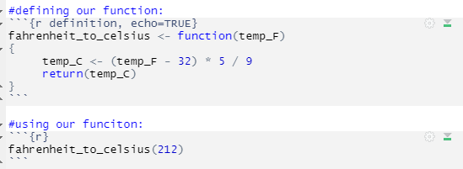
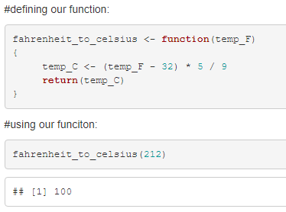
Functions: R markdown
This is how we define and use our function in R Markdown:
And here’s the output:
Note: it’s showing the function in our output because we told it to. Change to FALSE if you don’t want to show it

Slide 22
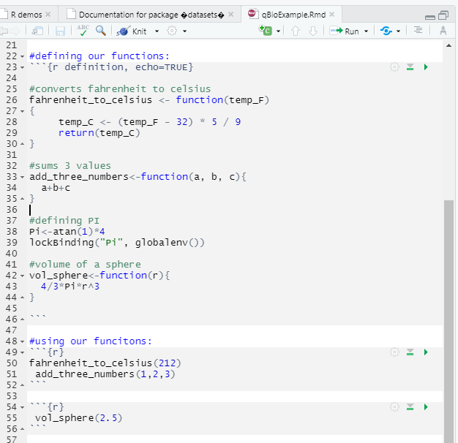
Functions: more examples in R Markdown
Note: only 1 definition section
I’ve added some comments in here so we can see them in use too
And a variable (made constant by lockbinding())
We can call these functions in as many subsequent code sections as we would like

Slide 23
Functions: more details
Note that I did not include a return() line in our new functions
add_three_numbers()
vol_sphere()
In R, explicit definition of return() is not necessary
It will return the last item processed in the function
But it’s good practice to use return() is to make sure it’s returning what you want it to
You have more control this way & reduce likelihood of returning the wrong thing

Slide 24
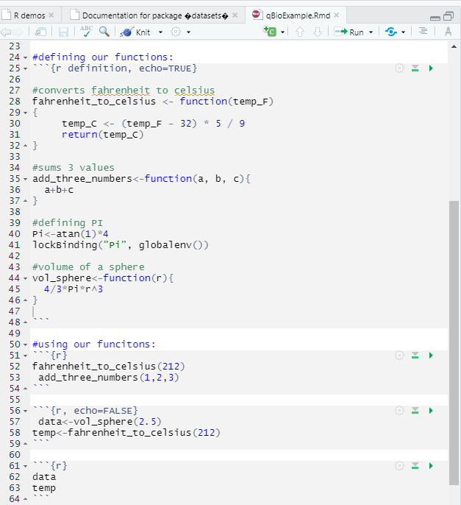
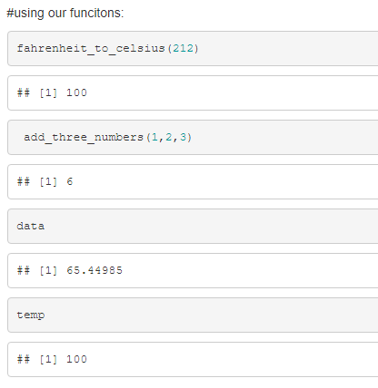
Functions: more details
Because our functions return() a value, we can assign this value to a different variable
And we can use this variable later. Here, I just print their values:

Slide 25
Functions: local variables
In Fahrenheit_to_Celsius(), we defined a variable temp_c within the function
This is called a local variable
It only exists within the function, and is deleted from memory upon return()*
*there are ways around this, but it’s a bad practice/habit (so I won’t show this)
If we try to use it outside the function, we will get an error

Slide 26
Global variables
We have also defined a global variable: Pi
Pi is defined at every line below its definition only
It may be used anywhere else
Although technically, Pi is a constant (we discussed this previously)

Slide 27
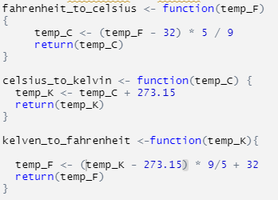

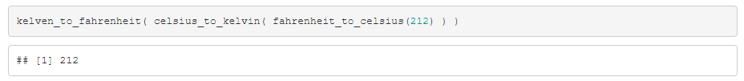
Nesting function calls: recursion
Because a function returns a value, we can use this value as the argument of another function
Fahrenheit
Celsius
Kelvin
Define 3 functions:
Call them recursively:
End up where we started:

Slide 28
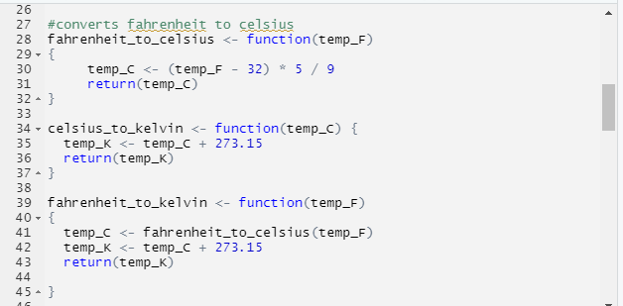
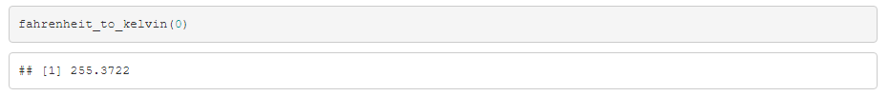
Recursion: calling a function within a function
Suppose we want to convert Fahrenheit to Kelvin
Option 1: reuse our code from before (copy & paste)
Option 2: call our fahrenheit_to_celsius() function inside fahrenheit_to_kelvin():
In this simple example it doesn’t really matter which option we use
But if these were more complicated functions, option 2 would be neater and easier to read
Call function within a function.
Remember, we must define them in the right order!

Slide 29
Recursion: calling a function within a function
Suppose we want to convert Fahrenheit to Kelvin
Option 1: reuse our code from before (copy & paste)
Option 2: call our fahrenheit_to_celsius() function:
Note: I’ve reused variable names in my new function. This is OK because these are local variables: only defined in the function.
This allows for intuitive naming conventions on our variables throughout scripts!

Slide 30
Recursion: calling a function within a function
Suppose we want to convert Fahrenheit to Kelvin
Option 1: reuse our code from before (copy & paste)
Option 2: call our fahrenheit_to_celsius() function:
The argument of the function is a local variable
Even if we use a global variable as the argument when we call the function
This why I can name the argument temp_F in both functions

Slide 31
Next time
Real world applications
Importing data from Excel
Fitting functions to data
AKA what we probably might actually want to do with R in the real world!
Case study: can we quantify the mysterious ΔG?

