Slide 1

Presentation of :
Relational DataBase Management Systems (RDBMS) checkpoint project
Realized by : Mohamed Hedi Attia

Slide 2

What is a Database
A database is a set of data stored in a computer.
This data is usually structured in a way that makes the data easily accessible.

Slide 3
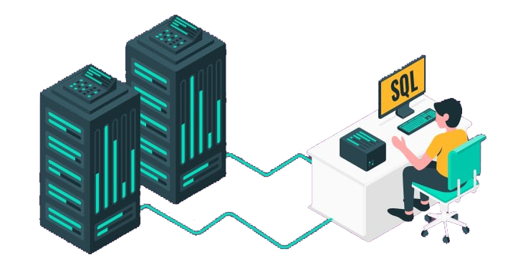
What is a Relational Database Management
System (RDBMS)?
A relational database management system (RDBMS) is a program that allows you to create, update, and administer a relational database.
Most relational database management systems use the SQL language to access the database.

Slide 4
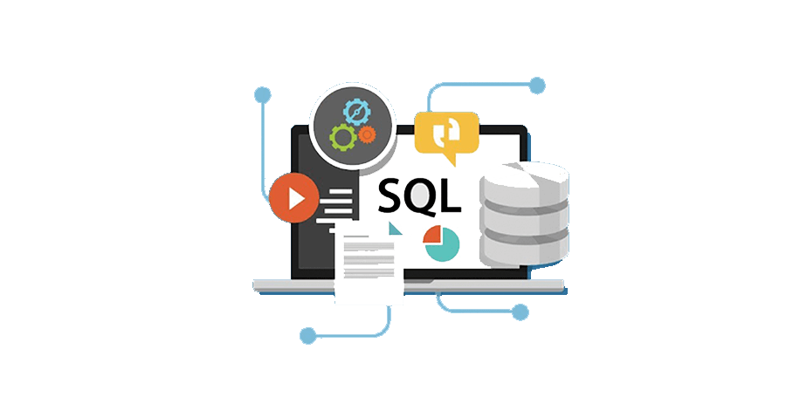
MySQL
MySQL is the most popular open source SQL database. It is typically used for web application development, and often accessed using PHP.
The main advantages of MySQL are that it is easy to use, inexpensive, reliable (has been around since 1995), and has a large community of developers who can help answer questions.

Slide 5

PostgreSQL
PostgreSQL is an open source SQL database that is not controlled by any corporation. It is typically used for web application development.
PostgreSQL shares many of the same advantages of MySQL. It is easy to use, inexpensive, reliable and has a large community of developers. It also provides some additional features such as foreign key support without requiring complex configuration.

Slide 6

SQL Server
SQL Server is a database server by Microsoft. The Microsoft relational database management system is a software product which primarily stores and retrieves data requested by other applications. These applications may run on the same or a different computer.

Slide 7

Choosing between
MySQL vs PostgreSQL vs SQL Server
Both PostgreSQL and MySQL are time-proven solutions that can compete with enterprise solutions such as Oracle and SQL Server.
MySQL has been famous for its ease of use and speed, while PostgreSQL has many more advanced features, which is the reason that PostgreSQL is often described as an open-source version of Oracle.

Slide 8

Conclusion
The choice between the three most popular databases ultimately boils down to the comparison of the functionality, use cases, and ecosystems. Companies that prioritize flexibility, cost-efficiency, and innovation usually choose open-source solutions. They can be integrated with multiple free add-ons, have active user communities, and are continuously updated.

Slide 9
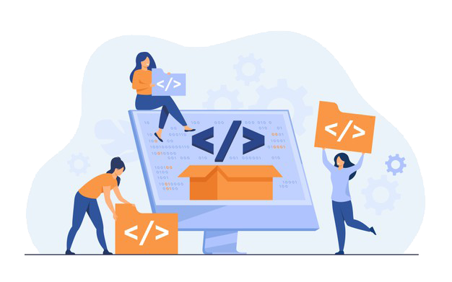

Thank you for your attention

