Slide 1

HTTP Security Header
Ives Laaf, IPC19

Slide 2


Slide 3
Agenda
Welcome & Expectations
Introduction (Terms, Concepts, etc.)
Part I – Easy to use
Part II – Complex Stuff
Part III – The Fancy New

Slide 4
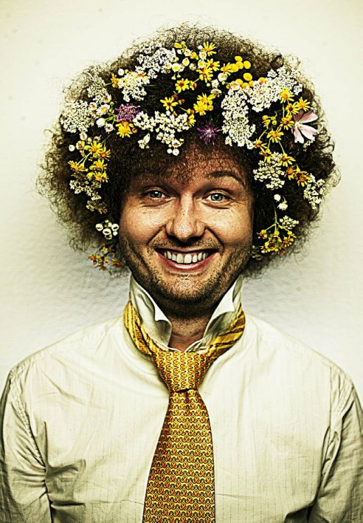
Whoami
Ives Laaf
Manager Compliance & Information Security @ adesso as a service
15 years in security & development
Computer Science Background
OWASP German Board Member
OWASP Stammtisch Karlsruhe
Twitter: @ektoplant
Xing, LinkedIn

Slide 5
OWASP
Best known for Top 10 Risk project
Many other tools, documentation, guidelines
ProActive Controls; ZAP Attack Proxy; Sheet Cheats; Containersecurity, Security Champions Playbook, OpenSAMM, etc.
Community Based (Hint: we need volunteers)
“Stammtische” in many places

Slide 6
Who are you?
Background?
Developer?
Do you know Security Headers?
What are your expectations?

Slide 7
Tools for the Workshop
Web-Browser (Chrome prefered)
Some Webserver (Apache prefered)
Some Proxy (OWASP ZAP, Fiddler, Postman, etc.)
Editor to edit configs
Free Account @ https://report-uri.com
https://observatory.mozilla.org
https://caniuse.com

Slide 8
Introduction
What means Infrastructure?
What means Trust?
What do we need from HTTPS?
What is an PKI – Public Key Infrastructure?
What do we need from DNS?

Slide 9
Do we need HTTPS?
Integrity
  Just a blog?
  MITM? Router at the Café/Train/Airport!
Confidentiality
  Privacy
  Secrets
Rating
Good Practice

Slide 10
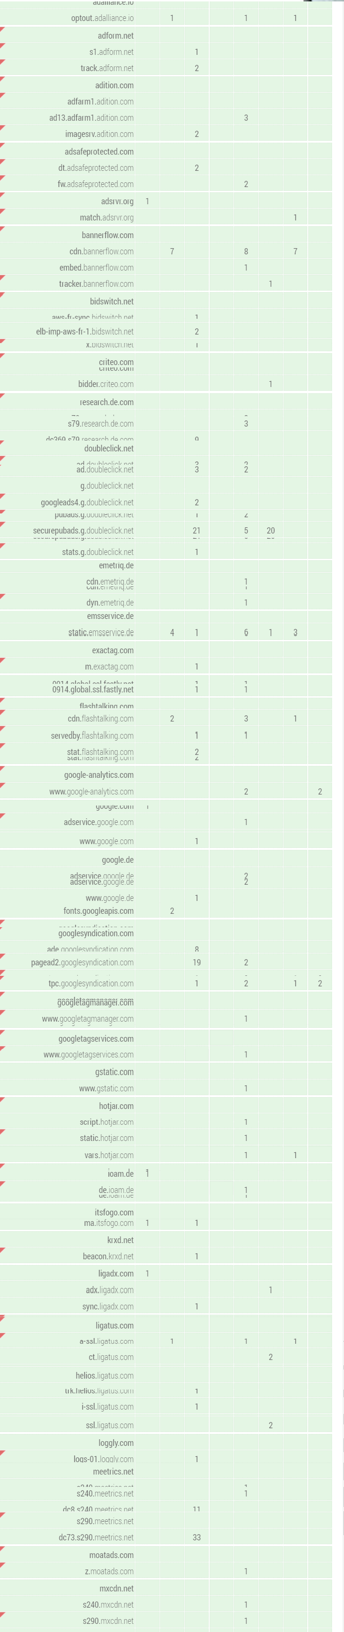
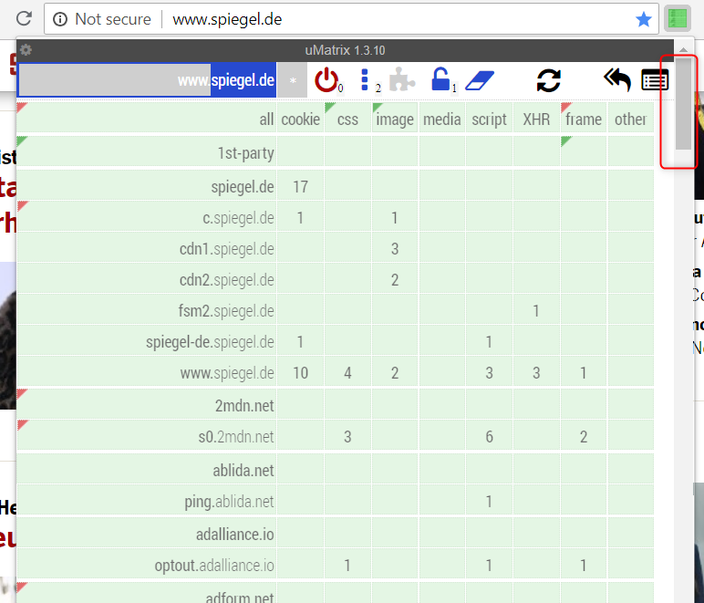

Slide 11
Trust
The Base of it All!
Notes:
Trust Roots
Tools you use
How is it established?
Is it threre? Magical Dust?
Vendors
Systems
Hardware

Slide 12
PKI
Public Key Infrastructure
http://pki.google.com
https://letsencrypt.org
Notes:
CA, Certs, CT,
http://pki.google.com
Let’s Encrypt –> CT

Slide 13
CT
Certificate Transparency
https://lab.dsst.io/slides/33c3/slides/8167.pdf
Notes:
CA, Certs, CT,
http://pki.google.com

Slide 14
OCSP
Online Certificate Status Protocol
Notes:
CA, Certs, CT,
http://pki.google.com

Slide 15
SSL
IS DEAD
Notes:
Proxies!
User Agents?
What does it help`?

Slide 16
TLS
1.0; 1.1; 1.2; 1.3
Notes:
Proxies!
User Agents?
What does it help`?

Slide 17
1-RTT
COOL
Notes:
Proxies!
User Agents?
What does it help`?

Slide 18
0-RTT
MAGIC BUT
DEVELOPERS ATTENTION NEEDED
Notes:
Proxies!
User Agents?
What does it help`?

Slide 19
CT
Certificate Transparency
Notes:
CA, Certs, CT,
http://pki.google.com

Slide 20
State of Web Application security
Where are we?

Slide 21
What are the issues?
XSS everywhere
  remote code execution of the web
Fix all the applications?
  will not work / does not scale
SQL Injection still on top 10
What could improve the situation then?
  Should scale
  Should reduce attack surfaces significantly

Slide 22
Application Independent Security -> Infrastructure
What might help to improve the situation?

Slide 23
(Web)-Infrastructure
What is Infrastructure?
  Protocols (HTTP, HTTPS, SSL, ACME)
  Standards (PKI, RFC, …)
  User Agent (Browser, Webviews, …)
  Server, Web Server (Apache, NGINX, IIS, Node.JS)
What is it not?
  Application
  Web Application
  Mobile Application

Slide 24
Issues With Infrastructure
Errors scale too
Fixes scale too
We get more dependent of it
Application based activities might be reduced
‘The Infrastructure will fix it’ – not
Training of users required (developers, administrators)

Slide 25
HTTP SECURITY HEADER
Notes:
Proxies!
User Agents?
What does it help`?

Slide 26
HTTP Security Header
Based on Protocol Extensions
Continuously Growing Approach
Can be applied without modifications of applications (some of it)
Raises the bar
Reduces some standard risks

Slide 27
Header Overview
X-XSS-Protection
X-Content-Type-Options
(HPKP) – Public Key Pinning Extension for HTTP
HSTS – HTTP Strict Transport Security
X-Frame-Options
CSP – Content Security Policy
SRI – Subresource Identity
CORS - Cross-origin Resource Sharing
Referrer Policy
Cookies
Redirects

Slide 29
Part I – Easy to use
X-XSS-Protection
X-Content-Type-Options
X-Frame-Options
Referrer Policy
Feature Policy

Slide 31
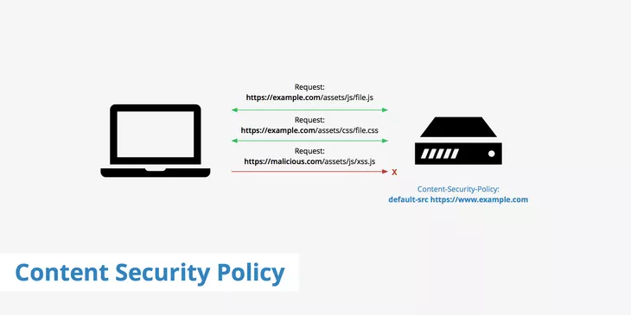

Slide 32
CSP Overview
default-src : Define loading policy for all resources type in case of a resource type dedicated directive is not defined (fallback),
script-src : Define which scripts the protected resource can execute,
object-src : Define from where the protected resource can load plugins,
style-src : Define which styles (CSS) the user applies to the protected resource,
img-src : Define from where the protected resource can load images,
the user agent applies to the protected resource,
script-nonce : Define script execution by requiring the presence of the specified nonce on script elements,

Slide 33
CSP Overview
media-src : Define from where the protected resource can load video and audio,
frame-src : Define from where the protected resource can embed frames,
frame-ancestors : Specifies valid parents that may embed a page using <frame>, <iframe>, <object>, <embed>, or <applet>.
font-src : Define from where the protected resource can load fonts,
connect-src : Define which URIs the protected resource can load using script interfaces,
form-action : Define which URIs can be used as the action of HTML form elements,
sandbox : Specifies an HTML sandbox policy that

Slide 34
CSP Overview
plugin-types : Define the set of plugins that can be invoked by the protected resource by limiting the types of resources that can be embedded,
reflected-xss : Instructs a user agent to activate or deactivate any heuristics used to filter or block reflected cross-site scripting attacks, equivalent to the effects of the non-standard X-XSS-Protection header,
report-uri : Specifies a URI to which the user agent sends reports about policy violation

Slide 36
Part III – The Fancy
Reporting & Monitoring

Slide 37
Image Sources (Free but for Credits)
  coffee: from Unsplash

