Slide 1

Security Champions?
Introduce them in your Organisation

Slide 2
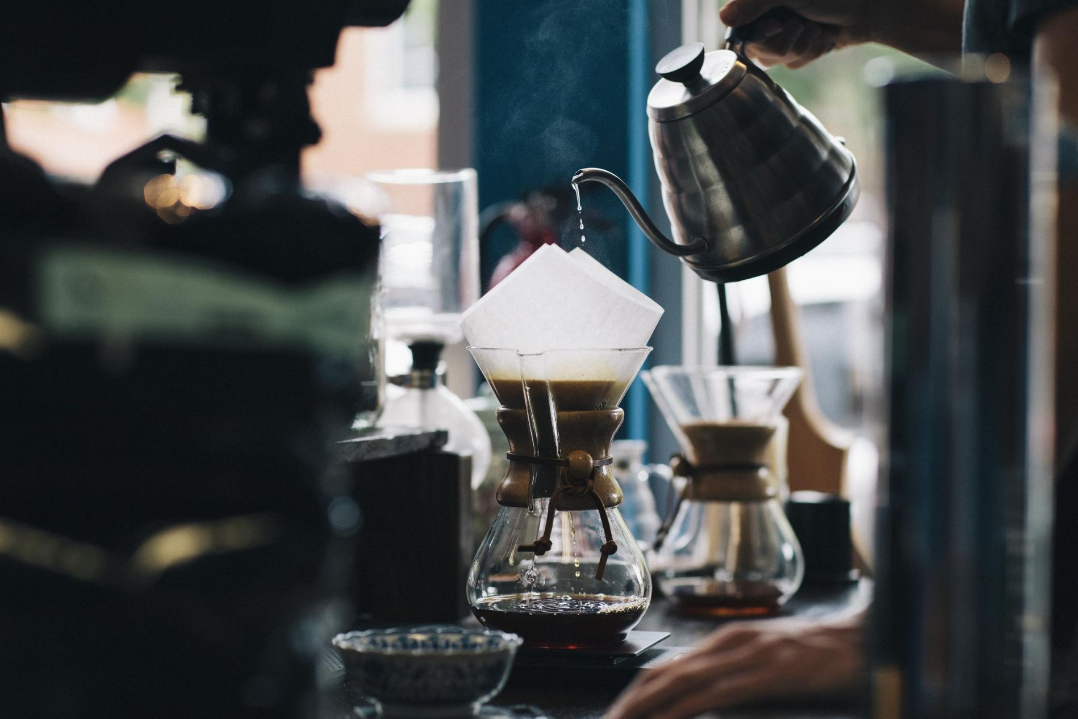

Slide 3
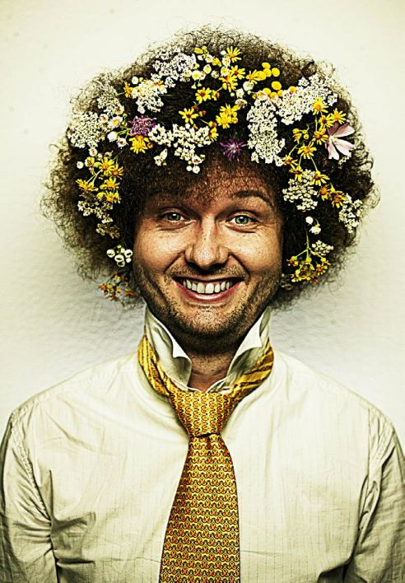
Whoami
Ives Laaf
Manager Compliance & Information Security @ adesso as a service
15 years in security & development
Computer Science Background
OWASP German Board Member
OWASP Stammtisch Karlsruhe
Twitter: @ektoplant
Xing, LinkedIn

Slide 4
Who are You?
Who is a Developer?
Who does DevOps?
Who is a Teamlead?
Who is a Manager?
Who is responsible for Security?
Who knows Security Champions?

Slide 5
Who is responsible for Security?
Manager?
Your companies security team?
CISO?
Developer?
Architekten?

Slide 6
OWASP
Best known for Top 10 Risk project
Many other tools, documentation, guidelines
ProActive Controls; ZAP Attack Proxy; Sheet Cheats; Containersecurity, Security Champions Playbook, OpenSAMM, etc.
Community Based (Hint: we need volunteers)
“Stammtische” in many places

Slide 7
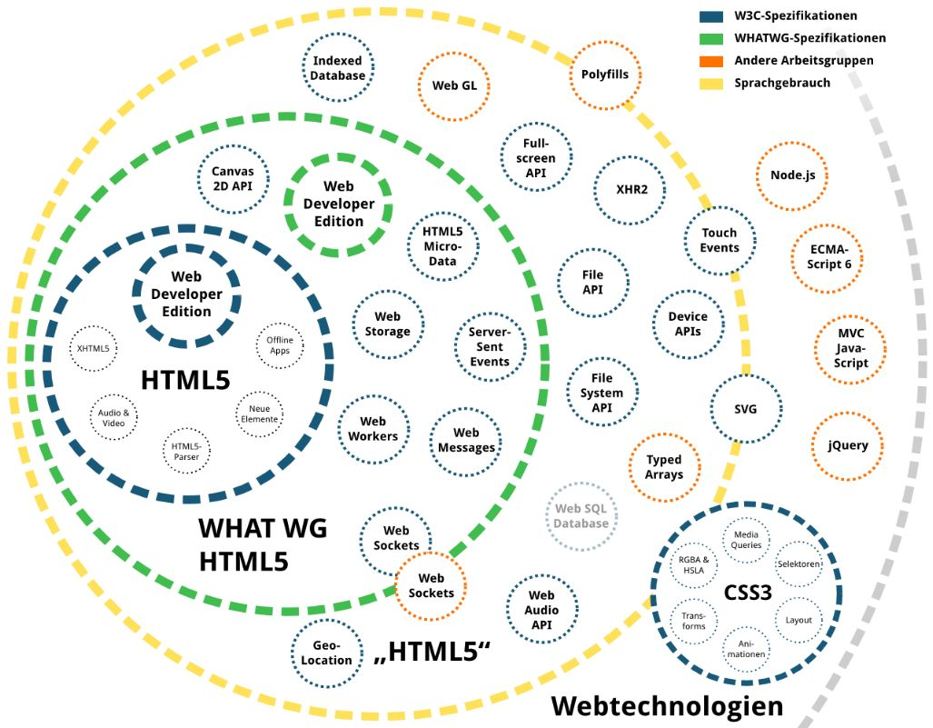
A (Web) Programmers Day
Quelle: https://www.peterkroener.de/html5-ist-webstandard-die-wichtigsten-fakten/

Slide 8
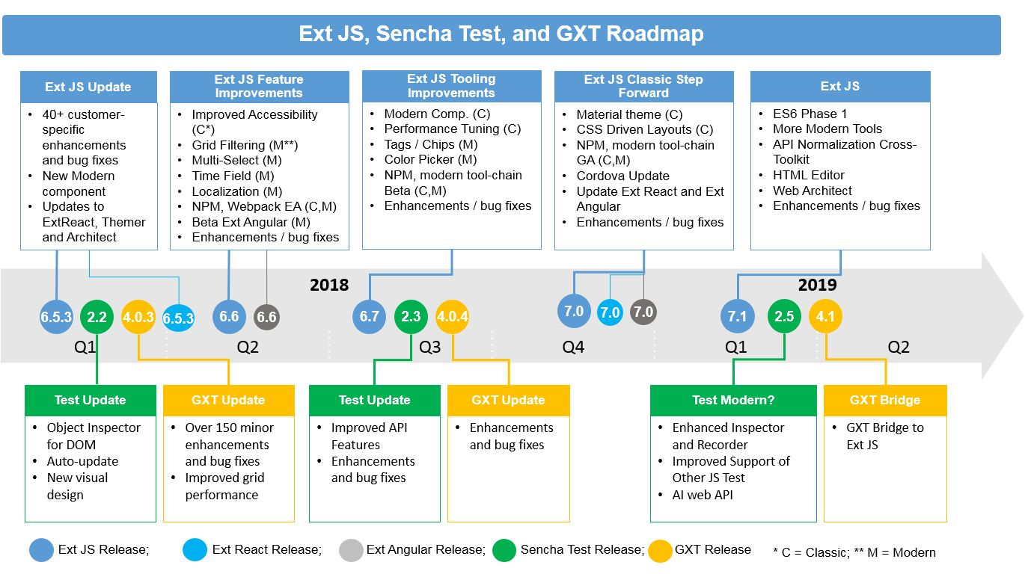
A (Web) Programmers Day
Quelle: https://www.sencha.com/blog/sencha-product-roadmap-update/

Slide 9
A Programmers Day
Project Deadlines
Meetings (Agile/Scrum; Company; etc.)
Frameworks, Browsers, Standards
Functional Requirements
Cross-Functional Requiements (aka Non-Functional)
Bugfixing
DevOps, DevSecOps

Slide 10
CCC hacks charging stations
We demand:
The security of the charging stations has to be raised to the state of the art.
Charging station operators must offer secure payment methods to their customers.
The payment data has not only to be protected within one charging cycle, but also when roaming between different charging operators as well.
https://www.ccc.de/en/updates/2017/e-motor

Slide 11
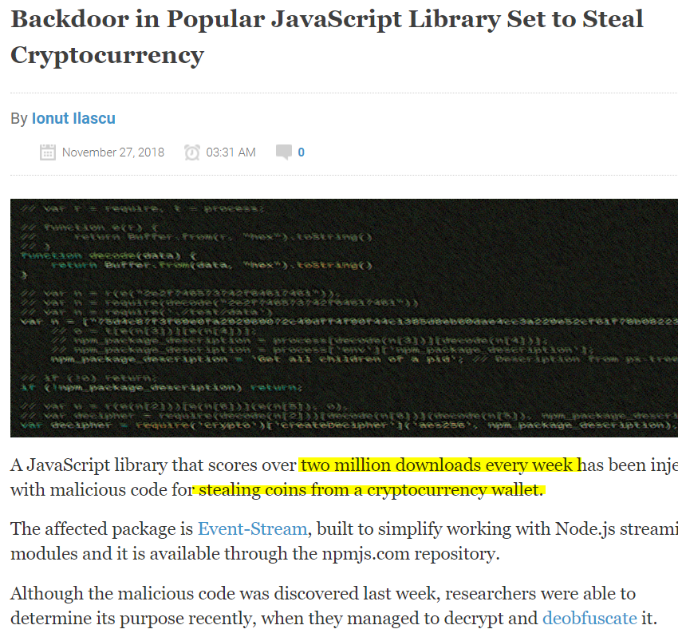
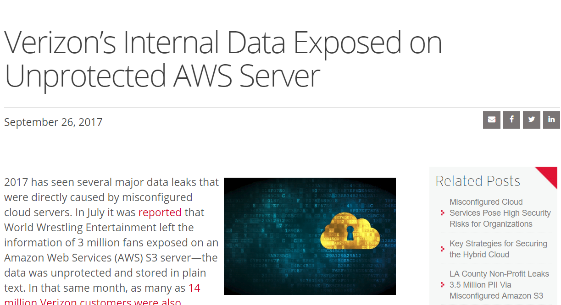
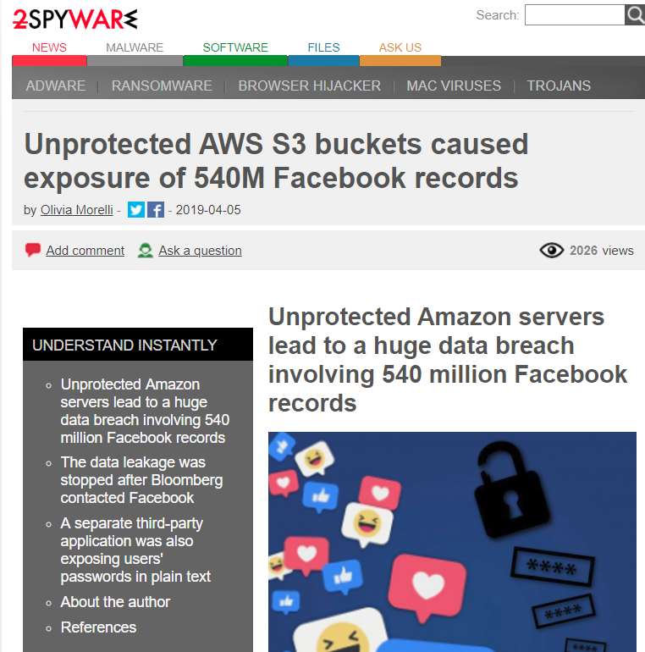
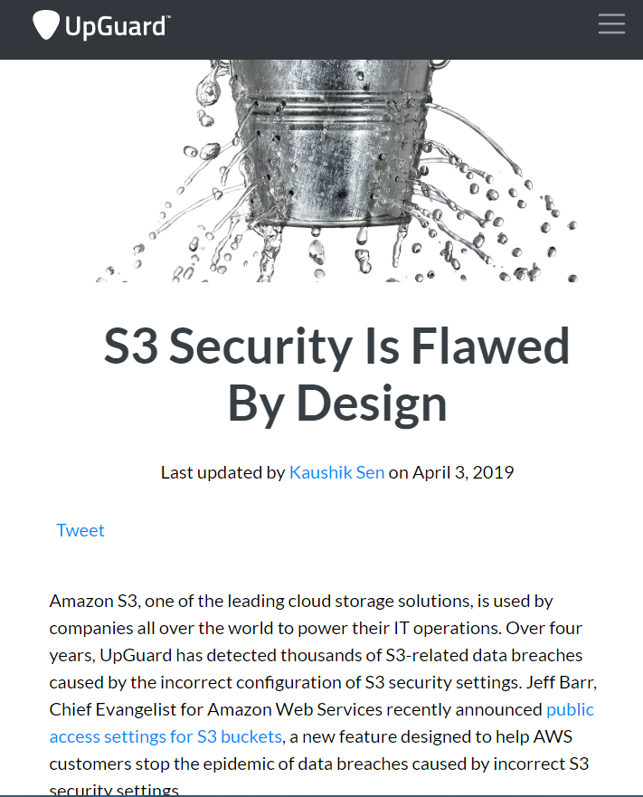
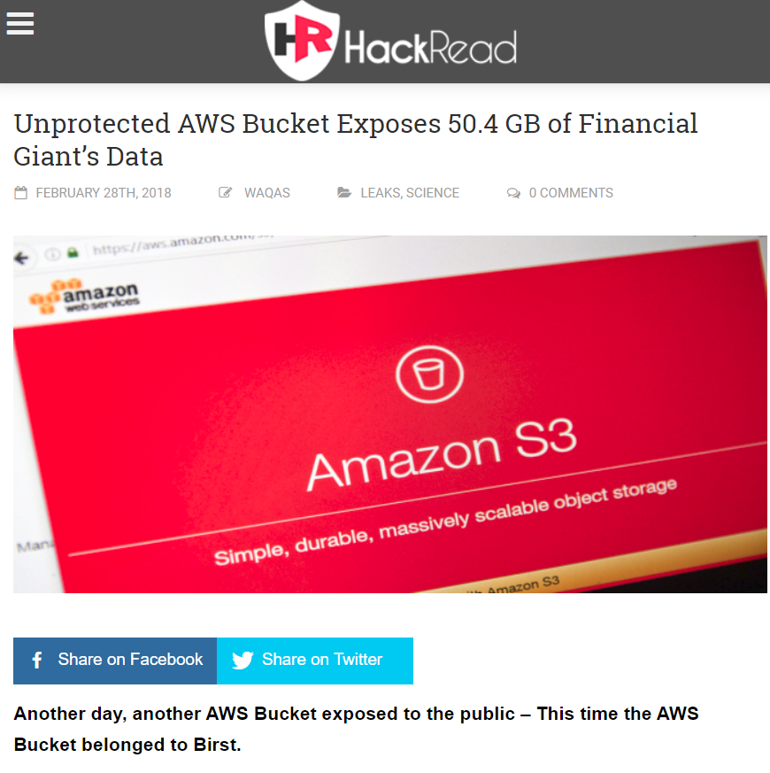
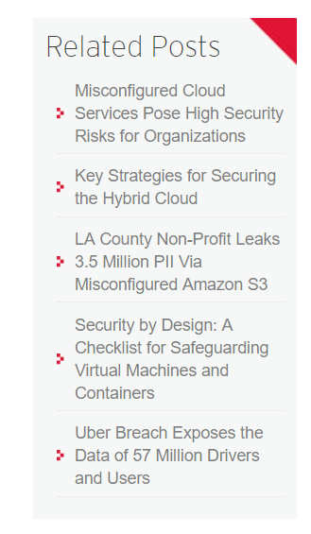
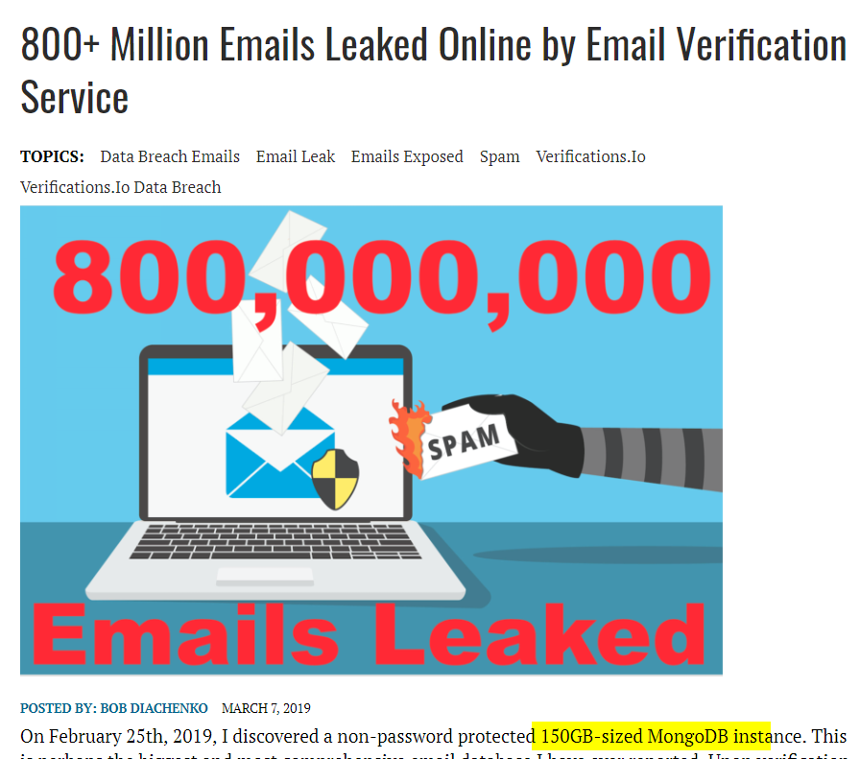
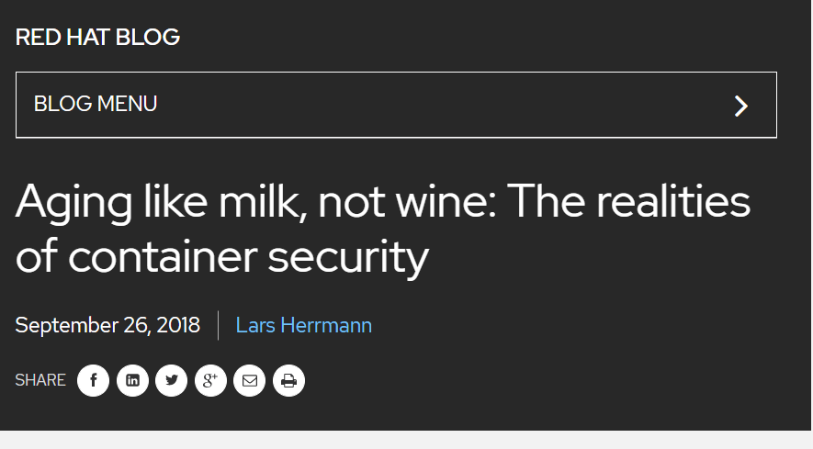
Notes:
Who uses MongoDB?
On the internet?
Unprotected?
Without Password?

Slide 12
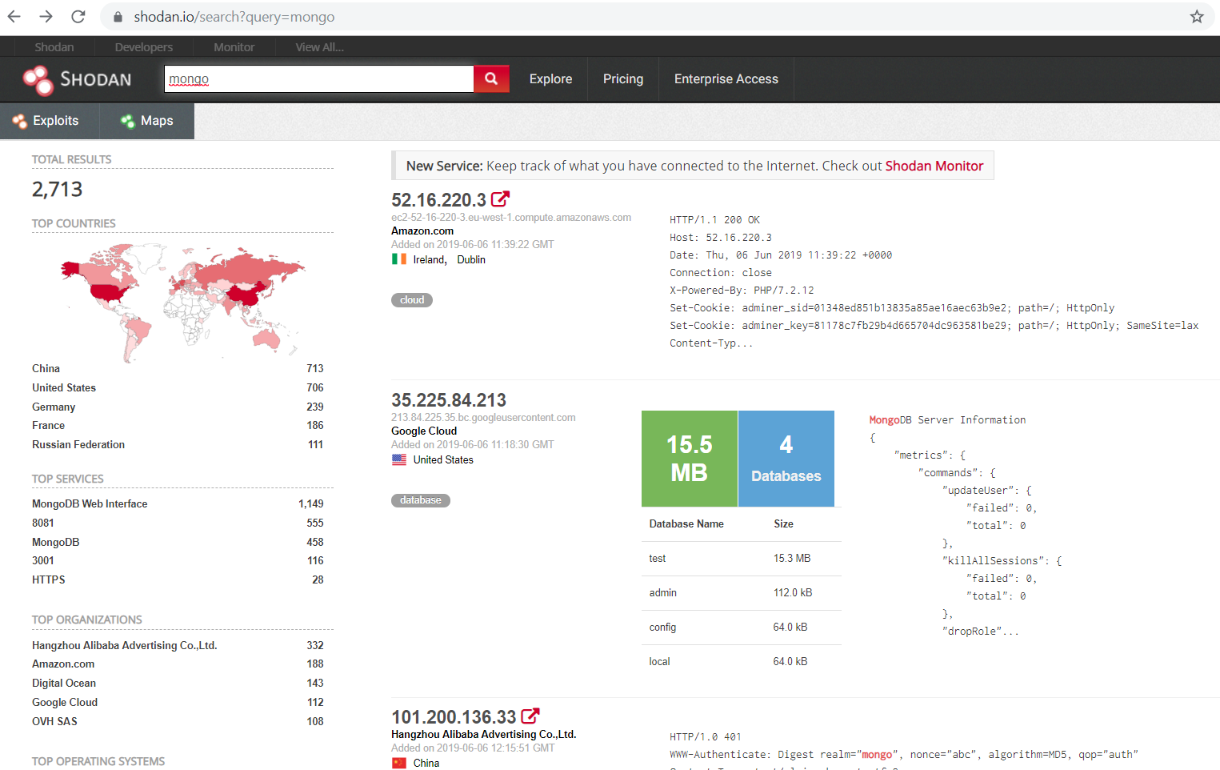
Infrastructure Search
Notes:
Who uses MongoDB?
On the internet?
Unprotected?
Without Password?

Slide 13
Security Champions
Previous Works / Based On OWASP
Dinis Cruz (Photobox)
http://blog.diniscruz.com/2015/10/what-are-security-champions-and-what-do.html
Alexander Antukh (Opera)
https://www.owasp.org/images/3/3c/OWASP_Bucharest_2017_Antukh.pdf

Slide 14
What is a security culture?
Open-mindness?
Personal engagement?
Responsibility?
Knowledge sharing?
Management support?

Slide 15
Security is important! But...
… it’s good enough for now
… these risks are not relevant
… it’s just a pilot project
… we’re changing too fast
… we depend on third-party solutions
… we don’t want no formalisms

Slide 16

Security Champion?
Photo by Fauzan Saari on Unsplash

Slide 17
Security Champion?
Developer
Architect
DevOps
Designer
Anyone Interested!
Maybe Not: a Teamlead

Slide 18
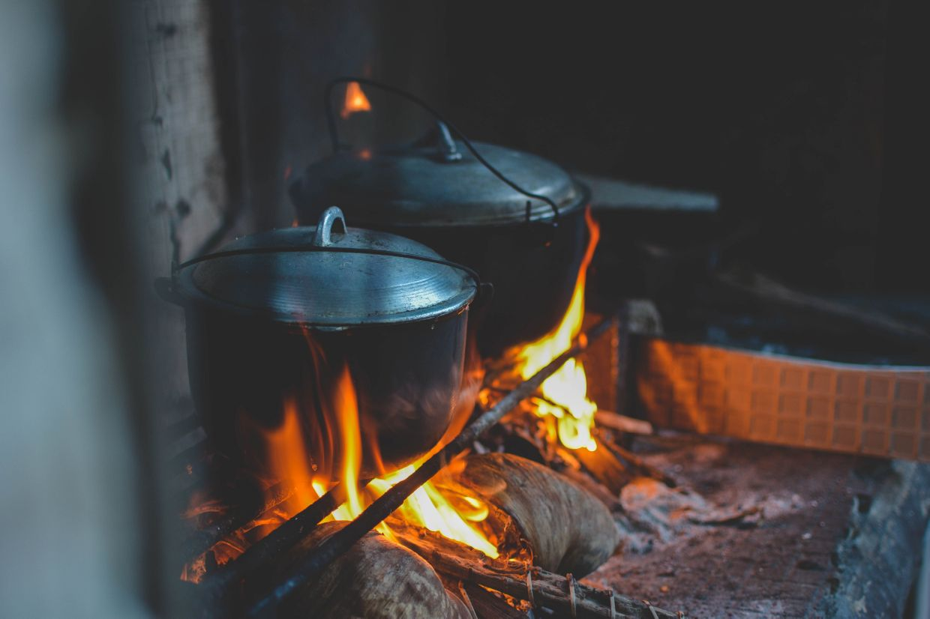
Security Champion is
Someone who knows
the projects kitchen

Slide 19
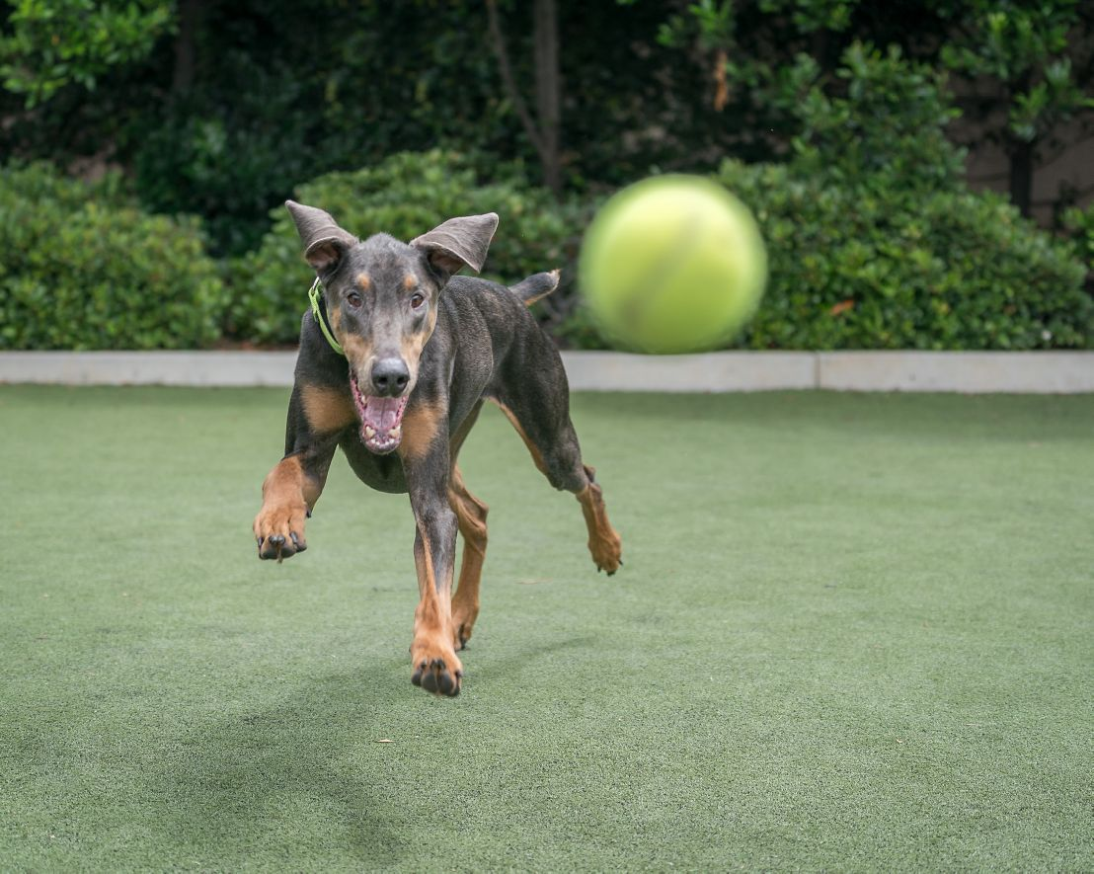
Security Champion is
Some one who want’s to
upgrade security
Notes:
Mindset! Important
Different Way of Thinking
Yesterday: Dev → Datascientist
Today: Dev → Hacker / Security

Slide 20
Benefits of SecChamps
Scaling security through multiple teams
Engaging “non-security” folks
Creating a security culture
Better & Faster response to (Security) Incidents

Slide 21
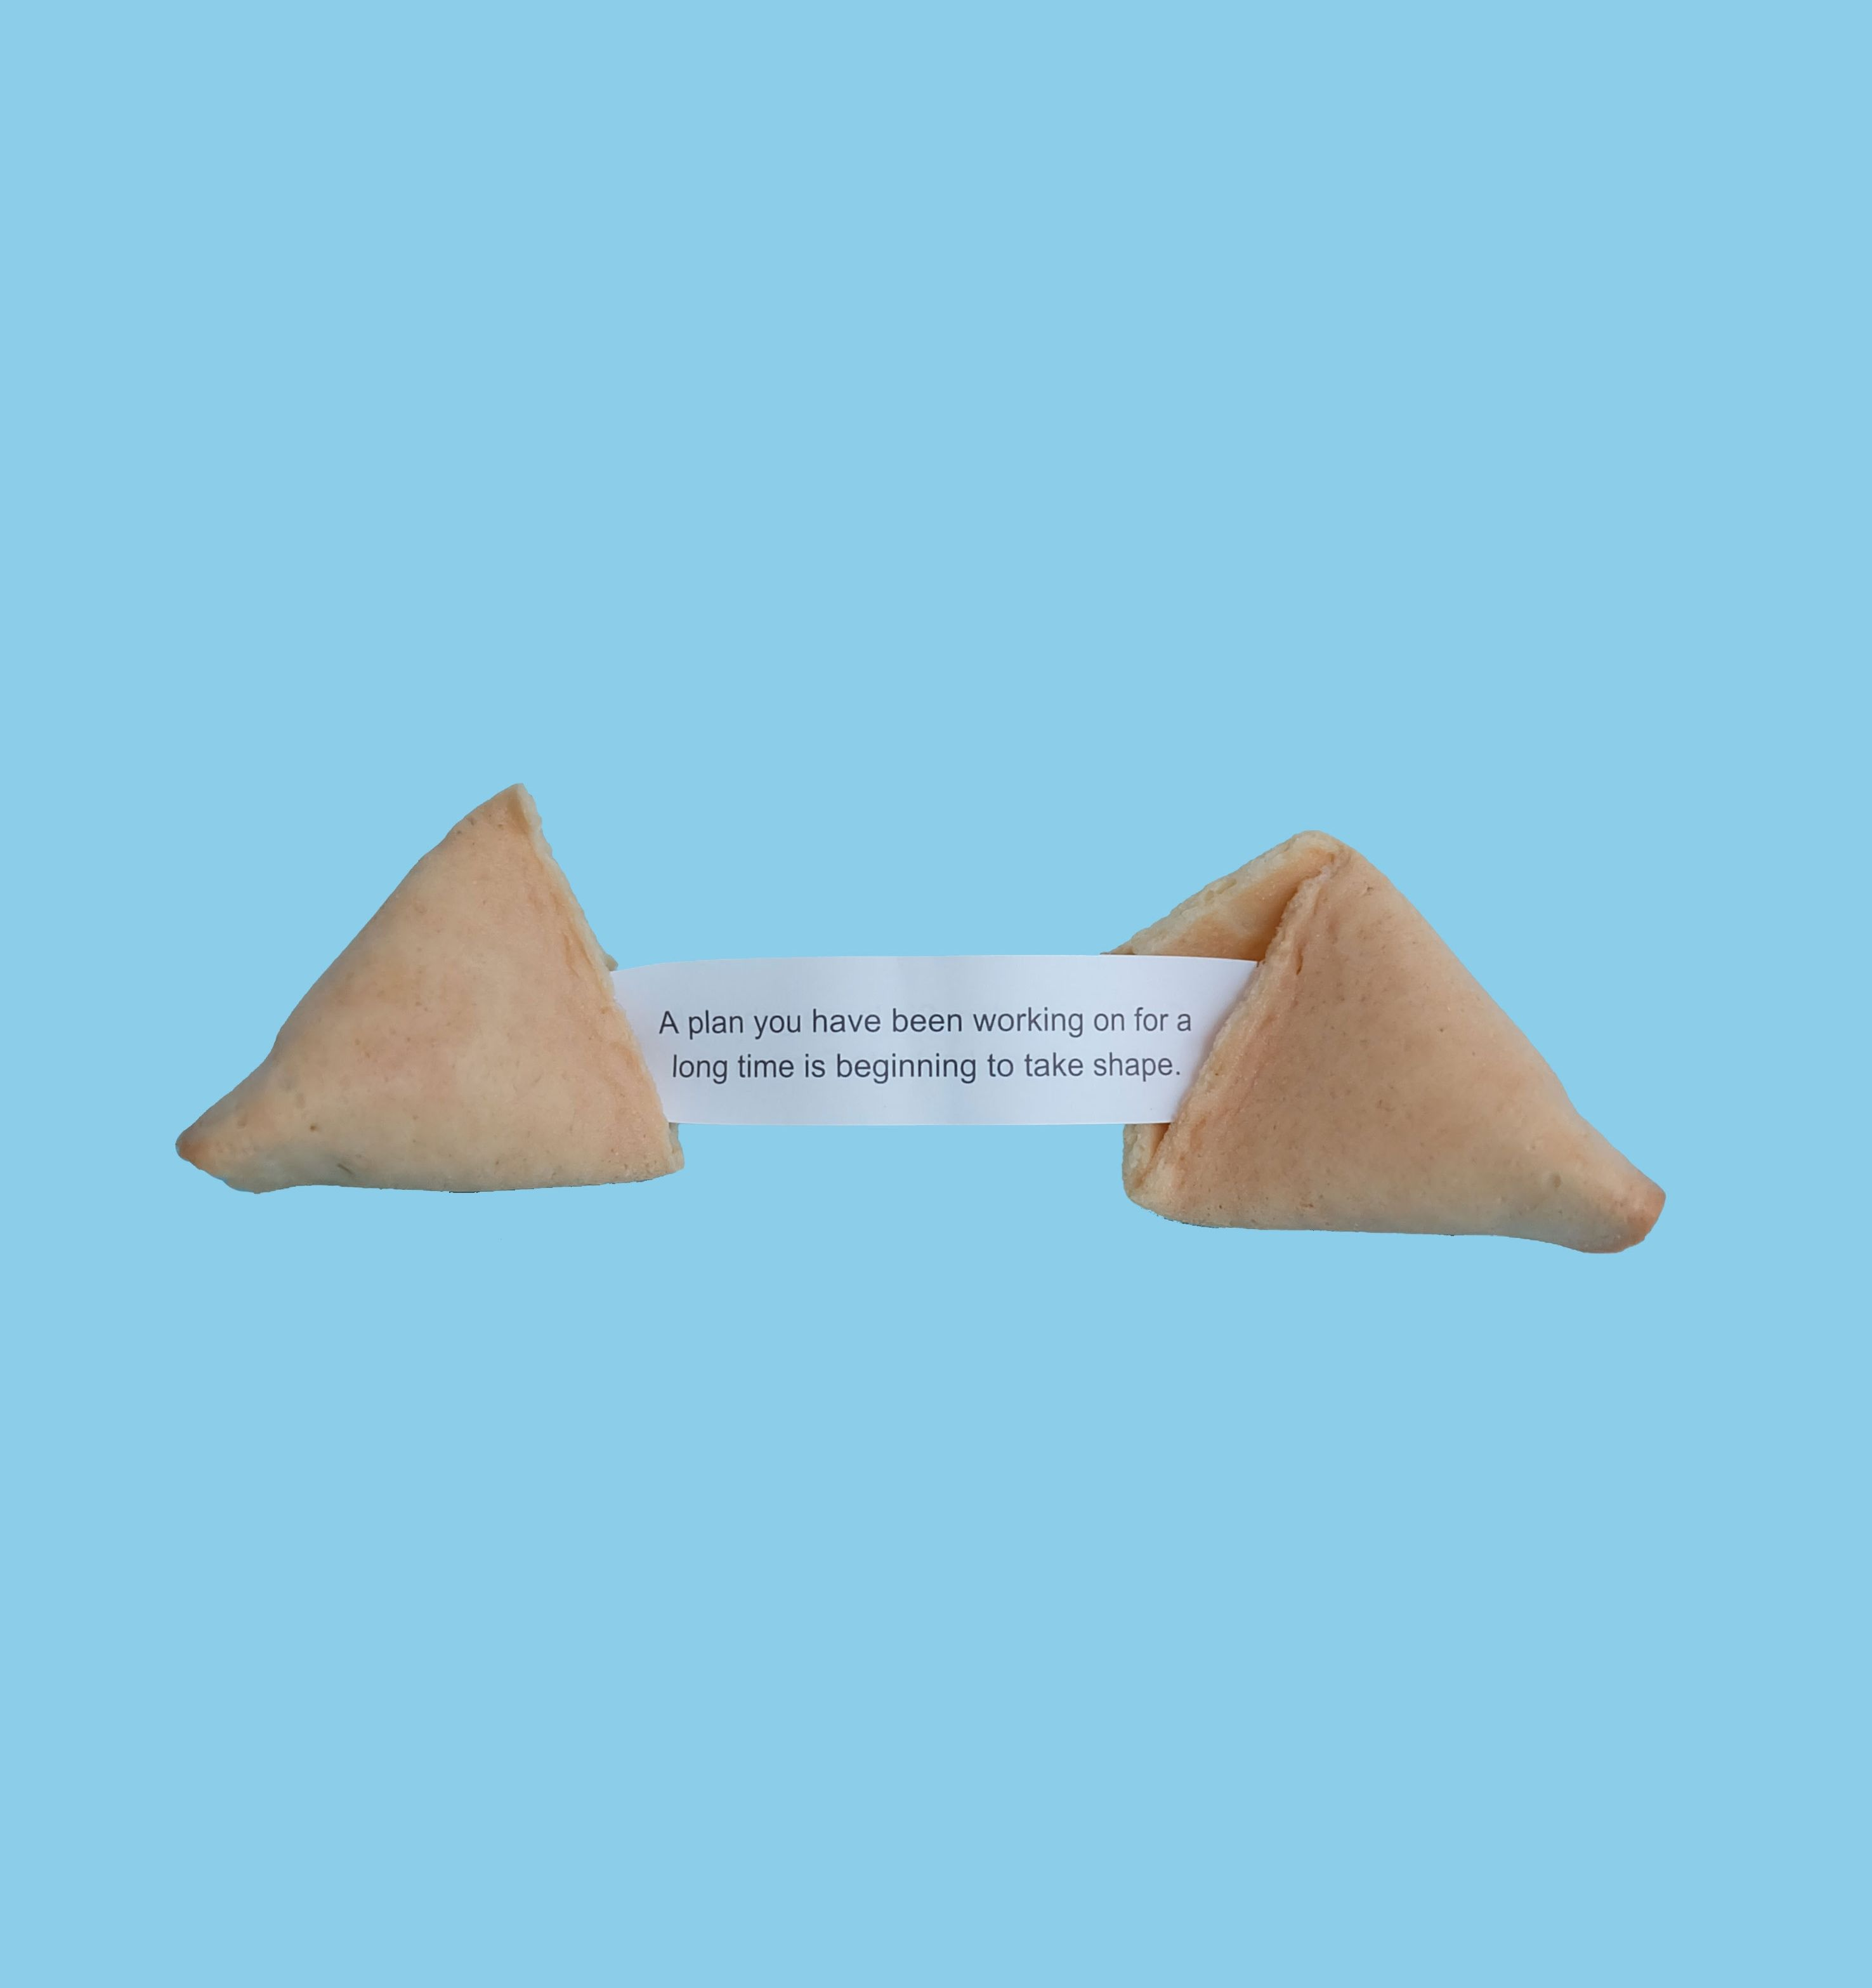
Expectations

Slide 22
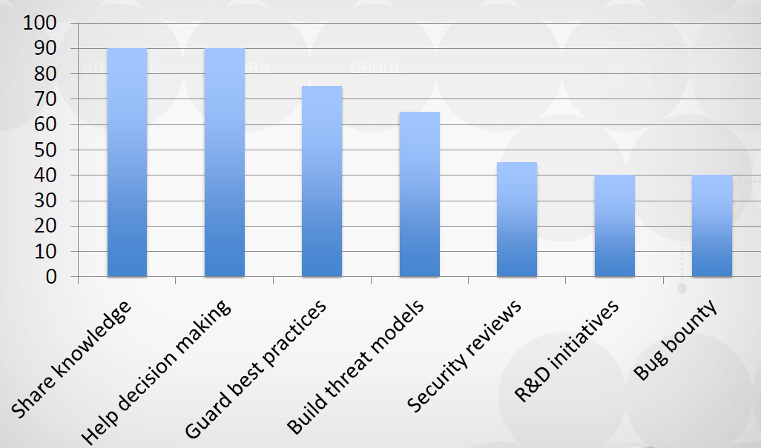
Expectations
Questionaire Outcome: OWASP Summit 2017; n=20

Slide 23
Expectations
Attend security conferences
Define best practices
Prioritize security-relevant stories in Backlog
Monitor vulnerabilities in tools/libraries
Write security tests for identified risks
More outcomes: http://bit.do/security_champions

Slide 24

Rewrap
You’re alone with a
million of security
problems
?????
Champions appear
and solve them
Winners Everywhere!
PROFIT!

Slide 25
Security Champions Playbook
1. Identify the teams
2. Define the role
3. Nominate champions
4. Set up communication channels
5. Build solid knowledge base
6. Maintain interest

Slide 26
1. Identify the team
1 product = 1 team?
Technologies?
Documentation?
Communication?
Management?
Current reviews?
Release calendar?

Slide 27
2. Define The Role
Measure current security state among the teams
Define goals you plan to achieve in mid-term
Identify places where Champions could help
Produce clearly defined roles for the Champions
Tool: OpenSAMM

Slide 28
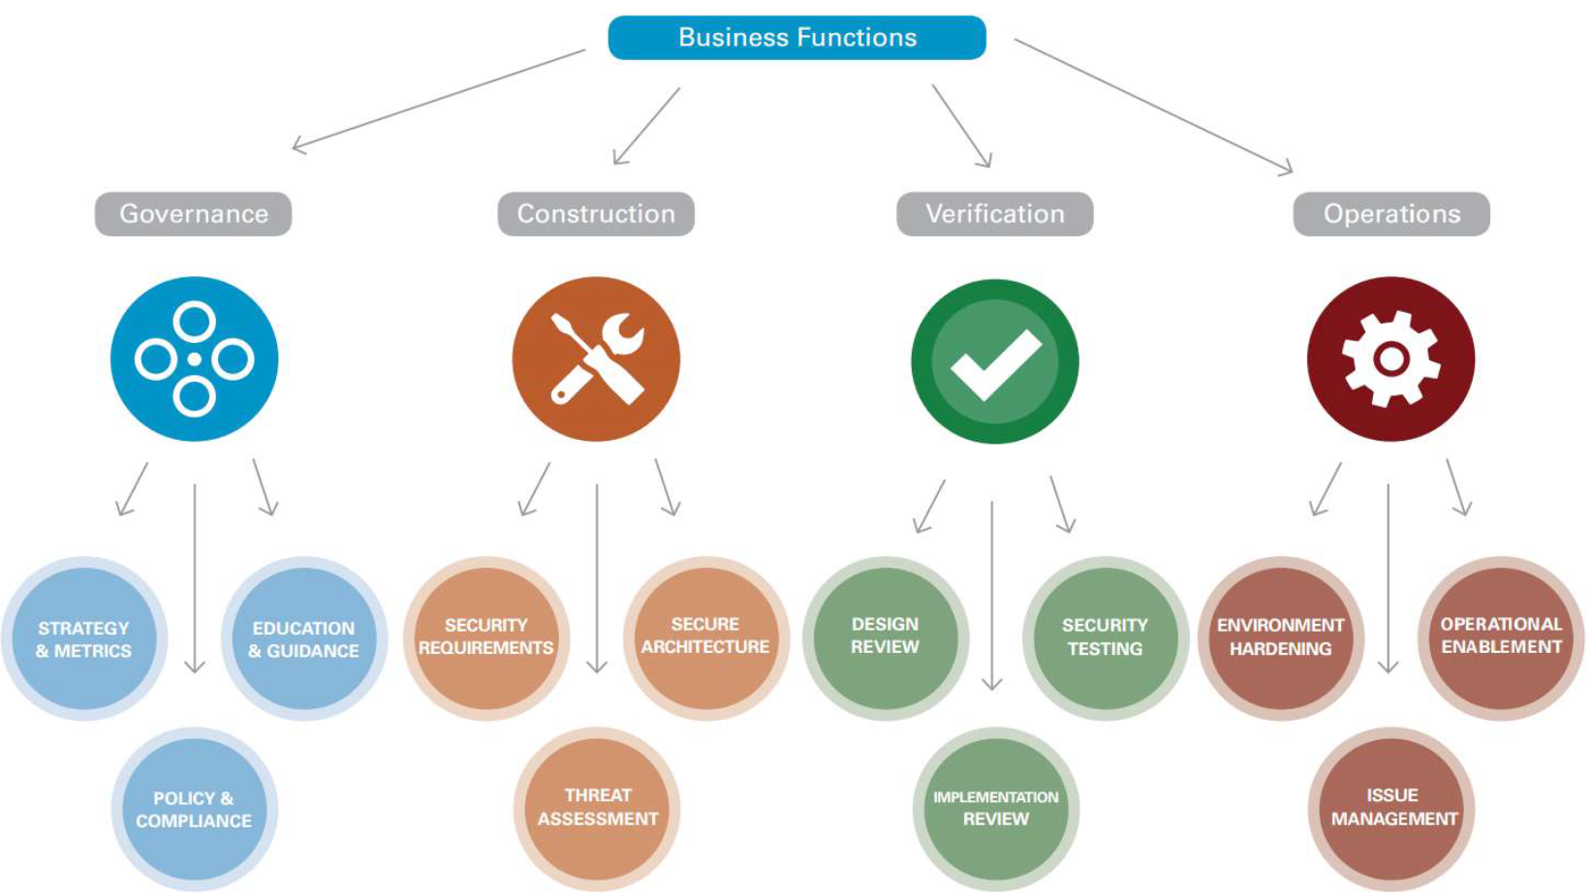
2. Define The Role

Slide 29
2. Define The Role
Depending on current progress and strategy, roles descriptions could be:
  Verify security reviews
  Control best practices within the team
  Raise issues for risks in the existing code
  Build threat models for new features
  Conduct automated scans for the code
  Investigate bug bounty reports

Slide 30
3. Nominate Champions
Enthusiasm! Don’t Appoint! Remember?

Slide 31

3. Nominate Champions
Get approvals on all levels
Communicate on all levels continously
Because otherwise you’ll hear the worst argument ever
I HAD NO TIME FOR SECURITY!!!

Slide 32
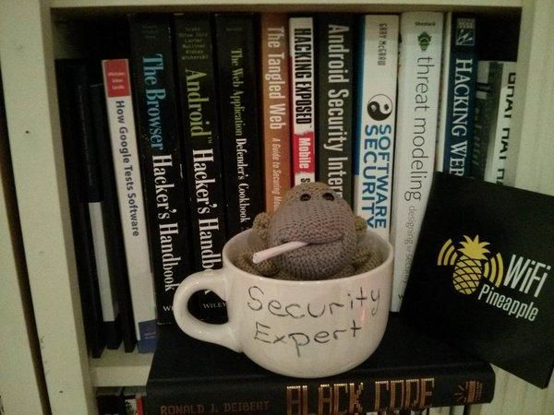
3. Nominate Champions
Once nominated, make her feel like a Champion:
  entry to the security meta-team
  official introduction to the peers
  insignia ;)

Slide 33
4. Communication Channels
Define / Establish / Maintain
  Slack?
  IRC?
  Skype/Teams?
  Keybase?
  Yammer?
  Mailing lists?

Slide 34
5. Build Solid Knowledge
Internal wiki as the main source
Security meta-team with listed champs
Clearly defined roles and procedures
Secure development best practices
Risks & vulnerabilities
Checklists/Tools: SecurityRAT/CAT

Slide 35
5. Build Solid Knowledge
Open source to the rescue!
  Security Knowledge Framework
  ASVS + MASVS
  CERT secure coding standards
  Container Security
  SecurityRAT / Dependcy Check
  and many more…

Slide 36
6. Maintain Interest
On ALL Levels!
Workshops & trainings
  Strategy / best practices
  Security quizes
  Hacker Thursdays
  "Month of bugs”
Keep them motivated!

Slide 37
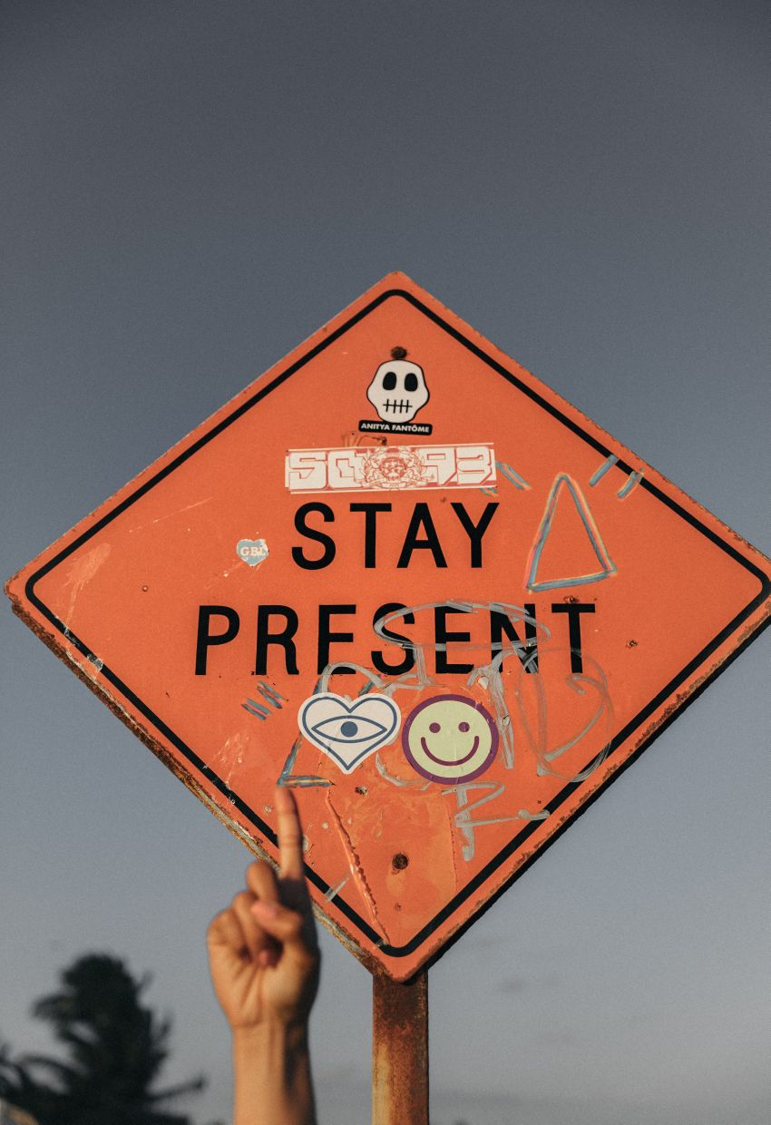

Slide 38
Maintain Interest
Monthly security newsletters
  Updates & plans
  Recognition for leaders
  Another source of communication
  Also serve as checkpoints for all
Visit Security Conferences
  https://infosec-conferences.com
  I go to the Developer Conferences ;-)

Slide 39
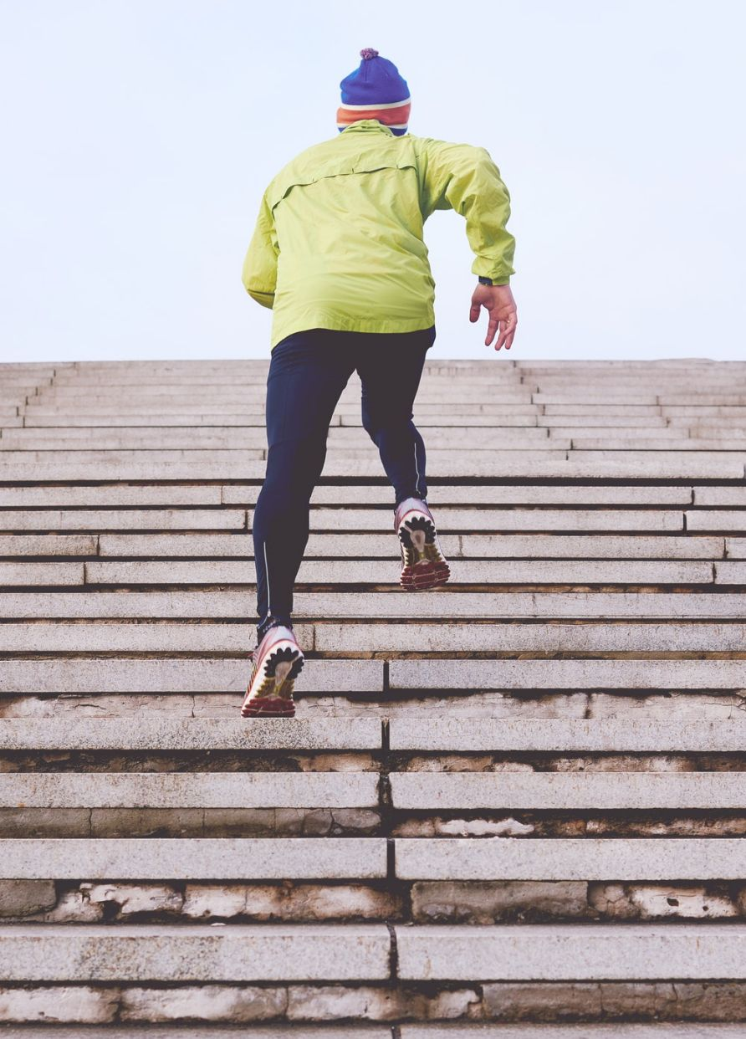
Your Next Steps?!
Improve your communicty / organisation!
  Introduce Security Champions
  Improve DevOps --> Introduce DevSecOps
  Introduce Security by Design
Make security grait working again!

Slide 40
Image Sources (Free but for Credits)
  cooking: Photo by MD Duran on Unsplash
  dog tennis ball: Photo by Jennifer Regnier on Unsplash
  cookie: Photo by Elena Koycheva on Unsplash
  stay present: Photo by Jakob Owens on Unsplash
  steps: Photo by Clique Images on Unsplash
  coffee:

