Slide 1
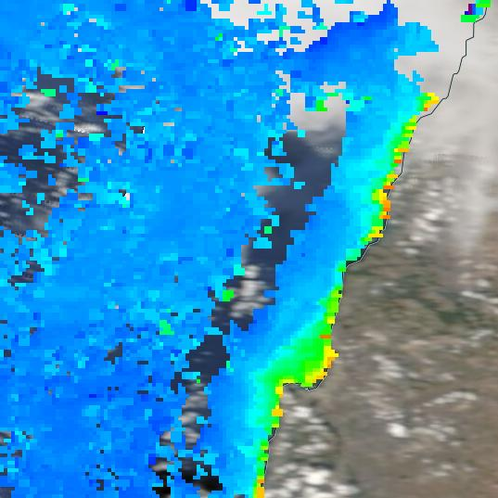
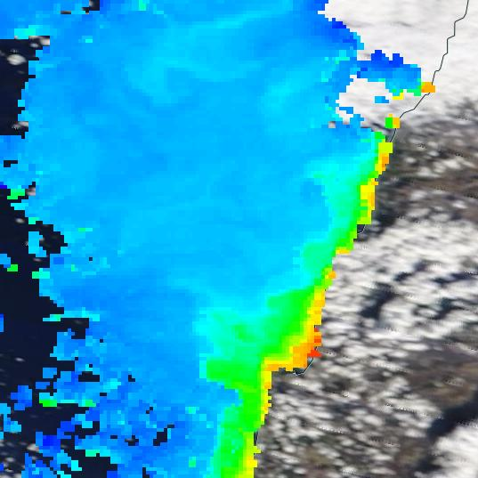
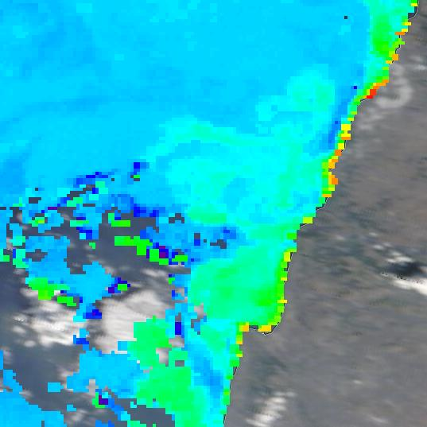
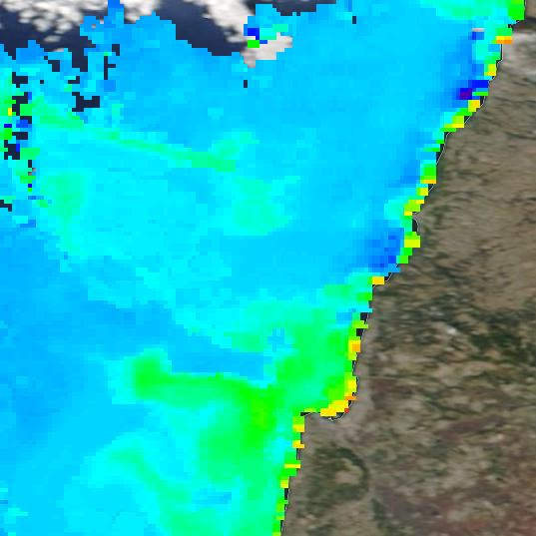
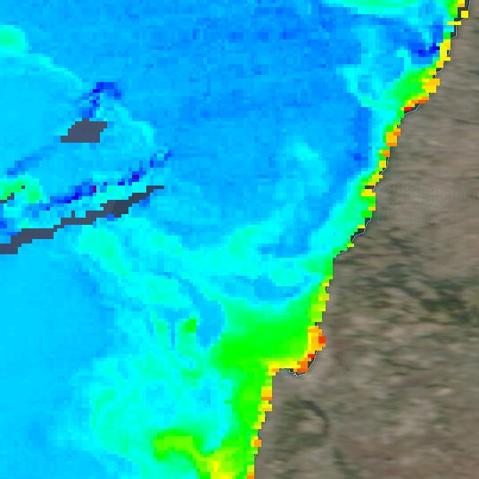
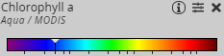
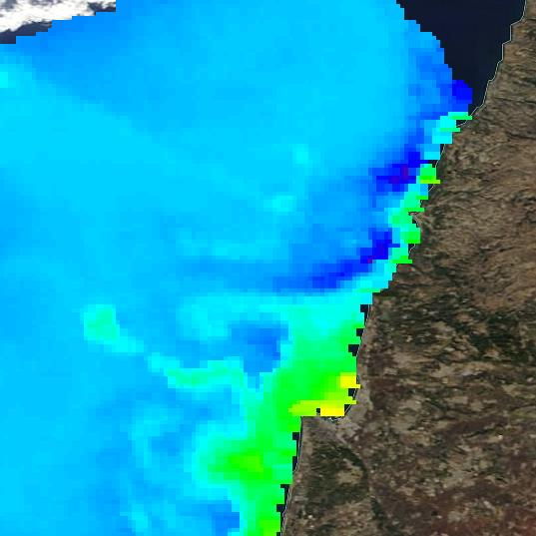
Chlorophyll A from worldview.earthdata.nasa.gov
03/11/2020
05/11/2020
11/11/2020
17/11/2020
19/11/2020
0.01 mg/m³
20
Chlorophyll A from flntu sensor, Themo - shallow station
chlA
ug/L
Dates
18/11/2020

