Slide 1
Learning MPAS-Ocean spinup states with a mesh GNN and fusion transformer
D. Wang, H. Kang (Oak Ridge National Laboratory)
A. Barthel (Las Almos National Laboratory)
Others (TBD)

Slide 2
Background and Problem
Background:
  GraphCast-style unstructured mesh modeling
  LandSim-style multi-source, early-to-equilibrium workflow
Problem:
  MPAS-Ocean needs long spinup for consistent T, S, circulation, and SSH on unstructured meshes (E3SM v3; MPAS-Ocean User Guide). Full spinup is costly on Perlmutter / Frontier even with METIS partitioning and optimized builds.

Slide 3
Approach and Deliverable
Approach:
  Build a TypedGraph from the MPAS mesh; encode early model fields and static geometry with a deep GNN + sparse mesh attention (GraphCast pattern). Fuse multi-source context and short trajectories with a transformer to predict restart-quality 3D state (LandSim-style early → equilibrium).
Deliverable:
  NetCDF restart / initial-condition fields compatible with existing workflows—namelist.ocean, streams, ocean_model, output.nc validation.

Slide 4
Steps and Evaluation Metric
Data & docs we have
  MPAS_Ocean_Users_Guide_E3SM_V3.0.0.pdf (mesh, streams, restart/history); training pairs = short MPAS runs + matching long spinup; HPC procedure for E3SM build, QU240 tests, Slurm, G-case scripts.
Steps:
  (1) Lock restart NetCDF schema. (2) Mesh → TypedGraph builder + tests. (3) Baselines (interpolation / persistence). (4) GNN single-time predictor. (5) Restart-from-ML vs full spinup short forward runs.
Evaluation metrics: (TBD with further discussion)
  RMSE / bias vs reference on native cells; stratification sanity; forward drift test after restart; wallclock and human time saved per new initialized case.

Slide 5
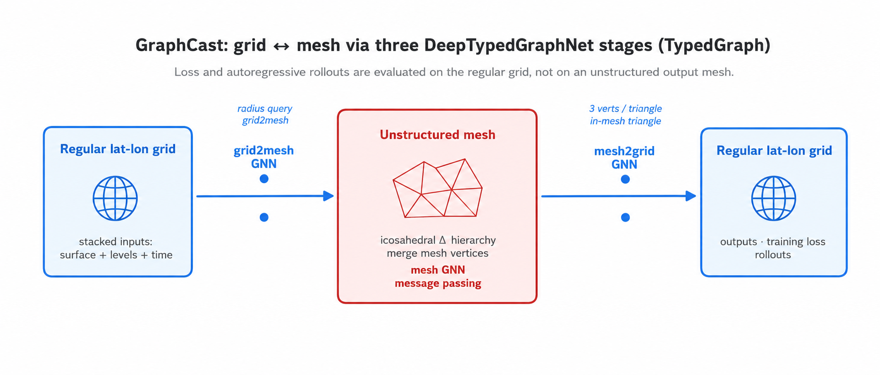
Background: Mesh-handling in GraphCast
MPAS analogy. MPAS-Ocean already uses an unstructured horizontal mesh; a GraphCast-style design could skip grid2mesh/mesh2grid for native-cell prediction if we do not want to fuse reanalysis on a regular grid with MPAS cell fields. (Need further discussion)

Slide 6
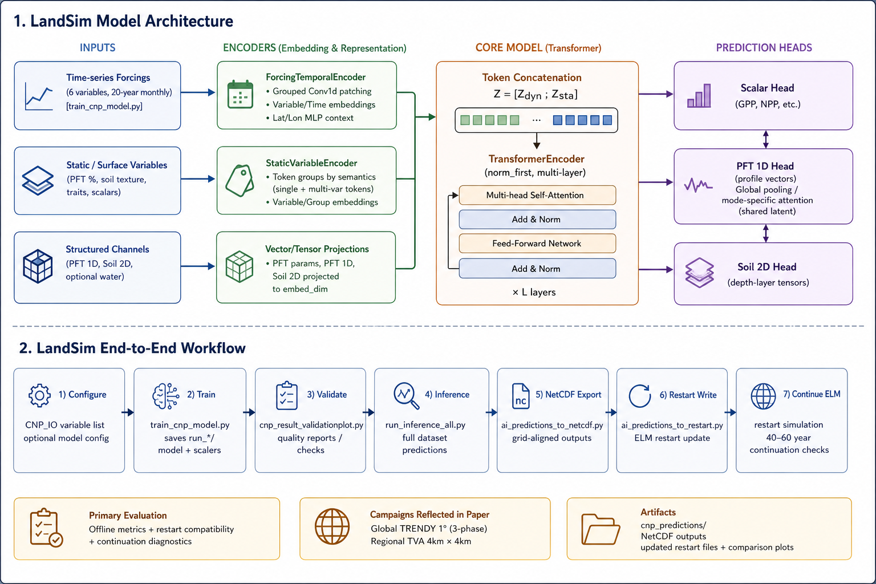
Background: Model Architecture and Dataflow

