Slide 1
Weekly water
availability prediction
October 2026
Yang Chen, Sean Turner, Haoran Niu, Dali Wang

Slide 2
Data Inputs and prediction target
Predictor | Source and processing | Model unit
Precipitation | Daymet daily precipitation, summed over 7 days | mm/week
Temperature | Daymet daily (Tmax + Tmin)/2, averaged over 7 days | °C
Runoff | NLDAS-2 Noah surface runoff + baseflow, summed | mm/week
Elevation | Area-weighted mean of the supplied elevation grid | m, static
Prediction target: Estimated Local Flow (ELF) is the reference target. Totally 52 locations (30 reservoirs + 22 river gauges)
ELF is not automatically total downstream inflow. Nickajack remains a model node but has no valid test reference.

Slide 3
Shared LSTM + GNN + site-specific heads
13 weekly steps
P, T, runoff, elevation
Shared LSTM
64 learned features
3 GNN layers
Upstream feature exchange
Site-specific head
One ELF estimate
LSTM learns time patterns
GNN adds upstream context
Each site has its own head
The same weights process each site’s own history, including the target week.
52 nodes and 49 directed links. Three layers reach at most three upstream links.
A small 64-to-1 mapping with Softplus produces a nonnegative estimate.
46,068 trainable parameters

Slide 4
Training, validation, testing
Role | Target period | Eligible site-weeks
Training | 1982–2004 | 50,084
Validation | 2005–2009 | 9,868
Testing | 2010-01-04 to 2016-10-09 | 15,025

Slide 5
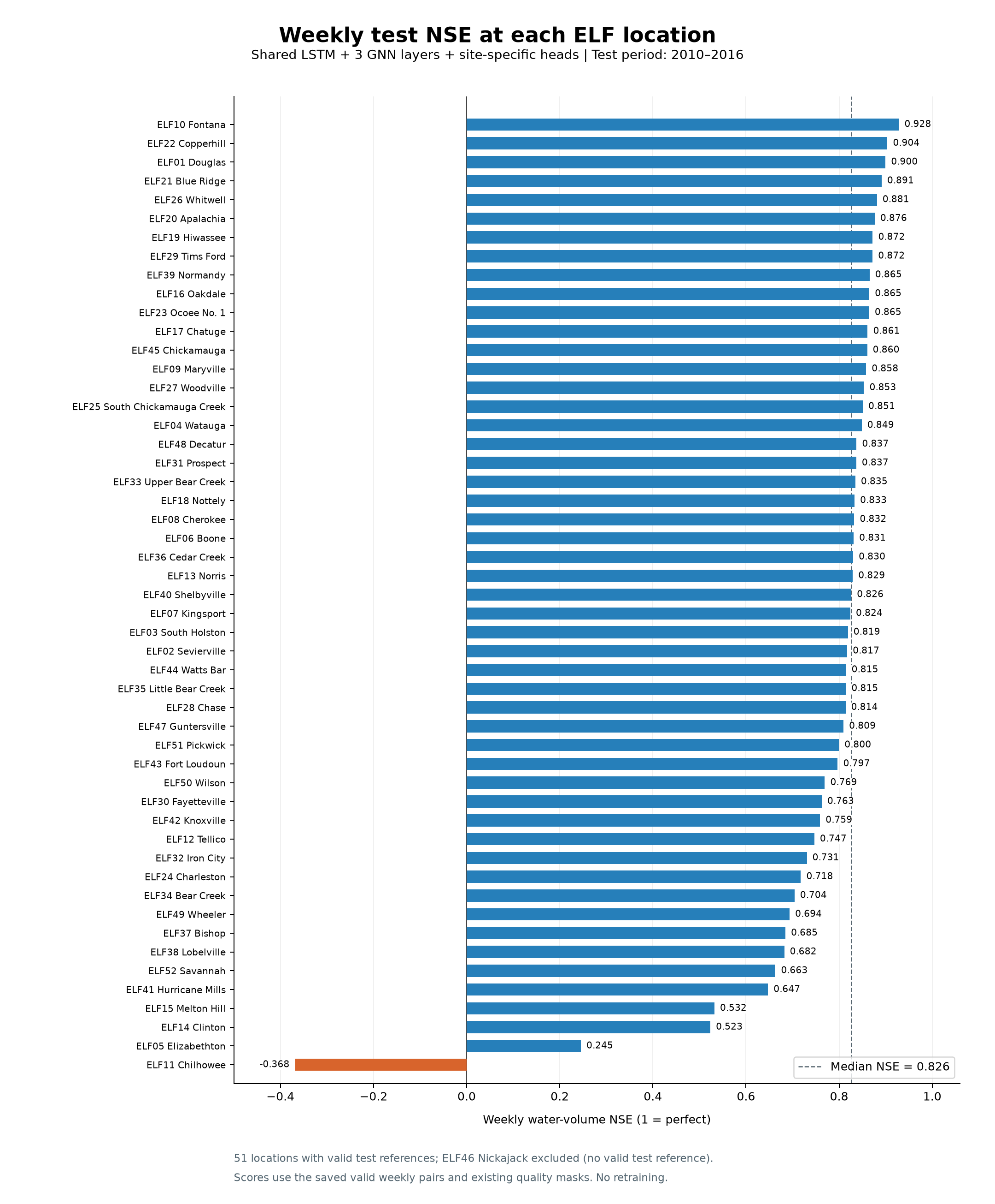
weekly NSE at each location
The median NSE for all locations is 0.826.
Chilhowee remains below zero.
Nickajack is not scored because no valid test reference remains.

Slide 6
Separate XGBoost models
A simpler per-site benchmark uses the same weekly inputs, data splits
52 independent regressors
Runoff dominates tree split gain. This is descriptive importance, it describes how the fitted trees used in the inputs. It does not measure causal value or the effect of removing runoff.
Mean NSE of all location: 0.773

Slide 7
XGBoost minus site-head NSE
Positive values favor XGBoost. Negative values favor the shared LSTM + GNN + site-head model.

Slide 8
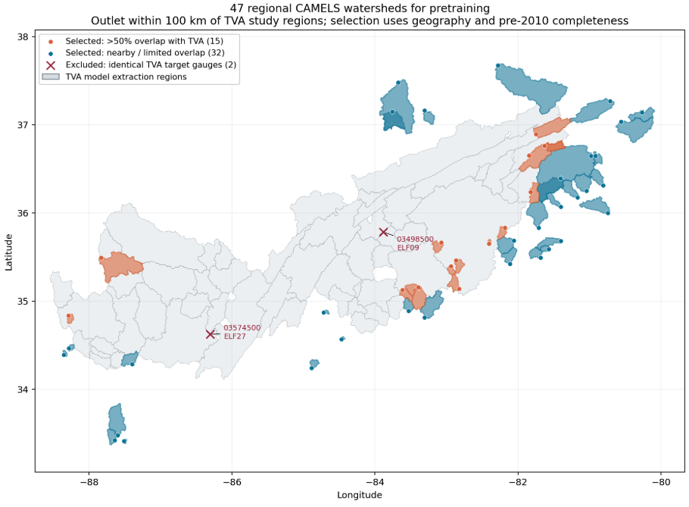
Regional CAMELS pretraining
47 regional watersheds provide additional training examples before TVA fine-tuning.
Pretrain the shared LSTM
Weekly P, T, runoff and elevation
USGS streamflow targets, not TVA ELF
Fine-tune on unchanged TVA data
Transfer only LSTM weights.
Initialize GNN and site heads anew.
Train all components on the TVA training split.
Median NSE 0.824 vs 0.826
17 sites improve, 34 worsen.

Slide 9
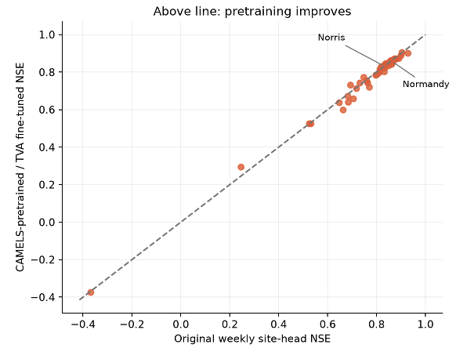
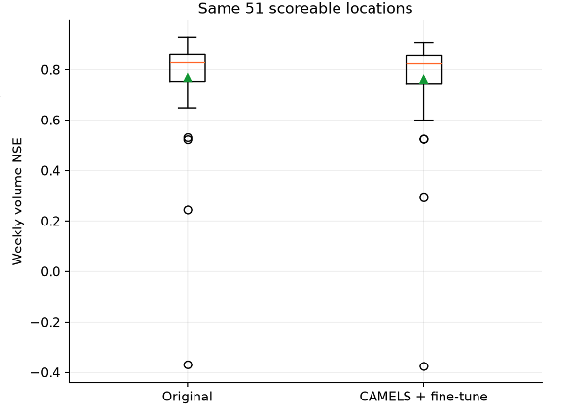
CAMELS comparison and interpretation
Regional pretraining does not improve median NSE in this single experiment.
Possible explanations include target mismatch and domain differences. These hypotheses were not isolated by the experiment.

