Slide 1
Data-Driven Quality and Risk Analytics: Governance-Relevant Change in the AI-Coding Era and PCAOB Audit Risk Data
Final Presentation
Name: Daljeet Kaur Johar
Mentor’s Name: Smitraj Raut

Slide 2
Executive Summary
1
Objective
Test whether AI-era coding adoption and the PCAOB's new inspection data have changed two established governance practices: software defect prediction and internal-control-weakness modeling.
2
Why It Matters
Both practices rest on evidence that predates 2023 (AI coding) or 2018 (audit data). QA and audit teams risk misallocating review effort if these old assumptions no longer hold.
30,733
JIRA issues
19,464
mined code samples
17,077
PCAOB records
113
SEC EDGAR disclosures
3
Results
Mostly negligible AI-era effects in QA across four Apache projects; a strong PCAOB severity model (96.46% accuracy, beating both baseline and Random Forest); cross-domain comparison inconclusive.
4
Usage
Decision-support scoring tools: a defect-proneness check for QA code review, and a PCAOB-style severity dashboard for audit engagement triage, both deployable on a rolling basis.

Slide 3
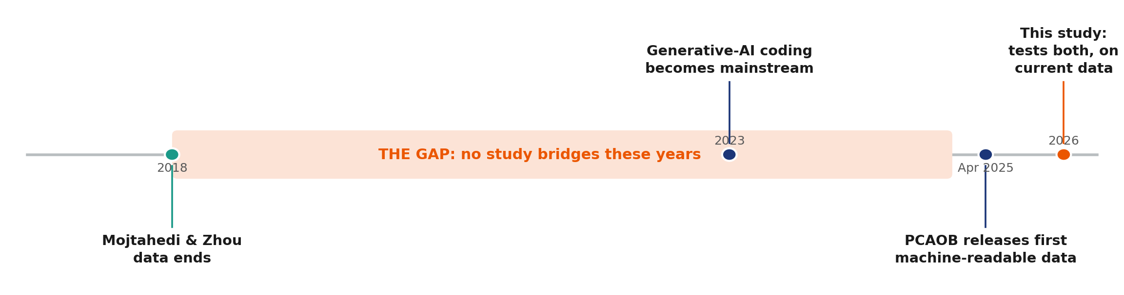
Gap Analysis
The gap: organizations run both QA review and IT audit on the same AI-assisted, currently-regulated systems, yet no prior study tests both together, on current data. Prior defect-prediction work predates 2023; the most recent internal-control study (Mojtahedi & Zhou, 2024) used non-ML methods on data through 2018 only.

Slide 4
Research Questions
RQ1
Code-metric × era effect on defect-proneness?
Joint LR test, 4 projects (N=19,464) → sig. in Camel/Hadoop only, all effects negligible
Negligible
RQ2
Issue-characteristic × era effect on resolution time?
Moderated OLS, full JIRA sample (N=30,733) → significant but negligible (f²=0.0011)
Negligible
RQ3
Can ML predict PCAOB severity (Part I.A vs. I.B)?
LogReg vs. Random Forest (N=17,077) → 96.46% accuracy vs. 82.23% baseline
Strong
RQ4
Do models identify remediation-time drivers?
Cox PH + OLS check (N=113) → no individual driver significant, concordance=0.604
Modest
RQ5
Is QA-domain change comparable to audit-domain change?
Cohen's f² + 1,000-resample bootstrap → only 43.5% of resamples support equivalence
Inconclusive

Slide 5
Data Description and EDA
30,733
Apache JIRA issues
Camel + Hadoop, 2005–2026
19,464
mined code samples
4 independent Apache projects
17,077
PCAOB deficiency records
14,043 Part I.A / 3,034 Part I.B
113
SEC EDGAR disclosures
61 remediated / 52 right-censored
Multicollinearity: RQ1's four code metrics are severely collinear (VIF ≈10–165), so individual coefficients aren't trustworthy — a joint test carries the analytical weight instead.
Censoring & imbalance: 46% of RQ4 companies were still unremediated (right-censored), driving the choice of a Cox model; class imbalance elsewhere was handled via weighting, not oversampling.

Slide 6
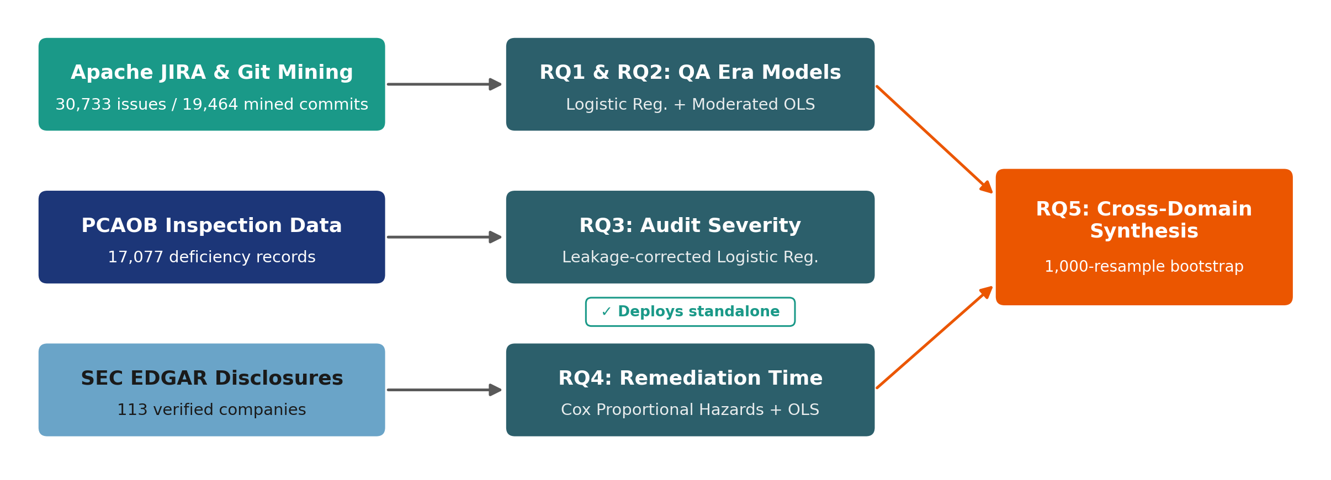
Architecture diagram/Workflow
Four independent data sources, each feeding its own model family — JIRA and git mining into RQ1/RQ2, PCAOB into RQ3, SEC EDGAR into RQ4.
Shared preprocessing/EDA per domain handles class-weighting and right-censoring explicitly.
RQ5 synthesis reuses the RQ1/RQ2 and RQ4 outputs for cross-domain comparison; RQ3 deploys standalone.

Slide 7
Model building
RQ1/3
Logistic Regression vs. Random Forest
Interpretable coefficients, benchmarked against an ensemble; RQ1 adds a joint LR test since code-size metrics are severely collinear (VIF≈10–165).
RQ2
Moderated OLS with era-interaction terms
Resolution time is heavily right-skewed, so 3 robustness checks were added: log-outcome, Gamma GLM, and a binary specification.
RQ4
Cox Proportional Hazards (primary) + OLS check
Cox correctly handles the 46% right-censoring rate in the remediation data; OLS on the 61 observed cases only is a disclosed sensitivity check.
RQ5
Cohen's f² synthesis + 1,000-resample bootstrap
Standardizes the QA and audit effect sizes for comparison, then stress-tests the point estimate with real resampling uncertainty.
Why: each model family was matched to the data's structure — censoring, collinearity, and skew each drove a specific choice.

Slide 8
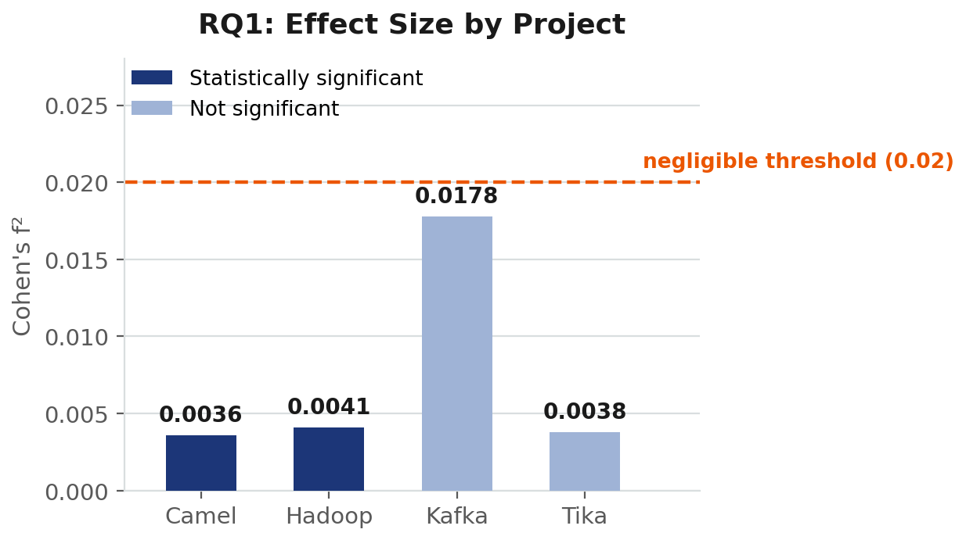
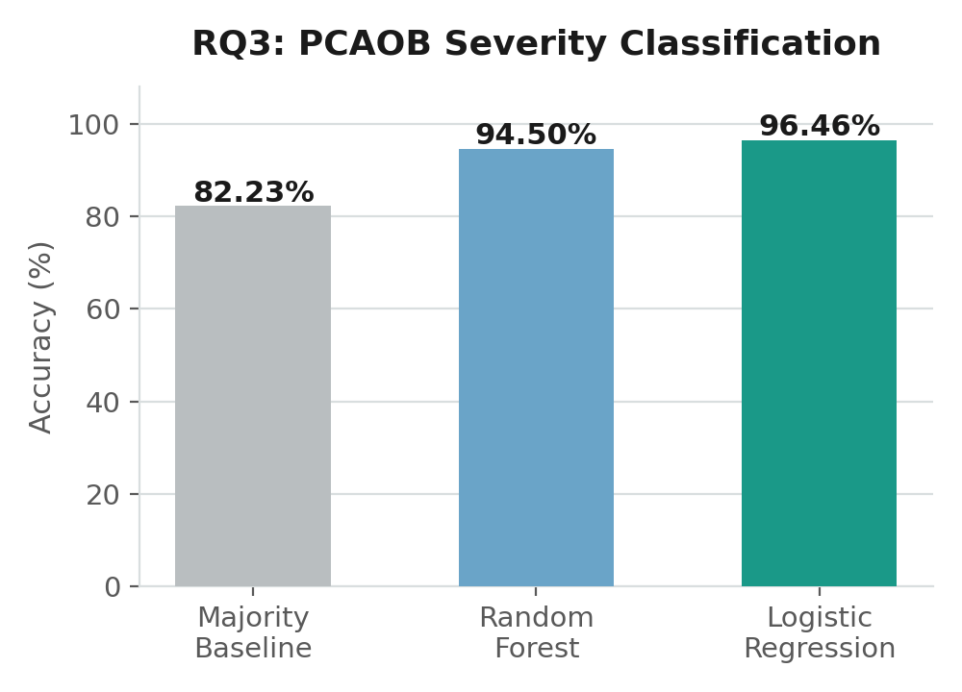
Results
All RQ1 effect sizes are negligible regardless of significance — even Camel/Hadoop's real effect is too small to matter.
RQ3’s Logistic Regression is both the most accurate AND most interpretable severity model — confirmed significant over Random Forest by McNemar’s test.

Slide 9
Implementation and User Benefit
For QA Teams
For Audit & Risk Committees
✓
Review allocation
Defect-proneness scoring surfaced as a pull-request check in the CI/CD pipeline, so reviewers see risk before merging.
✓
Deficiency prioritization
A PCAOB severity-prediction dashboard ranks engagements by predicted Part I.A / I.B risk, using the standard cited as the top driver.
✓
Operational efficiency
Reviewers focus effort on the highest-risk code changes instead of giving every pull request equal scrutiny.
✓
Remediation tracking
Cox-based remediation-risk ranking flags slow-moving material weaknesses, even though no single hazard driver is individually significant.
Continuously updatable: the pipeline re-scores new JIRA issues, PCAOB inspections, and SEC disclosures on a rolling basis.

Slide 10
Conclusion
Mixed, honestly-reported answer: no dramatic AI-era QA disruption (all effect sizes negligible); the strongest result is the PCAOB severity model; cross-domain equivalence is inconclusive.
Limitations
Severe RQ1 multicollinearity limits attribution to any single code metric; Kafka/Tika use a broader defect label than Camel/Hadoop; RQ4's N=61 sensitivity model is statistically unstable (non-significant overall F-test).
Future Work
Extend strict Bug-type labeling to Kafka/Tika for consistent labeling, grow the RQ4 sample beyond N=113, and resolve RQ2's specification-sensitive reassignment finding across model types.
Core contribution: a reproducible pipeline that discloses and corrects its own errors — arguably as valuable as any single result.

Slide 11
Bibliography
Ali, H. M., Hamza, M. Y., & Rashid, T. A. (2024). A comprehensive study on automated testing with the software lifecycle. arXiv.
Basyouni, A. (2025). Machine learning for risk assessment in audit and operational risk management [Preprint]. ResearchGate.
Benjamini, Y., & Hochberg, Y. (1995). Controlling the false discovery rate. Journal of the Royal Statistical Society: Series B, 57(1), 289–300.
Cohen, J. (1988). Statistical power analysis for the behavioral sciences (2nd ed.). Lawrence Erlbaum Associates.
Cotroneo, D., Improta, C., & Liguori, P. (2025). Human-written vs. AI-generated code. arXiv.
Donelson, D. C., Ege, M. S., & McInnis, J. M. (2015). Internal control weaknesses and financial reporting fraud. Auditing: A Journal of Practice & Theory, 35(3), 71–100.
Green, S. B. (1991). How many subjects does it take to do a regression analysis? Multivariate Behavioral Research, 26(3), 499–510.
Harding, W. (2025). AI Copilot code quality: 2025 data suggests 4x growth in code clones [White paper]. GitClear.
Huang, B., Wei, J., Tang, Y., & Liu, C. (2021). Enterprise risk assessment based on machine learning. Computational Intelligence and Neuroscience, 2021, Article 6049195.
Ji, X., Lu, W., & Qu, W. (2024). Determinants and economic consequences of voluntary disclosure of internal control weaknesses in China. Journal of Contemporary Accounting & Economics, 20(1).
Li, N., Shepperd, M., & Guo, Y. (2020). A systematic review of unsupervised learning techniques for software defect prediction. arXiv.

Slide 12
Bibliography (cont’d)
Mojtahedi, A., & Zhou, L. (2024). IT internal control material weaknesses in financial reporting. International Journal of Accounting Information Systems, 53, Article 100679.
Peduzzi, P., Concato, J., Kemper, E., Holford, T. R., & Feinstein, A. R. (1996). A simulation study of the number of events per variable in logistic regression analysis. Journal of Clinical Epidemiology, 49(12), 1373–1379.
Public Company Accounting Oversight Board. (2017). AS 1305: Communications about control deficiencies in an audit of financial statements.
Public Company Accounting Oversight Board. (2025). PCAOB makes available new downloadable datasets featuring PCAOB inspection findings [Press release].
Shepperd, M., Song, Q., Sun, Z., & Mair, C. (2014). Data quality: Some comments on the NASA software defect datasets. IEEE Transactions on Software Engineering, 39(9), 1208–1215.
Stradowski, S., & Madeyski, L. (2023). Industrial applications of software defect prediction using machine learning. Information and Software Technology, 159, Article 107192.
Tantithamthavorn, C. (n.d.). NASADefectDataset [Data set]. GitHub.
Wang, Y., Mantyla, M. V., Liu, Z., & Markkula, J. (2022). Test automation maturity improves product quality. Journal of Systems and Software, 188, Article 111259.
Yang, L. (2025). Predictive modeling of tax compliance risks. PLOS ONE, 20(9), Article e0331715.

