Slide 1



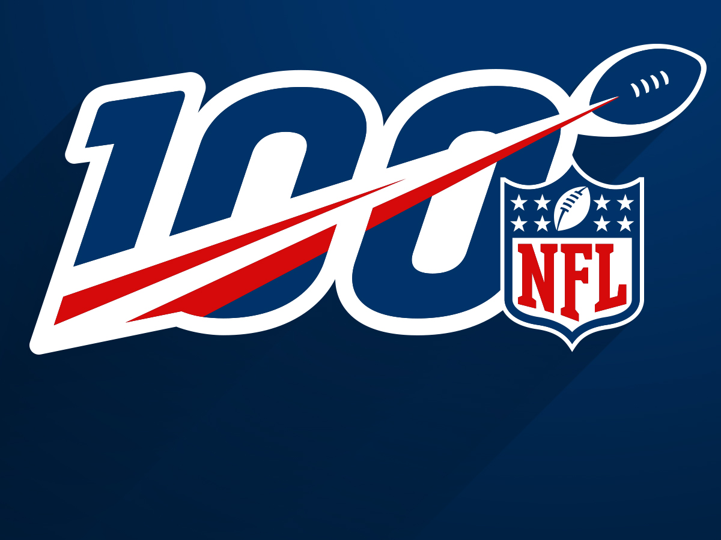
Impact of Salary Cap on Team Wins in the NFL
Group_by: Josh Dahle, Dallas Dickey, Matthew Fay, Kevin Hastings, Jack Hemer
November 7, 2019

Slide 2
The Situation
Salary cap used to limit the amount of money that a team can spend on its players’ salaries
2011 Collective Bargaining Agreement
Salary Cap increased each year since 2011
Data from 2015 – 2018
Team name, total players signed, average age of signed players, active salary cap, dead money, total cap spend, unused cap space, salary spend per position, and overall record
Assumptions:
Spending more on quarterbacks would lead to less wins
Using more of cap space with active players would lead to more wins
Teams with average aged rosters would lead to more wins

Slide 3
Gathering and Preparing Data
Team salary cap and position breakdown from Spotrac
Overall record from NFL
Import all data into 5 CSV files and read into R
4 individual year (2015 – 2018) and 1 master that includes all 4 years
…

Slide 4
What We Found

Slide 5
Obstacles

Slide 6
R Documentation

