Slide 2
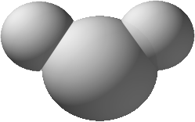
H
H
H₂0
H – O – H
O
(a)
(b)
(c)

Slide 3

1 | As You Like It | Shakespeare | Play | 1599
Needs common schema: Which column is which?
4 | Sonnet 78 | Shakespeare | Poem | 1609
6 | Edward II | Christopher Marlowe | Play | 1592
7 | Hero and Leander | Christopher Marlowe | Poem | 1593
3 | Othello | Shakespeare | Play | 1603

Slide 4
Year | Medium
1599 | Play
1604 | Play
1603 | Play
1609 | Poem
1590 | Poem
1592 | Play
1593 | Poem
1525 | Song
Author
Shakespeare
Shakespeare
Shakespeare
Shakespeare
Sir Philip Sidney
Christopher Marlowe
Christopher Marlowe
Henry VIII Rex
Title
As You Like It
Hamlet
Othello
“Sonnet 78”
Astrophil and Stella
Edward II
Hero and Leander
Greensleeves
Needs to reference entities – which thing are we talking about?

Slide 5
Needs to reference both schema and entities!
 | Medium
Row 7 | Poem
 | Author
Row 4 | Shakespeare
 | Title
Row 2 | Hamlet
 | Year
Row 2 | 1604
 | Medium
Row 6 | Play

Slide 6
Blue tie made in USA
http://www.example.com/products/solid_turquoise_tie
While I call this my solid turquoise tie, the fabric has a sheen to it that makes the colors…
Buffalo Wild Tie
http://www.example.com/products/Buffalo_tie
★     Rating: 5 $39.95 In Stock
Four color plaid background in an extra skinny Buffalo style makes this tie stand out in a cr….

Slide 7
Blue tie made in USA
http://www.example.com/products/solid_turquoise_tie
While I call this my solid turquoise tie, the fabric has a sheen to it that makes the colors…
Buffalo Wild Tie
http://www.example.com/products/Buffalo_tie
★     Rating: 5 $39.95 In Stock
Four color plaid background in an extra skinny Buffalo style makes this tie stand out in a cr….

Slide 8
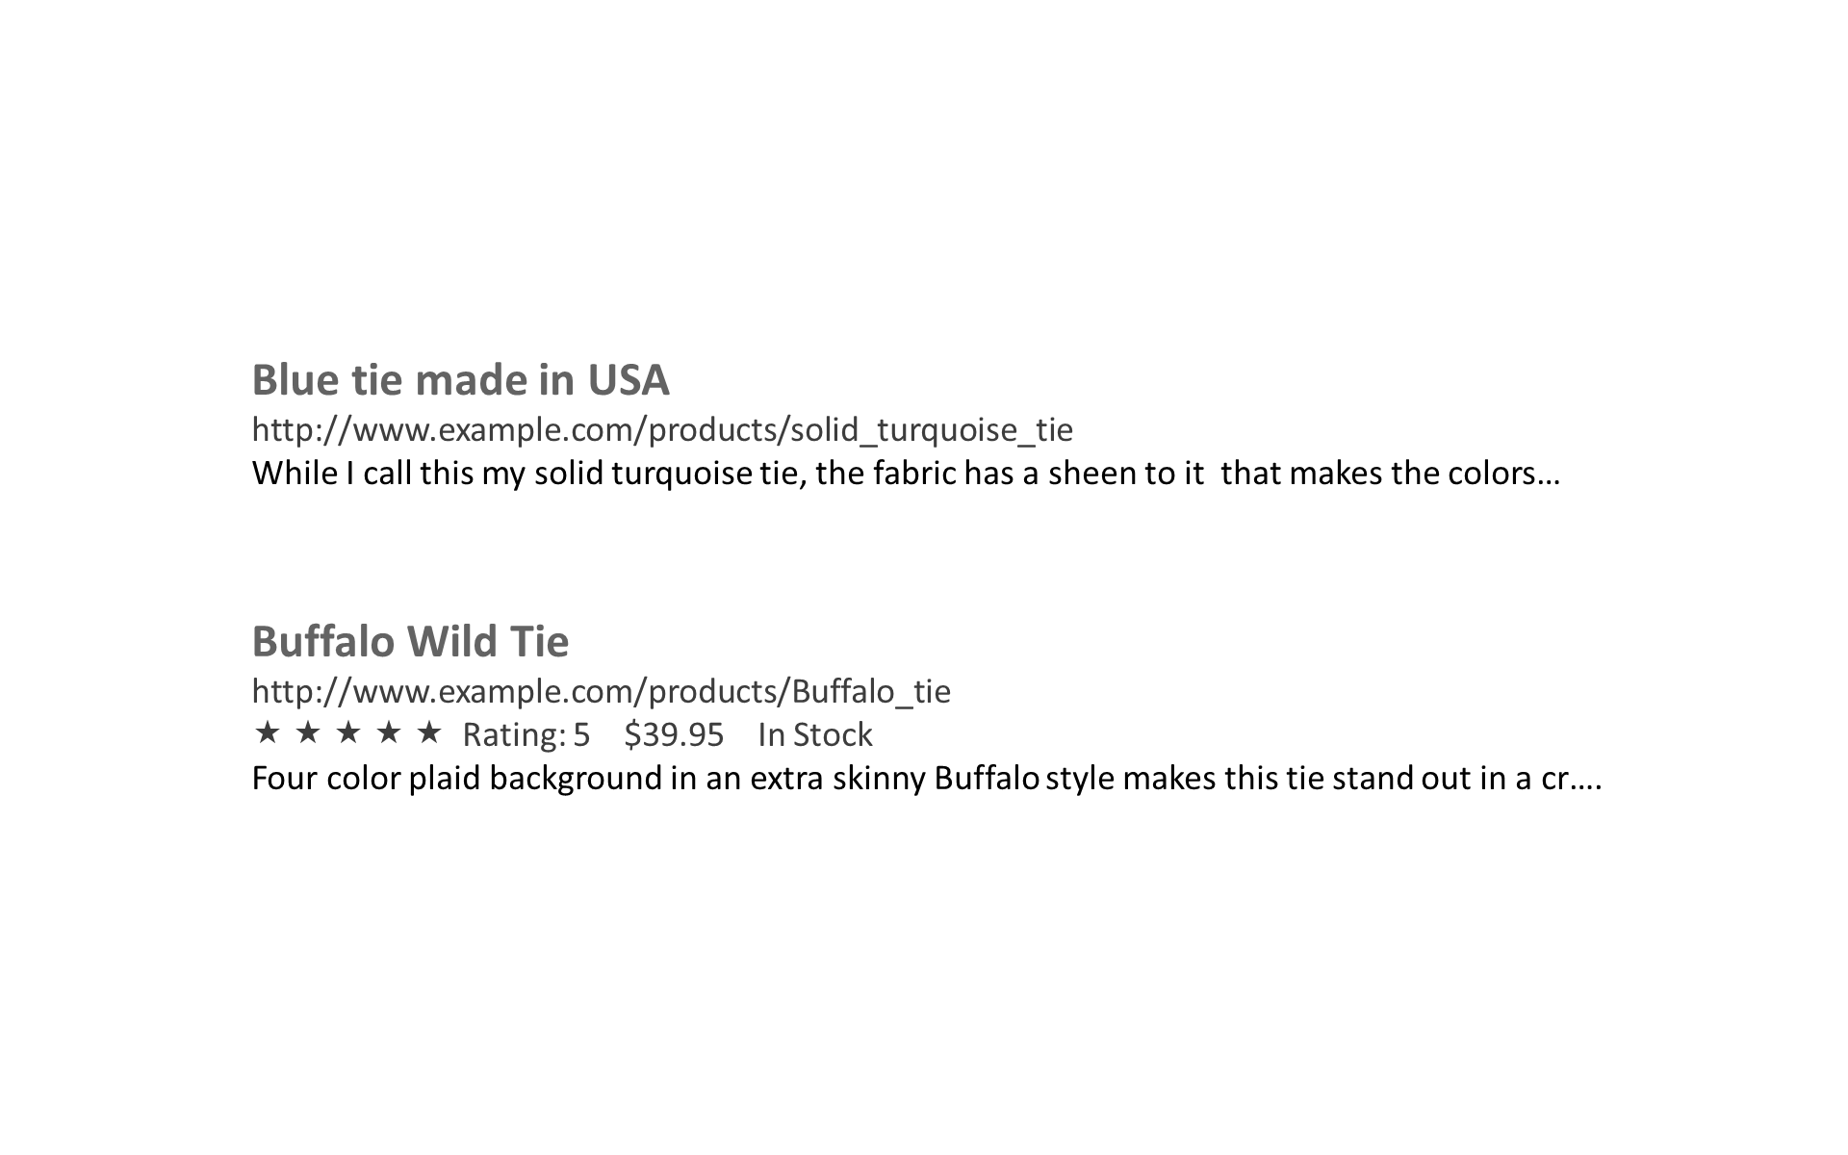

Slide 9
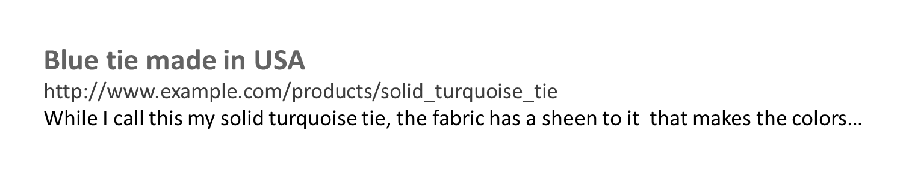


Slide 10
SSB
SSB
astro:Planet
horo:Planet
astro:Planet
horo:Planet
IAU:Planet
IAU:Planet

Slide 11
(a)
Rebirth
signifies
Pluto
signifies
Regeneration
prefSymbol
(b)
Methane
madeOf
Pluto
madeOf
prefSymbol
Nitrogen
♇
(c)
Rebirth
prefSymbol
Methane
signifies
madeOf
Pluto
madeOf
signifies
prefSymbol
Nitrogen
Regeneration
♇

Slide 13
Application
Analytics
User Interface
. . .
Query Engine
Database

Slide 14
Application
Analytics
User Interface
. . .
Query Engine
Converters
And Scrapers
Database
Parser /
Serializer
RDF Files
Web pages, Spreadsheets, Databases, etc.

Slide 15
Application
Analytics
User Interface
. . .
Inference and Query Engine
Converters
And Scrapers
Database
Parser /
Serializer
RDF Files
Web pages, Spreadsheets, Databases, etc.

Slide 16


Accept: text/html
HTML
http://ns.inria.fr.fabien.gandon#me
http://ns.inria.fr/fabien.gandon#me
303 REDIRECT
fr
HTML, XML, etc.
http://ns.inria.fr/fabien.gandon#me
1
GET
Inria.fr
Accept: application/
rdf+xml
RDF
ns.inria.fr
2
GET
http://ns.inria.fr/fabien.gandon#me

Slide 17
GET,POST,PUT, PATCH, DELETE, GET, PUT, PATCH, DELETE,OPTIONS,HEAD

