Slide 1
TELVERGENCE × RESTORATION ROYALTY
MASTER PACKET · AUGUST 17, 2026
Four days of build, one system, ready to ring.
Everything developed for Restoration Royalty and the surrounding network since Thursday — every site, every phase, every look — assembled in one place.
Prepared for Jimmy Mejia, Restoration Royalty LLC · By David Drew Allen, Telvergence, Inc.
Notes:
Opening frame. Four working days of build, presented as one system. Jimmy is enrolled and funded; this packet shows him everything that exists today and what happens next.

Slide 2
WHERE WE STAND
The short version
Restoration Royalty is enrolled with a ten-number Smart-DID block, four funnel sites are built and staged, and the Orlando and South Florida call campaign is scripted, scrubbed, and loaded.
10
$22.95
4
2
Smart-DIDs assigned
to the 786-400 block
Per line, per month
all-in, no setup
Funnel sites
built and staged
Markets loaded
Orlando + South Florida
The narrative is mold, water damage, and roofing — the work that repeats, insures cleanly, and books fast.
Telvergence, Inc. · Confidential — prepared for Jimmy Mejia
Notes:
Lead with status, not promises. Ten numbers assigned, price locked at $22.95, four sites live, two markets loaded.

Slide 3
PHASE LOG · PART ONE
What got built — Thursday and Friday
1
DAY 1 — THURSDAY
Every Restoration Royalty and FAST document, LOA, script, and call list pulled into one verified fact sheet. Legal names, service area, number block, and price all locked to a source document.
Accuracy pass
2
DAY 1 — THURSDAY
The core site: mold, water damage, and roofing across South Florida. Ten-number grid, 24/7 intake, insurance-documented workflow, free assessment as the call to action.
Restoration Royalty funnel
3
DAY 2 — FRIDAY
A second Restoration Royalty treatment built around memorable vanity numbers instead of the sequential block, so both directions can be compared side by side.
Vanity edition
4
DAY 2 — FRIDAY
Public-adjusting site with a live claims command center, a refer-and-earn ladder, and the one-page start. Same engine, different trade.
FAST Adjusting funnel
Telvergence, Inc. · Confidential — prepared for Jimmy Mejia

Slide 4
PHASE LOG · PART TWO
What got built — the weekend and today
5
DAY 3 — SATURDAY
A complete funnel for a contractor who has not signed yet — proof the system reproduces into any trade, in any market, in an afternoon.
YES Electrical
6
DAY 3 — SATURDAY
A nationwide weather grid tied to partner coverage by area code and exchange. When a cell fires over a county, the partners in that footprint light up and demand routes to them.
Storm Dispatch console
7
DAY 4 — SUNDAY
The revenue model written down, the master business plan and flywheel, and the Sub-Network Hub — the single presentation that carries the whole argument.
Plan, prospectus, hub
8
TODAY — MONDAY
All of it staged to one domain behind a clean directory, plus the go-live runbook: targets, caller-ID strategy, verbatim script, compliance rules, morning checklist.
Deployment and runbook
Telvergence, Inc. · Confidential — prepared for Jimmy Mejia

Slide 5
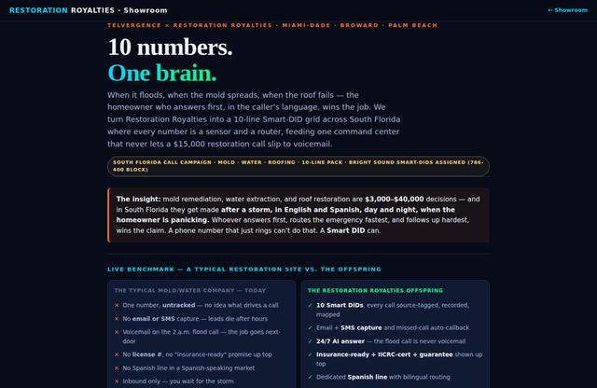
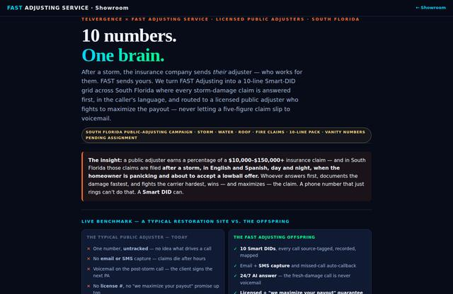
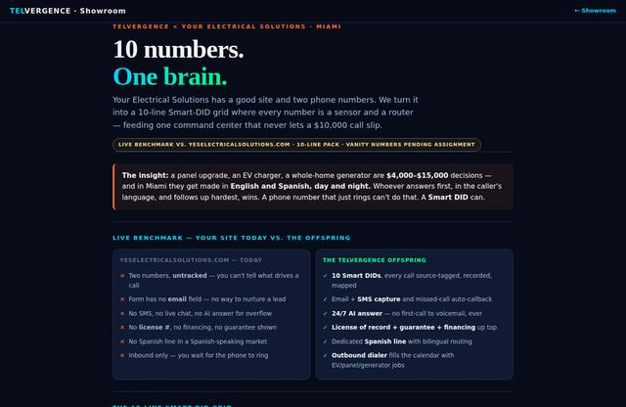
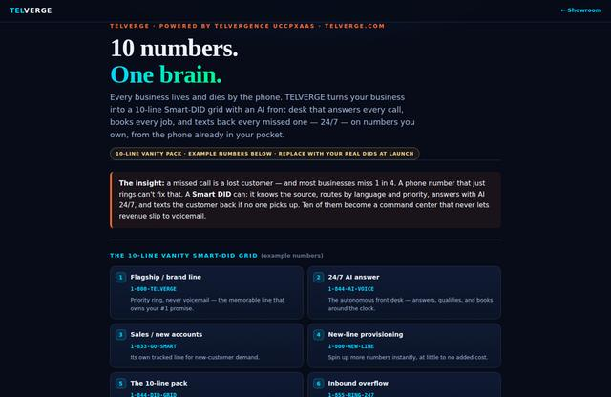
THE PROPERTIES
Four finished sites, one shared pipeline
Each one is a live, standalone page you can send to a prospect today — four nets catching calls in the same footprint.
RESTORATION ROYALTY
PUBLIC ADJUSTING
ELECTRICAL
PLATFORM
Restoration Royalties
FAST Adjusting
YES Electrical
TELVERGE
A homeowner who calls the electrical number after a storm has a wet ceiling too. The network shares what it catches, and the partner closest to the work takes it.
Telvergence, Inc. · Confidential — prepared for Jimmy Mejia
Notes:
Show the actual sites. These are screenshots of the live pages, not mockups.

Slide 6
RESTORATION ROYALTY
Restoration Royalties
Mold · water damage · roofing — South Florida
Ten assigned Smart-DIDs, branded caller ID, forwarding to your cell
Round-the-clock intake asks the four qualifying questions
Free moisture, mold, and roof assessment with a written scope
restorationroyalties.com/rr/
Telvergence, Inc. · Confidential — prepared for Jimmy Mejia
Notes:
Live page — open it in the browser if they want to click through.

Slide 7
PUBLIC ADJUSTING
FAST Adjusting Service
Claims representation · live claims board
Shares one pipeline view with Restoration Royalty
Live claims command center shows work in progress
Refer-and-earn ladder adds a channel without adding headcount
restorationroyalties.com/fast/
Telvergence, Inc. · Confidential — prepared for Jimmy Mejia
Notes:
Live page — open it in the browser if they want to click through.

Slide 8
ELECTRICAL
YES — Your Electrical Solutions
Miami electrical · storm-power demand
Built for a contractor who has not signed yet
Proves the model reproduces into any trade in an afternoon
Storm takes power down, electrical demand spikes, calls route
restorationroyalties.com/yes/
Telvergence, Inc. · Confidential — prepared for Jimmy Mejia
Notes:
Live page — open it in the browser if they want to click through.

Slide 9
PLATFORM
TELVERGE
The platform itself · ten vanity examples
Turns a curious contractor into an enrolled partner
Ten example vanity numbers so they can picture their own set
Same one-page start: letter of authorization and a card on file
restorationroyalties.com/telverge/
Telvergence, Inc. · Confidential — prepared for Jimmy Mejia
Notes:
Live page — open it in the browser if they want to click through.

Slide 10
THE ENGINE
How a ring becomes a job
1
Capture
Every entry point — site, ad, storm console, tapped card — is a tracked Smart-DID. The source is known before anyone says hello.
2
Answer, always
Intake picks up around the clock and asks the four questions: owner, insurance, claim filed, what is the damage.
3
Qualify and route
Owner-occupied with coverage goes straight to scheduling. Everything else is captured and tagged instead of lost.
4
Book the assessment
Free moisture, mold, and roof assessment with a written scope. Low friction to say yes — and the scope is what converts.
5
Document and close
Every call recorded, every scope written, everything packaged the way an insurer expects it.
Nobody misses a call. Every ring is a sale — or a reason we learn something.
Notes:
This is the operational core. The four qualifying questions are the ones Melissa already uses on inbound.

Slide 11
THE DASHBOARD
You see the money as it moves
Twenty years running predictive dialers taught one lesson: the operator who watches the numbers hourly keeps the business. The operator who waits for the monthly statement loses it.
LIVE
GUARDRAILS
FORWARD
Command center
Stop the bleed early
Predictive layer
Calls in, connects, contact rate
Assessments booked and cost each
Average hold time and abandon rate
Revenue in versus spend out
Alerts when cost per lead crosses your line
Flags the unprofitable source or hour
Pause, fix, resume — same day
Weather-driven demand by market
Capacity planned ahead of the surge
Which zip codes are about to get busy
And the system compounds: every recorded call improves the script, every booking teaches the routing. Month twelve outperforms month one without you doing anything differently.
Telvergence, Inc. · Confidential — prepared for Jimmy Mejia
Notes:
This is the ViciDial discipline translated into the platform — the dashboard that keeps inflows ahead of outflows every payday.

Slide 12
GROWTH
Where this goes for you
STAGE
WHAT YOU DO
WHAT IT PRODUCES
Partner
Run your ten lines; take the calls the network routes you
Booked assessments in your own footprint
Referrer
Introduce the contractors you already work beside
Ongoing residual on every line they run
Distributor
Hold a trade or a territory and sign under it
Override on the whole footprint, not one deal
White label
Run the platform under your own brand
An asset with its own name, book, and value
The part most people miss
A restoration company with a shoebox of invoices is worth its trucks. One with four years of clean call and claim data is worth a multiple. The record is the asset.
Notes:
The ladder is optional for Jimmy but it is where the residual side starts. The data point at the bottom is the exit argument.

Slide 13
GO-LIVE
The campaign, ready to run
Both markets are loaded, scripted, and compliance-checked.
ORLANDO / CENTRAL FL
SOUTH FLORIDA
407 · 689 · 321 · 352
954 · 754 · 305 · 786
Orlando, Winter Park, Kissimmee, Clermont, Sanford, Altamonte, Oviedo. Priority order: apartment and multifamily managers, condo and HOA firms, standalone PM firms, then roofers and GCs for overflow.
Severe tier first — Miramar, Pembroke Pines, Weston, Doral, Hialeah — then Miami Lakes, Miami Gardens, North Miami, Sunrise, Plantation, out to Coral Springs.
The pitch, in one breath
Compliance is not optional
Certified water, mold, and roofing restoration. The ask is a free assessment at the manager’s highest-occupancy property this week, with a written scope for ownership or the board.
Business-to-business only, manually dialed, published lines, recorded with disclosure. Residential comes in through the sites — never cold-called. Do-not-call scrubbed before every list.
Notes:
Compliance slide is deliberate — it is what keeps the program alive past month one and it reassures a client who has been burned by lead vendors.

Slide 14
THE PROPERTIES
Live links
All four sites plus the supporting material, on one domain.
Restoration Royalties
FAST Adjusting
restorationroyalties.com/rr/
restorationroyalties.com/fast/
YES Electrical
TELVERGE platform
restorationroyalties.com/yes/
restorationroyalties.com/telverge/
Sub-Network Hub
Restoration Royalties — vanity edition
restorationroyalties.com/hub/
restorationroyalties.com/vanity/
Showroom / inventory
Directory — all of it
restorationroyalties.com/showroom/
restorationroyalties.com
Sites go live on restorationroyalties.com once the domain is pointed. Confidential — prepared for Jimmy Mejia.

Slide 15
NEXT
The next seven days
1
Review the four sites
Look at both Restoration Royalty treatments — assigned block and vanity — and tell me which one goes out. Everything else is copy edits.
2
Confirm numbers and forward
Ten lines with branded caller ID forwarding to your cell. Confirm the forward target and we lock it.
3
Start the calls
Orlando and South Florida. Mold, water, roofing. Free assessment. Both lists loaded, script written.
4
Watch the board together
First week we read the dashboard daily — connects, bookings, cost per booking — and tune the script and hours off what it shows.
5
Then add trades
Every contractor you know who wants their phone to ring is a candidate. That is where the residual side starts for you.
Telvergence, Inc. · Confidential — prepared for Jimmy Mejia
Notes:
End on action, with the first item being a decision only Jimmy can make — which RR treatment ships.

Slide 16
You fulfill the work. We make the phone ring.
David Drew Allen · Telvergence, Inc. · 689-242-1041 · contact@telvergence.com
Confidential. Prepared for Jimmy Mejia, Restoration Royalty LLC. Not for redistribution. Telephone numbers shown on the YES Electrical and TELVERGE pages are illustrative examples pending assignment. Storm Dispatch coverage and predictive forecasting are described as product roadmap and are delivered in stages. Pricing and provisioning timelines are subject to carrier confirmation.
Notes:
Close on the division of labor, then the disclaimer. Leave the contact line on screen during questions.

