Slide 1
Quality Control for Metal Casting Product
Dallen Huang
Springboard

Slide 2
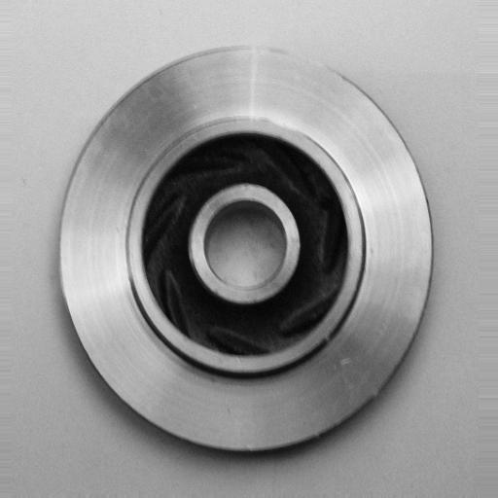
Name: Submersible Pump Impeller
Material: Stainless Steel
Manufacturing Processing: Casting
Types of Defective: Blow holes, Pinholes, Burr, Shrinkage defects, Mold material defects, Pouring metal defects, Metallurgical defects

Slide 3
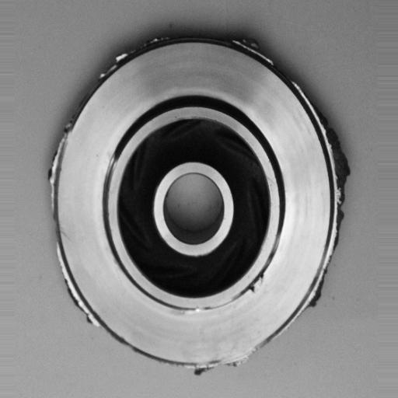
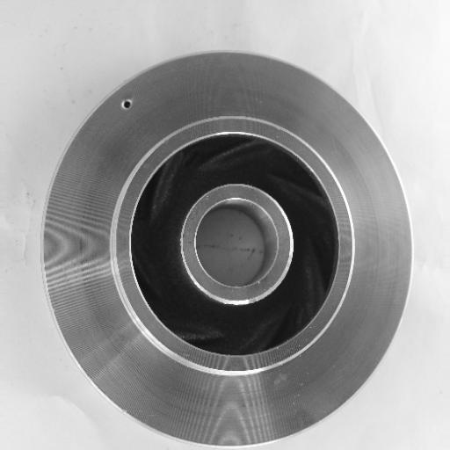
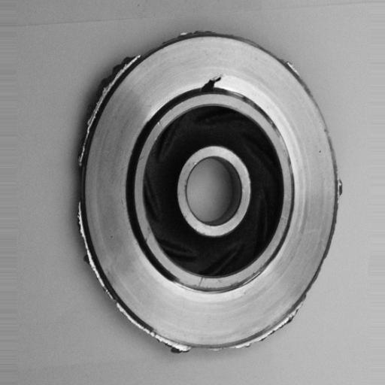
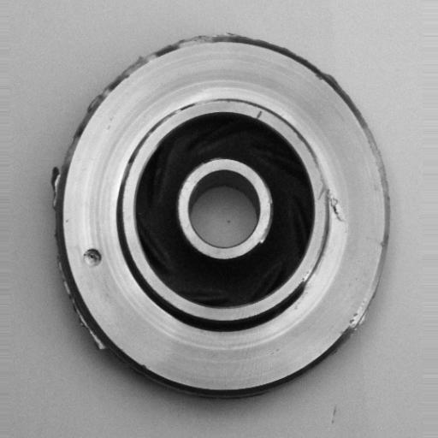
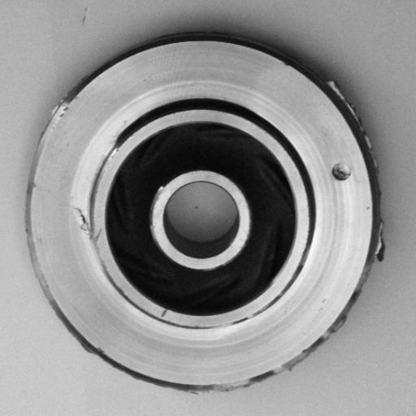
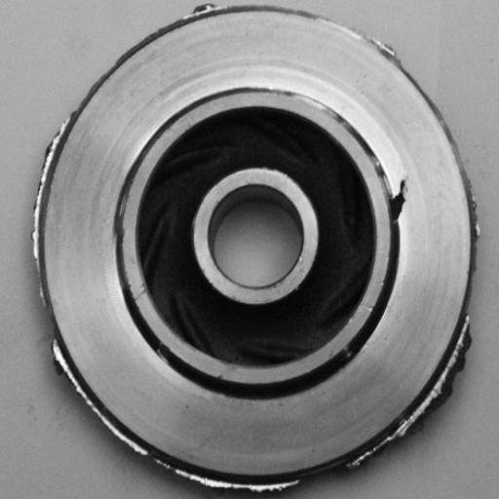

Slide 4
Product
Defective
Recycle
Human Inspection
OK
Packaging

Slide 5
Time-Intensive Inspections |  | Delayed Order
High Demand on Human Resources |  | Increased Operational Costs
Inconsistent Inspection Standards |  | Potential Quality Issues

Slide 6
Product
Human Inspection
OK
Photo Capture
Pass
Defective
AI Inspection
Defective
Recycle

Slide 7
Continuous Lighting Source:
Utilization of dual Tungsten Light Bulbs for consistent and uniform illumination.
Temperature Regulation:
Deployment of an Infrared Thermometer to ensure product temperatures are maintained between 12°C and 35°C.
Efficient Product Handling:
Integration of a Conveyor Belt System for precise and automated transportation of products to the designated inspection area.

Slide 8
Developing the AI Model:
Training a Neural Networks model to integrate with Quality Control Software for advanced inspection capabilities.
Data Integration and Pipeline Creation:
Establishing a pipeline for seamless transfer and processing of image data into the neural network model.
Automated Product Handling and Sorting:
Utilizing AI model outputs to direct the automated transportation and sorting of products in the inspection area.

Slide 9
Misclassification Analysis:
Inspect and identify misclassified products in both 'defective' and 'ok' categories.
Separate non-defective items from the 'defective' area.
Collect defective products from the 'ok' area for further analysis.
Model Improvement through Feedback Loop:
Reintegrate misclassified products into the training dataset.
Retrain the model with the updated dataset to enhance accuracy and reduce future misclassifications.

Slide 10
Input: 300*300 Greyscale Images
Output: Binary Classification Signals
‘ok’: Product passes the quality check
‘defective’ : Product fails due to defects.
Accuracy: 80.30% (2023/11/16)
Loss: 0.65
Maintenance: Improve model with new image data

Slide 11
Time-intensive Manual Operation
Fast, Automatic 90% AI-Powered Inspection
Heavy Human Resource Cost
One-Time investigation with Minimal Maintenance
Inconsistent Inspection Standards
Continually Enhance Accuracy Over Time

Slide 12
THANK YOU
Dallen Huang​
dallenwill@hotmail.com
2023-11-16

