Slide 1
Predictive Maintenance for Machine Failures
Dallen Huang
Springboard

Slide 2
High Machine Failure Rate: 3.57%
Escalating Repair Costs
Production Time Delays
Excessive Machine Wear

Slide 3
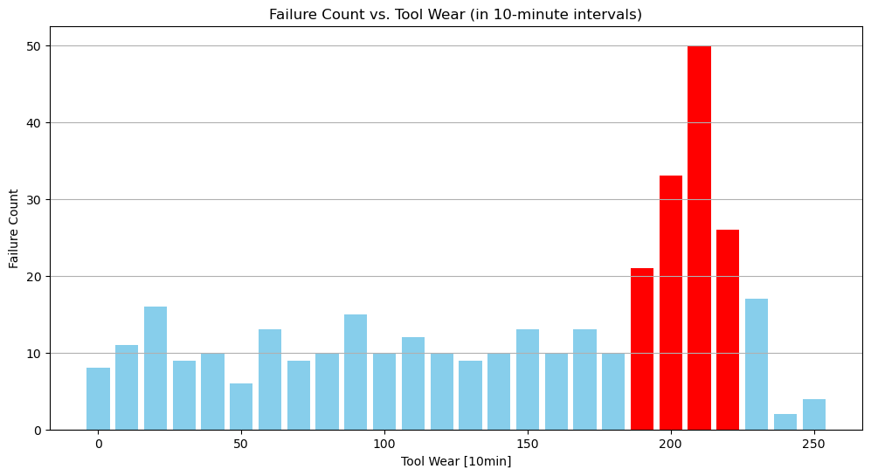

Slide 4
Failure Rate Increase with Tool Wear
Fact:
Tools are changed every 220 minutes of usage
Potential Solution:
Change Tools more frequently (Every 180 minutes)
Upgrade tools

Slide 5
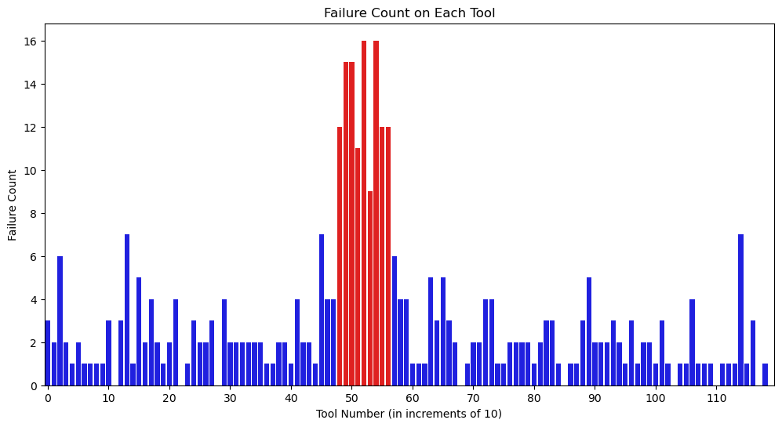

Slide 6
Fact:
Tool number 49 to 57 have Continuous abnormal performance
Potential Solution:
Check tool orders and report them to Tool Suppliers
Troubleshoot with Operators who were working during tool number 49 to 57

Slide 7
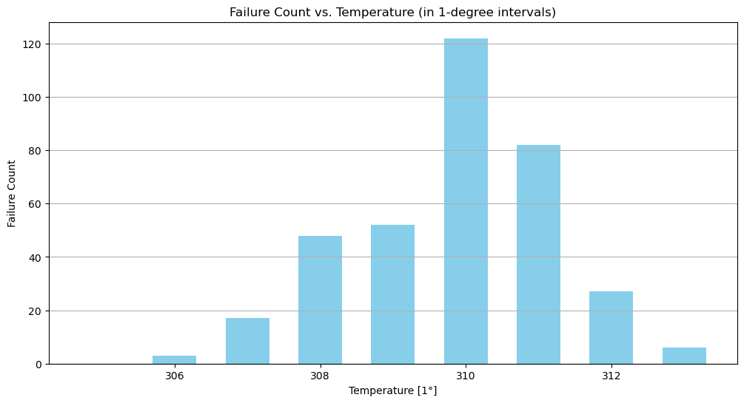

Slide 8
Fact:
Failure Rate Dramatically Increase after 310 K
Potential Solution:
Set Working Temperature Alarm (Above 310K)
Control Air Temperature (A/C, fan)

Slide 9
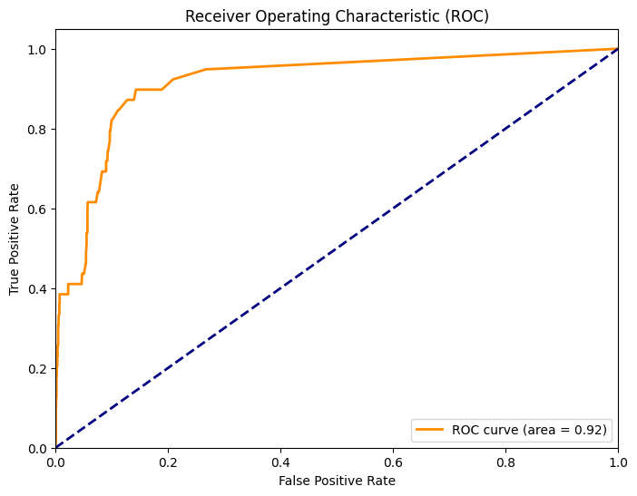
Accuracy: 0.9815
Precision (Class 1): 0.57
Recall (Class 1): 0.21
F1-score (Class 1): 0.30
ROC AUC Score: 0.916

Slide 10
Implement the model in maintenance process
Continuously collect new data and retrain the model periodically

Slide 11
Engineering Department:
Change Tools more frequently (Every 180 minutes)
Upgrade Tools
Troubleshoot with Operators who was working during tools with High Failure Rate
Set Working Temperature Alarm (Above 310K)
Control Air Temperature (A/C, fan)

Slide 12
Purchasing Department:
Report tool orders with high failure rate to Suppliers
Data Department:
Implement the Gradient Boosting Classifier in maintenance process
Continuously collect new data and retrain the model periodically

Slide 13
THANK YOU
Dallen Huang​
dallenwill@hotmail.com
2023-10-08

