Slide 1
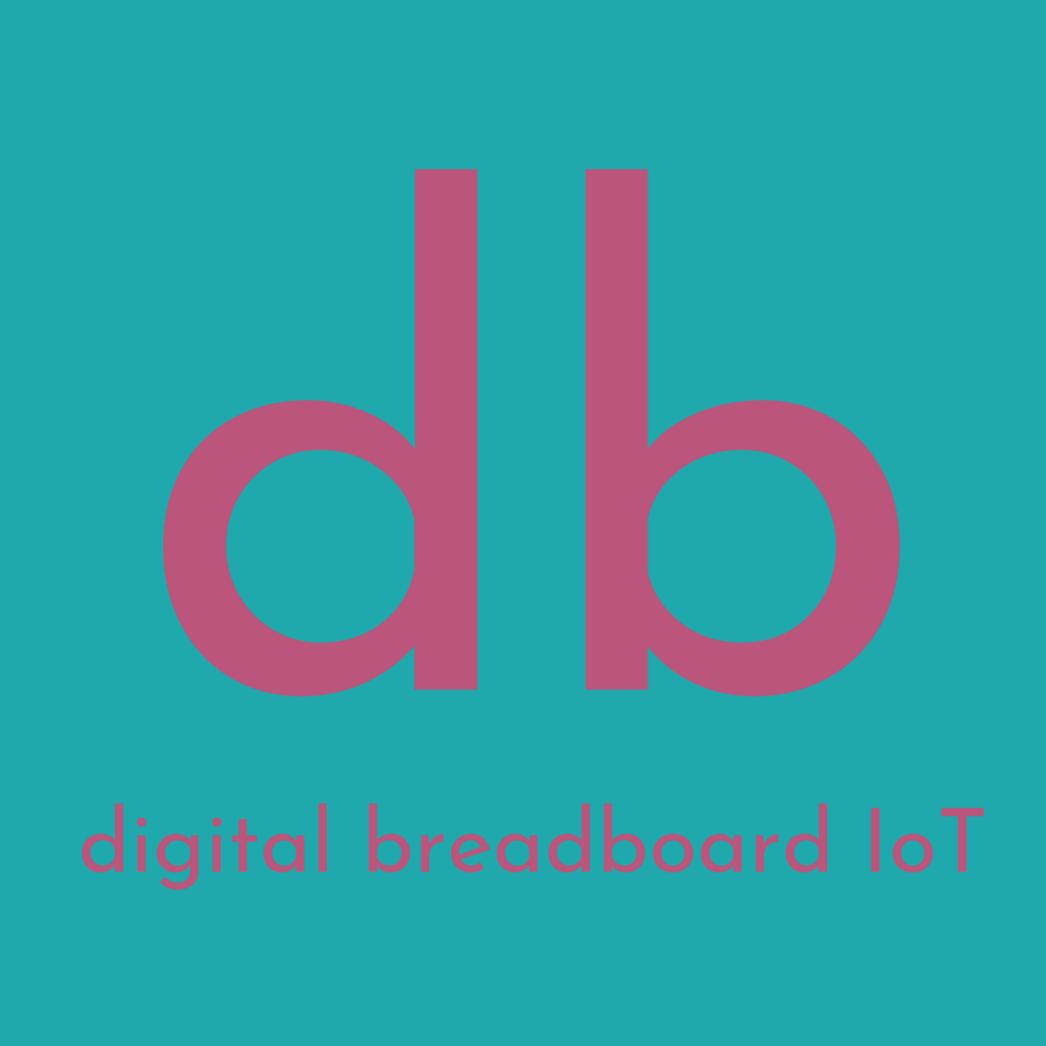
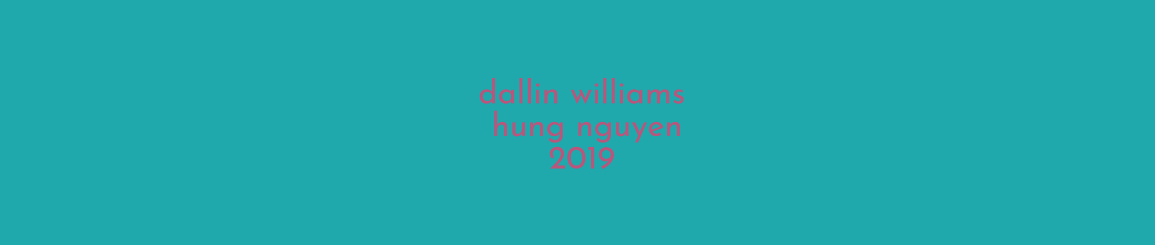

Slide 2
digital breadboard is a tool for developers and designers of internet of things projects
internet of things (IoT): the extension of internet capability into physical devices and everyday objects

Slide 3
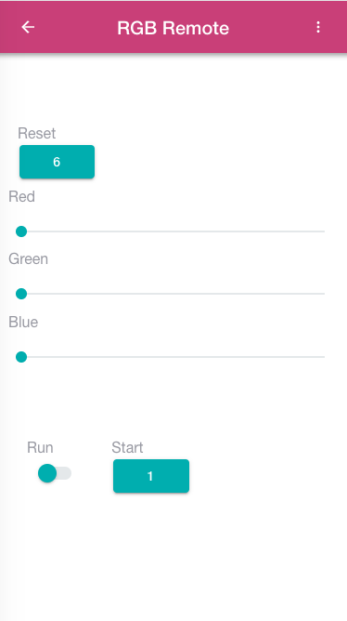
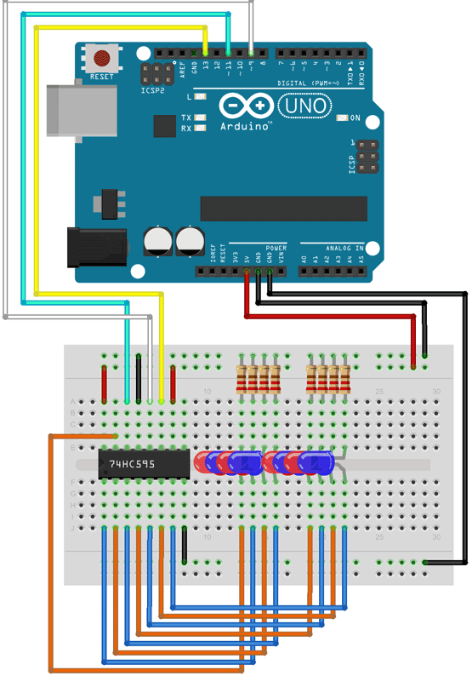


Slide 4
features
control hardware remotely from your phone over BLE
design your own custom UI with a drag-and-drop interface
searchable database of UIs published by other users

Slide 5
uses
prototyping
more convenient and flexible than a hardware interface
no soldering, wires, or breadboards
custom projects
hacking existing hardware
GATT standards
fast, portable, reconfigurable

Slide 6
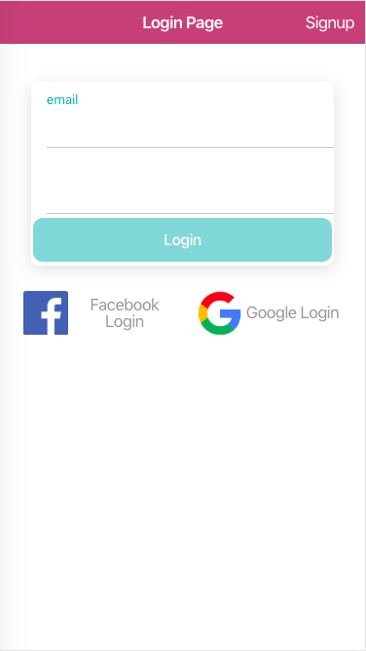
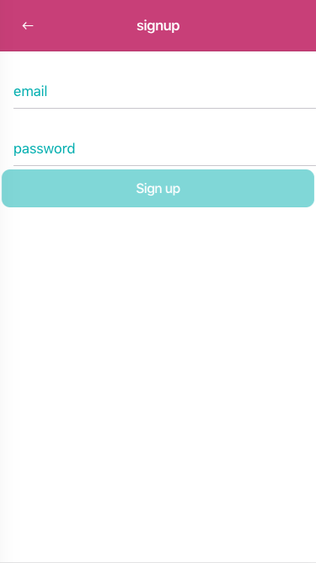
login

Slide 7
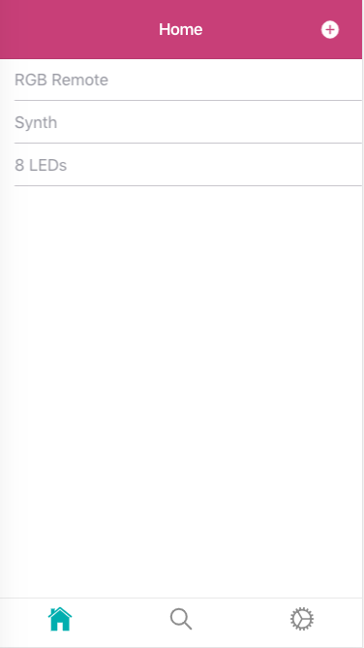
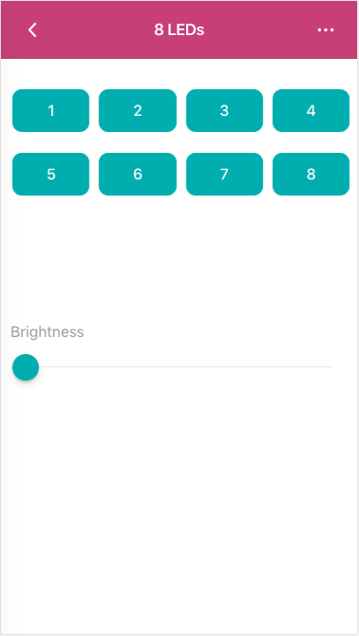
home

Slide 8
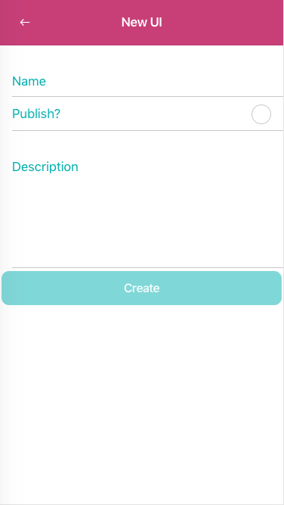
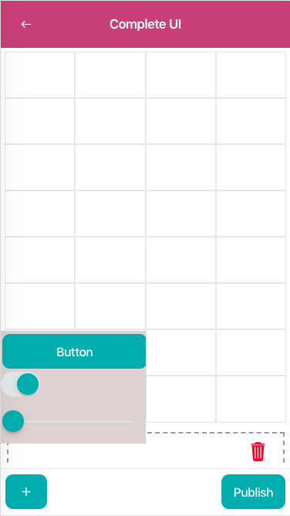
design

Slide 9
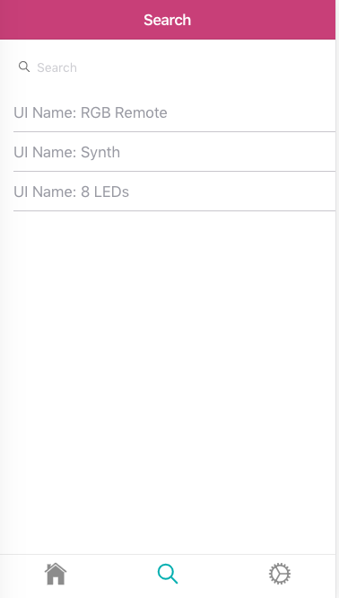
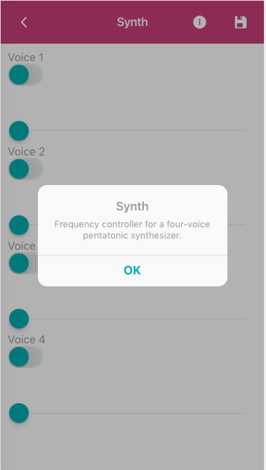
search

Slide 10
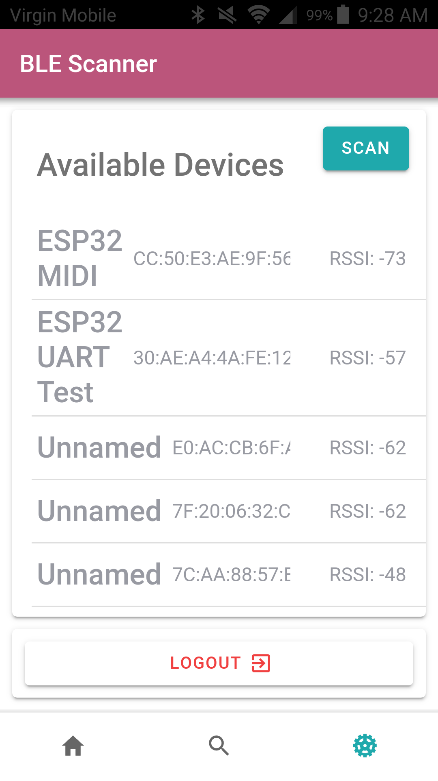
connect

Slide 11
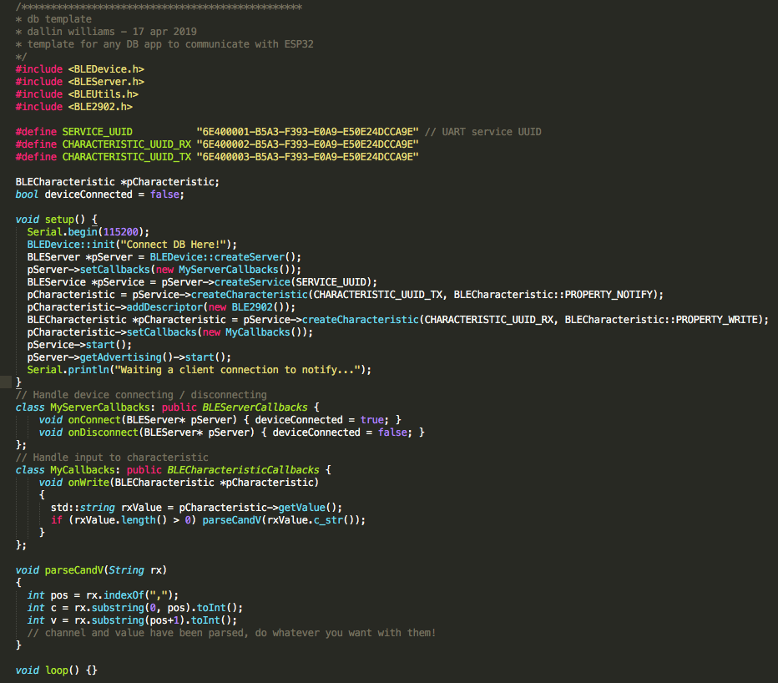
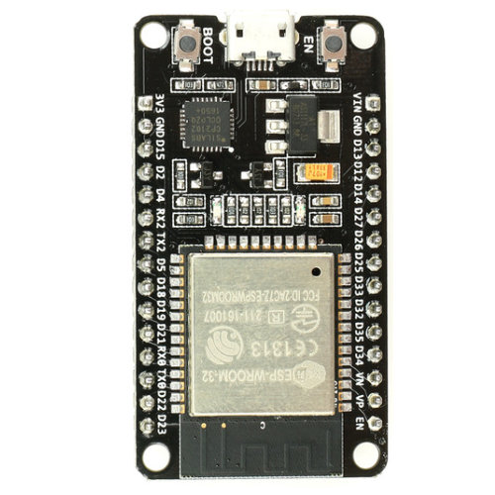
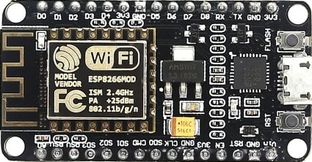
integrate

Slide 12
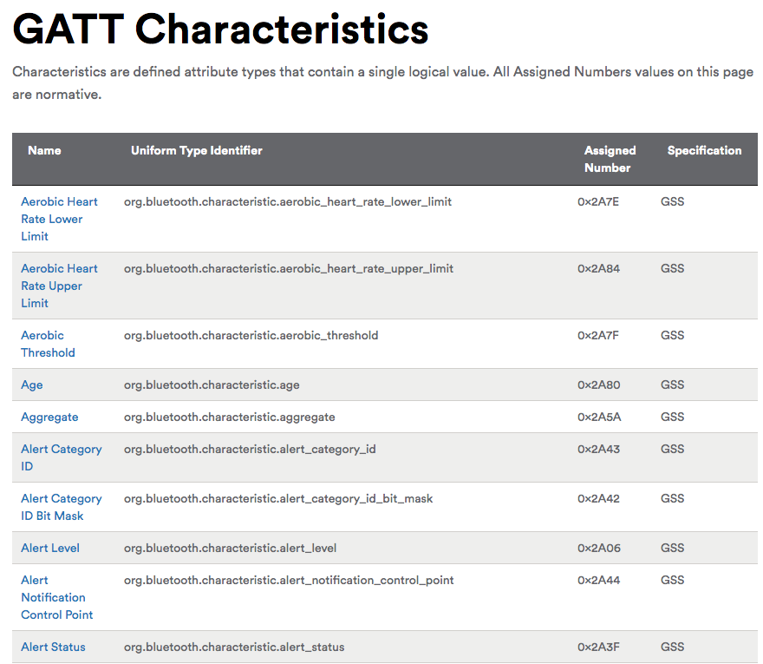
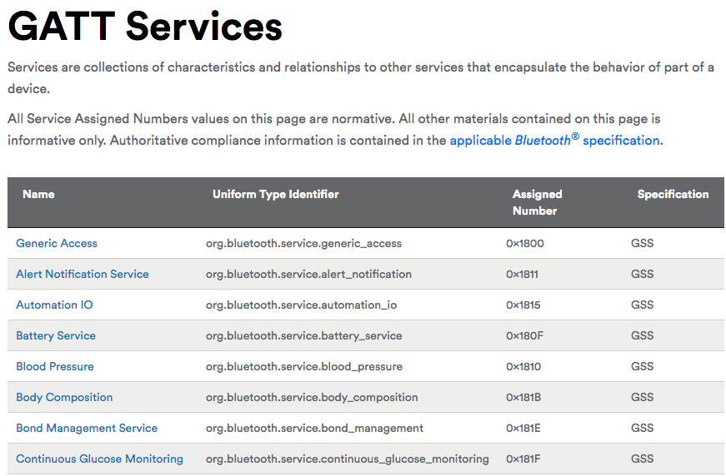

Slide 13
project ideas
smart home controller
lights, outlets, appliances, security system, energy use, temperature
web server gateway
read heart rate from FitBit
mood lamp
synthesizer
graphics generator

Slide 14
demo
mandelbrot rgb
synth

Slide 15
https://github.com/dallinw/db

