Slide 1
Introduction to Challenge #1
Associations between somatic growth and brain development
Author: Jonathan L. French, ScD
Presenter: Sofia Trommlerová

Slide 2
Data across lifecycle: from birth to later in life outcomes
IV. ADOLESCENCE
TO ADULTHOOD
Day 6000
Day 0
BIRTH
Day 1000
Day 1000
Day 3000
Day 6000
Fine
motor skills
II. MOTOR MILESTONES
Vocal
III. FINE MOTOR
SKILLS AND VOCAL
Notes:
I. FETAL GROWTH AND DEVELOPMENT
Risk factors
Child sex
Gestational age
II. MOTOR MILESTONES and III. FINE MOTOR SKILLS AND VOCAL
Risk factors
Birth size
Pathways / pathology
Nutrient intake
Microbiome
Enteric infection
Gut function
Nutrient absorption
Inflammation
IV. ADOLESCENSE TO ADULTHOOD
Risk factors
Social / demographic
Environmental
Behavioral
Pathways / pathology
Feeding practices
Nurturing

Slide 3
Background
Impaired somatic (physical) growth has been used as a surrogate for impaired neurocognitive development.
It is likely that somatic growth also tracks with brain development.
In this data set, children aged 3 months to 18 years were examined by MRI (2 to 4 scans each) to characterize brain development.
Somatic growth also was measured at most examinations.
Age-appropriate measures of cognitive development were collected at a subset of examinations.

Slide 4
Problem statement
How well can you predict concurrent cognitive scores based on somatic growth and/or brain development (and other predictors in the dataset)?
Can the trajectory of brain development can be inferred from measurements of somatic growth?

Slide 5
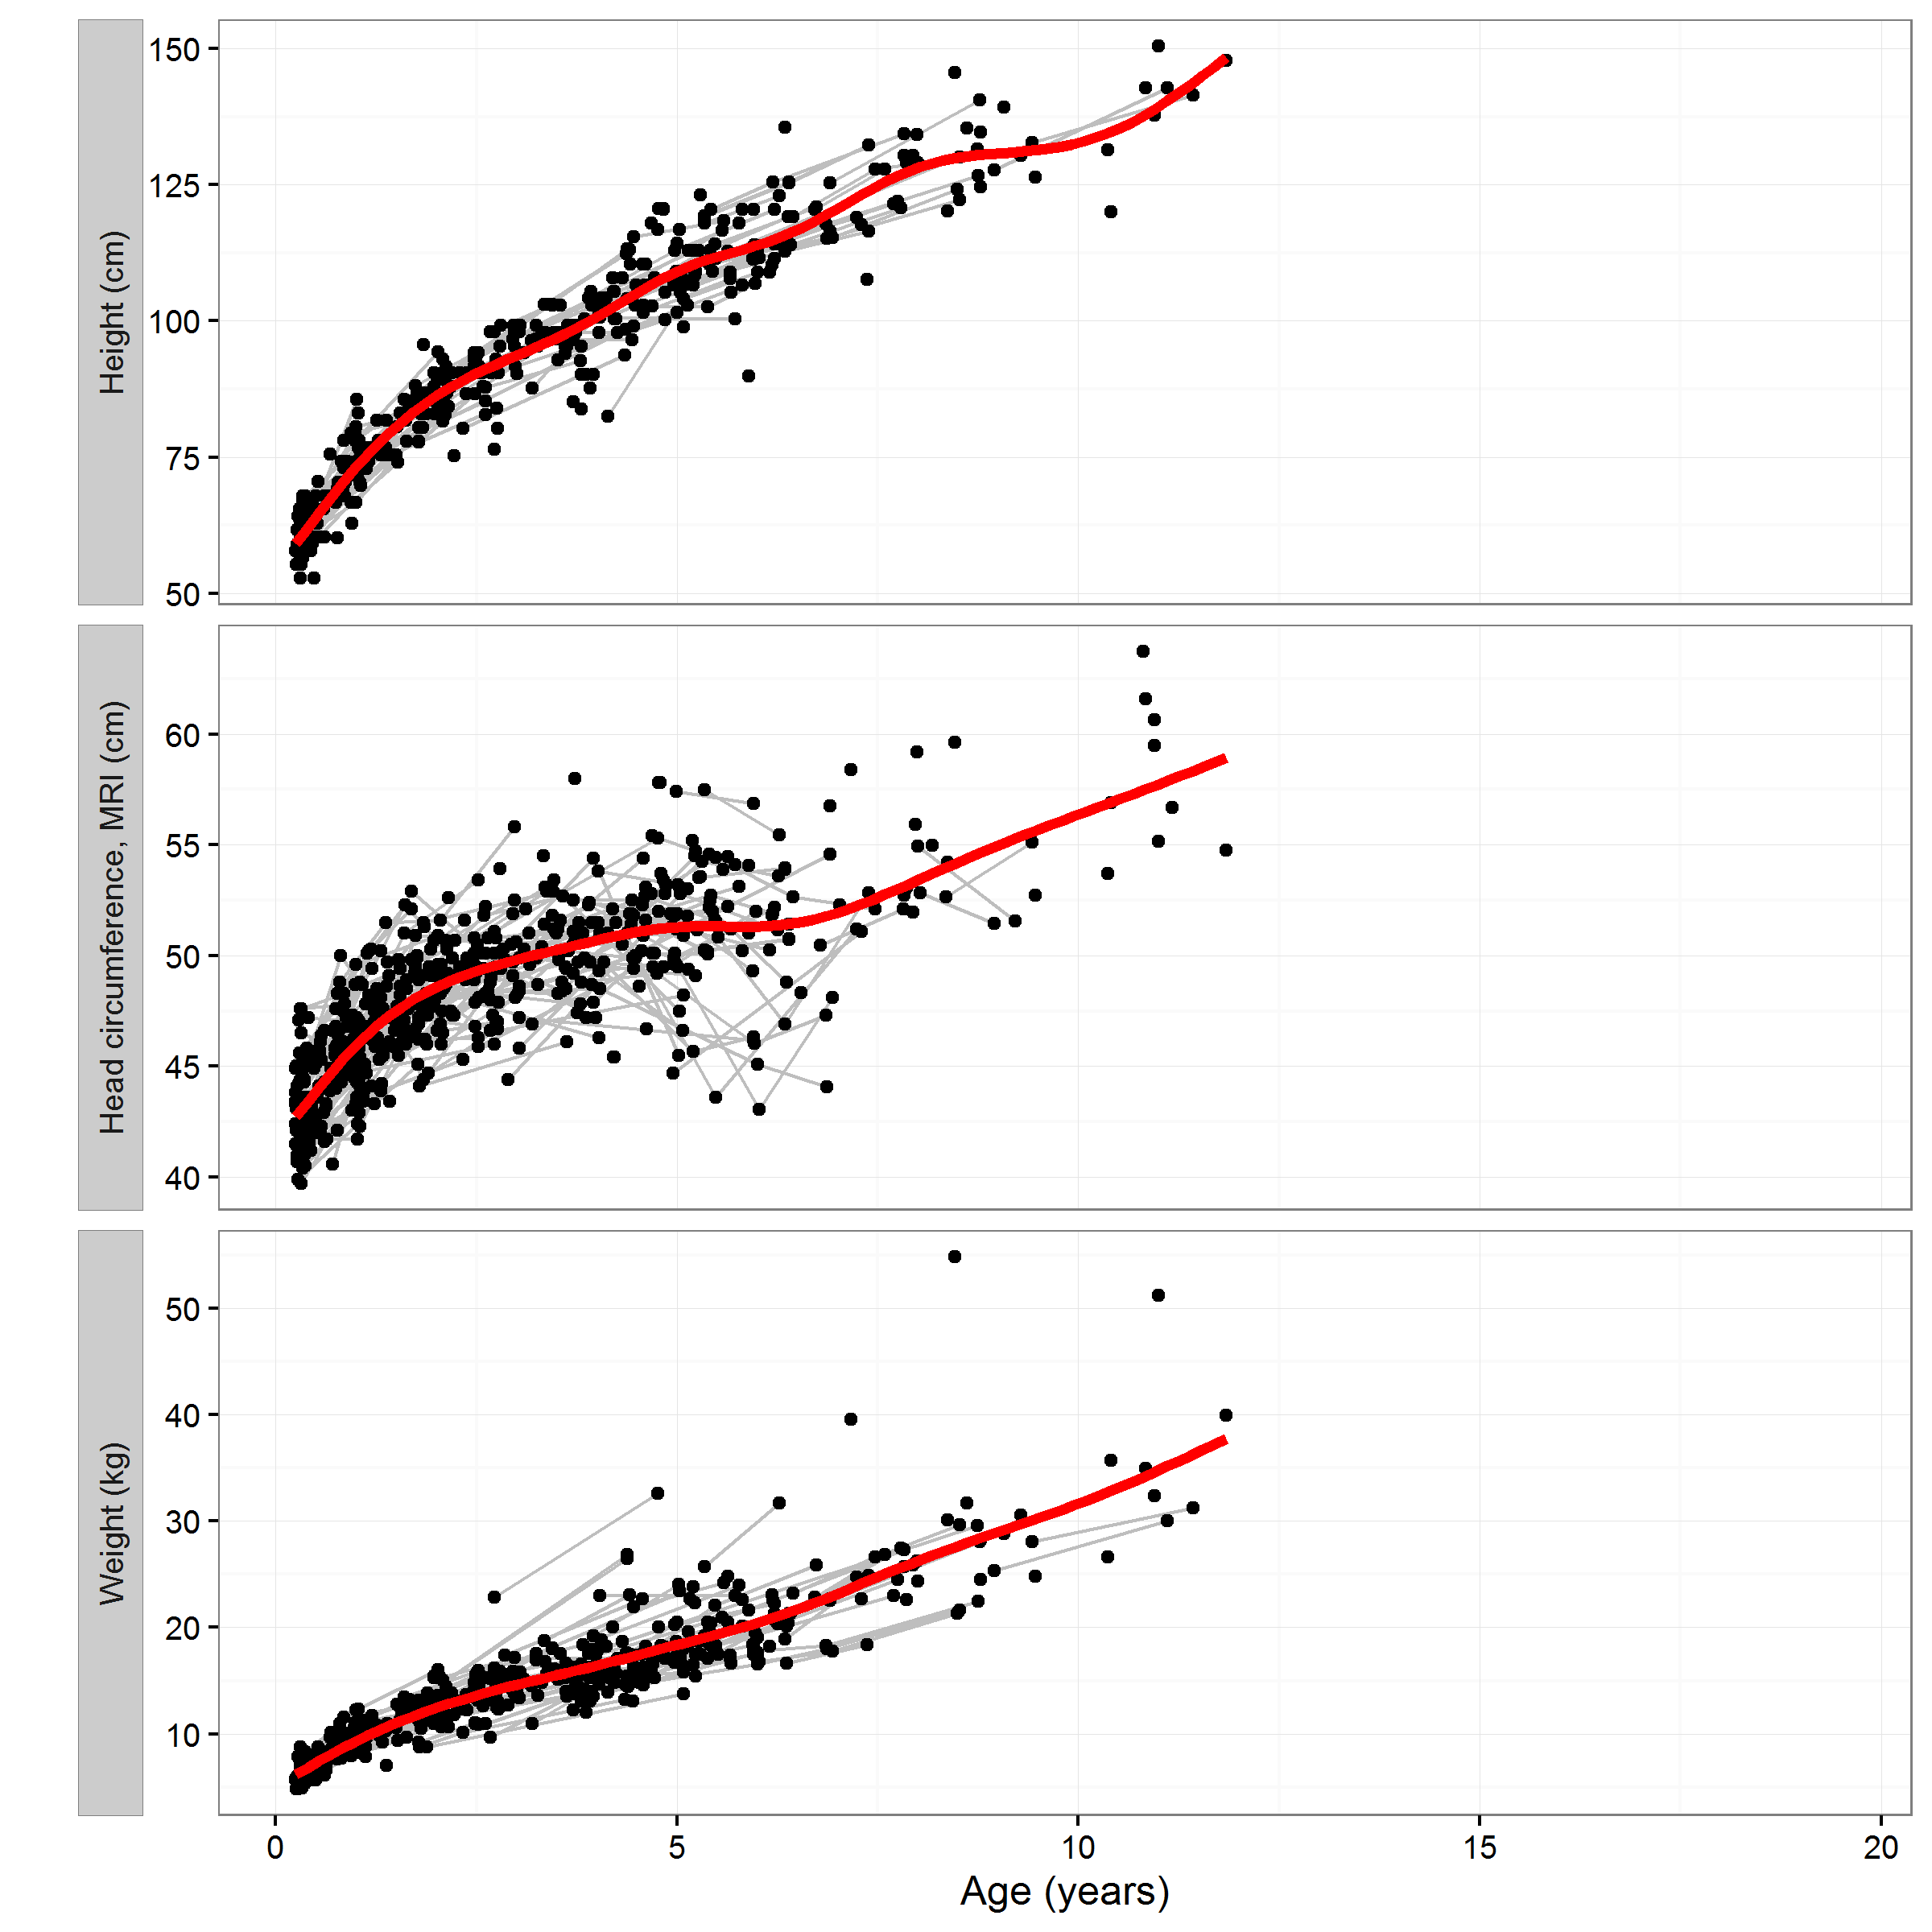
Measures of somatic growth
N = 374 children
Number of measurements varies
across children.
Measure | Median | Range
Height | 1 | 0 - 5
Head circ. (MRI) | 2 | 0 - 6
Weight | 1 | 0 - 5
Notes:
While we have a wide rage of ages, each child is only measured a relatively small number of times and over a relatively short period.

Slide 6
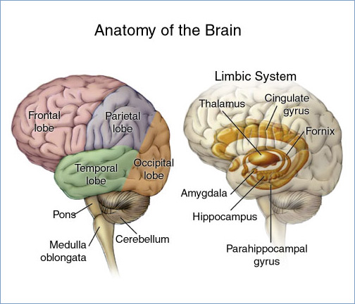
Measures of brain development
We will focus on the extent of myelination in different regions of the brain.
Myelin provides insulation for the axons of nerve cells.
Allows for more efficient conduction of signaling.
We have data on the extent of myelination in
Cerebellum
4 lobes of cerebral cortex
Frontal lobe
Parietal lobe
Occipital lobe
Temporal lobe
3 regions in corpus callosum (connecting left/right)
5 other ‘connecting’ structures
https://commons.wikimedia.org/wiki/File:Brain_headBorder.jpg
Notes:
Each region of the has a number of functions associated with it. E.g. Frontal = executive functioning (thinking/planning), Occipital = processes visual information; Temporal = hearing and language; Cerebellum = coordinates (voluntary) movement.
https://opentextbc.ca/introductiontopsychology/chapter/3-2-our-brains-control-our-thoughts-feelings-and-behavior/

Slide 7
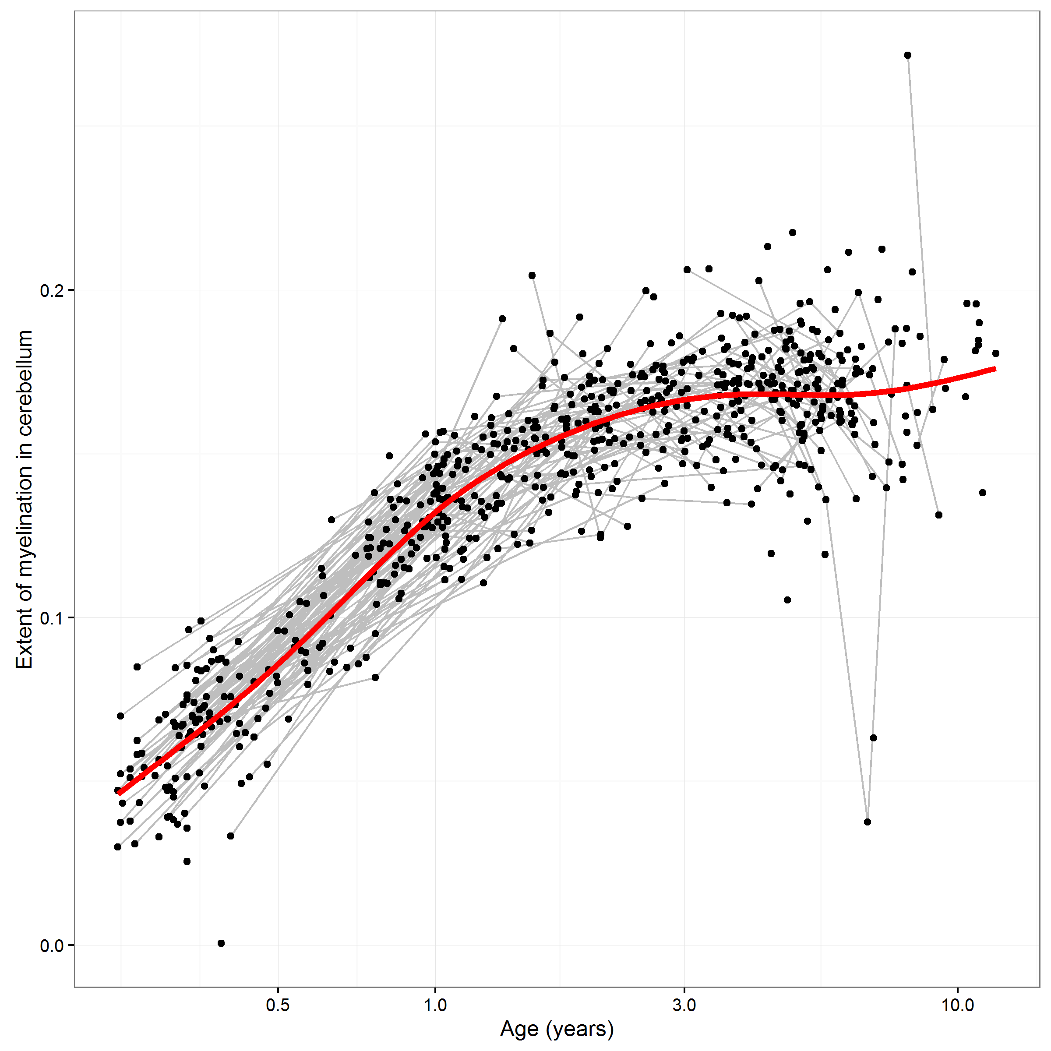
Measures of brain development
We will focus on the extent of myelination in different regions of the brain.
https://commons.wikimedia.org/wiki/File:Brain_headBorder.jpg

Slide 8
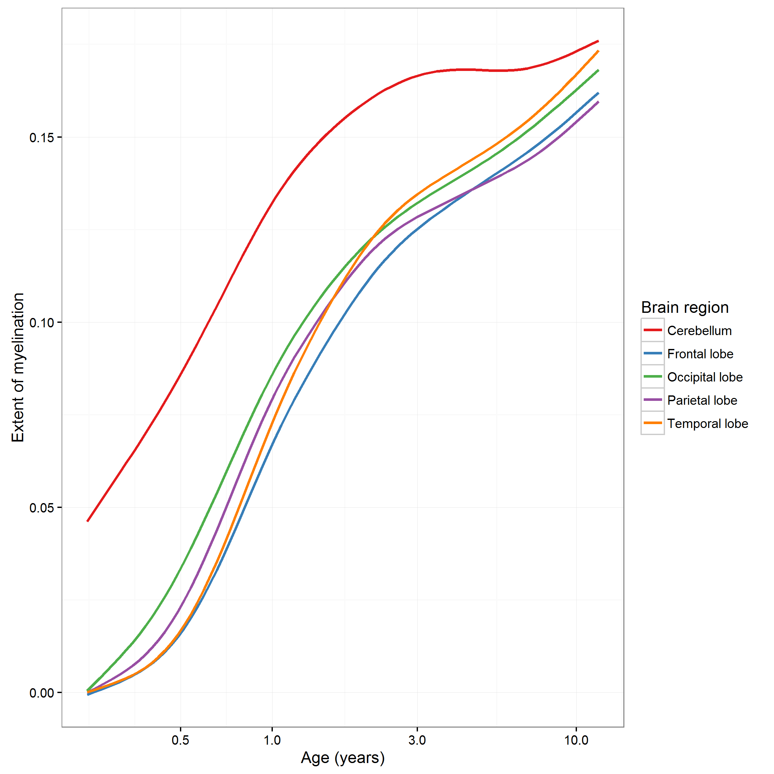
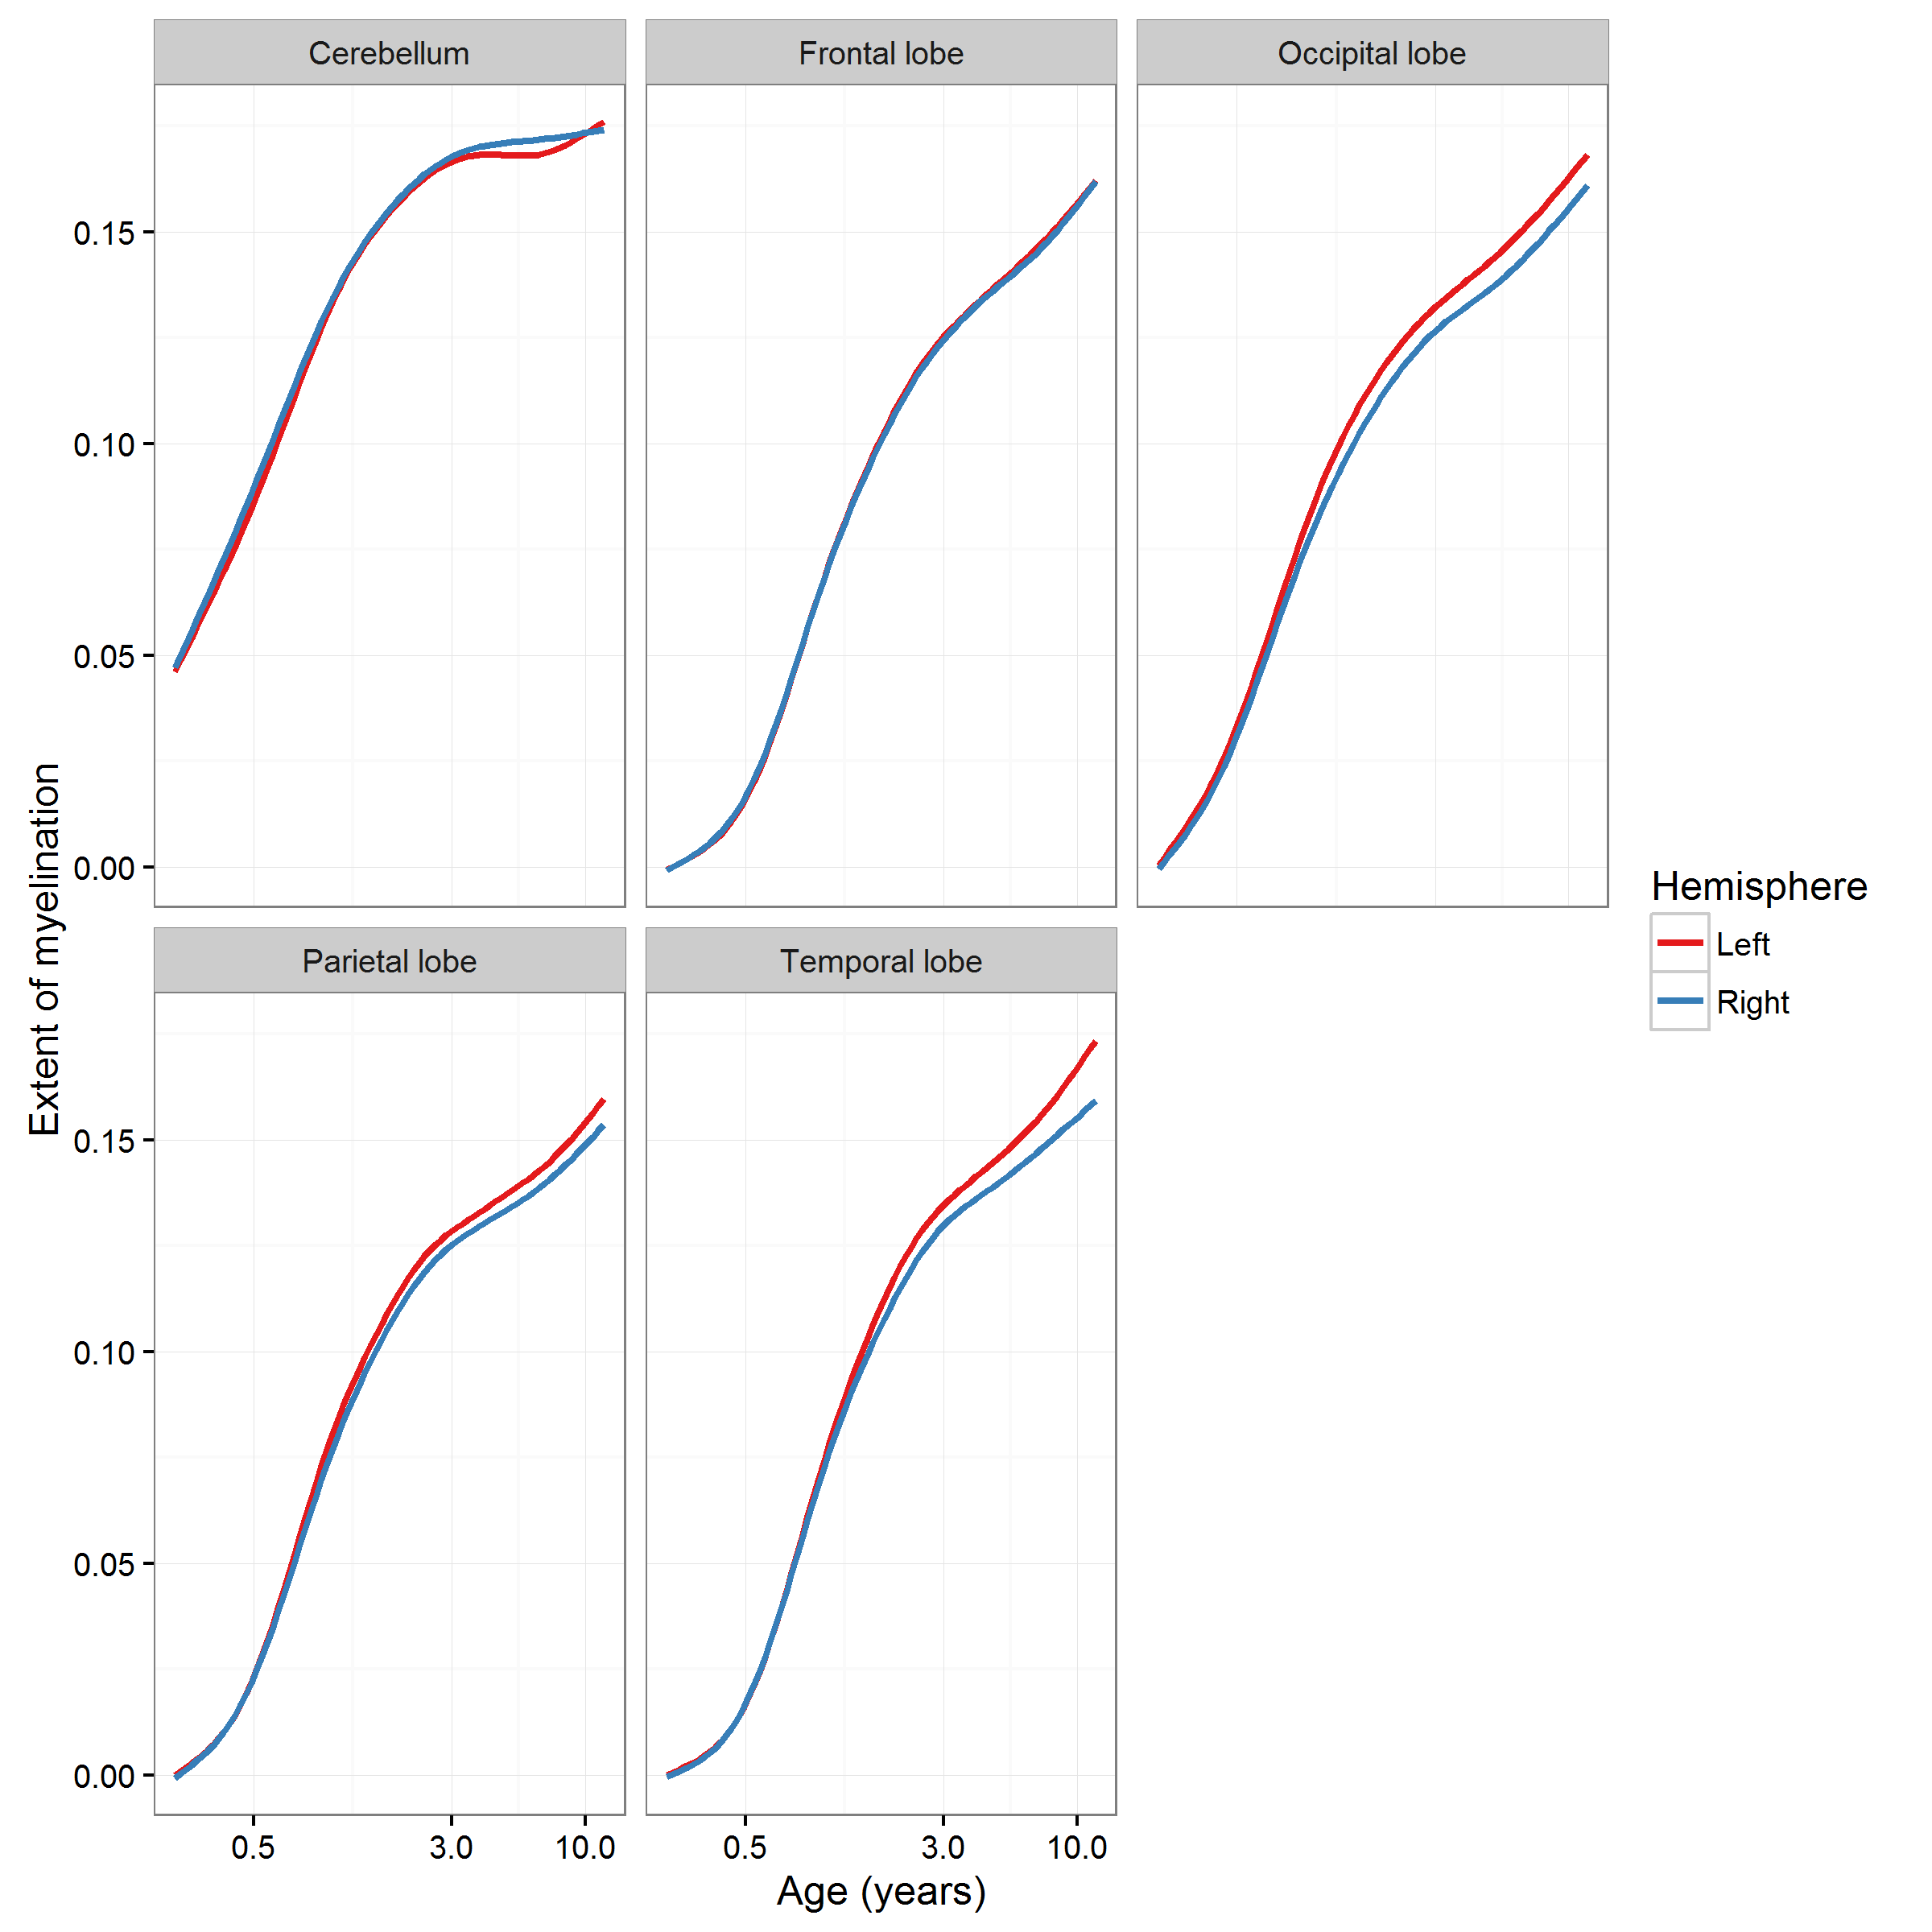
Extent of myelination in cerebral cortex lobes
Little difference in left and right hemispheres.

Slide 9
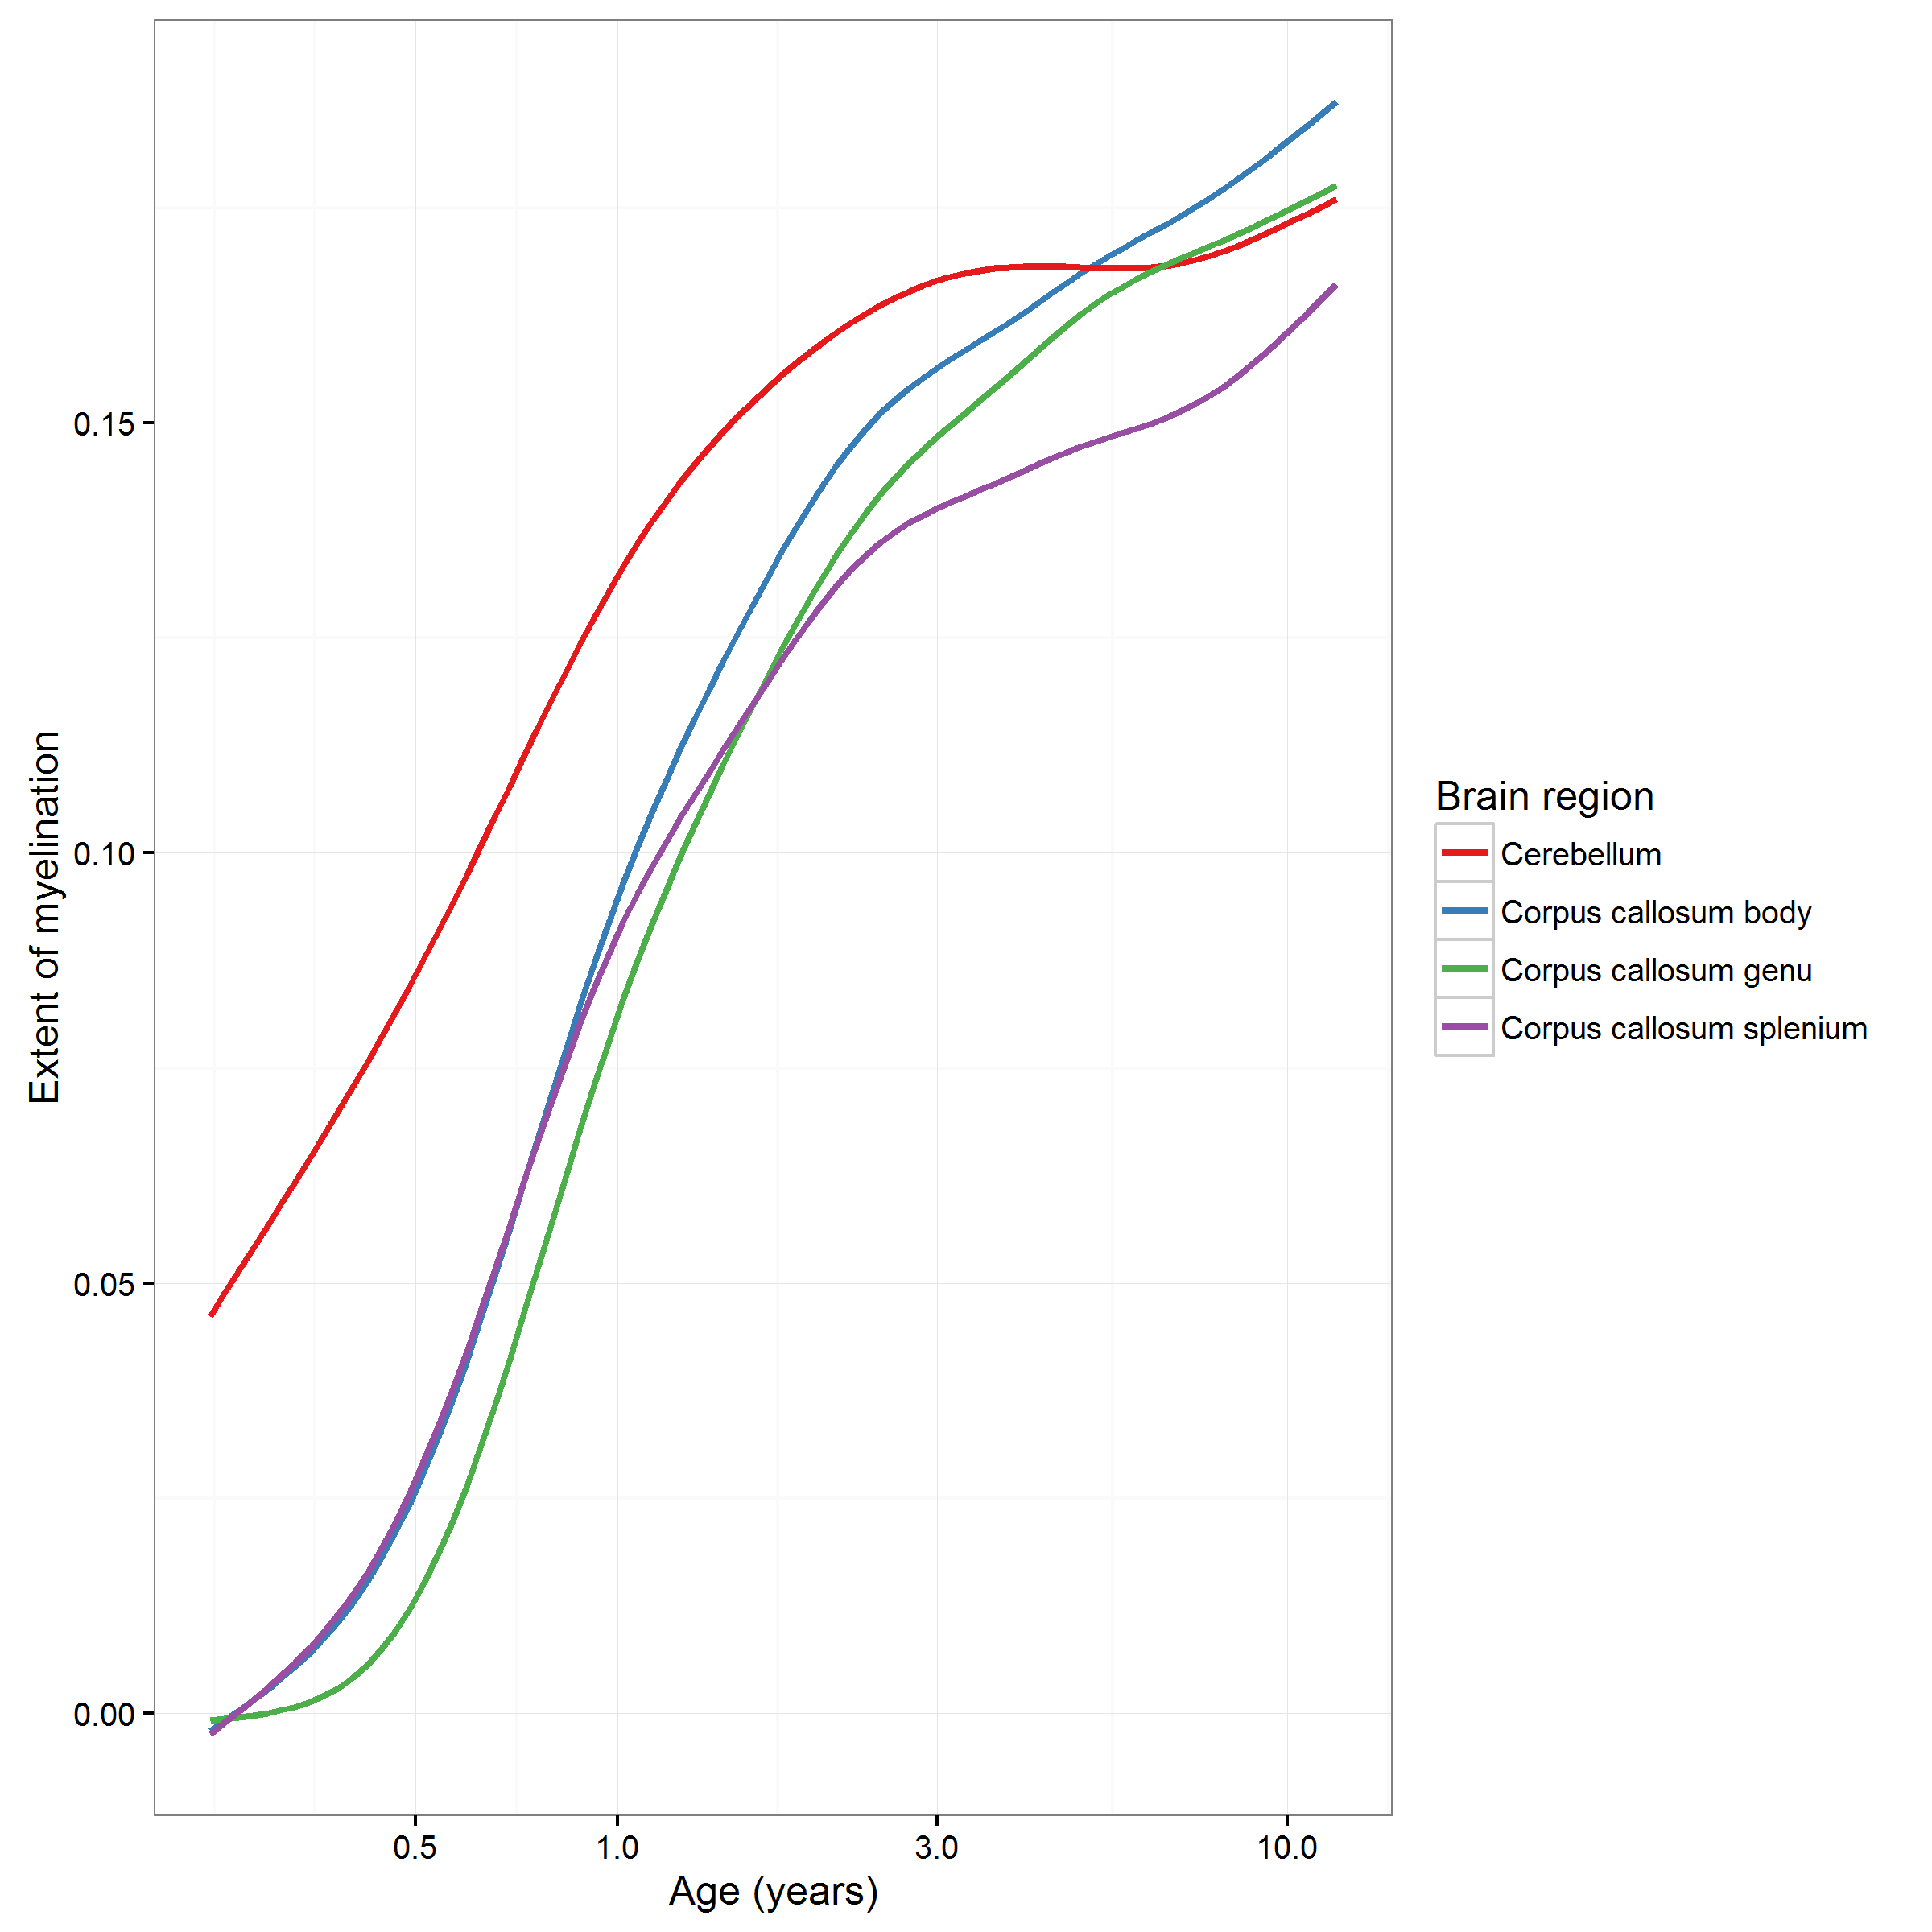
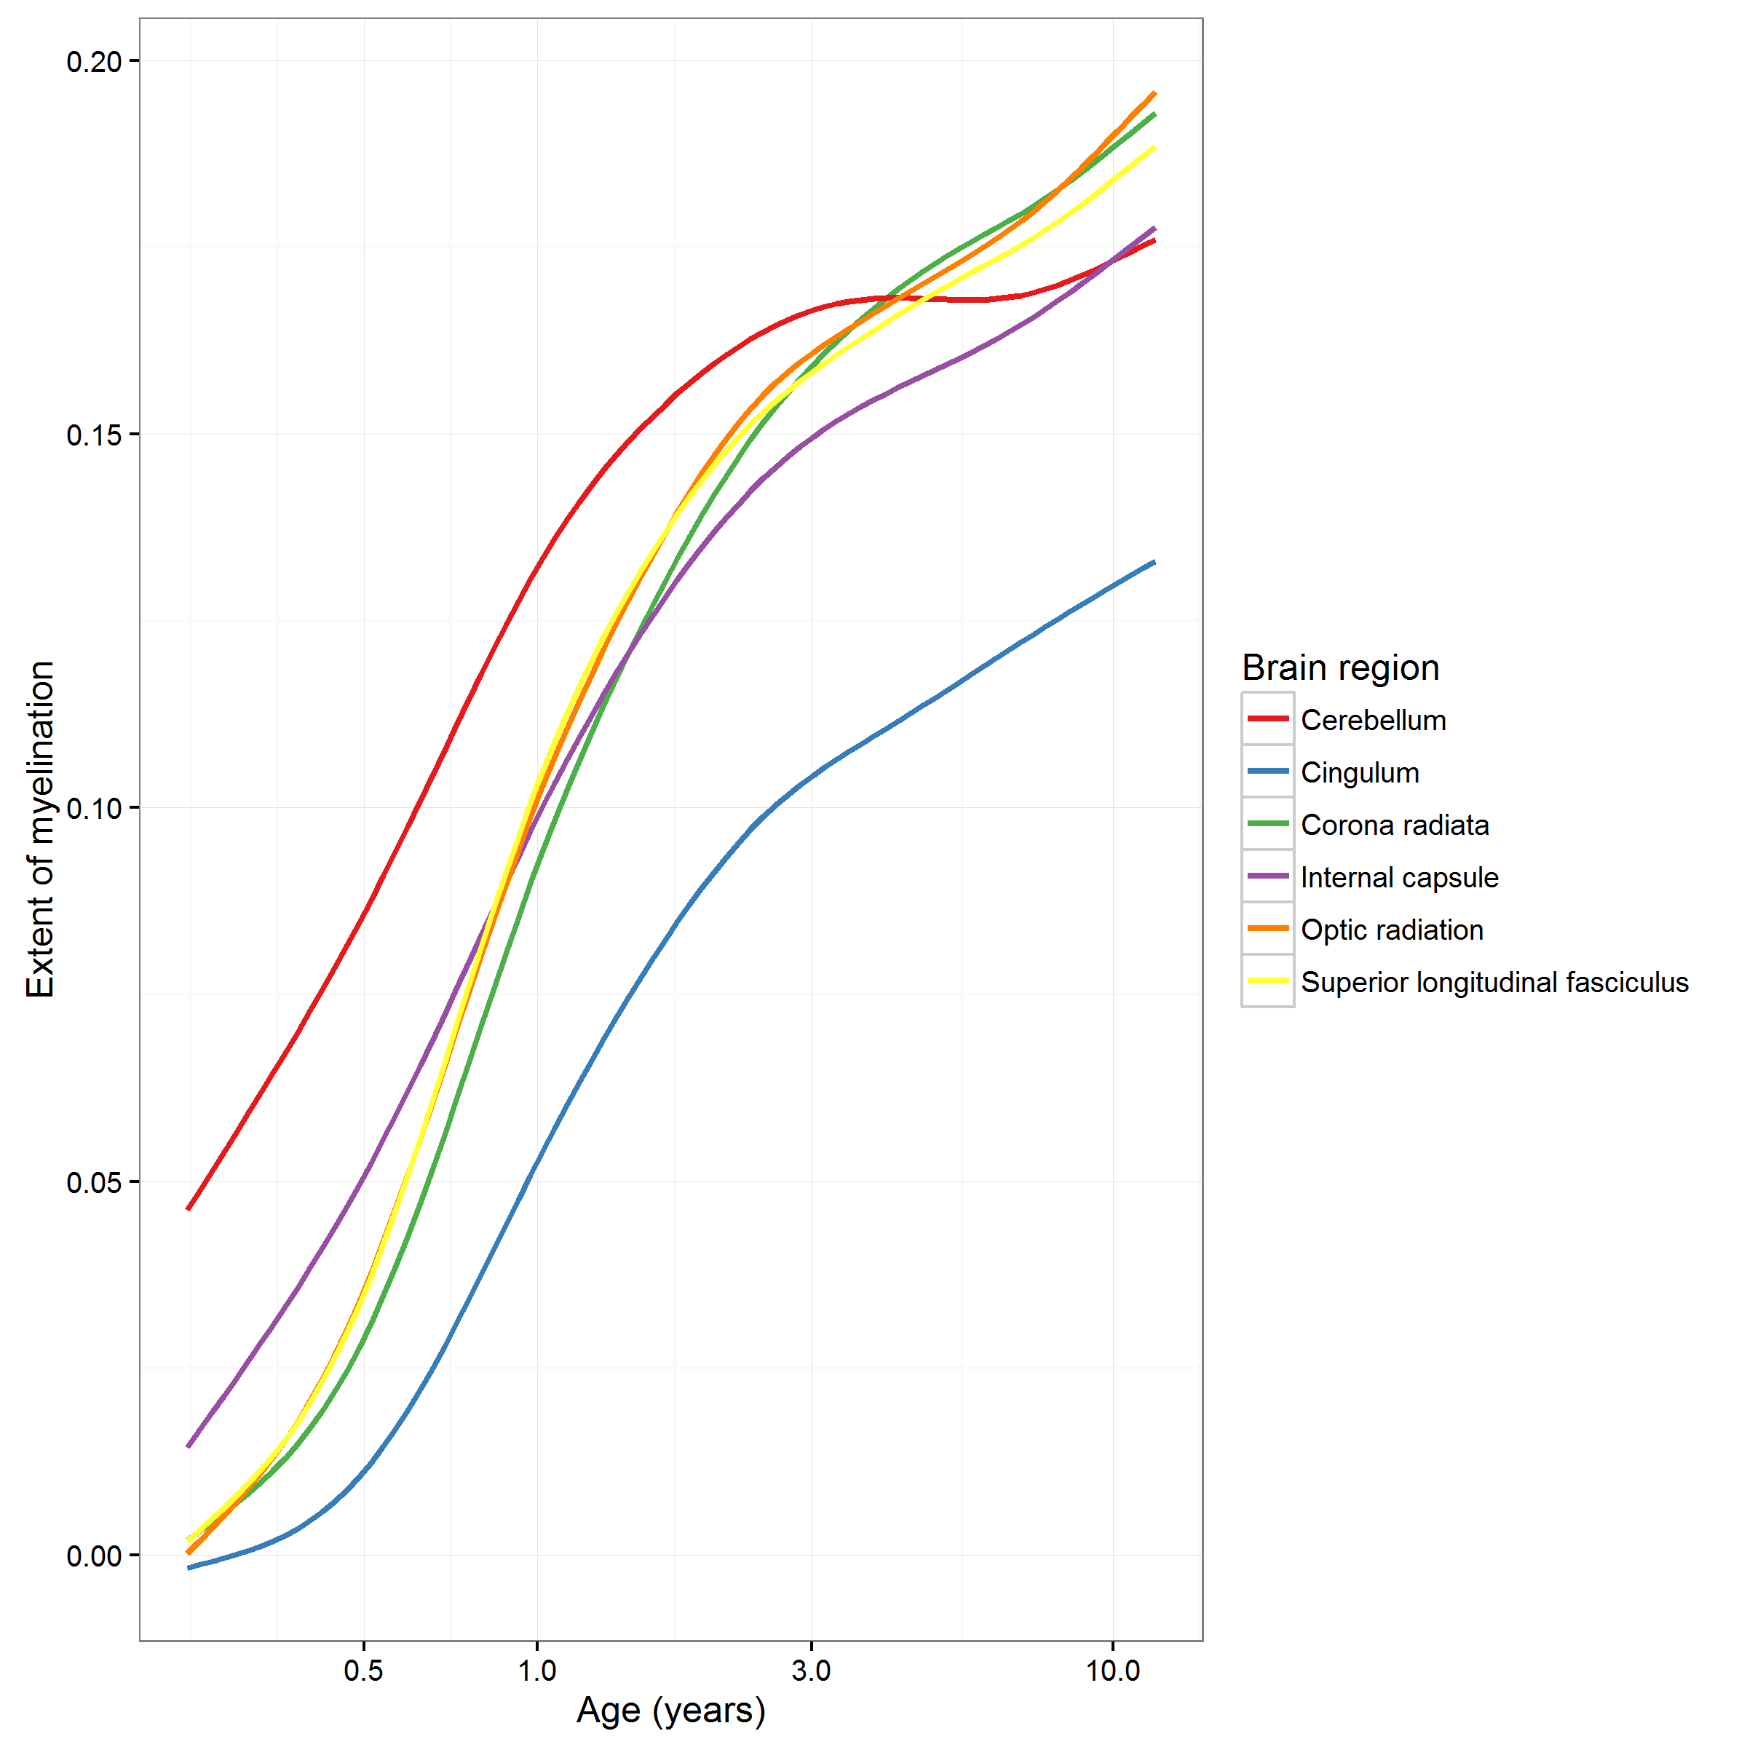
Extent of myelination in other regions

Slide 10
Cognitive development is also measured
Scale used depends on the age of the child
Mullen Scale of Early Learning (MSEL)
Designed for children birth to 5.5 years
Multiple domains (e.g., Expressive & Receptive Language, Fine & Gross Motor)
Multiple aggregations (e.g., Non-verbal development, Verbal Development, Early Learning Composite)
n=322 with data
Wechsler Preschool and Primary Scale of Intelligence (WPPSI)
Designed for children 2.5 to 7.5 years
“Domains” (e.g., Matrix reasoning, Vocabulary, Full Scale IQ)
n=40 with data
Wechsler Abbreviated Scale of Intelligence (WASI)
Designed for children (and adults) over 6 years
IQ “domains” (Performance, Verbal, Full-scale)
n = 83 with data

Slide 11
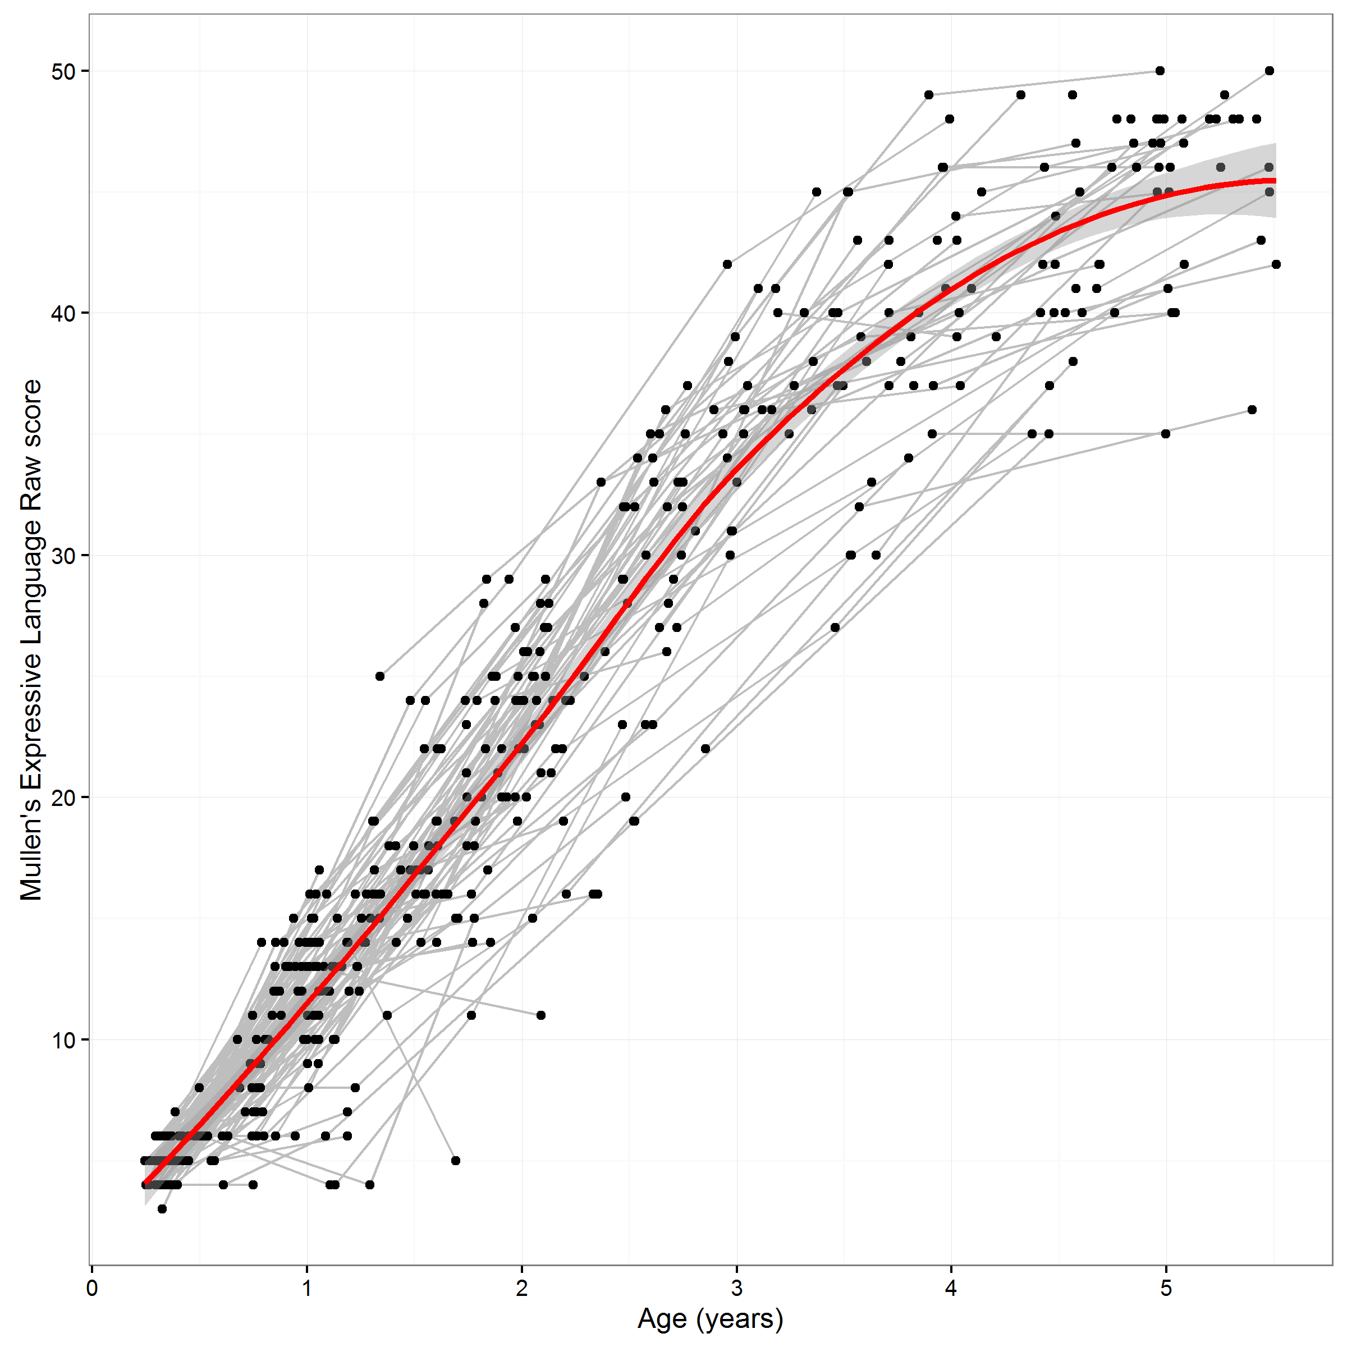
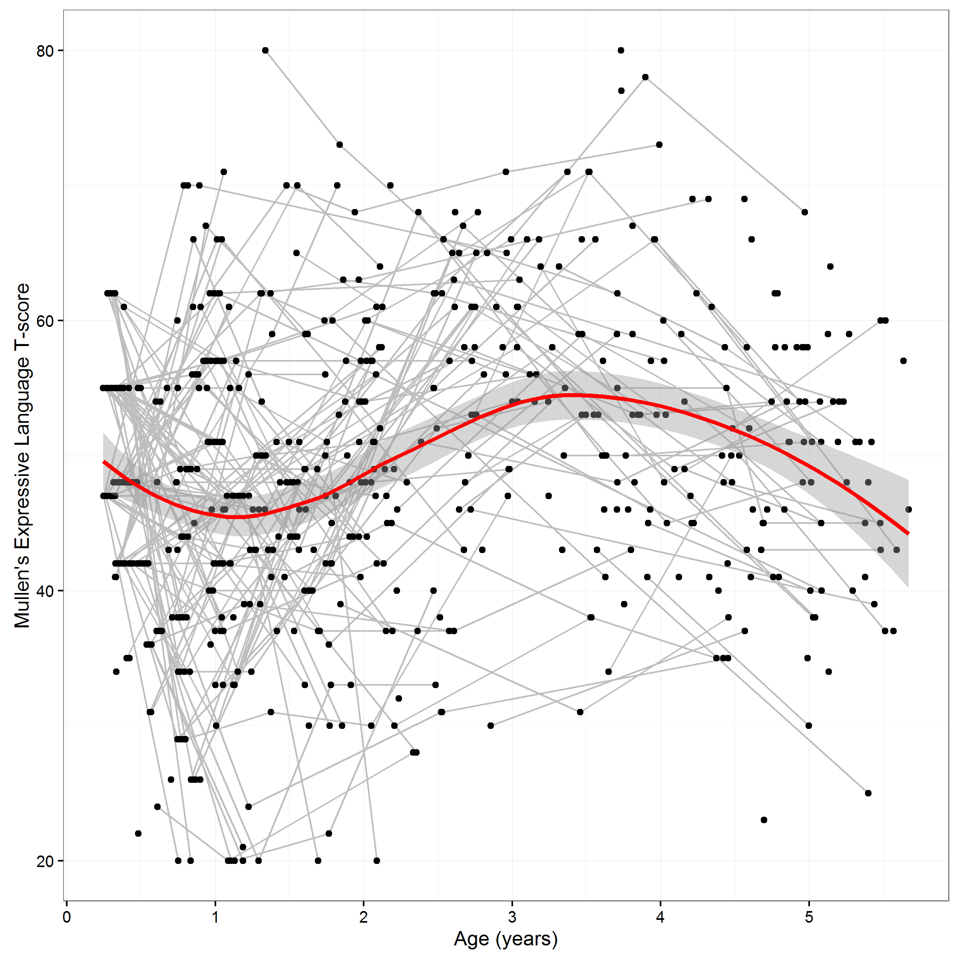
Cognitive development is also measured
Mullen Scale data has raw and age-normalized (t-score) values.
T-scores
Raw scores
Mullen’s raw-scores
Increase with age.
Mullen’s T-scores are
age-normalized

