Slide 1
Introduction to challenge #2
Improve upon Equations for Estimating Fetal Weight from Ultrasonograms
Author: Jayson D. Wilbur, PhD
Presenter: Sofia Trommlerová

Slide 2
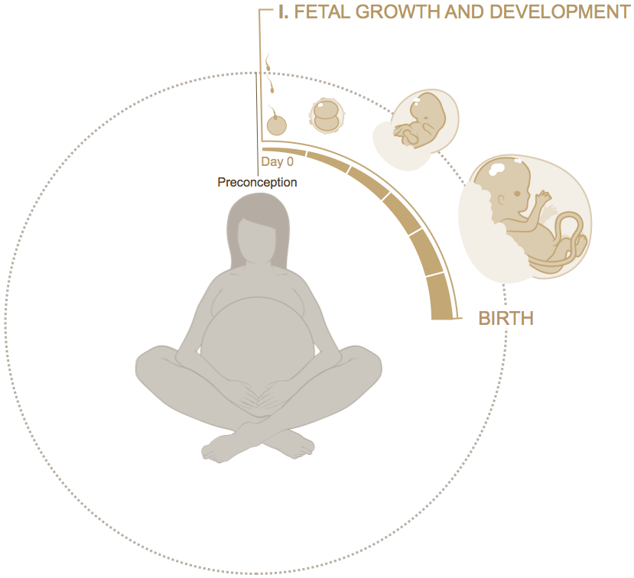
Background
Accurate estimation of fetal weight has an important role in routine antenatal care and for detection of fetal growth abnormalities.
Fetal weight is an important predictive parameter of neonatal morbidity and mortality.
Estimated fetal weight is taken into consideration when making clinical decisions involving induction or delay of labor and method of delivery.

Slide 3
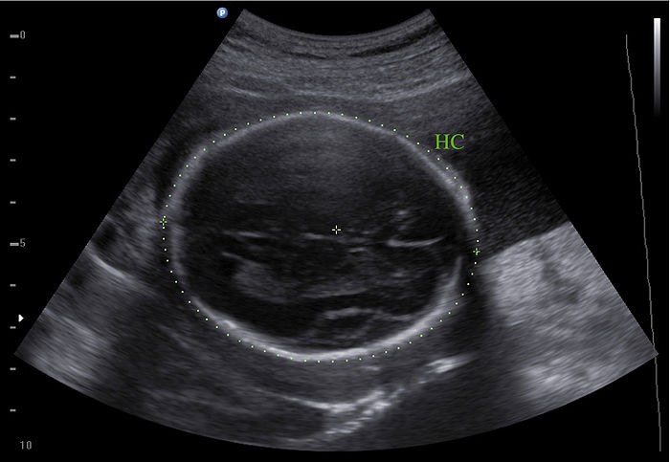
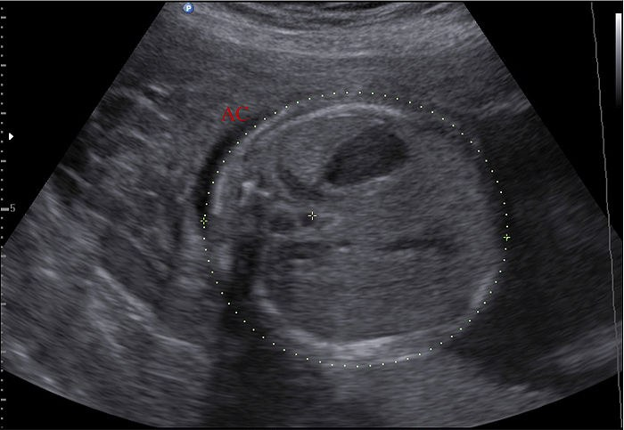
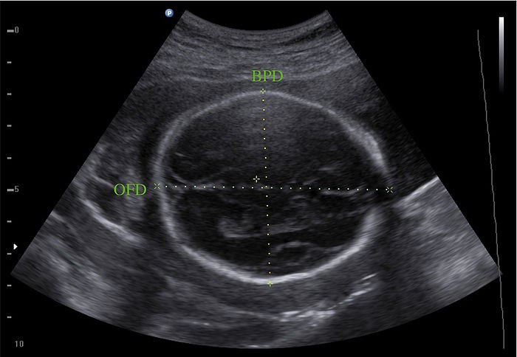
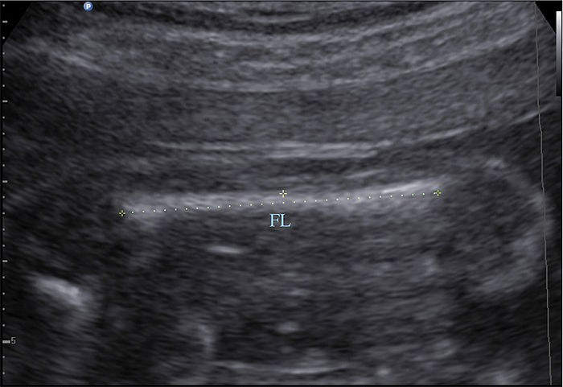
Background
Head Circumference
Abdominal Circumference
Several different equations have been proposed to estimate fetal weight from 4 key ultrasonogram measurements:
Head Circumference
Abdominal Circumference
Biparietal Diameter
Femur Length
Biparietal Diameter
Femur Length

Slide 4
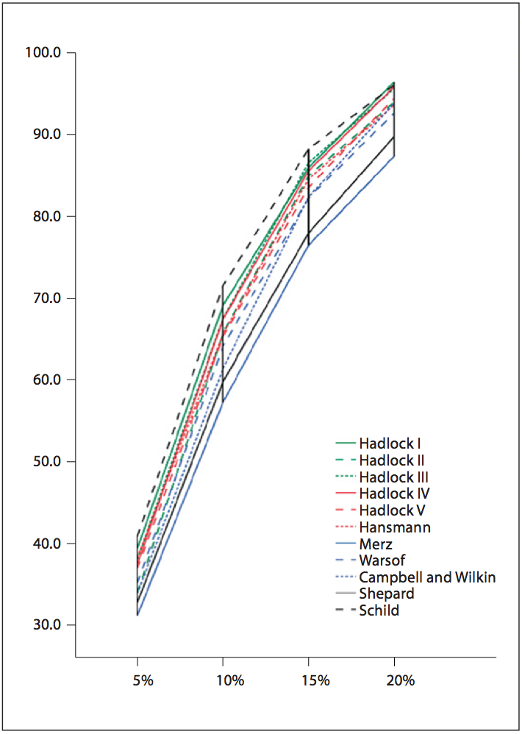
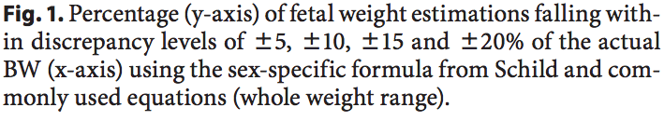
BACKGROUND
Each method has been evaluated by comparing the estimated weight to the birth weight for an ultrasonogram that was done close to birth.
But these methods are not explicitly designed to be predictive.

Slide 5
Problem
Predict Weight at Week 40
The problem proposed to Hackathon participants is to develop improved methods for predicting fetal weight at week 40 that take advantage of the longitudinal characteristics of the ultrasonogram and postnatal data set that will be made available to participants.

Slide 6
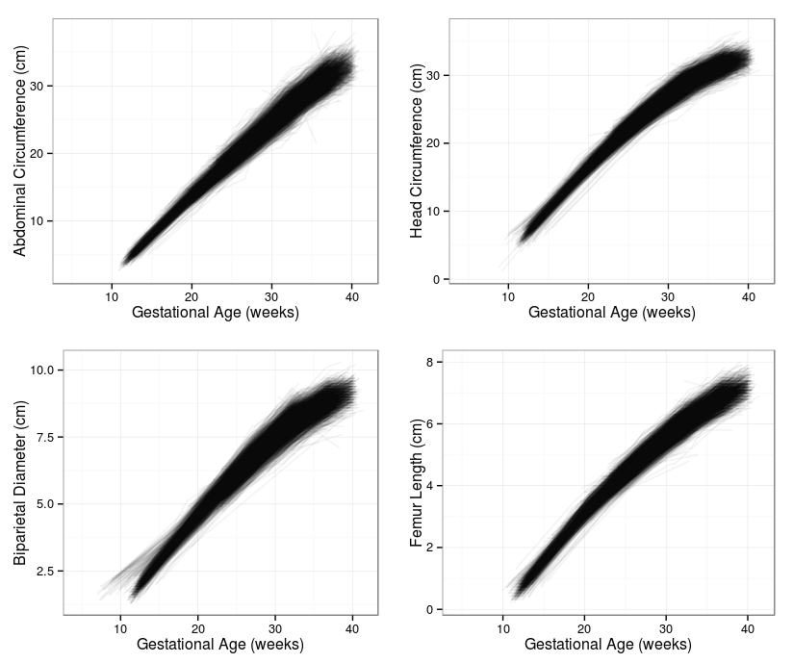
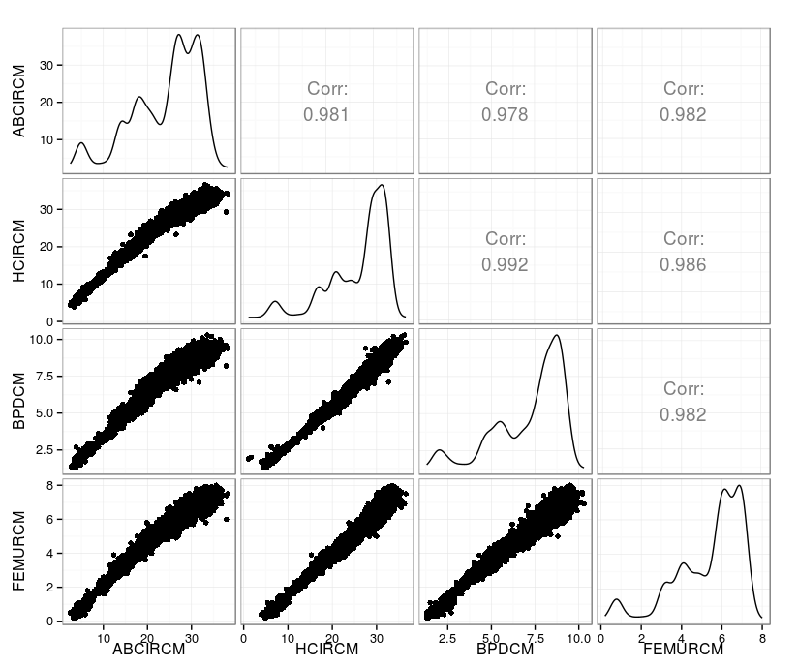
DATA

Slide 7
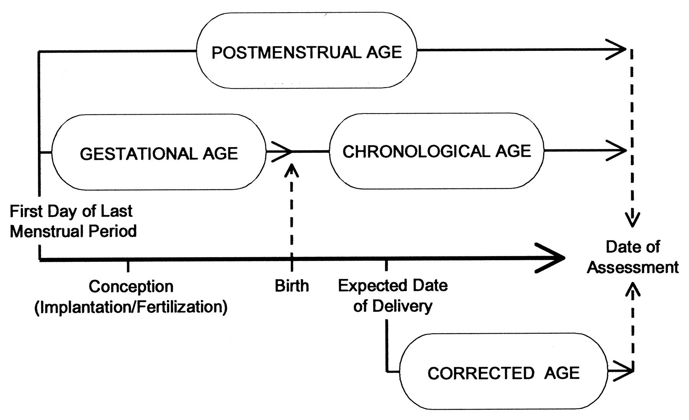
Age Terminology During the Perinatal Period
GAGEDAYS
AGEDAYS
Committee on Fetus and Newborn Pediatrics 2004;114:1362-1364

Slide 8
References
Pinette MG, Pan Y, Pinette SG, Blackstone J, Garrett J, Cartin A. Estimation of fetal weight: mean values from multiple formulas. J Ultrasound Med. 1999;18(12):813-817.
Anderson NG, Jolley IJ, Wells JE. Sonographic estimation of fetal weight: comparison of bias, precision and consistency using 12 different formulae. Ultrasound Obstet Gynecol. 2007;30(2):173-179.
Melamed N, Yogev Y, Meizner I, Mashiach R, Bardin R, Ben-Haroush A. Sonographic fetal weight estimation: which model should be used? J Ultrasound Med. 2009;28(5):617-629.
Papageorghiou AT, Ohuma EO, Altman DG, Todros T, Cheikh Ismail L, Lambert A,et al. International standards for fetal growth based on serial ultrasound measurements: the Fetal Growth Longitudinal Study of the INTERGROWTH-21st Project. Lancet. 2014;384(9946):869-879.
Villar J, Cheikh Ismail L, Victora CG, Ohuma EO, Bertino E, Altman DG, et al. International standards for newborn weight, length, and head circumference by gestational age and sex: the Newborn Cross-Sectional Study of the INTERGROWTH-21st Project. Lancet. 2014;384(9946):857-868.

