Slide 1
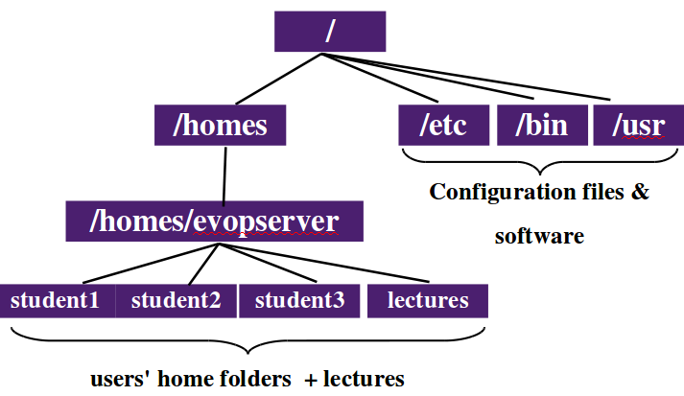
/home/<accountname>
/home/k00319235
/home/k00319236
/home/k00319237
/opt/evop/public/

Slide 2
