Slide 1
Our case for decentralized Polling
By: Dilanny, Luang, David, Daryna Aloff, Jonathan Pinder

Slide 2
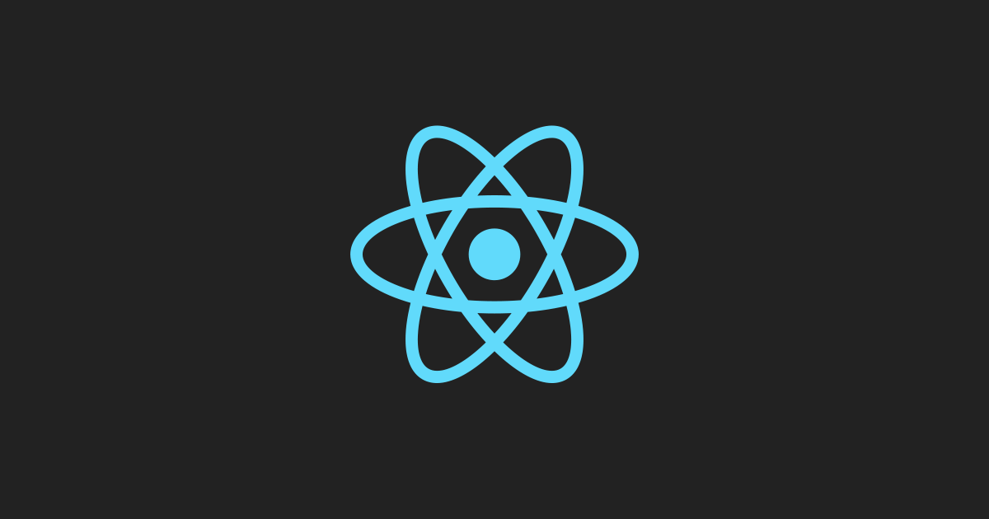
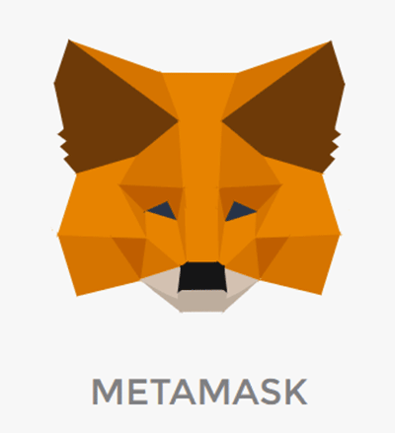



Technologies
React, Web3.js, Truffle, Ganache, MetaMask

Slide 3
Overview
An approach to collecting information via polls that integrates with existing “centralised” document verification systems.
Decentralized voting that allows users to participate and collect information from verified sources.

Slide 4
Design Methodology for Blockchain Applications
Analysis Stage
Identify entities involved in application, roles, and interactions
Design Stage
Model the attributes as state variables & interactions between them as functions
Implementation Stage
Use contracts (state variables, functions, modifiers, events) to
Methodology based on Blockchain and Applications by Bahga and Madisetti

Slide 5
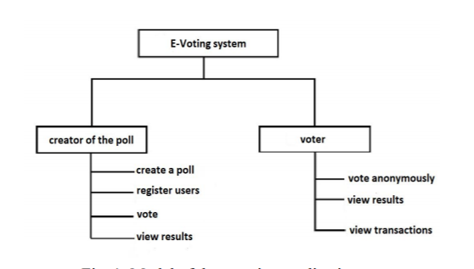
Analysis

Slide 6
Only admin (owner) can:
Create elections by submitting a name for the election
Add candidates to an election
Open elections, which allow voters to vote on the election
Close elections, which end voting and calculate a winner
All voters can:
Vote once for a candidate per open election
View election stats

Slide 7
Design
Poll Creator
State Variables
Bytes32 PollName
Uint voteCount
Functions
constructor(bytes32 [] nameofPolls, uint poll deadline)
Voter
State Variables
Bool voted
Uint vote
Bool canVote
Functions
vote(uint pollNumber)

Slide 8
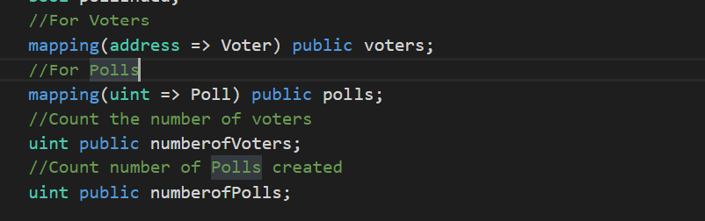
Poll Creation contract
We have two Structs that describe a Voter and a Poll. To keep track of Voters and Polls, we put them into separate mappings
When a user votes, a new Voter struct is created and added to the mapping. In order to count the number of votes a certain candidate has, we loop through all the Voters and count the number of votes. Thus, these mappings will hold the history of all Voters.

Slide 9
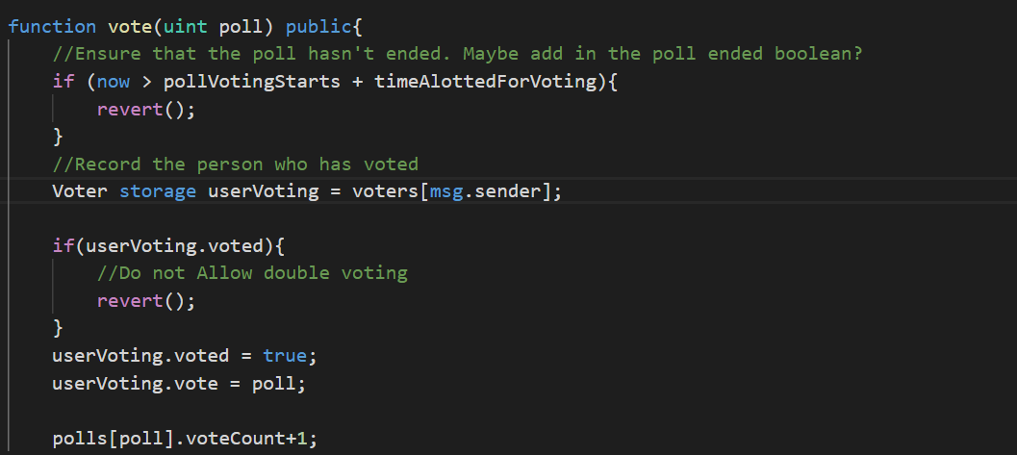
It implements require statements that will stop execution if the conditions are not met. First require that the voter hasn't voted before. We do this by reading the account address with "msg.sender" from the mapping. If it's there, the account has already voted.
Gas efficient approach using revert.

Slide 10
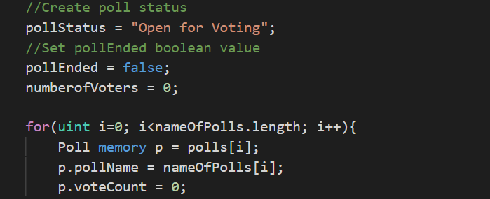
Poll Creation contract
Elections structs are state machines stored in contract storage - they maintain a status (either "Open" or "Closed") representing their lifecycle stage
Open: the election is open, voters can vote on the election and admins can close the election
Closed: the election is close, the winner is calculated and no further actions can be taken on the election

Slide 11
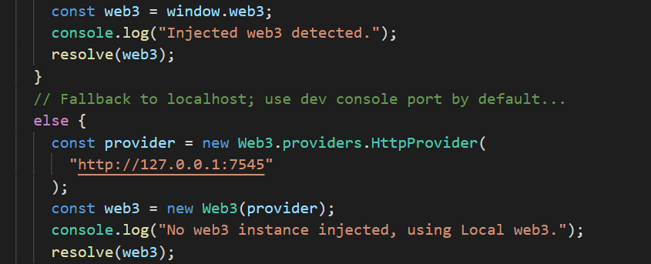
Web3 and Contracts
We connected to an Ethereum network by getting a handle on the Web3 object and setting the provider.

Slide 12
Many-to-One Application Template
Our polling application utilises the Many-to-One Template
Non Discriminatory user owns the contract, uses for a specific purpose
All others that interact with the contract have same role (i.e. Voters)

Slide 13
Resources
https://www.youtube.com/watch?v=qlJ3cs7o2DE&feature=youtu.be
Ethereum, ReactJS, Truffle tutorial by DappUniversity
Blockchain and Applications: A Hands-on-Approach by Arshdeep Bahga and Vijay Madisetti (textbook)
https://www.youtube.com/watch?v=DFRLM0dYU2w
Buidling for dApp with ReactJS

