Slide 1
Threat Intelligence Report
Lazarus Group
Date: 25APRIL2026 Report Type: Portfolio Focus: Advanced Persistent Threat (APT) Analysis Prepared By: Dalton Hunter Discipline: Threat Intelligence Version: 1.0

Slide 2
Lazarus Group
Threat Intelligence Report
Executive Summary
This report provides an analytical overview of the threat actor known as the Lazarus Group, based on Open-Source Intelligence (OSINT), dark web intelligence sources, and publicly available reporting. The assessment examines observed behavior, including actor background, targeting patterns and victimology, tactics, techniques and procedures (TTPs), indicators of compromise (IOCs), and an overall evaluation of capability and intent. The objective of this report is to consolidate available intelligence into a structured threat profile that supports understanding of associated risk, operational behavior, and observed activity attributed to the actor.
Methodology
This report was developed using Open-Source Intelligence (OSINT) and dark web–derived information obtained from publicly accessible and reputable sources, including security research publications, news reporting, technical analyses, and indexed web content. Structured queries were used to identify relevant information relating to Lazarus Group infrastructure, behavioral patterns, and associated identifiers.
All information was evaluated for credibility, relevance, and corroboration across multiple sources prior to inclusion. No unauthorized access, private datasets, or proprietary systems were used. The research was conducted using lawful and ethical methods for analytical and educational purposes.
Report Sections
Section 1: Threat Actor Overview
Section 2: Targeting & Victimology
Section 3: Tactics, Techniques, and Procedures (TTPs)
Section 4: Indicators of Compromise (IOCs)
Section 5: Analytic Assessment
25APRIL2026
| Portfolio: github.com/dalhunter |
This document is intended for educational and portfolio purposes only. All information presented is derived from publicly available open-source intelligence (OSINT) sources, including surface web, technical intelligence feeds, and publicly accessible dark web resources used for security research and threat monitoring. No unauthorized access to private systems or non-public data was used in the creation of this report.

Slide 3
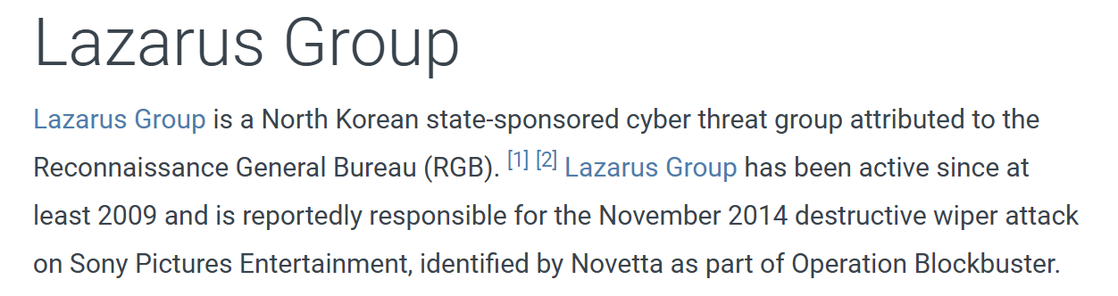
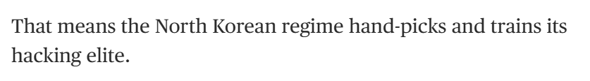
Lazarus Group
Threat Intelligence Report
Findings of Interest
Section 1: Threat Actor Overview
Lazarus Group is a North Korea linked advanced persistent threat (APT) actor assessed to operate as part of the Democratic People’s Republic of Korea (DPRK) state cyber operations ecosystem. The group conducts both espionage and financially motivated cyber operations, often through distinct but overlapping sub-clusters, including APT38. (Figure 1)
Active since at least the mid-2000s, Lazarus is widely recognized as one of the most established APT groups globally. Its activity has been consistently attributed by multiple government and private-sector intelligence organizations, reflecting a sustained, state-directed capability. Reporting also indicates DPRK prioritizes technical talent from STEM fields to support its cyber operations infrastructure. (Figure 2)
Lazarus Group – Names by Organization
U.S. Government: HIDDEN COBRA
MITRE ATT&CK: Lazarus Group (G0032)
Microsoft Threat Intelligence: ZINC, Diamond Sleet
CrowdStrike: Labyrinth Chollima, Stardust Chollima
Mandiant (Google): APT38 (financial subgroup) (Figure 3)
Secureworks: NICKEL ACADEMY
Broadcom: Lazarus Group
Historical Names: Guardians of Peace, BeagleBoyz, Bluenoroff, Andariel.
Figure 1
Figure 2
25APRIL2026
| Portfolio: github.com/dalhunter |
This document is intended for educational and portfolio purposes only. All information presented is derived from publicly available open-source intelligence (OSINT) sources, including surface web, technical intelligence feeds, and publicly accessible dark web resources used for security research and threat monitoring. No unauthorized access to private systems or non-public data was used in the creation of this report.

Slide 4
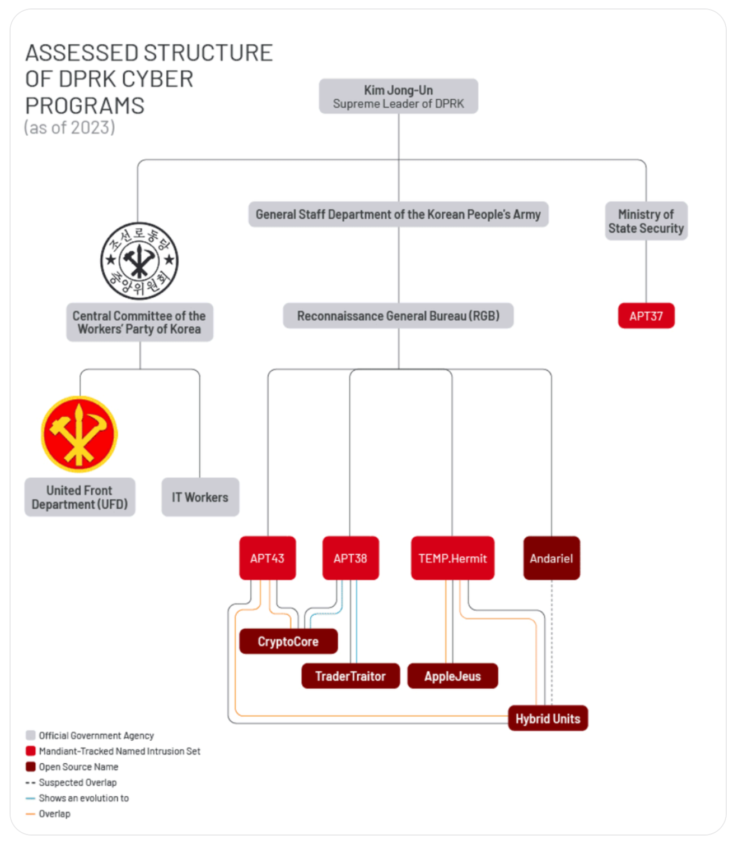
Lazarus Group
Threat Intelligence Report
Figure 3
25APRIL2026
| Portfolio: github.com/dalhunter |
This document is intended for educational and portfolio purposes only. All information presented is derived from publicly available open-source intelligence (OSINT) sources, including surface web, technical intelligence feeds, and publicly accessible dark web resources used for security research and threat monitoring. No unauthorized access to private systems or non-public data was used in the creation of this report.

Slide 5
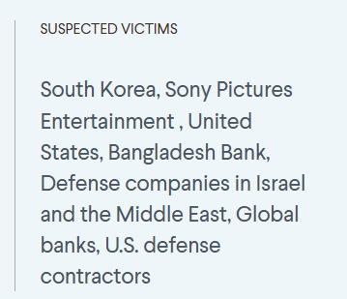
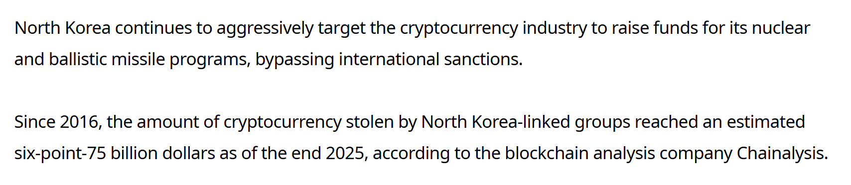
Lazarus Group
Threat Intelligence Report
Section 2: Targeting & Victimology
Lazarus Group selects targets based on financial value and strategic intelligence gain, focusing on organizations who yield either monetary profit or sensitive information. (Figures 4 - 5)
Primary Targets:
Cryptocurrency exchanges & wallets
Global banking infrastructure (SWIFT-related systems)
Defense contractors & aerospace organizations
Government agencies
Media / entertainment sector
Victimology Pattern:
High-value financial systems
Organizations with sensitive intelligence value
Crypto platforms with weak operational security
Figure 4
Figure 5
25APRIL2026
| Portfolio: github.com/dalhunter |
This document is intended for educational and portfolio purposes only. All information presented is derived from publicly available open-source intelligence (OSINT) sources, including surface web, technical intelligence feeds, and publicly accessible dark web resources used for security research and threat monitoring. No unauthorized access to private systems or non-public data was used in the creation of this report.

Slide 6
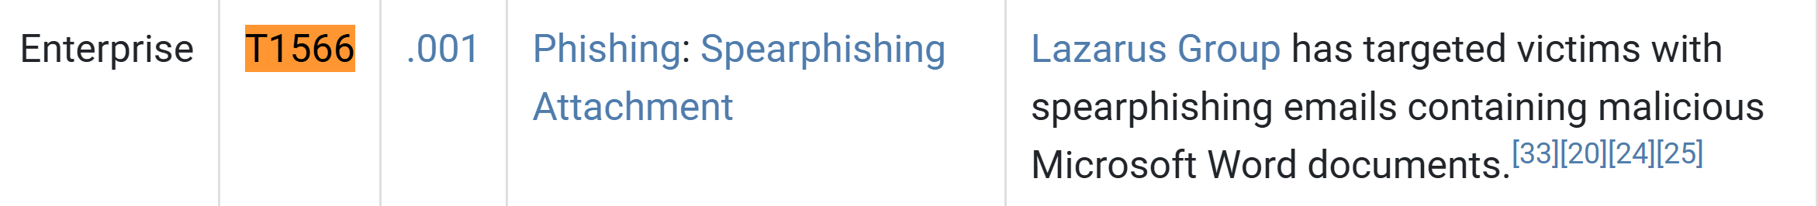
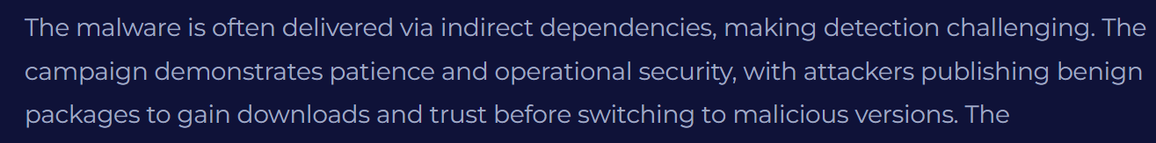
Lazarus Group
Threat Intelligence Report
Section 3: Tactics, Techniques, and Procedures (TTPs)
Lazarus Group uses various phishing, malware, and stealth techniques to break into systems, stay hidden, and steal data.
Initial Access (getting in): Spearphishing (T1566), Malicious Attachments (Figure 6)
They trick users into opening fake emails or files to gain access.
Execution (running commands): PowerShell (T1059.001), Command Shell (T1059.003)
They run malicious commands using Windows tools.
Persistence (staying inside): Registry Run Keys (T1547), Scheduled Tasks (T1053)
They make malware start automatically on reboot.
Credential Access (stealing logins): Credential Dumping (T1003)
They steal usernames and passwords from infected systems.
Defense Evasion (hiding activity): Obfuscated Files (T1027), Timestomping (T1070.006)
They hide malware and make files look normal.
Lateral Movement (moving across systems): SMB (T1021.002), RDP (T1021.001)
They spread to other computers in the network.
Command & Control (remote control): HTTPS (T1071), Encrypted channels
They control infected systems over hidden connections.
Exfiltration (stealing data): Over C2 channel (T1041), Cloud services
They send stolen data back to themselves.
Analyst Comments: Lazarus Group uses legitimate Windows tools such as Remote Desktop Protocol (RDP) and Server Message Block (SMB) to move within compromised networks while blending in with normal admin activity. This approach is typically used after initial access has been gained to reduce detection and maintain persistence. In contrast, initial compromise is often achieved through malicious software or social engineering techniques designed to gain entry and deploy malware. (Figure 7)
Figure 6
Figure 7
25APRIL2026
| Portfolio: github.com/dalhunter |
This document is intended for educational and portfolio purposes only. All information presented is derived from publicly available open-source intelligence (OSINT) sources, including surface web, technical intelligence feeds, and publicly accessible dark web resources used for security research and threat monitoring. No unauthorized access to private systems or non-public data was used in the creation of this report.

Slide 7
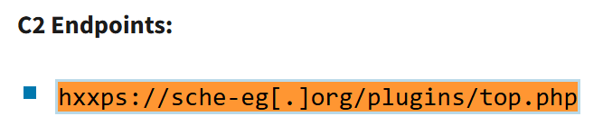
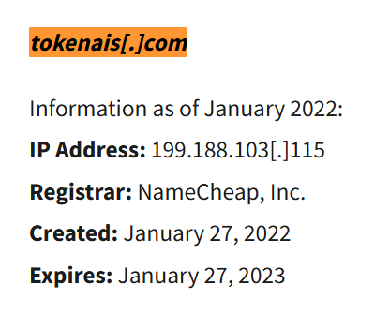
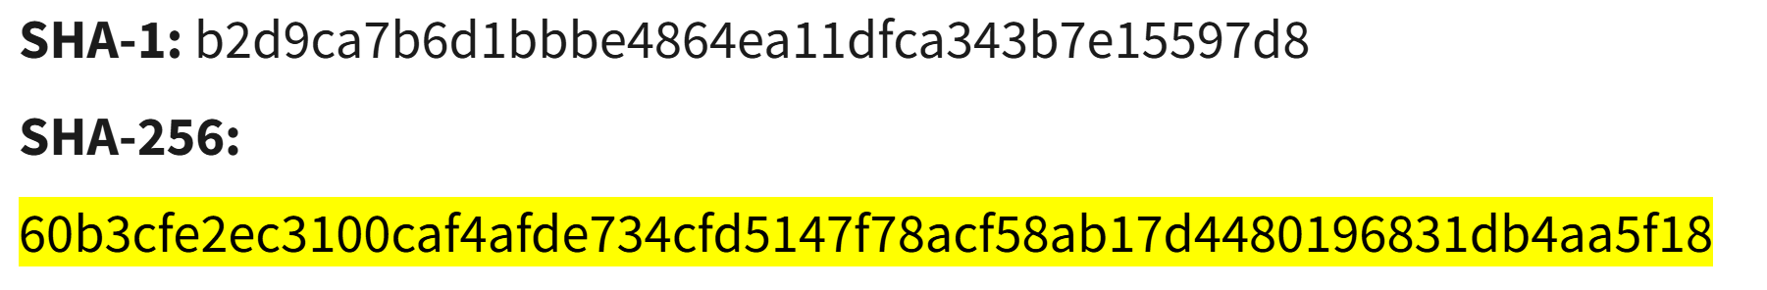
Lazarus Group
Threat Intelligence Report
Section 4: Indicators of Compromise (IOCs)
The “TraderTraitor” campaign is associated with North Korean state-sponsored cyber activity linked to the Lazarus Group ecosystem. The following indicators were identified from trojanized cryptocurrency applications and supporting infrastructure.
Malicious Domains
tokenais[.]com (Figure 8)
cryptais[.]com
Used to host fake cryptocurrency/AI trading applications and deliver malware through deceptive downloads and installers.
Command-and-Control (C2) Infrastructure
hxxps://www.esilet[.]com/update/
hxxps://sche-eg[.]org/plugins/top.php (Figure 9)
hxxps://dafnefonseca[.]com/wp-content/themes/top.php
Used for remote communication and payload delivery to infected hosts, enabling attacker control and staged malware execution.
File Hashes (Malware Samples)
60b3cfe2ec3100caf4afde734cfd5147f78acf58ab17d4480196831db4aa5f18 (Figure 10)
f0e8c29e3349d030a97f4a8673387c2e21858cccd1fb9ebbf9009b27743b2e5b
5b40b73934c1583144f41d8463e227529fa7157e26e6012babd062e3fd7e0b03
Associated with trojanized cryptocurrency/AI trading applications delivering remote access capability.
Malware
Manuscrypt (RAT)
Remote system control, data theft, and secondary payload deployment across compromised machines.
Analyst Comments: This reporting reflects indicators associated with a single identified campaign within the broader Lazarus Group ecosystem. This is not an exhaustive list of the actor’s broader infrastructure or activity scope.
Figure 9
Figure 8
Figure 10
25APRIL2026
| Portfolio: github.com/dalhunter |
This document is intended for educational and portfolio purposes only. All information presented is derived from publicly available open-source intelligence (OSINT) sources, including surface web, technical intelligence feeds, and publicly accessible dark web resources used for security research and threat monitoring. No unauthorized access to private systems or non-public data was used in the creation of this report.

Slide 8
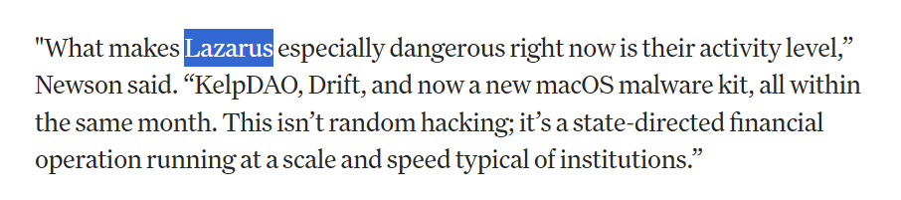
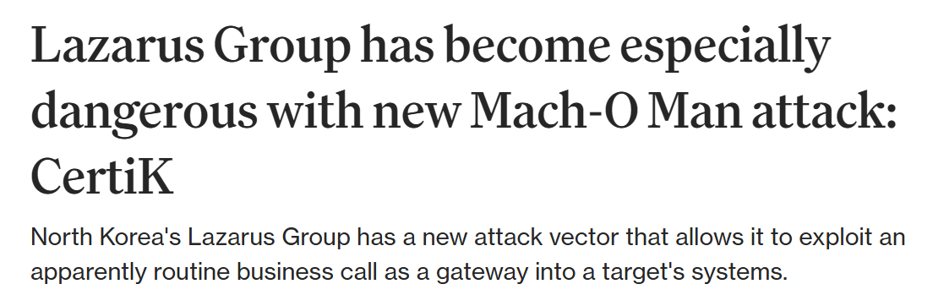
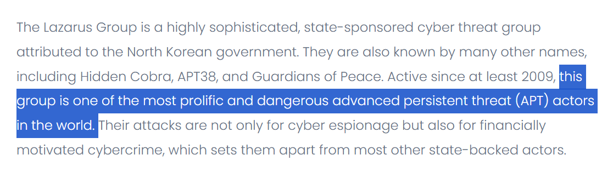
Lazarus Group
Threat Intelligence Report
Section 5: Analytic Assessment
Lazarus Group is assessed as a highly capable, state-linked threat actor operating on behalf of North Korea, conducting a broad range of cyber operations that include both financially motivated activity and strategic espionage. (Figures 11 - 13)
Threat Level: High - Based on demonstrated operational sophistication, sustained campaign activity, and the actor’s ability to rapidly adapt tooling and infrastructure. Lazarus Group continues to present a significant risk due to its combination of financial theft objectives and intelligence-gathering operations aligned with state priorities.
Figure 11
Figure 12
Figure 13
25APRIL2026
| Portfolio: github.com/dalhunter |
This document is intended for educational and portfolio purposes only. All information presented is derived from publicly available open-source intelligence (OSINT) sources, including surface web, technical intelligence feeds, and publicly accessible dark web resources used for security research and threat monitoring. No unauthorized access to private systems or non-public data was used in the creation of this report.

Slide 9
Lazarus Group
Threat Intelligence Report
Limitations of Open Source (OS) Information
This report is based solely on publicly available open-source intelligence (OSINT). The information presented is subject to limitations inherent in open-source collection, including potential gaps in availability, completeness, and timeliness of data at the time of analysis. While efforts are made to ensure accuracy and relevance, some relevant information may not be publicly accessible or may not be captured during the collection process. As such, findings should be interpreted as analytical assessments based on available data rather than exhaustive or definitive intelligence.
Information Fair Use and Restrictions
This report is based solely on open-source intelligence (OSINT), including publicly accessible surface web, technical intelligence feeds, and openly available dark web sources used for security research and threat monitoring. All information is provided strictly for educational and portfolio demonstration purposes in the field of cyber threat intelligence and analytical research. Data collection is limited to publicly available sources only. No restricted, private, or unauthorized access methods were used. Users are expected to comply with all applicable laws and regulations governing the use of publicly available information.
25APRIL2026
| Portfolio: github.com/dalhunter |
This document is intended for educational and portfolio purposes only. All information presented is derived from publicly available open-source intelligence (OSINT) sources, including surface web, technical intelligence feeds, and publicly accessible dark web resources used for security research and threat monitoring. No unauthorized access to private systems or non-public data was used in the creation of this report.

