Slide 1
Threat Intelligence Report
Scattered Spider
Date: 06MAY2026 Report Type: Portfolio Focus: Threat Actor Analysis Prepared By: Dalton Hunter Discipline: Threat Intelligence Version: 1.0

Slide 2
Scattered Spider
Threat Intelligence Report
Executive Summary
This report provides an analytical overview of the threat actor known as the Scattered Spider, based on Open-Source Intelligence (OSINT), dark web intelligence sources, and publicly available reporting. The assessment examines observed behavior, including actor background, targeting patterns and victimology, tactics, techniques and procedures (TTPs), indicators of compromise (IOCs), and an overall evaluation of capability and intent. The objective of this report is to consolidate available intelligence into a structured threat profile that supports understanding of associated risk, operational behavior, and observed activity attributed to the actor.
Methodology
This report was developed using Open-Source Intelligence (OSINT) and dark web–derived information obtained from publicly accessible and reputable sources, including security research publications, news reporting, technical analyses, and indexed web content. Structured queries were used to identify relevant information relating to Scattered Spider infrastructure, behavioral patterns, and associated identifiers.
All information was evaluated for credibility, relevance, and corroboration across multiple sources prior to inclusion. No unauthorized access, private datasets, or proprietary systems were used. The research was conducted using lawful and ethical methods for analytical and educational purposes.
Report Sections
Section 1: Threat Actor Overview
Section 2: Targeting & Victimology
Section 3: Tactics, Techniques, and Procedures (TTPs)
Section 4: Indicators of Compromise (IOCs)
Section 5: Analytic Assessment
06MAY2026
| Portfolio: github.com/dalhunter |
This document is intended for educational and portfolio purposes only. All information presented is derived from publicly available open-source intelligence (OSINT) sources, including surface web, technical intelligence feeds, and publicly accessible dark web resources used for security research and threat monitoring. No unauthorized access to private systems or non-public data was used in the creation of this report.

Slide 3
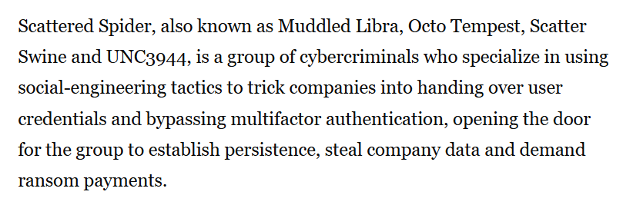
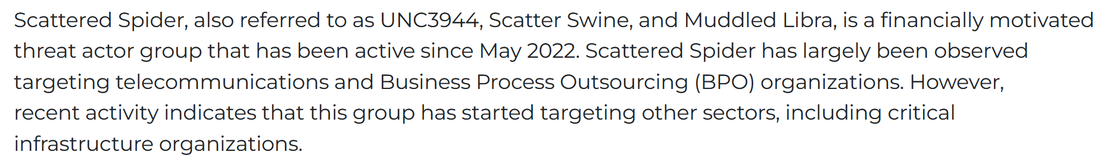
Scattered Spider
Threat Intelligence Report
Findings of Interest
Section 1: Threat Actor Overview
Scattered Spider is a financially motivated cybercriminal collective operating within a broader Western-based cybercrime ecosystem, rather than a nation-state advanced persistent threat (APT). The group is loosely organized and associated with underground communities such as “The Comm,” and ALPHV/BlackCat ransomware gang, conducting intrusion, data theft, and extortion operations primarily through social engineering and identity compromise. (Figure 1)
Active since at least 2022, Scattered Spider has emerged as a high-priority threat due to its ability to exploit enterprise identity systems at scale. The group demonstrates a decentralized structure with fluid membership and overlaps with other cybercriminal actors, relying heavily on tactics such as help desk impersonation, SIM swapping, and multi-factor authentication (MFA) bypass. (Figure 2)
Scattered Spider has been linked to high-profile intrusions against major organizations, including MGM Resorts and Caesars Entertainment, further demonstrating its capability to achieve significant operational and financial impact through non-technical attack vectors.
Scattered Spider – Names by Organization
MITRE ATT&CK: Scattered Spider (G1015) / UNC3944
Microsoft Threat Intelligence: Octo Tempest
CrowdStrike: Muddled Libra
Google / Mandiant: UNC3944
Additional reporting aliases: 0ktapus (campaign association), Scatter Swine
Figure 1
Figure 2
06MAY2026
| Portfolio: github.com/dalhunter |
This document is intended for educational and portfolio purposes only. All information presented is derived from publicly available open-source intelligence (OSINT) sources, including surface web, technical intelligence feeds, and publicly accessible dark web resources used for security research and threat monitoring. No unauthorized access to private systems or non-public data was used in the creation of this report.

Slide 4
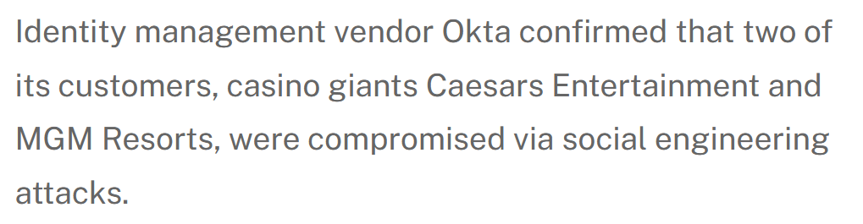
Scattered Spider
Threat Intelligence Report
Section 2: Targeting & Victimology
Scattered Spider selects targets based on accessibility of identity systems and potential for financial extortion, rather than geopolitical or intelligence value. The group prioritizes organizations where social engineering can be leveraged to gain initial access and escalate privileges.
Primary Targets:
Large enterprises with complex identity environments (Figure 3)
Hospitality and gaming (e.g., MGM Resorts, Caesars Entertainment) (Figures 4 - 5)
Retail and e-commerce
Telecommunications providers
Technology / SaaS platforms
Victimology Pattern:
Organizations with:
Help desk–driven password reset processes
Reliance on SMS or push-based MFA
Outsourced IT or support services
Large employee bases (increased social engineering surface)
High operational dependency on uptime (greater ransom leverage)
Analyst Comments: Scattered Spider’s targeting reflects an identity-first attack model, where victims are chosen based on access pathways and human vulnerabilities, not just industry or data type.
Figure 3
Figure 4
Figure 5
06MAY2026
| Portfolio: github.com/dalhunter |
This document is intended for educational and portfolio purposes only. All information presented is derived from publicly available open-source intelligence (OSINT) sources, including surface web, technical intelligence feeds, and publicly accessible dark web resources used for security research and threat monitoring. No unauthorized access to private systems or non-public data was used in the creation of this report.

Slide 5
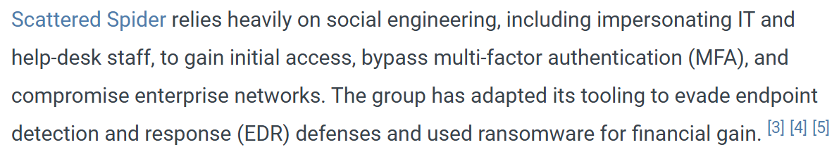
Scattered Spider
Threat Intelligence Report
Section 3: Tactics, Techniques, and Procedures (TTPs)
Scattered Spider uses various techniques to break into systems, stay hidden, and steal data. (Figure 6)
Initial Access (how they get in)
Phishing / social engineering (T1566) – tricking users into giving credentials
Help desk impersonation (T1566) – calling IT to reset passwords or MFA
MFA fatigue attacks (T1621) – sending repeated push requests until approved
SIM swapping – taking over phone numbers to bypass MFA
Used to gain access to accounts without exploiting software.
Execution (running commands)
PowerShell (T1059.001)
Command Shell (T1059.003)
Used for system access and account control.
Persistence (staying inside)
Valid Accounts (T1078) – maintaining access using compromised logins
MFA re-enrollment (T1556) – adding attacker-controlled authentication
Relies on account control instead of malware.
Credential Access (stealing logins)
Credential harvesting (T1566) – phishing login pages
MFA interception (T1556) – bypassing authentication methods
Password resets via IT workflows (T1078 / T1566)
Focused on taking over identities.
Defense Evasion (avoiding detection)
Valid Accounts (T1078) – appearing as legitimate users
Use of VPNs / proxies (T1090) – hiding real location
Minimal malware usage / Blends in with normal activity.
Lateral Movement (moving through systems)
Remote Desktop Protocol (RDP) (T1021.001)
Trusted account access across systems (T1078)
Uses legitimate access to expand within networks.
Exfiltration (stealing data)
Exfiltration over web/cloud services (T1041)
Data is removed using normal channels.
Figure 6
06MAY2026
| Portfolio: github.com/dalhunter |
This document is intended for educational and portfolio purposes only. All information presented is derived from publicly available open-source intelligence (OSINT) sources, including surface web, technical intelligence feeds, and publicly accessible dark web resources used for security research and threat monitoring. No unauthorized access to private systems or non-public data was used in the creation of this report.

Slide 6
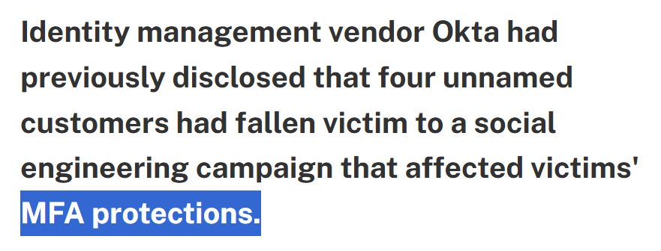
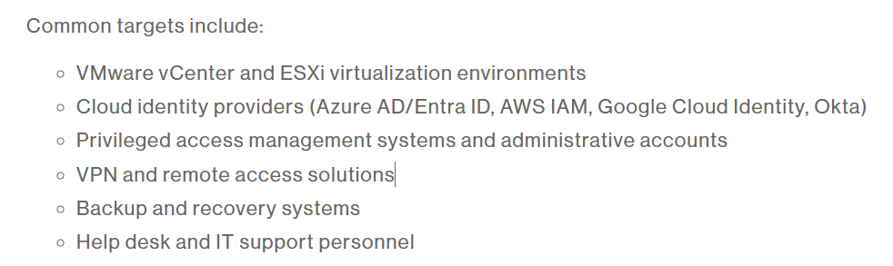
Scattered Spider
Threat Intelligence Report
Section 4: Indicators of Compromise (IOCs)
Scattered Spider activity is mainly identified through behavioral and identity-based indicators, rather than traditional malware signatures.
Identity / Authentication Indicators:
Unusual password reset requests via help desk
Multiple MFA push notifications (MFA fatigue) (Figure 7)
New MFA device added shortly after login changes
Privilege escalation in identity systems (Okta, Azure AD) (Figure 8)
Login Behavior Indicators:
Logins from new or unusual locations
Use of residential IP addresses or VPNs
Multiple failed logins followed by success
Network Indicators:
Remote access via RDP from unfamiliar devices (T1021.001)
Access through proxies or anonymization tools (T1090)
Tool / System Indicators:
Unusual use of:
PowerShell (T1059.001)
Remote admin tools and cloud portals
Figure 7
Figure 8
06MAY2026
| Portfolio: github.com/dalhunter |
This document is intended for educational and portfolio purposes only. All information presented is derived from publicly available open-source intelligence (OSINT) sources, including surface web, technical intelligence feeds, and publicly accessible dark web resources used for security research and threat monitoring. No unauthorized access to private systems or non-public data was used in the creation of this report.

Slide 7
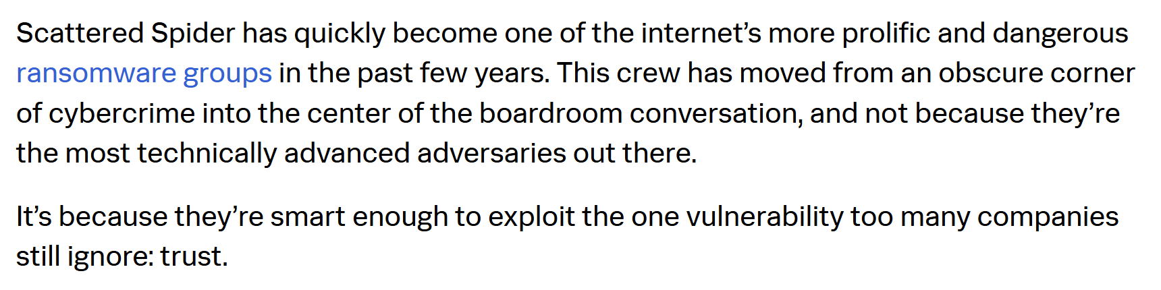
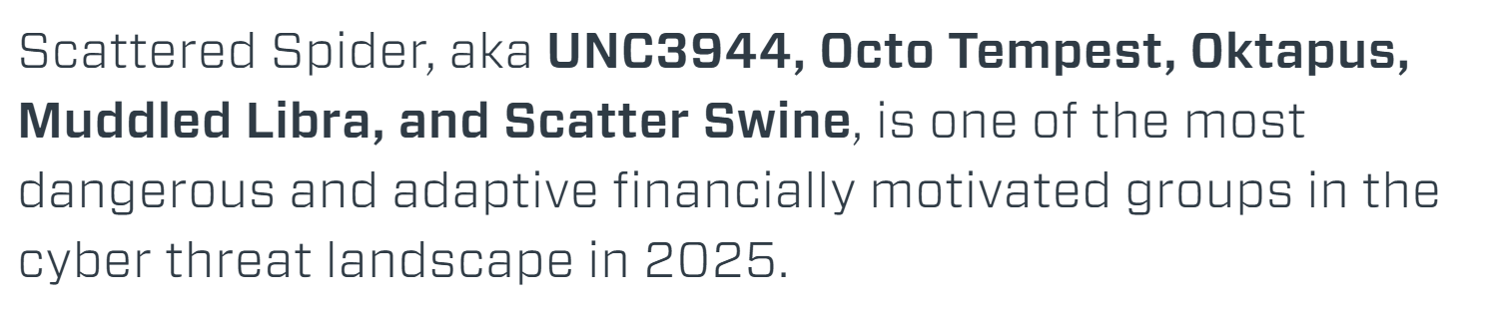
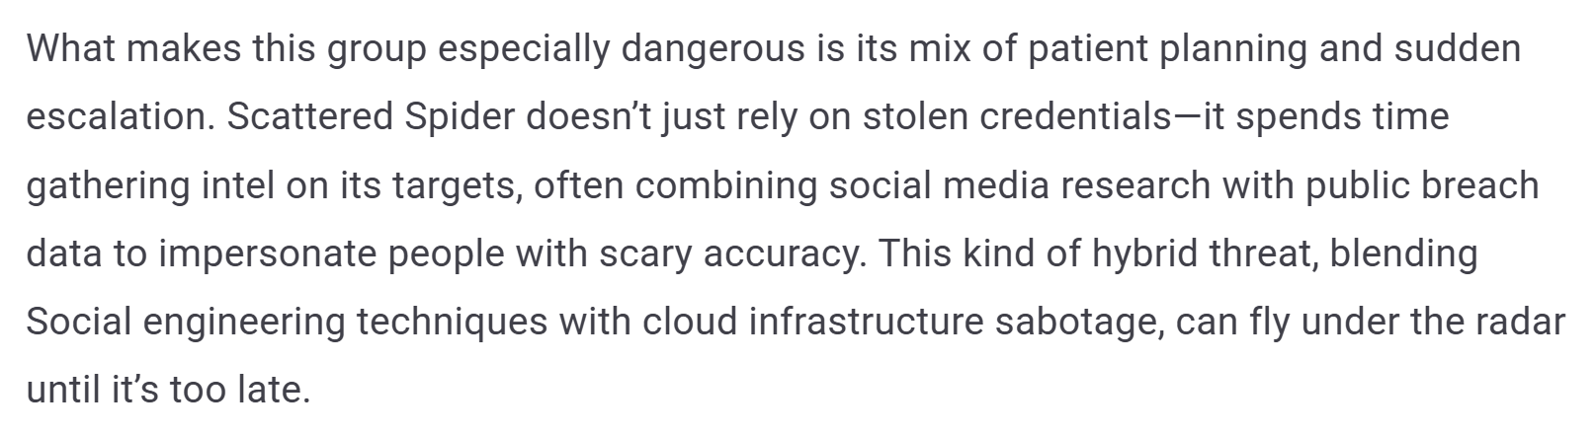
Scattered Spider
Threat Intelligence Report
Section 5: Analytic Assessment
Scattered Spider is assessed as a highly capable financially motivated cybercriminal collective operating within a broader Western-based cybercrime ecosystem. The group has no confirmed evidence of state-directed espionage activity (Figures 9 - 11)
The actor focuses primarily on financial theft and data extortion, using advanced social engineering and identity compromise techniques to gain access to enterprise environments. Its operations demonstrate strong adaptability, particularly in bypassing multi-factor authentication and exploiting help desk processes.
Threat Level: High - Based on its ability to consistently compromise large enterprises, bypass identity controls, and conduct high-impact extortion campaigns. The group remains a significant risk due to its evolving tactics, decentralized structure, and effectiveness in targeting identity systems rather than technical vulnerabilities.
Figure 9
Figure 10
Figure 11
06MAY2026
| Portfolio: github.com/dalhunter |
This document is intended for educational and portfolio purposes only. All information presented is derived from publicly available open-source intelligence (OSINT) sources, including surface web, technical intelligence feeds, and publicly accessible dark web resources used for security research and threat monitoring. No unauthorized access to private systems or non-public data was used in the creation of this report.

Slide 8
Scattered Spider
Threat Intelligence Report
Limitations of Open Source (OS) Information
This report is based solely on publicly available open-source intelligence (OSINT). The information presented is subject to limitations inherent in open-source collection, including potential gaps in availability, completeness, and timeliness of data at the time of analysis. While efforts are made to ensure accuracy and relevance, some relevant information may not be publicly accessible or may not be captured during the collection process. As such, findings should be interpreted as analytical assessments based on available data rather than exhaustive or definitive intelligence.
Information Fair Use and Restrictions
This report is based solely on open-source intelligence (OSINT), including publicly accessible surface web, technical intelligence feeds, and openly available dark web sources used for security research and threat monitoring. All information is provided strictly for educational and portfolio demonstration purposes in the field of cyber threat intelligence and analytical research. Data collection is limited to publicly available sources only. No restricted, private, or unauthorized access methods were used. Users are expected to comply with all applicable laws and regulations governing the use of publicly available information.
06MAY2026
| Portfolio: github.com/dalhunter |
This document is intended for educational and portfolio purposes only. All information presented is derived from publicly available open-source intelligence (OSINT) sources, including surface web, technical intelligence feeds, and publicly accessible dark web resources used for security research and threat monitoring. No unauthorized access to private systems or non-public data was used in the creation of this report.

