Slide 1
Remote Detection System
Dalton Neely

Slide 2
Objectives
Detect motion at users door
Send request to server using RESTful
Server sends a text message to user

Slide 3
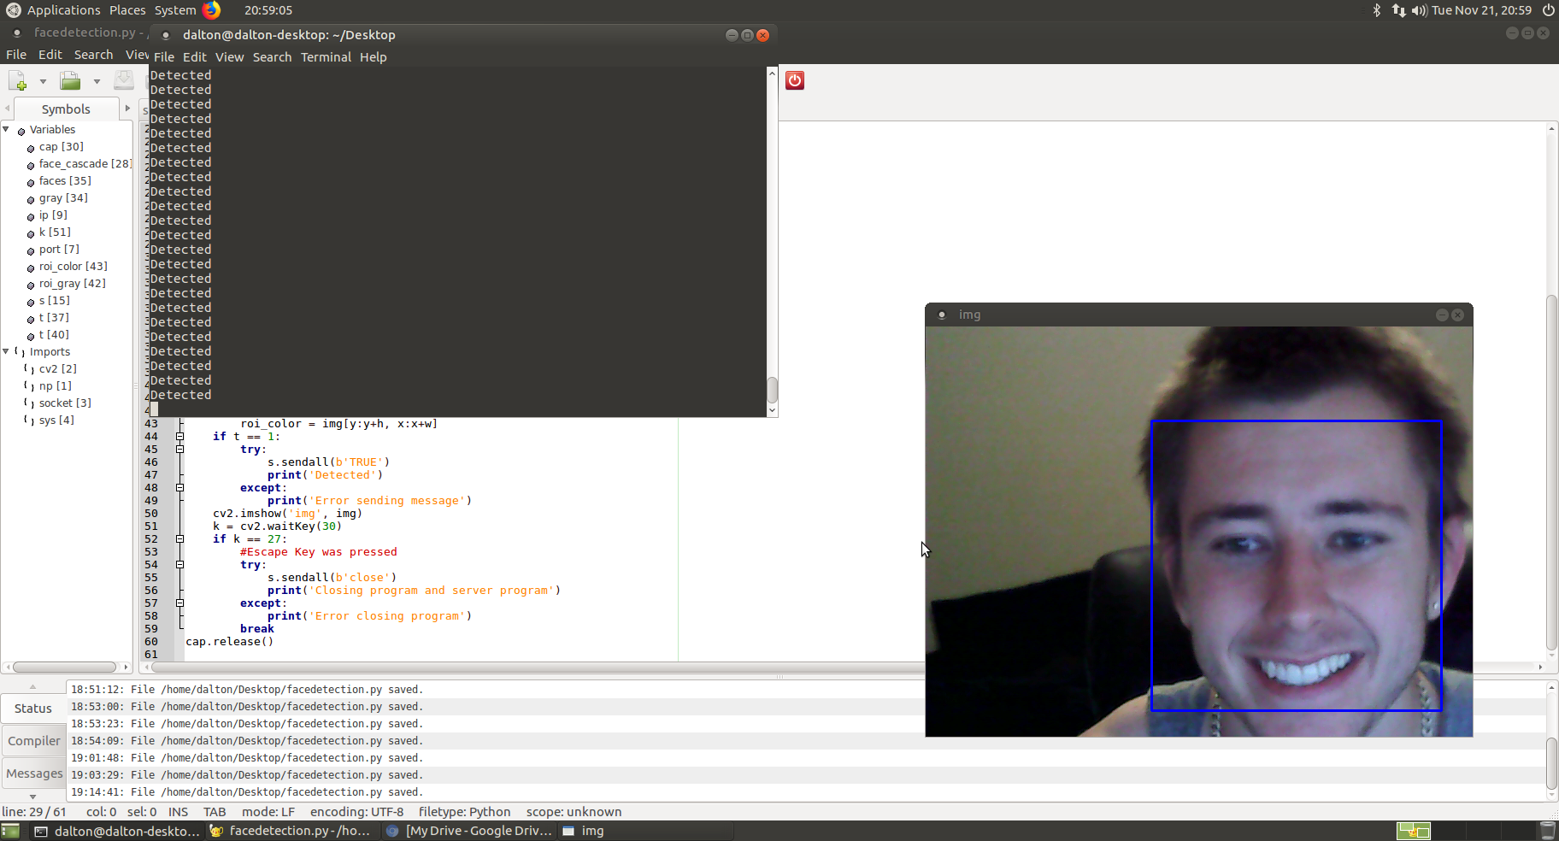
Detect Motion at Users Door
Note: Was not at my door, but would be easy to move the system. This was for face recognition demonstration purposes

Slide 4
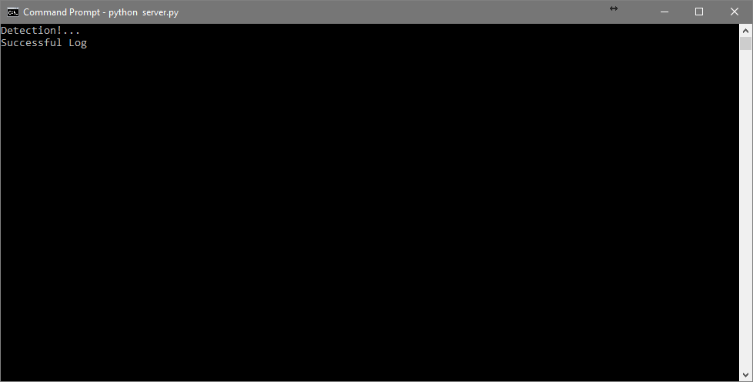
Send a Request to Server Using RESTful

Slide 5
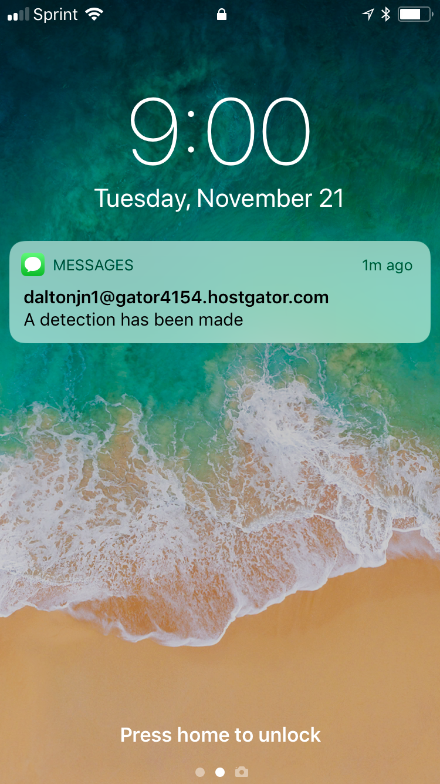
Server Sends a Text Message to User

Slide 6
Problems Encountered
Compiling OpenCV for ARM architecture
Learning to use Python
Finding out the difficulties using Windows 10 IoT Core
Training Haar Cascades

Slide 7
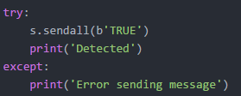
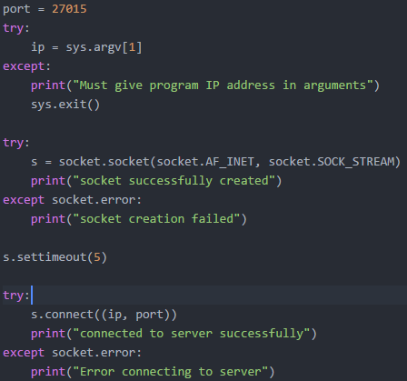
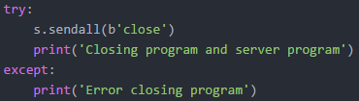
Python Client Socket Programming
Import the socket module
Create socket with the Address Family, and the Transmission Type (STREAM vs DATAGRAM)
Send making sure
Packet is transmitted
Connect that socket object
Using the IP Address and
the Port

Slide 8


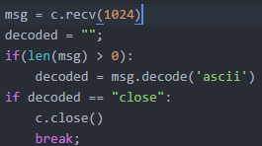
Python Server Programming
Import the Socket module
Create the socket object and specify the port number
Bind that port to that socket (the empty quotes means accept connection on local network)
Set that socket to listen on that port (5 is the maximum number of queued connections)
Accept the next incoming connection on that port (c is the connection object, and addr is the
client’s address information
Receive the message (1024 bytes)
Decode the message into ascii readable output
Close the connection

