Slide 1
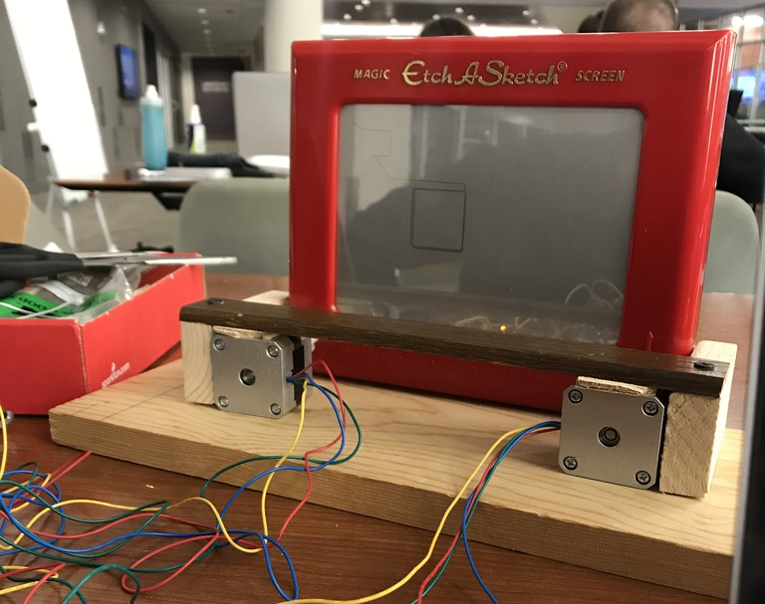


Etch-A-Gram
By: Meagan Brucker and Dalton Hahn
Project Overview
Use an Etch-A-Sketch and stepper motors to automatically draw uploaded pictures through the use of an Arduino.
Design Process
Construct the Etch-A-Sketch frame, wire the breadboard, and check connections.
Use OpenCV to perform image processing.
Determine the algorithm that creates the drawing path of the processed image in Python.
Program the Arduino to control the stepper motors.
Test and finalize the project.
Function/Uses
Allows users to upload any images to be drawn by the Etch-A-Sketch.
Arduino provides a simple interface for working with the stepper motors.
Automatically draw complex images without manually turning Etch-A-Sketch.
Challenges
Profile
Inaccuracy of the knobs on the Etch-A-Sketch.
Finding the best algorithm to determine the drawing path.
Limited memory space on the Arduino.
Meagan Brucker is a junior in Computer Engineering. She has been a member of E-Club since Fall 2017. Dalton Hahn is a graduate student in Computer Science at the University of Kansas.

