Slide 1
CHESS_RealTimeDIC
Visual Users Guide

Slide 2
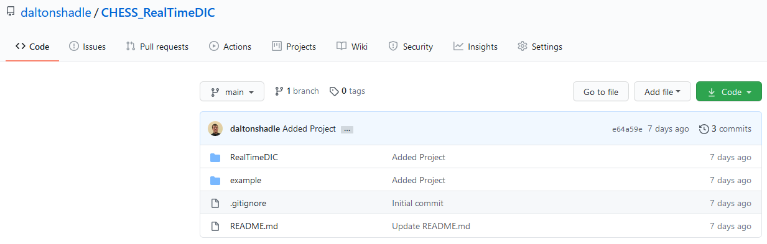
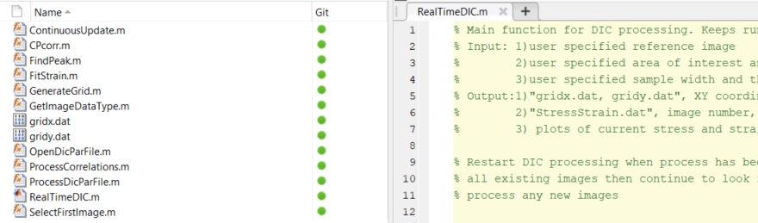
Setup
Download or clone git repository from GitHub: https://github.com/daltonshadle/CHESS_RealTimeDIC
Open project in MATLAB environment. The project is sectioned into individual cells to run, similar to traditional MATLAB scripting. Run each section sequentially.

Slide 3
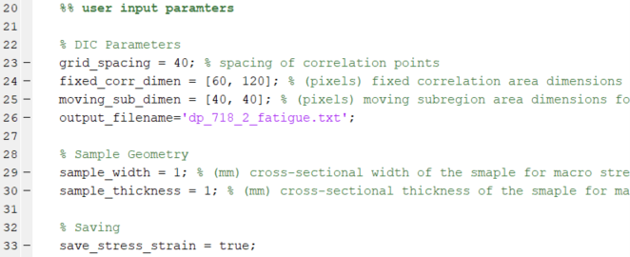
Initial Parameters
user input parameters: section allows users to define DIC parameters for processing
Pixel spacing between control points. Small spacing = better resolution, slower processing. Larger spacing = lower resolution, faster processing. Usual range = [20-100].
Fixed correlation area dimensions in pixels. This variable describes the subregion at each control point in which correlation is searched over. Usual range = [40-200, 40-200].
Moving correlation area dimensions in pixels. This variable describes the subregion inside each fixed correlation area in which correlation patterns are matched. Usual range = [20-180, 20-180]. Note: These dimensions must be smaller than fixed_corr_dimen.
Name of stress and strain output file for re-plotting.
Sample width dimension in millimeters. Used for stress calculation.
Sample thickness dimension in millimeters. Used for stress calculation.
Bool variable for indicating whether to save or not. True = save, False = no save.

Slide 4
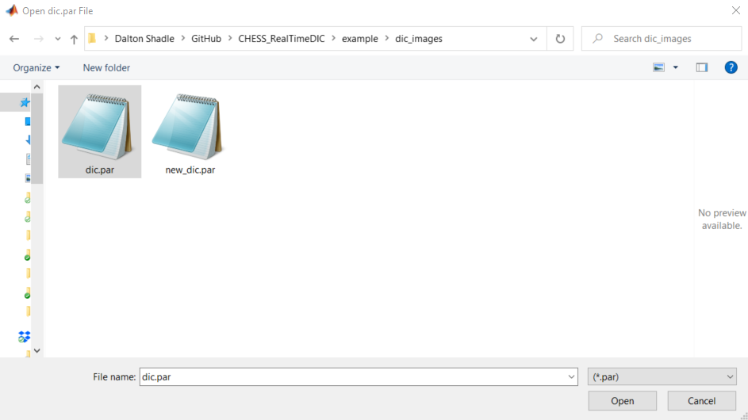
DIC.par Directory
select the dic.par: section allows users to open and process dic.par instrument file.
Function opens and processes dic.par instrument file. Gathers directory and matrix of instrument information.
1
2
3

Slide 5
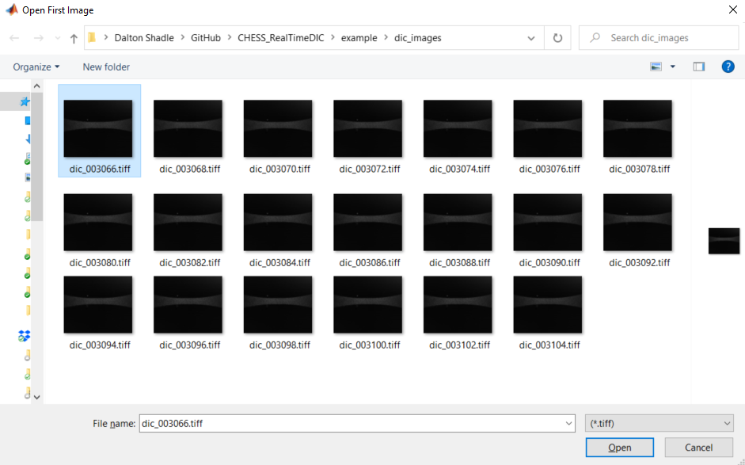
Image Directory
select the reference image: section allows users to define reference image for DIC processing
Function opens and processes first image. Gathers directory and structure for images.
1
2
3

Slide 6
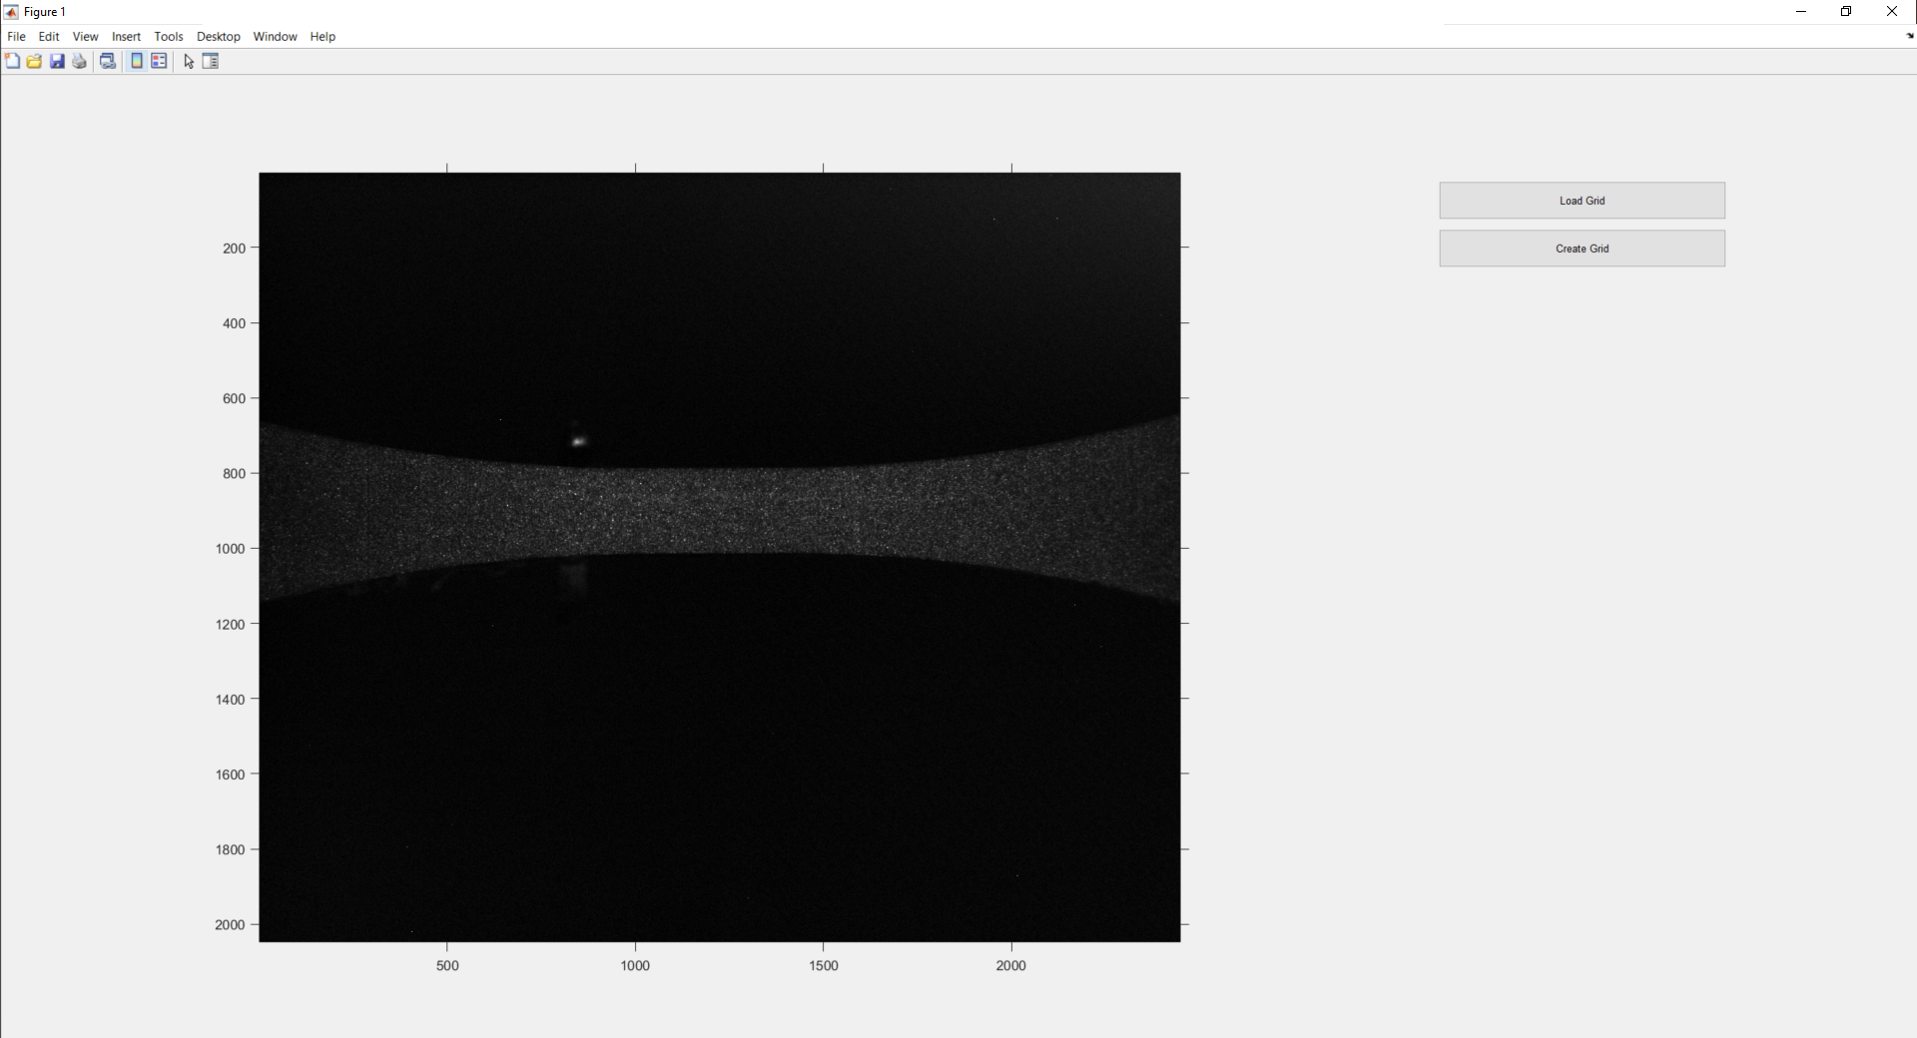
Control Point Grid Pattern (Start)
generate grid: section allows users to define the control point grid pattern for CPcorr
Function opens and processes first image. Gathers directory and structure for images.
Load Grid allows the user to load a grid pattern in from previously saved data.
First image
Create Grid allows the user to draw a grid pattern perimeter to automatically draw based on grid spacing.

Slide 7
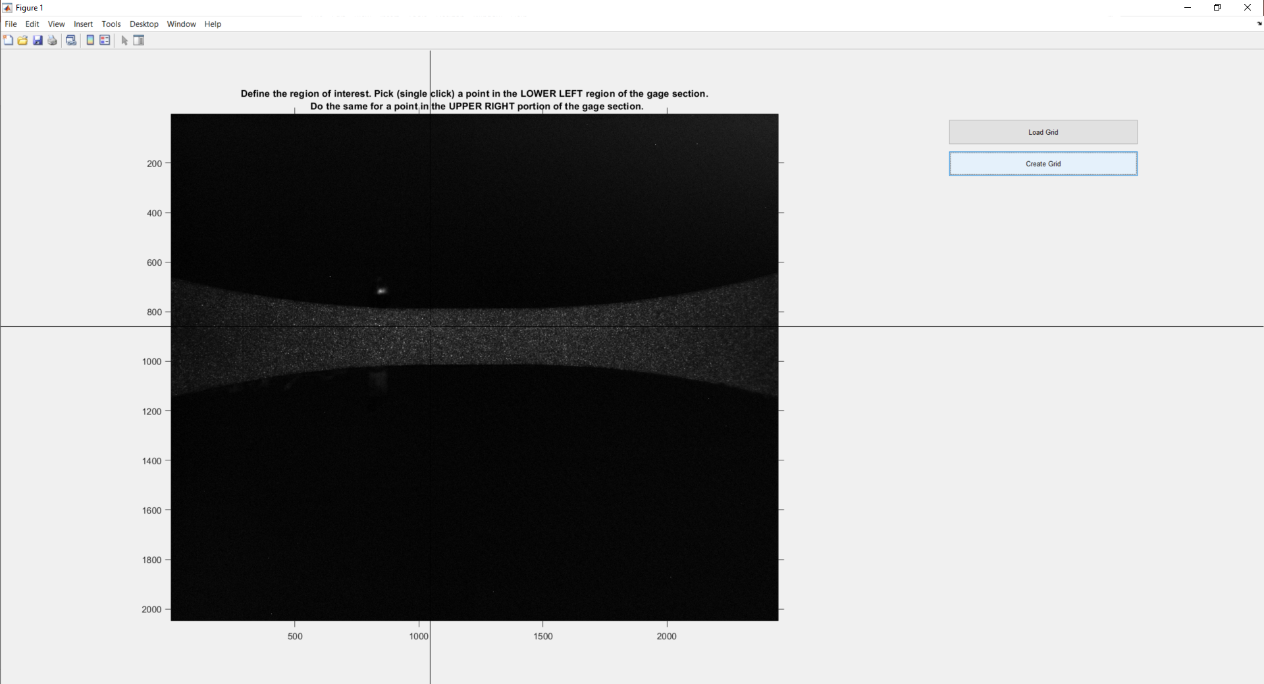
Control Point Grid Pattern (Create Grid)
generate grid: section allows users to define the control point grid pattern for CPcorr
Function opens and processes first image. Gathers directory and structure for images.
Moving the cursor and right-clicking on positions sets the lower-left and upper right bounds of a rectangular region of interest.

Slide 8
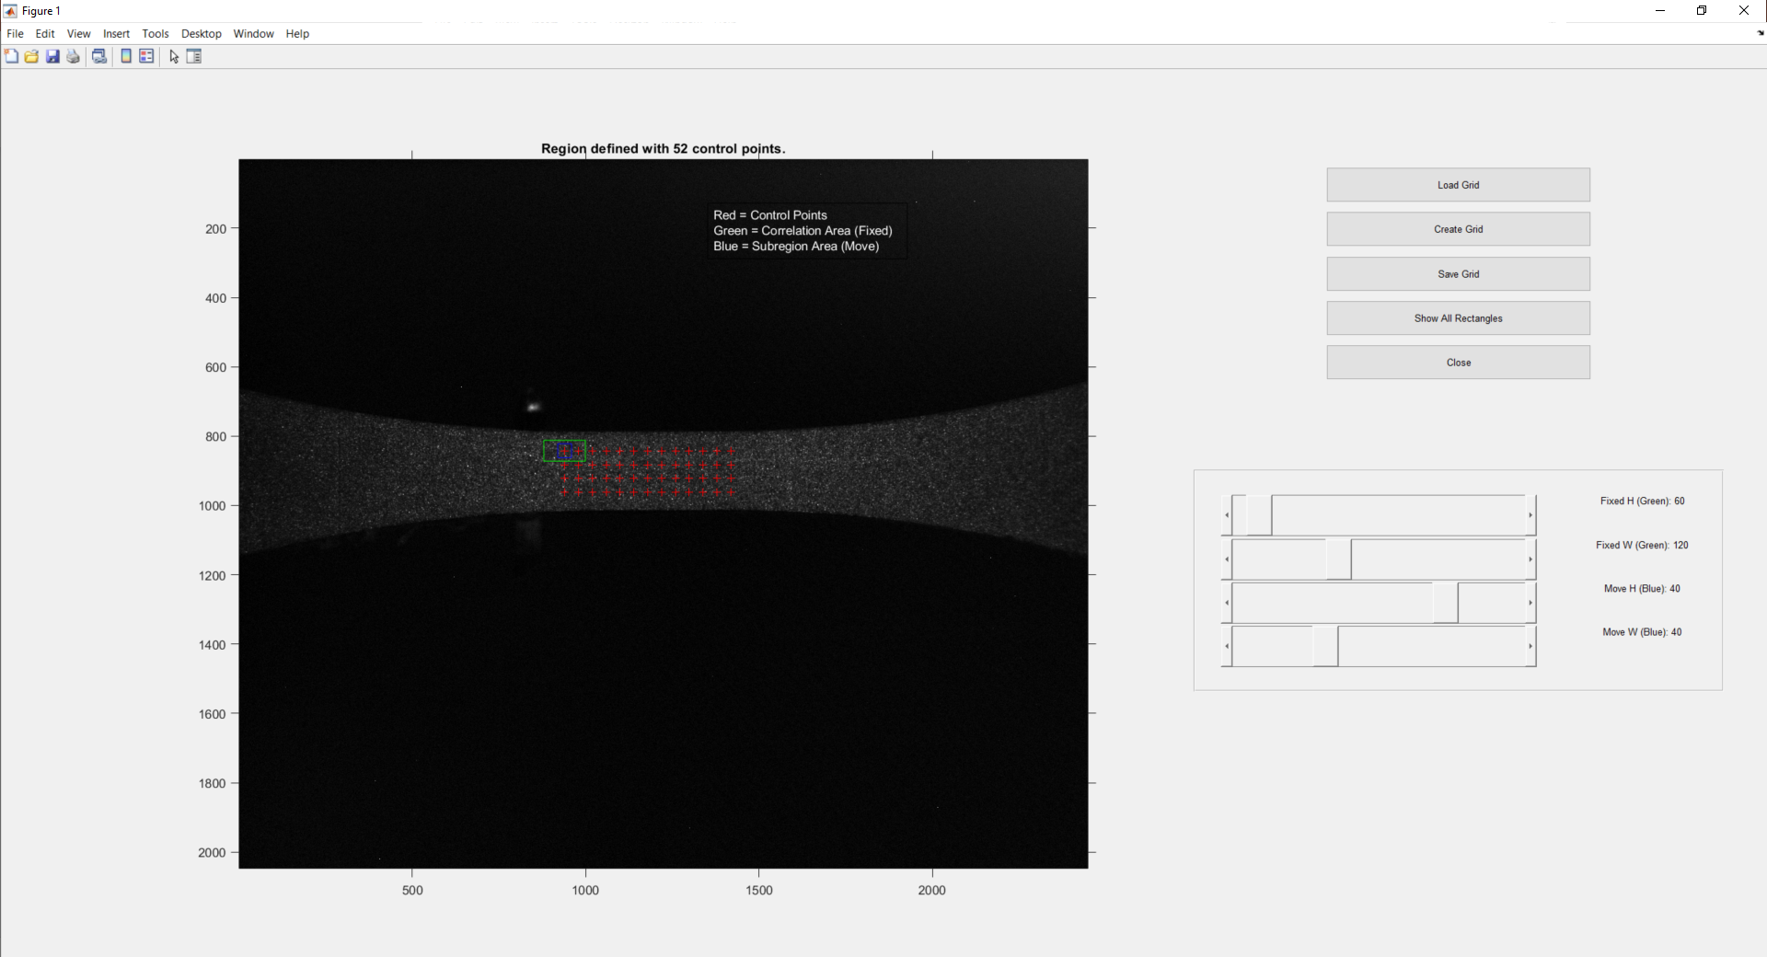
Control Point Grid Pattern (Create Grid)
generate grid: section allows users to define the control point grid pattern for CPcorr
Function opens and processes first image. Gathers directory and structure for images.
Save Grid allows the user to save the current grid pattern to current working directory of the project as gridx.dat and gridy.dat.
Show All Rectangles allows the user to toggle between seeing one control point sub-region group and seeing all control point sub-region groups. This is useful for defining sub-region size and overall area of interest.
Close allows the user to quit from the window and save grid pattern for processing.
Automatically generated grid pattern. Red points represent the central location of the control point sub-regions. Green outlines the fixed correlation sub-region, blue outlines the moving correlation sub-region.
Sub-region dimension sliders allow the user to change and update the dimensions of the control point sub-regions in real time. The final dimensions when the window is closed are used for processing.

Slide 9
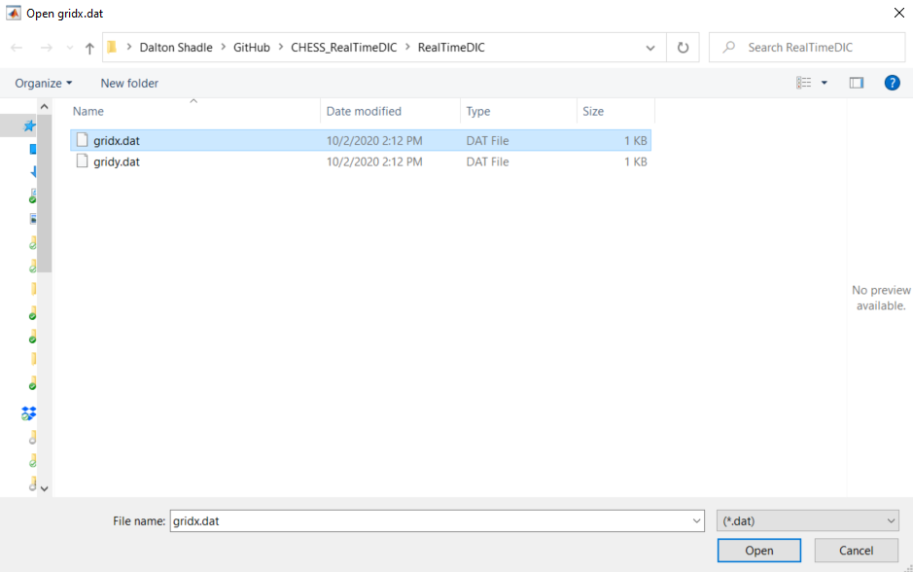
Control Point Grid Pattern (Load Grid)
generate grid: section allows users to define the control point grid pattern for CPcorr
Function opens and processes first image. Gathers directory and structure for images.
1
2
3

Slide 10
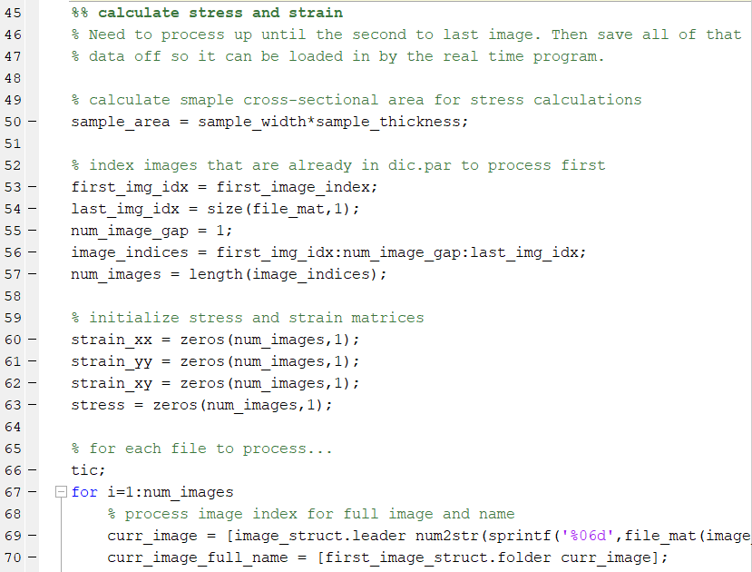
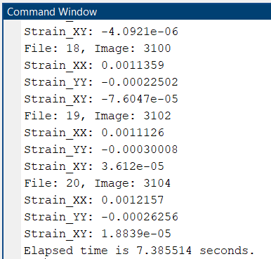
Process Previously Measured Data
calculate stress and strain: section allows users to process previously measured DIC data before entering real-time processing

Slide 11
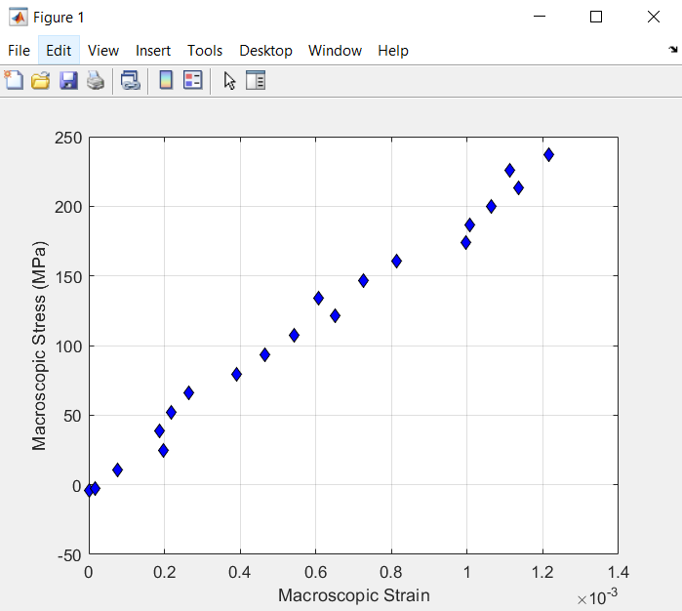
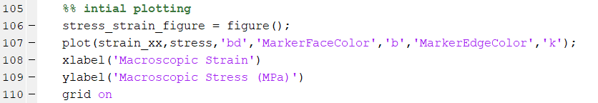
Plot Previously Measured Data
initial plotting: section allows users to plot previously measured DIC data before entering real-time processing
Stress-strain curve of previously measured DIC data plotted on a scatter plot figure. Each blue scatter point represents a stress and a strain value for a given DIC image.

Slide 12
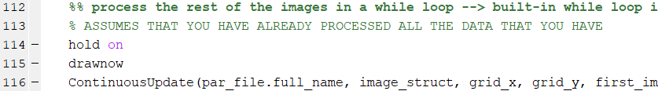
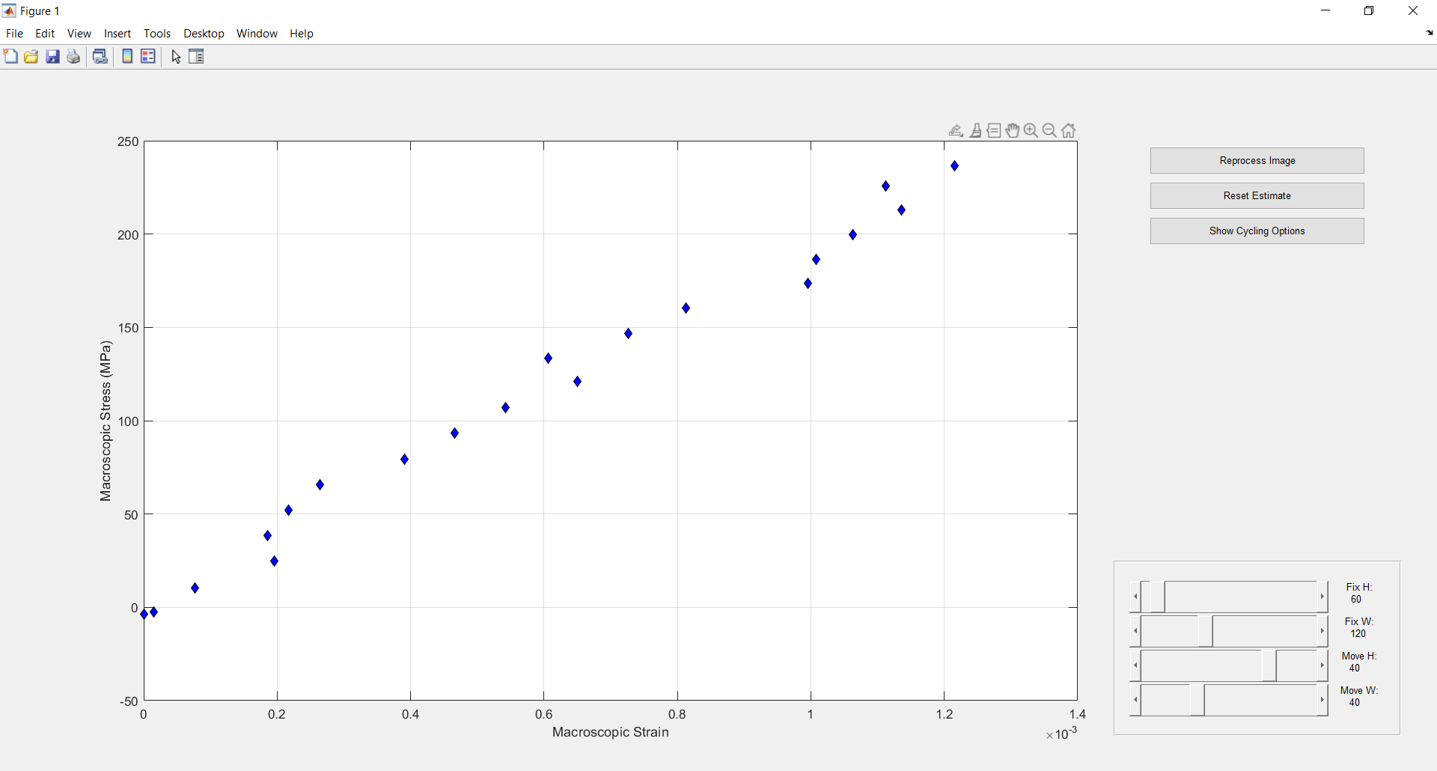
Real-time Continuous Update
process real-time: section allows users to process and plot new DIC measurements in real-time through GUI
Reprocess Image allows the user to redo the processing for the previously capture DIC measurement. This tool is useful when adjust any of the DIC parameters such as Reset Estimate or sub-region dimensions and can aid in regaining lost correlation.
Reset Estimate allows the user to reset the DIC processing variables to the original “zero-load” estimate of displacement. This tool is useful when regaining lost correlation.
Show Cycling Options allows the user to access a suite of options for mechanical cyclic loading. NOTE: These options are in development.
Sub-region dimension sliders allow the user to change and update the dimensions of the control point sub-regions in real time. This tool is useful when regaining lost correlation. NOTE: There is no visual queue for changing dimensions yet. This option is in development.

Slide 13
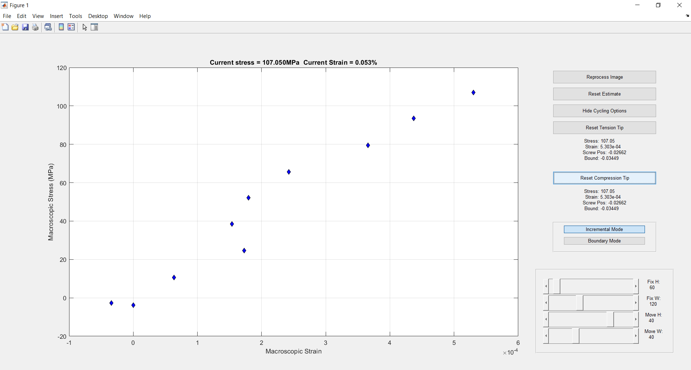
Real-time Continuous Update (Cycling)
process real-time: section allows users to process and plot new DIC measurements in real-time through GUI
Lock Tension Tip allows the user to create a reference point for the DIC data at the tension tip of a stress-strain curve. This tool is useful when implementing large end-to-end displacement cycling for mechanical loading.
Lock Compression Tip allows the user to create a reference point for the DIC data at the compression tip of a stress-strain curve. This tool is useful when implementing large end-to-end displacement cycling for mechanical loading.
Incremental Mode allows the user to process DIC measurements with incremental updates to displacement estimates. This mode is useful for experiments that make small incremental displacements. This modes is the traditional DIC code used at all previous CHESS DIC experiments.
Boundary Mode allows the user to process DIC measurements based on set reference points at the “zero-load”, tension tip, and compression tip of the stress-strain curve. This mode is useful for fully-reversed cyclic experiments. This modes is under development.

