Slide 1

Cars4u: Car Price Prediction
Comprehensive Analysis and Modelling
Author: Dmitry Luchkin, Data Analyst
Date: 3 August 2024

Slide 2
Agenda
Project Overview
Methodology
Comprehensive Analysis
Model Building
Conclusions

Slide 3

Project Overview

Slide 4
Context
The Car4u project aims to develop a model to predict used car prices using historical data.
Goals
Key Findings
Explore and prepare the Cars4u dataset
Estimate car prices based on features like location, brand, and technical specs.
The model predicts prices with high accuracy.
Significant factors influencing price include:
car segment, location, engine size, number of seats, car age, mileage, kilometers driven, transmission type, and new car price.

Slide 5
Methodology

Slide 6
Processing Steps
Initial Data Exploration
Data Cleaning
Exploratory Data Analysis
Feature Engineering
Model Building
Model Interpretation

Slide 7

Comprehensive Analysis

Slide 8
Data Overview
The source of the dataset is Kaggle*
It includes 7253 rows and 14 columns.
No duplicate rows were found in the dataset.
* https://www.kaggle.com/datasets/sukhmanibedi/cars4u

Slide 9
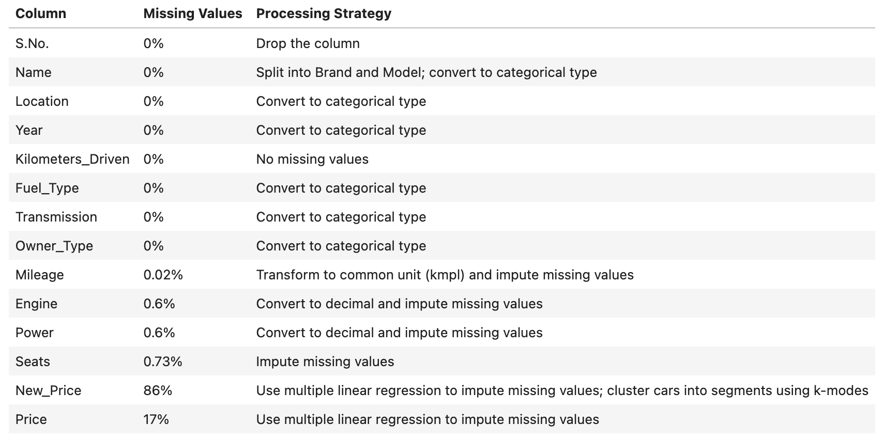
Data Processing
The initial data overview revealed missing values in the Mileage, Engine, Power, Seats, New_Price, and Price columns.

Slide 10
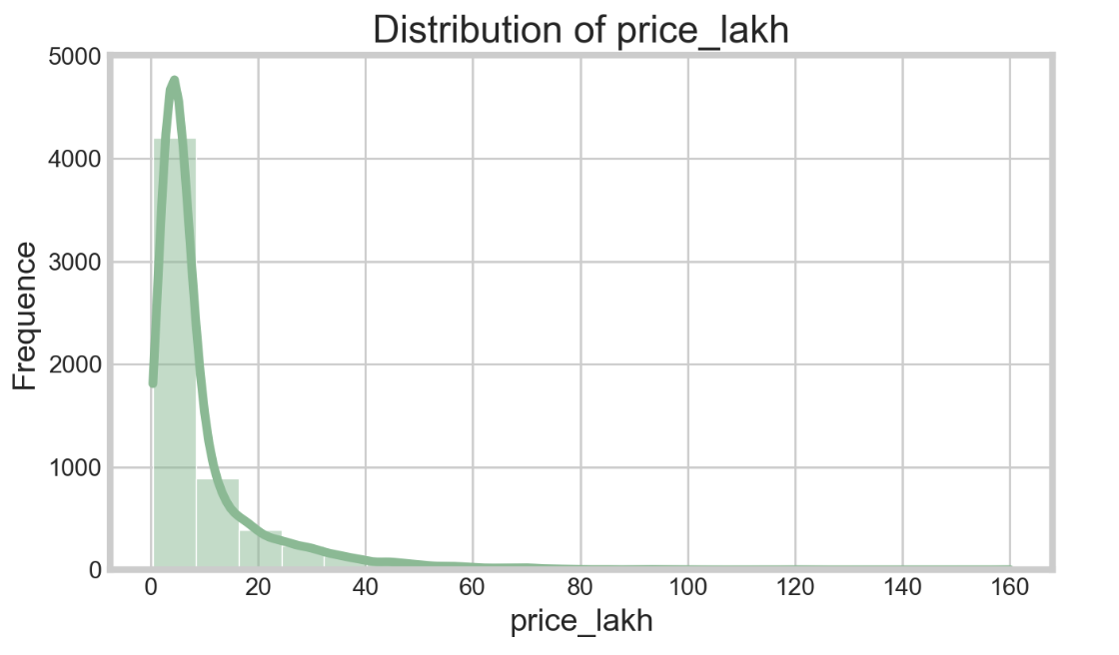
Car Price Distribution
The distribution of car prices is right-skewed (skewness=3.34).
The car price values need to be log transformed.

Slide 11
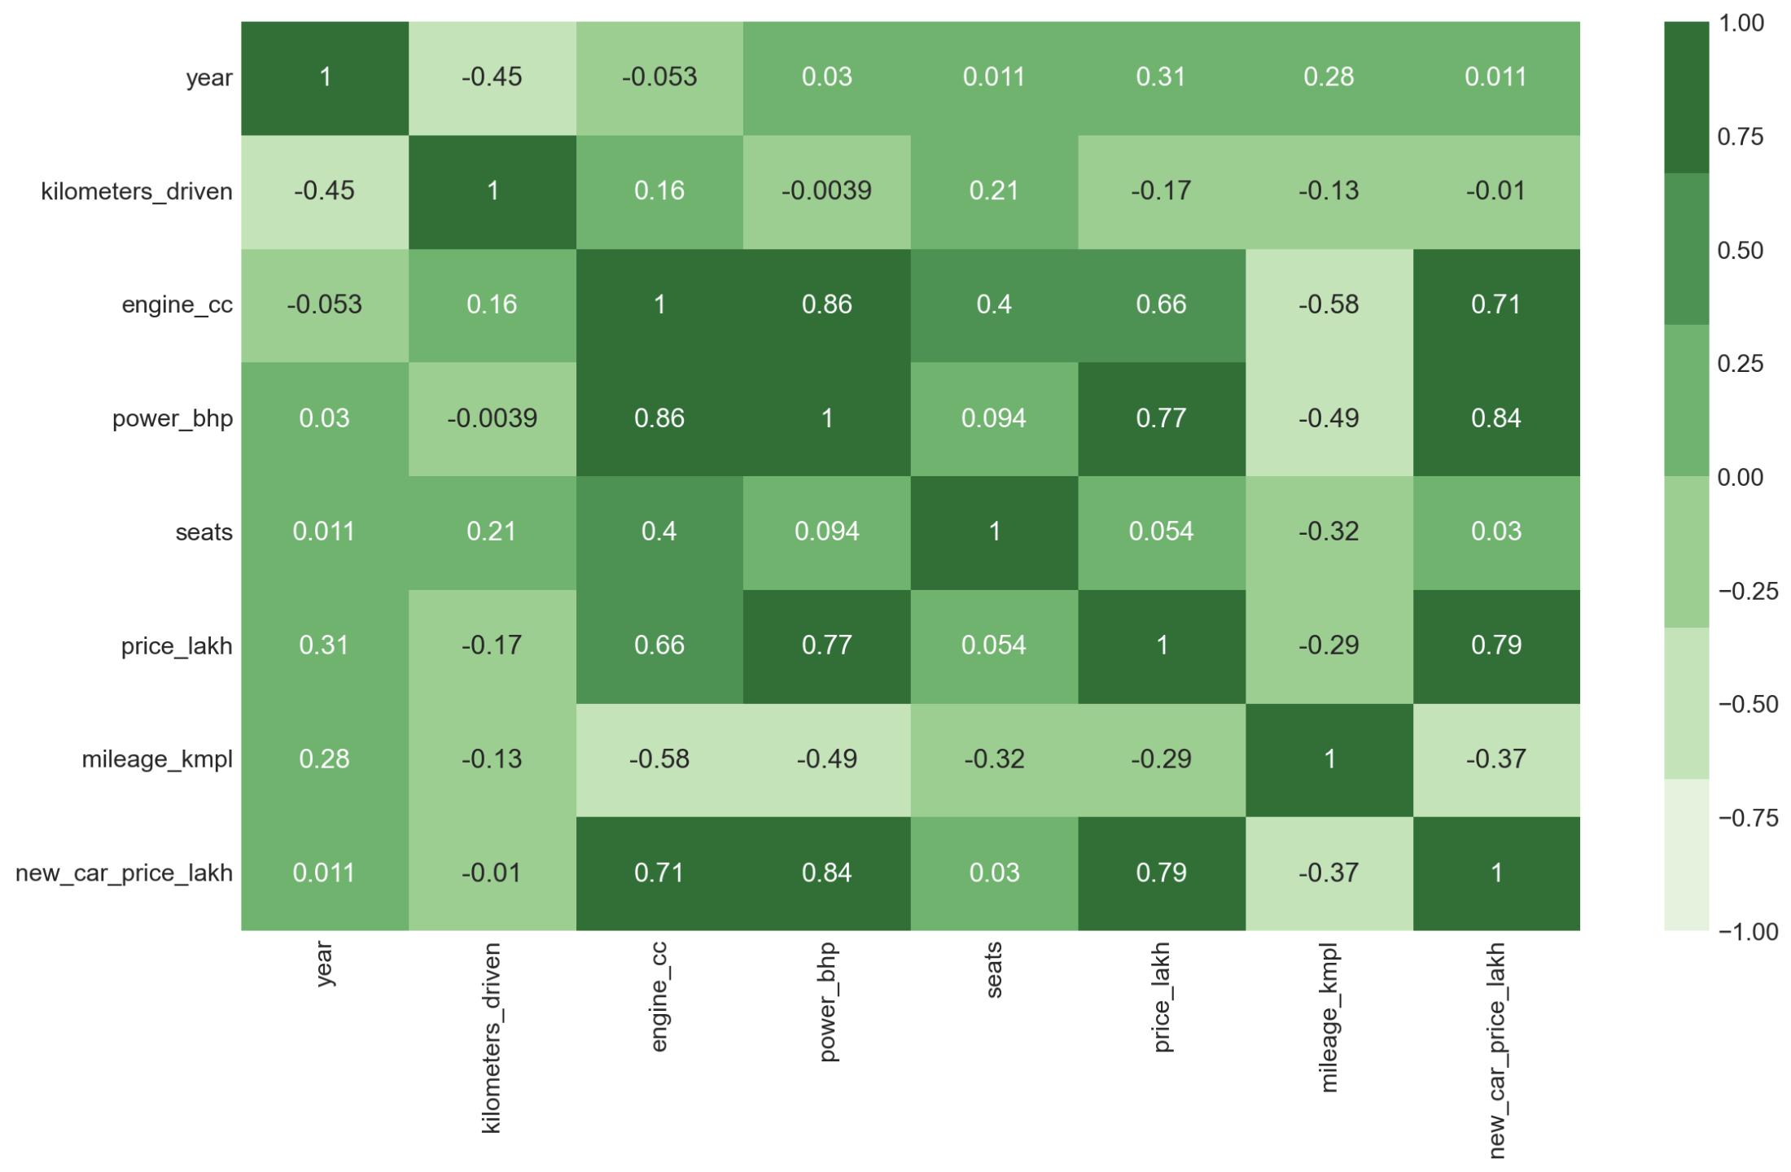
Car Price Correlation

Slide 12

Model Building

Slide 13
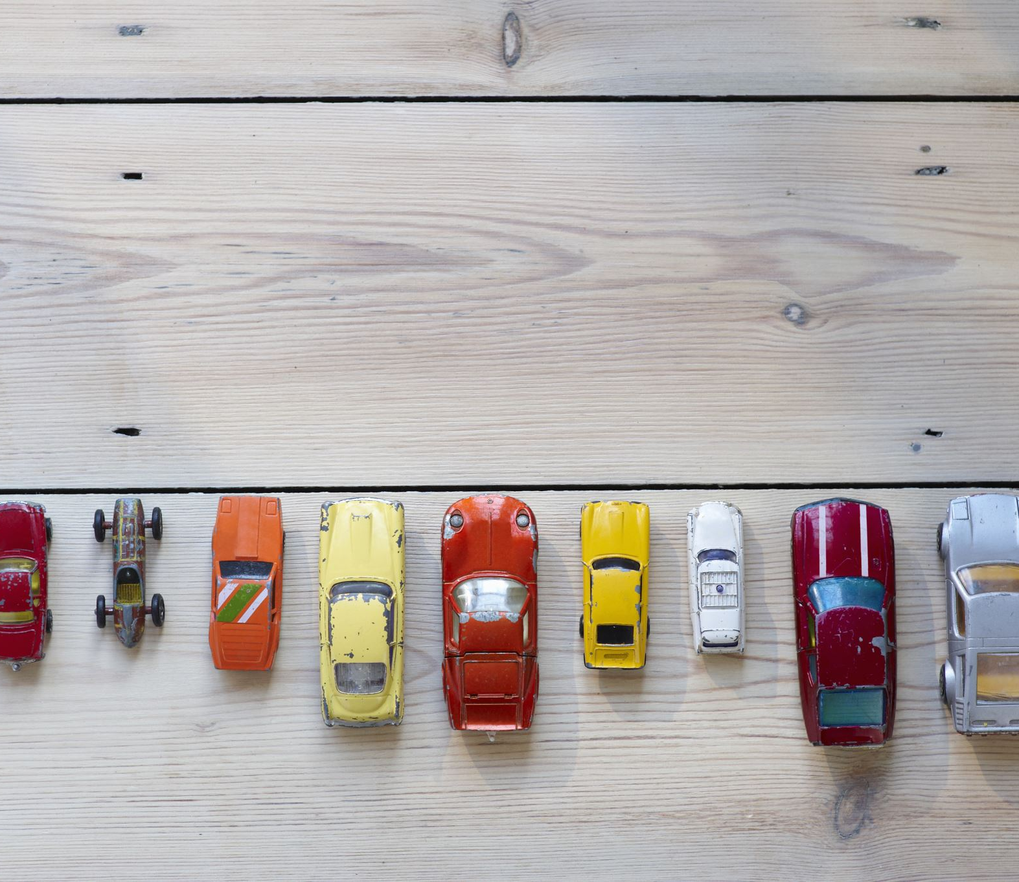
Features Engineering
From `owner_type` to `previous_owner` The category was encoded to a number of previous owners.
From `year` to `car_age` The year of manufacturing was transformed to a car age.
From `model` and `brand` to `car_segment` To avoid the multicollinearity cars were clustered by a new car price.

Slide 14
Build the Model
Hold-out validation 80/20
Metric | Training | Testing
Sum of Squared Errors (SSE) | 340.1914 | 85.4336
Mean Absolute Error (MAE) | 1.2140 | 1.2153
Mean Squared Error (MSE) | 1.0733 | 1.0735
Root Mean Squared Error (RMSE) | 1.0360 | 1.0361
Symmetric Mean Absolute Percentage Error (SMAPE) | 15.9% | 16.8%
R² | 0.9075 | 0.9061
Adjusted R² | 0.9071 | 0.9044

Slide 15
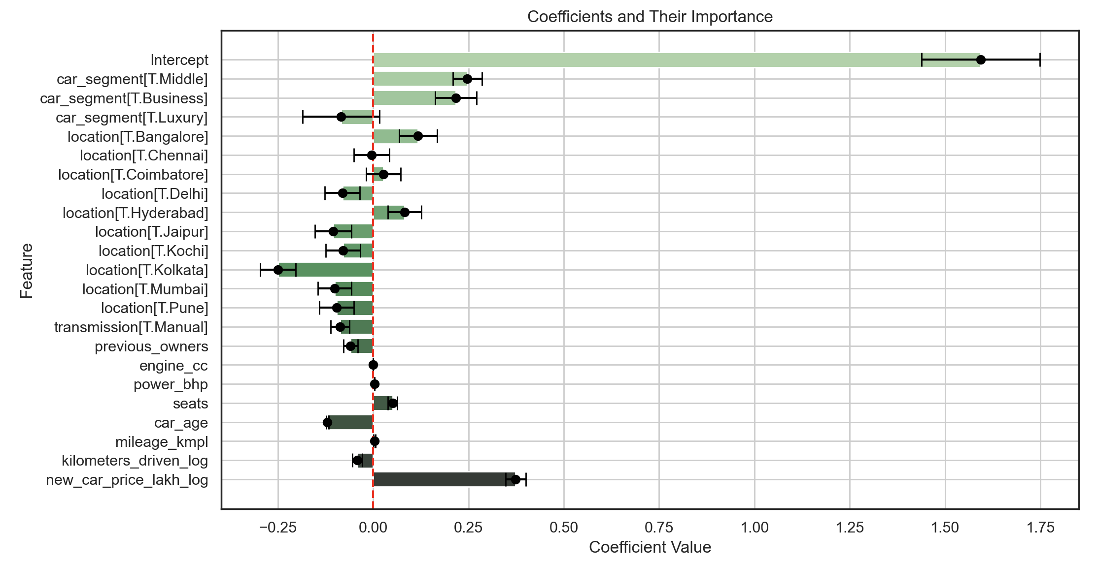
Model Interpretation

Slide 16
~90% of variable of used car price explained by the model
~1.21 Lakh is the average error
Significant predictors:
previous onwers, engine CC, power bhp, number of seats, car age, mileage km/l, kilometers driven, new car price, location, car segment
No multicollinearity

Slide 17

Conclusions

Slide 18
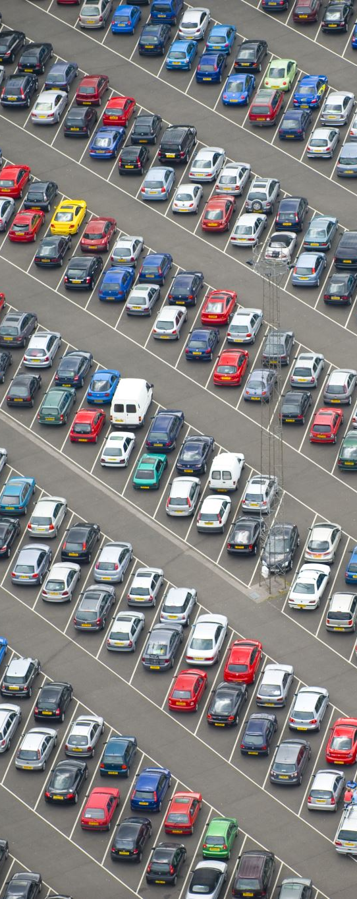
Understanding which factors most influence car prices helps Car4u set competitive pricing and optimize inventory.
The model assumes linear relationships and may not capture all complexities of the pricing dynamics.
The model accurately predicts car prices based on car segment, location, and other features.
Future Work: Explore additional features, non-linear models, and external factors to further improve predictions.
Recommendations: Implement the model to guide pricing decisions and continually update the model with new data.

Slide 19
Thank You

