Slide 1



Business Intelligence Report
MindfulChef Review Analysis
Extracting Actionable Insights from Customer Feedback
Prepared by:
Domingo Álvaro Martínez Romera

Slide 2
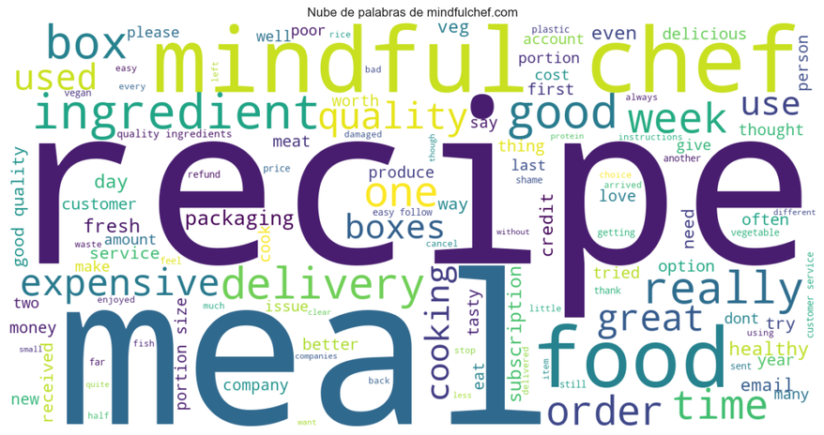


Key Topics in Reviews
Two dominant themes explain most of the customer feedback
Most frequent terms
Product quality & meal experience
Delivery, orders & customer service

Slide 3
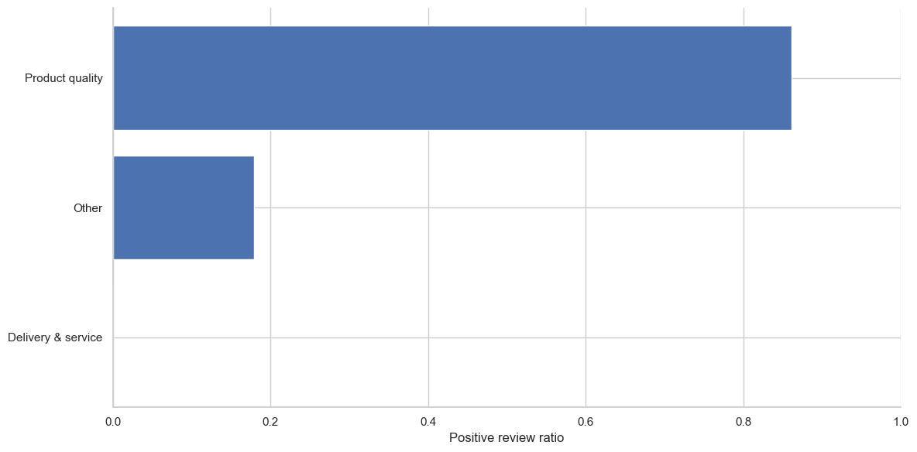
Sentiment by Topic
Product experience drives satisfaction, while service is the main source of dissatisfaction

Slide 4
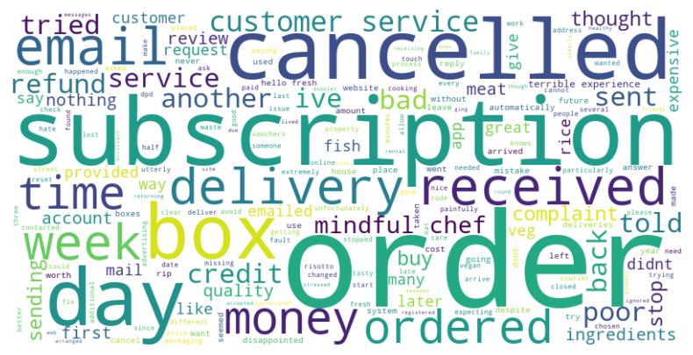
Root Causes of Delivery Issues
Based on NLP analysis of negative delivery reviews
Delivery delays and missing orders
Incomplete or incorrect orders
Subscription and billing issues
Poor customer service experience
Customer dissatisfaction stems from end-to-end operational failures, not product quality issues

Slide 5
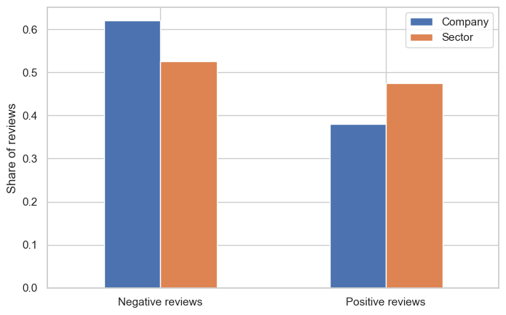
Comparison with Sector
The company shows a higher share of negative reviews compared to the sector, indicating a clear gap in customer satisfaction

Slide 6
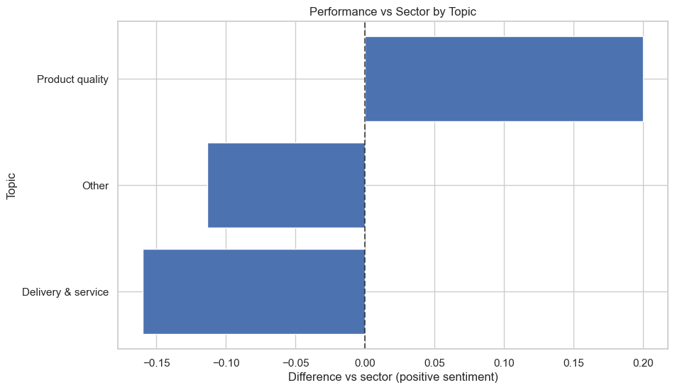
Gap Analysis
The company outperforms the sector in product quality, but significantly underperforms in delivery and service, which represents the main improvement opportunity

Slide 7

Conclusions & Recommendations
NLP Analytics
Leverage product quality as a key differentiator
Prioritize improvements in delivery and customer service
Focus on operational efficiency to close the satisfaction gap

