Slide 1
Data Pipelining
By Team 1 ( Manasi Dalvi & Vishal Satam
Under the guidance of Prof. Srikanth Krshnamurthy
at Northeastern University

Slide 2
What is Data Pipelining
Data pipelines are used to structure the dataflow by modularizing the code
A typical Data Science pipeline might include
Loading data from various sources
Cleaning and Wrangling Data
Performing Machine Learning Tasks
Data Storage
Consumption of data by visualization tools

Slide 3
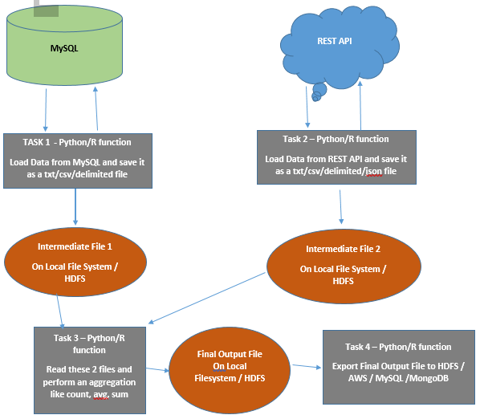
Example of how a Data Pipeline might look

Slide 4





Tools available and today’s focus
There are many workflow tools available in the market for building data pipelines
Examples : Airflow, Luigi, Dask, Celery,Pinball, Azkaban, Oozie, makefiles, etc
Airflow
Celery

Slide 5
Make

Slide 6
What is Make
GNU Make is an open source project available on the Unix kernel
Make is a build automation tool used to compile source code into byte code
Very old and robust technology. Used since C was mainstream
Make supports execution of shell commands
Dependencies can be specified for Targets which help us build the data pipeline
Shell commands can be used for running the python scripts
Builds and looks for files in the present working directory
Executed by using the make <target name optional>
If no target name is specified then, make executes the first target in the Makefile

Slide 7
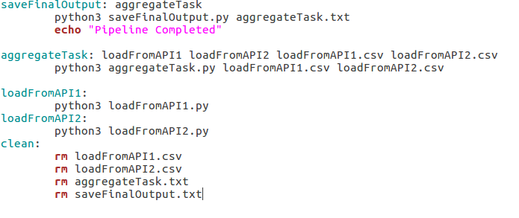
Makefile (Structure)
Dependenies
Targets can have dependent targets or dependent files
If the dependent target exists in the Makefile, it executes that target first forming dependency chain.
Otherwise checks if that file exists in the folder pwd.
If both the above conditions fail, then Make throws an error
Targets
Make attempts to build first target by default
Targets can be specified as dependencies
Recipe – These are a set of shell commands that make executes as specified under the corresponding target

Slide 8
Demo
Execution of a Makefile

Slide 9
Make for Windows (NMake)
Make is not supported on Windows.
We can use Make on Linux on VM
We can install and use make on Cygwin terminal
Install Nmake on windows - shipped as part of Microsoft Visual C++ Build Tools
Makefiles in Nmake have a different syntax which you can find on https://msdn.microsoft.com/en-us/library/dd9y37ha(VS.71).aspx
The basic idea is similar to GNU Make. NMake is also used as a build tool and can be used for data pipelining

Slide 10
Luigi

Slide 11
What is LUIGI
Luigi is a workflow engine created by Spotify
Luigi helps modularize code and build data pipelines
Handles dependency resolution, workflow management, visualization, handling failures, command line integration, and much more
Supports external frameworks such as Hive and Pig jobs
Has support for running Python and MapReduce jobs on HDFS
Everything is built in Python, We don’t need any additional XML configuration

Slide 12
Components of a LUIGI task
Create a Python class & extend the luigi.Task abstract class to create a Luigi Task
Override / Implement the following methods
Run – this is where we put the bulk of all the logic for the task goes.
Requires – This function returns(single) / yields(multiple) all the dependent tasks
Output – This method returns the target. This can be a file on Local System or HDFS
Complete -- Tasks that do not have a target from output() can override complete()
For eg: This can be used to send notifications of task completion
Mapper and Reducer – We can override these functions instead of overriding the run function if we want to return a HDFS target to perform a Hadoop Map Reduce job.

Slide 13
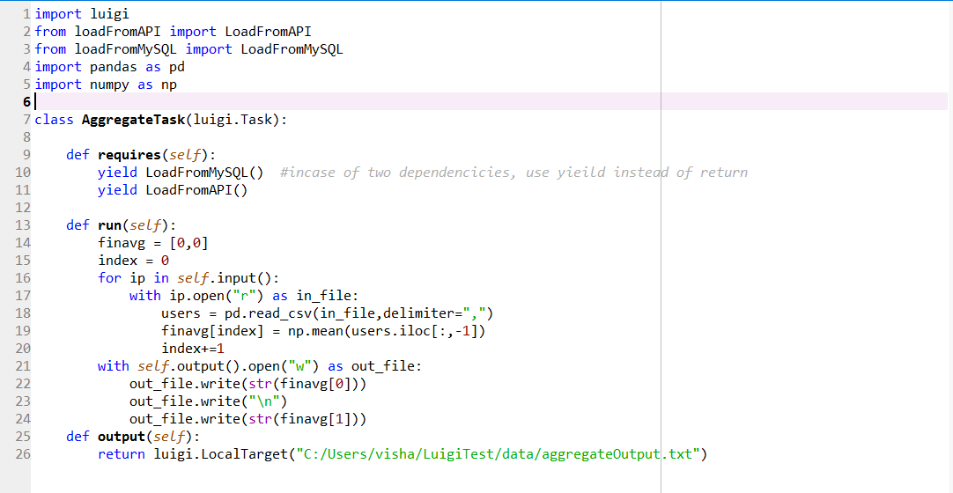
Sample Luigi Task

Slide 14
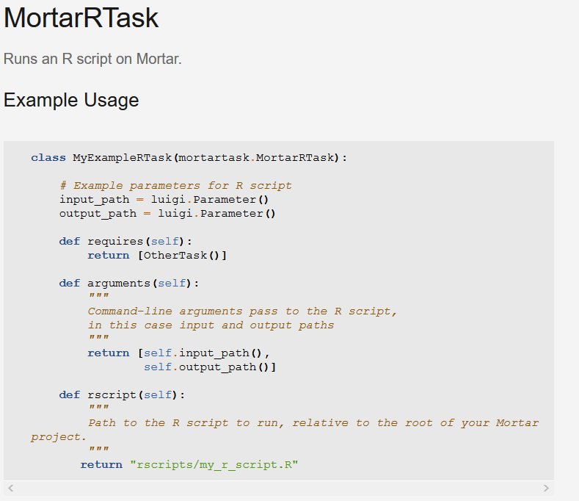
Creating data pipeline for R with Luigi
Framework for creating pipelines with R in Luigi. MortarRTask
Override following functions along with the function
arguments - This function specifies the arguments to be passed to R modules.
rscript : Path relative to the Mortar project where Luigi can find the R script.
output and run are covered by general MortarRTask, so we don’t have to include in R script Tasks
http://help.mortardata.com/technologies/luigi/r_tasks

Slide 15
Demo
Run the Luigi Scheduler daemon
Creating a dependency graph from Python classes
Execute the final Luigi task SaveFinalOutput
Visualize the executed dependency graph on Luigi Task Visualizer UI

Slide 16
DASK

Slide 17
What is DASK
Dynamic Task Scheduling
Optimized for interactive computational workloads
Flexible parallel computing library for analytic computing.
Big Data Like Collections for parallel processing in distributed Environments
DASK Array which mimics the Numpy Array
DASK Dataframe which mimics the Pandas Dataframe
DASK Bag which mimics iterators, Toolz and PySpark
2 types of schedulers are provided in the framework for DASK collections
Threaded – Executes sub tasks as lightweight threads
Multiprocessing –Executes sub tasks as processes

Slide 18
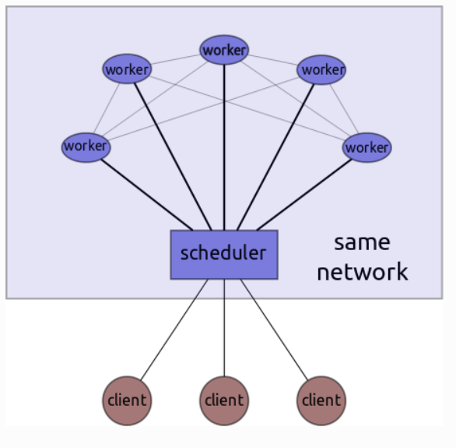
DASK Scheduler
DASK includes a scheduler for distributed computation in dask.distributed
Tasks are executed in parallel on different nodes in the network
Scheduler is asynchronous and event driven
Consists of 3 parts
Centralized scheduler – handles delegation of tasks
to workers and communicates with client.
Distributed Workers – perform the tasks
Clients – Create and request the scheduler to execute
the custom data pipeline

Slide 19
Modes of Execution
Compute method
The compute function is provided for DASK collections
This method acts as a wrapper for Get function
DASK Arrays and DASK Dataframes use the Threaded scheduler by default
DASK Bags use the Multiprocessing Scheduler by default.

Slide 20
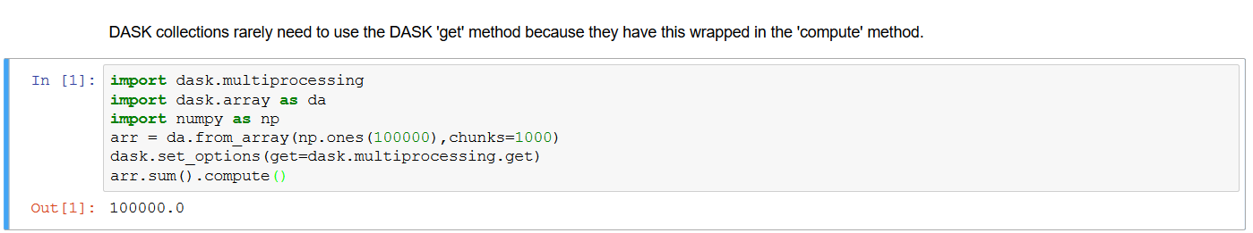
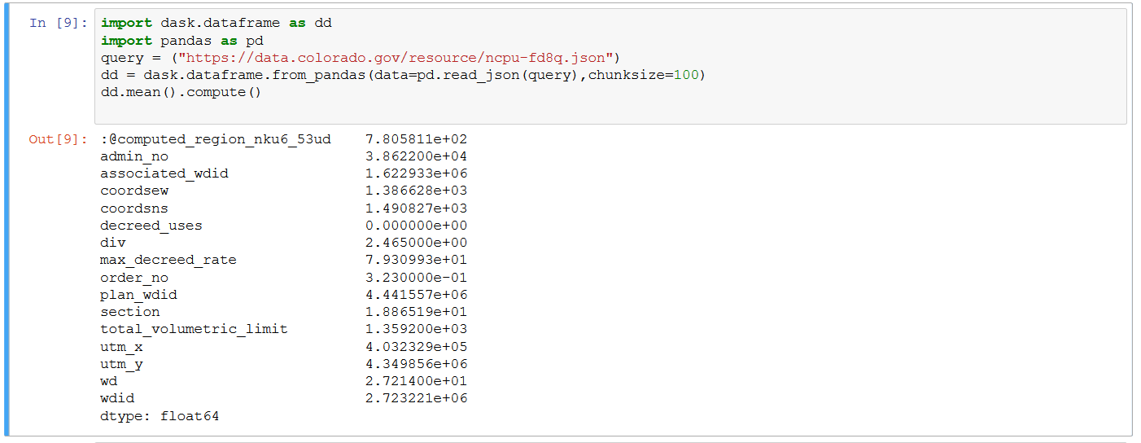

Slide 21
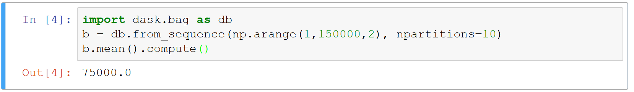
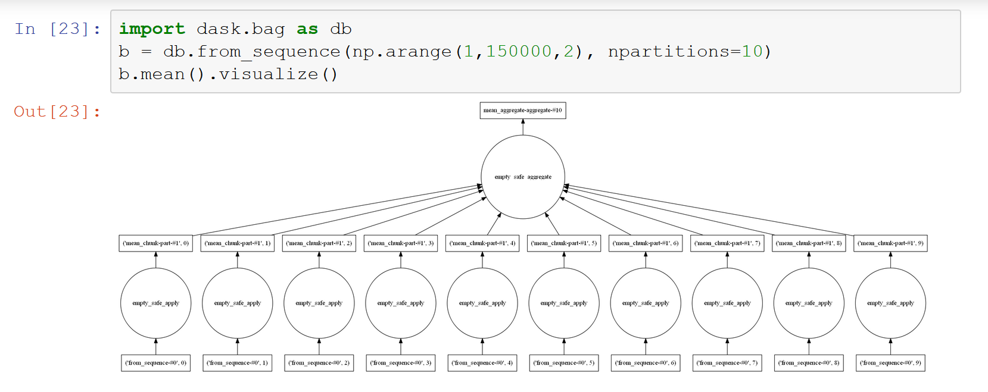

Slide 22
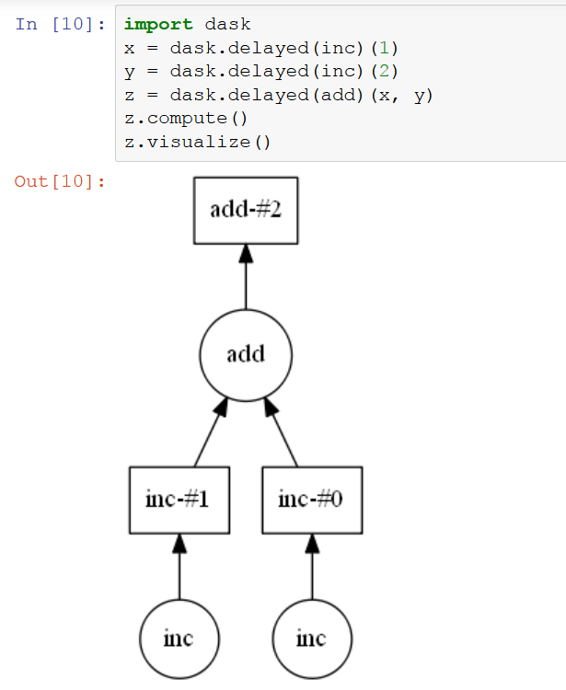
Modes of Execution
Delayed with Compute
The delayed function is used to schedule
tasks to run on the distributed cluster
Execution doesn’t occur immediately
We can build custom dependency graphs using delayed
Compute method is used eventually to run the tasks

Slide 23
Modes of Execution
Get
The get function is the entry point for all schedulers.
Can create custom graphs and execute in a distributed manner
Used to schedule tasks on scheduler provided by framework by importing get from dask.threaded or dask.multiprocessing
We can create a DASK Client which connects to the running scheduler and requests to execute custom data pipelines using the get function.

Slide 24
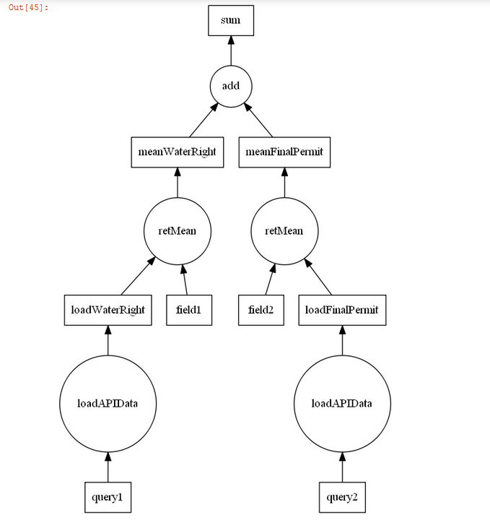
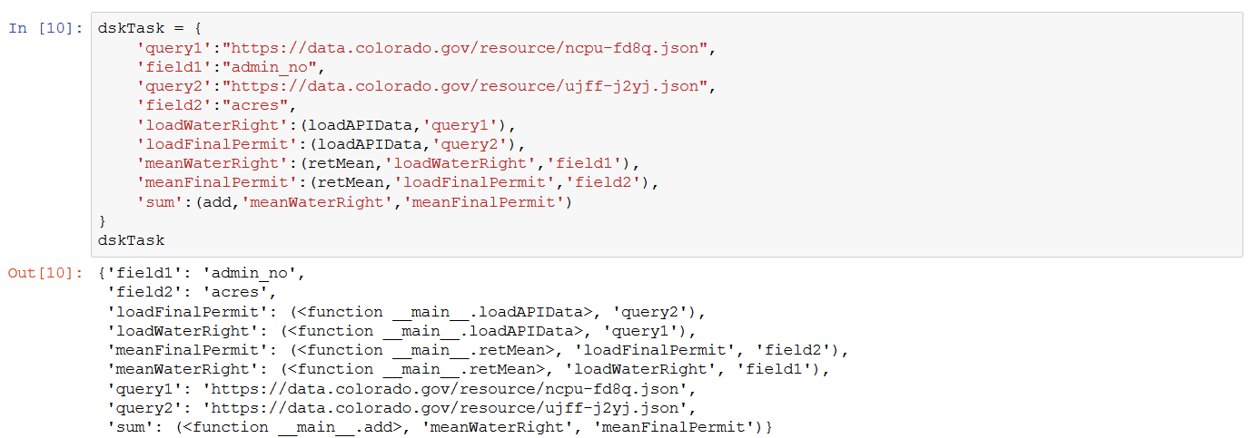
Custom Data Pipeline

Slide 25
DEMO
Scheduler Created on Local Machine
Distributed scheduler created on AWS on multiple nodes using dask-ec2 library
Visualize Scheduler status using BOKEH Web UI provided by DASK framework
http://distributed.readthedocs.io/en/latest/web.html

Slide 26
Celery

Slide 27

What is Celery
task queue based on distributed message passing.
Asynchronous, concurrent, distributed task queue
Built for use with Djano (initally commited as 'crunchy')
Written in Python
Focuses on real time operation
Supports scheduling

Slide 28
Health Benefits
For an end user:
Faster request/response cycle
Enhanced user experince
For a developer :
Scalability : add workers
Flexible : multiple custumization points
Actively developed
Extensive documentation
For a business:
Latency. equals ($$$)
For Amazon every 100ms latency costs 2% in sales

Slide 29
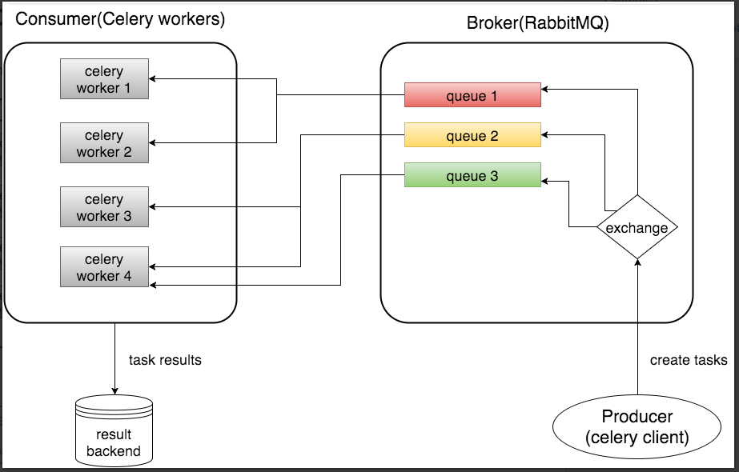
Celery Architecture and concepts
is a distributed task queue
task queue roles:
Producer : user application that creates and sends the message/task.
Broker : creates tasks queues >> delivers tasks to workers
Consumer: workers/Celery workers that execute the task
Queue: buffer space to store the tasks

Slide 30
Let's create a task.py
from celery import celery
app = Celery('tasks', broker='pyamqp://guest@localhost//' ,backend= 'redis://’)
@app.task
def multiply(x, y):
return x * y
single task, called multiply, returning the multiplication of two numbers
app -- instance of Celery
'tasks' -- the name of the current module
broker -- specifies the borker url used (RabbitMQ)
backend -- storage for task states and results

Slide 31
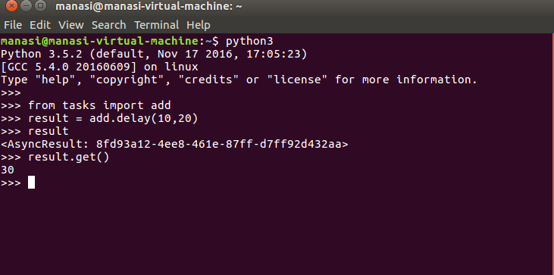
Running the celery worker
Start the RabbitMq server $sudo service rabbitmq-server start
Start Redis Server $ sudo redis-server
Start the celery worker $ celery -A tasks worker --loglevel=info -l debug
In a python shell,
delay() -- used for async calls
-- output in worker console

Slide 32
Demo example
from celery import Celery
from app import app
import requests
import time
app = Celery('celery_blog', broker='redis://localhost:6379/0')
@app.task
def fetch_url(url):
resp = requests.get(url)
print(resp.status_code)
def func(urls):
for url in urls:
fetch_url.delay(url)
#if __name__ == "__main__":
#func(["http://google.com", "https://amazon.in", "https://facebook.com", "https://twitter.com", "https://alexa.com"])
- fetch a list of urls along with response time from all urls
- parallel fetching instead of sequntial
- run the script using:
$ celery worker -A celery_blog -l info -c 5 (specify concurrency).

Slide 33
CelerySupport
The #celery channel is located at the Freenode network.
Mailing list celery_users
@asksol
Creator of Celery

Slide 34
Airflow

Slide 35
What is Airflow
Open-source workflow automation (and scheduling)
used for data pipeline model building tools
Similar to Apache Oozie, Azkaban, and Luigi.
Open sourced in 2016 -- incubation phase as an Apache project

Slide 36
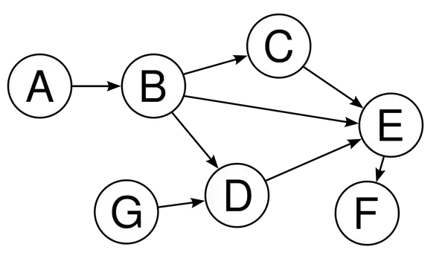
Airflow Concepts
Dags (Directed Acyclic Graphs)
Configuration file to outline HOW to execute a task
Contains a collection of tasks
Determines the order of execution
Time of implementation

Slide 37
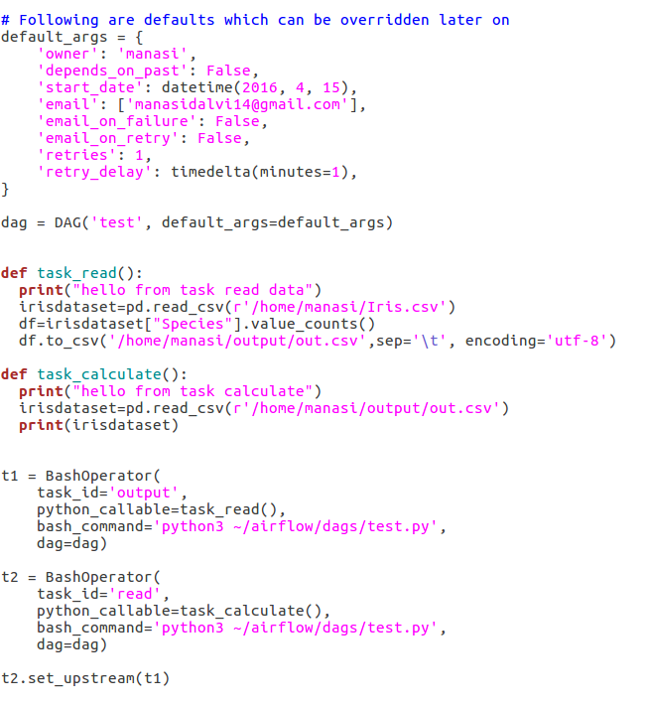
Dag example
Airflow Concepts
The dag contains two tasks t1 and t2
- task t1 reads a csv file >> calculates the counts for a column >> saves locally
- task t2 reads the file stored by t1 and prints the result
- t2 is dependent on t1, specified by
t2.set_upstream(t1)

Slide 38
Airflow Concepts
Operators
Building blocks of workflows
Decribes a single task
Used for task execution
Action operators : Performs an action (PythonOperator)
Transfer operator: To move data from one system to another (RedshiftToS3Transfer)
Sensor operator : Runs till a certain criterion is met.

Slide 39
Airflow Concepts
Tasks and Task instance
generated when instantiating operator objects
t1 = BashOperator(
task_id='readData',
bash_command='python3 tasks.py',
dag=dag)
task must include a task_id and owner.

Slide 40
Airflow CLI
Basic commands
airflow initdb # starts the metadb (sqlite default)
airflow webserver # strats the webserver
airflow list_dags #lists the loaded dags
airflow test Helloworld task_1 2017-06-05 # test individual tasks
airflow backfill Helloworld -s 2015-06-01 -e 2015-06-07 #run with dependencies.

Slide 41
Airflow Executors
Sequential Exceuter :jobs are run sequentially, no parallelism.
Local Executor :the local workers pick up and run jobs locally via multiprocessing
Celery executor : distributed mode, remote workers pick up and run jobs as scheduled and load-balanced, scalable.

Slide 42
Demo Example
Data pipeline
import file_1 from json api >> store locally
import file_2 from json api >> store locally
perform calculations
merge and save
Airflow uses SequentialExceutor by default
Change to LocalExecutor for parallel processing

Slide 43
Conclusion
Data Pipelining modularizes the code and reduces chaos
Every Tool we explored today has it’s own set of features, advantage & disadvantages.
We cannot conclude to say that one of them is the best tool
Explore and find the best one suited to your requirements (There are many out there)

Slide 44
Thank You

