Slide 1
Prediction & Classification Modelling
Team 1, Vishal Satam & Manasi Dalvi

Slide 2
Summarization
Auto Login using Cookies
Programmatically Download all data.
Summarize sample files from 2005- 2016
Wrangling
Fill Null Values, Checking Distribution of variables
Convert Data Types
Origination File – Since the data is small, we have kept the values as is.
Performance File – We have taken the minimum and maximum of all values to generate the summary file.

Slide 3
Exploratory Data Analysis
Perform EDA on Summary files
Analyze trends for interest rate and Delinquencies.

Slide 4
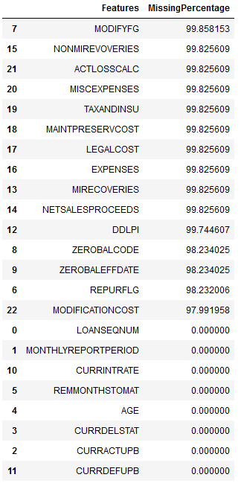
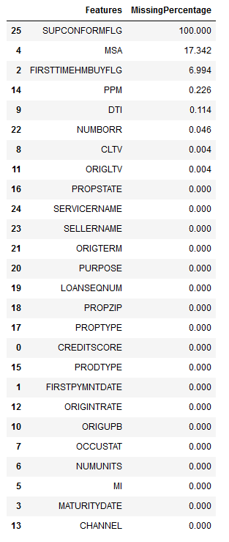
Missing Values

Slide 5
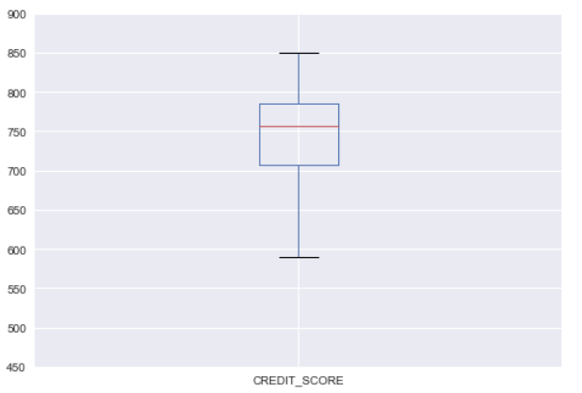
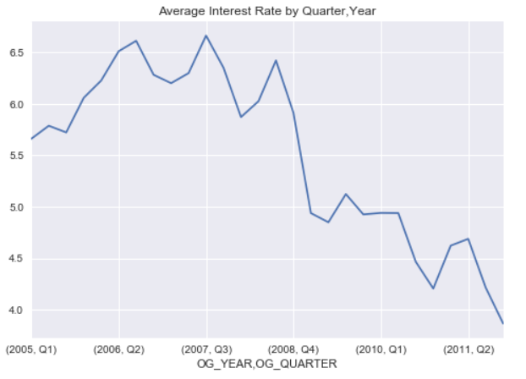
Exploratory Data Analysis

Slide 6
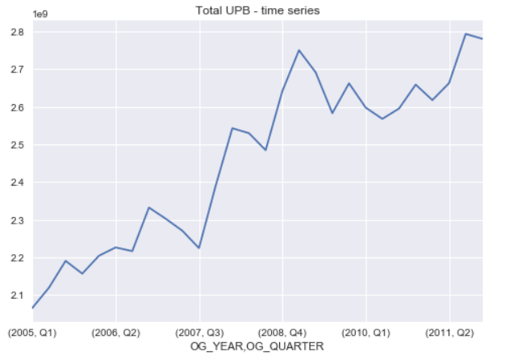
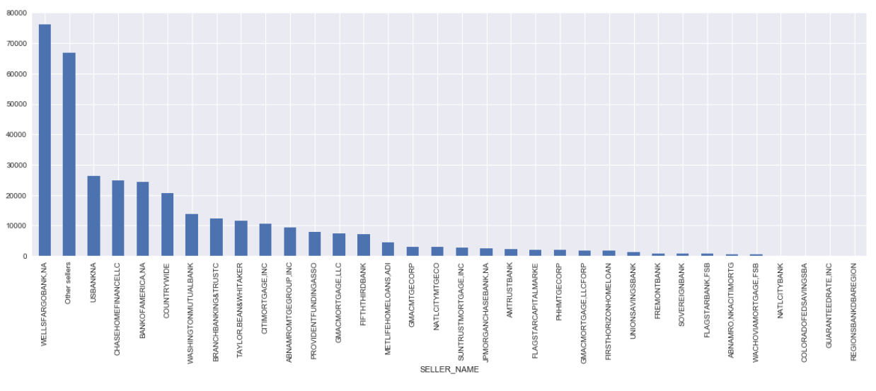
Exploratory Data Analysis

Slide 7
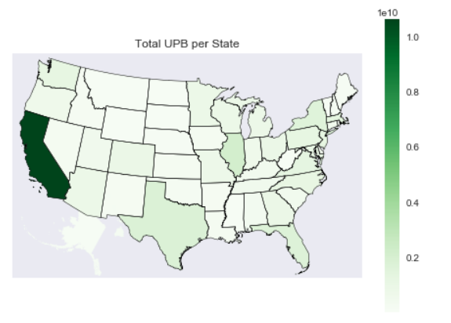
Exploratory Data Analysis

Slide 8
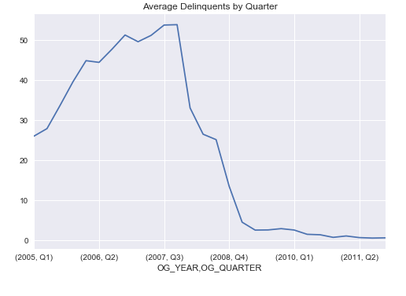
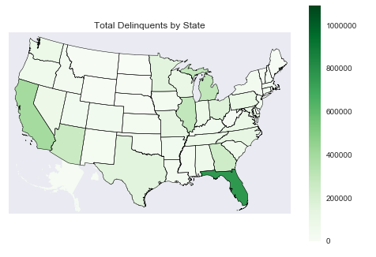
Exploratory Data Analysis

Slide 9
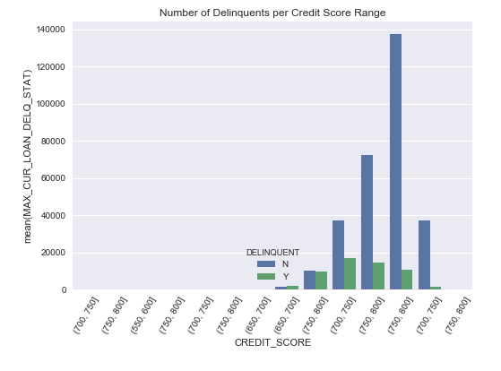
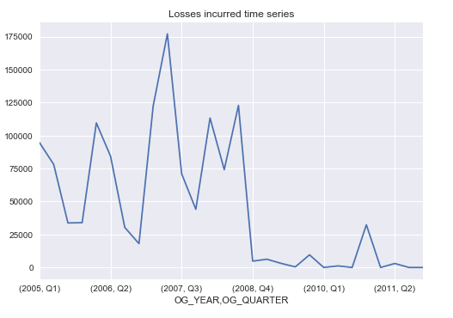
Exploratory Data Analysis

Slide 10
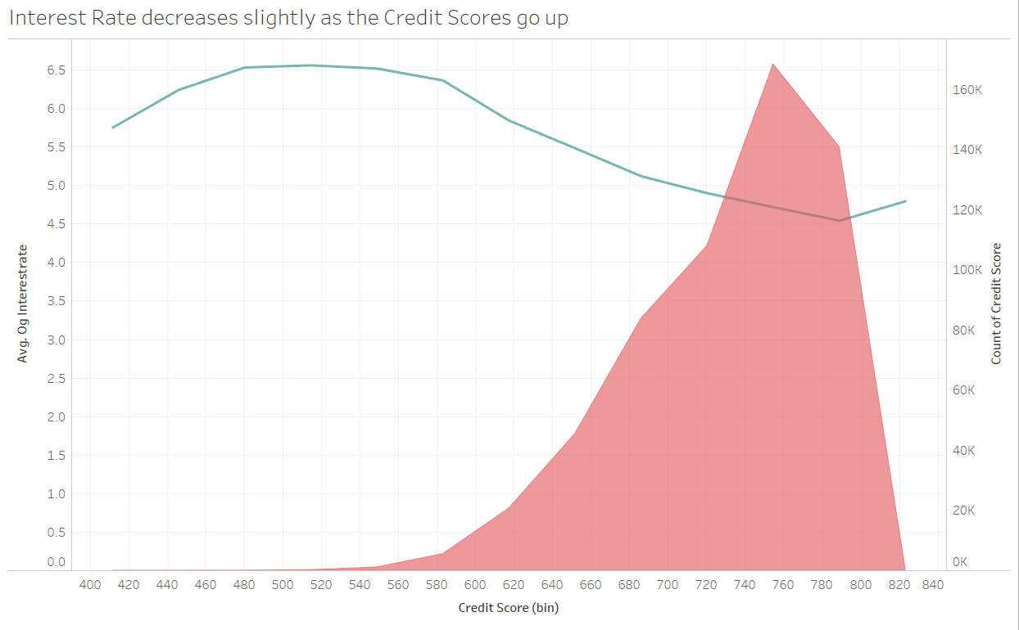
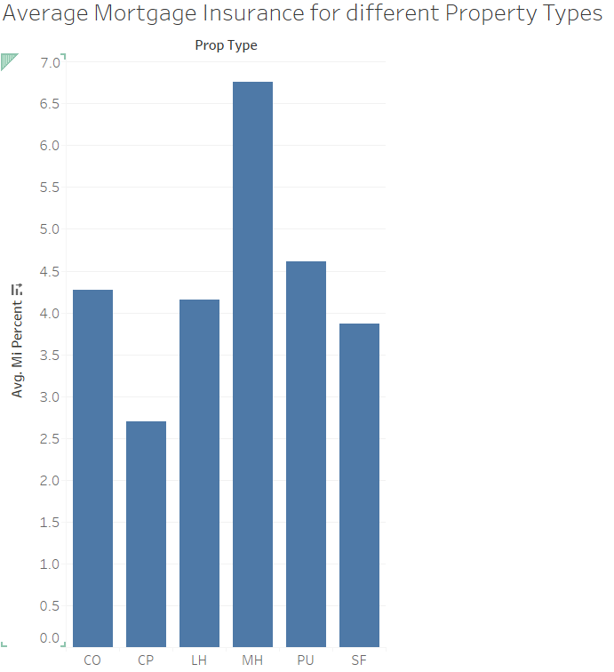
Exploratory Data Analysis

Slide 11
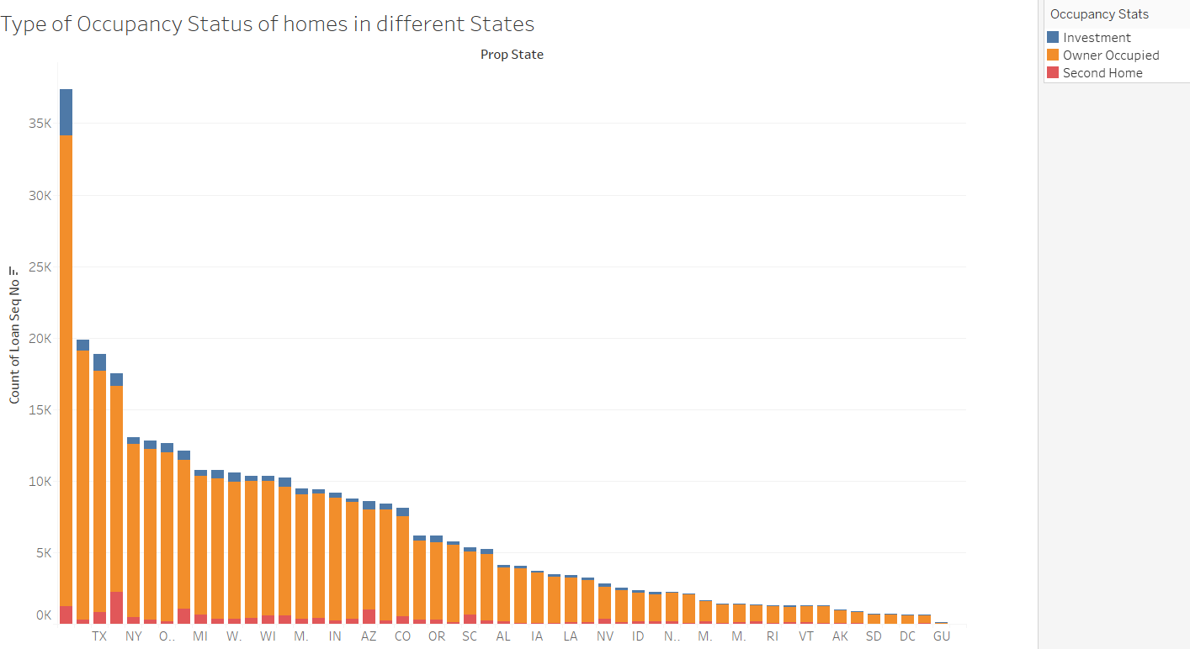
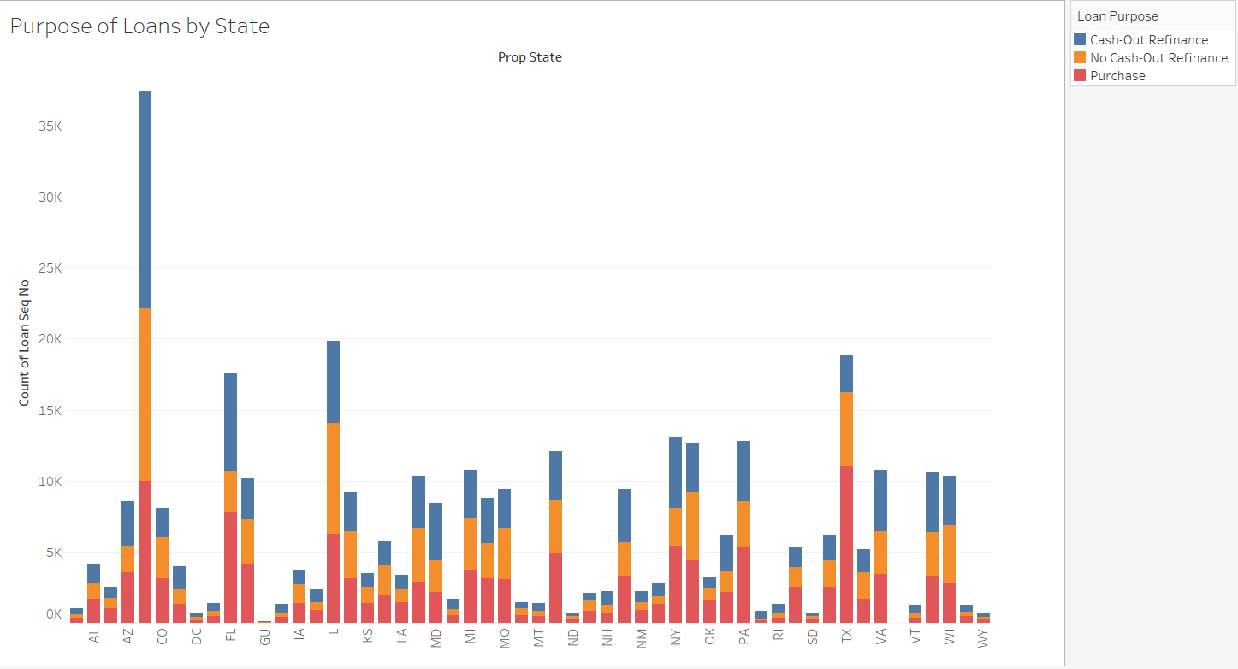
Exploratory Data Analysis

Slide 12
Feature Selection
Select subset of attributes which has the greatest impact towards our target.
Lasso Regression
penalizing heavy weighted parameters
Recursive Feature Elimination
recursively removing features and building a model on remaining features
greedy optimization.
Linear Regression

Slide 13
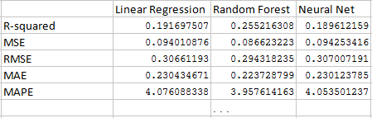
Algorithms
Training set on all quaters for year 2005
Linear Regression
Random Forest
Neural Network

Slide 14
Predictive Analysis
Algorithm used: Random Forest
Economic Boom (1999 2013)
Financial Crisis(2007 2008)
Market recovery(2009)
For future predictions

Slide 15
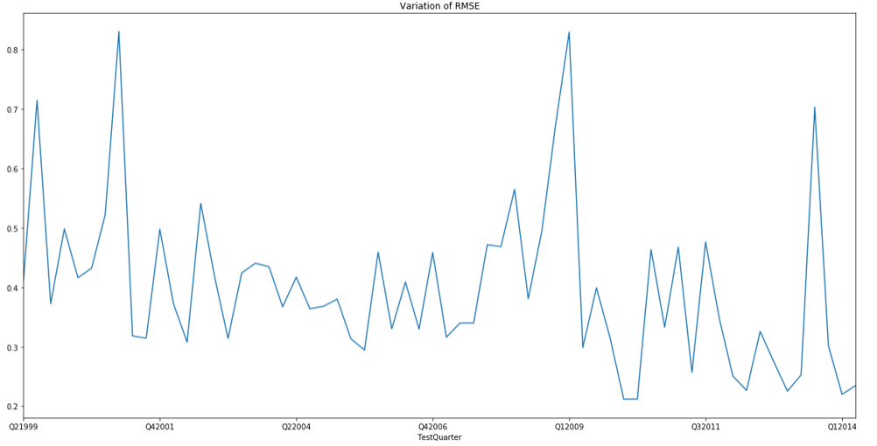
Economic Boom (1999 2013)
1999 - 2003
Error in prediction rises due to
higher interest rate during the
period 1999 to 2000
model trained on avg rates
varying between 4% to 5%

Slide 16
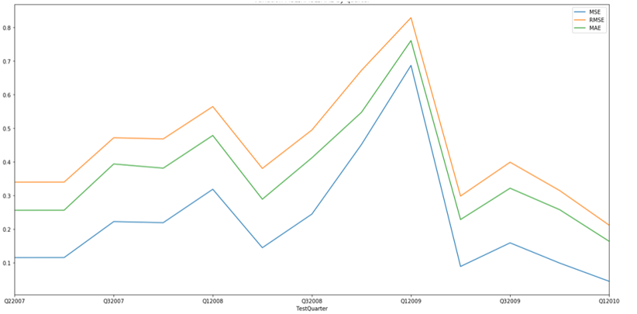
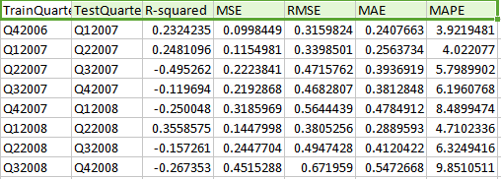
Financial crisis (2007 2008)
spikes in interest rate increaing the
error in prediction during years 2008 to 2009

Slide 17
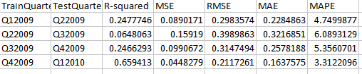
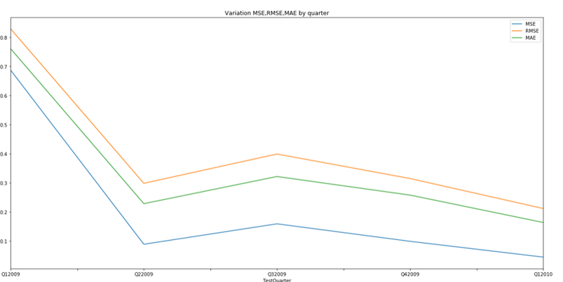
year 2009
With market recovering, the rates went down thus reducing the error percentage.

Slide 18
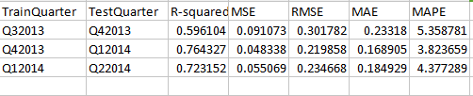
Prediction for next quarter. (2014)
Hypothesis: the model can be used for next quarter prediction if the interest rate values do not increase of decrease suddenly, ie if they remain in the similar range of values
Actual Values:
We run our model for the next two quarters Q1 2014 and Q2 2014. We can see that the values for rmse are low with an increased R-squared value.
Conclusion: The model can be used for stable interest rates for any future quarters.

Slide 19
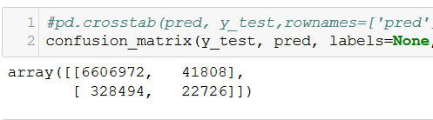
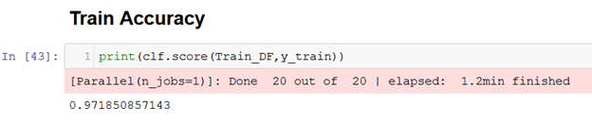
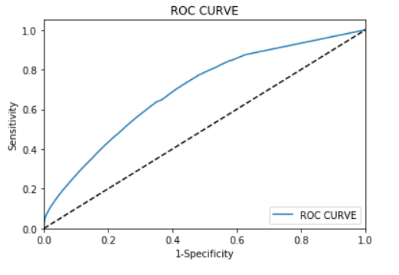
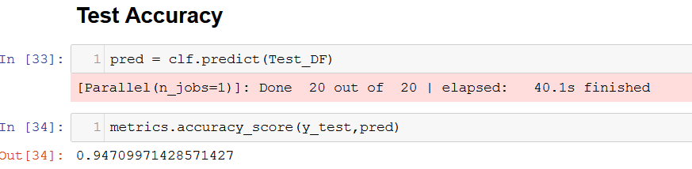
Classification
Algorithm chosen = Random Forest Classification algorithm

Slide 20
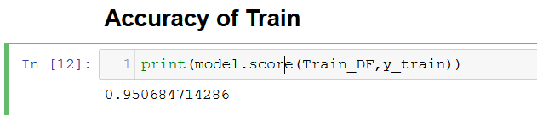
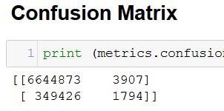
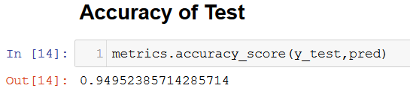
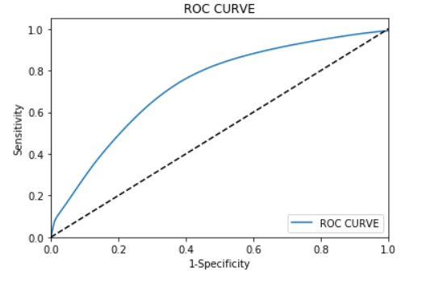
Classifications
Comparing Logistic Regression

Slide 21
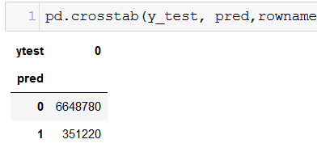
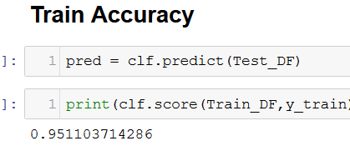
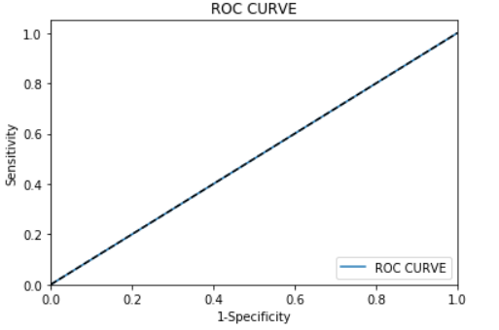
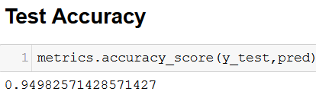
Classifications
Comparing Neural Network

Slide 22
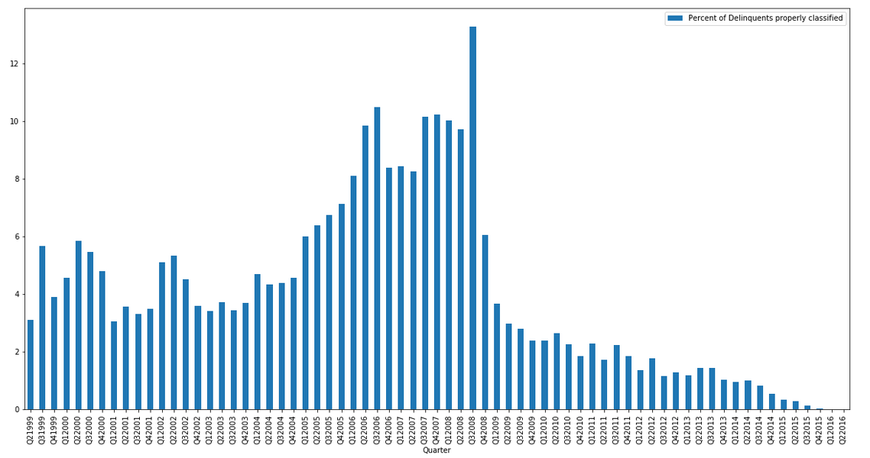
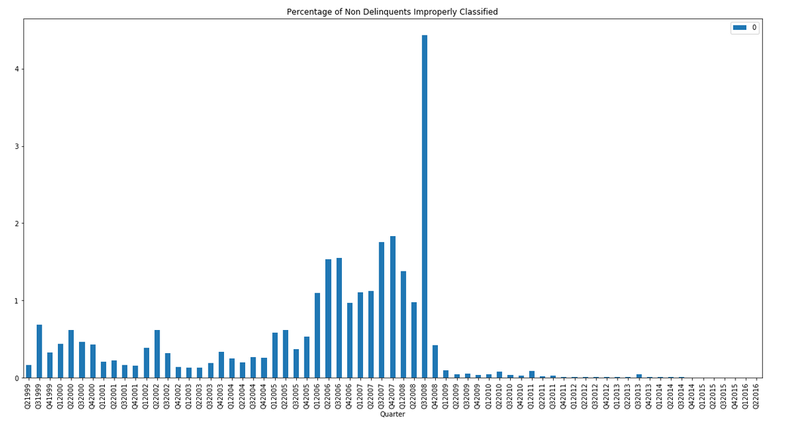

Slide 23
Work Contribution
Vishal Satam
Summarization
EDA
Classifcation
Manasi Dalvi
Cleaning
Feature selection
Prediction

