Slide 1
MIMIC NLP

Slide 2
Tools and Dataset Used:
Filename: https://github.com/dalwari/mimic-iii-clinical-database-demo-1.4/blob/main/mimic_nlp.ipynb
Dataset Used: https://github.com/dalwari/mimic-iii-clinical-database-demo-1.4/blob/main/nlp_med_notes.csv
Package Used: Spacy, Scispacy, BioClinicalBERT, Word2Vec, TSNE
Application Used: Dbeaver, VSCode

Slide 3
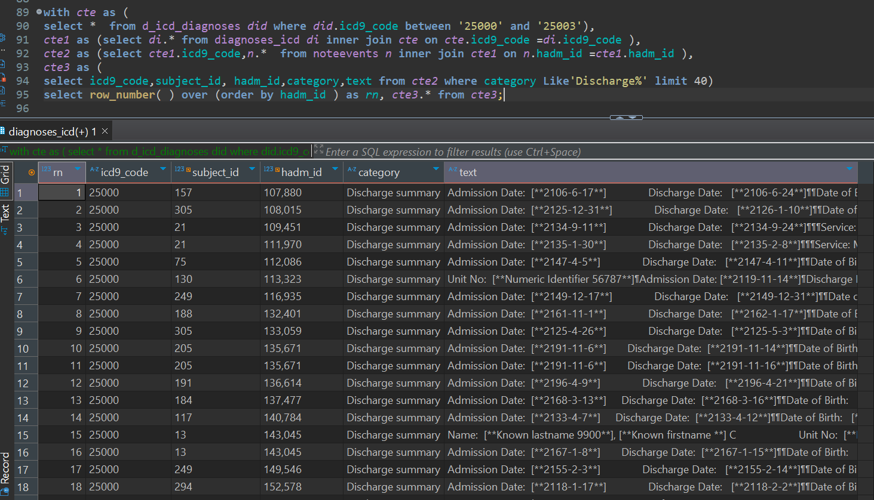
Dataset Preparation:
Write a sql query in Dbeaver
Use the ‘Export data’ option in Dbeaver to extract the dataset result as CSV file into NLP workspace

Slide 4
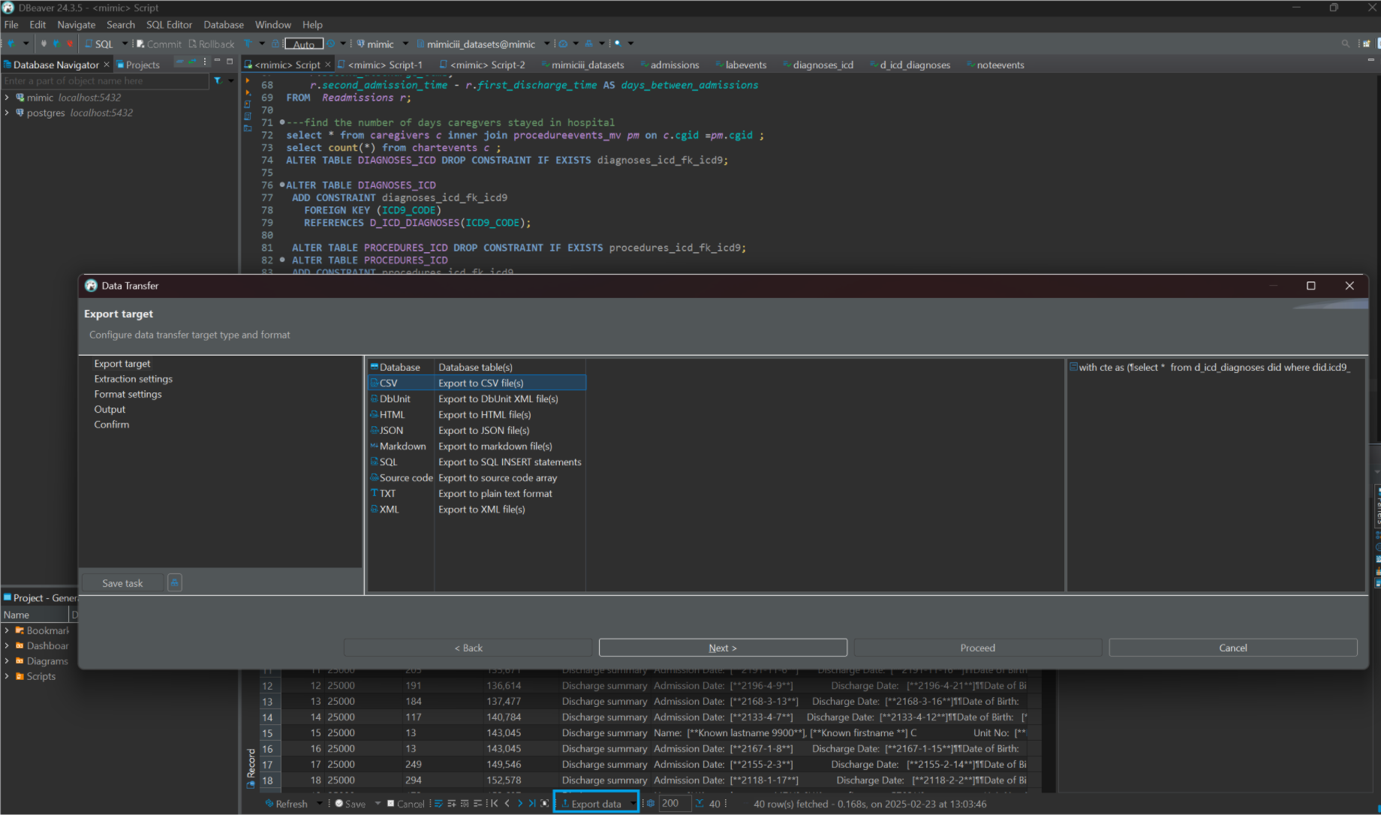
The disease of interest here is diabetes
The icd9_code for diabetes is between ‘25000' and '25003’
First we need to join d_icd_diagnoses and diagnoses_icd
The result of previous step subquery is joined with noteevents on hospital admission id.
The notes of ‘Discharge Summary’ needs to be filtered out limited to 40 records in order to process effectively.

Slide 5
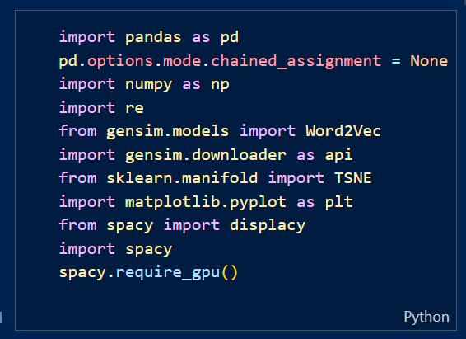
Named Entity Recognition:
Import the Spacy, Scispacy, Word2Vec, TSNE libraries
Load the spacy model
Prepare utility functions like,
clean_and_split_paragraph()
extract_entities()
fetch_entities()
visualize_entities()
extract_corpus()
fetch_corpus()
extract_passage_by_label()
do_data_process()

Slide 6
Utility Helper Functions:
clean_and_split_paragraph() is used to perform data cleaning by removing the extra spaces and redundant lines.
fetch_entities() and extract_entities() are used to print entities fetched using NER models.
fetch_corpus() and extract_corpus() are used to print corpus recognized from the dataset.
do_data_process() and extract_passage_by_label() are used to extract subparagraph from medical notes passage.
visualize_entities() is used to identitfy the different types of entities provided by different Spacy and SciSpacy models
For instance , History of Present Illness, Past Medical History, Brief Hospital Course, REVIEW OF SYSTEMS are the subparagraph labels

Slide 7
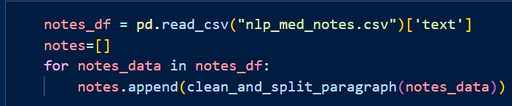
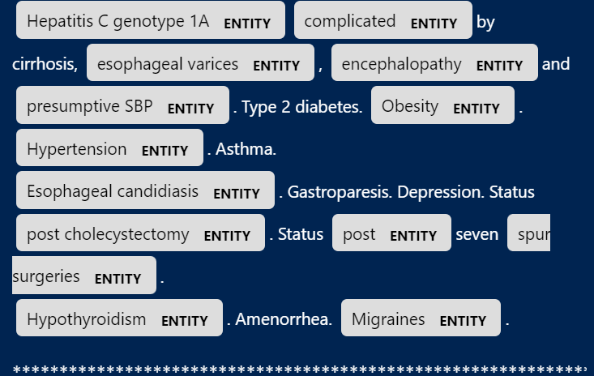
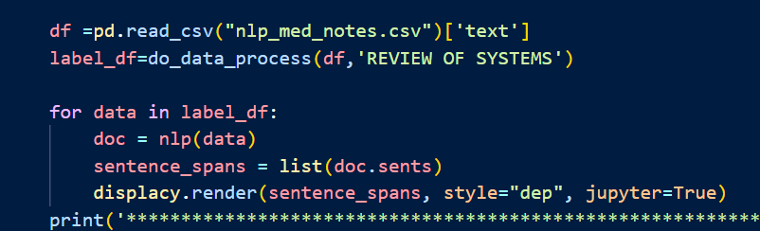
Load and clean the ‘nlp_med_notes.csv’ dataset
For each record extract the ‘PAST MEDICAL HISTORY’ subparagraph from text (i.e medical notes) field.
Visualize the extracted label_df to view the entities of spacy model.
Create a dependency tree using displacy from spacy model to show the relationship between words in a sentence.
A meaningful sentence can be extracted from ‘REVIEW OF SYSTEMS’ sub paragraph.

Slide 8
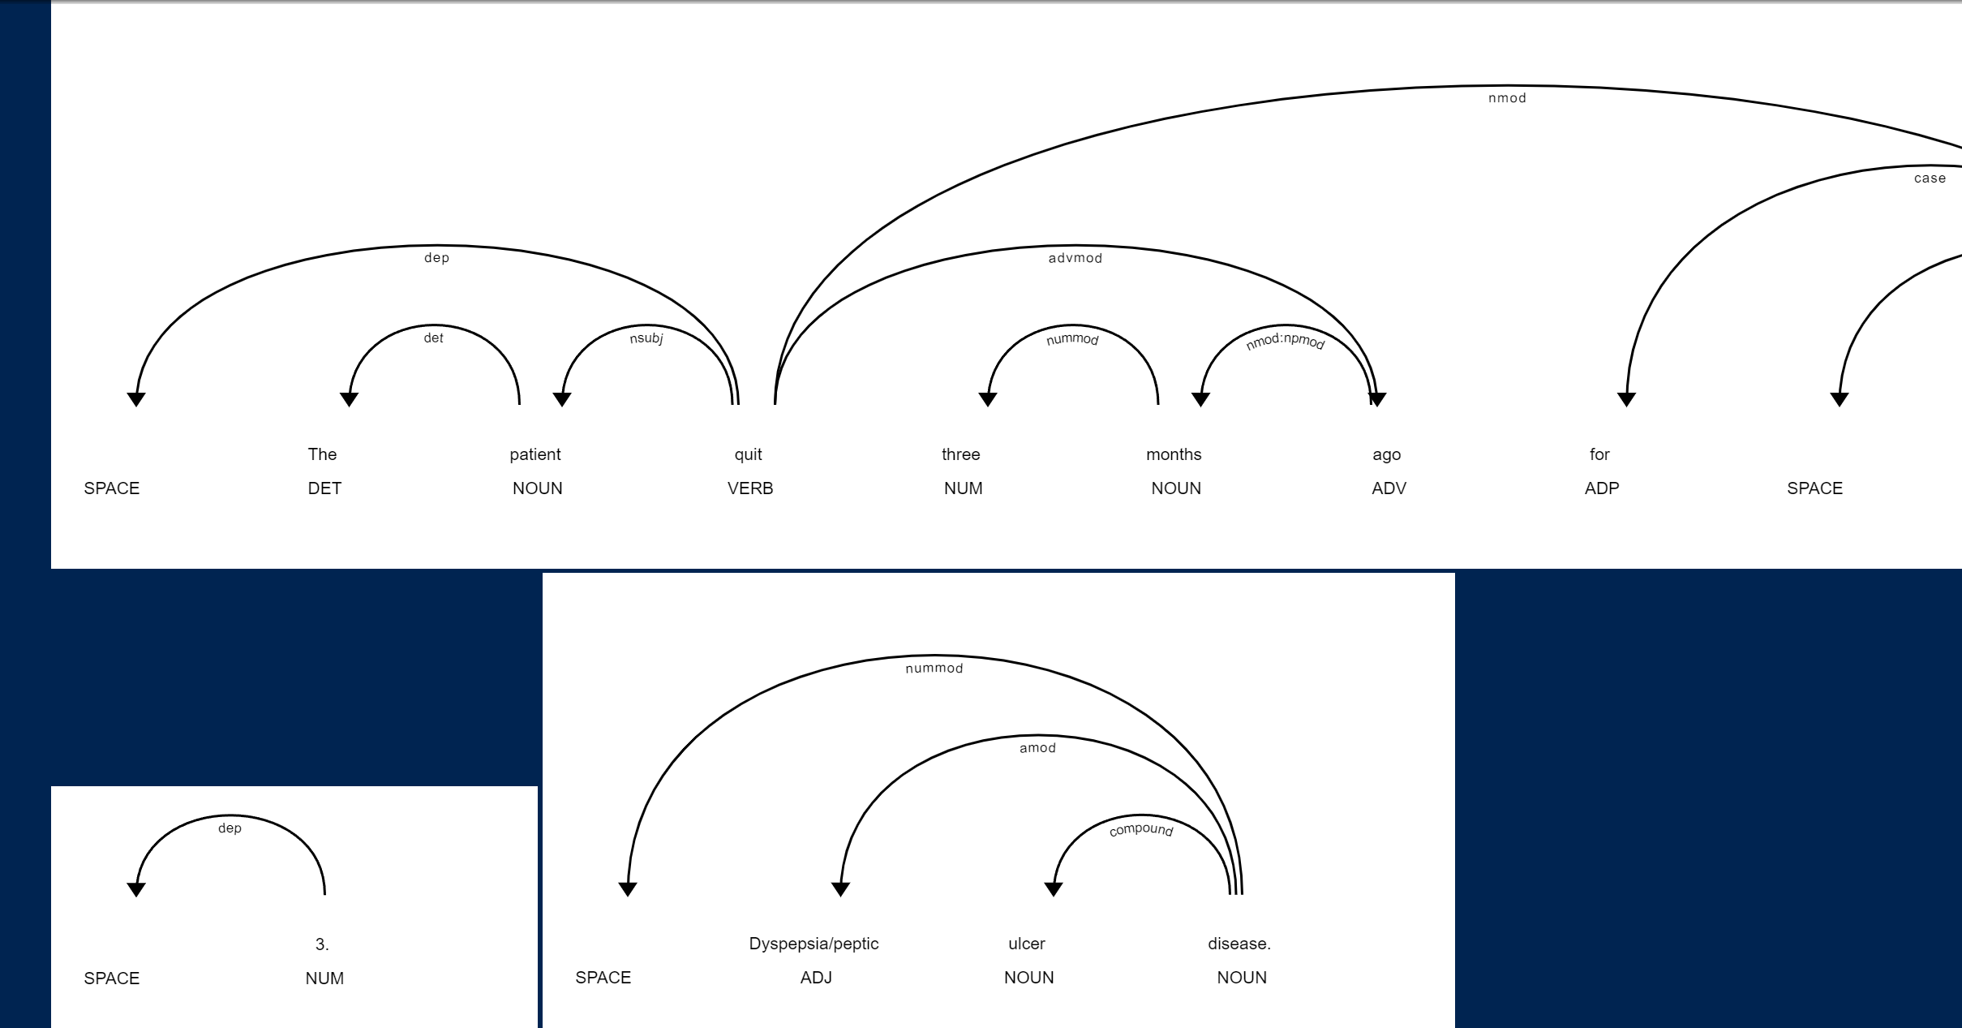

Slide 9
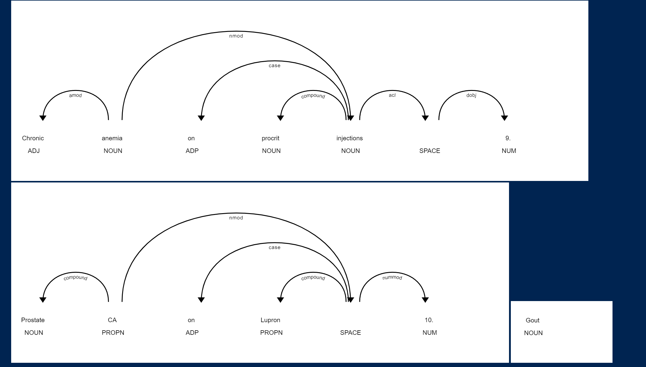

Slide 10
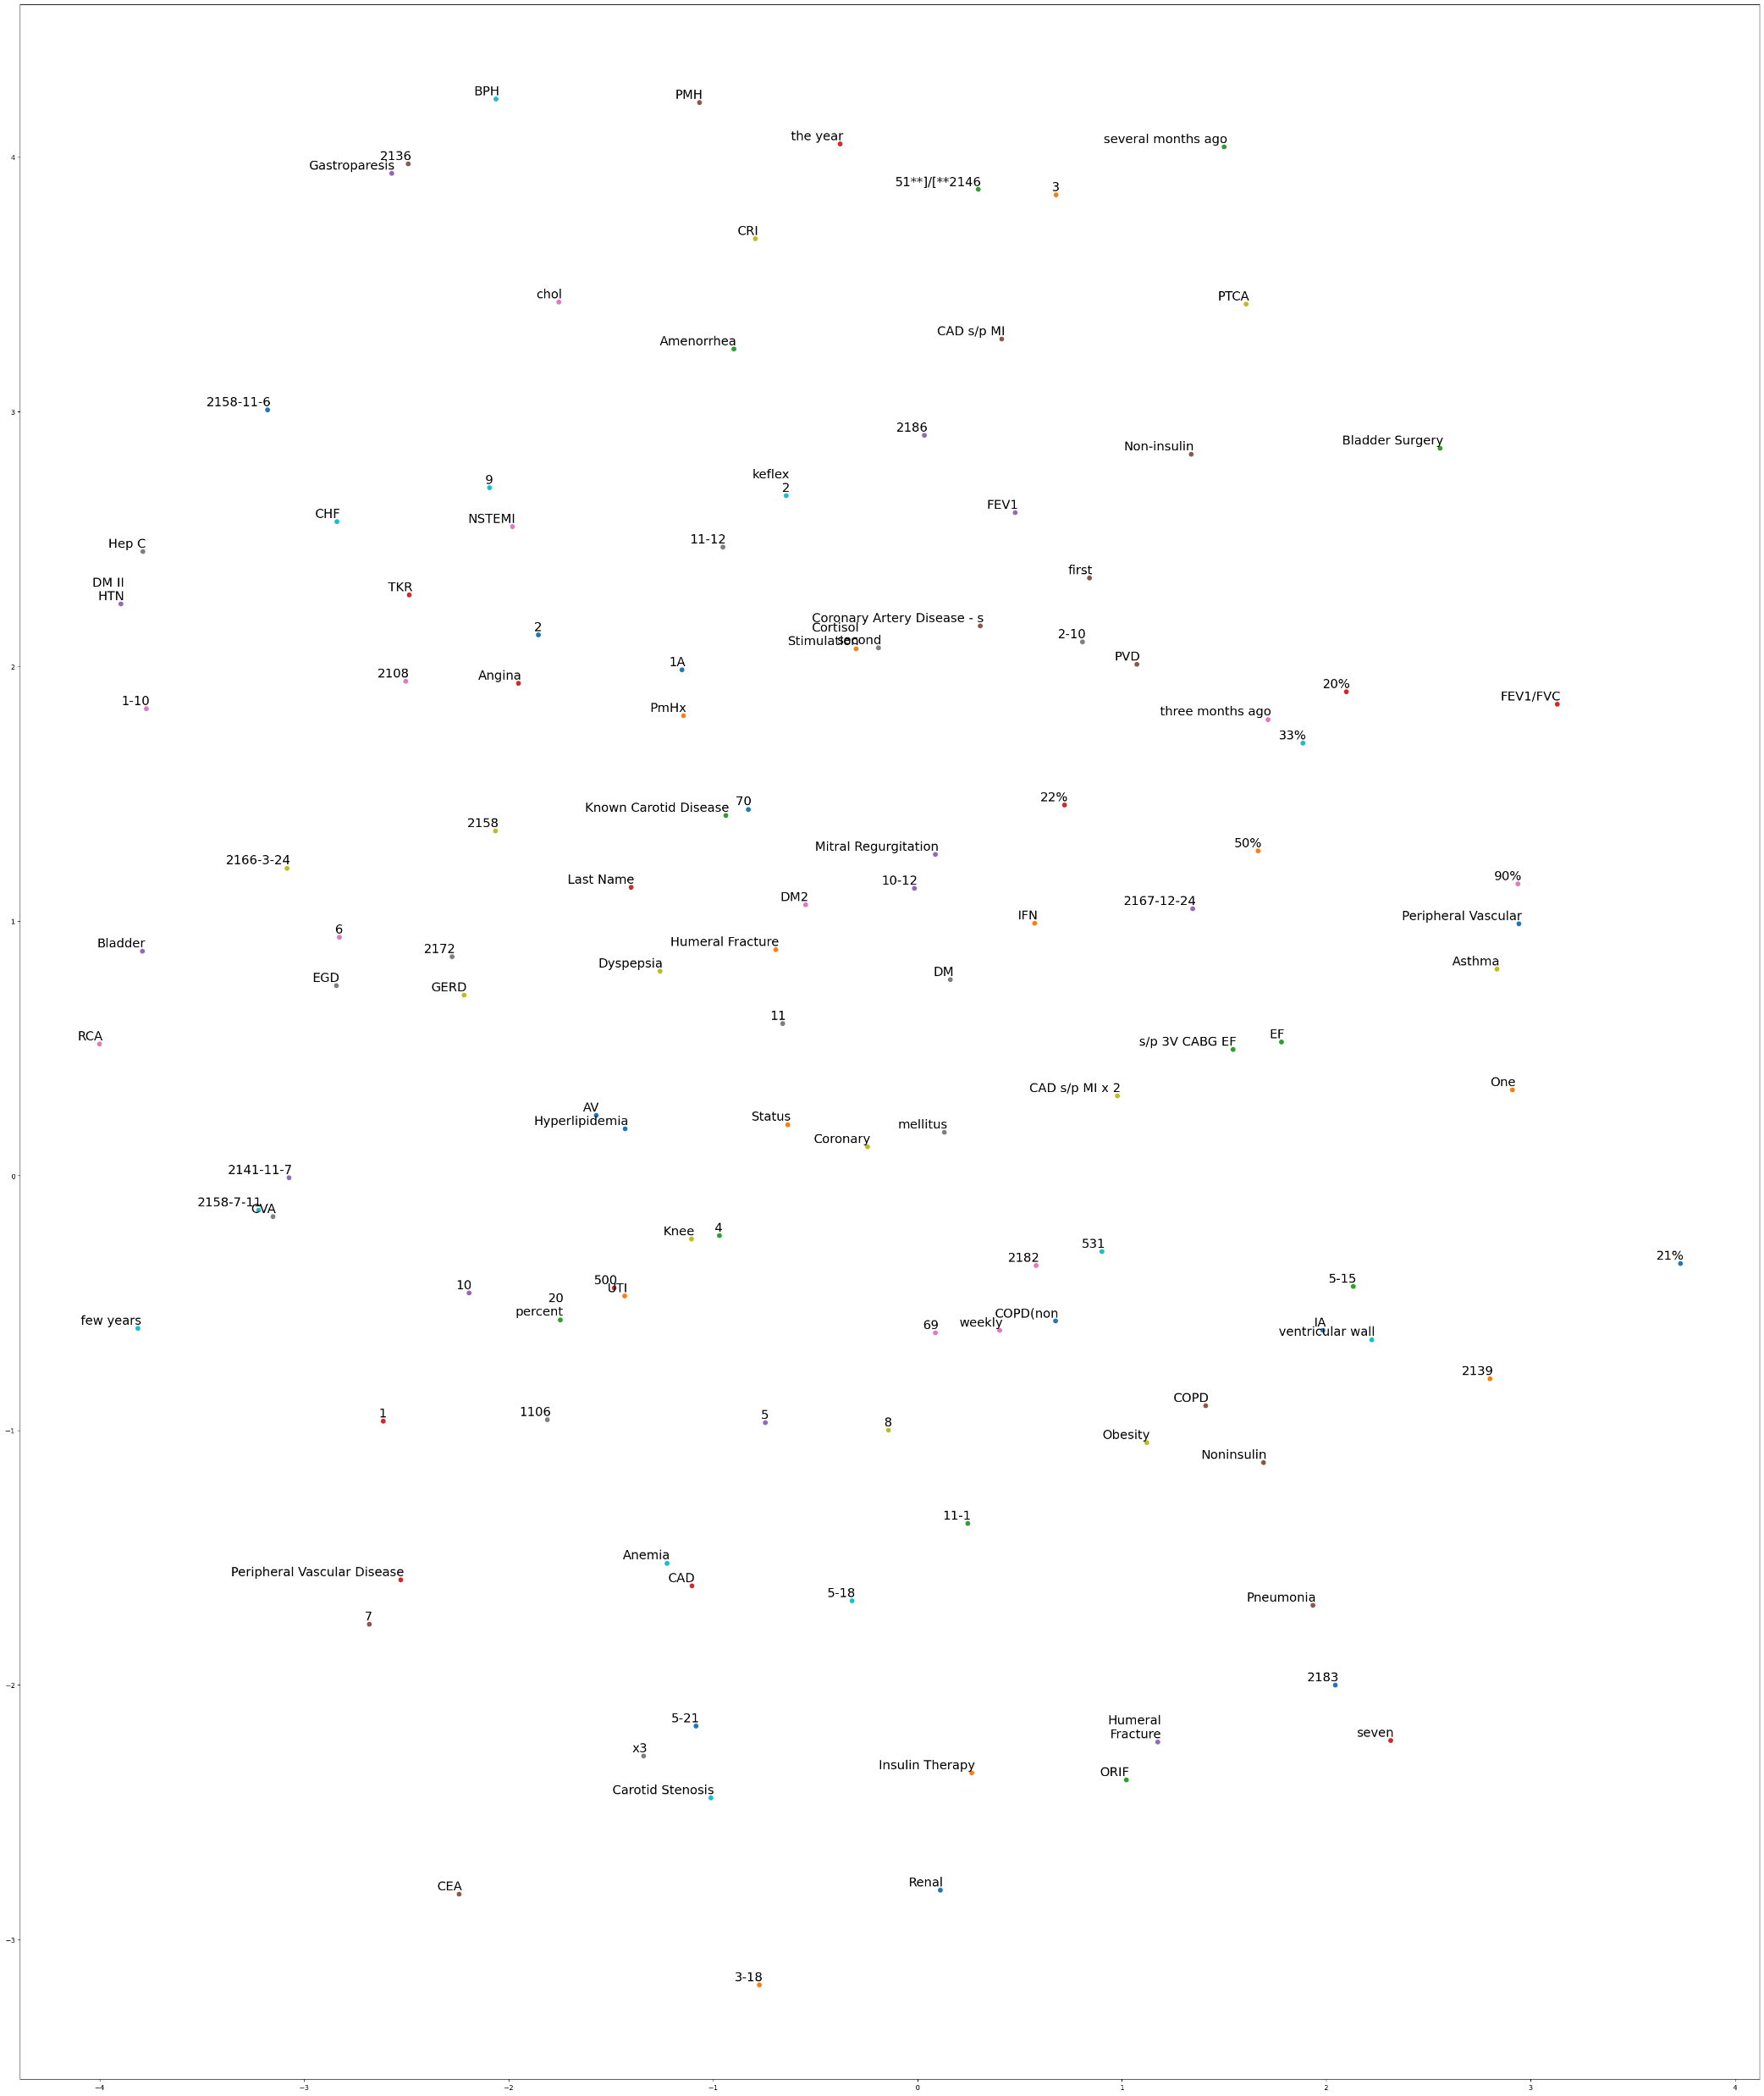

Spacy TSNE visualization: For Medication in medical notes
https://github.com/dalwari/mimic-iii-clinical-database-demo-1.4/blob/main/spacy_tsne_plot_diag.png

Slide 11
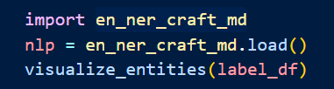
SciSpacy Usage:
SciSpacy models:
en_core_sci_md
en_core_sci_lg
en_ner_craft_md
en_ner_jnlpba_md
en_ner_bionlp13cg_md
en_ner_bc5cdr_md
Load the model and visualize the corpus.

Slide 12
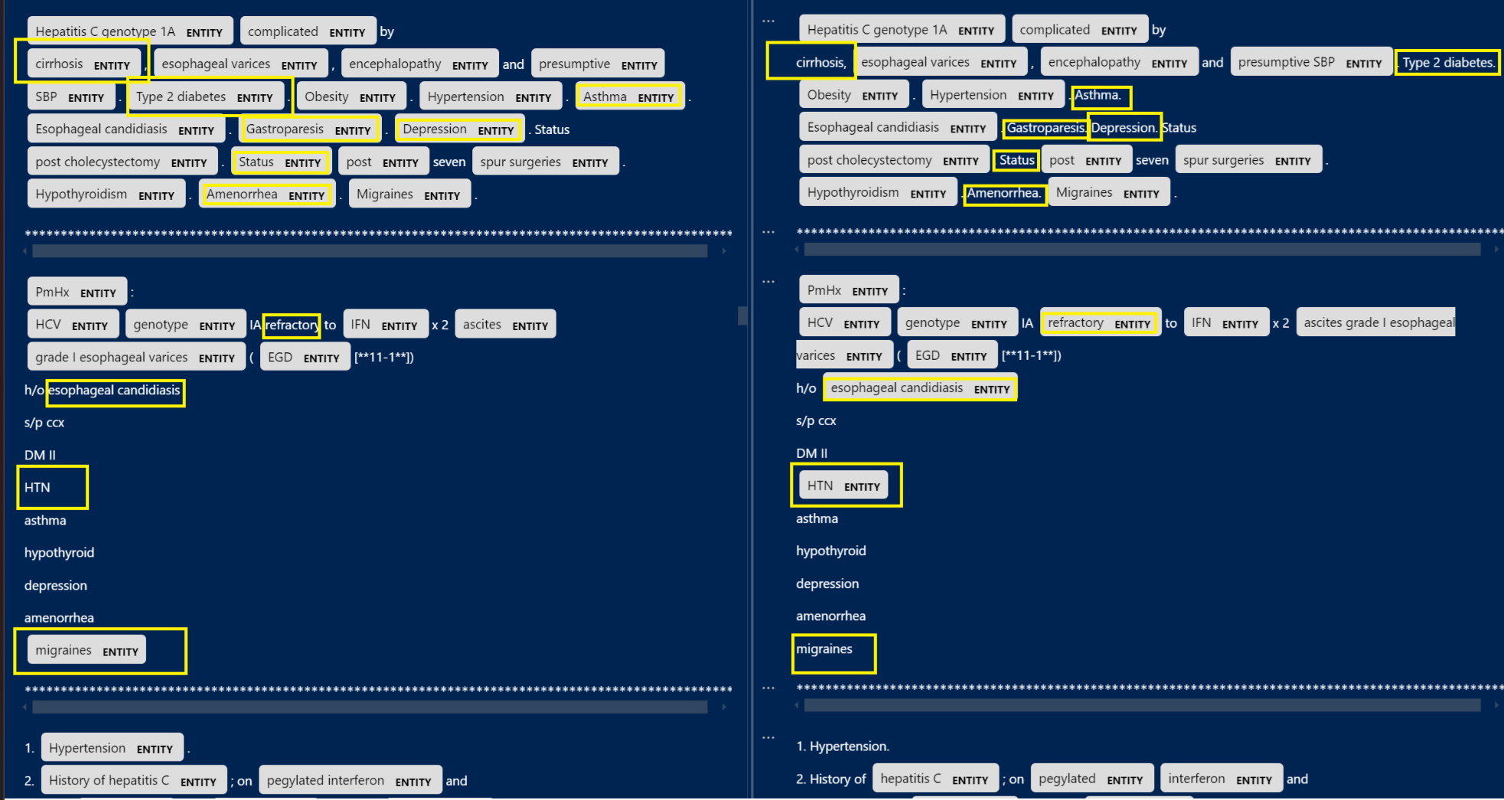
Sciscpacy: en_core_sci_lg
Spacy:

Slide 13
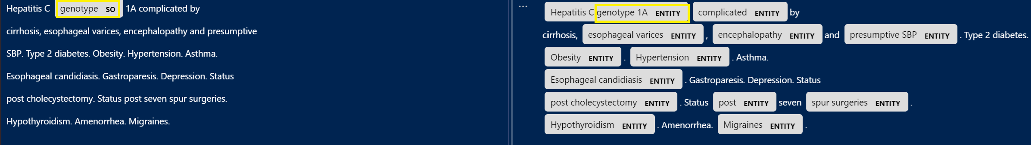
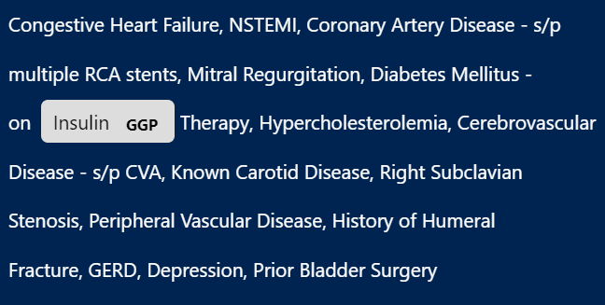
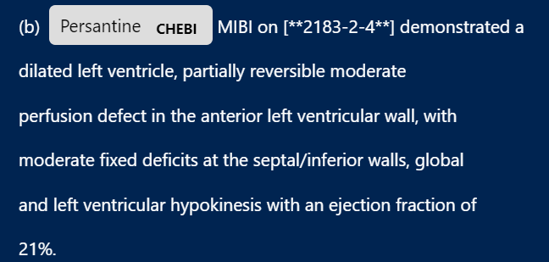
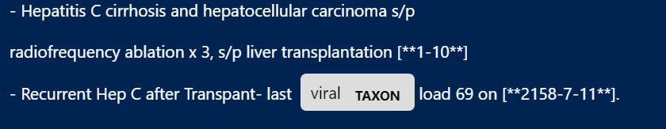
Scipacy: en_ner_craft_md
Spacy:

Slide 14

Scipacy: en_ner_craft_md
SO stands for Sequence Ontology
CL stands for Cell Ontology
CHEBI stands for Chemical Entities of Biological Interest
TAXON stands for Taxonomy
GCP stands for Gene Ontology Cellular Component
Scipacy: en_ner_jnlpba_md

Slide 15
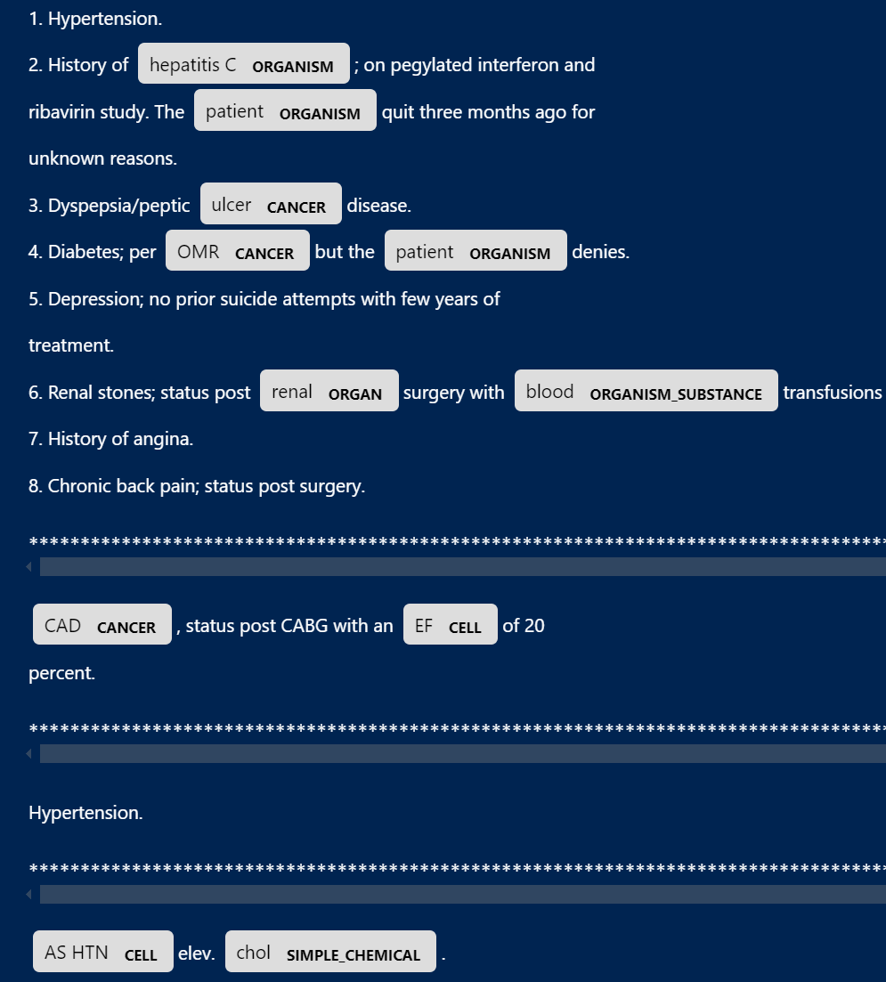
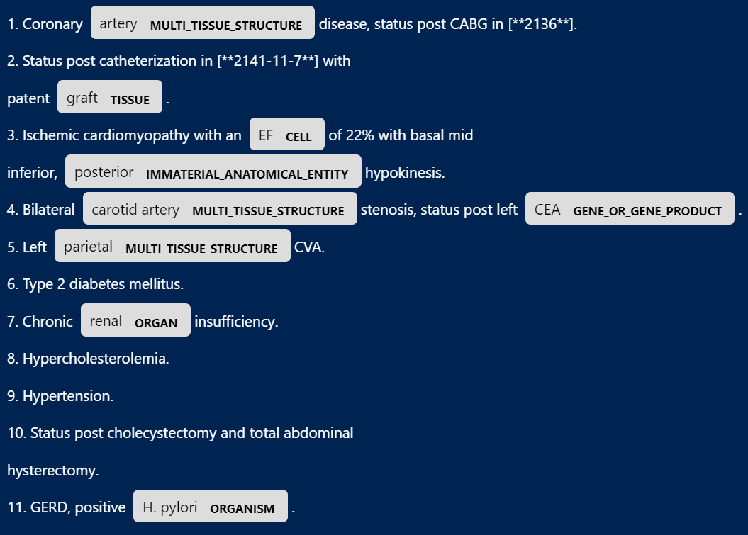
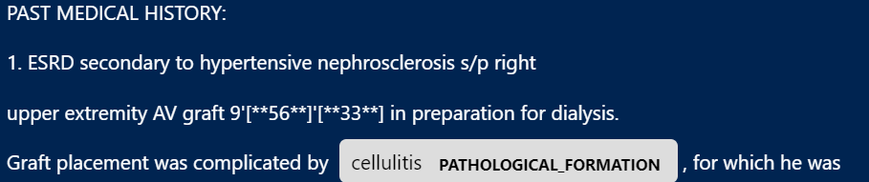
Scipacy: en_ner_bionlp13cg_md

Slide 16
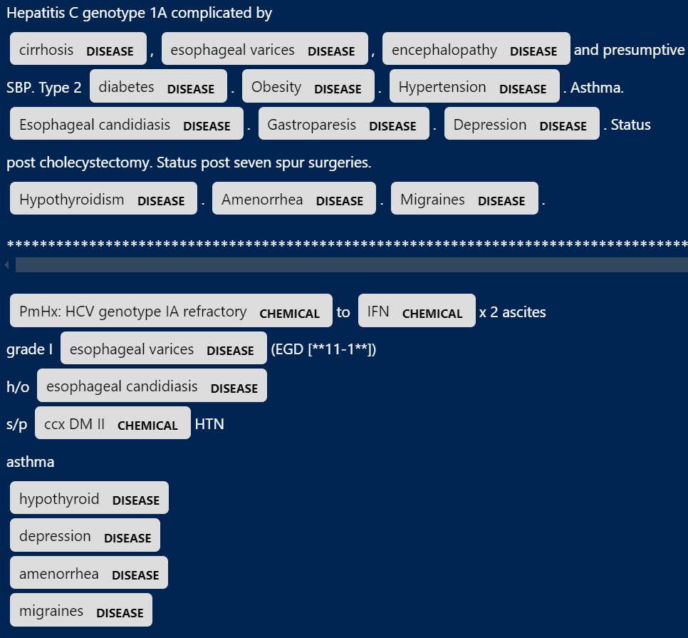
Scipacy: en_ner_bc5cdr_md
Conclusion:
With the help of different spacy models we are able to extract different kinds of NERs.

Slide 17
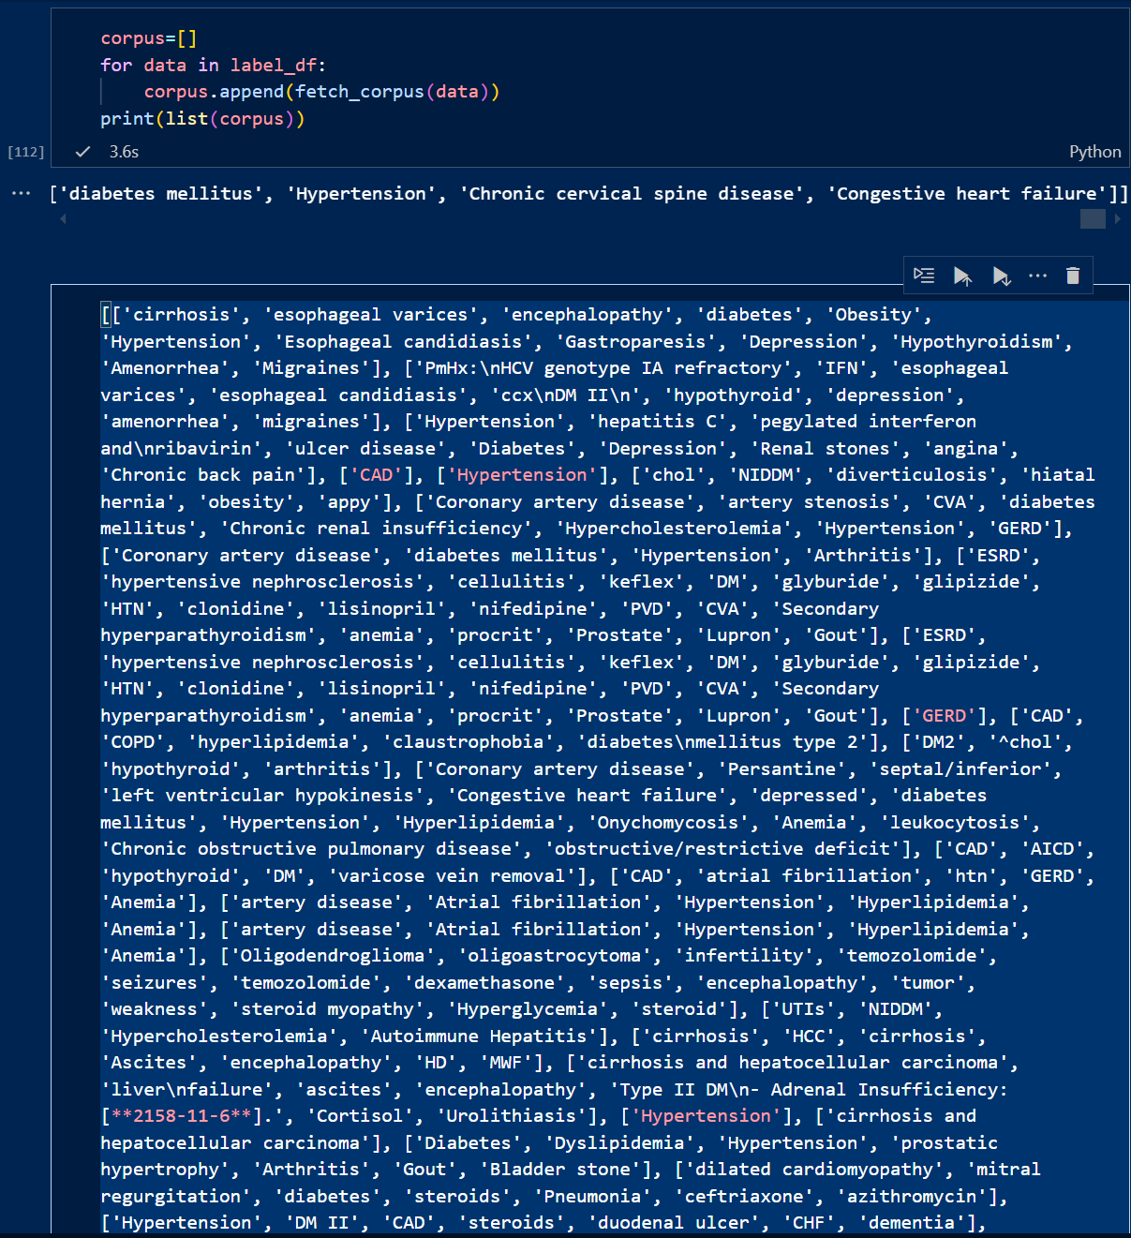
Word2Vec and TSNE plot usage:
Apply fetch_corpus() to retrieve the list of corpus from the medical note.

Slide 18
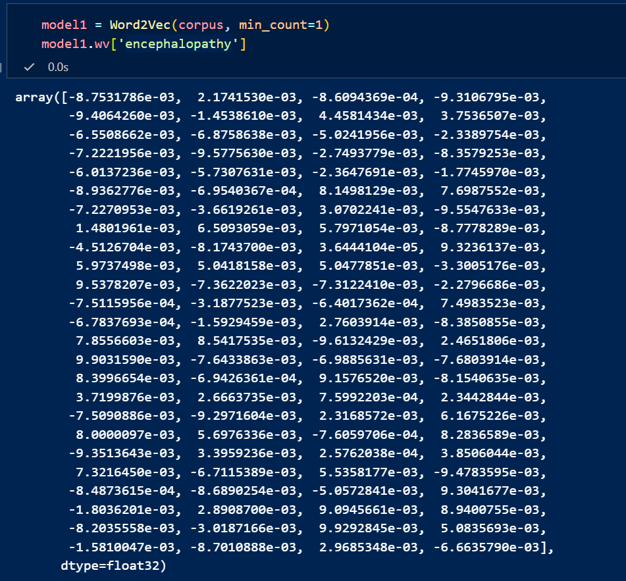
Code Snippet:
The resultant presents the similarity logits for the word ‘encephalopathy’

Slide 19
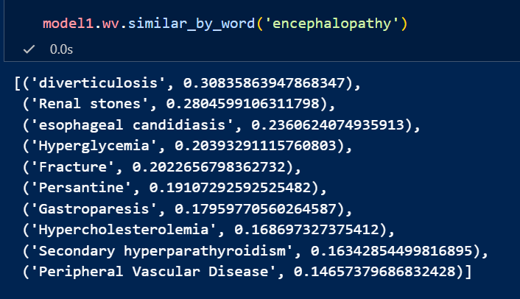
The code snippet shows the similar words that the model contains within it.

Slide 20

TSNE plot:
The corpus are plotted in tsne word embedding as per their logits.
SciSpacy TSNE plot:
https://github.com/dalwari/mimic-iii-clinical-database-demo-1.4/blob/main/tsne_plot_diag.png

Slide 21
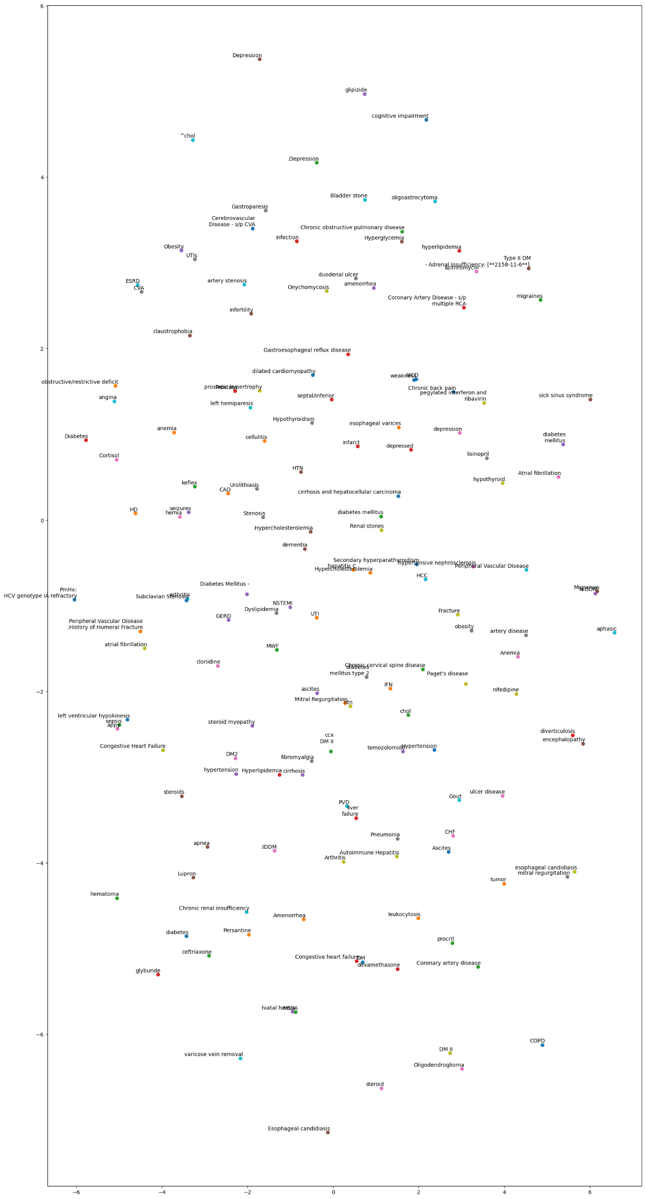

Slide 22
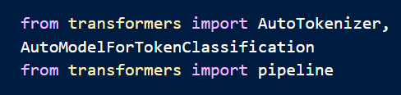
Clinical BERT:
Import transformers and classification package.
Initialize model.
Load dataset and examine ‘PHYSICAL EXAMINATION’ sub passage.

Slide 23
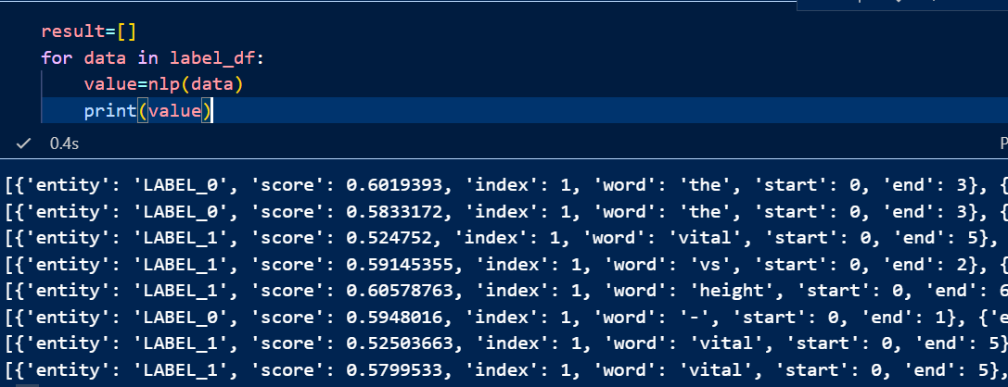
The output displays label and score for each word in a sentence.
The label is categorized by ClinicalBERT into LABEL_0 and LABEL_1
The score is given to each word in that label category.

Slide 24

For tokenization use import ntlk package
nltk.tokenize is used to split each text in list into individual words

Slide 25

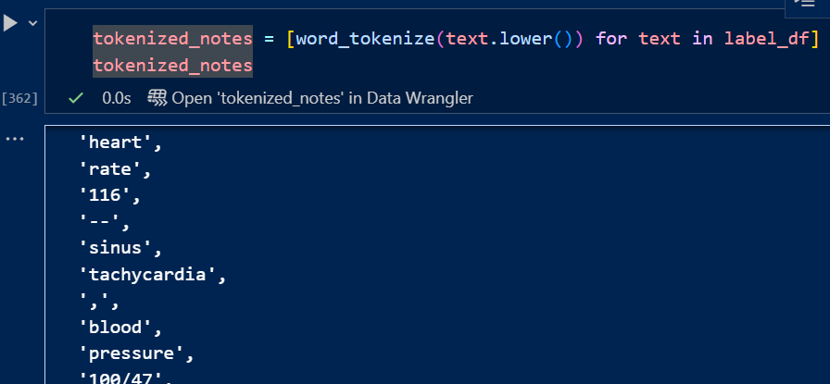
ClinicalBert can be visualized on ‘PHYSICAL EXAM’ label extracted subpassage from medical notes.
Tokenized notes presents the tokens extracted from the ‘PHYSICAL EXAM’ label_df
Word Vector is created by substituting the tokenized_notes.

Slide 26
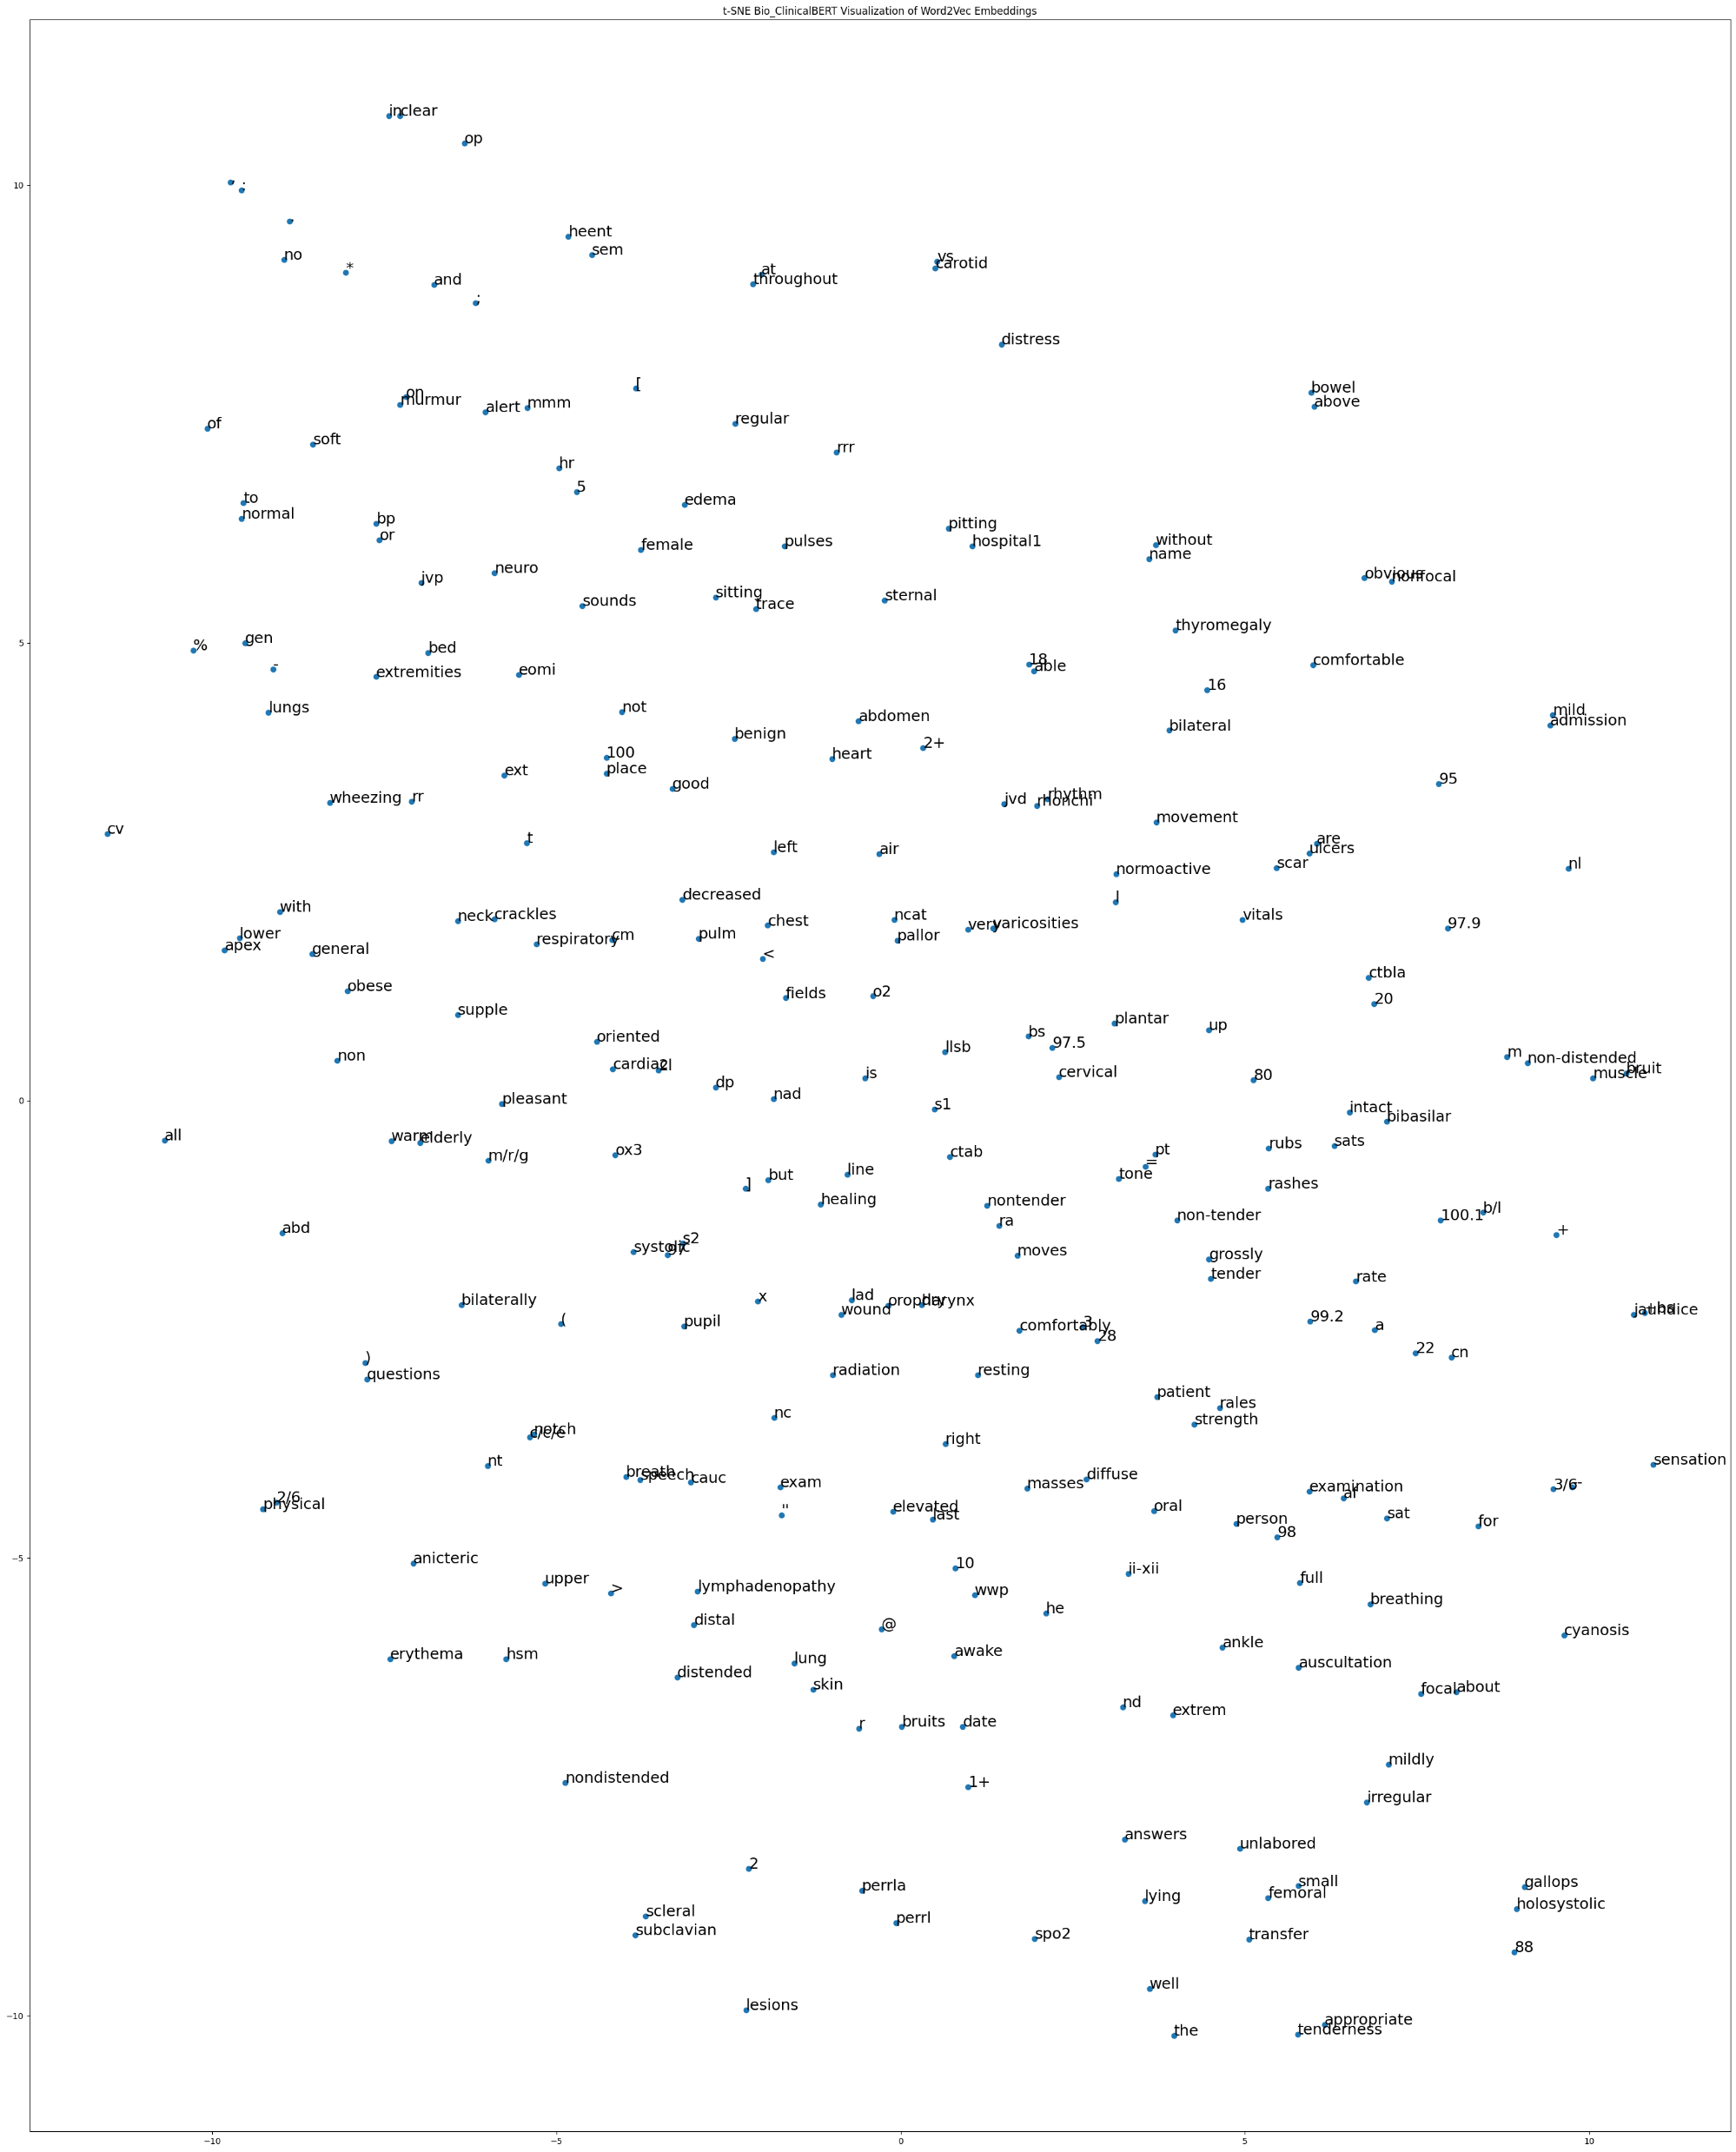
ClinicalBERT TSNE visualization: For Medication in medical notes
https://github.com/dalwari/mimic-iii-clinical-database-demo-1.4/blob/main/clinical_bert_tsne_plot.png

