Slide 1
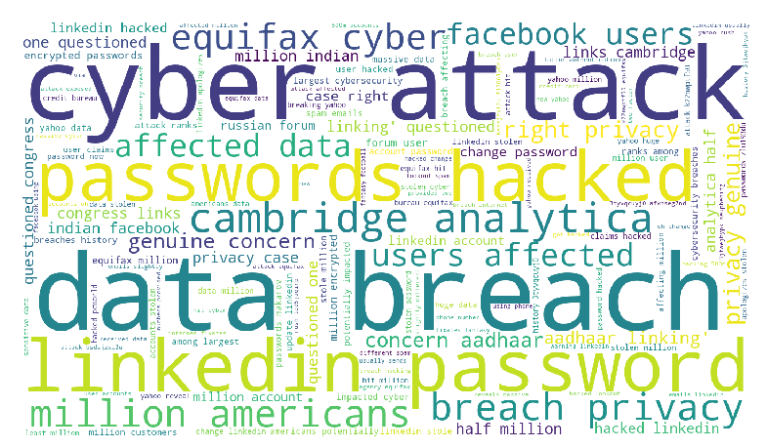
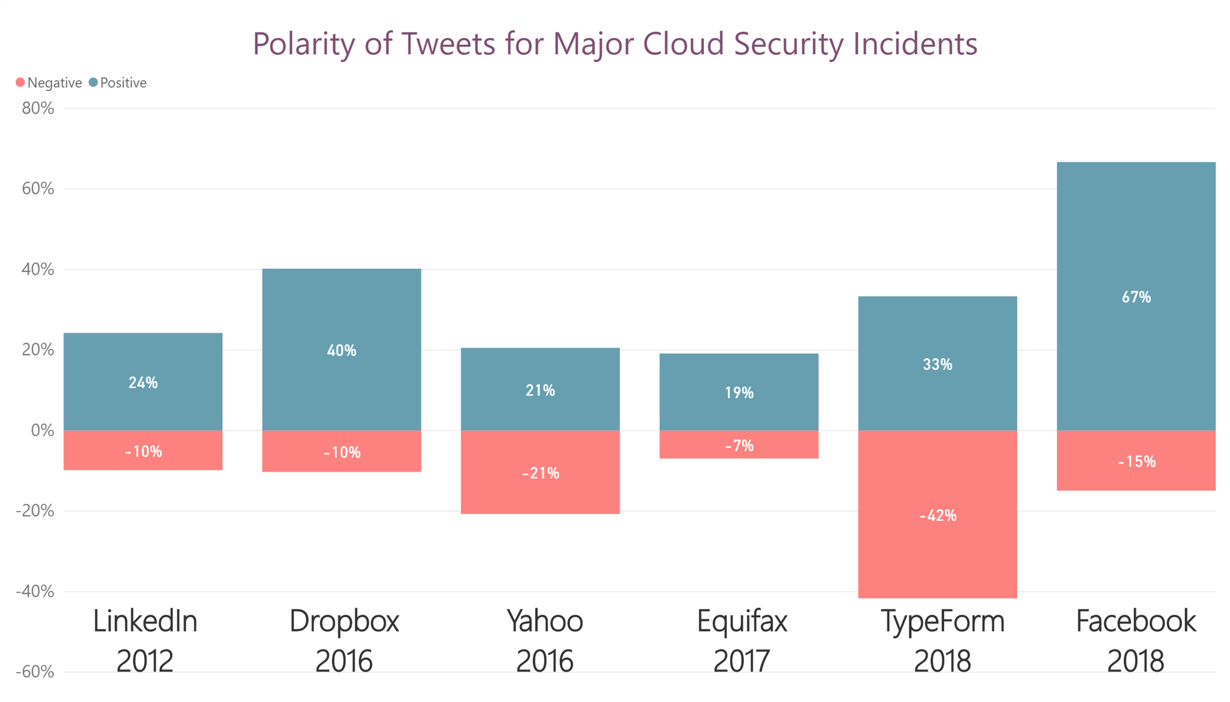
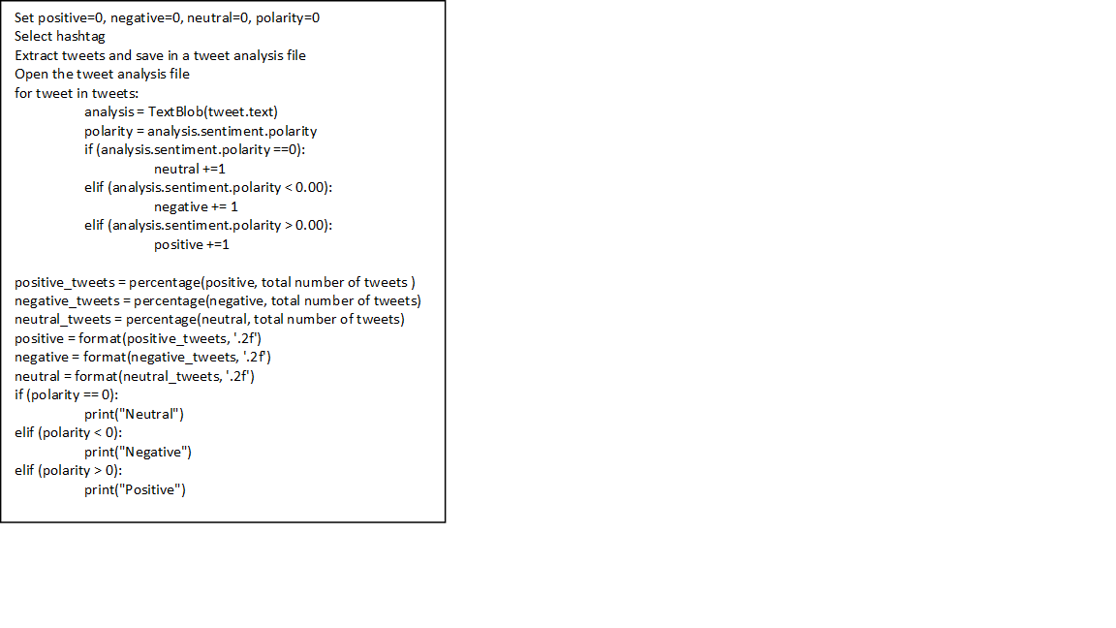
Measuring Awareness Of Cloud Security Threats: A Twitter Sentiment Analysis Ritika Joshi, Ashish Solanki, Dalyapraz Dauletbak Faculty Supervisor: Dr. Shilpa Balan Cyber Security & Awareness Fair Competition
Introduction
Cloud provides ease of accessibility to both, the clients and the users which made it the top choice of major organizations. However there have been tremendous financial losses due to cloud hacks which indicates that there is a need for the improvements in cloud security solutions.[1] Increase in the number of cyber threats is directly proportional to the increasing usage of cloud. Objective of this study is to raise the awareness of the cloud security problems and challenges. Main approach to analyse how much people are aware of those incidents and analyse the average polarity of their sentiments towards these incidents.
Research Background
In 2017, 146 million customers of Equifax faced a data breach, which involved their personal information like address, driver's license, credit cards and SSN. [4] Another recent example of a cloud data breach is that of Facebook where 30 million users had their information stolen such as personal data, device types for accessing Facebook, 10 last checked/tagged in place and even more.[5]
Research Methodology
Extraction of tweets over major cloud incidents with the use of Python libraries, such as tweepy, twython and searchtweets. Tweets are collected within one day of incident announcement to public. Twitter key words to identify critical issues in the cloud computing. Sentiment analysis with respect to how secure people feel about cloud threats was then done over the tweets dataset.
Analysis
Results
Conclusion
The awareness for LinkedIn, Dropbox, Equifax was high immediately after the announcement, whereas TypeForm incident was less mentioned in the Tweets. Negative polarity is high for Yahoo data leak. TypeForm negative polarity is high, however the awareness was comparatively low. Mostly used words for incidents spreading are: data breach, password, hack, cyber attack, affected data and privacy. The date and time has not influenced the awareness of the security threads, which means that awareness has no trends over time. Unexpectedly a positive polarity for the latest Facebook breach is considerably high (67% of all tweets)
References
[1] Alliance, Cloud Security. Top Threats Working Group The Treacherous 12 Cloud Computing Top Threats in 2016. Feb. 2016, downloads.cloudsecurityalliance.org/assets/research/top-threats/Treacherous-12_Cloud-Computing_Top-Threats.pdf. Accessed 11 Oct. 2018 [2] Alliance, Cloud Security. Cloud Computing Vulnerability Incidents: A Statistical Overview. Mar. 2013, https://cloudsecurityalliance.org/artifacts/cloud-computing-vulnerability-incidents-a-statistical-overview. Accessed 20 Oct. 2018 [3] Artur, Rot, Data and Services Security Issues and Challenges in Cloud Computing Environments. Proceedings of The 22nd World Multi-Conference on Systemics, Cybernetics and Informatics (WMSCI 2018). Mar. 2018 [4] Johnson, Alex. Equifax Breaks Down Just How Bad Last Year's Data Breach Was. NBC News, 8 May 2018, www.nbcnews.com/news/us-news/equifax-breaks-down-just-how-bad-last-year-s-data-n872496. Accessed 22 Oct. 2018 [5] O'Sulliva, Donie. Hackers Accessed Personal Information of 30 Million Facebook Users. Cable News Network, 12 Oct. 2018, www.cnn.com/2018/10/12/tech/facebook-hack-personal-information-accessed/index.html
Important Data Mined Keywords on Major Security Threats
Pseudo code of Sentiment Analysis Polarity Computation

