Slide 1

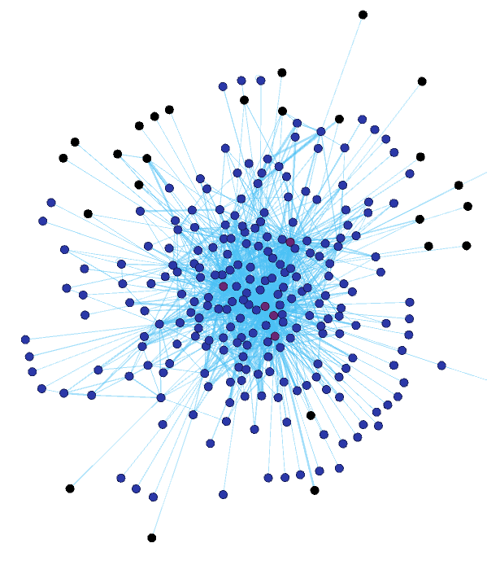
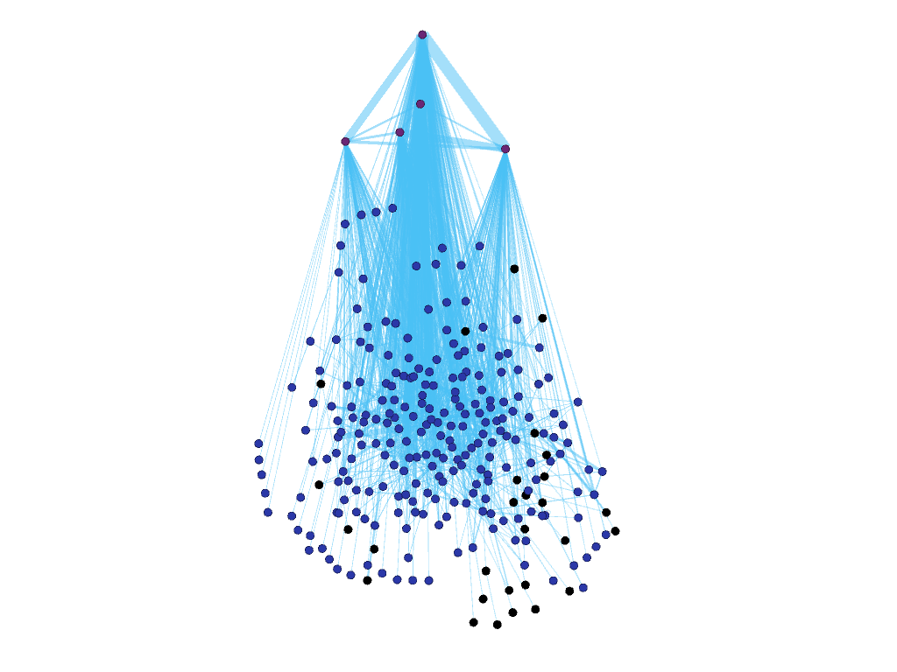
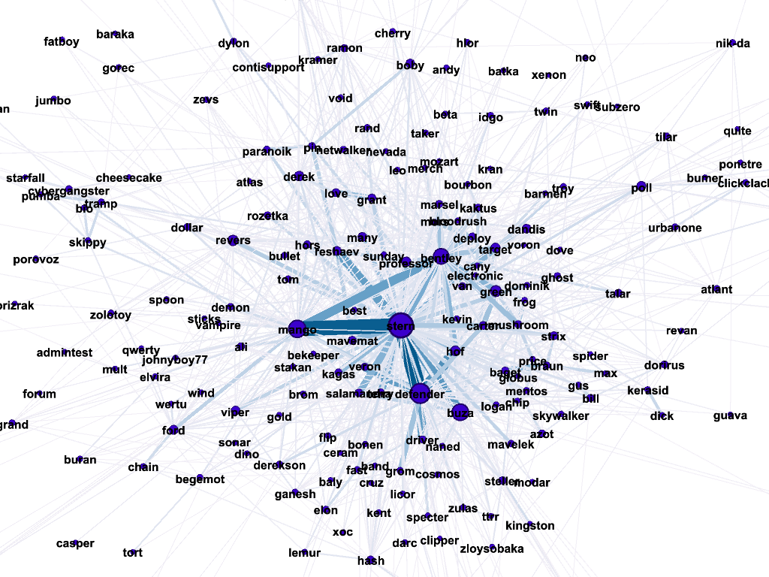
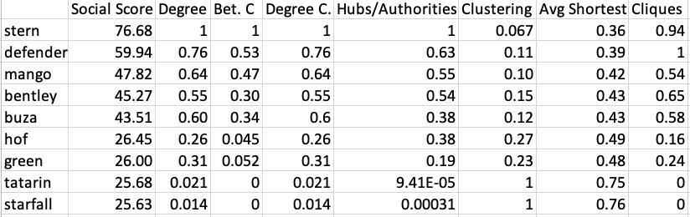
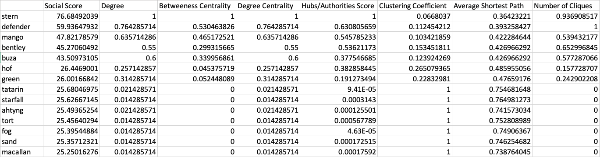


Uncovering the Organizational Hierarchy of a Cybercriminal Group: Story of a Ransomware Gang
Nadia Sabry , Luddy School of Informatics, Computing, and Engineering, Indiana University Mentored by: Dalya Manatova
1. What/Who is Conti?
4. Interaction Modeling
5. Analysis
Cybercrime is a huge cost to the global economy
Conti is a cybercrime group known to produce ransomware and is operating out of Russia
The group is responsible for nearly $130 million in USD damages
Organized cybercriminals are hard to study due to a lack of resources on their inner workings
An insider leaked over 60,000 internal messages
Each node represents a user
Edges represent the complete conversation between two users.
Complete conversion is determined by a set of messages exchanged between users within a small-time window.
Weight of each edge is determined by the number of complete conversations between users.
Managers/Leaders are highly connected to many nodes, as they oversee workflows
stern
bentley
defender
buza
mango
Upper-Level Employees have longer lifespans and established positions, ranging from software development to administrative roles
Lower-Level Employees have high turnover rate and little connectivity to the rest of the graph, likely contractor positions
2. Motivation
Using the social interactions of the group based off the messages, create a social network and use that information to create the group’s leadership hierarchy.
Some detailed evidence from messages that this hierarchy exists:
“I have 100 people here, half of them, even 10 percent, do not do what they need, and they only ask for money, because they think that they are f****** useful. ”
“We have salaries on the 1st and 15th, usually 2 times a month”
“Let's get the dollar out of the game. He is a f***** up bastard.”
"it would suck if he leaked something on our structure, or on coders... the forum is pretty famous, all information will fly around in a moment...”
Table of top ~10-15 users based on their score (including their scores)
Top ten users ranked by social score. Individual attribute scores displayed.
50% of users have a lifespan less than 6 months. 25% have less than 30 days. This indicates a high turnover for the group.
Mapping the organization’s hierarchy is based on previous research [1], where we calculate a social score for each user, using the attributes below:
*
3. Challenges
*We expect the lower-level employees are in contractor positions, which is why they don’t cluster with one another (low interaction)
Degree
Betweenness Centrality (Bet. C)
Degree Centrality (Degree C.)
Hubs/Authorities
Clustering Coefficient (Clustering)
Average Shortest Path
Number of Cliques
Social Score
Each attribute is normalized, then each user’s score is found using:
$$\frac{\sum_{a}{w_{a}∗a}}{\sum_{a}{w_{a}}}$$
where $a$ is each attribute value and $w_{a}$ is the weight for that attribute (all weights are equal here)
**We expect this to be different from existing literature due to the high turnover rate within the group and likelihood of the group working as a startup rather than a typical, more established organization
Unstructured conversations
Several platforms utilized
Conversations are all in Russian and Operation Security jargon
Extraction of hierarchical roles from chats is an understudied field
6. Future Work
More complex measure of interaction between users
Determining weight for each attribute in social score
Integrating NLP into existing work to increase accuracy
Acknowledgments: This research was conducted as part of the UROC program, run by Dr. Lamara D. Warren..
References: G. Creamer, R. Rowe, S. Hershkop, and S. J. Stolfo, “Segmentation and automated social hierarchy detection through email network analysis,” Advances in Web Mining and Web Usage Analysis, pp. 40–58, 2009.

