Slide 1

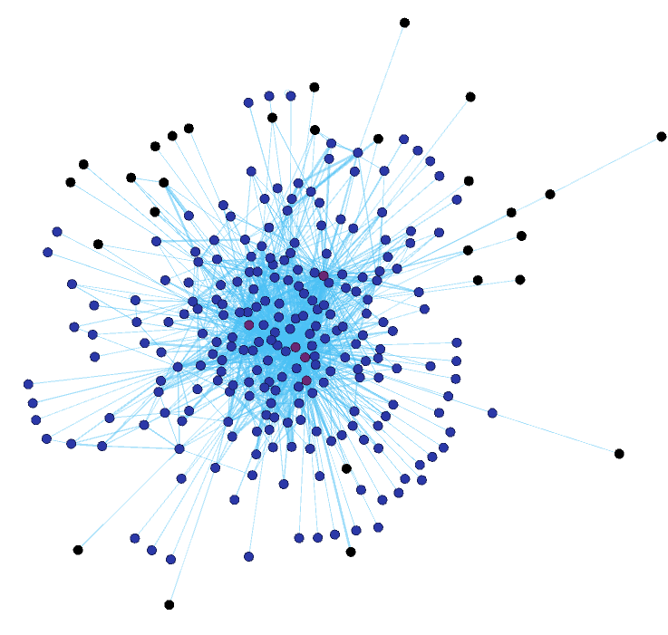
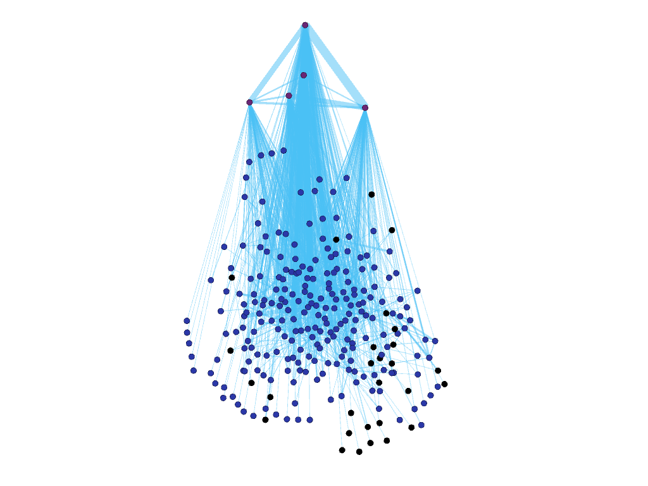
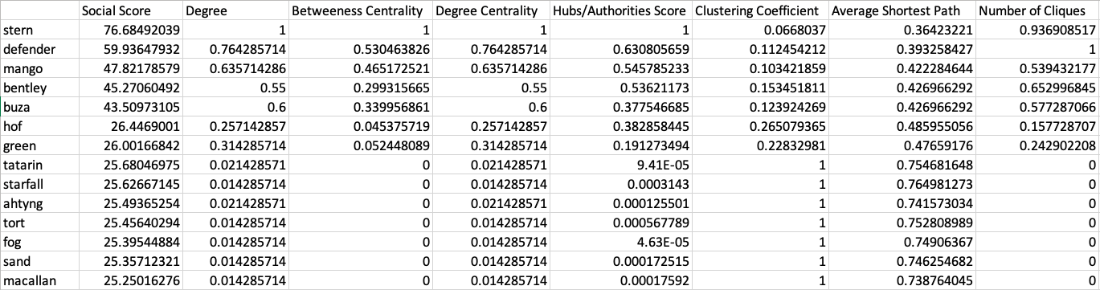

Undercovering the organizational ecosystem of cybercriminal group Conti
Nadia Sabry and Dalya Manatova, School of Informatics and Computing, Indiana University
1. Motivation
3. Interaction Modeling
4. Analysis
Cybercrime is a huge cost to the global economy--ransomware is a huge component
Organized cybercriminals are hard to study due to a lack of resources on their inner workings
Conti is a cybercrime group known to produce ransomware and is operating out of St. Petersburg, Russia
Conti ransomware is known to have affected all versions of Microsoft Windows
The United States government has offered upwards of $15 million dollars to information on Conti
Over 60,000 internal messages were leaked by an insider that was unhappy with the group’s bolstered support for Russia in light of the attacks on Ukraine
Using these messages, we map the social network and create the group’s leadership hierarchy
Manager to CEO:
"it's not the first day of this guy's account, a bunch of posts, I figured he's some kind of virtual Robingud...:) it would suck if he leaked something on our structure, or on coders... the forum is pretty famous, all information will fly around in a moment...”
Coordinating workflows:
"work with netwalker or not what do you think?”
"we need to do some recon, find out everything we can on these targets”
Coordinating payments:
"hello, can you send two payments to ZZ"
Hierarchical representation of the social network. Top node is stern, our CEO. Other notable users are defender, mango, buza, and bentley.
Table of top ~10-15 users based on their score (including their scores)
Each user is represented by a node
Edges represent the interaction between two users
Weight of each edge is determined by the number of meaningful conversations between two users
Meaningful conversations are determined by average time of message frequency
Users have a varied lifespan, which indicates a high turnover for the group
Mapping of the organization of the gang based on the previous research from Creamer et. al 2009
Calculated the metrics that we find important for mapping the hierarchy
Top fifteen users, ranked by social score. Attributes that contribute to social score are displayed as well.
Clustering coefficient
2. Challenges
Betweenness centrality
6. Future Work
Unstructured conversations
Several platforms utilized
Conversations are all in Russian
Learning Network Science methodology
Degree centrality
More complex measure of interaction between users
Determining weight for each attribute in social score
Integrating NLP into existing work to increase accuracy
SOCIAL SCORE
Acknowledgments: This research was conducted with support from UROP.

