Slide 1
Analytics zoo overview
Module 6

Slide 2
Overview
Understand Analytics Zoo features
Quick look at Zoo APIs

Slide 3
Analytics zoo

Slide 4
Analytics Zoo
Analytics Zoo provides a unified analytics + AI platform
It brings together Apache Spark*, TensorFlow*, Keras* and BigDL
Supports 'pipeline' style programming (popular in Scikit* and Spark)
Data wrangling and analysis using PySpark*
Deep learning model development using TensorFlow* or Keras*
Provides built-in deep learning models (more on this later)
*Other names and brands may be claimed as the property of others.

Slide 5
Analytics Zoo & Apache Spark*
Standard Spark* jobs
No changes to the Apache Spark* or Apache Hadoop* clusters needed
Iterative
Each iteration of the training runs as a Spark* job
Data parallel
Each Spark* task runs the same model on a subset of the data (batch)
(see next slide for diagram)
*Other names and brands may be claimed as the property of others.

Slide 6
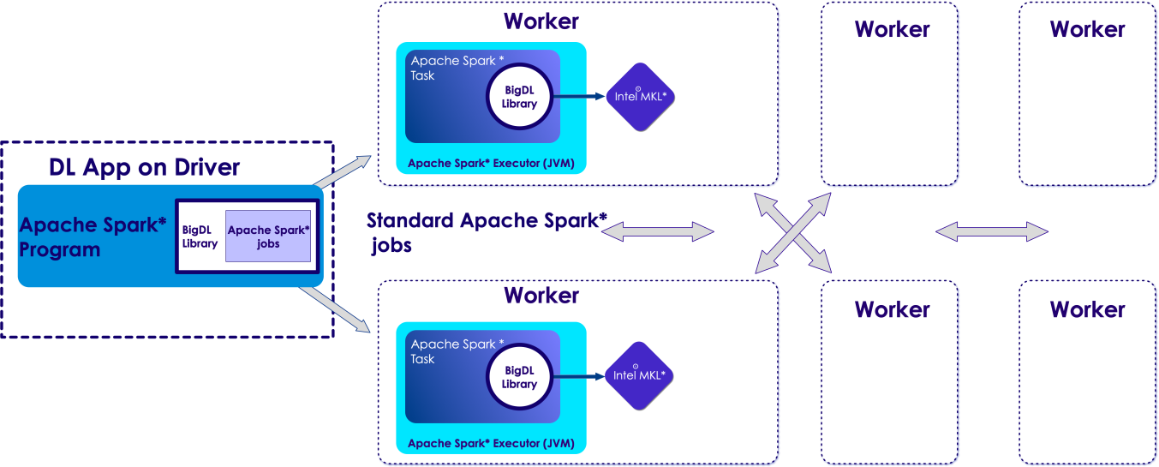
Analytics Zoo & Apache Spark*
*Other names and brands may be claimed as the property of others.
Apache Spark*
-submit
your python* file
Analytics-zoo.jar
zoo-python*.zip
MKL* native lib

Slide 7
Analytics Zoo Features

Slide 8
Analytics Zoo Features (List)
Distributed Tensorflow* and Keras* on Apache Spark*/BigDL
High-level abstractions and APIs (Keras style)
Native DL support for Spark DataFrames and ML Pipelines
Built-in deep learning models
Built-in feature engineering operations for data preprocessing
Model serving APIs (w/ OpenVINO support)
Support Web Services, Spark, Storm, Flink, Kafka, etc.

Slide 9
Zoo Features: High-level API
Analytics provides DataFrame-based high-level API
Also supports native integration with Apache Spark* ML Pipeline
These are in NNFrames package
NNFrames provides both Python* and Scala* APIs
Compatible with Spark* v1.6 and v2.x

Slide 10
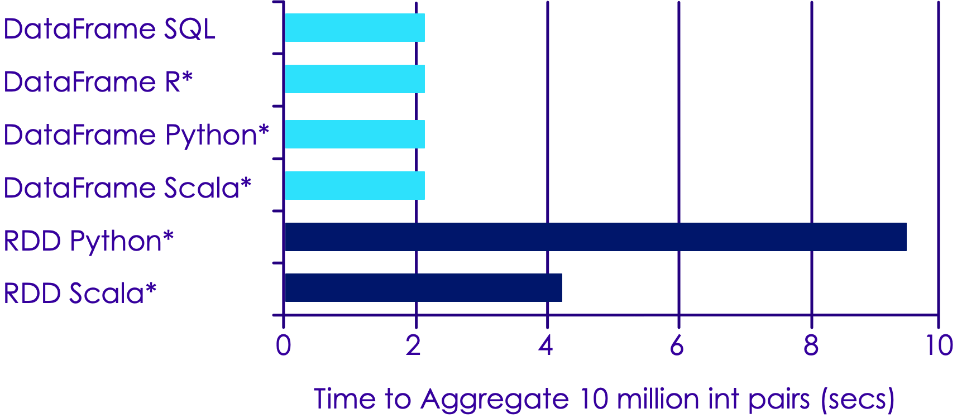
Apache Spark DataFrame Performance

Slide 11
Zoo : Keras* Style APIs
## 6.11 - Zoo : Keras Style APIs from zoo.pipeline.api.keras.layers import Convolution2D, MaxPooling2D, Dense from zoo.pipeline.api.keras.models import Sequential model = Sequential() .add(Convolution2D(32, 3, 3, activation='relu', input_shape=(1, 28, 28))) \ .add(MaxPooling2D(pool_size=(2, 2))) \ .add(Flatten()) .add(Dense(10, activation='softmax')))

Slide 12
NNFrames Highlights
Easy-to-use DataFrame (DataSet)-based API for training, prediction and evaluation
Integration with Apache Spark* ML pipeline and compatibility
Can use feature transformers and algorithms in Spark* ML.
Run inference or transfer learning from pre-trained models of Caffe*, Keras*, Tensorflow* or BigDL.
Training of BigDL built-in neural models (e.g., Inception, ResNet, Wide And Deep).
Rich toolset for feature extraction and processing, including image, audio and texts

Slide 13
NNFrames Useful Classes
Class | Description
NNEstimator | Extends org.apache.spark.ml.Estimator
NNModel | Extends Apache Spark's* ML Transformer
NNClassifier | Used for classification tasks
NNClassifierModel | Specialized NNModel for classification task
NNImageReader | Reads in Image data
*Other names and brands may be claimed as the property of others.

Slide 14
zoo.feature.image Package : Feature Engineering of Images
Class | Description
NNImageReader | Reads images into Apache Spark* DataFrame
Image Transformers | Zoo provides many pre-defined image processing transformers built on top of OpenCV™
 | ImageBrightness – adjusts Image brightness
 | ImageResize – resize image
 | ImageMatToTensor - Transform opencv mat to tensor
 | for full list see here

Slide 15
NNFrames: NNImageReader
Load images into DataFrames using NNImageReader Process loaded data using DataFrame transformations
## 6.9 - NNImageReader from zoo.common.nncontext import init_nncontext from zoo.pipeline.nnframes import NNImageReader sc = init_nncontext() # read images from a path imageDF = NNImageReader.readImages('/path/to/images', sc) getName = udf(lambda row: ...) df = imageDF.withColumn("name", getName(col("image")))

Slide 16
zoo.feature.image Package: Feature Engineering of Images
Process Images using built-in feature engineering operations
## 6.10 – Zoo Image Processing from zoo.pipeline.nnframes import NNImageReader, ChainedPreprocessing from zoo.feature.image import RowToImageFeature, ImageChannelNormalize, ImageMatToTensor, ImageFeatureToTensor transformer = ChainedPreprocessing( [RowToImageFeature(), ImageChannelNormalize(123.0, 117.0, 104.0), ImageMatToTensor(), ImageFeatureToTensor()])

Slide 17
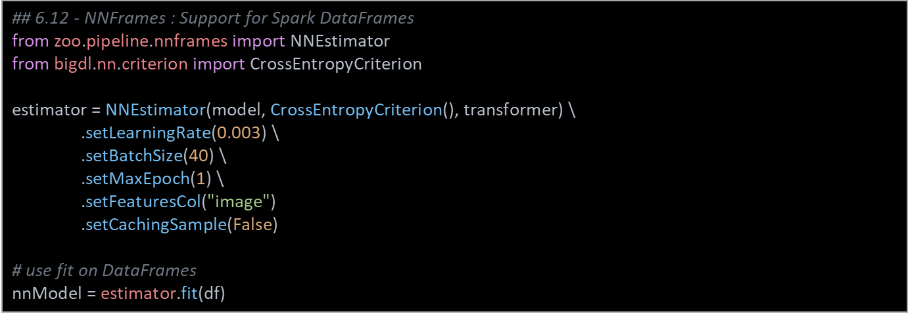
NNFrames: Native DL Support in Apache Spark* Dataframes
Train Model Using Spark ML Pipelines Process loaded data using DataFrame transformations

Slide 18
Distributed Tensorflow on Zoo
We will illustrate 3 steps
Data wrangling using Spark
Model development
Distributed training

Slide 19
Distributed Tensorflow on Zoo
Data wrangling using Spark
from zoo import init_nncontext
from zoo.pipeline.api.net import TFDataset
sc = init_nncontext()
#Each record in the train_rdd consists of a list of NumPy ndrrays
train_rdd = sc.parallelize(file_list)
.map(lambda x: read_image_and_label(x))
.map(lambda image_label: decode_to_ndarrays(image_label))
#TFDataset represents a distributed set of elements,
#in which each element contains one or more TensorFlow Tensor objects.
dataset = TFDataset.from_rdd(train_rdd,
names=["features", "labels"],
shapes=[[28, 28, 1], [1]],
types=[tf.float32, tf.int32],
batch_size=BATCH_SIZE)

Slide 20
Distributed Tensorflow on Zoo
2. Deep Learning model development using Tensorflow
import tensorflow as tf
slim = tf.contrib.slim
images, labels = dataset.tensors
labels = tf.squeeze(labels)
with slim.arg_scope(lenet.lenet_arg_scope()):
logits, end_points = lenet.lenet(images, num_classes=10, is_training=True)
loss = tf.reduce_mean(tf.losses.sparse_softmax_cross_entropy(logits=logits, labels=labels))

Slide 21
Distributed Tensorflow on Zoo
3. Distributed training on Spark
from zoo.pipeline.api.net import TFOptimizer
from bigdl.optim.optimizer import MaxIteration, Adam, MaxEpoch, TrainSummary
optimizer = TFOptimizer.from_loss(loss, Adam(1e-3))
optimizer.set_train_summary(TrainSummary("/tmp/az_lenet", "lenet"))
optimizer.optimize(end_trigger=MaxEpoch(5))

Slide 22
Transfer Learning APIs
We are loading a Caffe model Removing last few layers Freezing firest few layers And appending a few layers
from zoo.pipeline.api.net import *
full_model = Net.load_caffe(def_path, model_path)
# Remove layers after pool5
model = full_model.new_graph(outputs=["pool5"])
# freeze layers from input to res4f inclusive
model.freeze_up_to(["res4f"])
# append a few layers
image = Input(name="input", shape=(3, 224, 224))
resnet = model.to_keras()(image)
resnet50 = Flatten()(resnet)

Slide 23
Model Serving API – Java
import com.intel.analytics.zoo.pipeline.inference.AbstractInferenceModel; public class TextClassification extends AbstractInferenceModel { public RankerInferenceModel(int concurrentNum) { super(concurrentNum); } ... } public class ServingExample { public static void main(String[] args) throws IOException { TextClassification model = new TextClassification(); model.load(modelPath, weightPath); texts = ... List<JTensor> inputs = preprocess(texts); for (JTensor input : inputs) { List<Float> result = model.predict(input.getData(), input.getShape()); ... } }

Slide 24
Model Serving API – Open VINO (Python)
from zoo.common.nncontext import init_nncontext from zoo.feature.image import ImageSet from zoo.pipeline.inference import InferenceModel sc = init_nncontext("OpenVINO Object Detection Inference Example") images = ImageSet.read(options.img_path, sc, resize_height=600, resize_width=600).get_image().collect() input_data = np.concatenate([image.reshape((1, 1) + image.shape) for image in images], axis=0) model = InferenceModel() model.load_tf(options.model_path, backend="openvino", model_type=options.model_type) predictions = model.predict(input_data) # Print the detection result of the first image. print(predictions[0])

Slide 25
Analytics Zoo Built-in Models

Slide 26
Built-in models
Model | Description
Object Detection | Identification of Objects within Images
Image Classifier | Classification of Images as one of n classes
Text Classification | Identifying Text as one of n classes
Recommendation | Predict User-item relationship

Slide 27
Object Detection API
Analytics Zoo provides a collection of pre-trained models for Object Detection
These models can be used for out-of-the-box inference
Two typical kind of pre-trained Object Detection models: SSD and Faster RCNN-supported models
PASCAL VOC model
COCO model

Slide 28
Object Detector Sample Usage – Python*
## 6.4 - Object Detection API from zoo.common.nncontext import init_nncontext from zoo.models.image.objectdetection import ImageSet, ObjectDetector sc = init_nncontext("image detector app") model = ObjectDetector.load_model(model_path) image_set = ImageSet.read(img_path, sc) output = model.predict_image_set(image_set)

Slide 29
Image Classification API
Analytics Zoo provides a collection of pre-trained models for Image Classification
Provided models:
Alexnet
Inception-V1
VGG
Resnet
Densenet, Mobilenet, Squeezenet
You can download the models here

Slide 30
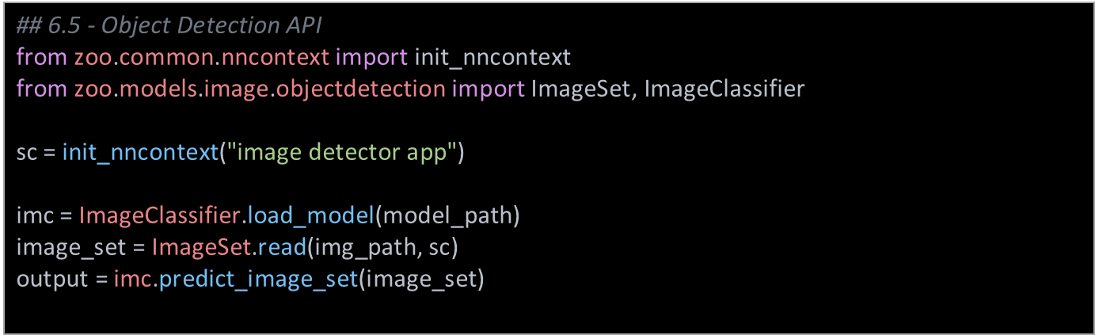
Image Classification Usage

Slide 31
Text Classification API
Analytics Zoo provides pre-defined models having different encoders that can be used for classifying texts.
Features:
Easy-to-use models, could be fed into NNFrames or BigDL Optimizer for training
The encoders we support include CNN, LSTM and GRU
Example 1

Slide 32
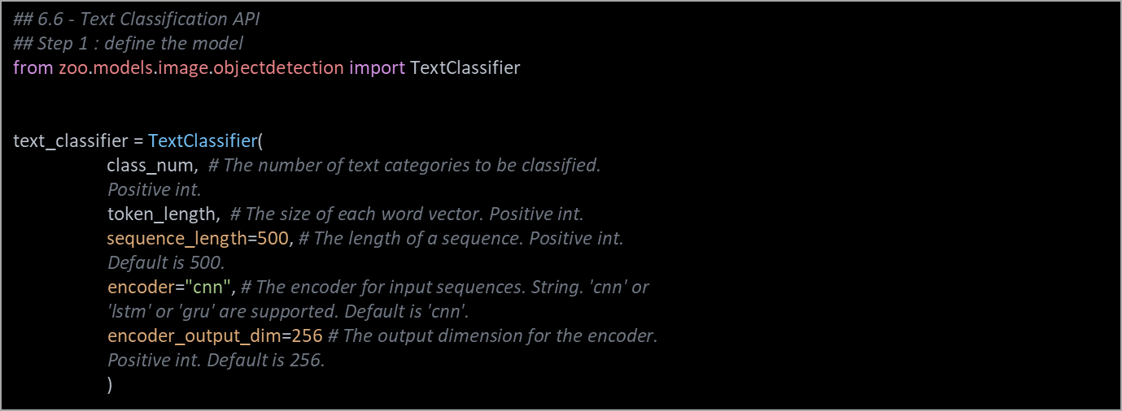
Text Classifier Sample Code

Slide 33
Text Classifier Sample Code
## Step 2 : train the model optimizer = Optimizer( model=text_classifier, training_rdd=train_rdd, criterion=ClassNLLCriterion(logProbAsInput=False), end_trigger=MaxEpoch(20), batch_size=128, optim_method=Adagrad(learningrate=0.01, learningrate_decay=0.001)) optimizer.set_validation( batch_size=128, val_rdd=val_rdd, trigger=EveryEpoch(), val_method=[Top1Accuracy()])

Slide 34
Text Classifier Sample Code
## Step 3 : Predict # Predict for probability distributions. results = text_classifier.predict(rdd)
# Predict for class labels. By default, label starts from 0. result_classes = text_classifier.predict_classes(rdd)

Slide 35
Recommendation API
Analytics Zoo provides two Recommender models, including Wide and Deep (WND) learning model and Neural network-based Collaborative Filtering (NCF) model.
Features:
Easy-to-use models, could be fed into NNFrames or BigDL Optimizer for training
Recommenders can handle either explicit or implicit feedback, given corresponding features
It provides three user-friendly APIs to predict user item pairs, and recommend items (users) for users (items)
Example1

Slide 36
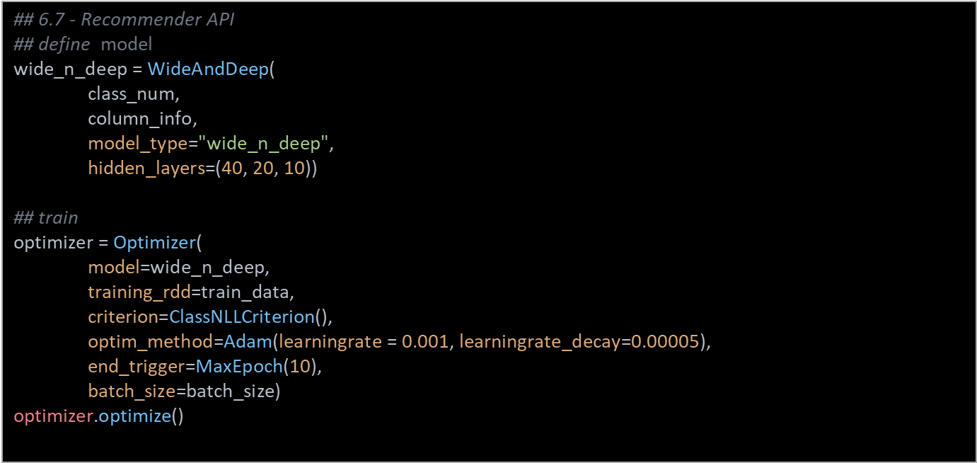
Recommendation API Usage

Slide 37
Recommendation API Usage
## predict userItemPairPrediction = wide_n_deep.predict_user_item_pair(valPairFeatureRdds)
userRecs = wide_n_deep.recommend_for_user(valPairFeatureRdds, 3) itemRecs = wide_n_deep.recommend_for_item(valPairFeatureRdds, 3)

Slide 38
Getting Started With Analytics Zoo

Slide 39
Use Docker Images (Easiest Option)
Official BigDL docker : https://github.com/intel-analytics/analytics-zoo/tree/master/docker
Community docker images
https://hub.docker.com/r/elephantscale/bigdl
## Sample usage
$ git clone https://github.com/elephantscale/bigdl-docker
$ cd bigdl-docker
$ docker pull elephantscale/bigdl
$ ./run-bigdl-docker.sh elephantscale/bigdl
## Go to http://localhost:8888 to access Jupyter page

Slide 40
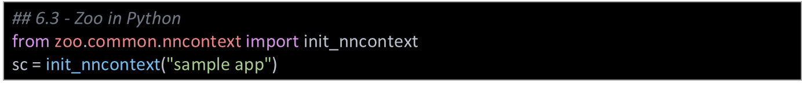
Using Analytics Zoo in Python*
Make sure the following env variables are set
SPARK_HOME
ANALYTICS_ZOO_HOME
always first call init_nncontext() at the very beginning of the code. This will create a SparkContext with optimized performance configuration and initialize the BigDL engine
*Other names and brands may be claimed as the property of others.

Slide 41
Recap
Learned about:
High level Dataframe APIs in Apache Spark*
Analytics Zoo API
Handy classes in Analytics Zoo

Slide 42
Recommended Resources
Intel Analytics Zoo : https://github.com/intel-analytics/analytics-zoo
Intel AI Academy : https://software.intel.com/ai-academy
https://software.intel.com/en-us/ai-academy/basics

