Slide 1
Analytics zoo overview
For Review:
Please add comments using 'Insert → Comment' menu
Module 6

Slide 2
Questions for BigDL team
Tell us what we need to include / remove
Do we want to show any code ?
Currently I have the code in 'appendix', we can remove / re-order based on feedback

Slide 3
Analytics zoo

Slide 4
Analytics Zoo
Analytics Zoo provides a unified analytics + AI platform
It brings together Apache Spark*, TensorFlow*, Keras* and BigDL
Supports 'pipeline' style programming (popular in Scikit* and Spark)
Data wrangling and analysis using PySpark*
Deep learning model development using TensorFlow* or Keras*
Provides built-in deep learning models (more on this later)
*Other names and brands may be claimed as the property of others.

Slide 5
Analytics Zoo
Standard Spark* jobs
No changes to the Apache Spark* or Apache Hadoop* clusters needed
Iterative
Each iteration of the training runs as a Spark* job
Data parallel
Each Spark* task runs the same model on a subset of the data (batch)
(see next slide for diagram)
*Other names and brands may be claimed as the property of others.

Slide 6
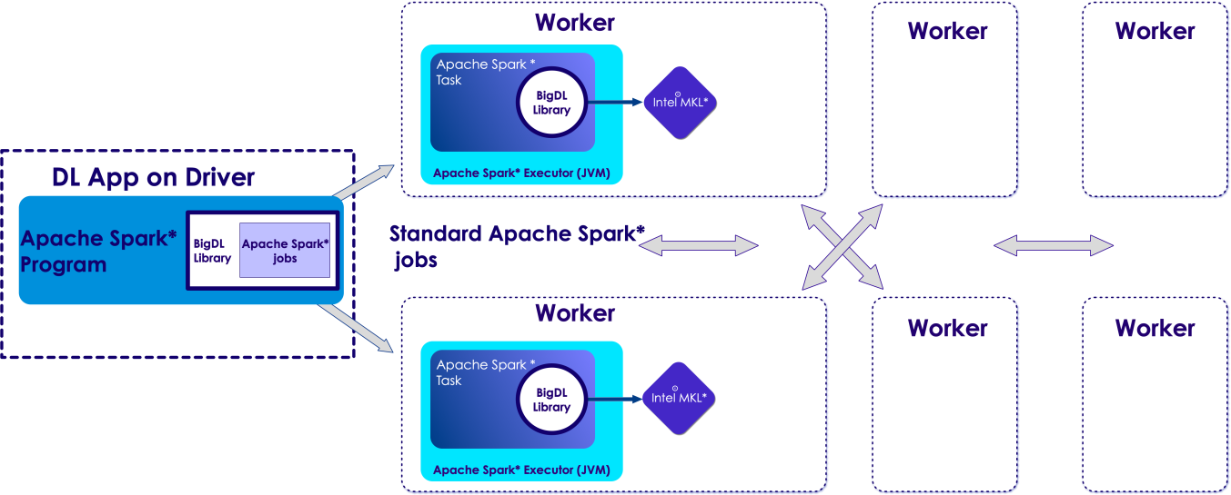
Analytics Zoo & Apache Spark*
*Other names and brands may be claimed as the property of others.
Apache Spark*
-submit
your python* file
Analytics-zoo.jar
zoo-python*.zip
MKL* native lib

Slide 7
Analytics zoo features

Slide 8
Analytics Zoo Features (List)
Distributed Tensorflow* and Keras* on Apache Spark*/BigDL
High-level abstractions and APIs
Built-in deep learning models

Slide 9
Zoo Features: high-level API
Analytics provides DataFrame-based high-level API
Also supports native integration with Apache Spark* ML Pipeline
These are in NNFrames package
NNFrames provides both Python* and Scala* APIs
Compatible with Spark* v1.6 and v2.x

Slide 10
NNFrames Highlights
Easy-to-use DataFrame (DataSet)-based API for training, prediction and evaluation
Integration with Apache Spark* ML pipeline and compatibility
Can use feature transformers and algorithms in Spark* ML.
Run inference or transfer learning from pre-trained models of Caffe*, Keras*, Tensorflow* or BigDL.
Training of BigDL built-in neural models (e.g., Inception, ResNet, Wide And Deep).
Rich toolset for feature extraction and processing, including image, audio and texts

Slide 11
NNFrames Useful Classes
Class | Description
NNEstimator | Extends org.apache.spark.ml.Estimator
NNModel | Extends Apache Spark's* ML Transformer
NNClassifier | Used for classification tasks
NNClassifierModel | Specialized NNModel for classification task
NNImageReader | Reads in Image data
*Other names and brands may be claimed as the property of others.

Slide 12
zoo.feature.image Package : Feature Engineering of Images
Class | Description
NNImageReader | Reads images into Apache Spark* DataFrame
Image Transformers | Zoo provides many pre-defined image processing transformers built on top of OpenCV™
 | ImageBrightness – adjusts Image brightness
 | ImageResize – resize image
 | ImageMatToTensor - Transform opencv mat to tensor
 | for full list see here

Slide 13
Analytics Zoo Built-in Models

Slide 15
Built-in models
Model | Description
Object Detection | Identification of Objects within Images
Image Classifier | Classification of Images as one of n classes
Text Classification | Identifying Text as one of n classes
Recommendation | Predict User-item relationship

Slide 16
Object Detection API
Analytics Zoo provides a collection of pre-trained models for Object Detection
These models can be used for out-of-the-box inference
Two typical kind of pre-trained Object Detection models: SSD and Faster RCNN-supported models
PASCAL VOC model
COCO model

Slide 17
Image Classification API
Analytics Zoo provides a collection of pre-trained models for Image Classification
Provided models:
Alexnet
Inception-V1
VGG
Resnet
Densenet, Mobilenet, Squeezenet
You can download the models here

Slide 18
Text Classification API
Analytics Zoo provides pre-defined models having different encoders that can be used for classifying texts.
Features:
Easy-to-use models, could be fed into NNFrames or BigDL Optimizer for training
The encoders we support include CNN, LSTM and GRU
Example 1

Slide 19
Recommendation API
Analytics Zoo provides two Recommender models, including Wide and Deep (WND) learning model and Neural network-based Collaborative Filtering (NCF) model.
Features:
Easy-to-use models, could be fed into NNFrames or BigDL Optimizer for training
Recommenders can handle either explicit or implicit feedback, given corresponding features
It provides three user-friendly APIs to predict user item pairs, and recommend items (users) for users (items)
Example1

Slide 20
Getting Started With analytics Zoo

Slide 21
Use Docker
TODO : show commands to pull the official docker container

Slide 22
Appendix : Analytics Zoo APIs

Slide 23
Getting Started with Analytics Zoo – Python*
There are 2 ways of getting Analytics Zoo going with Python*
Option 1 : Using PIP
Option 2 : Manual install
(see next slides for more details)
*Other names and brands may be claimed as the property of others.

Slide 24
Analytics Zoo Install for Python* – Option 1 : Using PIP
## 6.1 - Analytics Zoo install with PIP pip install --upgrade pip # change the zoo version accordingly pip install analytics-zoo==0.2.0 # for Python 2.7 pip3 install analytics-zoo==0.2.0 # for Python 3.5 and Python 3.6
This is tested with PIP v9.0.1
Pip install only supports local mode
This method also installs PySpark*
For up to date instructions see here
*Other names and brands may be claimed as the property of others.

Slide 25
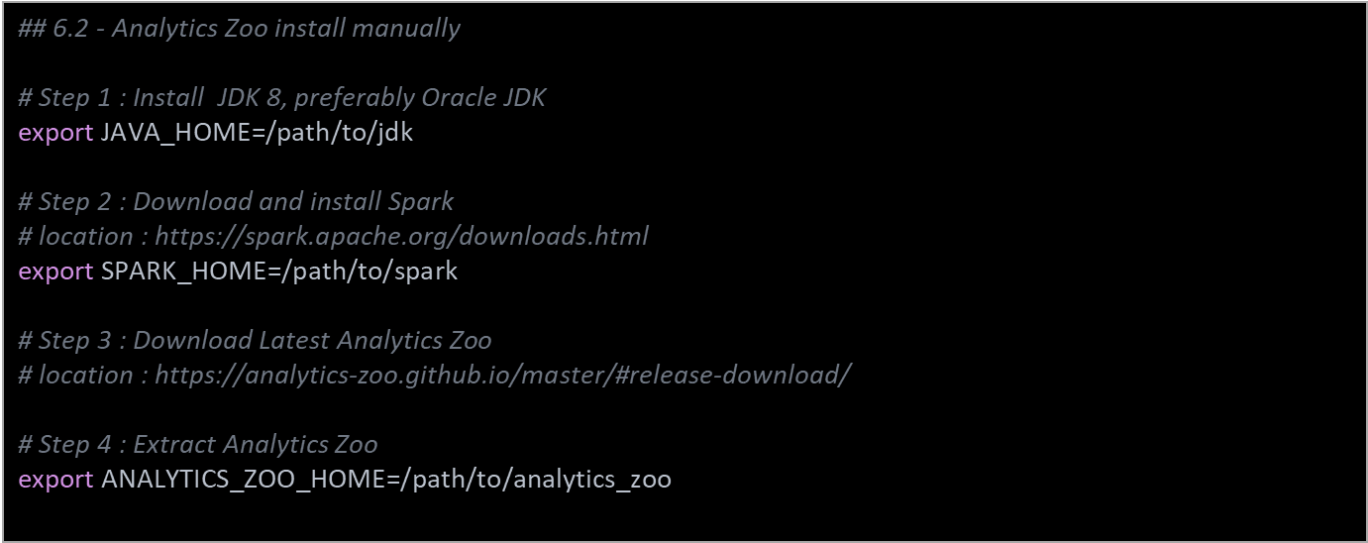
Analytics Zoo Install for Python* – Option 2 : Manual Install (1 of 2)
*Other names and brands may be claimed as the property of others.

Slide 26
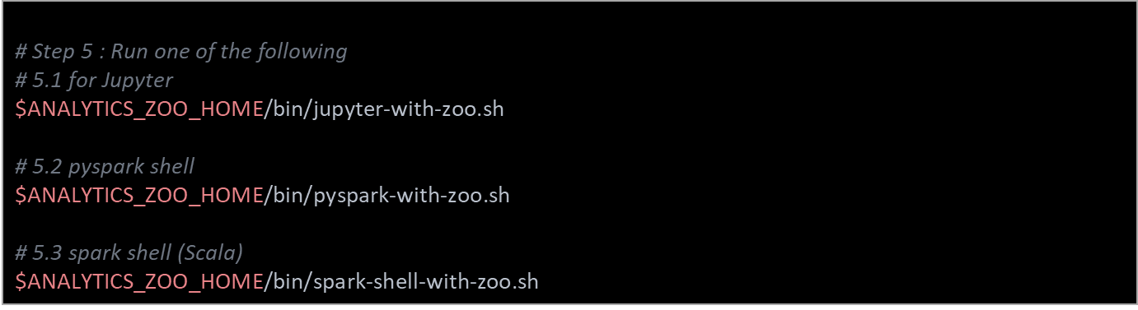
Analytics Zoo Install for Python* – Option 2 : Manual Install (2 of 2)
*Other names and brands may be claimed as the property of others.
*Other names and brands may be claimed as the property of others.

Slide 27
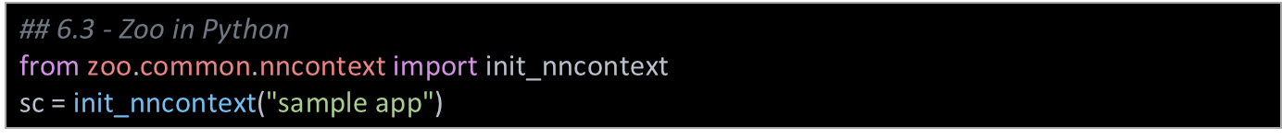
Using Analytics Zoo in Python*
Make sure the following env variables are set
SPARK_HOME
ANALYTICS_ZOO_HOME
always first call init_nncontext() at the very beginning of the code. This will create a SparkContext with optimized performance configuration and initialize the BigDL engine
*Other names and brands may be claimed as the property of others.

Slide 28
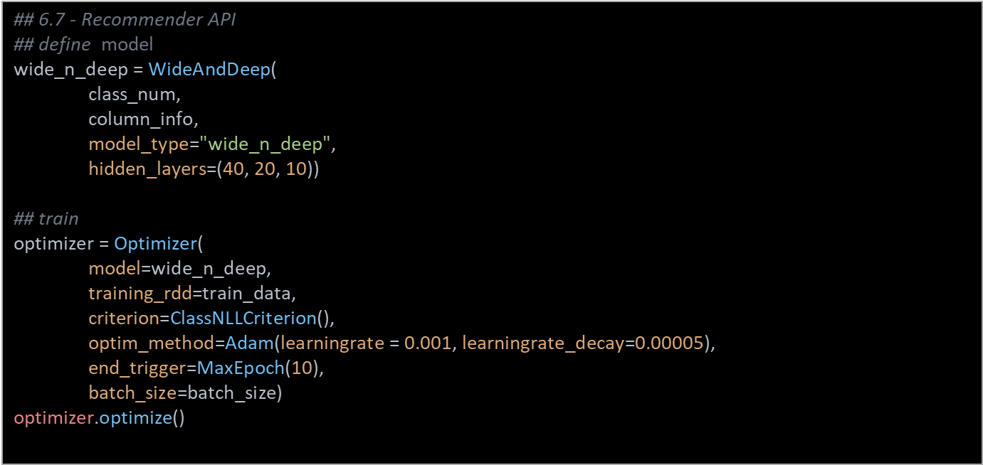
Recommendation API Usage

Slide 29
Recommendation API Usage
## predict userItemPairPrediction = wide_n_deep.predict_user_item_pair(valPairFeatureRdds)
userRecs = wide_n_deep.recommend_for_user(valPairFeatureRdds, 3) itemRecs = wide_n_deep.recommend_for_item(valPairFeatureRdds, 3)

Slide 30
NNFrames: NNImageReader
Load images into DataFrames using NNImageReader Process loaded data using DataFrame transformations
## 6.9 - NNImageReader from zoo.common.nncontext import init_nncontext from zoo.pipeline.nnframes import NNImageReader sc = init_nncontext() # read images from a path imageDF = NNImageReader.readImages('/path/to/images', sc) getName = udf(lambda row: ...) df = imageDF.withColumn("name", getName(col("image")))

Slide 31
zoo.feature.image Package: Feature Engineering of Images
Process Images using built-in feature engineering operations
## 6.10 – Zoo Image Processing from zoo.pipeline.nnframes import NNImageReader, ChainedPreprocessing from zoo.feature.image import RowToImageFeature, ImageChannelNormalize, ImageMatToTensor, ImageFeatureToTensor transformer = ChainedPreprocessing( [RowToImageFeature(), ImageChannelNormalize(123.0, 117.0, 104.0), ImageMatToTensor(), ImageFeatureToTensor()])

Slide 32
Zoo : Keras* Style APIs
## 6.11 - Zoo : Keras Style APIs from zoo.pipeline.api.keras.layers import Convolution2D, MaxPooling2D, Dense from zoo.pipeline.api.keras.models import Sequential model = Sequential() .add(Convolution2D(32, 3, 3, activation='relu', input_shape=(1, 28, 28))) \ .add(MaxPooling2D(pool_size=(2, 2))) \ .add(Flatten()) .add(Dense(10, activation='softmax')))

Slide 33
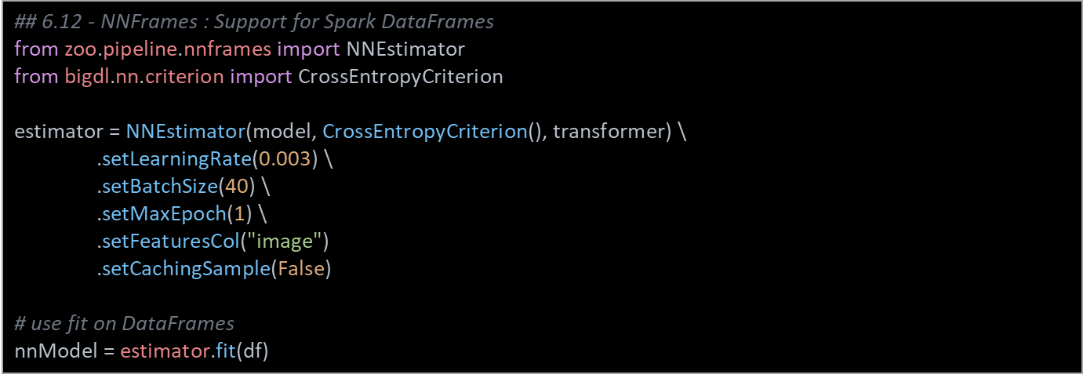
NNFrames: Native DL Support in Apache Spark* Dataframes
Train Model Using Spark ML Pipelines Process loaded data using DataFrame transformations

Slide 34
Object Detector Sample Usage – Python*
## 6.4 - Object Detection API from zoo.common.nncontext import init_nncontext from zoo.models.image.objectdetection import ImageSet, ObjectDetector sc = init_nncontext("image detector app") model = ObjectDetector.load_model(model_path) image_set = ImageSet.read(img_path, sc) output = model.predict_image_set(image_set)

Slide 35
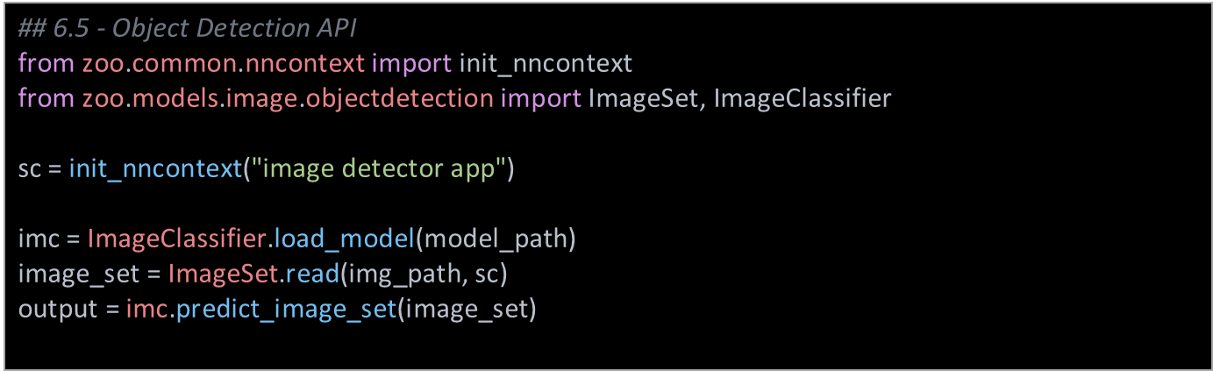
Image Classification Usage

Slide 36
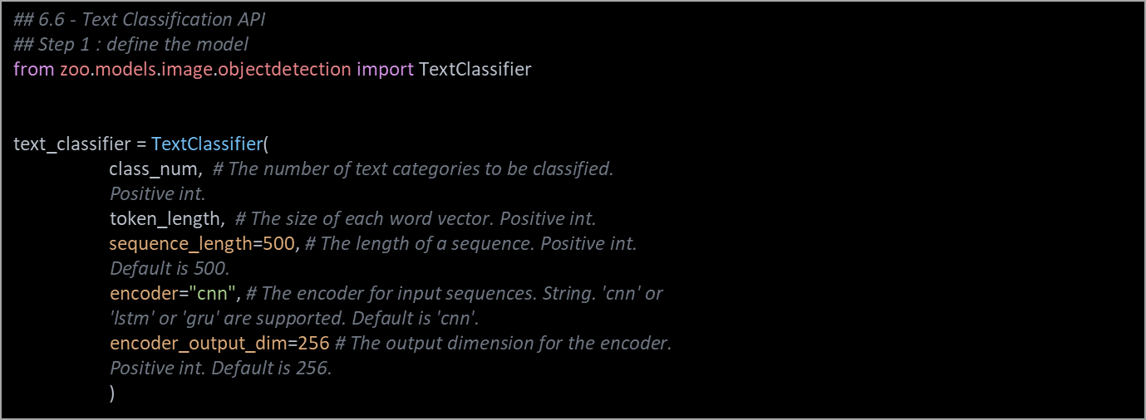
Text Classifier Sample Code

Slide 37
Text Classifier Sample Code
## Step 2 : train the model optimizer = Optimizer( model=text_classifier, training_rdd=train_rdd, criterion=ClassNLLCriterion(logProbAsInput=False), end_trigger=MaxEpoch(20), batch_size=128, optim_method=Adagrad(learningrate=0.01, learningrate_decay=0.001)) optimizer.set_validation( batch_size=128, val_rdd=val_rdd, trigger=EveryEpoch(), val_method=[Top1Accuracy()])

Slide 38
Text Classifier Sample Code
## Step 3 : Predict # Predict for probability distributions. results = text_classifier.predict(rdd)
# Predict for class labels. By default, label starts from 0. result_classes = text_classifier.predict_classes(rdd)

Slide 39
Recap
Learned about:
High level Dataframe APIs in Apache Spark*
Analytics Zoo API
Handy classes in Analytics Zoo

Slide 40
Recommended Resources
Intel Analytics Zoo : https://github.com/intel-analytics/analytics-zoo
Intel AI Academy : https://software.intel.com/ai-academy
https://software.intel.com/en-us/ai-academy/basics

