Slide 1
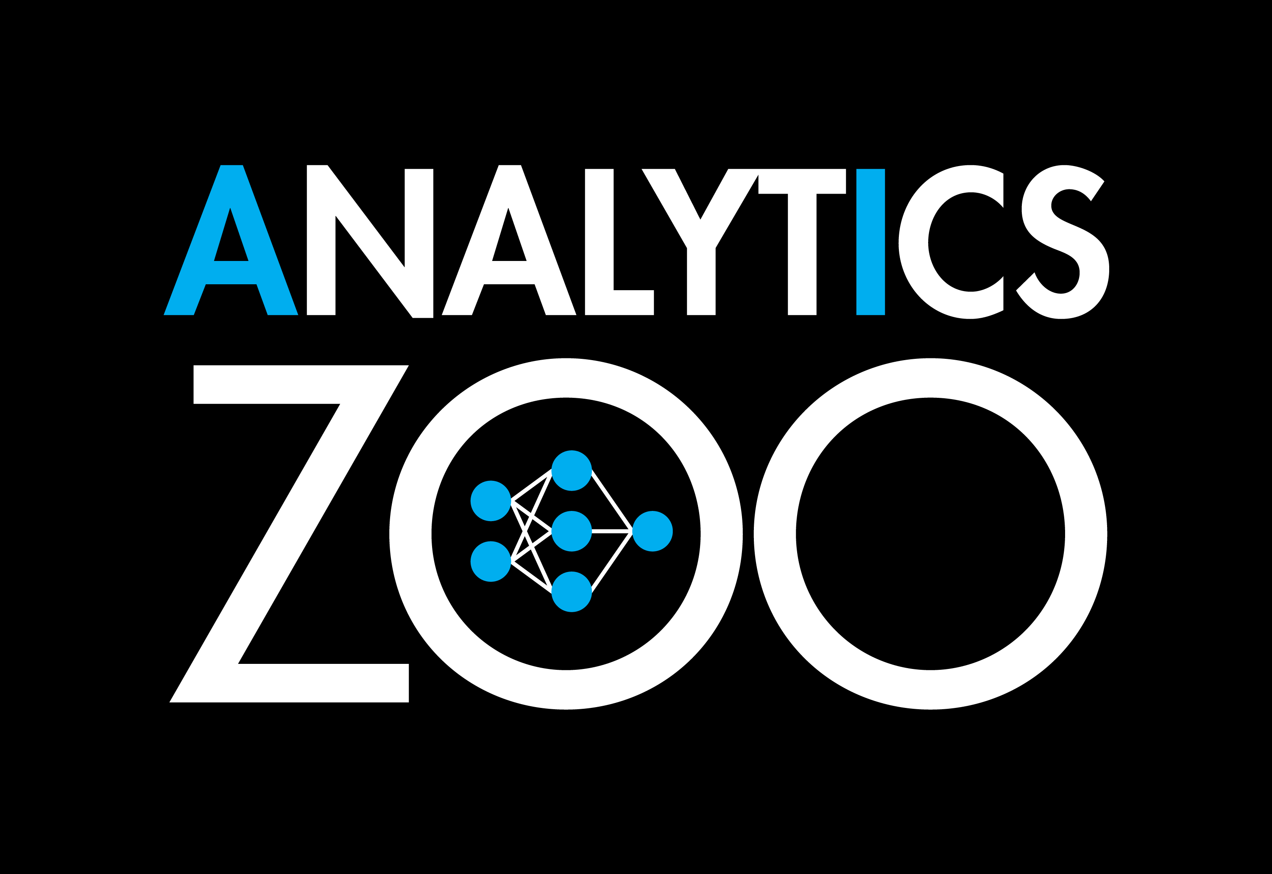
Overview
Module 1

Slide 2
Overview
Understand Analytics Zoo features
Quick look at Analytics Zoo APIs

Slide 3
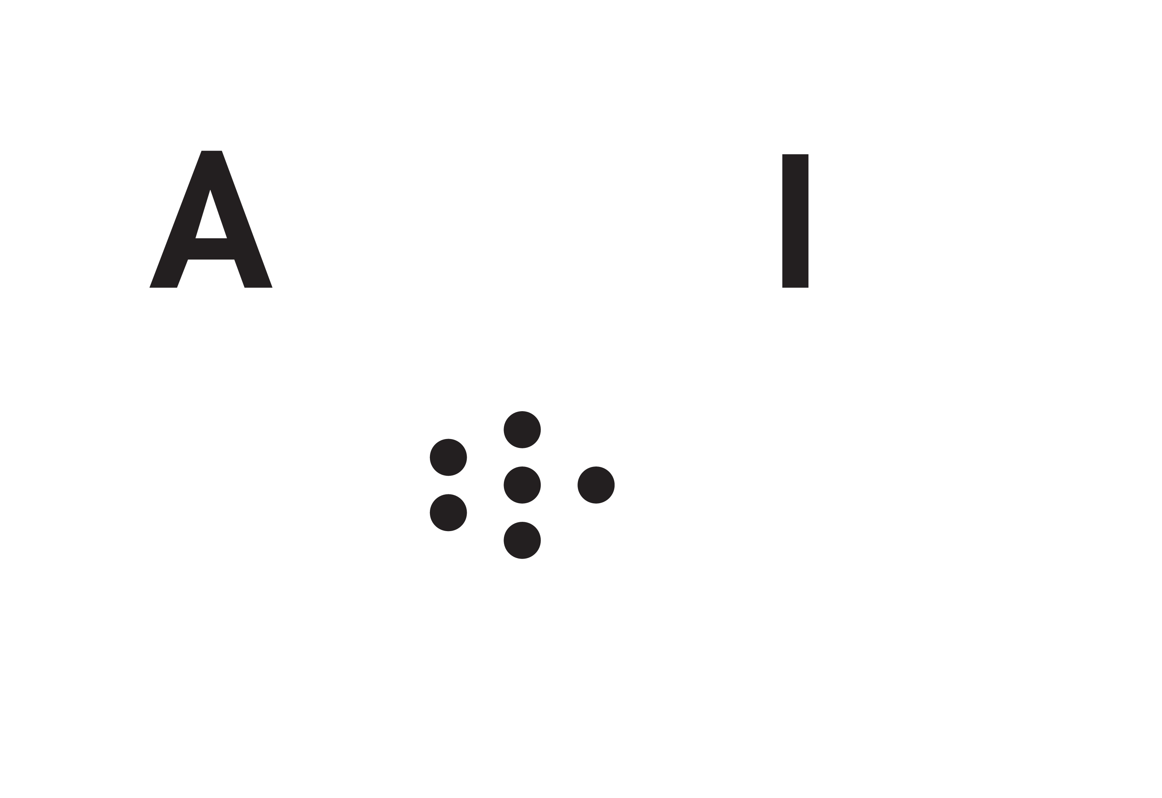
Introduction

Slide 4
Analytics Zoo
Analytics Zoo provides a unified analytics + AI platform
Brings together Apache Spark*, TensorFlow*, Keras*, and BigDL
Supports 'pipeline' style programming (popular in Scikit* and Spark)
Data wrangling and analysis using PySpark*
Deep learning model development using TensorFlow* or Keras*
Provides built-in deep learning models (more on this later)
*Other names and brands may be claimed as the property of others.

Slide 5
Analytics Zoo & Apache Spark*
Standard Spark* jobs
No changes to the Apache Spark* or Apache Hadoop* clusters are needed
Iterative
Each iteration of the training runs as a Spark job
Data parallel
Each Spark task runs the same model on a subset of the data (batch)
(see next slide for diagram)
*Other names and brands may be claimed as the property of others.

Slide 6
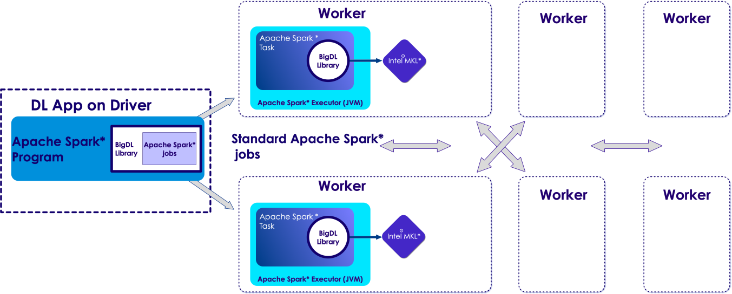
Analytics Zoo & Apache Spark* scheduling
*Other names and brands may be claimed as the property of others.
Apache Spark*
-submit
your Python* file
Analytics-zoo.jar
zoo-python.zip
Intel^{(R)} MKL* native lib

Slide 7
Features

Slide 8
Analytics Zoo Features
Distributed TensorFlow* and Keras* on Apache Spark*/BigDL
High-level abstractions and APIs (Keras style)
Native DL support for Spark DataFrames and ML Pipelines
Built-in deep learning models
Built-in feature engineering operations for data preprocessing
Model serving APIs (w/ OpenVINO* support)
Support Web Services, Spark, Apache Storm*, Apache Flink*, Apache Kafka*, etc.

Slide 9
Analytics Zoo Features: High-level API
Analytics Zoo provides DataFrame-based high-level API
Also supports native integration with Apache Spark* ML Pipeline
These are in NNFrames package in Analytics Zoo
NNFrames provides both Python* and Scala* APIs
Compatible with Spark v1.6 and v2.x

Slide 10
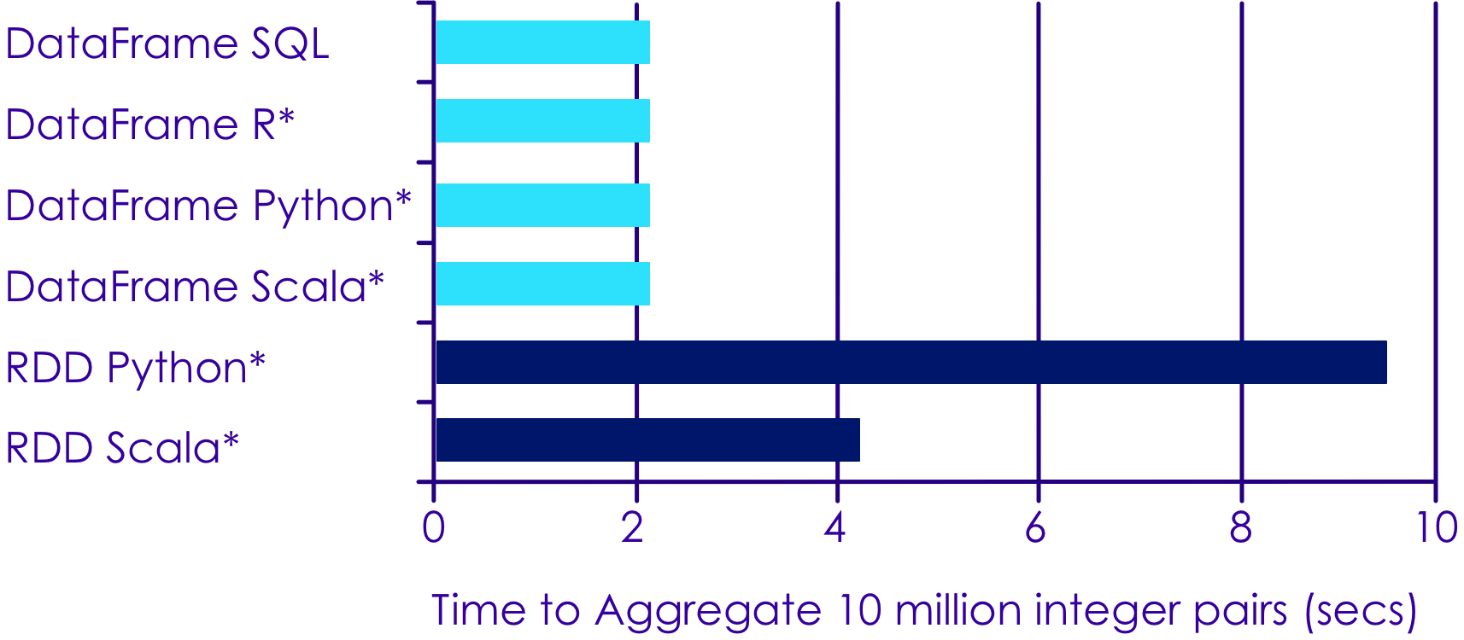
Apache Spark DataFrame Performance

Slide 11
Analytics Zoo : Keras* Style APIs
## 6.11 - Zoo : Keras Style APIs from zoo.pipeline.api.keras.layers import Convolution2D, MaxPooling2D, Dense from zoo.pipeline.api.keras.models import Sequential model = Sequential() .add(Convolution2D(32, 3, 3, activation='relu', input_shape=(1, 28, 28))) \ .add(MaxPooling2D(pool_size=(2, 2))) \ .add(Flatten()) .add(Dense(10, activation='softmax')))

Slide 12
NNFrames Highlights
Easy-to-use DataFrame (DataSet)-based API for training, prediction and evaluation.
Integration with Apache Spark* ML pipeline and compatibility.
Can use feature transformers and algorithms in Spark ML.
Run inference or transfer learning from pre-trained models of Caffe*, Keras*, TensorFlow*, or BigDL.
Training of BigDL built-in neural models (e.g., Inception, ResNet, Wide And Deep).
Rich toolset for feature extraction and processing, including image, audio, and texts.

Slide 13
NNFrames Useful Classes
Class | Description
NNEstimator | Extends org.apache.spark.ml.Estimator
NNModel | Extends Apache Spark's* ML Transformer
NNClassifier | Used for classification tasks
NNClassifierModel | Specialized NNModel for classification task
NNImageReader | Reads in image data
*Other names and brands may be claimed as the property of others.

Slide 14
zoo.feature.image Package : Feature Engineering of Images
Class | Description
NNImageReader | Reads images into Apache Spark* DataFrame
Image Transformers | Analytics Zoo provides many pre-defined image processing transformers built on top of OpenCV
 | ImageBrightness – adjust image brightness
 | ImageResize – resize image
 | ImageMatToTensor - transform OpenCV mat to tensor
 | For full list see here

Slide 15
NNFrames: NNImageReader
Load images into DataFrames using NNImageReader Process loaded data using DataFrame transformations
## 6.9 - NNImageReader from zoo.common.nncontext import init_nncontext from zoo.pipeline.nnframes import NNImageReader sc = init_nncontext() # read images from a path imageDF = NNImageReader.readImages('/path/to/images', sc) getName = udf(lambda row: ...) df = imageDF.withColumn("name", getName(col("image")))

Slide 16
zoo.feature.image Package: Feature Engineering of Images
Process images using built-in feature engineering operations
## 6.10 – Zoo Image Processing from zoo.pipeline.nnframes import NNImageReader, ChainedPreprocessing from zoo.feature.image import RowToImageFeature, ImageChannelNormalize, ImageMatToTensor, ImageFeatureToTensor transformer = ChainedPreprocessing( [RowToImageFeature(), ImageChannelNormalize(123.0, 117.0, 104.0), ImageMatToTensor(), ImageFeatureToTensor()])

Slide 17
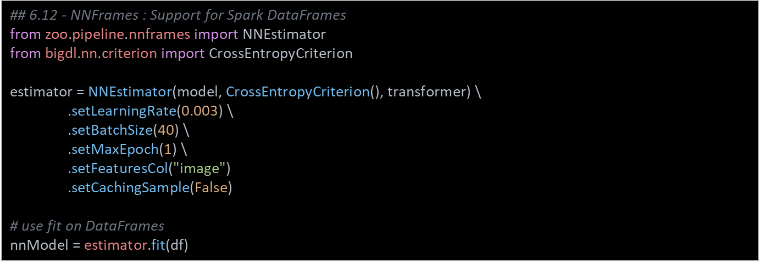
NNFrames: Native DL Support in Apache Spark* Dataframes
Train model using Apache Spark* ML Pipelines Process loaded data using DataFrame transformations

Slide 18
Distributed Tensorflow* on Analytics Zoo
We illustrate three steps:
Data wrangling using Apache Spark*
Model development
Distributed training

Slide 19
Distributed TensorFlow* on Analytics Zoo
Data wrangling using Apache Spark*
from zoo import init_nncontext
from zoo.pipeline.api.net import TFDataset
sc = init_nncontext()
#Each record in the train_rdd consists of a list of NumPy ndrrays
train_rdd = sc.parallelize(file_list)
.map(lambda x: read_image_and_label(x))
.map(lambda image_label: decode_to_ndarrays(image_label))
#TFDataset represents a distributed set of elements,
#in which each element contains one or more TensorFlow Tensor objects.
dataset = TFDataset.from_rdd(train_rdd,
names=["features", "labels"],
shapes=[[28, 28, 1], [1]],
types=[tf.float32, tf.int32],
batch_size=BATCH_SIZE)

Slide 20
Distributed TensorFlow* on Analytics Zoo
2. Deep Learning model development using Tensorflow*
import tensorflow as tf
slim = tf.contrib.slim
images, labels = dataset.tensors
labels = tf.squeeze(labels)
with slim.arg_scope(lenet.lenet_arg_scope()):
logits, end_points = lenet.lenet(images, num_classes=10, is_training=True)
loss = tf.reduce_mean(tf.losses.sparse_softmax_cross_entropy(logits=logits, labels=labels))

Slide 21
Distributed TensorFlow* on Analytics Zoo
3. Distributed training on Apache Spark*
from zoo.pipeline.api.net import TFOptimizer
from bigdl.optim.optimizer import MaxIteration, Adam, MaxEpoch, TrainSummary
optimizer = TFOptimizer.from_loss(loss, Adam(1e-3))
optimizer.set_train_summary(TrainSummary("/tmp/az_lenet", "lenet"))
optimizer.optimize(end_trigger=MaxEpoch(5))

Slide 22
Transfer Learning APIs
We are loading a Caffe* model Removing last few layers Freezing first few layers And appending a few layers
from zoo.pipeline.api.net import *
full_model = Net.load_caffe(def_path, model_path)
# Remove layers after pool5
model = full_model.new_graph(outputs=["pool5"])
# freeze layers from input to res4f inclusive
model.freeze_up_to(["res4f"])
# append a few layers
image = Input(name="input", shape=(3, 224, 224))
resnet = model.to_keras()(image)
resnet50 = Flatten()(resnet)

Slide 23
Model Serving API – Java*
import com.intel.analytics.zoo.pipeline.inference.AbstractInferenceModel; public class TextClassification extends AbstractInferenceModel { public RankerInferenceModel(int concurrentNum) { super(concurrentNum); } ... } public class ServingExample { public static void main(String[] args) throws IOException { TextClassification model = new TextClassification(); model.load(modelPath, weightPath); texts = ... List<JTensor> inputs = preprocess(texts); for (JTensor input : inputs) { List<Float> result = model.predict(input.getData(), input.getShape()); ... } }

Slide 24
Model Serving API – Open VINO* (Python*)
from zoo.common.nncontext import init_nncontext from zoo.feature.image import ImageSet from zoo.pipeline.inference import InferenceModel sc = init_nncontext("OpenVINO Object Detection Inference Example") images = ImageSet.read(options.img_path, sc, resize_height=600, resize_width=600).get_image().collect() input_data = np.concatenate([image.reshape((1, 1) + image.shape) for image in images], axis=0) model = InferenceModel() model.load_tf(options.model_path, backend="openvino", model_type=options.model_type) predictions = model.predict(input_data) # Print the detection result of the first image. print(predictions[0])

Slide 25
Built-in Models

Slide 26
Built-in models
Model | Description
Object Detection | Identification of objects within images
Image Classifier | Classification of images as one of n classes
Text Classification | Identifying text as one of n classes
Recommendation | Predict user-item relationship

Slide 27
Object Detection API
Analytics Zoo provides a collection of pre-trained models for object detection
These models can be used for out-of-the-box inference
Two typical types of pre-trained object detection models: SSD and Faster RCNN-supported models
PASCAL VOC model
COCO model

Slide 28
Object Detector Sample Usage – Python*
## 6.4 - Object Detection API from zoo.common.nncontext import init_nncontext from zoo.models.image.objectdetection import ImageSet, ObjectDetector sc = init_nncontext("image detector app") model = ObjectDetector.load_model(model_path) image_set = ImageSet.read(img_path, sc) output = model.predict_image_set(image_set)

Slide 29
Image Classification API
Analytics Zoo provides a collection of pre-trained models for image classification, including:
Alexnet
Inception-V1
VGG
Resnet
Densenet, Mobilenet, Squeezenet
You can download the models here.

Slide 30
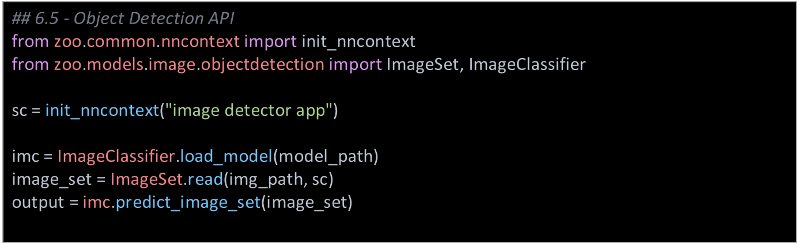
Image Classification Usage

Slide 31
Text Classification API
Analytics Zoo provides pre-defined models with different encoders that can be used for classifying texts.
Features:
Easy-to-use models could be fed into NNFrames or BigDL Optimizer for training
The encoders we support include CNN, LSTM, and GRU
Example 1

Slide 32
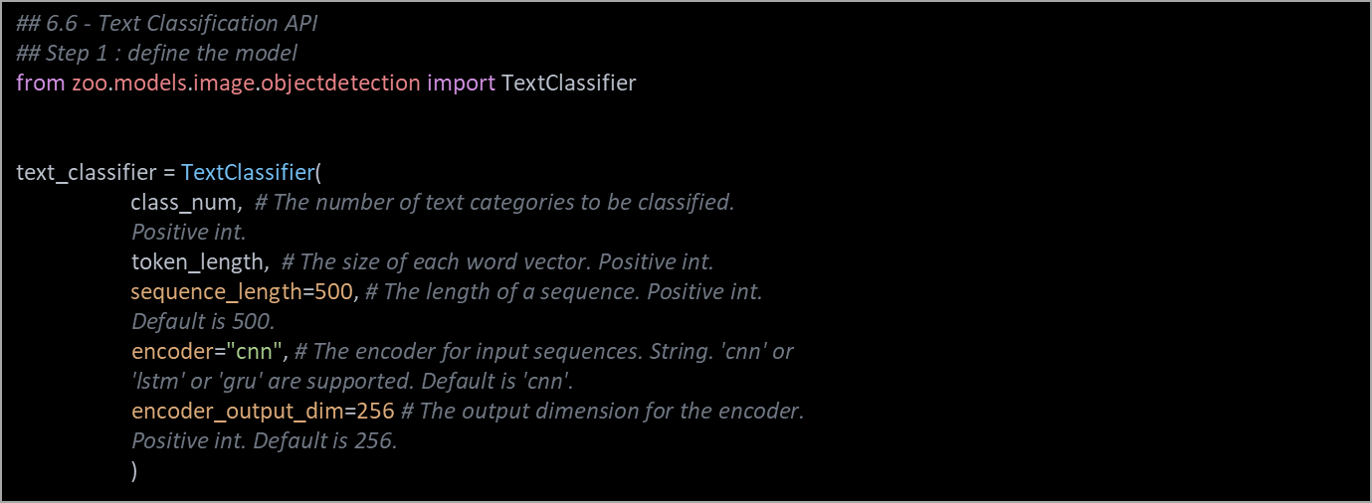
Text Classifier Sample Code (1 of 3)

Slide 33
Text Classifier Sample Code (2 of 3)
## Step 2 : train the model optimizer = Optimizer( model=text_classifier, training_rdd=train_rdd, criterion=ClassNLLCriterion(logProbAsInput=False), end_trigger=MaxEpoch(20), batch_size=128, optim_method=Adagrad(learningrate=0.01, learningrate_decay=0.001)) optimizer.set_validation( batch_size=128, val_rdd=val_rdd, trigger=EveryEpoch(), val_method=[Top1Accuracy()])

Slide 34
Text Classifier Sample Code (3 of 3)
## Step 3 : Predict # Predict for probability distributions. results = text_classifier.predict(rdd)
# Predict for class labels. By default, label starts from 0. result_classes = text_classifier.predict_classes(rdd)

Slide 35
Recommendation API
Analytics Zoo provides two Recommender models: Wide and Deep (WND) learning model and Neural network-based Collaborative Filtering (NCF) model.
Features:
Easy-to-use models, could be fed into NNFrames or BigDL Optimizer for training
Recommenders can handle either explicit or implicit feedback, given corresponding features
They provide three user-friendly APIs to predict user item pairs and recommend items (users) for users (items)
Example1

Slide 36
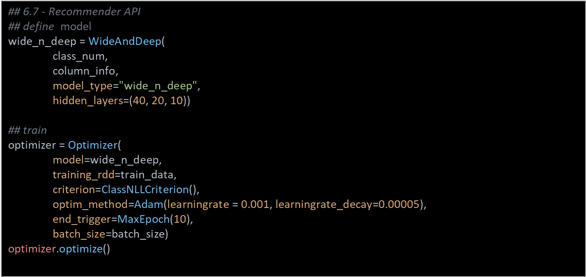
Recommendation API Usage (1 of 2)

Slide 37
Recommendation API Usage (2 of 2)
## predict userItemPairPrediction = wide_n_deep.predict_user_item_pair(valPairFeatureRdds)
userRecs = wide_n_deep.recommend_for_user(valPairFeatureRdds, 3) itemRecs = wide_n_deep.recommend_for_item(valPairFeatureRdds, 3)

Slide 38
Getting Started

Slide 39
Use Docker Images (Easiest Option)
Official BigDL docker: https://github.com/intel-analytics/analytics-zoo/tree/master/docker
Community docker images: https://hub.docker.com/r/elephantscale/bigdl
## Sample usage
$ git clone https://github.com/elephantscale/bigdl-docker
$ cd bigdl-docker
$ docker pull elephantscale/bigdl
$ ./run-bigdl-docker.sh elephantscale/bigdl
## Go to http://localhost:8888 to access Jupyter page

Slide 40
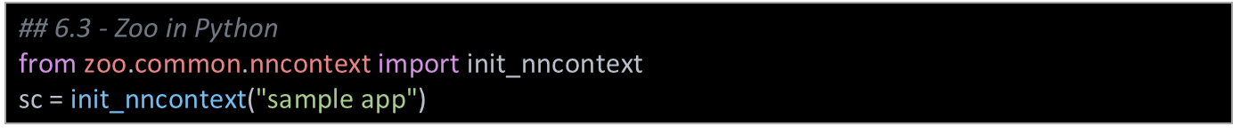
Using Analytics Zoo in Python*
Make sure the following env variables are set:
SPARK_HOME
ANALYTICS_ZOO_HOME
Always call init_nncontext() at the very beginning of the code. This will create a SparkContext with optimized performance configuration and initialize the BigDL engine.
*Other names and brands may be claimed as the property of others.

Slide 41
Recap
The presentation described:
High level Dataframe APIs in Apache Spark*
Analytics Zoo API
Handy classes in Analytics Zoo

Slide 42
Recommended Resources
Intel® Analytics Zoo : https://github.com/intel-analytics/analytics-zoo
Intel® AI Academy Home: https://software.intel.com/ai-academy
Intel® AI Academy Library: https://software.intel.com/en-us/ai-academy/basics

