Slide 1

ANDROID WIDGETS:
ExpandableListView
Presentation by Adam Gessel
http://github.com/damageless

Slide 2
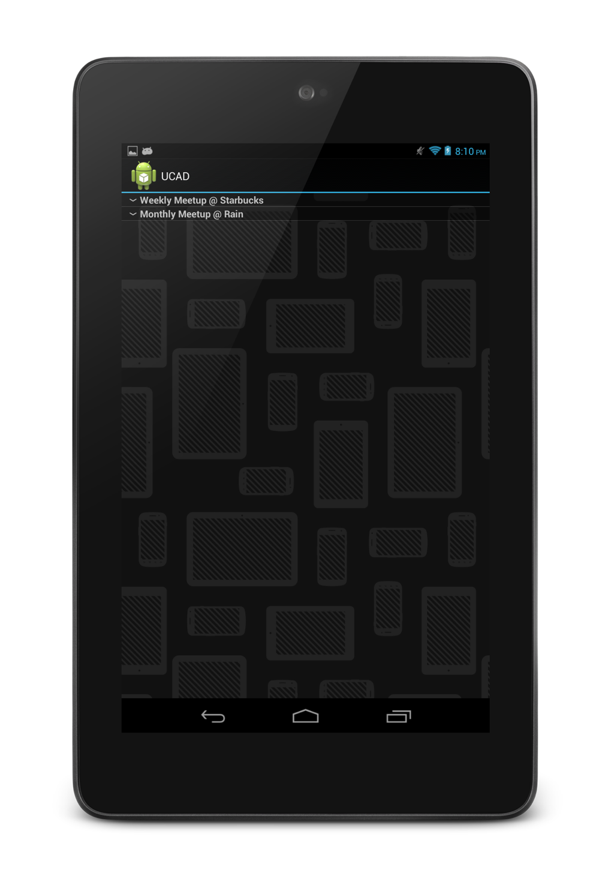

ExpandableListView Intro

Slide 3


Slide 4

ExpandableListView Basics
You define groups that have children
By clicking on the group, the list is expanded to show children
Must use an adapter that extends BaseExpandableListAdapter

Slide 5
The XML
<ExpandableListView
android:id="@android:id/list"
android:layout_width="match_parent"
android:layout_height="match_parent"
/>
Initialization
mListView = (ExpandableListView) getListView();
mListAdapter = new UCADCalendarExpandableListAdapter();
mListView.setAdapter(mListAdapter);

Slide 6

The Adapter
private class UCADCalendarExpandableListAdapter extends BaseExpandableListAdapter {
10 Required Methods...

Slide 7
Required Methods (Adapter)
int getGroupCount()
int getChildrenCount(int groupId)
Object getGroup(int position)
Object getChild(int position)
View getGroupView(int position, boolean isExpanded, View convertView, ViewGroup viewGroup)
View getChildView(int groupPosition, int childPosition, boolean isLastChild, View convertView, ViewGroup parent)

Slide 8
Required Methods (Adapter)
boolean isChildSelectable(int groupPosition, int childPosition)
long getGroupId(int position)
long getChildId(int groupPosition, int childPosition)
boolean hasStableIds()

Slide 9
Counterintuitive Methods
hasStableIds()
This indicates whether the item IDs (that are retrieved from getGroupId(int) and getChildId(int) always refer to the same object.
getGroupId(int) and getChildId(int)
These indicate the Group ID and Child ID (respectively) for the given position.

Slide 10
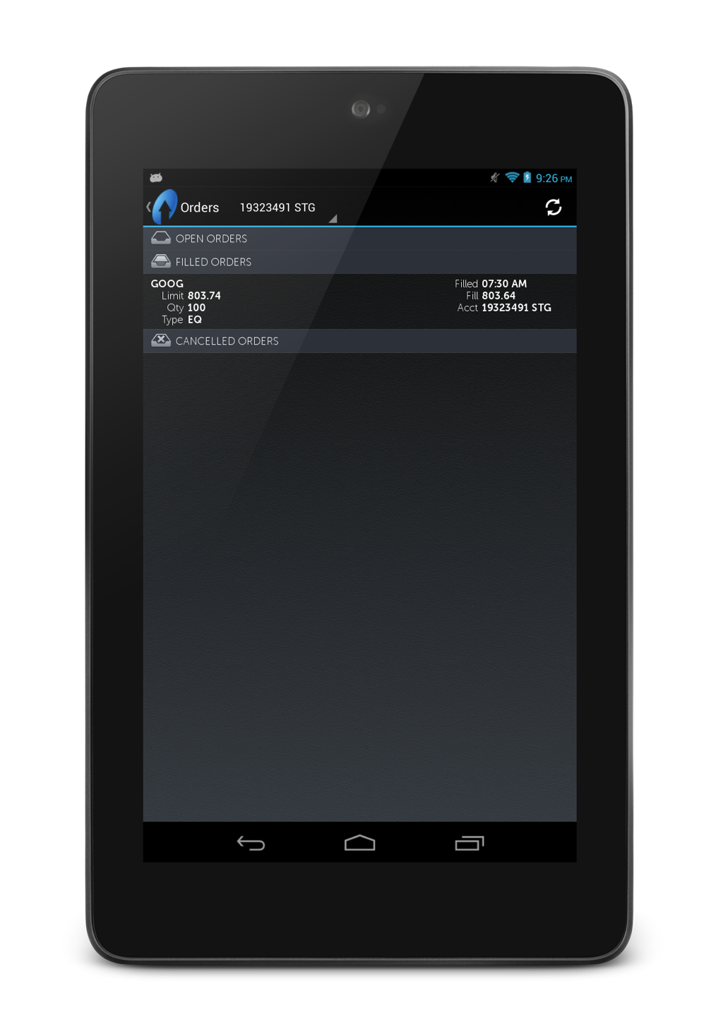
Indicators

Slide 11
Indicators
It is possible to set Group Indicators to any Drawable
mListView.setGroupIndicator(null);
Also possible to hide the indicators completely
(as shown above)

Slide 12
ViewHolder Pattern
This is a pattern that optimizes the ListView by reducing the calls to findViewById(int)
Each widget/view is put into a private class, which is put into the tag of the convertView object that is re-used
HeaderViewHolder headerViewHolder;
if(convertView == null) {
convertView = LayoutInflater.from(getSherlockActivity()).inflate(R.layout..., null);
headerViewHolder = new HeaderViewHolder();
headerViewHolder.orderHeaderNameTextView = (TextView) convertView.findViewById(R.id...);
headerViewHolder = (HeaderViewHolder) convertView.getTag();

Slide 13
ViewHolder Pattern
The ViewHolder pattern is still a viable option for making an efficient ListView.
You can create a ChildViewHolder and HeaderViewHolder
private class ChildViewHolder {
TextView orderSymbolTextView;
TextView orderLimitTextView;
TextView orderQtyTextView;
TextView orderTypeTextView;
TextView orderFilledTextView;
TextView orderFillTextView;
TextView orderAcctTextView;
TextView orderFilledLabelTextView;
TextView orderReasonTextView;
TextView orderDurationTextView;
TextView orderDurationLabelTextView;
TextView orderFillLabelTextView;
TextView orderStatusLabelTextView;
TextView orderStatusTextView;
}
private class HeaderViewHolder {
ImageView orderHeaderImageView;
TextView orderHeaderNameTextView;
}

