Slide 1
ASSIGNMENT
RevoU Mini Course
Data Analytics
Dhea Amalia Lutfiani
( 7 Feb – 18 Feb )

Slide 2
Case Study Instructions
PYTHON CODE CHALLENGE
QUESTION
Product = [“Apple”, “Orange”, 100, “Grape”, 120.33, “Cherry”, 13.00, “Pear”, 500, “Melon”, “Strawberry”]
There are two types of data there: string and also numbers. Therefore, the first part is how to identify the string and number (both float and integer) from the list.

Slide 3
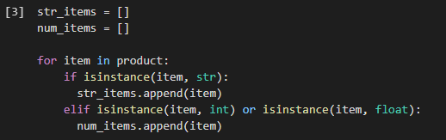
Case Study
PYTHON CODE CHALLENGE
Product = [“Apple”, “Orange”, 100, “Grape”, 120.33, “Cherry”, 13.00, “Pear”, 500, “Melon”, “Strawberry”]
Python with Google Colab
1. Make list on python tools
2. Create separate code

Slide 4
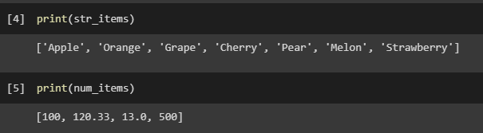
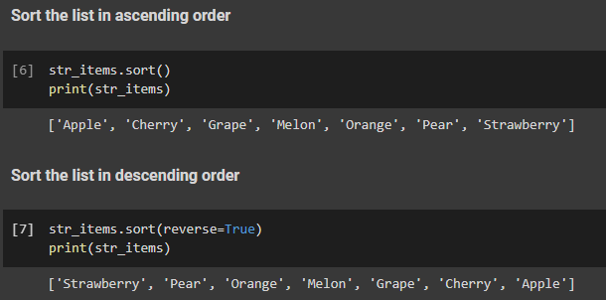
Case Study
PYTHON CODE CHALLENGE
Product = [“Apple”, “Orange”, 100, “Grape”, 120.33, “Cherry”, 13.00, “Pear”, 500, “Melon”, “Strawberry”]
Python with Google Colab
3. Print the code
4. We can sort the list by ascending (lowest to highest) and descending (highest to lowest)
String List

Slide 5
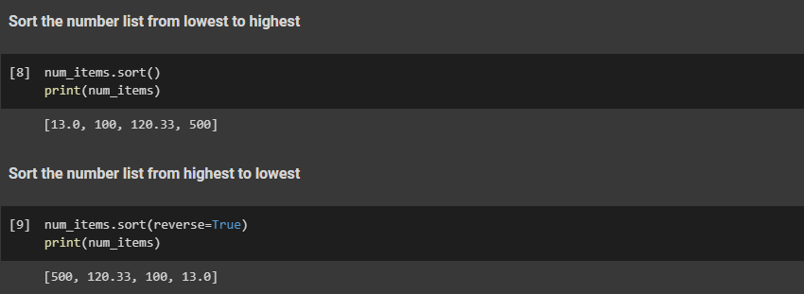
Case Study
PYTHON CODE CHALLENGE
Product = [“Apple”, “Orange”, 100, “Grape”, 120.33, “Cherry”, 13.00, “Pear”, 500, “Melon”, “Strawberry”]
Python with Google Colab
4. We can sort the list by ascending (lowest to highest) and descending (highest to lowest)
Number List

Slide 6
THANK YOU
Dhea Amalia Lutfiani
( 7 Feb – 18 Feb )

