Slide 1
San Francisco Bikeshare Trip Insight TAKEN FROM CASE STUDY RevoU Mini Course - Data Analytics
Portfolio Data Analytics
1st
Dhea Amalia Lutfiani
( 7 FEB – 18 FEB )

Slide 2
Case Study Instructions
QUESTION
Table of interest :
‘bigquery-public-data.san_francisco_bikeshare.bikeshare_trips’
Look at this data and start thinking. List down 3 trends/points that you want to show.
From here, try to explore the data and make changes, filter, and prepare the data that you need.
Create some visualizations or dashboard with the best type of chart you have learned.
The easiest is with Google Data Studio or Google Sheets.
Then, make 1-2 slides from the Graphs with the insights you got to present your findingsto the stakeholders (read this article from HBR)

Slide 3
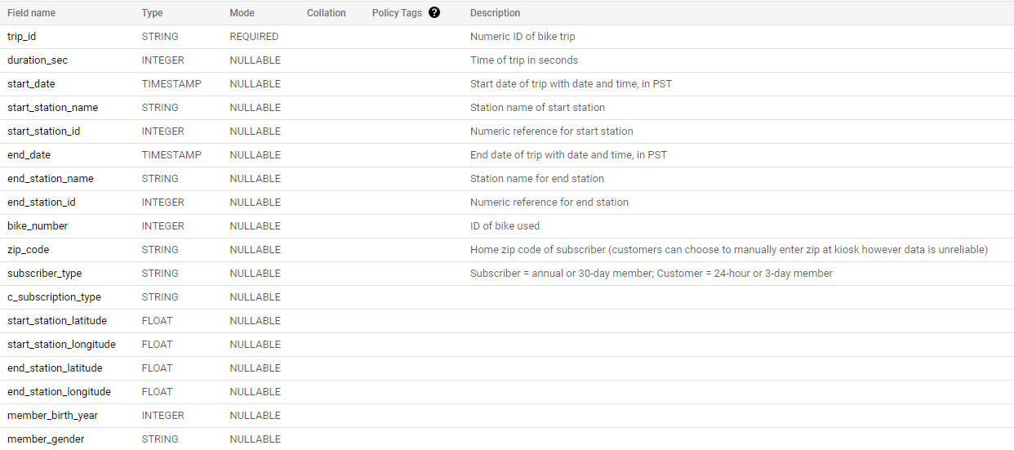
Preview Data
Schema from the Dataset :

Slide 4
Preview Data
Schema from the Dataset :
From this data preview, we can find out the description of each column and know which columns can be used to answer problems or which columns can be useful for finding new insights.

Slide 5
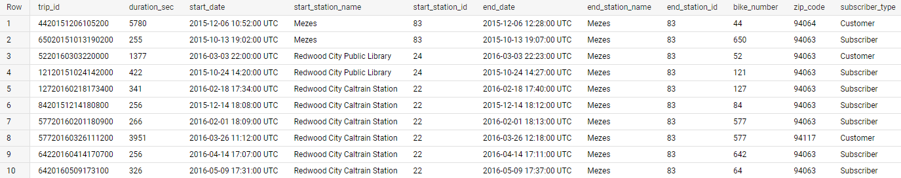
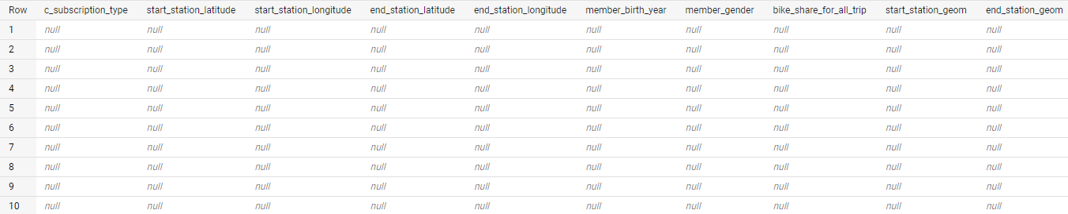
Preview Data
Preview the Data :

Slide 6
Defining Question
List down trends/points that you want to show :
Number of trips per month
Average duration of the trips per month
The monthly trend of the total trips and the average of duration time
Who are the most enthusiasts or renters of this San Francisco bikeshare? (Male or Female)
From which customers do we get more revenue? (from subscriber or customer)

Slide 7
Exploring Data
Include SQL with BigQuery
There are 2 queries used in this project.
The first query is to answer problem questions for numbers 1 and 2.
And the second query is to answer other problems, namely problems number 3, 4, and 5.
Why are these two queries separated?
Because I personally want to answer the first and second problems in the entire span of time. This is done in order to see what happened and how the picture or outline of the company's situation.
And to answer another problem, I use a more specific time, starting in 2017.
Why did I choose this range?
Will be answered in the second probem later.

Slide 8
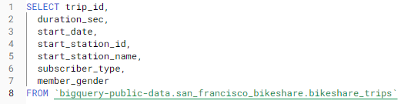
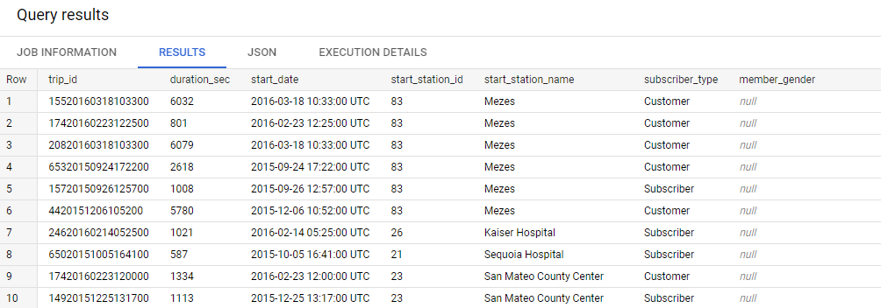
Exploring Data
Include SQL with BigQuery
First Query
And the result :

Slide 9
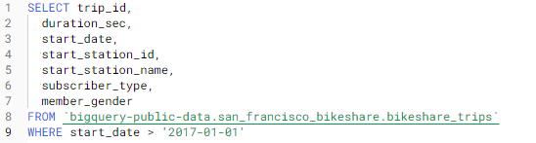
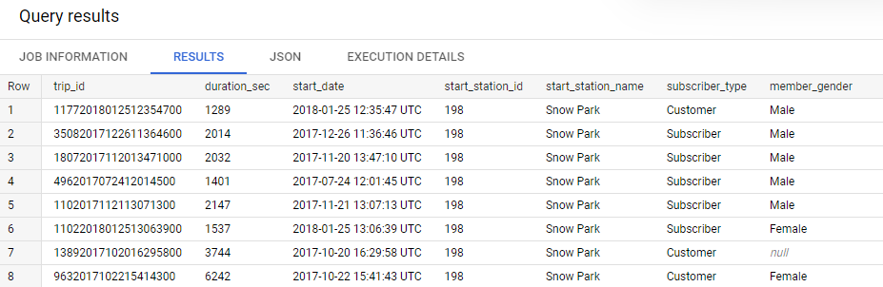
Exploring Data
Include SQL with BigQuery
2. Second Query
And the result :

Slide 10
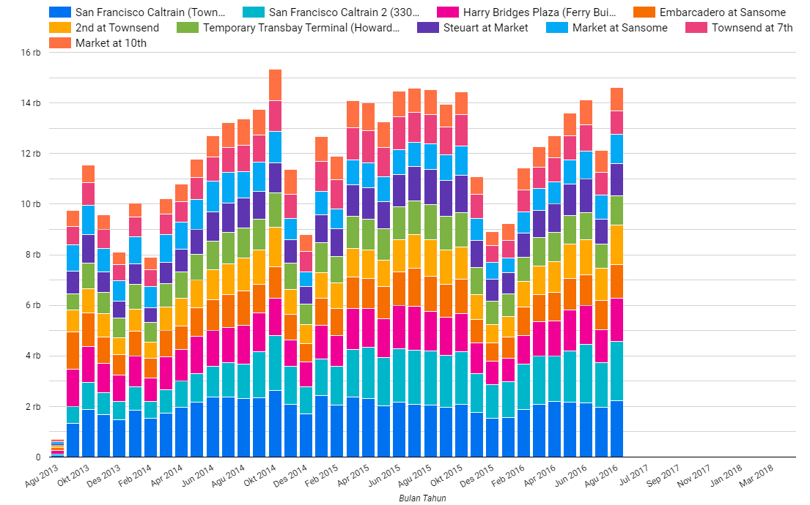
Visualization with Insight
Number of trips per month
This diagram shows the number of trips per month at each station. We can say that :
Where Market at Sansome station has the highest number of trips per month than any other station.
Every year in the end of the year, the users of this San Francisco bikeshare service are decreasing.
And in October 2014, had the most number of trips.

Slide 11
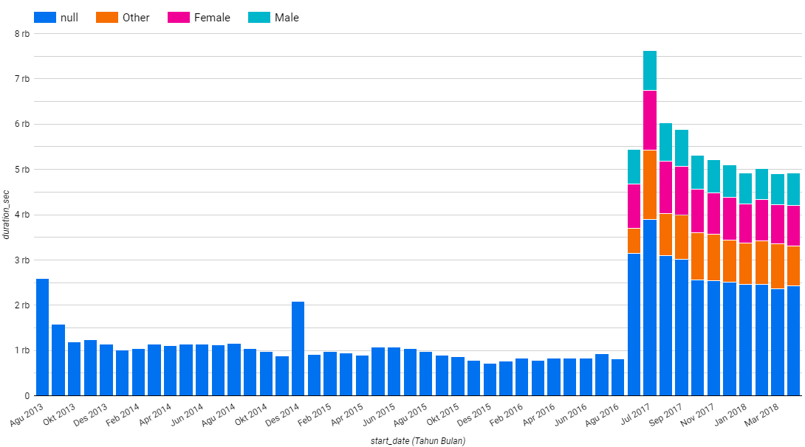
Visualization with Insight
2. Average duration of the trips per month
This chart shows the average duration of bikeshare usage/ borrowing (grouped by gender).
However, it can be seen that:
The implementation of this gender grouping started in June 2017.
From Sept 2016 to May 2017 no data was recorded.
And the highest average duration of the trips per month occurred in July 2017

Slide 12
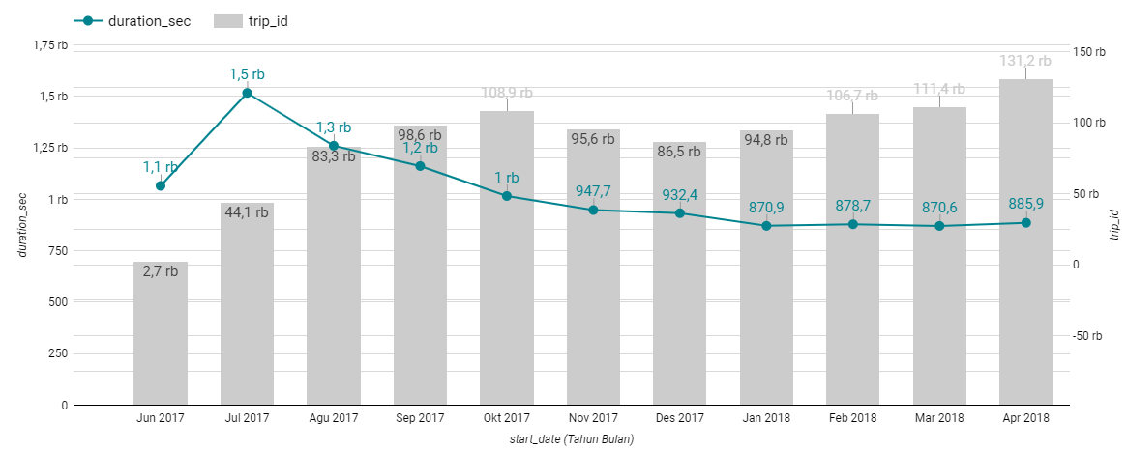
Visualization with Insight
3. The monthly trend of the total trips and the average of duration time (after re-open the bikeshare)
Means that for a large number of trips, it is not necessarily a lot of time spent on bikeshare for each trip.
Where in the diagram it can be seen that the trend in the number of trips from the beginning of the bikeshare reopening until April 2018 tends to increase but for the average duration of use of this bikeshare, it tends to decrease.
Which means the number of trips is a lot but the use is only for a short time.

Slide 13
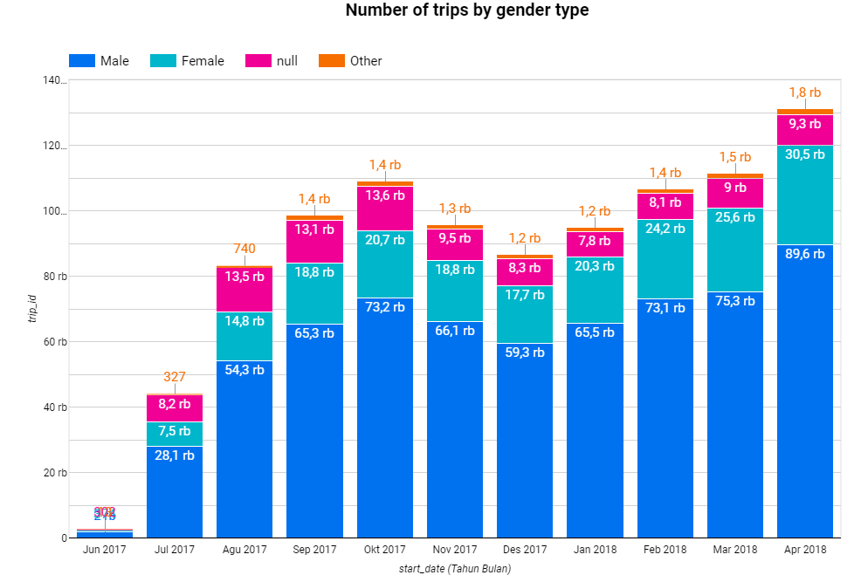
Visualization with Insight
4. Who are the most enthusiasts or renters of this San Francisco bikeshare? (Male or Female)
In this section we can focus on the data starting in 2017, because in this data there is already a gender distinction between male and female and we can find more detailed insight.
From the diagram below, it can be seen that the most users of bikeshare are male.
Which reaches more than half the number of service users each month.
And it is undeniable that there are still service users who do not want to provide information about their gender.

Slide 14
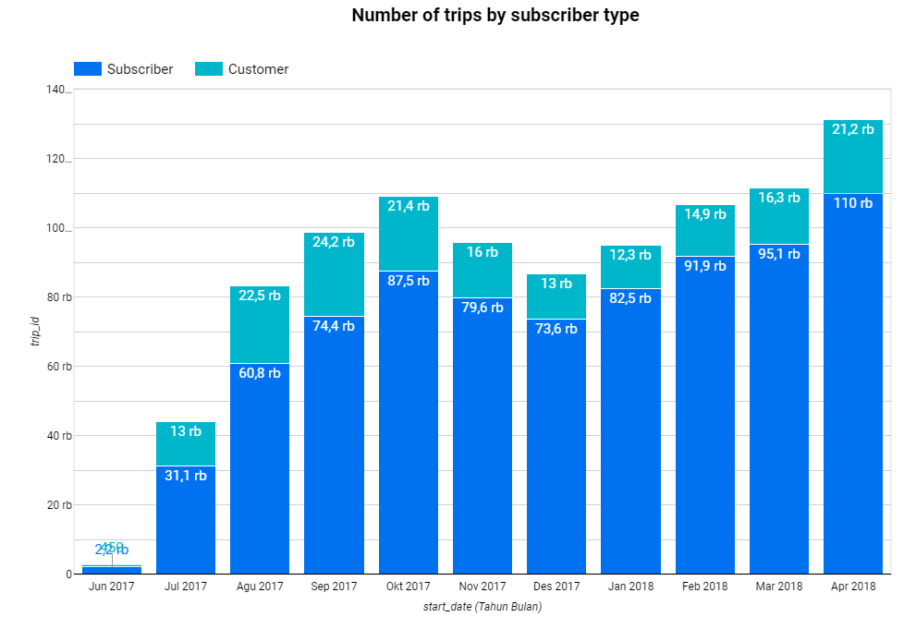
Visualization with Insight
5. From which customers do we get more revenue? (from subscriber or customer)
From the diagram below, it can be seen that :
We got more revenue from subscriber.
Which is a customer segment that becomes a monthly or annual member who has a longer period.

Slide 15
THANK YOU
Dhea Amalia Lutfiani
( 7 FEB – 18 FEB )

