Slide 1
San Francisco Bikeshare Trip Insight TAKEN FROM MY ASSIGNMENT RevoU Mini Course Data Analytics
Portfolio Data Analytics
1st
Dhea Amalia Lutfiani
( 7 Feb – 18 Feb )

Slide 2
Case Study Instructions
SQL & DATA VISUALIZATION
QUESTION
Table of interest :
‘bigquery-public-data.san_francisco_bikeshare.bikeshare_trips’
Look at this data and start thinking. List down 3 trends/points that you want to show.
From here, try to explore the data and make changes, filter, and prepare the data that you need.
Create some visualizations or dashboard with the best type of chart you have learned.
The easiest is with Google Data Studio or Google Sheets.
Then, make 1-2 slides from the Graphs with the insights you got to present your findings
to the stakeholders (read this article from HBR)

Slide 3
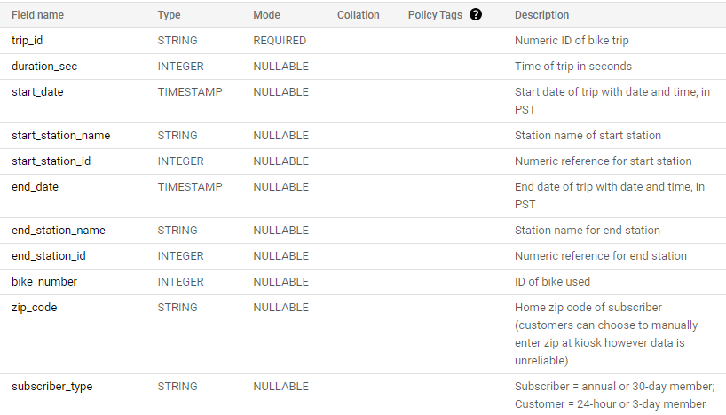
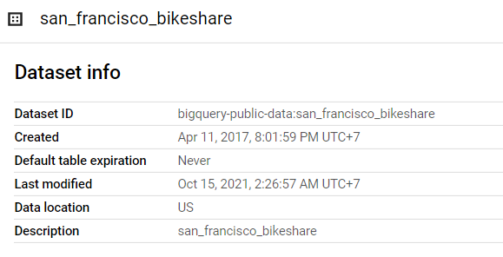
Case Study
SQL & DATA VISUALIZATION
Schema from the Dataset :
Detail from the Dataset :

Slide 4
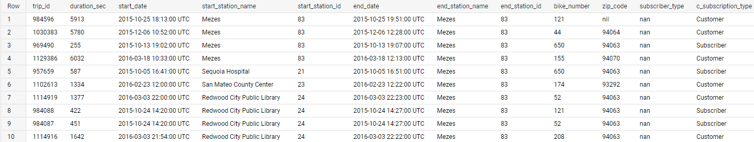
Case Study
SQL & DATA VISUALIZATION
Preview the Data:

Slide 5
Case Study
SQL & DATA VISUALIZATION
List down 3 trends/points that you want to show :
Number of trips per month
Average duration of the trips per month
From which customers do we get more revenue? (from subscriber or customer)

Slide 6
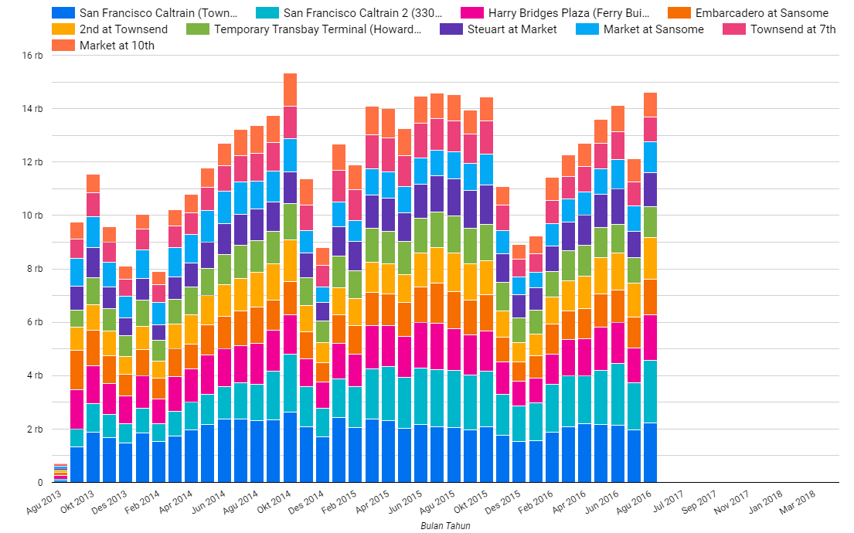
Case Study
SQL & DATA VISUALIZATION
Number of trips per month
This diagram shows the number of trips per month at each station.
We can say that :
Where Market at Sansome station has the highest number of trips per month than any other station.
Every year in the end of the year, the users of this San Francisco bikeshare service are decreasing.
And in October 2014, had the most number of trips.

Slide 7
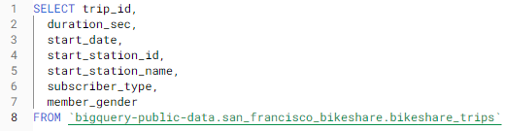
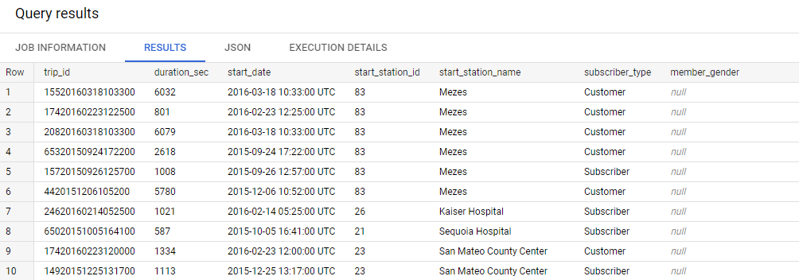
Case Study
SQL & DATA VISUALIZATION
Number of trips per month
Query : with BigQuery – Google cloud
BigQuery Documentation – Query Syntax

Slide 8
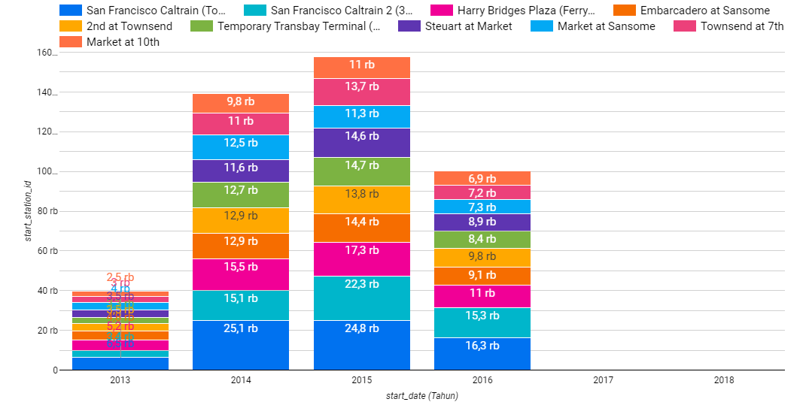
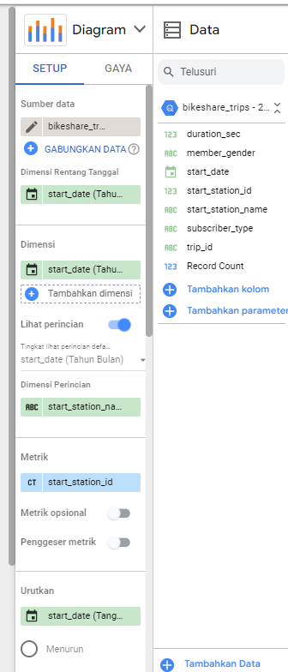
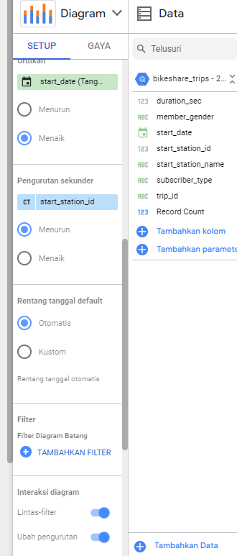
Case Study
SQL & DATA VISUALIZATION
Number of trips per month
Per year
Visualization : Google Data Studio

Slide 9
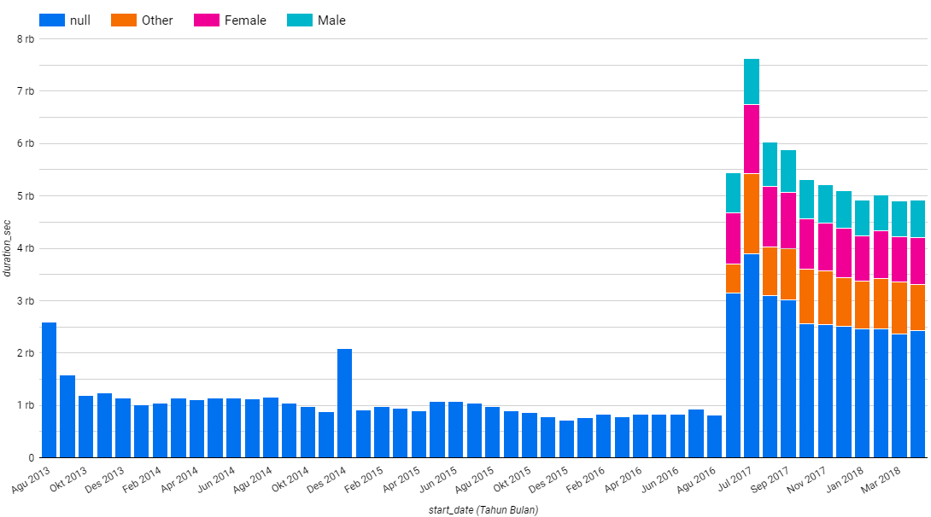
Case Study
SQL & DATA VISUALIZATION
2. Average duration of the trips per month
This chart shows the average duration of bikeshare usage/borrowing (grouped by gender).
However, it can be seen that:
The implementation of this gender grouping started in June 2017.
From Sept 2016 to May 2017 no data was recorded.
And the highest average duration of the trips per month occurred in July 2017

Slide 10
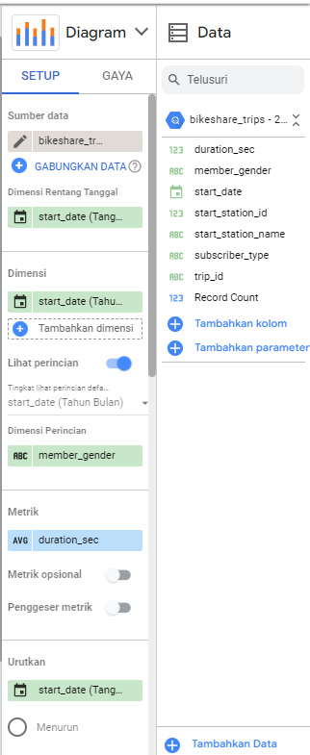
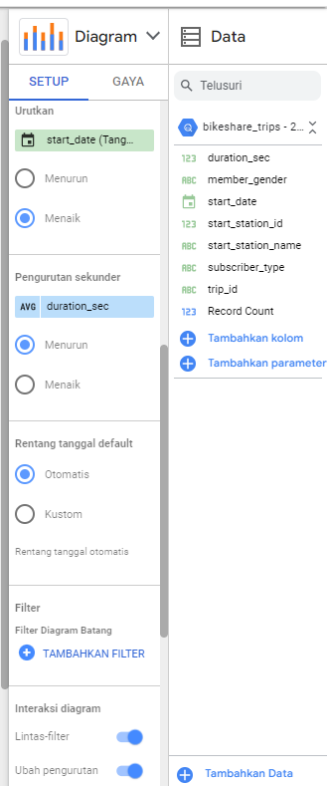
Case Study
SQL & DATA VISUALIZATION
2. Average duration of the trips per month
Query : with BigQuery – Google cloud
Visualization : Google Data Studio

Slide 11
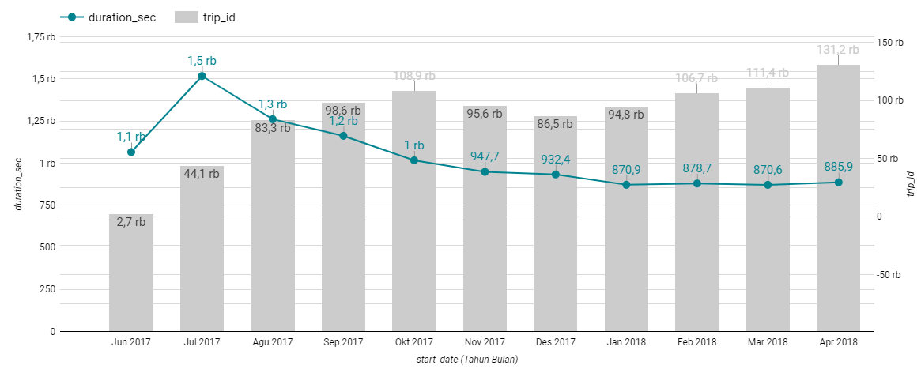
Case Study
SQL & DATA VISUALIZATION
This is a diagram if we put together the number of trips and the average duration of time taken each month starting in 2017.
Means that for a large number of trips, it is not necessarily a lot of time spent on bikeshare for each trip.
Where in the diagram it can be seen that the trend in the number of trips from the beginning of the bikeshare reopening until April 2018 tends to increase but for the average duration of use of this bikeshare, it tends to decrease. Which means the number of trips is a lot but the use is only for a short time.

Slide 12
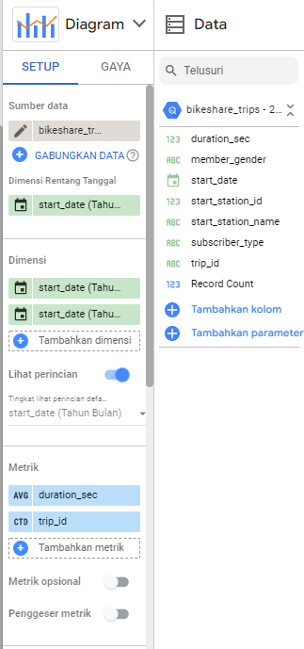
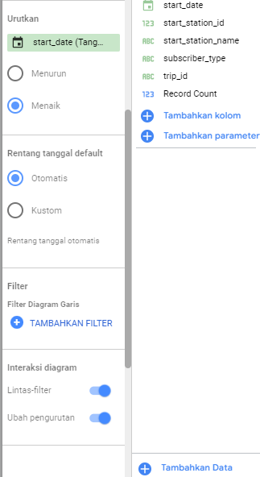
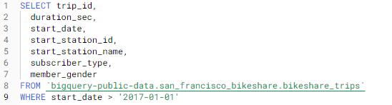
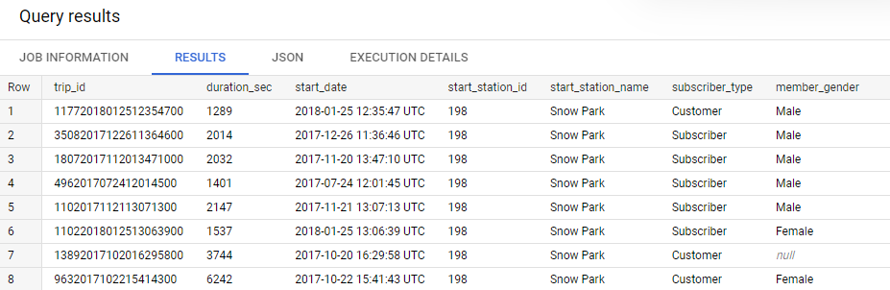
Case Study
Visualization : Google Data Studio
SQL & DATA VISUALIZATION
Query : with BigQuery – Google cloud

Slide 13
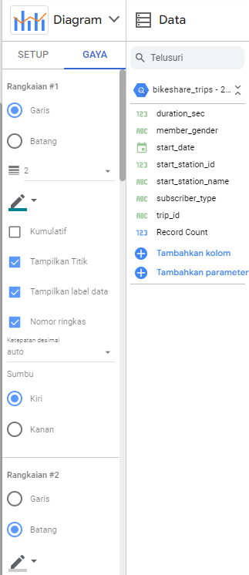
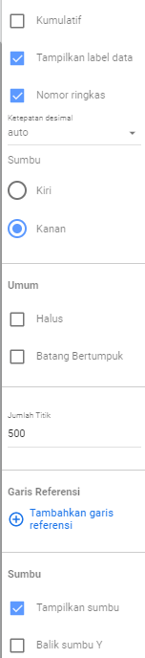
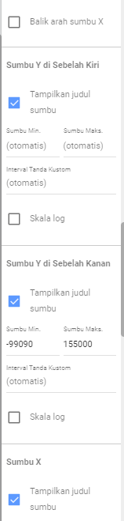
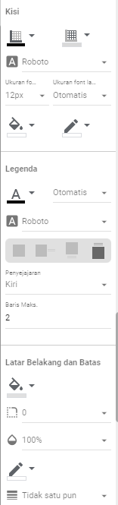
Case Study
Visualization : Google Data Studio
SQL & DATA VISUALIZATION

Slide 14
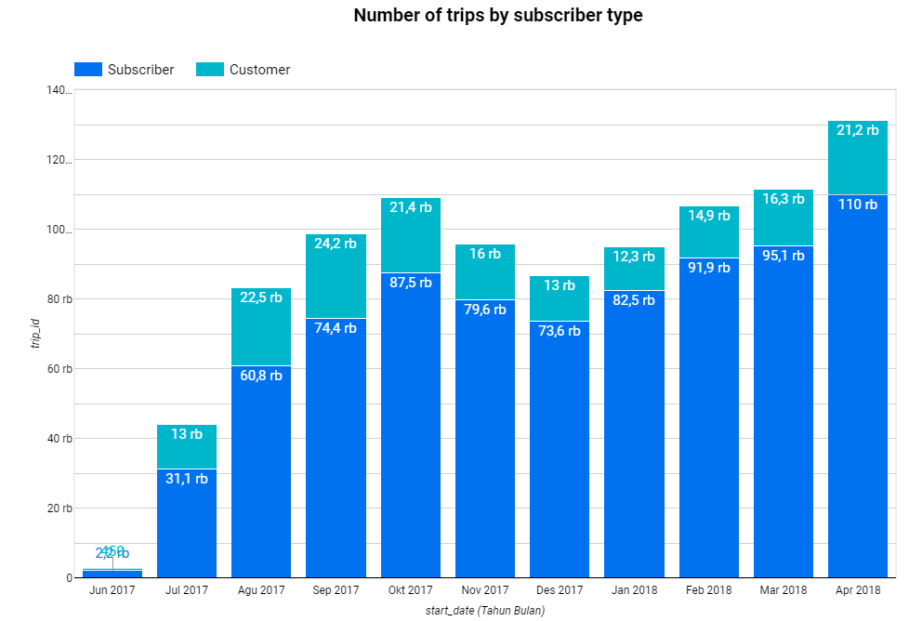
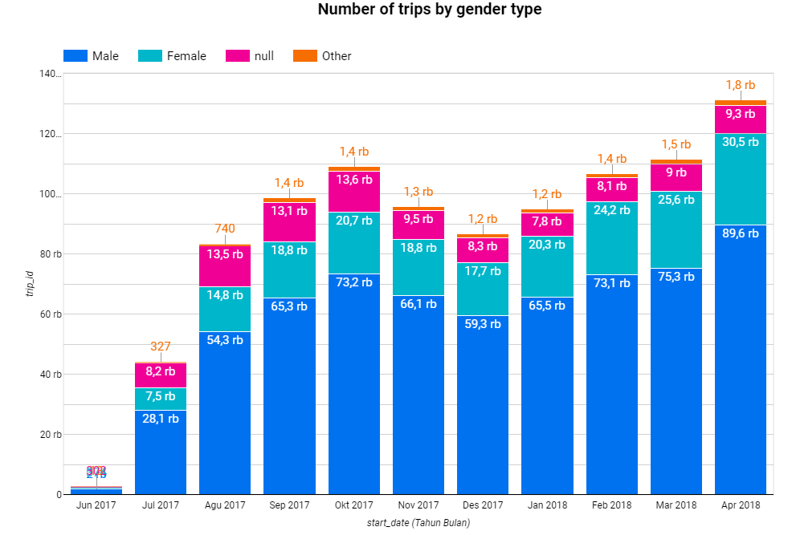
Case Study
SQL & DATA VISUALIZATION
3. From which customers do we get more revenue? (from subscriber or customer)
In this section we can focus on the data starting in 2017, because in this data there is already a gender distinction between male and female and we can find more detailed insight.
From the diagram below, it can be seen that the most users of bikeshare are subscribers and if based on gender, the ones who use bikeshare services the most are male. And we get more revenue from subscriber.

Slide 15
THANK YOU
Dhea Amalia Lutfiani
( 7 Feb – 18 Feb )

