Slide 1
STUDY CASE from RevoU Mini Course Data Analytics
Dhea Amalia Lutfiani

Slide 2
Case Study Instructions
QUESTION
Table of interest : NYC AirBnB Dummy Data
Look at this data and start thinking. List down 3 trends/points that you want to show.
From here, try to explore the data and make changes, filter, and prepare the data that you need.
Create some visualizations or dashboard with the best type of chart you have learned.
The easiest is with Google Data Studio or Google Sheets.
Then, make 1-2 slides from the Graphs with the insights you got to present your findings to the stakeholders (read this article from HBR)

Slide 3
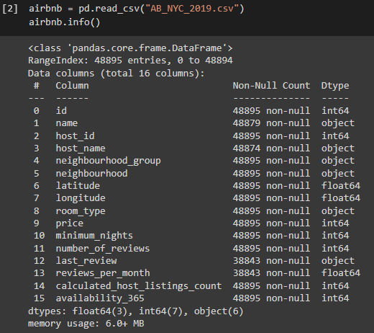
Python & Data Cleaning
Info from the Dataset :
From this information, it can be seen that:
There are 16 columns and the amount of data varies from 38843 to 48895
> 38843 in the last_review and reviews_per_month columns
> 48874 in the hostname column
> 48879 in name column
In the last_review column the data type is object, whereas in the data table it contains date
Therefore it is necessary to do data cleaning because the data in the name and host_name columns cannot be empty, considering that there can be no AirBnB transactions if there is no name ordering.
While in the last_review and reviews_per_month columns the occurrence of empty data is normal because of the nature of the review that is not mandatory in a transaction
So we have to eliminate data that is empty and the number of data becomes 48874 data.

Slide 4
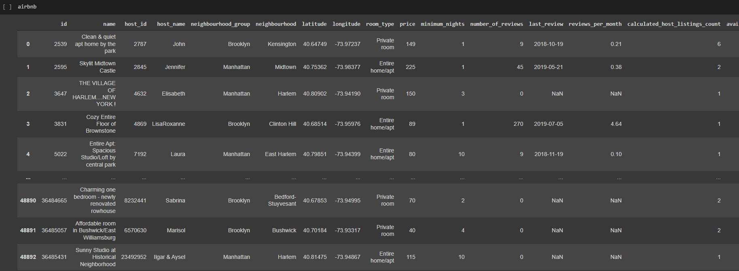
Python & Data Cleaning
Preview the Data before data cleaning:

Slide 5
Python & Data Cleaning
DATA CLEANING
Messy data is a common problem you’d likely face when you have data from sources like spreadsheets. It is important to clean your data before doing any analysis.
Things to do in data cleaning :
Change data type
Remove duplicated data
Remove empty data
Remove outliers
Remove unnecessary data
Things to do in data cleaning :
Menyesuaikan tipe data per-kolom
Menghilangkan nilai kosong
Menghilangkan outliers
Cek lagi dalam perjalanan (selama step by step) cleaning data
Cleaning Data : Python (Google Collab)

Slide 6
Python & Data Cleaning
DATA CLEANING
Messy data is a common problem you’d likely face when you have data from sources like spreadsheets. It is important to clean your data before doing any analysis.
Things to do in data cleaning :
Change data type : last_review column become datetime, latitude and longitude colume become objects
Remove duplicated data
Remove empty data : Delete null data so the number of data becomes 48858
Remove outliers : Delete data that has a value that exceeds the upper and lower limits (data outliers) in the 'price' column, so that the total data becomes 45882
Remove unnecessary data

Slide 7
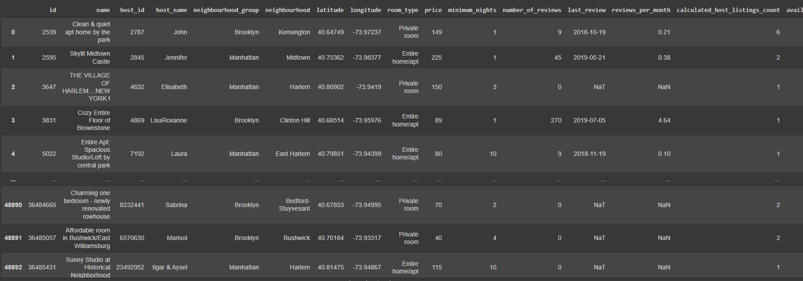
Python & Data Cleaning
Preview the Data after data cleaning:

Slide 8
Defining the Problem
What is AirBnB largest segment of rented properties?
How many properties are there in each borough?
How is the rental price distribution for each room type?
How many property does each host rents via AirBnB?
How is the trend of property review? Are there any properties that’s left too long without any price review?

Slide 9
SQL & DATA VISUALIZATION
What is AirBnB largest segment of rented properties?
How many properties are there in each borough?
How is the rental price distribution for each room type?
How many property does each host rents via AirBnB?
How is the trend of property review? Are there any properties that’s left too long without any price review?

Slide 10
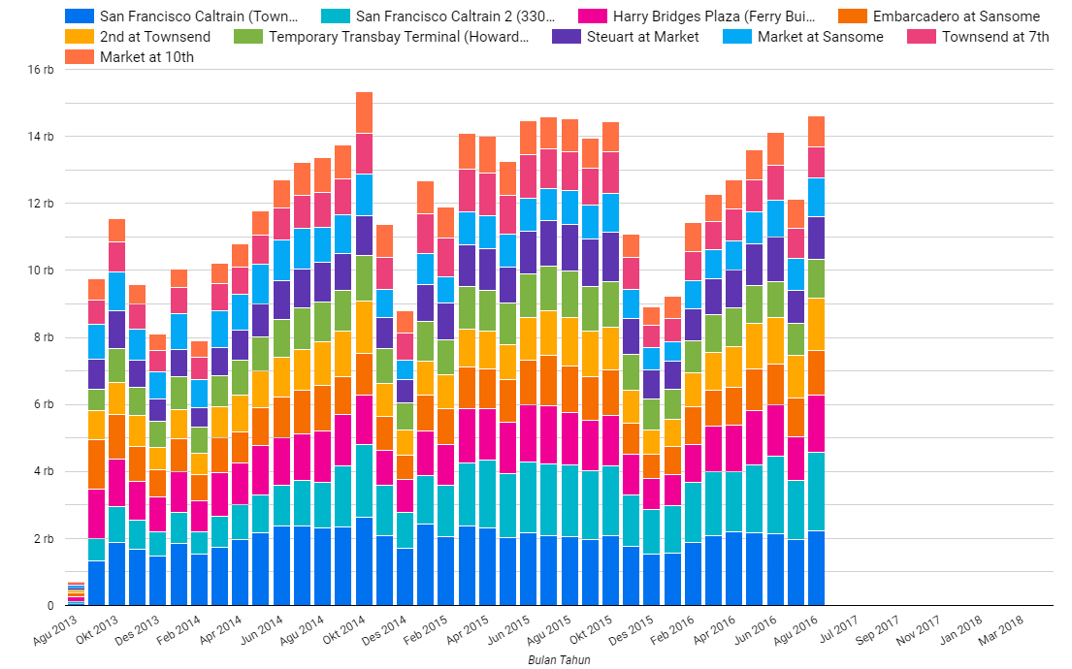
SQL & DATA VISUALIZATION
Number of trips per month
This diagram shows the number of trips per month at each station.
We can say that :
Where Market at Sansome station has the highest number of trips per month than any other station.
Every year in the end of the year, the users of this San Francisco bikeshare service are decreasing.
And in October 2014, had the most number of trips.

Slide 11
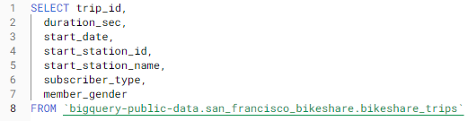
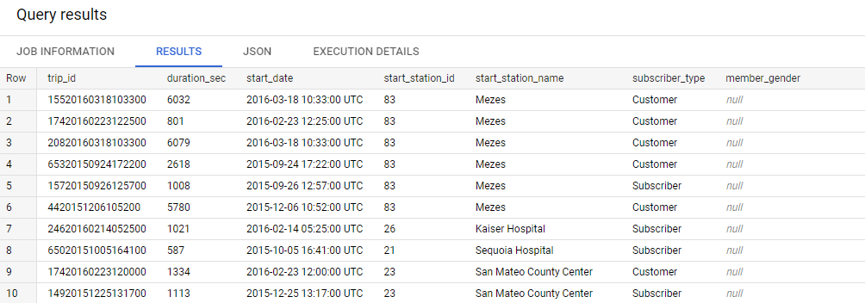
Case Study
SQL & DATA VISUALIZATION
Number of trips per month
Query : with BigQuery – Google cloud

Slide 12
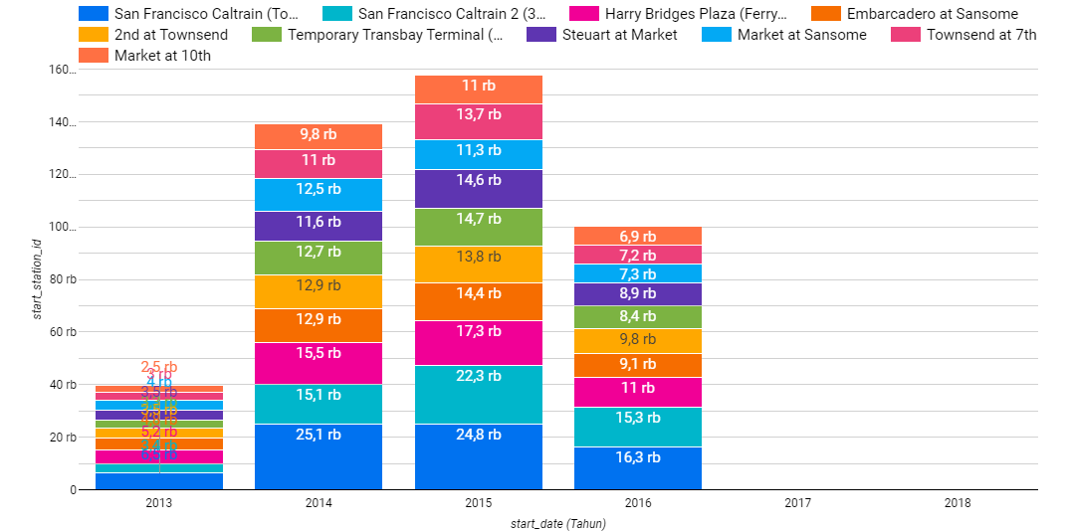
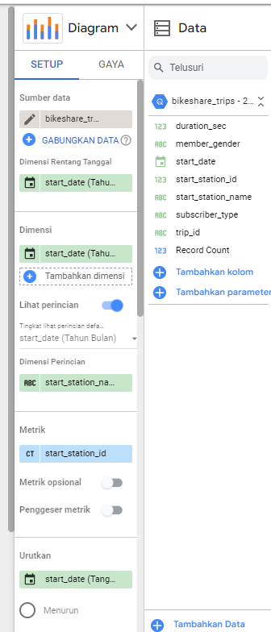
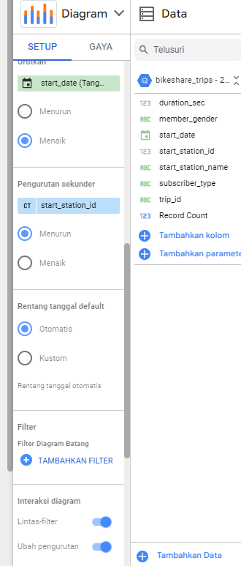
Case Study
SQL & DATA VISUALIZATION
Number of trips per month
Per year
Visualization : Google Data Studio

Slide 13
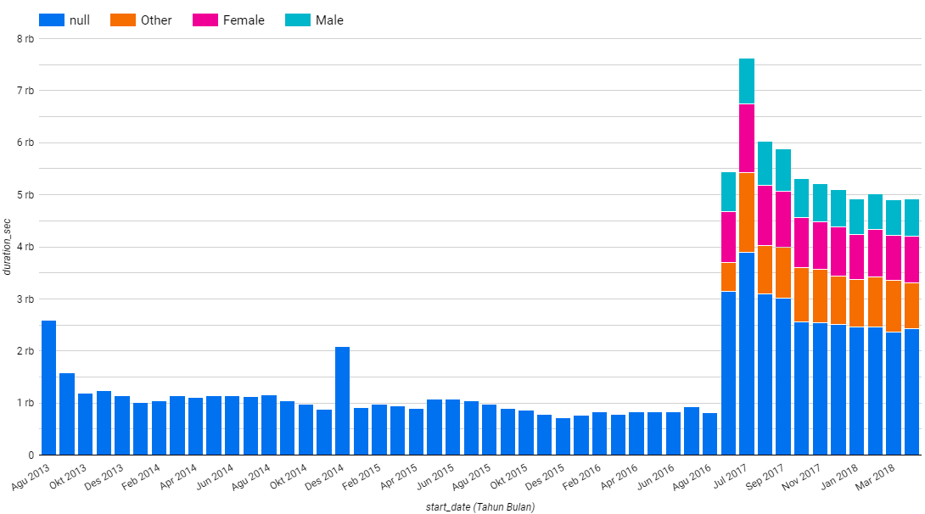
Case Study
SQL & DATA VISUALIZATION
2. Average duration of the trips per month
This chart shows the average duration of bikeshare usage/borrowing (grouped by gender).
However, it can be seen that:
The implementation of this gender grouping started in June 2017.
From Sept 2016 to May 2017 no data was recorded.
And the highest average duration of the trips per month occurred in July 2017

Slide 14
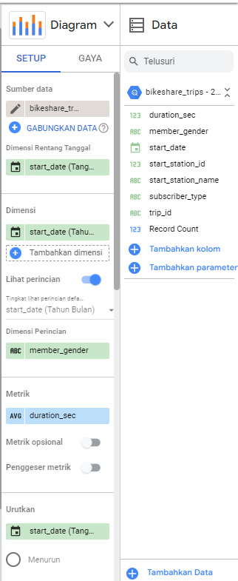
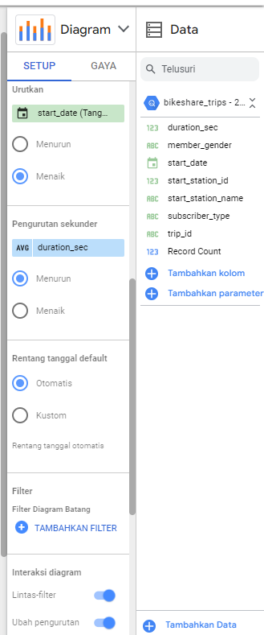
Case Study
SQL & DATA VISUALIZATION
2. Average duration of the trips per month
Query : with BigQuery – Google cloud
Visualization : Google Data Studio

Slide 15
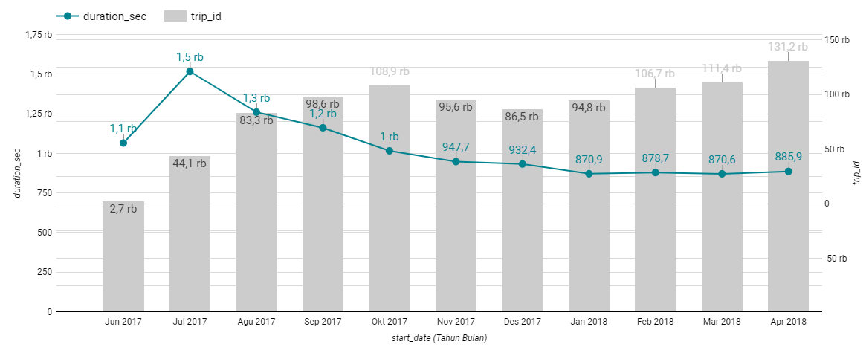
Case Study
SQL & DATA VISUALIZATION
This is a diagram if we put together the number of trips and the average duration of time taken each month starting in 2017.
Means that for a large number of trips, it is not necessarily a lot of time spent on bikeshare for each trip.
Where in the diagram it can be seen that the trend in the number of trips from the beginning of the bikeshare reopening until April 2018 tends to increase but for the average duration of use of this bikeshare, it tends to decrease. Which means the number of trips is a lot but the use is only for a short time.

Slide 16
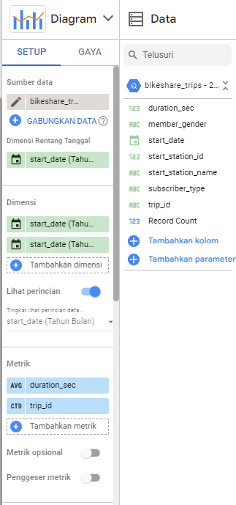
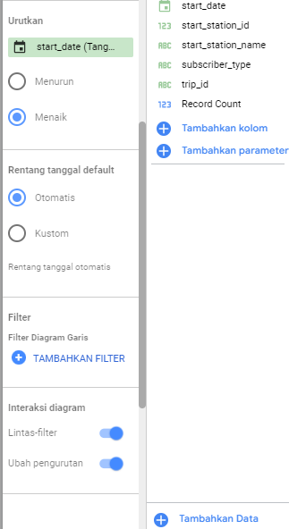
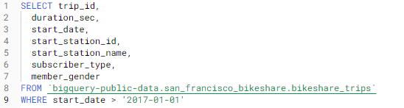
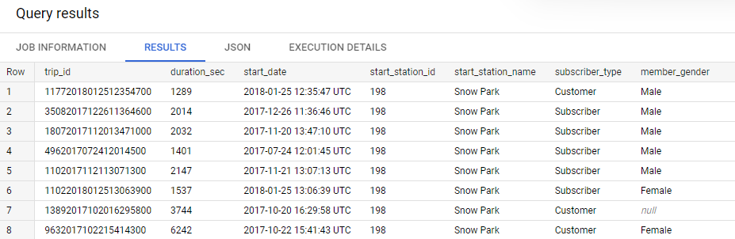
Case Study
Visualization : Google Data Studio
SQL & DATA VISUALIZATION
Query : with BigQuery – Google cloud

Slide 17
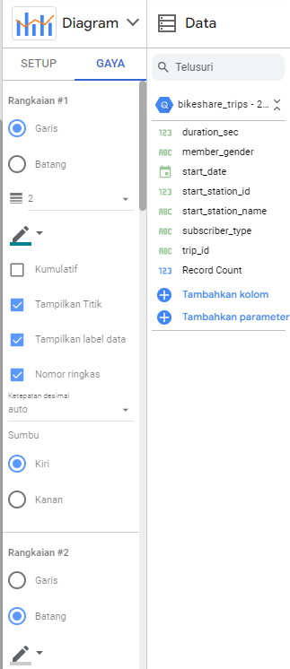
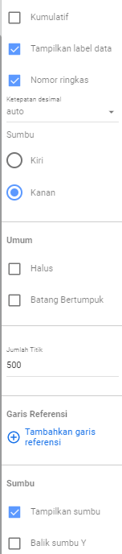
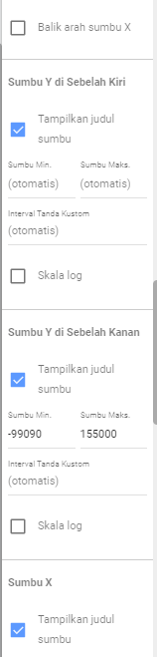
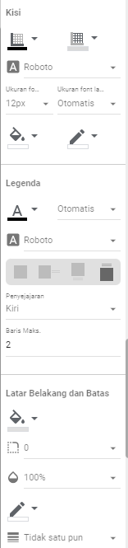
Case Study
Visualization : Google Data Studio
SQL & DATA VISUALIZATION

Slide 18
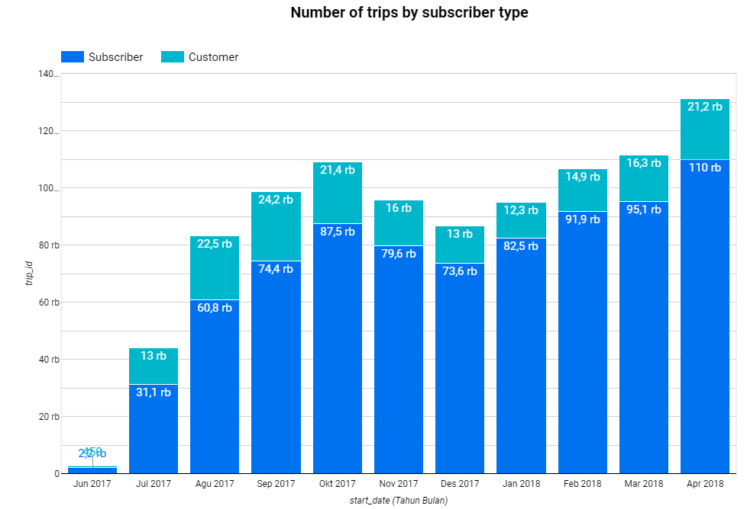
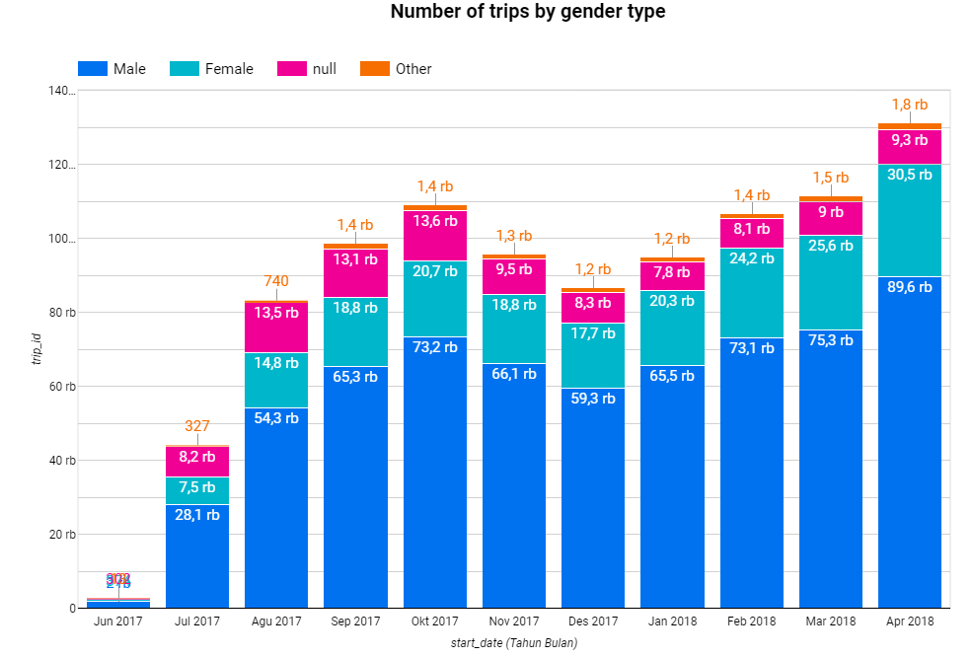
Case Study
SQL & DATA VISUALIZATION
3. From which customers do we get more revenue? (from subscriber or customer)
In this section we can focus on the data starting in 2017, because in this data there is already a gender distinction between male and female and we can find more detailed insight.
From the diagram below, it can be seen that the most users of bikeshare are subscribers and if based on gender, the ones who use bikeshare services the most are male. And we get more revenue from subscriber.

Slide 19
THANK YOU
Dhea Amalia Lutfiani
( 7 Feb – 18 Feb )

