Slide 1
Iowa Liquor Sales Insight TAKEN FROM CASE STUDY RevoU Mini Course - Data Analytics
Portfolio Data Analytics
2nd
Dhea Amalia Lutfiani
( 27 JUNE – 8 JULY )

Slide 2
Case Study Instructions
QUESTION
Table of interest :
‘bigquery-public-data.iowa_liquor_sales.sales’
Look at this data and start thinking. List down 3 trends/points that you want to show.
From here, try to explore the data and make changes, filter, and prepare the data that you need.
Create some visualizations or dashboard with the best type of chart you have learned.
The easiest is with Google Data Studio or Google Sheets.
Then, make 1-2 slides from the Graphs with the insights you got to present your findingsto the stakeholders (read this article from HBR)

Slide 3
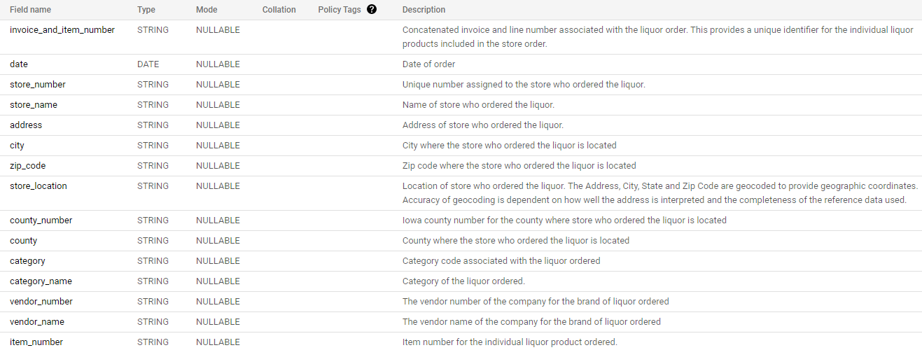
Preview Data
Schema from the Dataset :

Slide 4
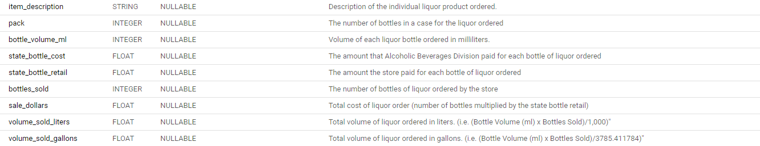
Preview Data
Schema from the Dataset :
From this data preview, we can find out the description of each column and know which columns can be used to answer problems or which columns can be useful for finding new insights.

Slide 5
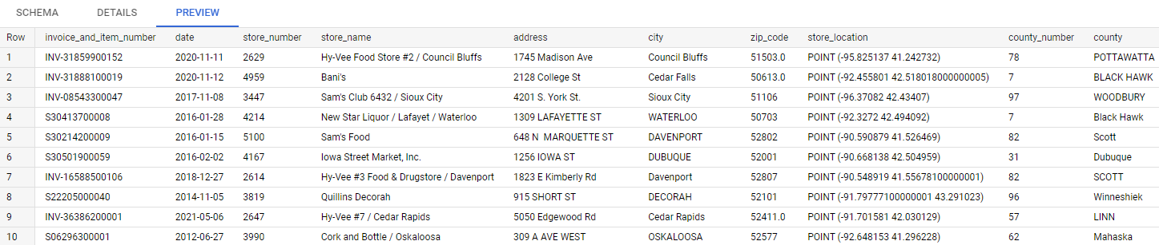
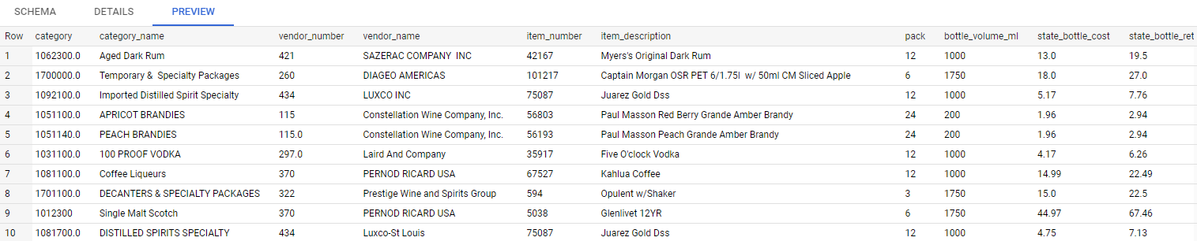
Preview Data
Preview the Data :

Slide 6
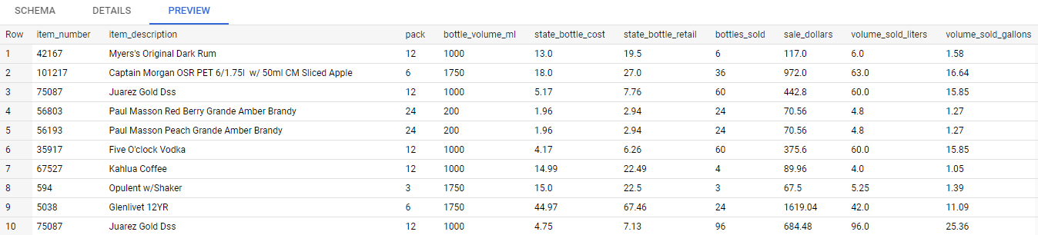
Preview Data
Preview the Data :

Slide 7
Defining Question Defining the Problems
There are 2 approaches that we can do to solve a problem :
You can be given a problem to solve, or
You can be given a dataset to find answers to problems from the data.
In this case, we are seeking for problem we can answer with these set of data. The first thing we should do is looking at the table schema and to see what informations are available.
Make sure that your problem is well-defined, as specific as possible ☺

Slide 8
Defining Question
List down trends/points that you want to show :
How was the monthly trend of sales?
How was our sales in Iowa’s City?
Which category sells the most liquor?
At which day in a week most of customers buy a liquor?
Is liquor with large volume has a better sales compared with small volume?

Slide 9

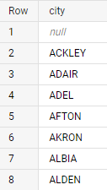
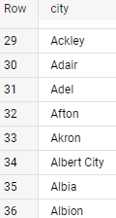
Exploring Data
Include SQL with BigQuery and Data Cleaning
Look for the data with BigQuery > SQL
For some columns with string fields such as in the "city, country, and others" column, the case for this data is that their filling is not the same. Some use only capital letters and some use capital letters at the beginning of the word. Therefore, it is necessary to do Data Cleaning to equalize the data entry string in that column.
The following is a query to see one of these columns:
And the result :

Slide 10

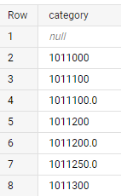

Exploring Data
Include SQL with BigQuery and Data Cleaning
Syntax to convert all strings to capital, for example as follows in the city column :
And the result is that all the contents or values ​​of the city column are only CAPITALIZED and no value is the same.
2. For the category column, it has the same data or value entries but the writing is different. This is also where data cleaning is needed.
The following is a query to view those columns :
And the result :
There are 2 values ​​that are the same but written differently, namely ".0" behind.

Slide 11
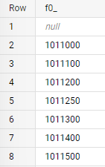


Exploring Data
Include SQL with BigQuery and Data Cleaning
Syntax to remove ".0" in the category column:
And the result :
No more data equal to writing ".0"
3. For columns that have more than 1 value, data cleaning is also required. As in the following category_name column, with the same number but different values.
The following is a query to view the column :

Slide 12
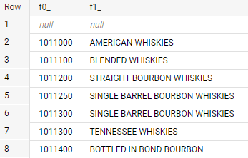
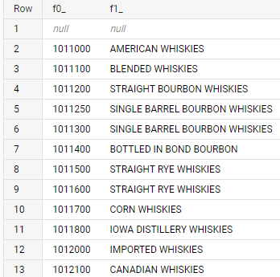

Exploring Data
Include SQL with BigQuery and Data Cleaning
And the result :
Syntax to take just one value from the same nomor identity :
And the result :
No 2 or more numbers with the same identity have different category_name values

Slide 13
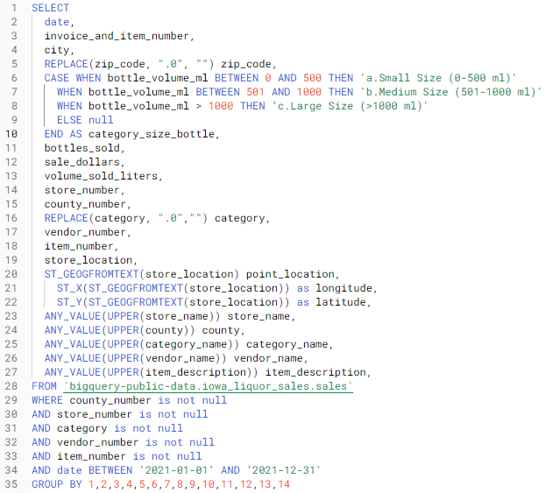
Exploring Data
And finally, the following is a combined query that results from data exploration:
Where there is an aggregate function for grouping bottle sizes, taking only one data value for the identity number value, and cleaning data that has been described previously, such as removing the string ".0".
In addition, there is also a separation of location data between its longitude and latitude, as well as eliminating null values ​​in certain columns.

Slide 14
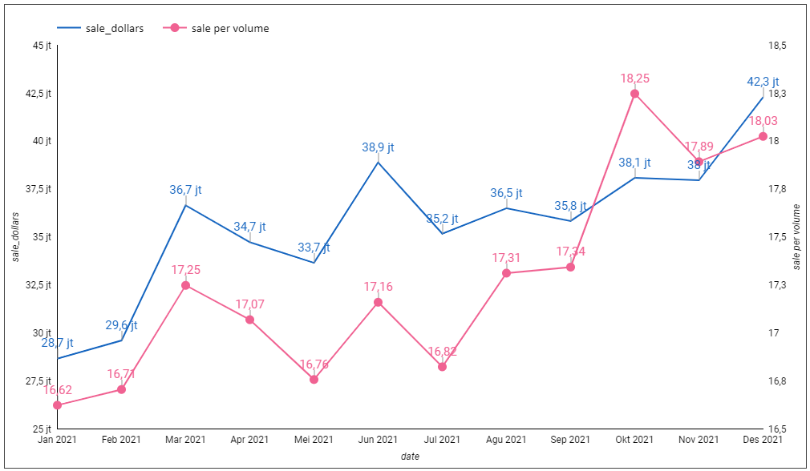
Visualization with Insight
How was the monthly trend of sales?
From the diagram, it can be seen that sales in 2021 tend to increase from the beginning to the end of the year. Where the highest sales are in December 2021.
Then for the largest ratio of sales per volume occurred in October 2021 and the smallest ratio occured in January 2021.
It means volumes with higher prices were sold better in October 2021 .

Slide 15
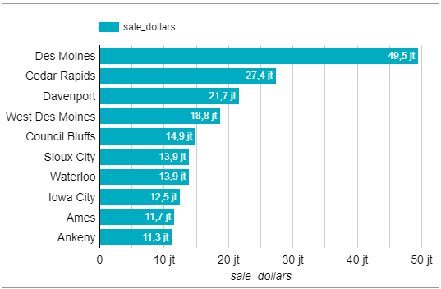
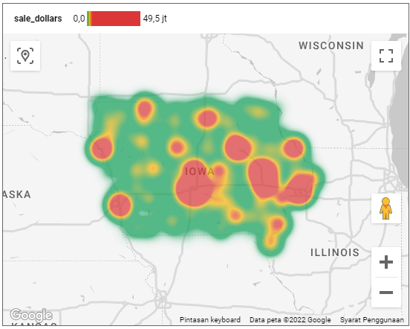
Visualization with Insight
2. How was our sales in Iowa’s City?
From the bar chart above Des Moines is the city with the largest liquor sales in Iowa with nearly $50 million. And sales in Des Moines reached 1.8 times the sales of the second rank, namely Cedar Rapids.
Then the following heatmap shows the 10 cities with the highest sales in Iowa, indicated in red and the other cities with low sales in green.

Slide 16
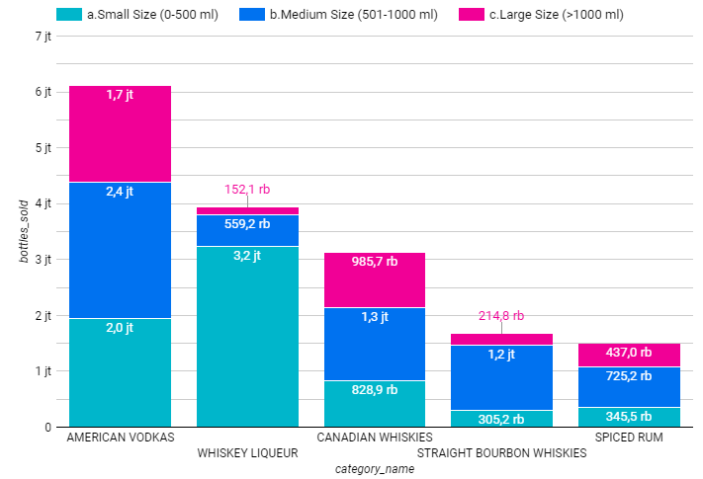
Visualization with Insight
3. Which category sells the most liquor?
The following chart shows the top 5 categories or types of liquor purchased in Iowa.
We know that the most sold liquor is American Vodkas with a total of more than 6 million, but with almost the same number of purchases per size.
Sales of liquor type Whiskey Liqueur small size is the most sold liquor to 3.2 million dollars.

Slide 17
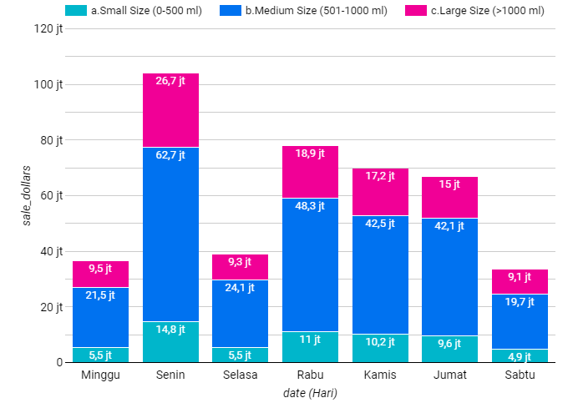
Visualization with Insight
4. At which day in a week most of customers buy a liquor?
Monday was the day with the largest amount of liquor sales reaching 26.7 million dollars and Saturday was the lowest selling day with less than 10 million dollars.
It can be concluded that liquor sales are fluctuating every day.

Slide 18
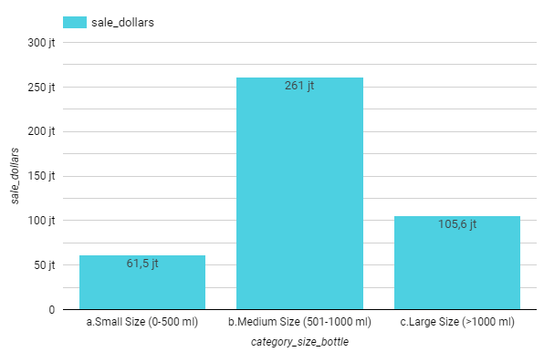
Visualization with Insight
5. Is liquor with large volume has a better sales compared with small volume?
When compared, it turns out that liquor sales for the large size are greater than the small size.
However, the largest sales are obtained from the sale of liquor with medium size, which is 501 ml to 1000 ml.

Slide 19
THANK YOU
Dhea Amalia Lutfiani
( 27 JUNE – 8 JULY )

