Slide 1
Salary Project TAKEN FROM CASE STUDY RevoU Mini Course - Data Analytics
Portfolio Data Analytics
^{3nd}
Dhea Amalia Lutfiani
( 25 JULY – 5 august )

Slide 2
Case Study Instructions
QUESTION
Table of interest :
Salary Dataset
Look at this data and start thinking. List down 3 trends/points that you want to show.
From here, try to explore the data and make changes, filter, and prepare the data that you need.
Create some visualizations or dashboard with the best type of chart you have learned.
The easiest is with Google Data Studio or Google Sheets.
Then, make 1-2 slides from the Graphs with the insights you got to present your findingsto the stakeholders (read this article from HBR)

Slide 3
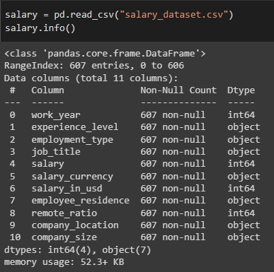
Preview Data
Info from Dataset
From this information, it can be seen that:
There are 11 columns and the amount of data varies is 607 data
The data type of the salary dataset are int64 and object

Slide 4
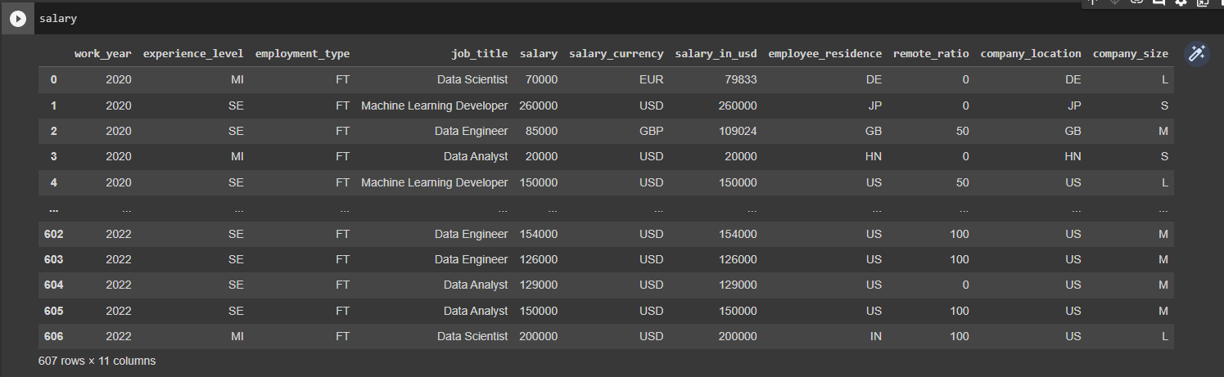
Preview Data
Preview the Dataset before data cleaning:

Slide 5
Python and Data Cleaning
Data Cleaning
Messy data is a common problem you’d likely face when you have data from sources like spreadsheets. It is important to clean your data before doing any analysis.
Things to do in data cleaning :
Change data type
Remove duplicated data : from 607 data to 562 data, where there are 45 duplicate data, which is 7.41% of the total data.
Remove empty data
Remove outliers : Delete data that has a value that exceeds the upper and lower limits (data outliers) in the ‘salary_in_usd' column, so that the total data becomes 552.
Remove unnecessary data
Link Google Colab :
https://colab.research.google.com/drive/1I2zP1P0Rt_ThnIZ7aHZOMfDXjs602xsS?usp=sharing

Slide 6
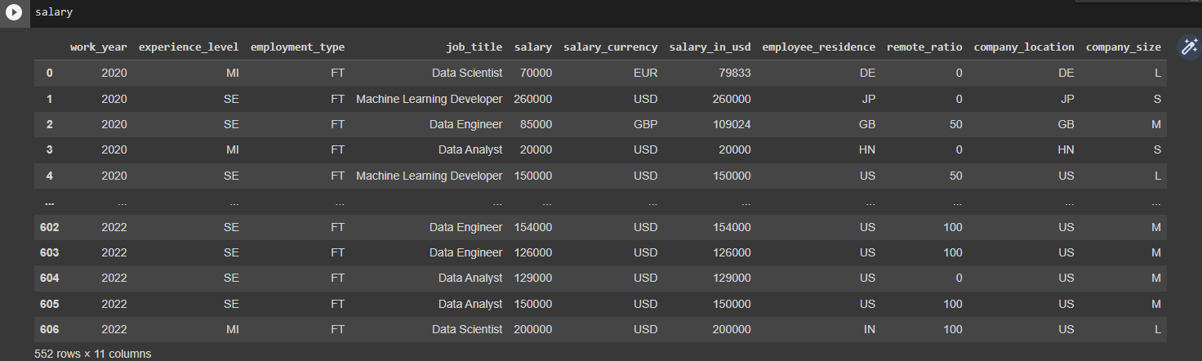
Python and Data Cleaning
Preview the Dataset after data cleaning:

Slide 7
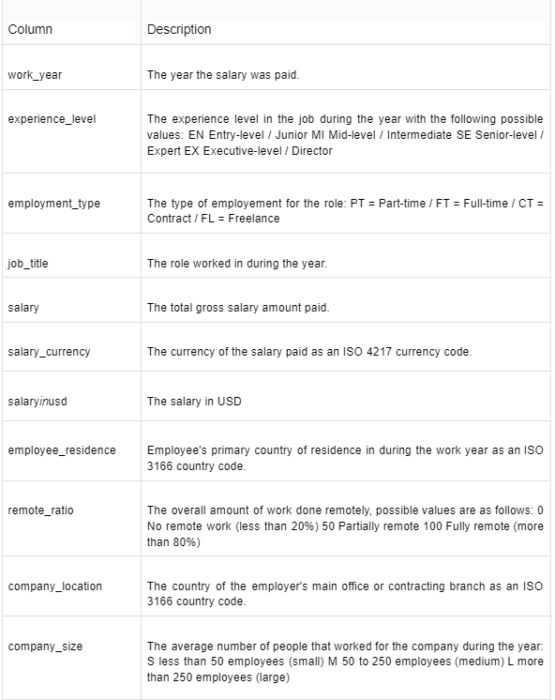
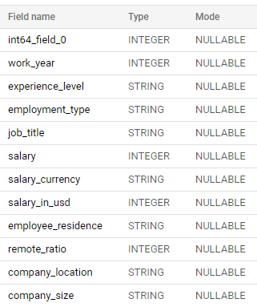
Preview Data
Description :
After cleaning the data in python on Google Colab, then we make a query from the data with BigQuery
Schema from the Dataset :
From this data preview, we can find out the description of each column and know which columns can be used to answer problems or which columns can be useful for finding new insights.

Slide 8
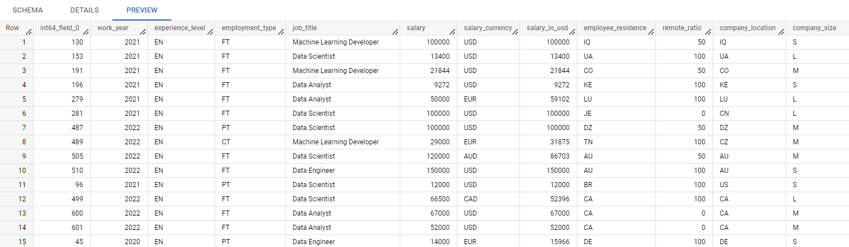
Preview Data
Preview the Data :

Slide 9
Defining Question
List down trends/points that you want to show :
Average salary_in_usd on experience level every year
Average salary_in_usd on job title every year
What jobs have the highest and lowest salaries?
What types of employment_type pay the most?
What are the most common areas of work?
Located where most of the workers work?

Slide 10
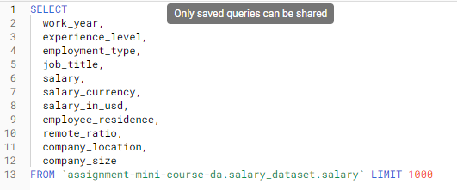
Exploring Data
Include SQL with BigQuery
The following is a ready-to-use query for data visualization in Google Data Studio :

Slide 11
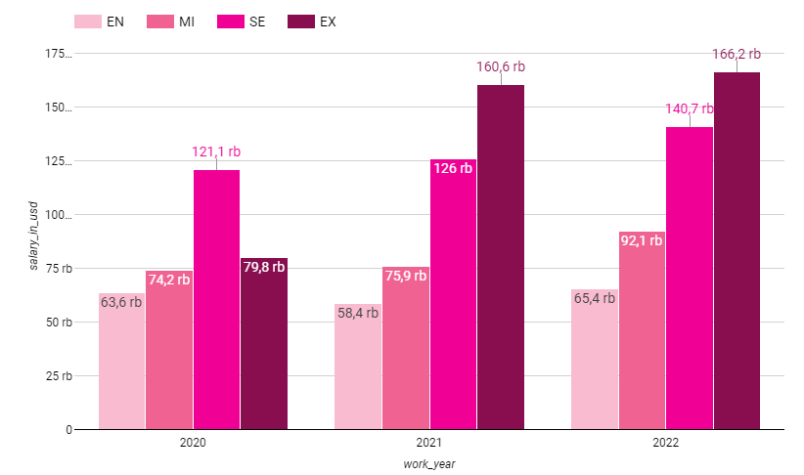
Visualization with Insight
Average salary_in_usd on experience level every year
From the diagram, it can be seen that the average salary in each year tends to be constant, even though the salary at the EX experience level has increased by 2 times in 2021.
And if you look at the average salary given according to the level of work experience. Where if the worker has higher experience then the salary given is also higher.
The average salary given to EX in 2020 is lower than that given to SE in that year. This can be caused by the number of EX workers more than SE and with a different nominal for each company.

Slide 12
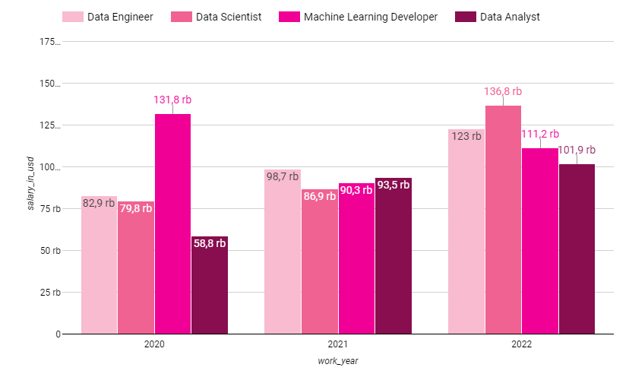
Visualization with Insight
2. Average salary_in_usd on job title every year
For the average salary in accordance with the role of work each year, this has increased every year for the roles of Data Engineer, Data Scientist, and Data Analyst.
Meanwhile, the Machine Learning Developer role experienced fluctuations where the highest average salary was in 2020 which then fell by 31.5%, and then increased again in 2022.
And the largest average salary is for the Data Scientist role in 2022.

Slide 13
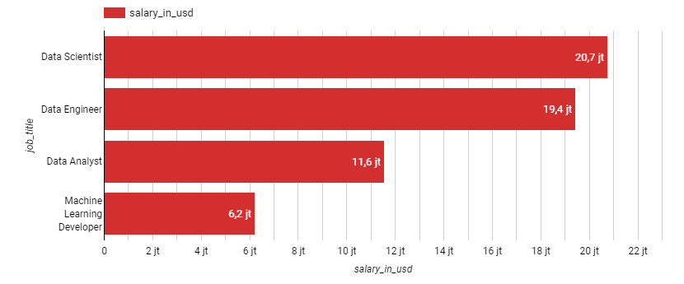
Visualization with Insight
3. What jobs have the highest and lowest salaries?
The biggest salary is the salary for Data Scientist jobs and the smallest salary is for Machine Learning Developer jobs

Slide 14
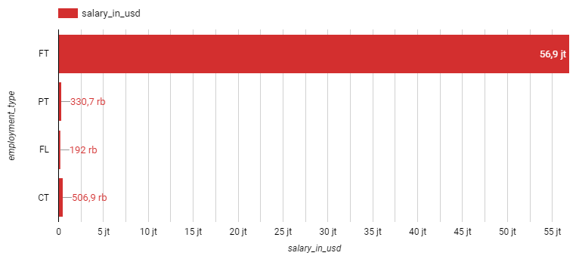
Visualization with Insight
4. What types of employment_type pay the most?
The employment_type that gets the largest salary is the FT or Full Time type, which means that the majority of the workers in the salary_dataset are Full Time workers.

Slide 15
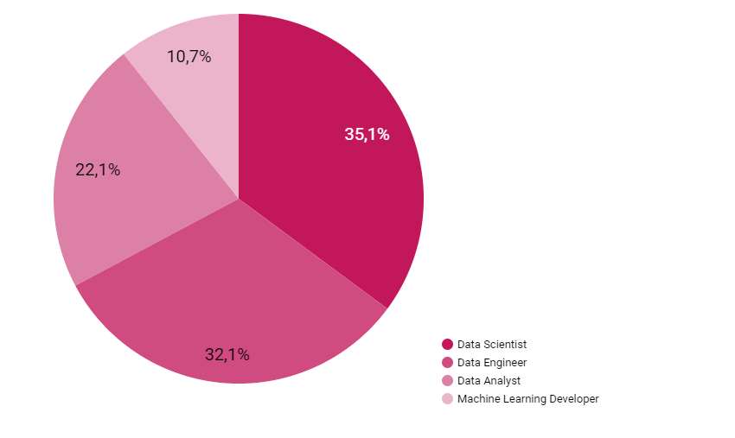
Visualization with Insight
5. What are the most common areas of work?
The field of work that is most in demand is Data Scientist with a total of 35.1% of the total, which is 194 workers.
The second rank is Data Engineer with 177 workers, 32.1% of the total.
This shows that Data Scientist and Data Engineer are in the top 2 jobs that are mostly used as professions.

Slide 16
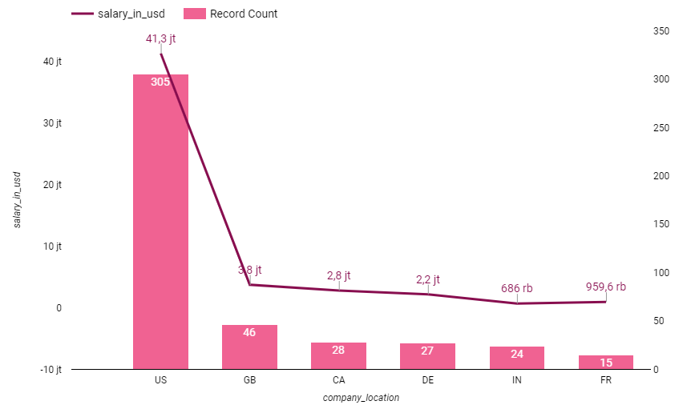
Visualization with Insight
6. Located where most of the workers work?
From all the locations in the data, only the top 6 locations for working people were taken.
It can be seen that the US became the most favorite location among the others, more than 6 times from the second location called GB.
And the US spends about 41.3 million dollars on its workers.

Slide 17
THANK YOU
Dhea Amalia Lutfiani
( 25 JULY – 5 august )

