Slide 1

Data Analytics using R
Visualization
By
D. Jyothi
Assistant Professor
Department CSE( Data science)
MLR Institute of Technology,
Hyderabad.

Slide 2
PIE CHART BAR CHART LINE CHART KERNAL DENSITY PLOT QUANTILE QUANTILE PLOT BOX AND WHISKER PLOT BUBBLE CHART IMAGE PLOT MOSAIC PLOT VIOLIN PLOT
Overview

Slide 3
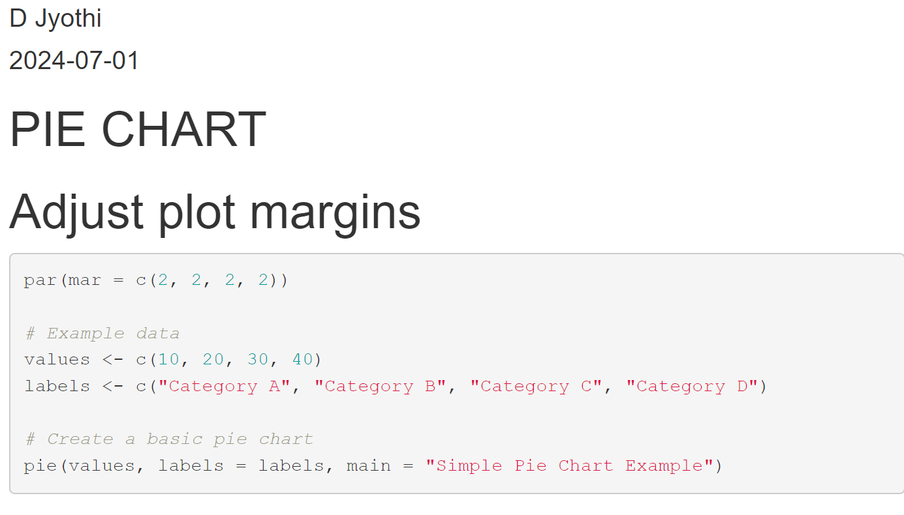
PIE CHART

Slide 4
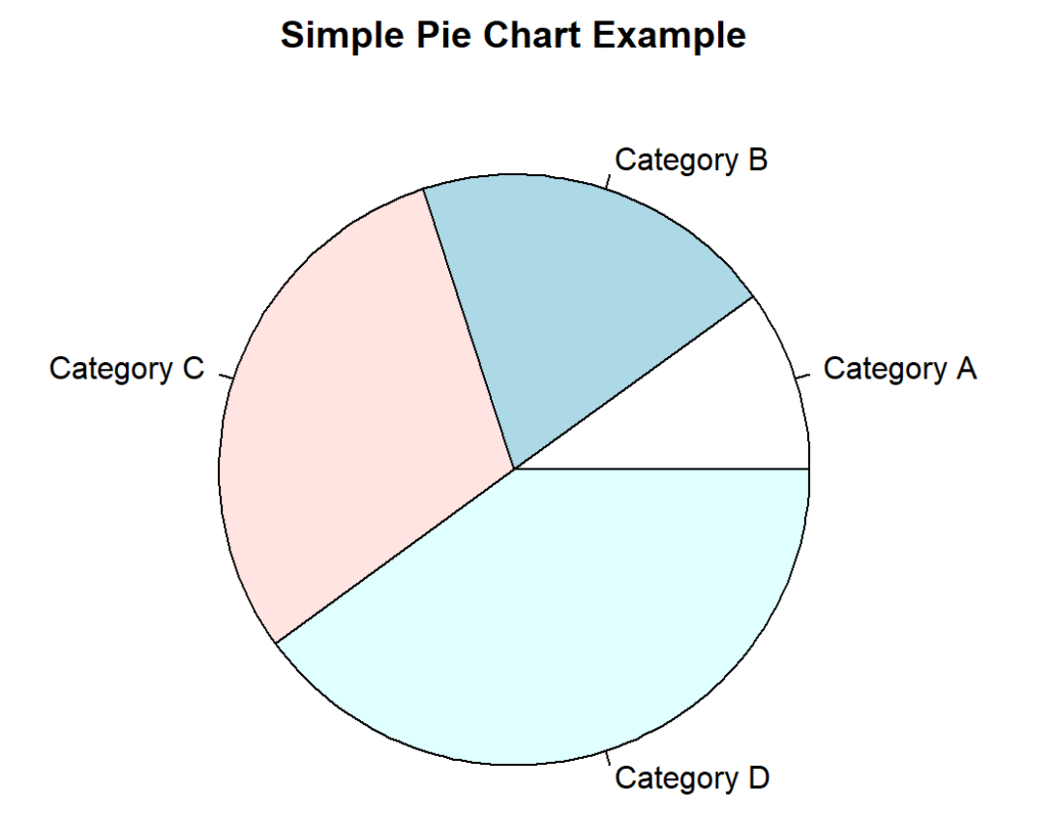

Slide 5
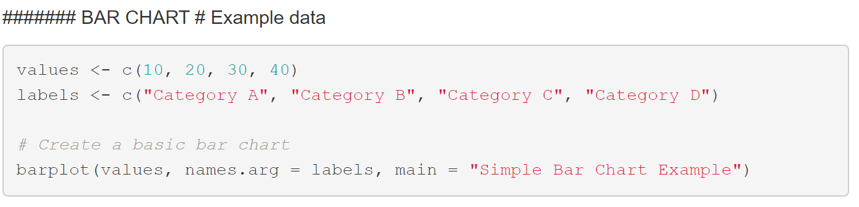
BAR CHART

Slide 6
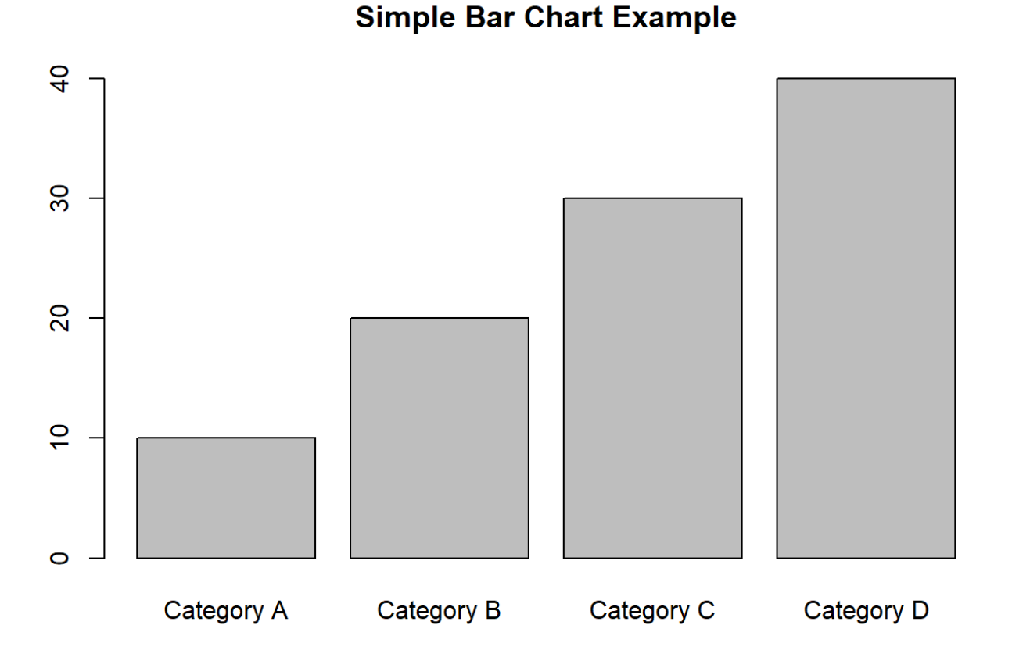

Slide 7
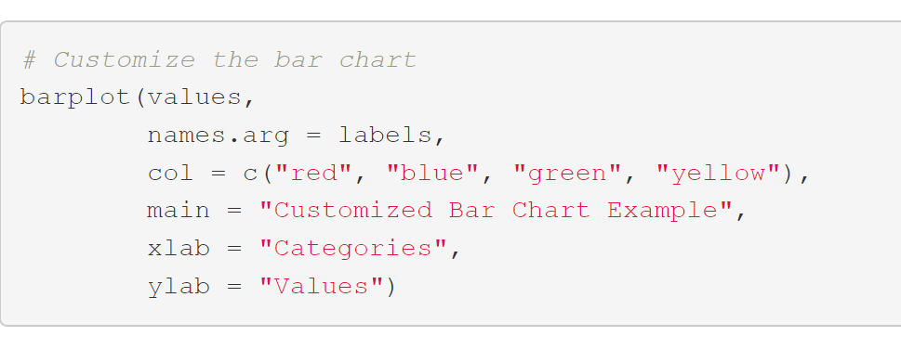
CUSTOMIZE BAR CHART

Slide 8
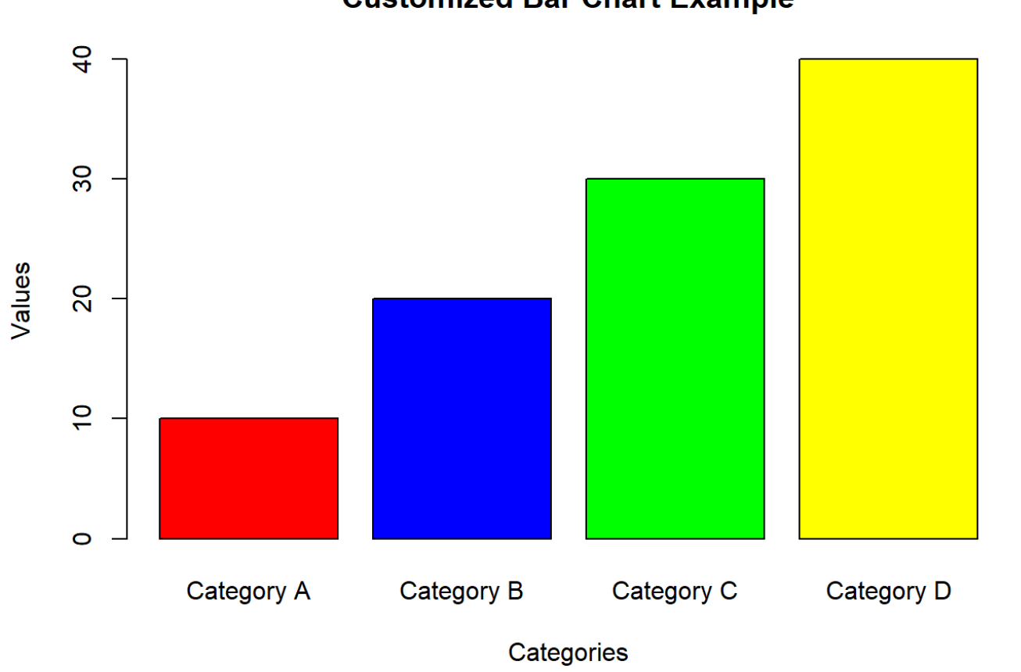

Slide 9
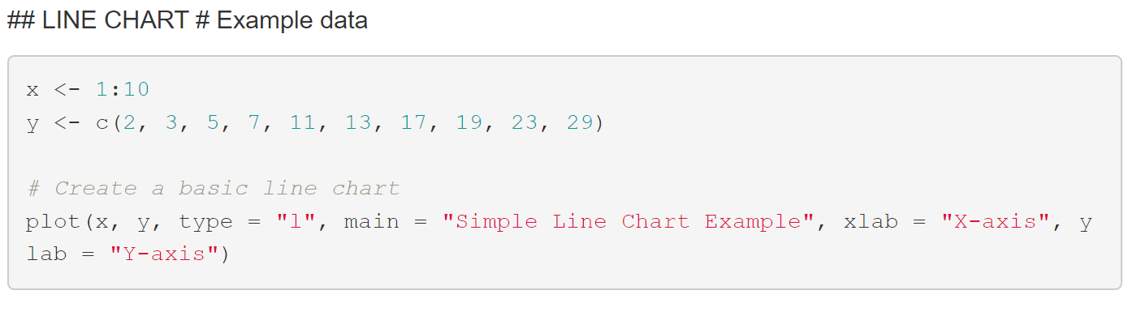
LINE CHART

Slide 10
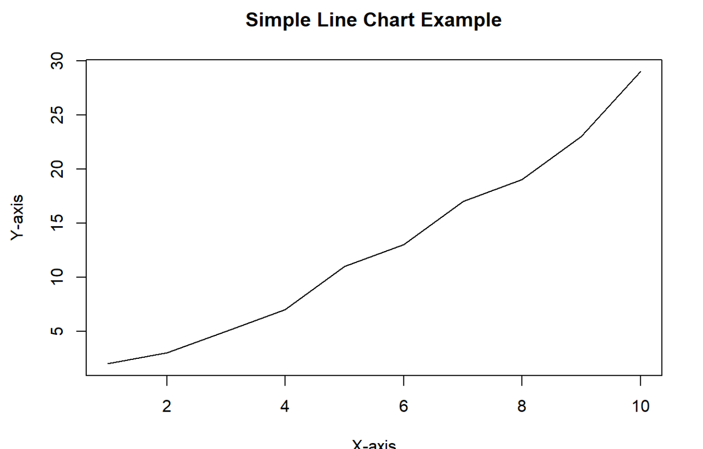

Slide 11
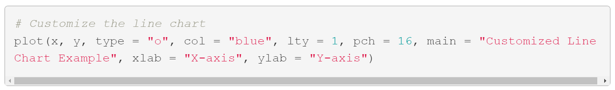
CUSTOMIZE LINE CHART

Slide 12
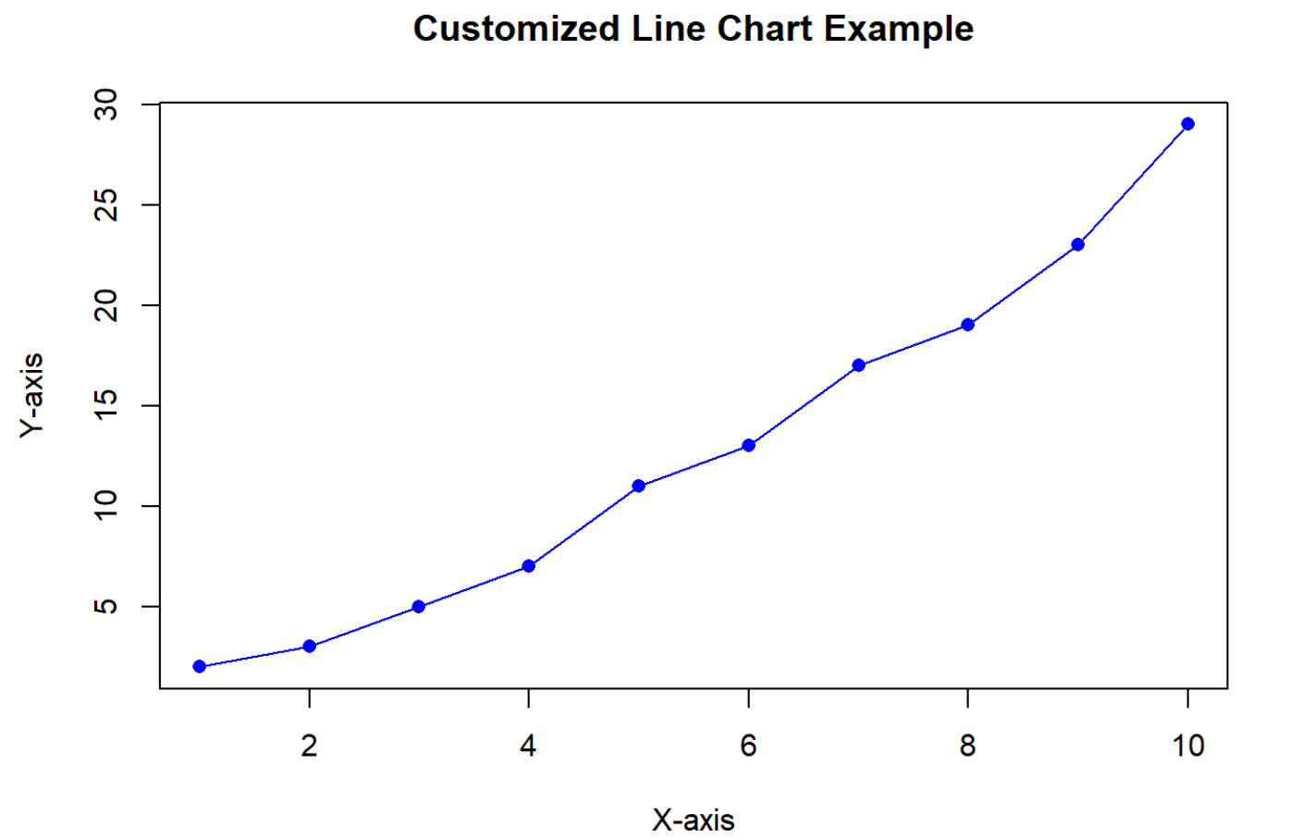

Slide 13
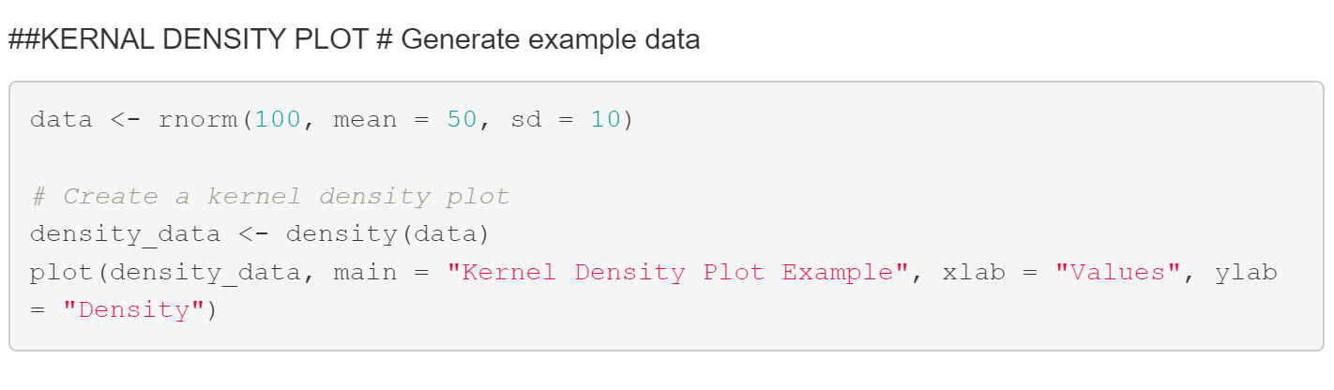
KERNAL DENSITY PLOT

Slide 14
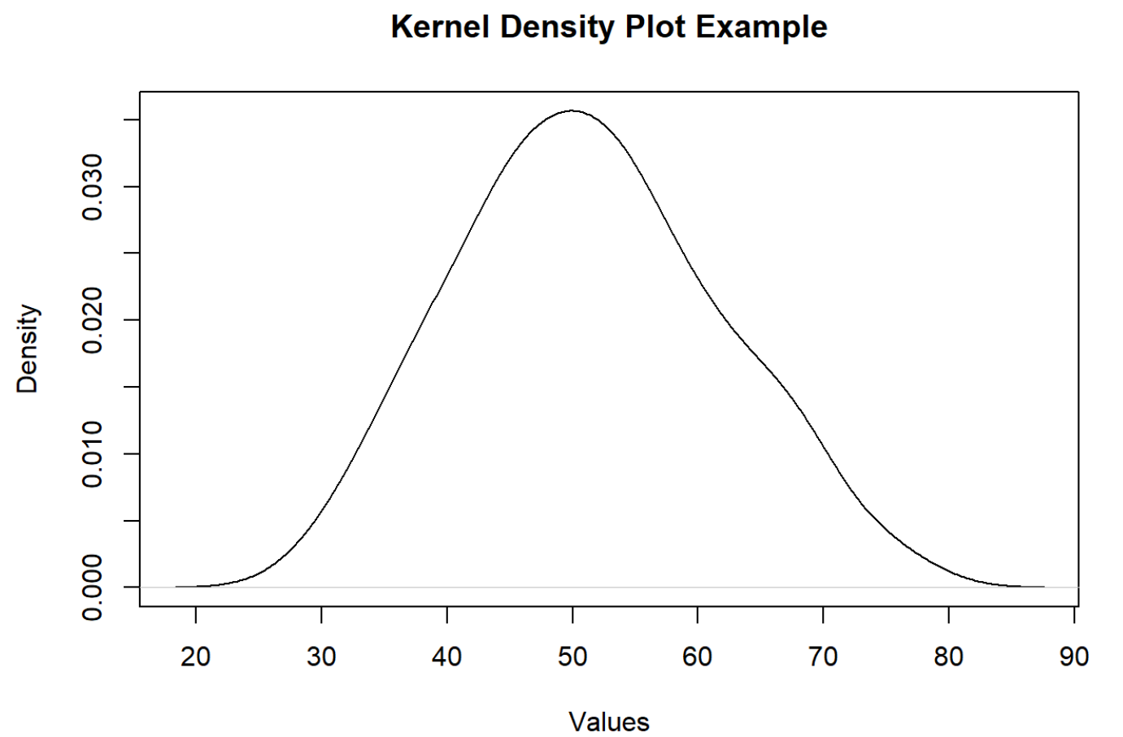

Slide 15
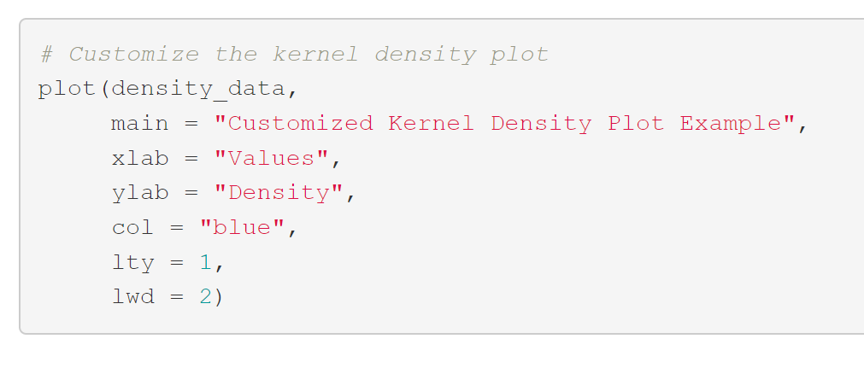
CUSTOMIZE KERNEL DENSITY PLOT

Slide 16
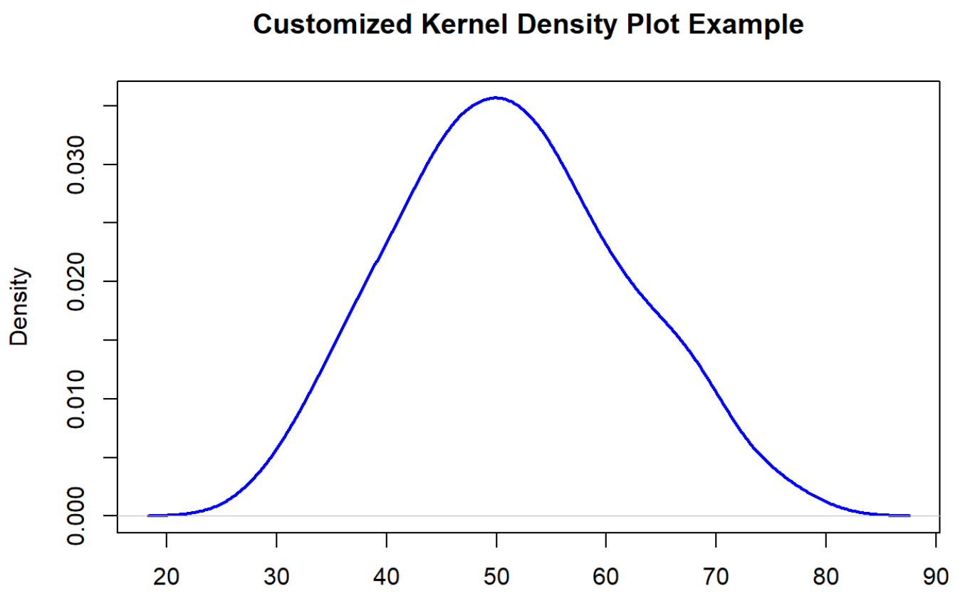

Slide 17
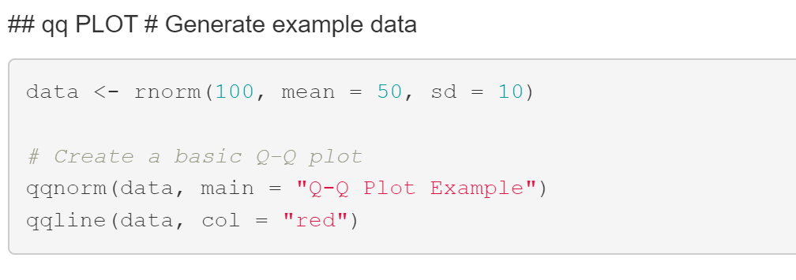
QUANTILE QUANTILE PLOT

Slide 18
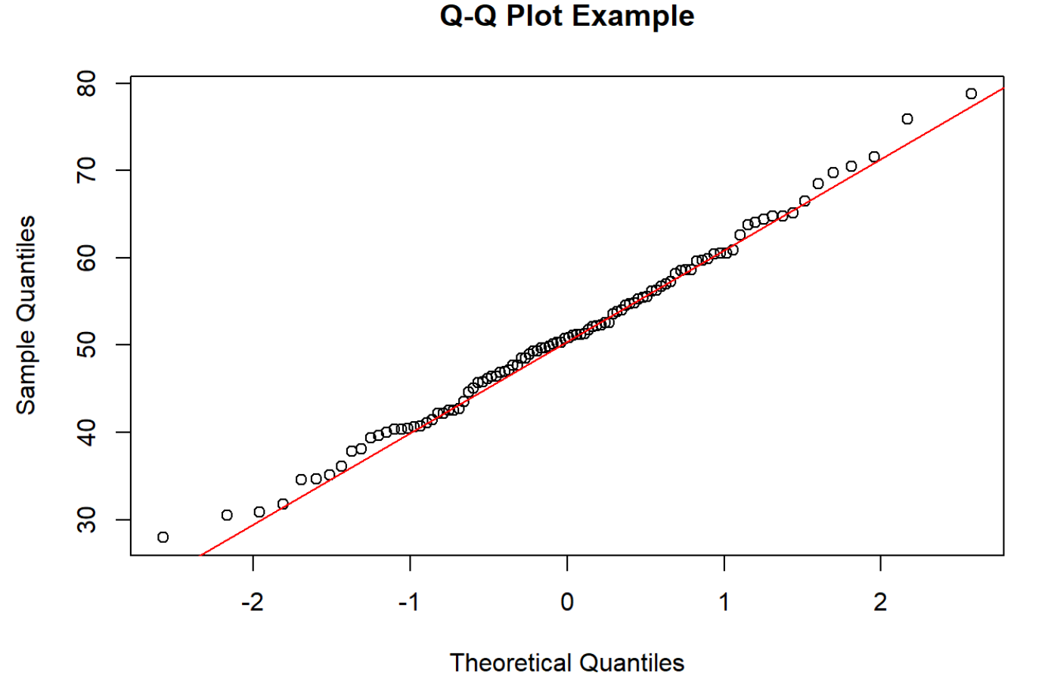

Slide 19
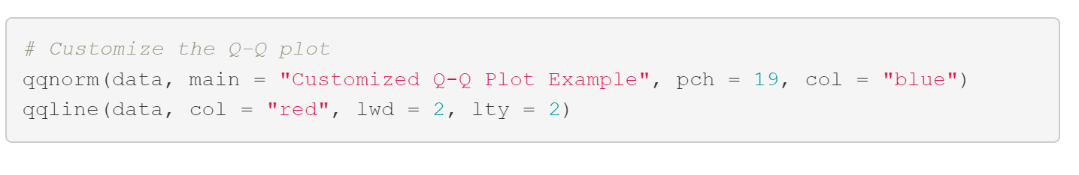
CUSTOMIZE QQ PLOT

Slide 20
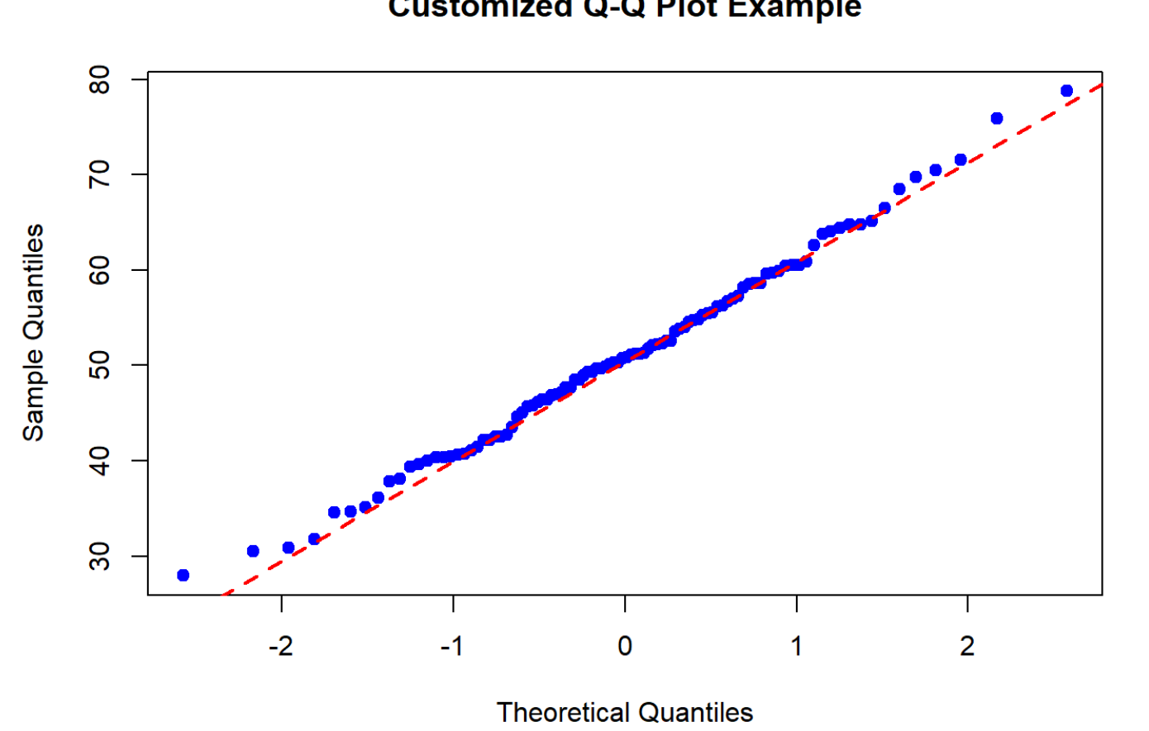

Slide 21
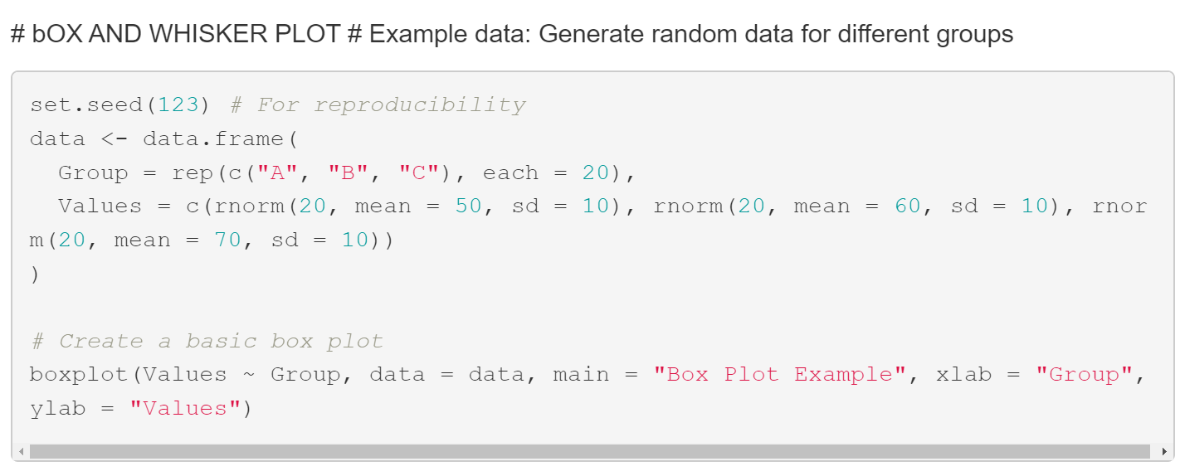
BOX AND WHISKER PLOT

Slide 22
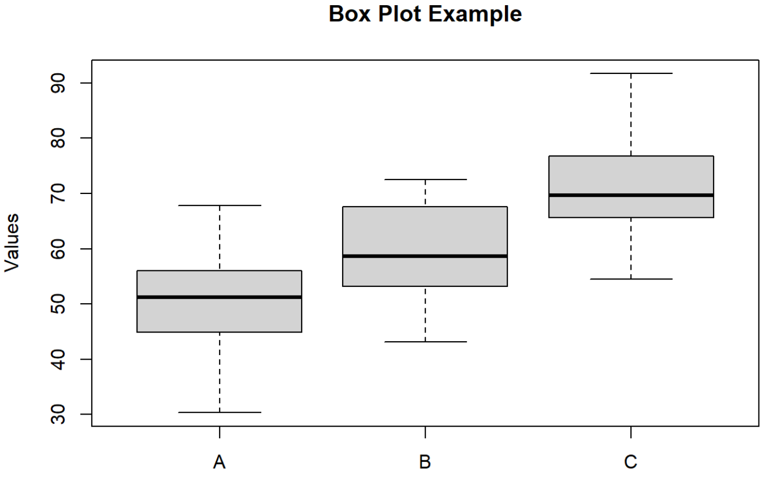

Slide 23
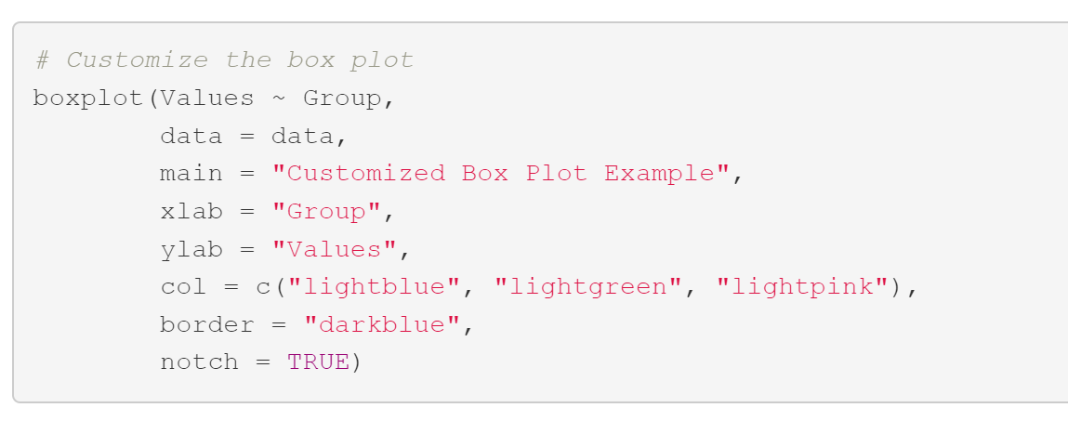
CUSTOMIZE BOX PLOT

Slide 24
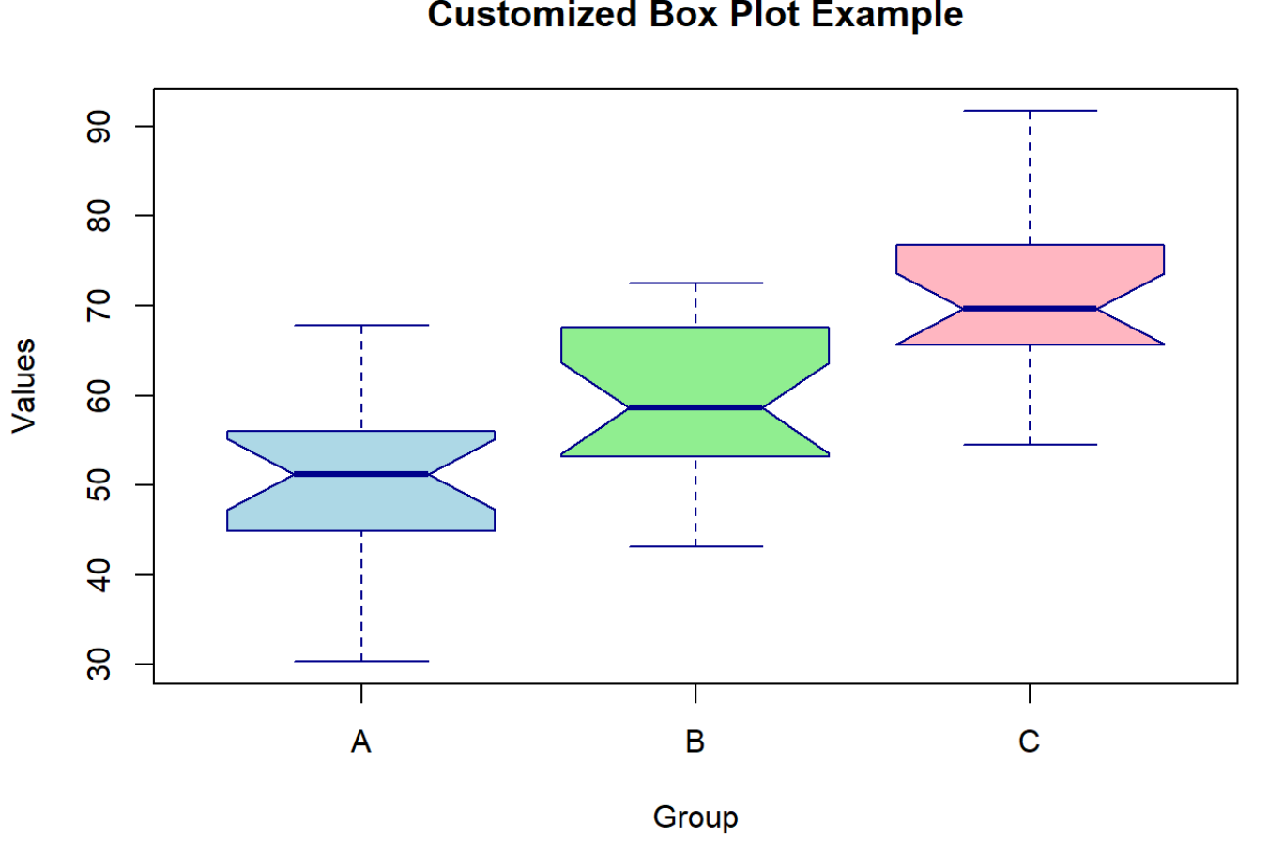

Slide 25
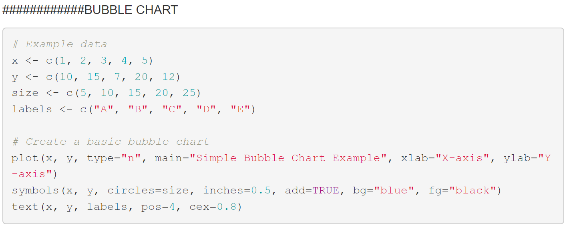
BUBBLE CHART

Slide 26
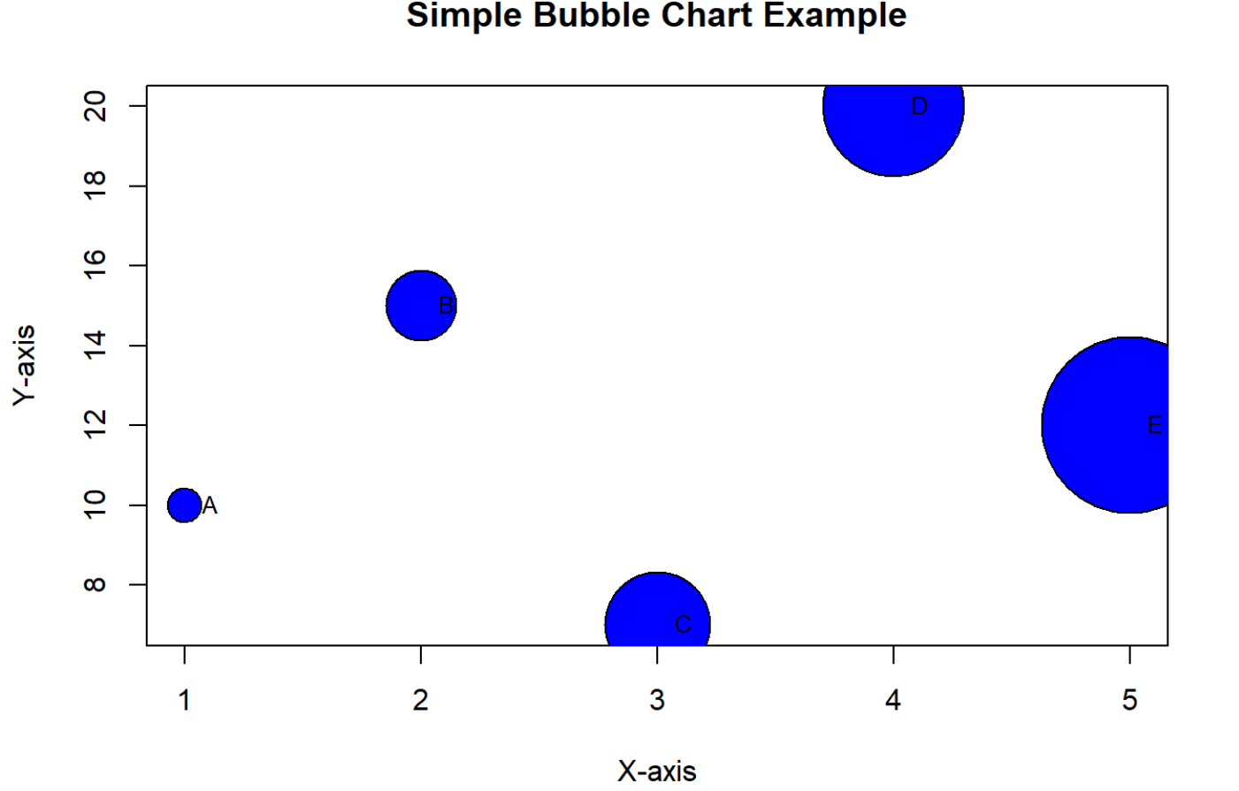

Slide 27
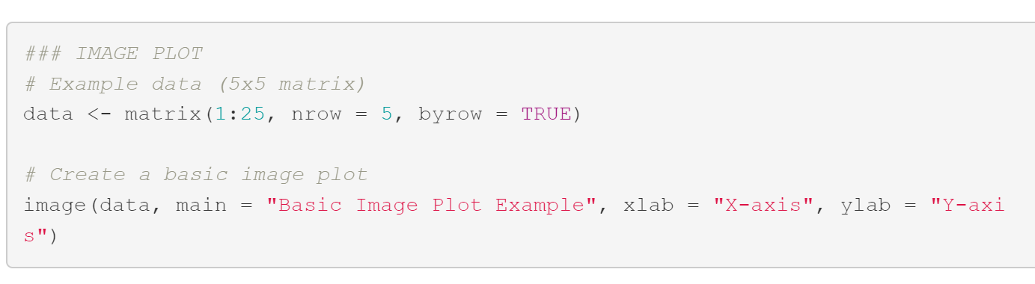
IMAGE PLOT

Slide 28
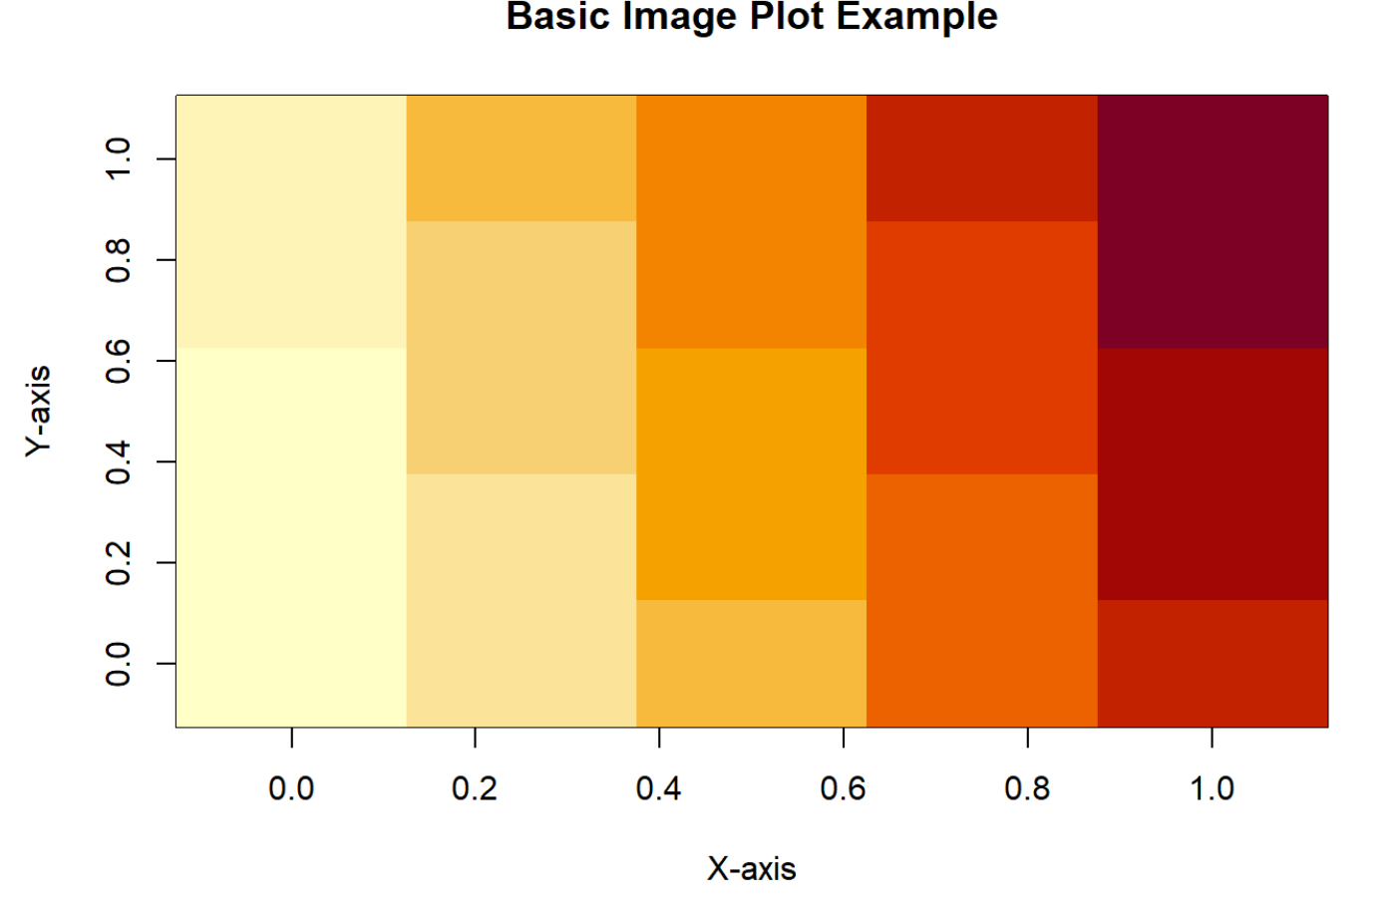

Slide 29
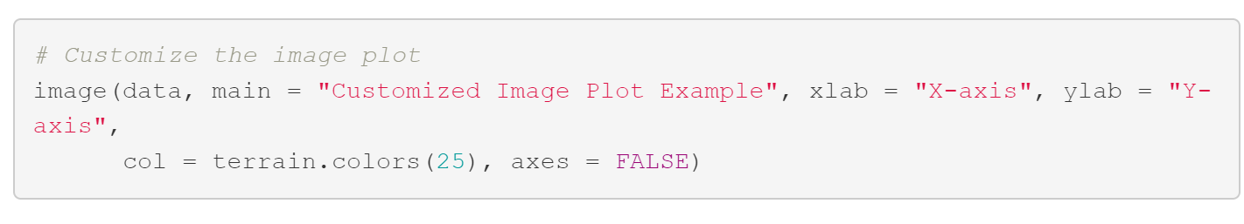
CUSTOMIZE IMAGE PLOT

Slide 30
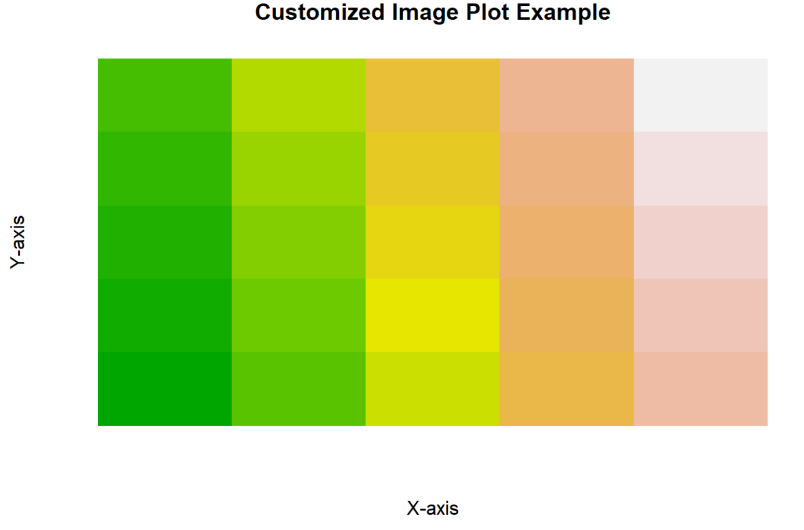

Slide 31
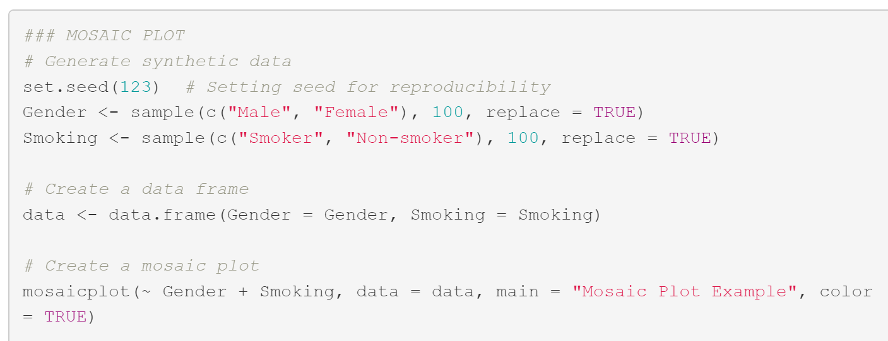
MOSAIC PLOT

Slide 32
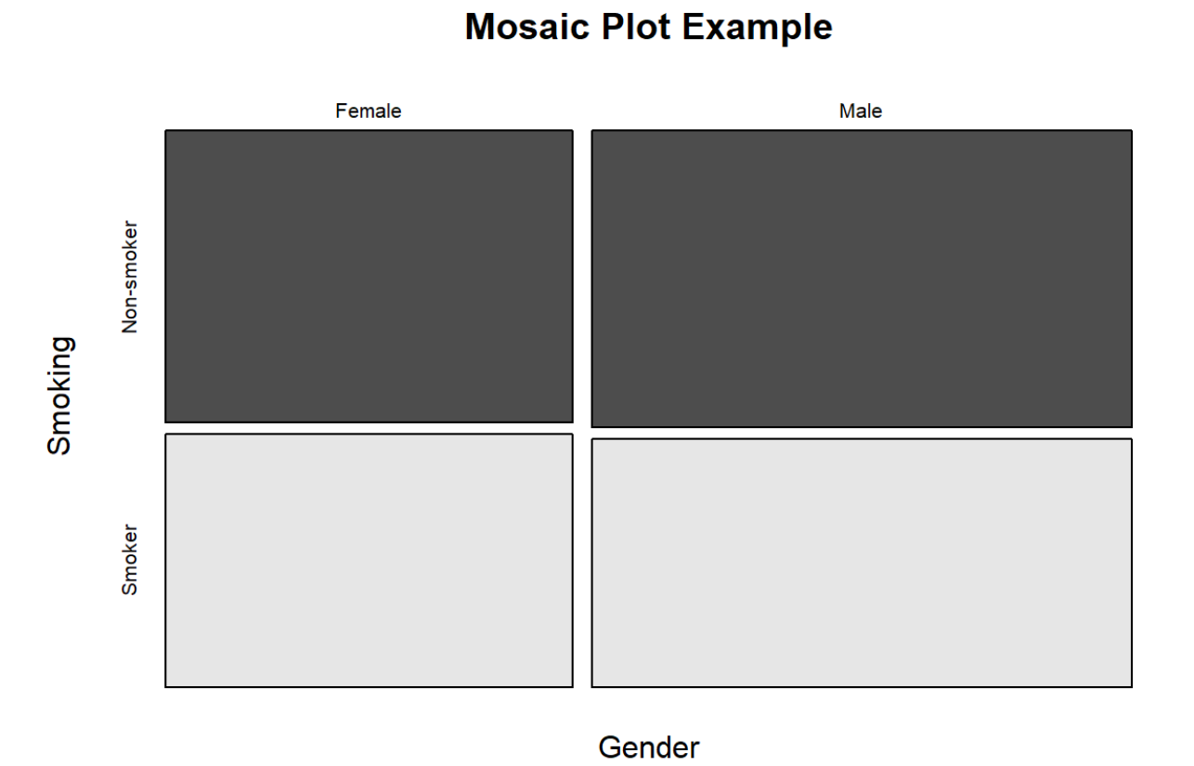

Slide 33
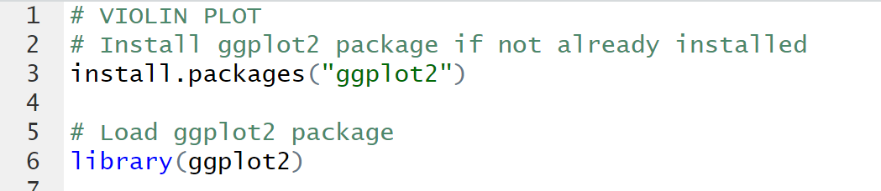
VIOLIN PLOT

Slide 34
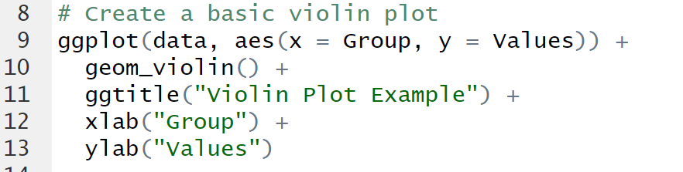

Slide 35
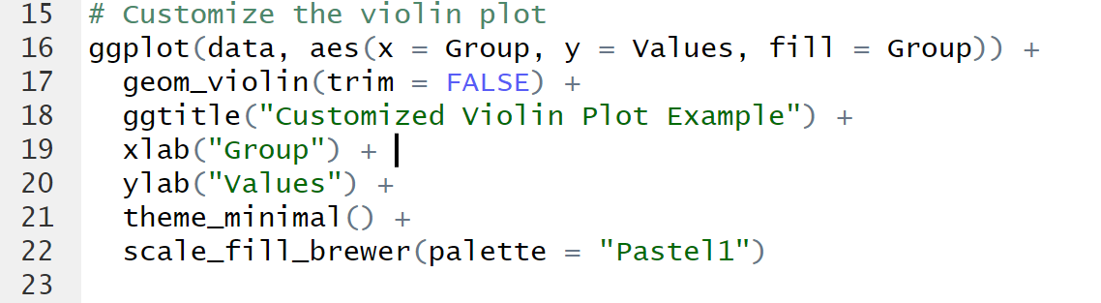

Slide 36
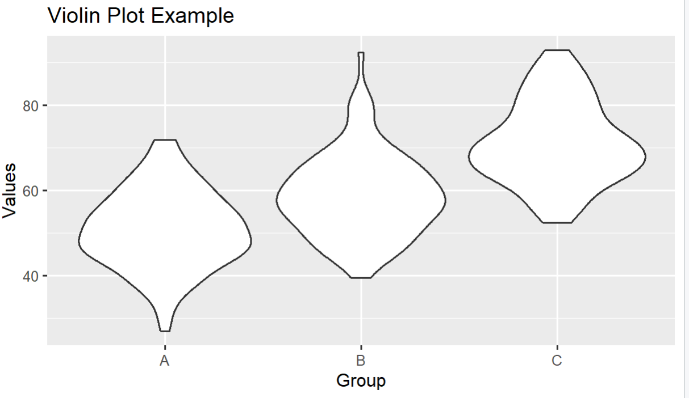

Slide 37
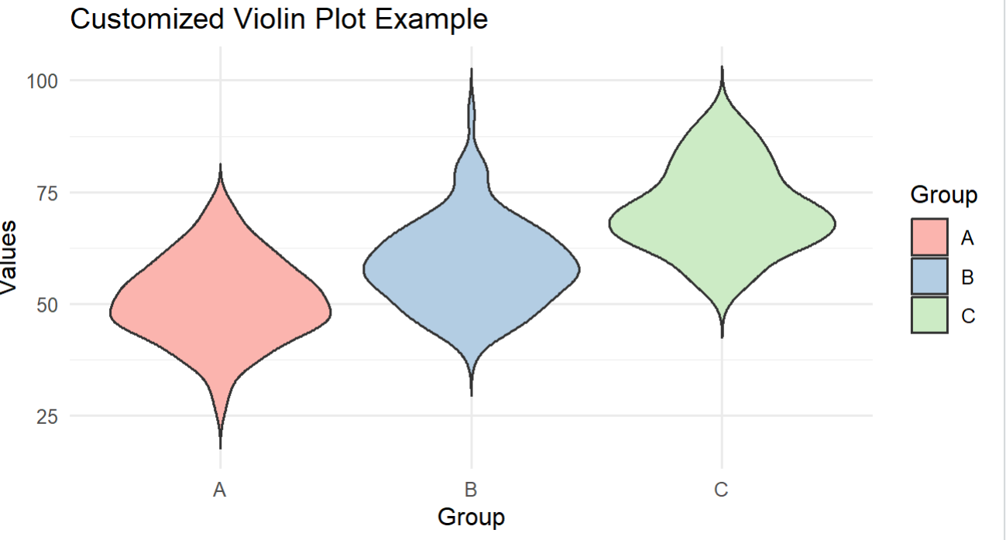

Slide 38
THANK YOU

