Slide 1
The Deliverable

Slide 2
1. Poor Information. No interpretation is plausible because the only information in the document is a list of vulnerabilities: not very comprehensive when you consider all the intricacies of the test.
2. Shock Factor. Some companies are inexperienced in having tests and are shocked by the level of access the tester obtained, so much so that the entire focus is on the seemingly amazing depth the tester made into their network. Obviously, the level of success is based on hundreds of details (most introduced here) that when exposed would not be nearly as impressive. For example, it may be a shock to find that your prankster-friend sneaked into your house and stole your jewelry, until you find out that your alarm system was off and all your windows were open—kind of puts it into perspective.

Slide 3
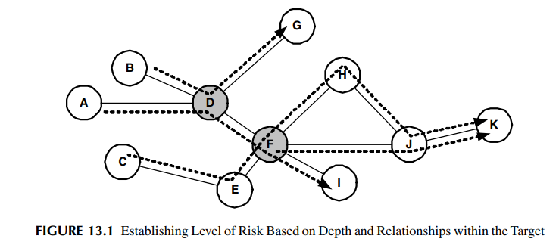
FINAL ANALYSIS

Slide 4
Critical. Critical findings are those that place the enterprise at a high degree of risk. These types of threats are usually recommended to be corrected immediately, and can often be brought to the attention of the White Team during the test. The critical classification is usually assigned to vulnerabilities that have a high threat potential in the current environment.
Warning. A warning is representative of a threat to the company that needs to be addressed in a meaningful timeframe. It is not a risk that poses an immediate threat to the enterprise; however, it could have grave repercussions if not corrected in the near future

Slide 5
Informational. Informational risks that are identified during a penetration test are those that pose a low level of risk to the organization, but in any case, need to be fixed just as the other two previously discussed. This classification of the analysis of the data collected during the penetration test is included in the final deliverable to provide additional remediation plans for the enterprise. These can sometimes include proactive measures to ensure the enterprise is protected on an ongoing basis after the penetration testing is completed. It also helps to ensure that if a third party were to come back to the enterprise, security controls would have improved within the enterprise and the same identical issues would not be discovered again

Slide 6
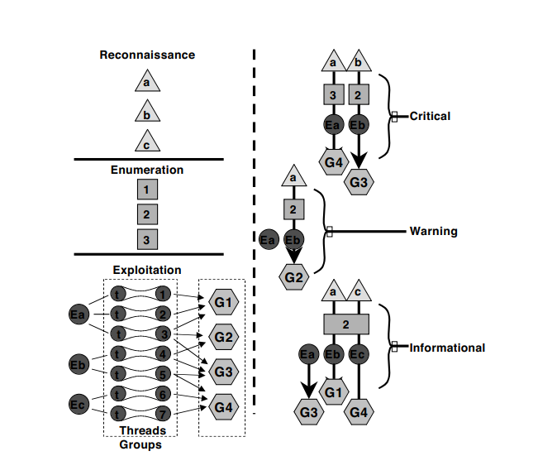
POTENTIAL ANALYSIS

Slide 7
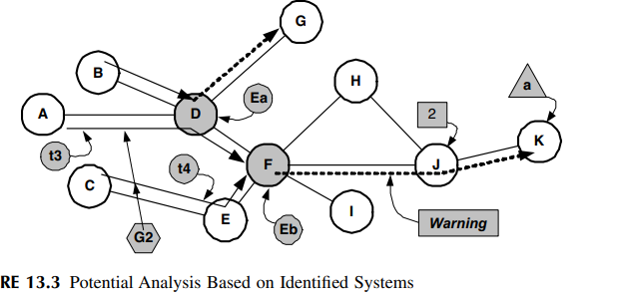

Slide 8
THE DOCUMENT
The following is an introduction to the overall format of the deliverable:
• Executive summary
• Present findings
• Planning and operational summary
• Rank vulnerabilities based on business goals and needs
• Defining the processes and tasks employed during each phase
• Present recommendations based on a timeline founded on risk mitigation
• Outline any predetermined exceptions by the company
• Final analysis and potential analysis with levels of risk in not mitigating
• Conclusion

Slide 9
ALIGNING FINDINGS
TECHNICAL MEASUREMENT
Severity
Exposure
BUSINESS MEASUREMENT
Cost
Risk

Slide 10
PRESENTATION
REMEDIAL
TACTICAL
STRATEGIC

Slide 11
Integrating the Results INTEGRATION SUMMARY
1. Mitigation.
2. Defense Planning.
3. Incident Management.
4. Security Policy

Slide 12
MITIGATION
TEST
PILOT
IMPLEMENT
VALIDATE

Slide 13
DEFENSE PLANNING
ARCHITECTURE REVIEW
Architecture Review Structure
AWARENESS TRAINING
Awareness Program

Slide 14
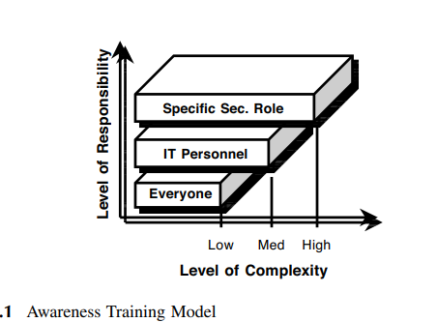

Slide 15
INCIDENT MANAGEMENT
Minimize the damage from network intrusions by having a well-established plan in place.
• Decrease network downtime from security incidents.
• Preserve evidence from attacks.
• Increase the firm’s overall security posture and awareness

Slide 16
Detect.
Identify.
Isolate
Eradicate.
Recover.
Learn.

Slide 17
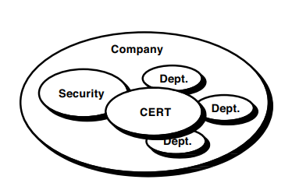
CERT Organizational Structure

Slide 18
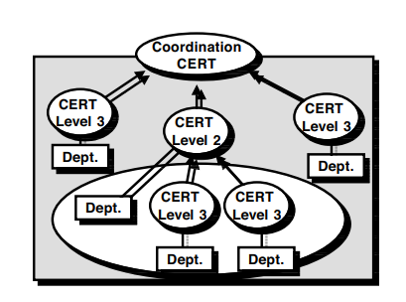
CERT Interaction with Other Departments and CERTS within the Company

Slide 19
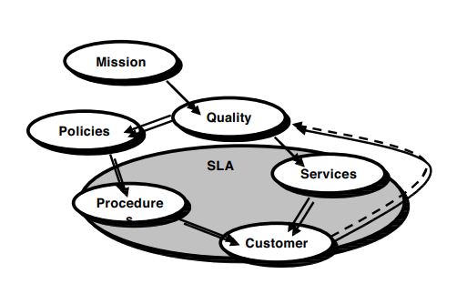
CERT Service and Quality Framework

Slide 20
Common CERT Services
Incident Response
Vulnerability Awareness
Communications
Threat Analysis
Incident Tracking
Collaboration
Coordination

Slide 21
DATA CLASSIFICATION
Classification Authority
Marking
Access Control.
Handling Hard-Copy Documents.
Transmission
Storage
Disposal.

