Slide 1
UNIT-3

Slide 2
TECHNICAL PREPARATION
ATTACKING SYSTEM
Operating System
Tools
Data Management and Protection.
Communications
Operating System
Tools
Data Management and Protection

Slide 3
THE HUNTER BECOMING THE HUNTED
Baseline a Standard Build.
Bootable CD
Modified Storage
Dynamic Encryption
E-Mail.
Documentation
Codenames

Slide 4
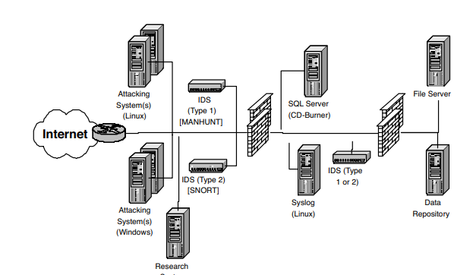
ATTACKING NETWORK
Attacking Network Architecture

Slide 5
• By sourcing the attack from a set of known IP addresses, the target can easily identify traffic from the tester.
• By sourcing the attack from a point deeper in the network, the potential exists for exposing internal systems to undesirable traffic.
• If the test is performed from different locations that do not have supporting systems, the likelihood of exposing the target’s data increases.
• In the event a different ISP is used that is unaware of the tester’s activities, traffic may be blocked or reported to authorities

Slide 6
MANAGING THE ENGAGEMENT
PROJECT INITIATION
Identify Sponsors
Building the Teams

Slide 7
WHITE TEAM PROBLEMS AFFECTING THE TEST
Shadow Consultant.
Technical Representation
Customer Relations
Schedule and Milestones
Tracking
Escalation
Customer Approval.

Slide 8
DURING THE PROJECT
Status Reports.
Monitoring
Value
Scope Management.
Deliverable Review

Slide 9
SOCIAL ENGINEERING
THE PHYSICALITY OF SOCIAL ENGINEERING
E-MAIL
TRUSTING E-MAIL
Value

Slide 10
penetration test include fraudulent e-mails can be very valuable for the following reasons:
Inexpensive
Knowing What’s Available.
Security Culture
Information Type
Impact

Slide 11
Controlling Depth
One Shot
Three Strikes.
Illicit Content
Subject Matter
Length
Subject

Slide 12
HELPDESK FRAUD
GOOD HELPDESK PRACTICES GONE WRONG

Slide 13
Value
Protocol
Services
Exposure
Inexpensive

Slide 14
Controlling Depth
Group.
Subject.
Number of Calls
PROWLING AND SURFING
INTERNAL RELATIONS AND COLLABORATION
CORPORATE IDENTITY ASSUMPTION

Slide 15
PHYSICAL SECURITY
OBSERVATION
DUMPSTER DIVING
WARDRIVING AND WARCHALKING
THEFT

Slide 16
INTERNET RECONNAISSANCE
GENERAL INFORMATION
Web Sites
Newsgroups
TECHNICAL RECONNAISSANCE
Ping Sweeps
Scans
Passive Scan
Active Scan
Interactive Scan

