Slide 1
Enumeration

Slide 2
ENUMERATION TECHNIQUES
Connection Scanning
SYN Scanning
FIN Scanning
Fragment Scanning
TCP Reverse IDENT Scanning
FTP Bounce Scanning
UDP Scanning
ACK Scanning

Slide 3
SOFT OBJECTIVE
LOOKING AROUND OR ATTACK?
IS IT SCANNING OR EXPLOITATION?

Slide 4
ELEMENTS OF ENUMERATION
Account Data
Architecture
Operating Systems
Wireless Networks
Applications
Custom Applications

Slide 5
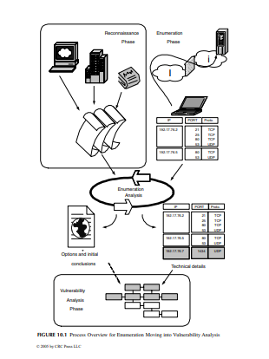
PREPARING FOR THE NEXT PHASE

Slide 6
WEIGHING THE VULNERABILITY
HACKING AN OLD HOLE IS BAD BUSINESS
Trojans
Today’s Hole
Huge-Hole Syndrome
Too Many
Hacker Tracks

Slide 7
SOURCE POINTS
OBTAINED DATA
THE NEEDLE IN THE HAYSTACK

Slide 8
THE INTERNET
Advisories
Vulnerabilities
Incidents
Read the Manual
Default Installs
Default Passwords
Hidden Accounts
Protocol Standards

Slide 9
NASTY TOOLS AND THE DIFFICULTY IN FINDING THEM
VENDORS
Alerts
Service Packs

Slide 10
REPORTING DILEMMA
REPORTING PROBLEMS IS NOT ALWAYS EASY

Slide 11
INTUITIVE TESTING

Slide 12
EVASION
Intrusion Detection System
Signature Analysis.
Protocol Analysis.
Anomaly Detection
Anomaly Signatures
Statistical Modeling
Observation.
Evasion

Slide 13
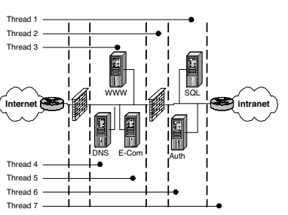
THREADS AND GROUPS

Slide 14
Threads 1 and 6 take the attack to the next level by interacting with the servers on the protected layer behind the inner firewalls and before the internal network. However, it should be noted that to accomplish this task (for the purposes of this demonstration) the same tactics used in thread 2 may not fully apply. In other words, to get to the SQL and authentication servers the tester would have to traverse the outer router and firewall while having enough structure left in the thread to penetrate the inner firewall. If thread 2 tactics were used, the inner firewall might thwart the attack.

Slide 15
Finally, thread 7 makes it into the internal network. This could be achieved by several different tactics including false packets, manipulating one of the servers in the DMZ or inner servers, or simply taking advantage of poor security practices. Attacks that penetrate into the internal network are typically founded on gaps in the layers of applied security. These usually leverage a small opportunity in an element found in one of the outer systems and pry it open to gain greater access. Once on the internal network there are several opportunities to move deeper quickly

Slide 16
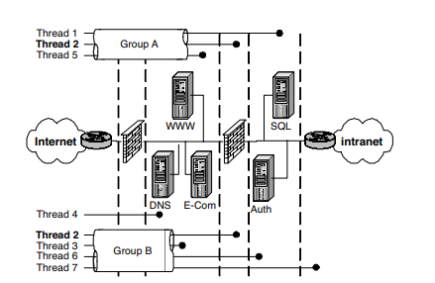
GROUPS

Slide 17
OPERATING SYSTEMS
WINDOWS
UNIX

Slide 18
PASSWORD CRACKERS
ROOTKITS

Slide 19
APPLICATIONS
WEB APPLICATIONS
DISTRIBUTED APPLICATIONS
CUSTOMER APPLICATIONS

Slide 20
WARDIALING
One of the earliest forms of attack was using the phone system to gain access to a company’s assets. Several years ago this was an extremely successful method for attacking remote systems because prior to VPN technology most if not all remote access was provided by modems on servers or terminal devices on the company’s network

Slide 21
Randomize
After Hours
Take Your Time
Number Scanning
System Type Scanning
Banner Collection
Brute Force

Slide 22
NETWORK
PERIMETER
NETWORK NODES

Slide 23
SERVICES AND AREAS OF CONCERN
SERVICES
Services Started by Default
WINDOWS PORTS
Null Connection
REMOTE PROCEDURE CALLS (RPC)

Slide 24
SIMPLE NETWORK MANAGEMENT PROTOCOL (SNMP)
SNMP is used by network management systems to determine the “health” of a networked device. These devices range from routers and switches to servers and desktops. SNMP is a cleartext protocol as discussed earlier. The information gathered by this protocol can be used by hackers to gain valuable knowledge such as the OS version, failed hardware, the managing NMS server IP, subnet mask, and internal and external IP information. There are two “default” network paths for SNMP, public (read only) and private (read/write). Because SNMP is a default service running on your network devices (routers and switches), you can bet that unless someone changed the default community strings, they are still set to public and private. Anyone with an SNMP tool can gain the information discussed earlier via the “public” community string. If they have the “private” string they now have write access on your device and can change information, and take control if you will, of your device.

Slide 25
BERKELEY INTERNET NAME DOMAIN (BIND)
BIND is an application used to provide users and applications with domain name service. It is a very popular and common target for attacks because it is the most widely distributed DNS software and the servers running BIND are usually accessible from the Internet. Moreover, it does not help that a new vulnerability is exposed every three or four months, offering yet another form of access to attackers

Slide 26
COMMON GATEWAY INTERFACE (CGI)
CGI programs are readily available on the Internet and some companies even have internal developers to create these programs for custom Web applications. Developers are constantly challenged to include security practices when they are creating these programs. Elements such as running the programs with least-privilege or using valid buffers to prevent overflows are two examples of creating and implementing programs with slightly more resistance to attack. Another would be ensuring data arrays process their data correctly. All too often a program accepts data entry from a user, places it in an array or variable that stores the information in memory, and then proceeds to process the data without checking first if the entry was valid.

Slide 27
CLEARTEXT SERVICES
Services that use unencrypted data present another challenge for administrators. These services transmit their data in the clear, which allows anyone “watching” on the same network the ability to retrieve that information, most importantly user IDs and passwords. These two key pieces of information will be used to log in to the system the valid user attempted to log in to when the information was gathered. Services such as FTP, telnet, and e-mail are frequently used by everyday users, especially e-mail. All it takes is a hacker with a sniffer tool to easily capture this data

Slide 28
NETWORK FILE SYSTEM (NFS)
UNIX systems utilize NFS to share files and directories and drives across the network. NFS is insecure in its natural state. Most administrators allow read and write access to everyone rather than narrow down the list to a select few. The issue lies with NFS running on an Internet-facing server. This provides attackers, anyone really, with access to the files, directories, or drives on that system. The attacker is only limited to the actual permissions applied to the mounted system. Meaning, if the “world” or “other” group has write privileges, then so does your attacker. They can place any files or remove files from your NFS share. There are other vulnerabilities within an unpatched “nfsd,” the daemon that runs NFS, that gives an attacker root privileges

Slide 29
DOMAIN NAME SERVICE (DNS)
DNS does the name resolution portion of BIND. It translates a domain name into an IP address and vice versa. Applications use DNS exclusively to look up address information when they need to send information over the Internet. Without DNS, users would have to know the exact IP address every time they wanted to surf the Web or send an e-mail. DNS is critical to the Internet.

Slide 30
FILE AND DIRECTORY PERMISSIONS
Files and directories are owned by users on a system. This means for other users to access or execute these files, the owner must assign the appropriate level of permission to his files and directories. Permissions are very similar between UNIX and Windows. There are three basics: read, write, and execute. Although there are many more in Windows, UNIX offers a “special” one called “setuid/setguid.” Our three basics are self-explanatory. Read gives the owner and anyone in the group permission to “read” the file. Write gives the owner and anyone in the group permission to “write” to the file (Windows calls it modify). And last, execute gives the owner and anyone in the group permission to “execute” the file. These permissions, if not restricted, can lead to vulnerabilities

Slide 31
FTP AND TELNET
r issue with FTP is the fact that some administrators fail to remove or lock down the anonymous or guest account. These accounts, even with read-only access, can still provide some very valuable information about your system. If this service is not configured properly, administrators can give write privileges to these accounts as well, resulting in more serious consequences

Slide 32
INTERNET CONTROL MESSAGE PROTOCOL (ICMP)
ICMP is used mainly by administrators as a quick way to determine if a server or, more appropriately, if an interface on a server is up or down. Ping provides a very simple answer and is one of the most common denial-of-service attacks. One of the first tools created to perform the denial-of-service attack is POD or ping of death. Traceroute on the Windows platform utilizes ICMP and actually provides the path a packet takes to reach that interface, usually in great detail. That detail is used by hackers to find out the IP of your firewall or Internet router

Slide 33
IMAP AND POP
Commonly used by Internet e-mail applications, these protocols allow remote users to access their e-mail over the Internet. This means ports have to be open on the firewall to permit this access. Hackers using a firewall scanning tool such as “firewalk” can determine all the open ports and using known exploits for IMAP and POP can gain access to your network and/or e-mail systems. Also remember this traffic is not usually encrypted, unless you are using SSL.

Slide 34
NETWORK ARCHITECTURE
A company may only have one DNS server used by both internal and external users. If left inside the network, external users would not be able to resolve names internal to the company without opening DNS ports on the firewall. The same holds true for internal users if the DNS resides outside the firewall. The same principle applies for e-mail users.

