Slide 1
JUSTIFYING INTRUSION DETECTION
UNIT-3

Slide 2
INTRUSION DETECTION IN SECURITY
If the company deals with personal health information, it may need to comply with HIPAA privacy requirements; if it’s a financial institution, it will need to deal with the Office of Thrift Supervision (OTS). These regulatory bodies are likely to be a part of the organization’s strategy and will have an impact on your intrusion detection and prevention strategy.
After gaining a solid understanding of business strategy, the organization must determine whether this strategy fits with its security strategy.

Slide 3
Attack type It is important that you are able to collect data on the amount and type of attacks that threaten your organization. While this is a dynamic number, at any time it can be helpful to determine what areas of your security program can be bolstered and what areas have sufficient controls in place.
Probability of detection This will allow an organization to create a metric that identifies the amount of correctly detected attacks during a specific time frame. This is an effective measurement of your IDS capabilities and the fine tuning that may be needed.

Slide 4
Correlation abilities This will help you determine your ability to correlate information from other systems, such as firewalls, with the current IDS and IPS data to detect attacks. This can be very effective, especially when detecting “low-and-slow” attacks.

Slide 5
IDS Deployment Costs
When considering costs, it is important that you evaluate three areas: the infrastructure cost, the residual costs, and the support costs
Infrastructure costs are the costs in setting up the actual IDS/IPS system. You will need to determine what hardware and software you will need, what consulting services you may need, and the number of hours needed to install the hardware and software and deal with network connectivity issues. Another important factor to consider is the cost of educating the technical staff on the proper use of the product. Even if staff members educate themselves, a non trivial cost can affect the company because some other project is not getting done while the staff is learning to use the product

Slide 6
Residual costs include extra cabling, more bandwidth, and new networking hardware. Finally, you must consider the support costs related to keeping the IDS/IPS up and running. This will include hardware and software upgrades and time spent on analysis and responding to events, upgrading and tuning the systems, and basic administration. In determining these costs, you may find it helpful to talk with organizations of similar size and with similar security needs.

Slide 7
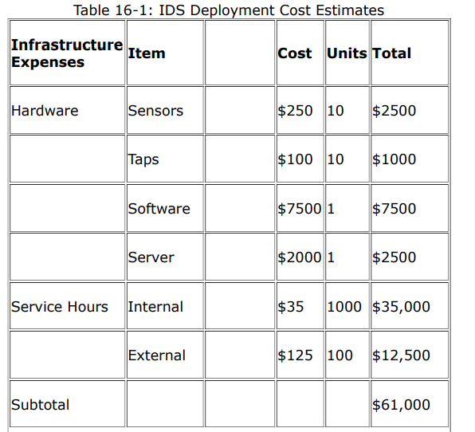
RETURN ON INVESTMENT
IDS Deployment Costs

Slide 8
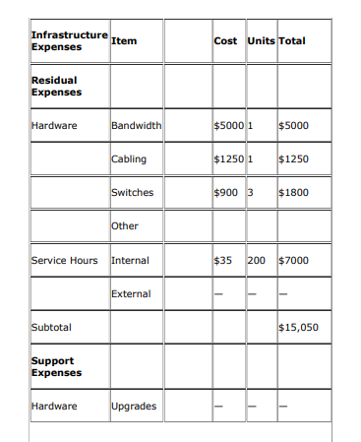

Slide 9
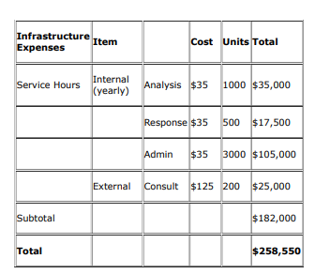

Slide 10
Justifying the Cost
Soft return on investment (SROI) Bases the decision on fear, uncertainty, and doubt (FUD); unfortunately, a surprising amount of security decisions are made this way.
Hard return on investment (HROI) Bases the decision on quantifiable data that will help determine the real business value of the product.

Slide 11
Determination of the HROI can be accomplished by finding the annual loss expectancy (ALE), which can be figured by first looking at the single loss expectancy (SLE)—the expected impact of a specific one-time event in some terms, usually monetary, on the organization. An SLE is usually derived from formal documentation on business impact or a business impact analysis (BIA). The SLE is not a precise number but and estimate. Once the SLE has been determined

Slide 12
annual rate of occurrence (ARO) of an event should be determined. The ARO is done on an annualized basis in which the frequency of an event is to occur. This data can be derived from industry research or your own attack metrics. For example, if a threat occurs once every three years, it has an ARO of 1/3 or 0.33, while a threat happening five times in a year has an ARO of 5/1 or 5.0. To arrive at the ALE, use the following formula: Single Loss Expectancy (SLE) X Annual Rate of Occurrence (ARO) = ALE

Slide 13
The ALEcan be used to justify the need for intrusion detection and prevention. For example,-let’s say you want to protect a mission-critical server that holds customer data. If damaged or destroyed, the server itself is valued at $5000, but the loss of information and reputation could be valued at $10,000,000. You have determined that the SLE for this asset is 70 percent and the AROis once in every three years or 0.33. Using the formula, we would determine the ALE to be $2,310,000. From this information, management can determine whether it is justifiable to implement a $500,000 IDS or IPS system for protection of this asset.

Slide 14
Acquisition
1. Define your organization’s requirements.
2. Research the IDS/IPS products.
3. Select a vendor’s product to test.
4. Test the product.
5. Select the product.

Slide 15
Requirements
Detect denial-of-service (DoS) attacks Detect attacks against your web server Detecting attacks against routers or firewalls Increase forensic capabilities Be able to handle evasion techniques

Slide 16
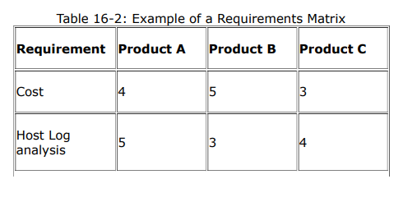

Slide 17
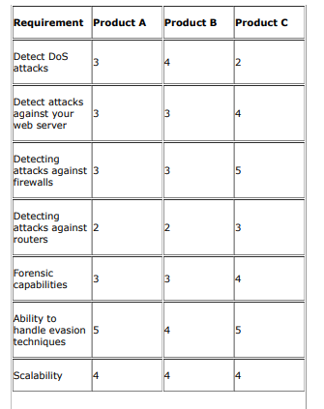

Slide 18
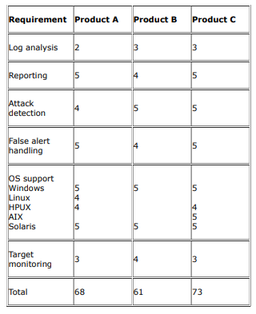

Slide 19
Research
High sensor stability and integrity
Counteract attack evasion
Attack recognition with maximum real traffic stress
Comprehensive detection without discarding traffic or missing attacks
Inline mode detection

Slide 20
Vendor Selection
Financial stability If a company is not financially secure enough to be around for the next few years, you may want to look somewhere else.
Service What services does the vendor offer? How is the service you have received so far? How willing are they to help you with your unique needs?
Reputation A company’s reputation is important. Ask colleagues in the industry about how they have been treated by the company.

Slide 21
Testing
Verify vendor’s claims Provide insight into the implementation Test performance
At the beginning of this process, you should determine what you want to measure. The following is a common list of measurable attributes, which may vary depending on your organization’s circumstances:
The number of false positives
The number of positive detections
Packets per second
Attack variety
Attack diagnosis
Network impact

Slide 22
Selection
The final step is to make a selection based on the requirements, research, and testing that has occurred. This information can be put into a matrix similar to the requirements matrix discussed earlier

Slide 23
Managing Intrusion Detection
This section will cover some other important issues in managing a successful intrusion detection and prevention program: deployment and managing in a distributed environment.

Slide 24
Deployment
Once an intrusion detection or prevention technology has been selected, it is time for implementation of the technology. The basic steps to a successful implementation are
1. Having a well-planned policy
2. Installing the software
3. Planning for and hiring staff resources

Slide 25
Managing in a Distributed Environment
Managing a decentralized environment has the advantage of a less complicated setup that can be managed locally, and information can be communicated with the other locations as needed. However, in a decentralized environment, the cost of more equipment, difficulties in data correlation, inconsistent management across the enterprise, and operational inefficiencies may prove to be disadvantages. Managing on a centralized basis, in most cases, is a better solution in a distributed environment.

Slide 26
Another issue to consider is the communication across a distributed environment. With one location in Lisbon, Spain, and another in Chicago, how do you send large amounts of highly sensitive data, such as agent activity with IP addresses and server names, across securely and efficiently? One way to do this is to use the native communications built into the IDS. It may be possible to transmit this information over a private line, such as a T1 line, depending on your company’s capabilities. When a private line is not available, you can use a virtual private network (VPN)

Slide 27
Threat Briefing
– Threat agents---criminals, terrorists, subversive or secret groups, state sponsored, disgruntled employees,, hackers, pressure groups, commercial groups
– Capability---software, technology, facilities, education and training, methods, books and manuals
– Threat inhibitors---fear of capture, fear of failure, level of technical difficulty, cost of participation, sensitivity to public perception, law enforcement activity, target vulnerability, target profile, public perception, peer perception
– Threat amplifiers---peer pressure, fame, access to information, changing high technology, deskilling through scripting, skills and education levels, law enforcement activity, target vulnerability, target profile, public perception, peer perception
– Threat catalysts---events, technology changes, personal circumstances – Threat agent motivators---political, secular, personal gain, religion, power, terrorism, curiosity

Slide 28
Top ten Database Security Threats
1. Excessive Privilege Abuse---users are granted database access privileges that exceed the requirements of their job function; e.g., a university administrator whose job requires only the ability to change student contact information may take advantage of excessive database update privileges to change grades
2. Legitimate Privilege Abuse ---- Users may abuse legitimate database privileges for unauthorized purposes; e.g. a rogue health worker who is willing to trade patient records for money
3. Privilege Elevation---Attackers may take advantage of database platform software vulnerabilities to convert access privileges from those of an ordinary user to those of an administrator. Vulnerabilities may be found in stored procedures, built-in functions, protocol implementations, and even SQL statements
4. Database Platform Vulnerabilities--- Vulnerabilities in underlying operating systems (Windows 2000, UNIX, etc.) and additional services installed on a database server may lead to unauthorized access, data corruption, or denial of service.
5. SQL Injection--- a perpetrator typically inserts (or “injects”) unauthorized database statements into a vulnerable SQL data channel. Using SQL injection, attackers may gain unrestricted access to an entire database

Slide 29
6. Weak Audit Trail--- Weak database audit policy represents a serious organizational risk on many levels.--- regulatory risk, deterrence, and detection and recovery
7. Denial of Service (DoS)--- access to network applications or data is denied to intended users
8. Database Communication Protocol Vulnerabilities--- e.g., Four out of seven security fixes in the two most recent IBM DB2 FixPacks address protocol vulnerabilities; similarly, 11 out of 23 database vulnerabilities fixed in the most recent Oracle quarterly patch relate to protocols
9. Weak Authentication--- allowing attackers to assume the identity of legitimate database users by stealing or otherwise obtaining login credentials
10. Backup Data Exposure--- Backup database storage media is often completely unprotected from attack. As a result, several high profile security breaches have involved theft of database backup tapes and hard disks

Slide 30
Ten web threats
1. Bigger, Subtler DDoS Attacks---Distributed Denial of Service Attacks
2. Old Browsers, Vulnerable Plug-Ins---e.g., browser vulnerabilities and, more frequently, the browser plug-ins that handle Oracle's Java and Adobe's Flash and Reader.
3. Good Sites Hosting Bad Content---in VOHO watering hole attack, attackers infected legitimate financial and tech industry websites in Massachusetts and Washington, D.C., commonly accessed by their intended victims
4. Mobile Apps And The Unsecured Web--- bring-your-own-device movement has led to a surge in consumer-owned devices inside corporate firewalls
5. Failing To Clean Up Bad Input---e.g., Since 2010, SQL injection has held the top spot on the Open Web Application Security Project's list of top 10 security vulnerabilities

Slide 31
6. The Hazards Of Digital Certificates--- a series of hacks against certificate authorities gave attackers the tools they needed to issue fraudulent SSL certificates that could disguise a malicious website as a legitimate
7. The Cross-Site Scripting Problem--- An attacker going after a banking site with a cross-site scripting vulnerability could run a script for a login box on the bank's page and steal users' credentials.
8. The Insecure 'Internet Of Things„--- Routers and printers, videoconferencing systems, door locks and other devices are now networked via Internet protocols and even have embedded Web servers. In many cases, the software on these devices is an older version of an open source library that's difficult
9. Getting In The Front Door--- Automated Web bots scrape from Web pages information that can give a competitor better intelligence on your business.
10. New Technology, Same Problems--- People click links all day long -- people are pretty trained to think that clicking a link on the Web is safe.

Slide 32
Major Security Threats on Information Systems
1. Intrusion or Hacking---gaining access to a computer system without the knowledge of its owner---Tools: . Poor Implementation of Shopping Carts, Hidden fields in the html forms, Client-side validation scripts, Direct SQL attack, Session Hijacking, Buffer Overflow Forms, Port Scan
2. Viruses and Worms--- programs that make computer systems not to work properly-- - Polymorphic Virus, Stealth Virus, Tunneling Virus, Virus Droppers, Cavity Virus
3. Trojan Horse--- These programs are having two components; one runs as a server and another one runs as a client; data integrity attack, steal private information on the target system, store key strokes and make it viewable for hackers, sending private local as an email attachment.
4. Spoofing---fooling other computer users to think that the source of their information is coming from a legitimate user---IP Spoofing, DNS Spoofing, ARP Spoofing

Slide 33
5. Sniffing---used by hackers for scanning login_ids and passwords over the wires. TCPDUmp and Snoop are better examples for sniffing tools.
6. Denial of Service---The main aim of this attack is to bring down the targeted network and make it to deny the service for legitimate users. In order to do DoS attacks, people do not need to be an expert. They can do this attack with simple ping command

