Slide 1
Applications and Tools

Slide 2
Bro Intrusion Detection System
Bro was developed by Vern Paxson of Lawrence Berkeley National Labs and the International Computer Science Institute. It is a Unix-based Network Intrusion Detection System (NIDS).
Bro also detects intrusion attempts by searching particular patterns in network traffic. So they both fall into the category of signature-based NIDS.
distinguishes itself by offering high speed network capability
real time, high-volume intrusion detection, Bro uses two network interfaces

Slide 3
Bro provides a patched kernel for FreeBSD to reduce CPU load. With proper hardware and OS tuning, Bro is claimed to be able to keep up with Gbps network speed and perform real time detection

Slide 4
Prelude Intrusion Detection System
Prelude is a Hybrid Intrusion Detection System distributed under GNU General Public License, primarily developed under Linux. It also supports BSD and POSIX platforms. Prelude works at both host and network levels providing a more complete solution
It also has dedicated plugins in order to enable communication with several other well known IDSs. The sensors send messages to a central unit (i.e. Manager) which processes them and is responsible for event logging
Besides the Manager, Prelude also includes a module responsible for graphical feedback to the user

Slide 5
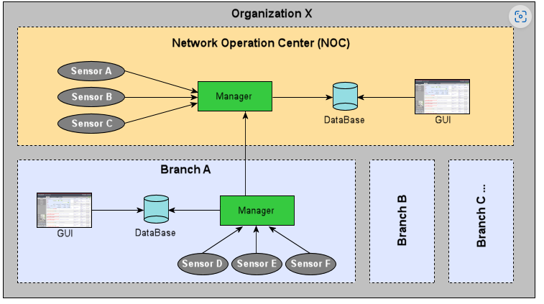

Slide 6
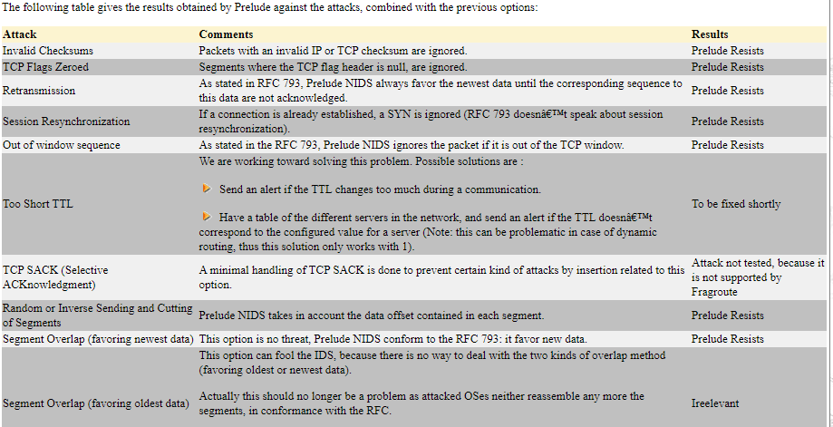

Slide 7
It relies on signature based detection. Since Prelude analyzes user, system, and network activities, it targets both the host and network based intrusions.

Slide 8
Cisco Secure IDS
made up of the various NIDS and HIDS solutions
Cisco focuses on four goals in its product line:
Accuracy
Enabling Investigation and Response
Comprehensive Management
Flexible deployment
software feature set allows the router to monitor for 59 unique attacks.

Slide 9
The IDS feature set allows the router to take real-time action once it discovers an attack.
It can take three actions:
Alarm
drop packets
reset a TCP connection.

Slide 10
Many experts agree that the processes for infrastructure management and incident response are the most critical success factors.

Slide 11
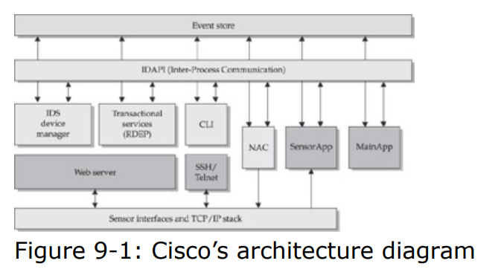
Assigning Packet Capture to Signatures

Slide 12
Session Sniping is a method of stopping attacks by closing the TCP session associated with that attack. The Cisco NIDS accomplishes this by sending a TCP RST (reset) packet from the command and control interface to the identified attacking host and to the victim or target host.
Shunning is the process of applying access control lists (ACLs) to nearby routers or switches to block individual connections or hosts to stop attacks. Cisco supports shunning on all IOS devices, the Catalyst 6500 line, and the PIX firewall.

Slide 13
IDS Best Practice Requirements
Area | Component | Intrusion Detection Requirements IDS System Characteristics | Where Cisco's Product Line Stands
IDS system characteristics | Comprehensive set of intrusion signatures | Signature-based IDS systems suffer from a fundamental flaw. They only identify events that can be described (in detail) before they take place. However, the majority of intrusion detection systems operate by recognizing signatures of network attacks. These signatures can describe the details of violations of network protocols, packets destined for suspicious ports, the presence of particular byte sequences in the data payload of a packet, suspicious packet sequences, and so forth. The number and type of signatures available is a key requirement of an IDS system. | Cisco has a comprehensive set of signatures developed by its Cisco Countermeasures Research Team (C-CRT). The C-CRT is made up of engineers from the WheelGroup acquisition. They develop signatures based on years of experience in both commercial and government roles.
IDS system characteristics | High performance on sensors | The IDS sensors must be able to process packets at a rate fast enough to keep up with network load. If the sensor becomes overloaded, it might begin to drop packets, and those dropped packets could lead to a significant increase in false negatives. Therefore, it's important to build network sensors capable of handling the traffic load on the segment they'll be monitoring. | Cisco offers a comprehensive product line with solutions to fit most needs. This includes standalone appliances, router and switch modules, host based intrusion prevention, and integration into existing Cisco infrastructure.

Slide 14
Capability to create custom filters | One might want to identify specific events of interest for which monitoring is required, but public-domain activity signatures don't exist. The capability to create custom filters gives us the capability to record and analyze these events. | Cisco provides the capability to create highly detailed custom signatures through a comprehensive wizard

Slide 15
IDS system characteristics | Acceptable false-positive and false negative rates | While this rate (ratio of false positives to false negatives) is entirely dependent on the type of network traffic seen by the IDS, managing these failure rates is essential. The false-negative rate can be reduced through a well designed engine that recognizes a large number of attack signatures. The false-positive rate can be reduced through an engine that supports threshold tuning and well defined filters. | Cisco's TAME is a leading engine based on years of development. In addition, Cisco offers customization of all signatures to increase accuracy.

Slide 16
Architecture | Network-based IDS component | Network-based IDS places a crucial role in appropriately covering an environment. Network IDS is best at covering aggregated network segments, places where different portions of a network architecture meet. | Cisco offers several options for network based deployment with flexible options for integration into existing infrastructure.

Slide 17
Architecture | Host-based IDS component | Host-based IDS provide protection of critical assets. Host-based IDS (HIDS) takes advantage of the existing processing on each host process, packet, and data stream, adding a small overhead for inspection. Typically, these operate at the kernel layer of a host, and are given an excellent vantage point into attempted operations on a host. Because network-based IDS must account for the multiple ways that hosts reconstruct network traffic, HIDS holds a distinct advantage in terms of accuracy. | Cisco's acquisition of the Okena product line provides best in class host based intrusion prevention for Windows, Solaris and (soon) Linux.

Slide 18
Architecture | Distributed architecture | The most common (and most effective) design for an IDS is that of a distributed system, with remote sensors deployed throughout the network, a central data collection facility, and one or more analyst consoles on the analyst's desktop | Cisco offers a highly scalable distributed system for event processing from detection to alerting and response.

Slide 19
Architecture | Communication architecture | In a “push” communication architecture, the sensors feed their data into the analysts console as events of interest are identified. This gives us a near real-time intrusion detection capability. This is in contrast to a “pull” communication architecture, in which the analyst console polls the sensors periodically for newly identified events of interest. | Cisco has recently switched from a push based to a pull based architecture.

Slide 20
Analysis support | Intrusion reporting, response, and recovery policies and procedures | The IDS is a tool that will provide a skilled analyst with the information needed to identify network intrusion attempts. The analyst is ultimately responsible for decisions regarding response and recovery. The use of software to automate these steps, however, is attractive in some scenarios. To ensure these actions are carried out in a manner both consistent and acceptable, specific policy elements should be implemented to govern response and recovery. | Cisco offers a comprehensive set of reporting and response options. These are the free Event Viewer and Cisco Works VMS. Also, Cisco is automating investigation with the release of the Threat Response software.

Slide 21
Analysis support | Integrated console and database for host- and network-based components | An integrated console and database provides several advantages to the intrusion analyst. The integrated database gives the analyst the capability to do thorough event correlation through database queries, reducing the need for manual correlation. The integrated console allows the analyst to identify and respond to alerts from a single interface, improving the efficiency of their work. | Cisco Works VMS 2.2 offers the capability to manage events from all Cisco IDS products, including the Cisco Security Agent and the Network IDS

Slide 22
Analysis support | Significant drill-down capability to provide detailed information on demand | A well-designed IDS console will provide basic information at first glance, and allow the analyst to “drill down” to important details. On request, the IDS should give the analyst significant and complete data for analysis and classification of the event. | Cisco provides drill-down capability all the way to captured packets from attacks. Views are customizable and filterable to ensure the right data is presented.

Slide 23
Analysis support | Relational database back end | An RDB back end can be queried, giving the analyst the capability to mine the IDS data for trends, patterns, and detailed information about events of interest. A database back end can also be used for building reports and archiving data. | Cisco uses a MySQL backend for the Event Viewer with export capability. VMS uses an MS SQL run time (a.k.a. MSDE) back end.

Slide 24
Analysis support | Report generation capability | IDS should give the capability to create reports. This capability, directly from the system itself, removes the requirement to add additional software to the solution. The system would ideally provide some canned reports and should offer the capability to create customized reports. | Cisco provides comprehensive reporting in both the Event Viewer and VMS products. These features are maximized on the Windows version of the CiscoWorks Monitoring Module. Some areas aren't supported on Solaris yet. There's no support for events from the Management Center for Cisco Security Agents, version 4.0. Also, the Cisco IDS Network Module for routers IDS version 4.1 isn't supported, but IDS 4.0 is supported. No additional reports are available for firewall and Cisco Security Agents. Also, there's no support for saving the preferences of column ordering in the Event viewers on solaries version

Slide 25
Analysis support | Well-built analyst console | A well-built analyst console is important. A console that isn't reliable and robust can render the work done by the sensors. Advanced features for distributing administration responsibilities and required access are also important factors in the construction of the console. | The VMS console is a mature product with a world-class software engineering group developing it. Cisco Works VMS offers Centralized Role-Based Access Control (RBAC)

Slide 26
Analysis support | False-positive management | False positives can be a time consuming failure mode for the intrusion analyst. To combat this problem, the IDS should offer a mechanism for false-positive management. Common techniques include adjustable alarm thresholds and console enhancements to facilitate information management. | Cisco offers fully tunable signatures and alarm thresholds.

Slide 27
Analysis support | Event correlation capability | Network activity that triggers IDS alerts could be more than a traffic anomaly or a single attack. Some of the events of interest identified by the IDS might, in fact, be part of a coordinated (possibly distributed) attack. The IDS should offer tools to identify any correlation in these events of interest. If the back end is a relational database, then this correlation can be done through database queries. If the back end isn't a relational database, it might be possible to achieve this correlation through custom scripts or other techniques. | Network activity that triggers IDS alerts could be more than a traffic anomaly or a single attack. Some of the events of interest identified by the IDS might, in fact, be part of a coordinated (possibly distributed) attack. The IDS should offer tools to identify any correlation in these events of interest. If the back end is a relational database, then this correlation can be done through database queries. If the back end isn't a relational database, it might be possible to achieve this correlation through custom scripts or other techniques.

Slide 28
Analysis support | Database stores raw data | The database should store be able to store completed packets. because complete packets provide a much more powerful trend analysis/correlation capability particularly as new features are added. | Cisco's network IDS products have the capability to perform packet capture when a signature fires. This means that the entire packet or stream of packets can be analyzed at a later time when required.

Slide 29
Internal (IDS) security | Encrypted traffic between sensor and console | Because IDS management traffic is the “key to the kingdom,” the capability to protect this data is crucial. | Cisco's RDEP uses SSL/TLS to protect network communications.
Internal (IDS) security | Hardened agent and console hosts The IDS is a key component in the | The IDS is a key component in the defense of the network. If the IDS is easily compromised, not only do we lose this critical piece of our security solution, we run the risk of the IDS giving up valuable information about the network environment. To mitigate this risk, we must protect ourselves from attacks against the IDS itself. An essential component of this protection is hardening of the OSs on machines hosting IDS sensor and console components. These hosts should be completely dedicated to their IDS functions, running nothing other than that required by the IDS software. | Cisco provides the capability to use the CSA to protect the VMS station. The network IDS line is difficult to attack on the network because it doesn't have an IP address.

Slide 30
Response and recovery capabilities | Intrusion response capability | An attractive approach to intrusion response would be for the IDS to generate a real-time “recommended response” to a detected intrusion. This assists the analyst in quickly responding to intrusions, but provides the opportunity to sanity-check the response to avoid disaster. | Cisco is adding the threat response software to automate investigations and speed response. With the highly accurate data this produces, response options are clear.

Slide 31
Snort
Snort is a rule-based IDS. Snort uses signatures to identify types of attacks that occur but, unlike a pure signature-based IDS, Snort does not stop there. It also uses and provides considerable additional contextual information, including how attacks have transpired and what the origin of each attack

Slide 32
NFR Security
NFR Security was founded in 1996 by Marcus Ranum, a pioneer in IDS technology called Network Flight Recorder

Slide 33
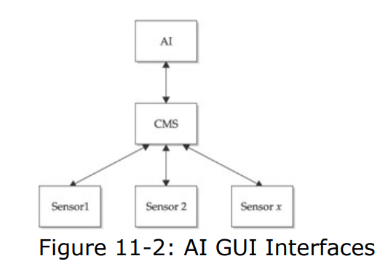
NFR Architecture
operates in a three-tier environment, consisting of the sensors, a Central Management System (CMS), and an Administrative Interface (AI)

Slide 34
Sentivist Sensor
The Sentivist sensors are passive devices that collect data on the wire. The sensors provide detection capabilities from <10 MB/s connection rates through Gig speeds, using multiple network connections per single sensor .

Slide 35
Sentivist Central Management System CMS
The collection point or Central Management System provides a single collection/aggregation point for data collected by the sensors. The data spooled on the sensors are pushed into a proprietary data file store located on the CMS. The Many to one relationship provides for 20 to 30 sensors push of alerts and forensics data to the CMS.
CMS also provides for a multifaceted Output mechanism. The CMS can provide data via any scriptable data format (such as shell scripts, or perl programs) or via the AI.

Slide 36
Administrative Interface (AI)
The AI is a Windows 32 program that provides a GUI interface to the alerts, forensics, and controls of the Sentivist environment. The AI allows you to select and set up the sensors’ detection capabilities, to monitor alerts and events collected by the sensors in real time, and to query supporting data collected by the sensors. All management of the IDS environment can be done via the AI

Slide 37
Sentivist Signatures
One of the most unique characteristics of the Sentivist system is its attack signature model. Unlike other systems that rely on either Snort-based signatures, or closed proprietary signature models, NFR’s Sentivist provides an open signature format. The signature library permits true hybrid detection capabilities within the N-Code language. Much like Perl, N-Code provides the flexibility of a true lexical language for exploring traffic streams in real time.

