Slide 1
UNIT-II
Architecture and Implementation

Slide 2
Centralized
With a centralized architecture, all of the monitoring, detection, and response activities are controlled directly by a central console. Figure 5.1 illustrates a generic centralized IDS architecture.

Slide 3
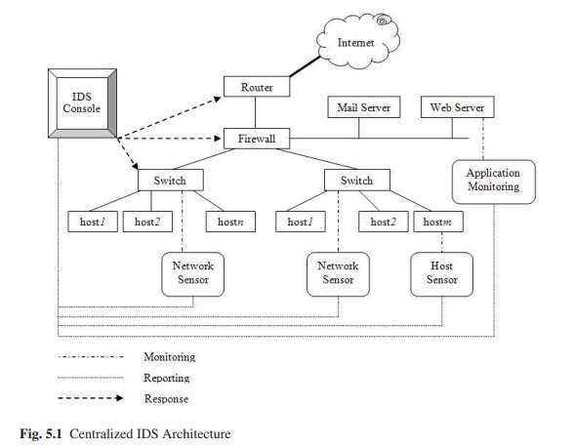

Slide 4
Distributed
Data collection is implemented locally in each subnet and is then reported to one or more central locations
IDS console collects reports from local sensors and then sends reports to the higher level IDS console
This higher level IDS console might send all reported information to another higher level IDS console that manages the detection and response among a set of cooperating networks.

Slide 5
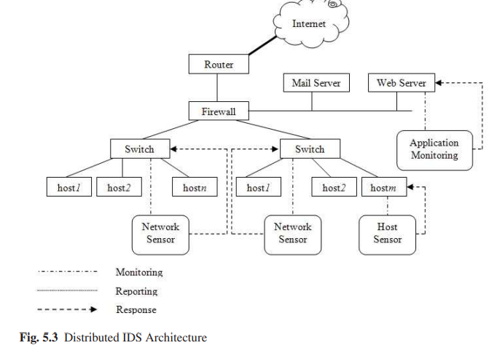

Slide 6
Agent based approach is used for hierarchical IDSs, they are also utilized for implementing fully distributed IDSs where data is collected and analyzed at a number of locations which is directly proportional to the number of monitored components

Slide 7
Intelligent Agents
In an agent-based system, the individual agents are designed to manage a particular task and work together to fulfill the requirements of the whole system. The main drawbacks of agent systems include the overhead of a large number of processes and the lack of viable research in understanding and addressing agents’ potential security problems. In this section, we discuss some typical examples regarding the agent-based intrusion detection.

Slide 8
Distribution of the computation cost
The reduction in the amount of information sent over the network, the platform independence, the asynchronous operation, and the ease of updating .
Efficiency
Fault tolerance
Extensibility
Scalability
Resilience to degradation.

Slide 9
Autonomous Agents for Intrusion Detection (AAFID)
AAFID is a distributed IDS developed by the Center for Education and Research in Information Assurance and Security (CERIAS) at the Purdue University
there are four components included in the system architecture, namely agents, filters, transceivers, and monitors.
Filters provide a subscription-based service to agents with two main functions, namely data selection and data abstraction.
When an agent starts a subscription request to a filter, it specifies which records it wants based on some criteria and then the filter replies the request with records satisfying the criteria to the agent

Slide 10
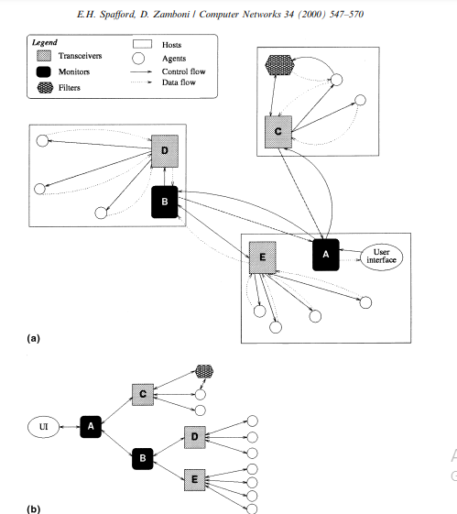

Slide 11
Fig. 1. Physical and logical representations of a sample intrusion detection system that follows the AAFID architecture (called an AAFID system).
(a) Physical layout of the components in a sample AAFID system, showing agents, transceivers and monitors, as well as the communication and control channels between them.
(b) Logical organization of the same AAFID showing the communication hierarchy of the components. The bidirectional arrows represent both the control and data flow between the entities. Notice that the logical organization is independent of the physical location of the entities in the hosts.

Slide 12
When an agent starts a subscription request to a filter, it specifies which records it wants based on some criteria and then the filter replies the request with records satisfying the criteria to the agent
The transceiver has the ability to start, stop or send configuration commands to agents and can also perform data reduction on the data received from different agents.
Monitors can also be organized in a hierarchical fashion so that one monitor may in turn report to the other higher level monitor. In case an monitor is down or fails to do operations, the transceiver can send its report to more than one monitor, thus providing the redundancy and resistance to the failure of one of the monitors

Slide 13
Multi-Management agents System-based Network Security Architecture
MANSMA (Multi-Agents system-based Network Security Management Architecture) consisting of two layers, namely the Manager Layer and the Local Layer. The Manager Layer is used to manage the global security of a large network; and the Local Layer is to manage the security of a domain.
There are three types of agents identified in the Manager Layer, namely Security Policy Manager Agent (SPMA), Extranet Manager Agent (EMA), and Intranet Manager Agent (IMA)

Slide 14
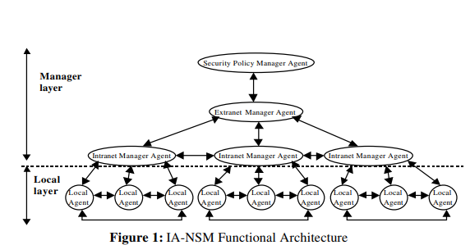

Slide 15
The Security Policy Manager Agent (SPMA) manages the security policies specified by the security officer.
The Extranet Manager Agent (EMA) manages the security of the entire distributed network. Its role is to manage and control Intranet Manager Agents (IMA). These agents report pertinent analysis to the EMA. The role of the latter is then to perform another analysis on suspicious events in order to confirm or not the detection of an attack. It can also ask for another data processing and delegate then new monitoring tasks to the IMAs.
The Extranet Manager Agent communicates with the Security Policy Manager Agent. This latter can specify new security policy, new monitoring tasks or new attacks to detect. The EMA is also responsible for distributing the set of Local Agents to each IMA.
The Intranet Manager Agent (IMA) manages the security of a local network. It controls the Local Agents and analyzes the monitored events reported by these agents.

Slide 16
Intranet Manager Agent (IMA). The SPMA maintains the global security policy that is determined by a human administrator. The EMA takes the control of IMAs and manages the distributed Extranet. Each IMA manages the security of a local network and is able to control specified agents

Slide 17
Hummingbird
Frincke et al. described a distributed IDS , called Hummingbird, in which a set of Hummer agents are deployed on a single host or a set of hosts for detecting
intrusions. Hummers in the system communicate with each other through a manager, a subordinate, and peer relationships. During the communication, managers transmit commands to subordinates. Such commands include gather/stop for data gathering or forward/stop for data forwarding. Peers send requests to other peers for gathering, forwarding or receiving data, and other peers then decide whether to accept or reject such requests.

Slide 18
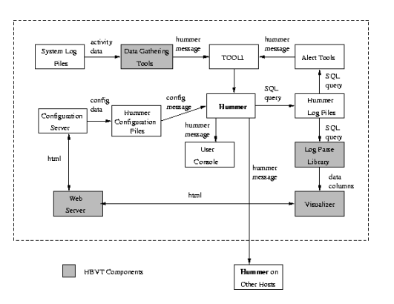

Slide 19
Hummingbird compiles data collected from multiple workstations on different networks through running a local hummer on each workstation. As a result, system administrators can react more quickly to security threats.
The architecture of Hummingbird system mainly consists of three parts, namely Message Distribution Unit (MDU), Data Distribution Unit (DDU) and Data Collection Unit (DCU). MDU communicates with other hummers; DDU decides which data should be sent to other hummers; and DCU uses data collection modules to collect data. The three components communicate with each other through a local hummer network that is implemented based on sockets.

Slide 20
Multi-agent-based IDS
Hegazy et al. propose a multi-agent IDS where they classify agents into four categories:
(1) Simple Reflex Agents, connecting with networks and being able to collect packets moving around
(2) Analysis Agents, requesting the buffer (i.e., logs) from the Simple Reflex Agents (i.e. sniffing agents) and building a list of suspicious packets,

Slide 21
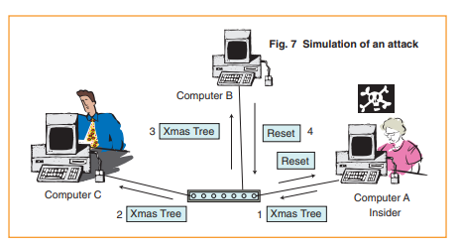

Slide 22
(3) Goal-based Agents, requesting the list of suspicious packets from their complementary analysis agents for making an intrusion decision and taking necessary actions, and
(4) Utility-based Agents, mapping the percept states into a set of numbers that measure how closely the goals are achieved.The simulation results show that the system can detect the X-mass tree attack.

Slide 23
Adaptive Hierarchical Agent-based Intrusion Detection System
An Adaptive Hierarchical Agent-based Intrusion Detection System , called AHA! IDS, is proposed by Ragsdale et al. in [14], which is based on a fully distributed, multi-agent framework, consisting of 4 major components: (1) Director Agents, being responsible for detecting intrusive behavior, (2) Surrogate Agents, taking and covering the responsibilities of Director Agent when it fails in some cases, (3) Manager Agents, being responsible for detecting intrusive activities on a subset of systems for which a Director is responsible, and (4) Tool Agents, employed by a Manager agent to detect intrusive activity

Slide 24
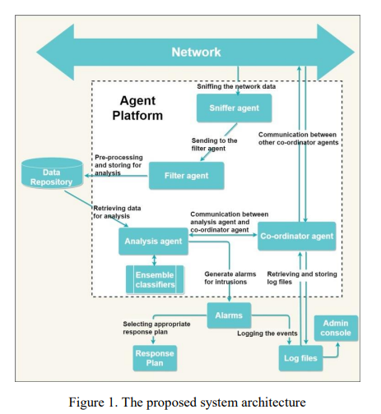

Slide 25
Fuzzy Adaptive Survivability Tools (FAST)
In [15, 16], Shajari and Ghorbani proposed an intelligent multi-agent based intrusion detection system, called Fuzzy Adaptive Survivability Tools (FAST) , in order to protect a network against the large-scale intrusions.
The FAST system is based on an automated detection model and a response approach for survivability, in which different intelligent agents are used to identify normal and abnormal patterns automatically and adaptively.
FAST system is able to make decisions about events that meet the predefined criteria and site-specific policies. In FAST, fuzzy logic is used to identify the degree of suspicion of each attack and to deal with the uncertainties of response.

Slide 26
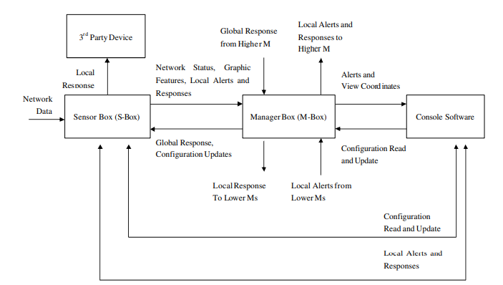

Slide 27
A sensor operates at the lowest level of the system hierarchy. The sensor is responsible for monitoring network traffic, detecting malicious activities and providing appropriate local responses. Each sensor has two interfaces to the local network. The first interface connects to the mirror port of the local switch and is used for collecting network data in promiscuous mode
The second interface connects to a regular network port and is used for communication with a higher level MS-box, console, and third party devices.

Slide 28
The management module is responsible for managing S-boxes and MS-boxes at a lower level of hierarchy in the network
Therefore, MS-box is capable of performing jobs related to the S-box as well as high level management of the sensors at lower level
The console is the user interface for the FAST. The console software will run on a separate computer and is designed to communicate with all management and sensor modules in the network.

Slide 29
Mobile Agents
Mobile agents have been commonly used to design and implement distributed applications in a dynamic environment
It was claimed in the paper that mobile agents are:
(1) expensive
(2) difficult to develop, test and debug
(3) difficult to authenticate and control
(4) vulnerable to a number of attacks coming from malicious executing environments.

Slide 30
Intrusion Detection Agent system (IDA)
Asaka et al. propose and implement an intrusion detection prototype system based on mobile agents, called Intrusion Detection Agent system (IDA) . The agents in IDA collect the information related to the intrusion along the intrusion-route and then apply them to make decisions about whether an intrusion has occurred. The IDA system provides a set of functions that enable efficient information retrieval and also make it possible to detect compromised intermediate hosts.
IDA will collect and analyze corresponding information, and then make an intrusion decision
IDA is that they can autonomously migrate to target systems to collect information related to intrusions, thus eliminating the need to transfer system logs to the server.

Slide 31
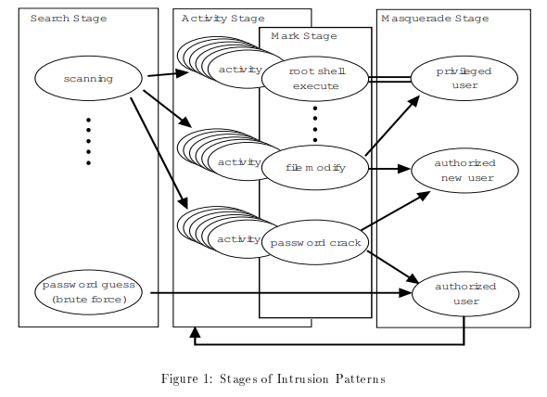

Slide 32
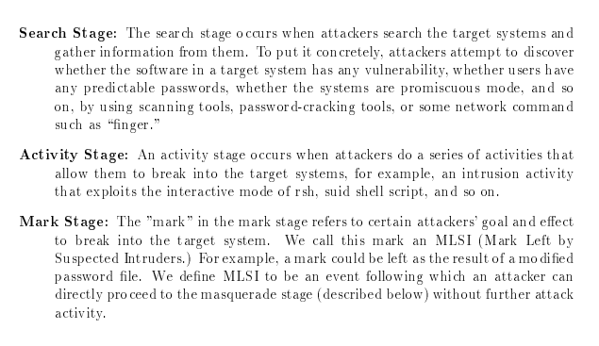

Slide 33


Slide 34
IDA system is composed of 6 components, namely manager, sensors, bulletin boards, message boards, tracing agents, and information-gathering agents.
The IDA manager resides on each network segment. The sensors are deployed on each target system and are used to monitor system logs for inspecting MLSIs
Once a MLSI is found by a sensor, it will be reported to the manager agent. The intrusion-route tracing agent traces the path of an intrusion and identifies the original point of a real attacker

Slide 35
During the intrusion route tracing period any intermediate node that is compromised can be detected.
sensor detects an MLSI and reports it to the manager and then the manager launches a tracing agent to the target system. The tracing agent migrates autonomously from machine to machine and traces the intrusion independently without the involvement of the manager.
The manager agent has an interface between administrators and the system, in which it manages the mobile agents and bulletin boards, and accumulates and weighs the information entered by the mobile agents on the bulletin board. In case the weights exceed a predefined threshold, an intrusion alert will be reported.

Slide 36
Mobile Agents for Intrusion Detection (MAIDS)
Helmer et al. propose and implement an intrusion detection system based on distributed intelligent mobile agents. They called the system MAIDS in which data mining techniques are performed to provide global and temporal views for the entire network system
In MAIDS, data gathering agents parse system logs and activity data into a common format. The low level agents classify recent activities and then send data and current classification states to other peers or higher level agents. The higher level agents implement data mining based on the entire knowledge base and data sources on the system.

Slide 37
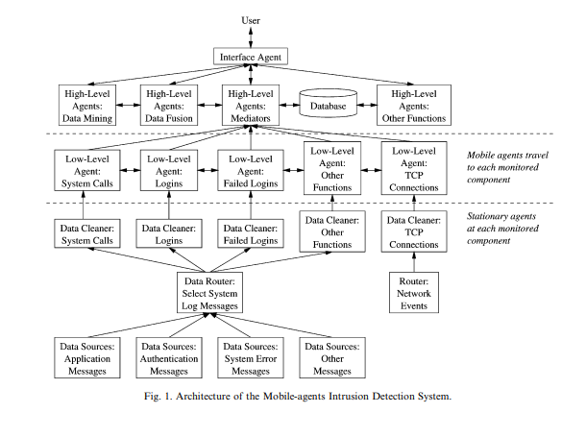

Slide 38
Distributed data cleaning agents process data collected from log files, networks, and system activities. The mobile agents are above this layer. They focus on system calls, TCP connections, and logins. These lower-level agents form a rough opinion of intrusions and can travel to each of their associated data cleaning agents, gather recent information, and classify the data to determine whether suspicious activity is occurring

Slide 39
Intelligent agents on this level maintain the data warehouse by combining knowledge and data from the lower layer of agents and then applying data mining algorithms to them.

Slide 40
Co operative Intrusion Detection
1. Local control over policy decisions by each cooperating network is important since most likely the sites do not trust each other.
2. The local network collects the information to be used in identifying the policy violations and decides whether to provide the information to other parties or not.
3. The data authenticity and integrity on different domains must be proved since the source can be compromised and may submit misleading data.
4. Hosts and networks that identify some policy violations are not responsible for the policy enforcement. Instead, the policy enforcement remains a local decision.
5. An authentication mechanism is necessary among cooperating networks.

Slide 41
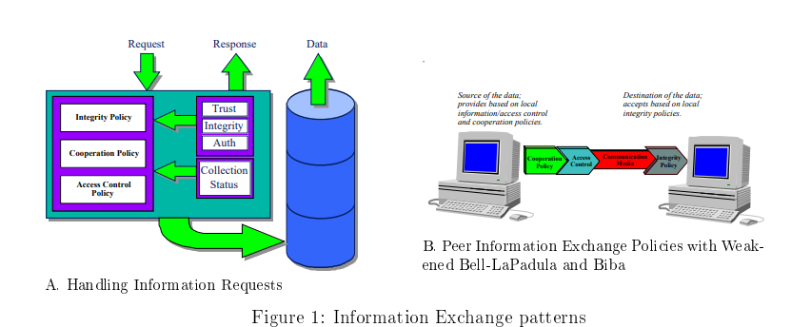

Slide 42
6. A hierarchical architecture of cooperative entities is necessary. The high level manager has higher authority than low level subordinates. Information sharing on the hierarchy can be vertical (i.e. a manager in high level and its subordinate in low level) or horizontal (i.e. between two subordinates).
7. Data collection should be redundant so that the system can keep operating when one data collector is compromised or becomes unavailable.
8. Data reduction is necessary when collecting data in order to avoid high volume data exchange among cooperating partners.
9. Data sanitization is required to avoid possible security risks to the transmitting network caused by the sharing of critical host and network specific attributes.
10. In a cooperating framework with a large number of cooperating networks, the data volume is huge and as a result, the data visualization tools are required for the human system/network administrator to analyze the data in a timely manner

Slide 43
In the cooperative IDS, the secure communication protocol between agents is very important since the whole IDS might be simply broken down by a compromised agent. In [21], Xue et al. propose a multi-agent system for distributed intrusion detection in which different types of agents communicate with each other through a public-key encryption algorithm used to encrypt all the communication and passwords in the system.

Slide 44
Tiered Architectures
Single-Tiered Architecture
A single-tiered architecture, the most basic of the architectures discussed here, is one in which components in an IDS or IPS collect and process data themselves, rather than passing the output they collect to another set of components. An example of a single-tiered architecture is a host-based intrusion-detection tool that takes the output of system logs and compares it to known patterns of attack.
Multi-tiered architecture involves multiple components that pass information to each other. Many of today’s IDSs, for example, consist of three primary components: sensors, analyzers or agents, and a manager

Slide 45
A single tier offers advantages, such as simplicity, low, and independence from other components (an advantage if they should become compromised or disabled). At the same time, however, a single-tiered architecture usually has components that are not aware of each other, reducing considerably the potential for efficiency and sophisticated functionality.

Slide 46
Multi-Tiered Architecture
Sensors perform data collection. For example, network sensors are often programs that capture data from network interfaces. Sensors can also collect data from system logs and other sources, such as personal firewalls and TCP wrappers.
Sensors pass information to agents, which monitor intrusive activity on their individual hosts. Each sensor and agent is configured to run on the particular operating environment in which it is placed. Agents are normally specialized to perform one and only one function. One agent might, for example, examine nothing but TCP traffic, whereas another might examine only FTP (File Transfer Protocol) connections and connection attempts.

Slide 47
tack has occurred or is occurring, it sends information to the manager component, which can perform a variety of functions including the following:
Collecting and displaying alerts on a console
Triggering a pager or calling a cellular phone number
Storing information regarding an incident in a database
Retrieving additional information relevant to the incident
Sending information to a host that stops it from executing certain instructions in memory
Sending commands to a firewall or router that change access control lists
Providing a management console a user interface to the manager component Providing a management console a user interface to the manager component

Slide 48
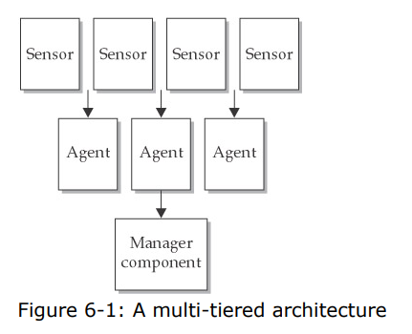

Slide 49
Advantages
greater efficiency and depth of analysis

Slide 50
Peer-to-Peer Architecture
peer-to-peer architecture involves exchanging intrusion-detection and intrusion prevention information between peer components, each of which performs the same kinds of functions. This peer-to peer architecture is often used by cooperating firewalls (and, to a lesser degree, by cooperating routers or switches). As one firewall obtains information about events that are occurring, it passes this information to another, which may cause a change in an access control list or addition of restrictions on proxied connections. The second firewall can also send information that causes changes in the first. Neither firewall acts as the central server or master repository of information.

Slide 51
The main advantage of a peer-to-peer architecture is simplicity. Any peer can participate in what is effectively a group of peer machines, each of which can benefit from the information the others glean. The main downside is a lack of sophisticated functionality due to the absence of specialized components (although the functionality is better than what is possible in a single-tiered architecture because the latter does not even have cooperating components).

